Slide 1
Current operational community standards: GSICS perspective
Dave Doelling and the GSICS VIS/NIR subgroup
CLARREO Pathfinder Science Workshop
November 2-3, 2021:

Slide 2
GSICS
Global Space-based Inter-Calibration System (GSICS) is an international collaborative effort initiated in 2005
  to monitor, improve and harmonize the quality of observations from operational weather and environmental satellites
  GSICS aims at ensuring consistent accuracy among space-based observations worldwide for climate monitoring, weather forecasting, and environmental applications
  To settle on best practices and apply across agencies to derive robust consistent GSICS calibration coefficients
The GSICS comprehensive calibration strategy includes
  monitoring instrument performances,
  operational inter-calibration of satellite instruments,
  tying the measurements to absolute references and standards
  recalibration of archived data.
GSICS member agencies include
  CMA, CNES, ESA, EUMETSAT, IMD, ISRO, JAXA, JMA, KMA, NASA, NIST, NOAA, ROSCOSMOS, ROSHYDROMET, USGS, WMO
GSICS active subgroups staffed by member agencies
  UV, VIS/NIR, IR, MW
  Data working to host GSICS calibration products and web site

Slide 3
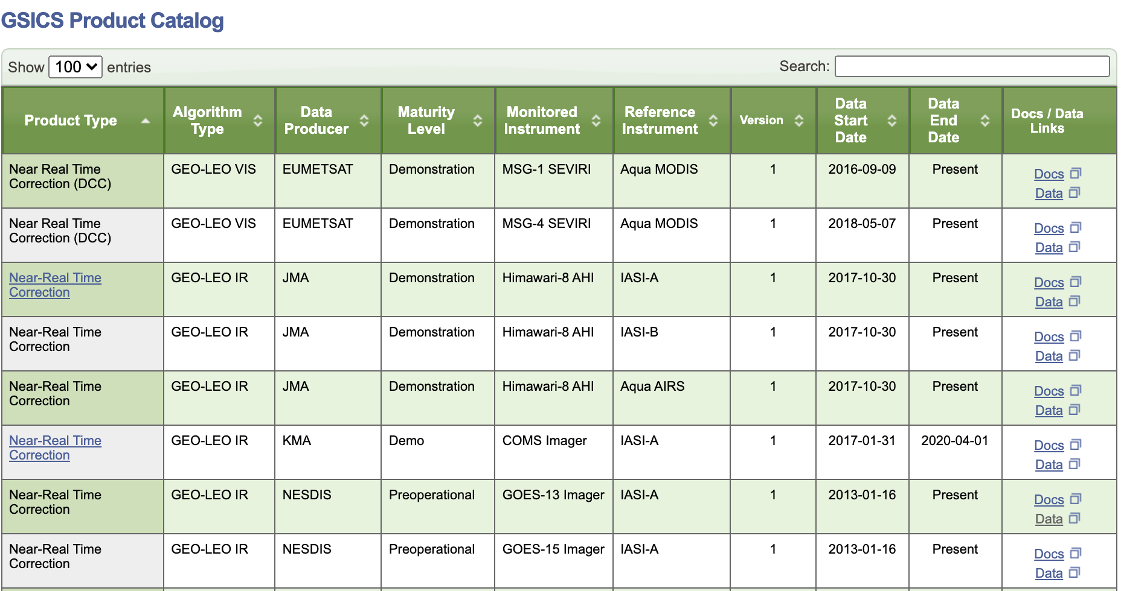
GSICS products
users can select Himawari-8 IR calibration coefficients that have been reference with respect to IASI-A, IASA-B, or Aqua-AIRS
• GSICS GEO agencies have calibrated against Aqua-MODIS and are transitioning to N20-VIIRS
• GSICS GEO agencies will have products that are referenced to multiple VIS/NIR reference sensors • Users may have developed their cloud code with a given reference sensor and want uniform scaling on a future sensor to derive consistent cloud properties across sensors

Slide 4
Selection of GSICS VIS/NIR reference sensor
Does the sensor have onboard calibration systems and an active calibration team
Is there well-documented pre-launch characterization and continued documentation of instrument performance
Is the sensor L1B radiance product publicly available in near real time, in an easily readable format, and archived?
Does the sensor L1B processing and archive center has adequate resources to readily reprocess the data after major sensor calibration anomalies are detected and mitigated with proper data and software version control
Preference is given to sensor having multiple sensor copy missions having overlapping records within the same orbit and allowances made for inter-calibration opportunities
In the absence of SI traceable sensor, is the sensor used for climate quality cloud, aerosol and land use and ocean color retrievals as these groups also monitor instrument performance

Slide 5
N20-VIIRS is the current GSICS VIS/NIR recommended reference sensor
Aqua-MODIS was the first recommended reference sensor. As the sensor has aged it is difficult to monitor and mitigate stability, RVS, polarization issues
N20-VIIRS is now the GSICS VIS/NIR reference sensor.
  It is the newer and better understood of the two VIIRS sensors
  Two active calibration teams with channel calibration differences less than 0.2%
  The NPP and N20 VIIRS analogous visible channels relative calibration difference can differ by ~4%
  N20-VIIRS was not selected because it has the better absolute calibration
The VIS/NIR absolute calibration reference will be resolved when CLARREO observations become available.

Slide 6
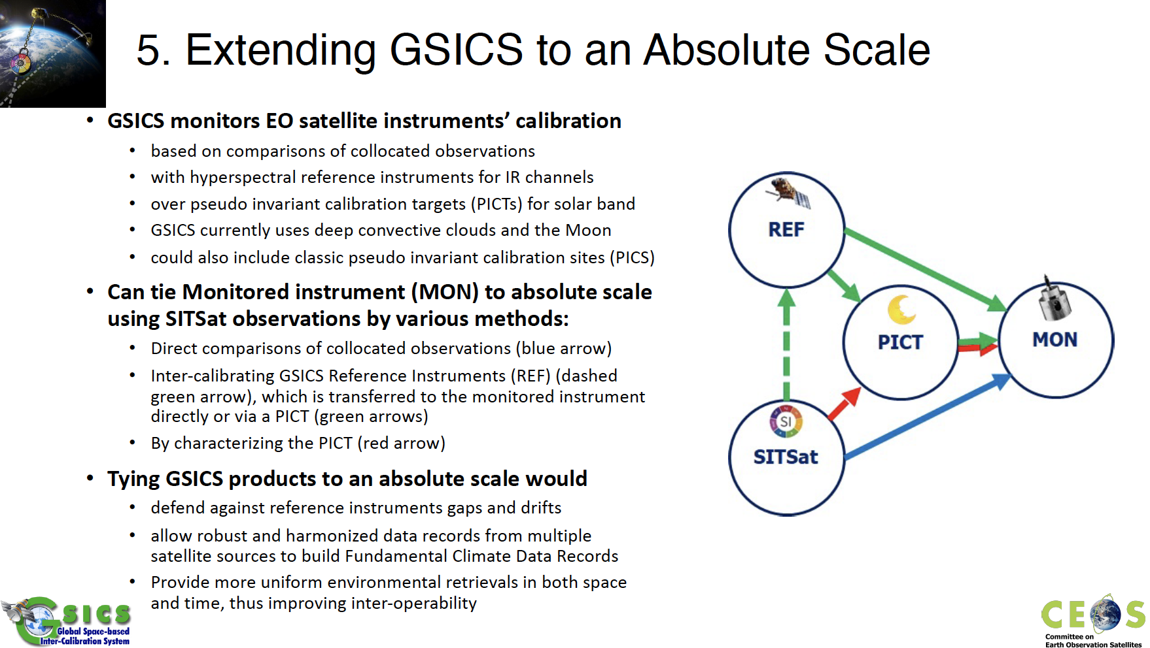
Tim Hewison summary of SITSCOS workshop GSICS goas for CLARREO

Slide 7
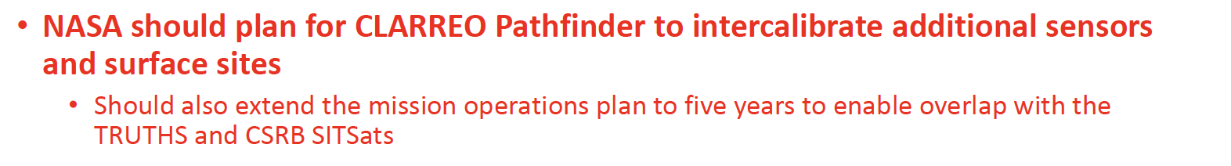
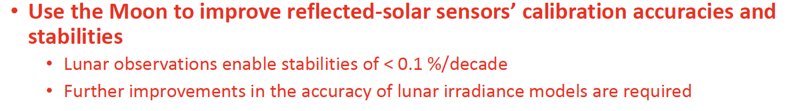

SITSCOS Workshop Report: Recommendations for CLARREO
Tim Hewison summary of SITSCOS workshop GSICS goas for CLARREO

Slide 8
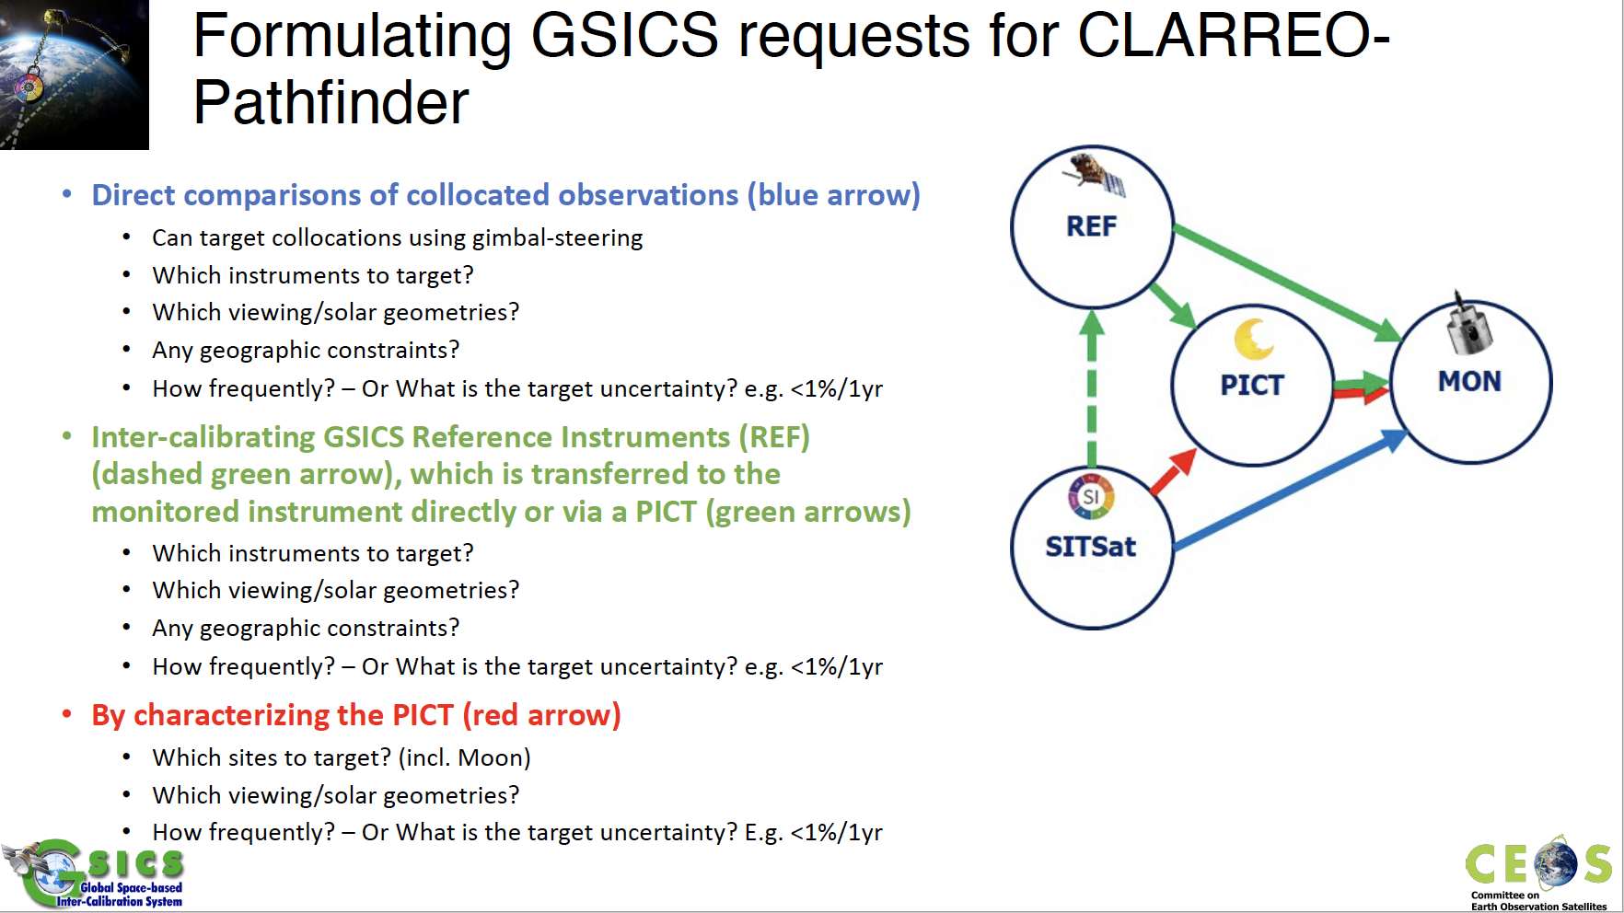
Tim Hewison summary of SITSCOS workshop GSICS goas for CLARREO

Slide 9
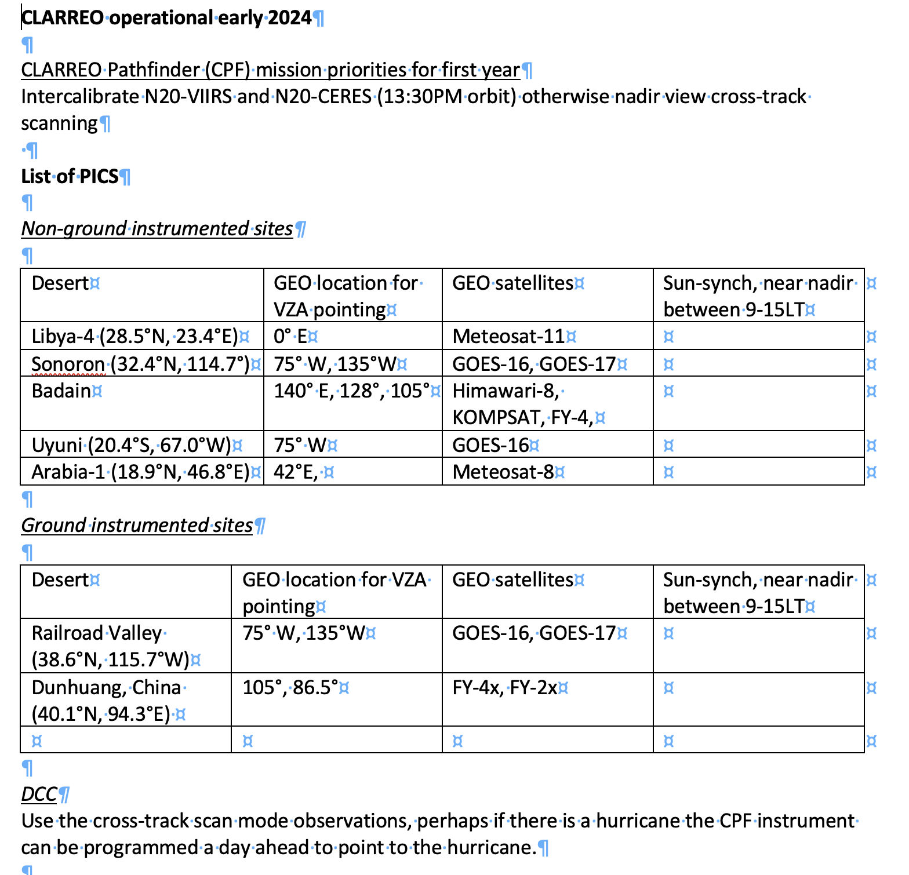
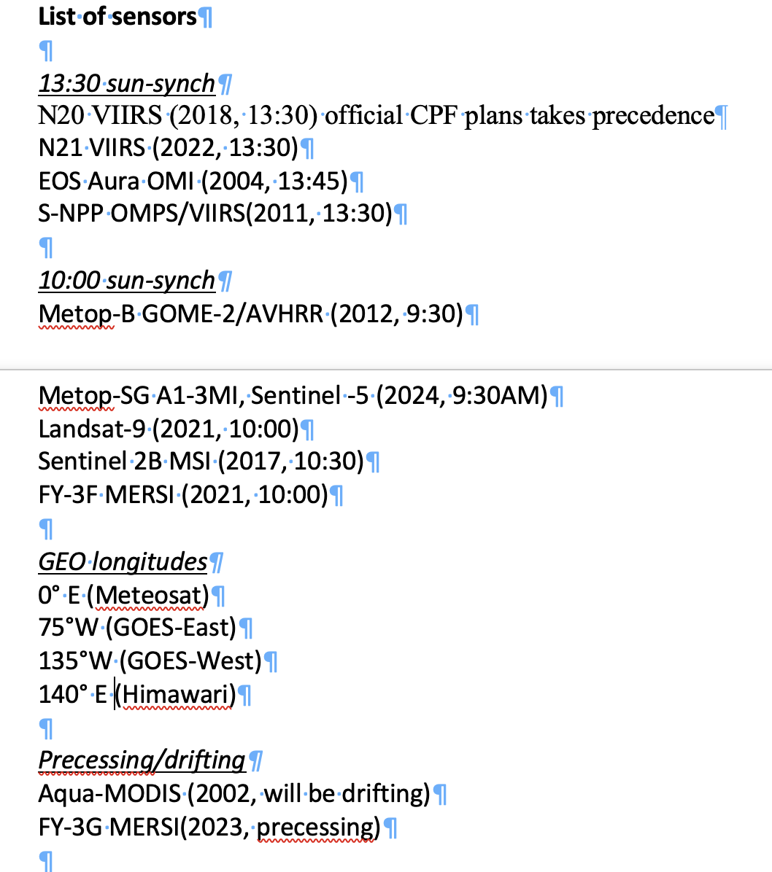
I am putting together a list of GSICS priority sensors and PICS

Slide 10
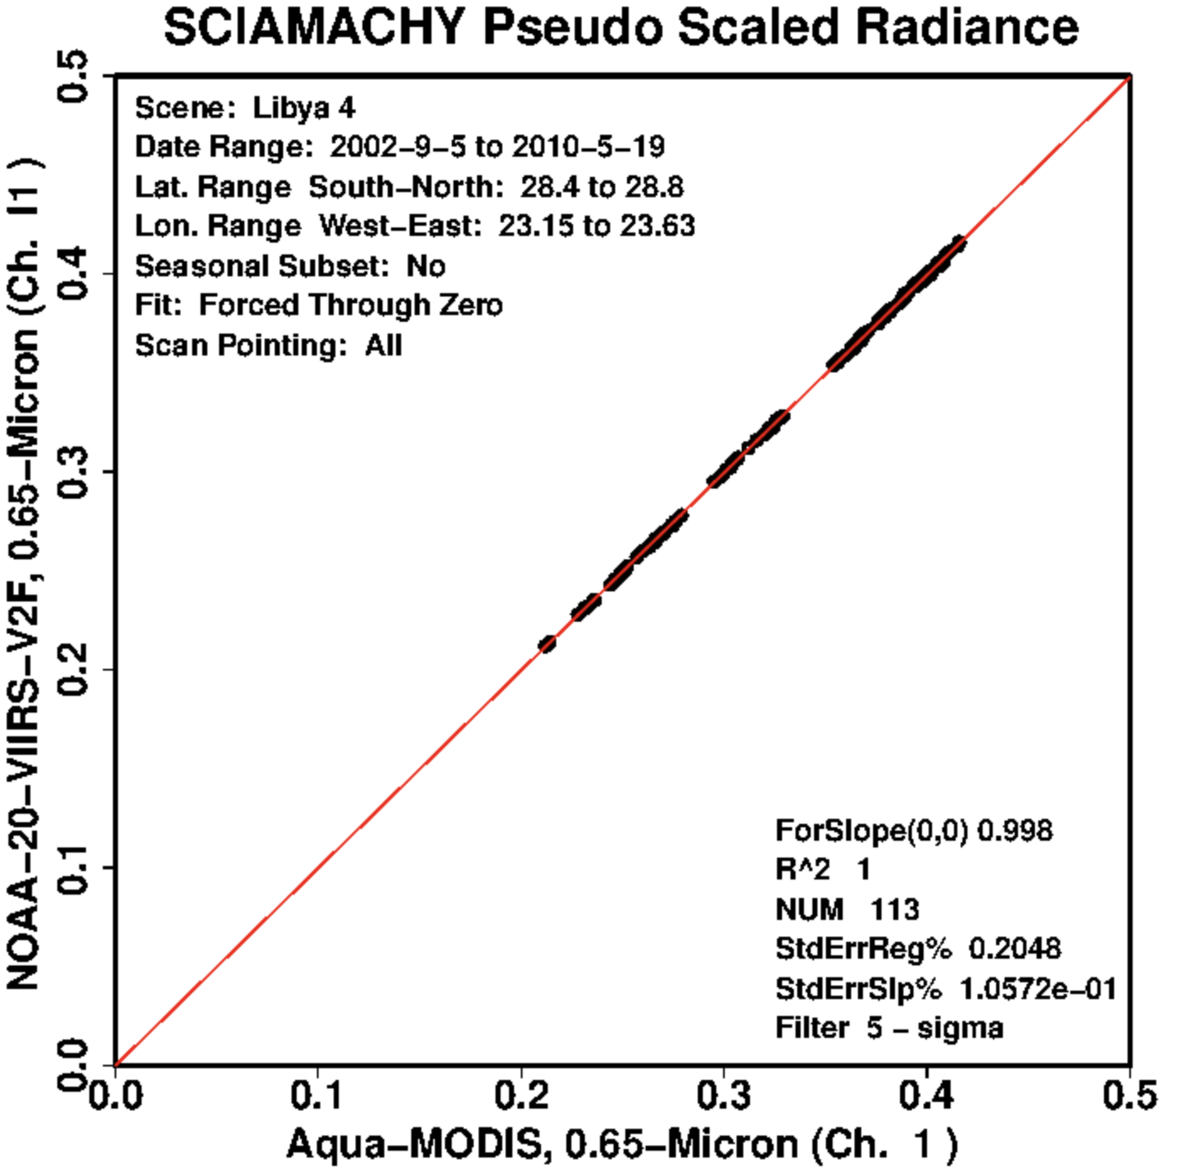
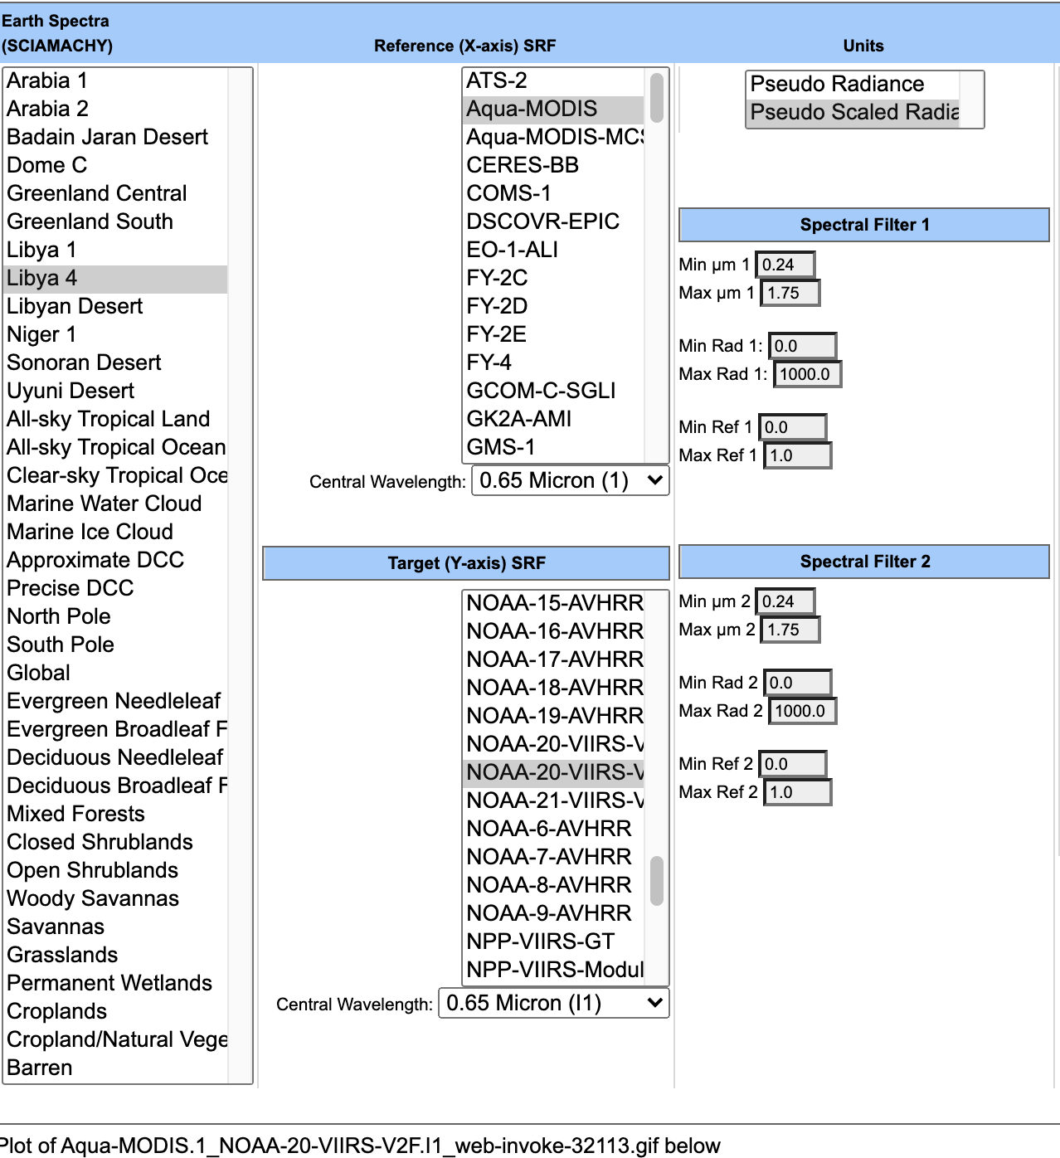
Spectral band Adjustment Factor
radiometrically scale Aqua-MODIS B1 and N20 VIIRS I1
• Current SBAF tool based on SCIAMACHY hyper-spectral radiances
• CLARREO spectral characterization of PICS and intercalibration targets will reduce the uncertainty of SBAFs
https://satcorp.larc.nasa.gov/cgi-bin/site/showdoc?mnemonic=SBAF

Slide 11


DSCOVR EPIC
• DSCOVR diurnally samples the Earth 11-22 times per day
• Use EPIC as proxy for CLARREO to validate radiometric scaling and stability monitoring
Dec 23, 2020, 16:30 GMT
June 23, 2021, 9:01 GMT
• DSCOVR spacecraft is located at L1 1.5M-km from Earth
• Observes the Earth in near backscatter position
• Unlike a geostationary satellite imager, the nadir solar view is at the center of the image
• EPIC imager has a 0.48µm, 0.55µm, 0.64µm and 0.76µm channels and no IR channels
• It has no onboard calibration systems – must verify its stability
Notes:
The DSCOVR spacecraft is located at L1, which is 1.5M km away from the Earth and is located on the Sun and Earth plane, this means that the center of the image is both the view and solar nadir view. The EPIC observes the Earth in near backscatter conditions. The EPIC sensor has a blue, green, red and 0.76µm visible channels along with an oxygen A and B bands. The EPIC image is based on an SMOS detector array and does not have any onboard calibration systems. EPIC observes the the sunlit disk between 10-20 times a day, allowing diurnal sampling and the ability to inter-calibrate all Earth viewing sensors to verify EPICs stability

Slide 12
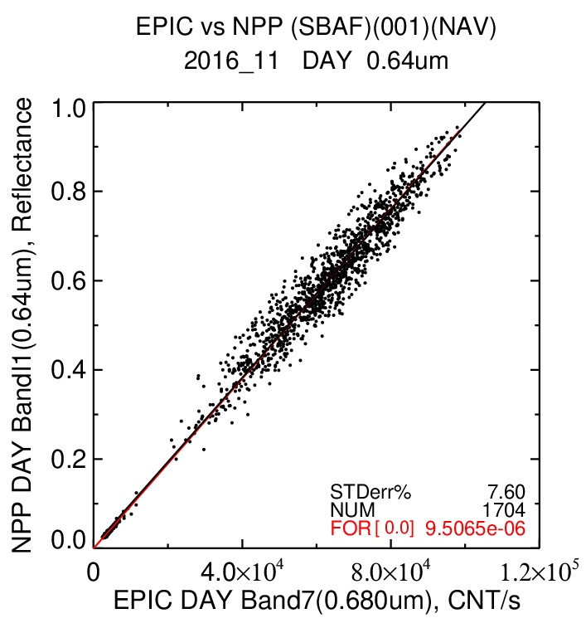
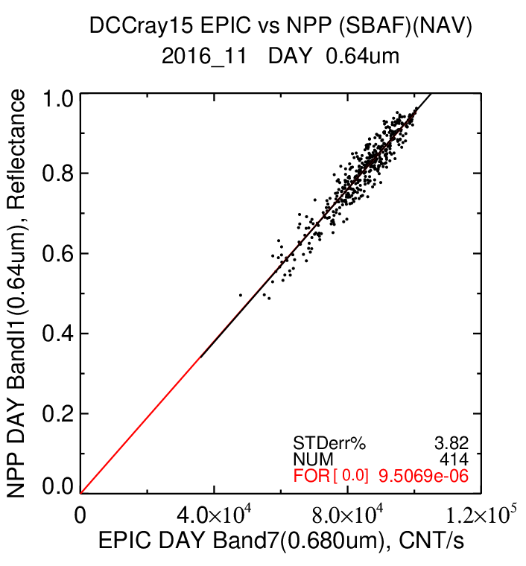
EPIC and VIIRS ATO-RM and DCC-RM consistency
ATO-RM EPIC and NPP 0.65µm
November 2011
DCC-RM EPIC and NPP 0.65µm
November 2011
The linear fit (red line) through the offset of 0 is almost identical
Notes:
Here we apply ATO-RM and DCC-RM between EPIC with NPP-VIIRS 0.65µm channel. The left plot shows the ATO-RM EPIC and NPP reflectance pairs, while the right plot shows the corresponding DCC-RM reflectance pairs.
A linear fit through the offset is computed and shown as the red line and the corresponding force fit slopes shown in red text are almost identical.
This validates the ray-matching methods using EPIC provide similar consistent as when applied between MODIS and VIIRS.

Slide 13
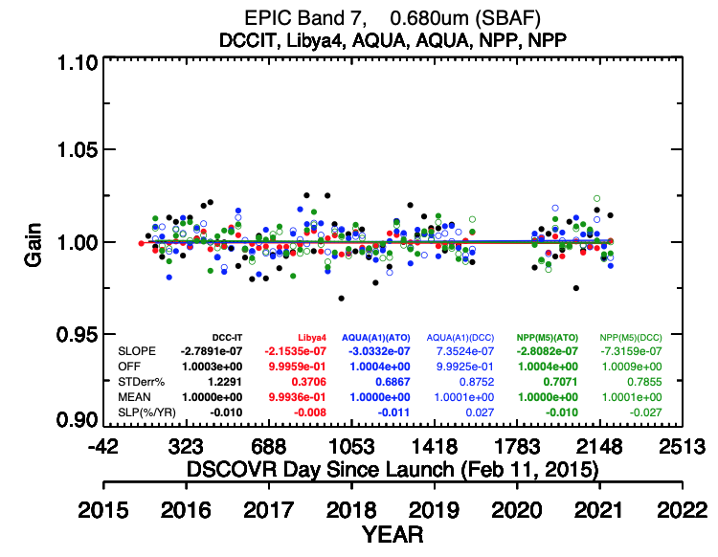
EPIC stability assessment of MODIS and VIIRS
• DCC-IT and Libya-4 invariant targets do not rely on MODIS or VIIRS stability
• Libya-4 and DCC-IT indicate the EPIC band 7 (0.64µm) is stable
ATO-RM •
DCC-RM o
• All linear trends within 0.03%/year
• DCC-IT, Libya-4,
Aqua MODIS ATO-RM and DCC-RM
NPP VIIRS ATO-RM and DCC-RM were normalized over the record to take out the absolute calibration difference
DCC-IT •
Libya-4 •
Aqua •/o
NPP •/o
Notes:
The DCC_IT, Libya-4, Aqua-MODIS and NPP-VIIRS based ATO-RM and DCC-RM show that their monthly gain trends are less then 0.03%/year, which is remarkable. The invariant target methods, which do not rely on the stability of either MODIS or VIIRS have consistent trends with the MODIS and VIIRS based ray-matched trends. This implies that we can use the EPIC sensor as an invariant target

Slide 14
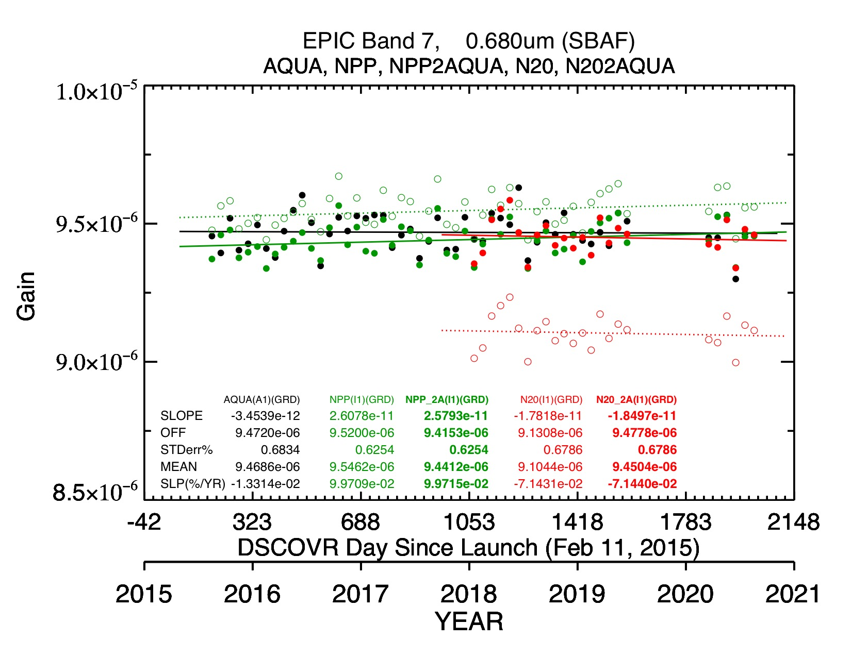
Before and After Radiometric Scaling to Aqua-MODIS
Aqua-MODIS is the reference for radiometric scaling
Before scaling -------
After scaling _____
NPP VIIRS before scaling
NPP VIIRS after scaling
N20 VIIRS after scaling
Aqua
NPP
N20
N20 VIIRS before scaling
NPP | NPP | N20
Before scaling | 0.82% | -3.85%
After scaling | -0.29% | -0.19%
Notes:
Here we show a plot of the NPP and N20-VIIRS monthly gains with respect to Aqua-MODIS used as the reference to scale the VIIRS gains with. Before scaling N20 VIIRS shown as the dashed red line was nearly 4% below the Aqua black trend line. After scaling the difference is now within 0.2%. Similarly, for NPP-VIIRS before radiometric scaling the green dashed line was 0.8% above the Aqua black trend line, after scaling the two are now within 0.3%. This validates the MODIS and VIIRS ray-matching inter-calibration methods can provide robust radiometric scaling factors.

Slide 15
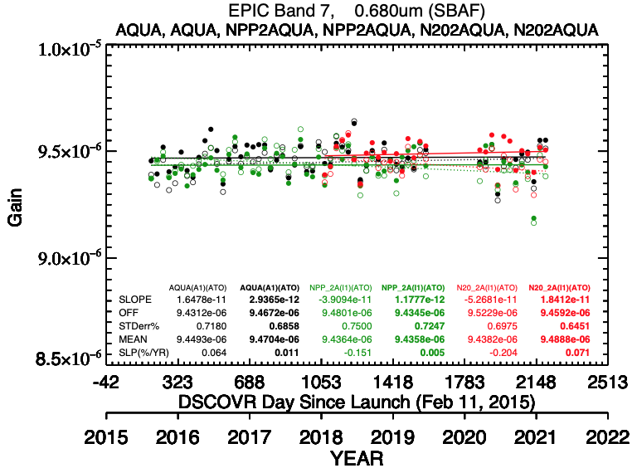
Before and After MODIS and VIIRS drift correction
Before drift correction -------
After drift correction _____
N20 VIIRS drift corrected
NPP VIIRS drift corrected
N20 VIIRS before drift correction
NPP VIIRS before drift correction
Aqua
NPP
N20
Before After
Before After
Before After
Also, smaller linear trend standard errors after drift correction
NPP (%/yr) | Aqua | NPP | N20
Before drift | +0.06 | -0.15% | -0.20%
After drift | +0.01 | +0.01% | +0.07%
Notes:
Here we show a plot of the Aqua-MODIS, NPP-VIIRS and N20-VIIRS ATO-RM monthly gains before and after drift correction. The NPP-VIIRS negative trend shown as the green dashed line of -0.15%/year was stabilized within 0.01%/yr after drift correction, the red dashed line shows the N20 negative trend of -0.2%/yr and after drift correction is now within 0.07%/yr. Note that for Aqua was pretty stable to begin with at 0.06%/yr and after drift correction wihtinb 0.01%/year.
Note that all of the trend standard errors were slightly reduced after applying drift correction
This validates that the 3-month running mean DCC IT normalized to the first 5-years drift correction algorithm is robust and improves the stability of the sensor record.

Slide 16
Conclusions
CLARREO SI-Traceable reference will be the GSICS absolute calibration
N20 VIIRS radiometrically scaled to CLARREO will be the GSICS recommended GSICS calibration reference
Aqua-MODIS and N20-VIIRS overlapping sensor records will transfer the absolute calibration reference back in time.
  This will allow current and historical GEO sensors to be tied to the CLARREO calibration referece
CLARREO characterized Earth invariant targets as well as the moon will directly transfer the CLARREO calibration reference
  Will also improve sensor stability assessment
  Validate the overlapping sensor record calibration

