Slide 1
LunaNet: The Lunar Internet for Space Communications & Position, Navigation, & Timing (PNT) Capabilities
Presenter: Laurie Mann, GSFC, Navigation and Mission Design Branch
Main Contributors & POC:
James Schier, NASA Chief Architect for Space Communications and Navigation
Cheryl Gramling, Assoc. Chief for Technology, Mission Engineering and Systems Analysis Division
Juan Crenshaw, GSFC, Navigation and Mission Design Branch
David Israel, GSFC LunaNet Architect
Jaime Esper, GSFC LCRNS Project Manager

Slide 2
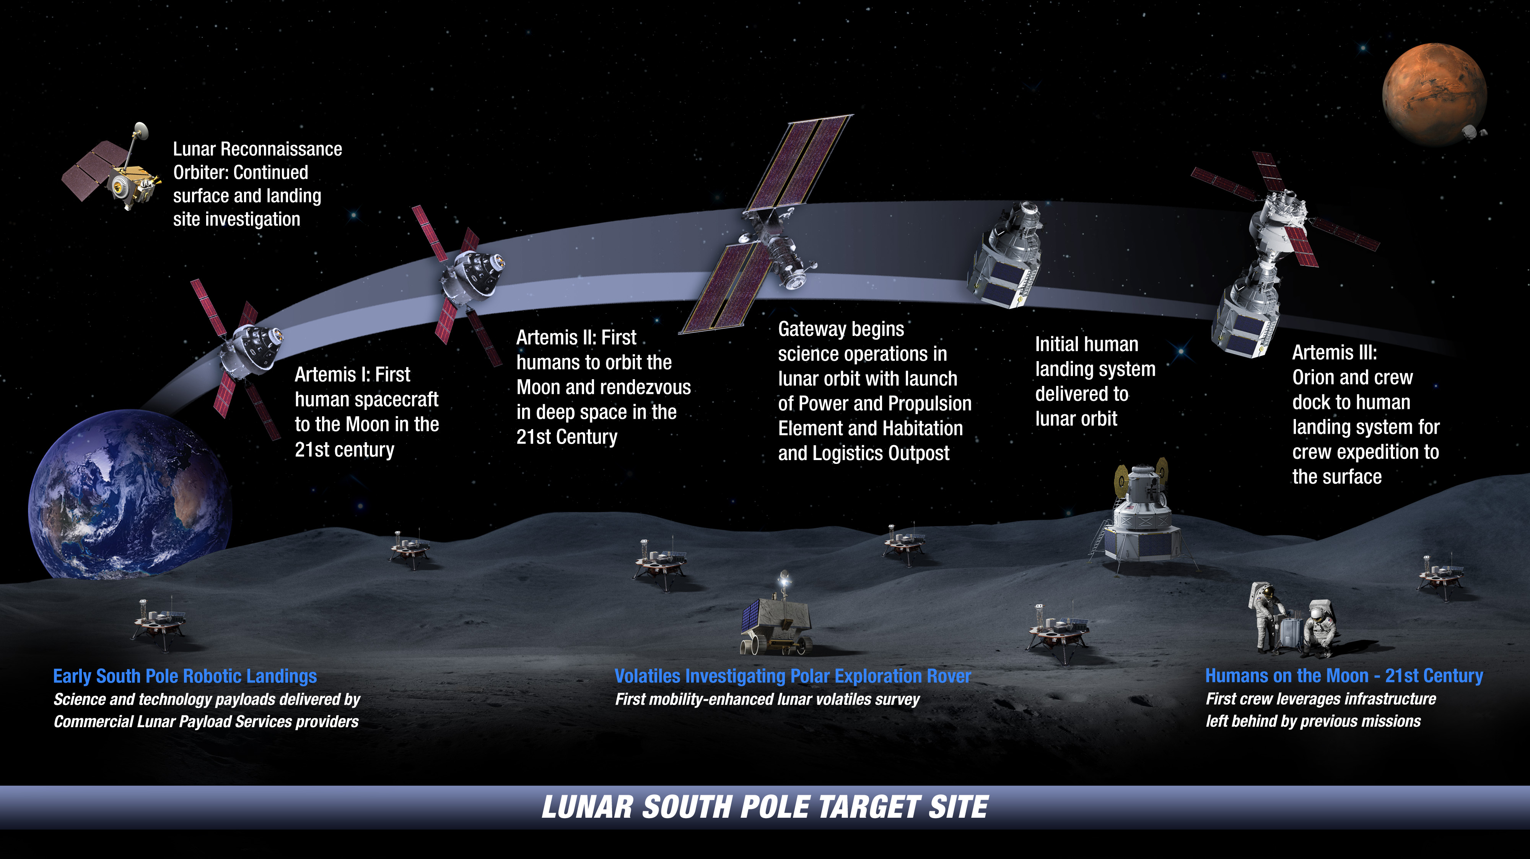

: Landing Humans On the Moon in 2024
including near side and far side missions

Slide 3
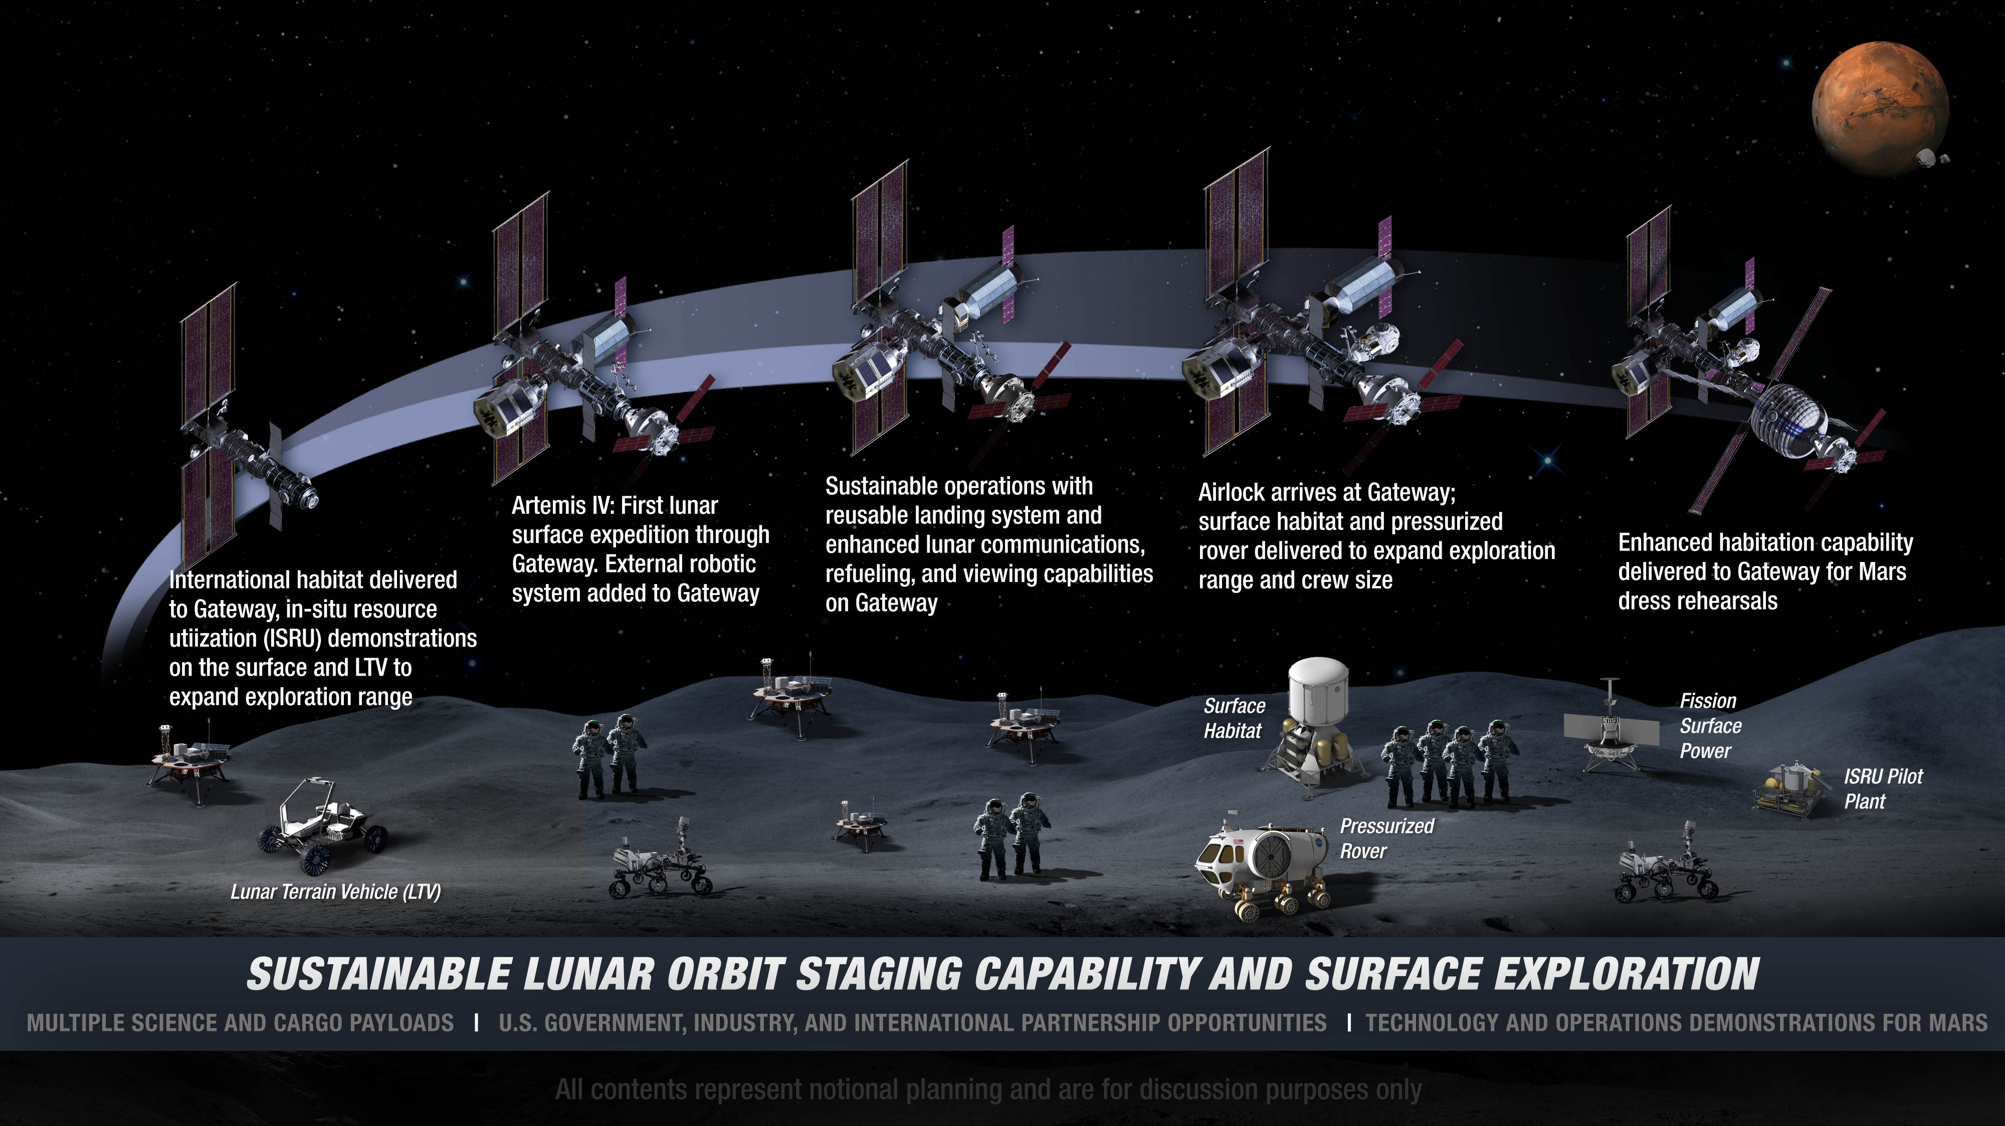
: Extending Lunar Missions to Prepare for Mars

Slide 4
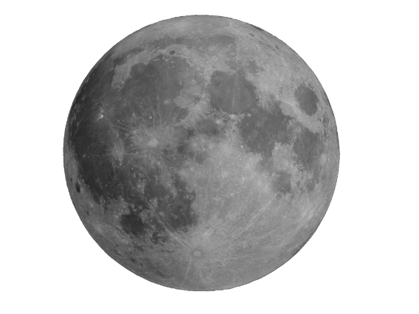
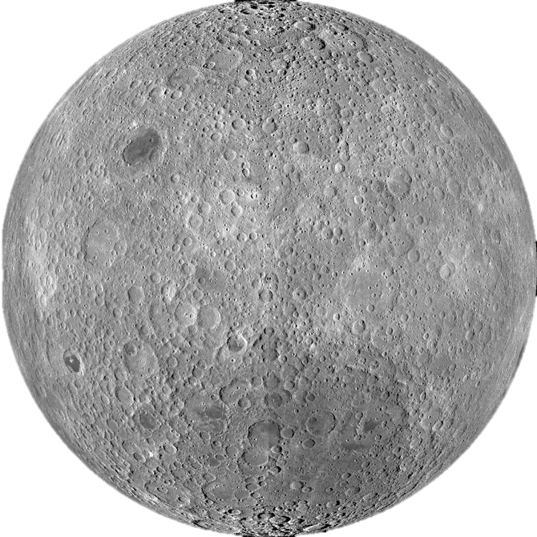
Potential Early Lunar Comm Relay Users
NEAR SIDE
FAR SIDE
Orbiting Spacecraft
CLPS missions beginning in 2021: ~2 per year
to multiple sites – some near South Pole
CLPS missions
2024, 2025, 2027 …
CLPS ~ 2024 Q2
Schrodinger Basin
Reference site: 75°S 133°E
Artemis missions beginning in 2024
Within 6° of South Pole
SOUTH
POLAR REGION
Communication and navigation infrastructure can open new regions for exploration and enable more capable and affordable missions.

Slide 5
Lunar Exploration 21st Century Challenges
Current Deep Space Network (DSN) near capacity serving existing & planned deep space missions
  Development of new 34m DSN antennas adds insufficient capacity for Artemis
Planning to develop new Lunar Exploration Ground Segment (LEGS) with 18m-class antennas to offload DSN for lunar Science & Exploration
Lunar relays required due to CLPS far side missions & South Pole human outpost combined solar & communications availability
Use of Moon to prepare for Human Exploration of Mars drives need for increasing crew & vehicle autonomy driving inclusion of Earth-independent PNT to provide local services and to improve the accuracy, availability, coordination, and timeliness of in-situ knowledge
“Greenfield” opportunity to develop open, interoperable architecture for integrated Communication and PNT (CPNT) services reusable throughout the solar system → LunaNet!

Slide 6
Cislunar PNT Challenges
 | CHALLENGE
REFERENCE SYSTEMS | Knowledge, dissemination, and synchronization of time across long distances, accounting for relativity
 | Earth resources needed for onboard or local systems (local coordinate frames & time)
 | Reliable, accurate, and stable time and frequency references (for in-situ observations, correlation, accurate orbit knowledge)
 | Tying local reference frames to International Celestial Reference Frame (ICRF)
MEASUREMENT LIABILITY | Continuous availability of one particular data source to inform the solution
 | Reliance on single limited data set that may introduce unobservable bias
 | Mutual reliance across elements(direct or indirect) as a reference source for position & time – leading to unmeasured errors
 | Resolve discrepancies between measurement types/sources (i.e., weighting, modeling errors, observability, fault detection)
AUTONOMY | In-situ high-availability, coordinated, timely autonomous operations for missions in extreme environments, with high dynamics, or cannot limit operations to RTLT with earth
SECURITY | Vulnerability/susceptibility of inter-spacecraft PNT services
 | Single-sensor weakness to tampering (jamming, spoofing)
RECOVERY | Rapid state reconvergence post-maneuver, especially in highly dynamic situations (rendezvous, EDL, risk mitigation maneuvers)
RESOURCES | SWaP-C associated with multiple unique sensors for PNT vs for multi-use sensors (& TRL challenge)
 | Onboard computing resources (e.g., image and signal processing)
STANDARDS | Lack of standardization for inter-spacecraft links, especially for metric tracking, time transfer & optical PNT
 | Standardized PNT messages for space-based exchange (ephemeris, time, maneuvers)

Slide 7
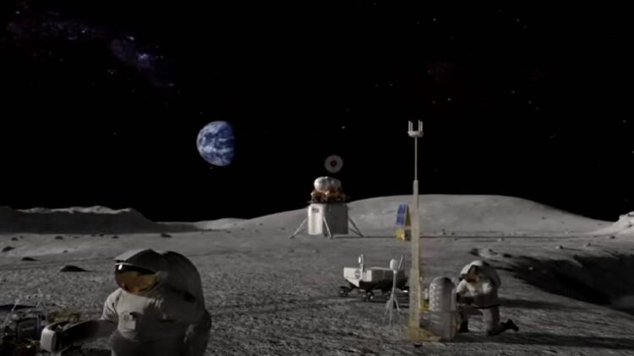
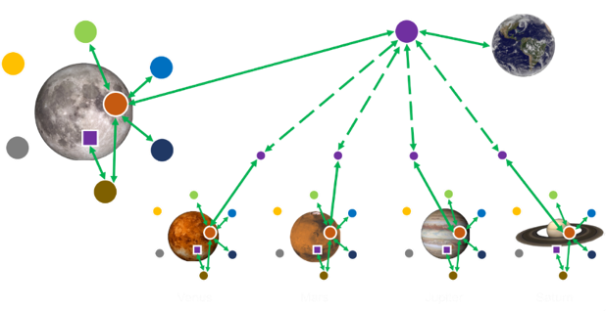
Introduction to the Lunar Network, LunaNet
LunaNet is envisioned as a set of cooperating networks providing communications and navigation services for users on and around the Moon. The LunaNet concept is based on a framework of mutually agreed-upon standards, protocols, and interface requirements that enable interoperability. LunaNet is intended to allow many lunar mission users to engage the services of diverse commercial and government service providers in an open and evolvable architecture.
  Service-Oriented: LunaNet services can include data transmission and distribution of position, navigation, timing (PNT), and situational awareness information.
  Scalable: LunaNet can be introduced as part of the earliest missions and accommodate expansion as new users and service providers come online.
  Open: LunaNet is based on open international standards like the Internet
  Resilient: As LunaNet grows into many networks and users, it becomes steadily more resilient to individual failures and outages
  Secure: LunaNet protects sensitive and proprietary data while preventing or rapidly recovering from cyber threats
  Extensible: The LunaNet concept is applicable to any planetary body.
  LunaNet is not a particular satellite or constellation of satellites, nor is it a project, program, or organization.
There is broad interest in developing and implementing lunar communications & PNT services among industry (US and foreign), international partners, and NASA.

Slide 8
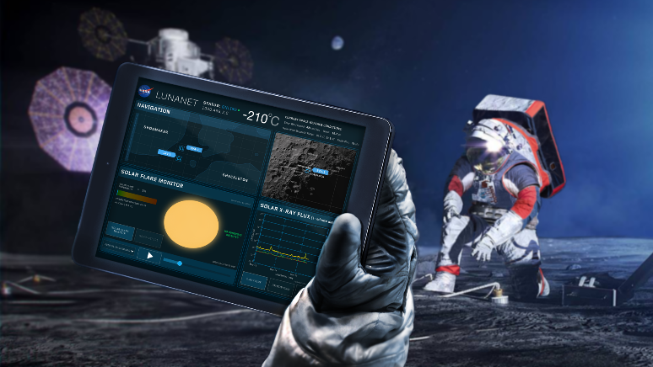
Planetary Network Services
Networked Communication Services
Critical data transmitted in real time.
Data aggregated and transmitted in store-and-forward mode from orbiting and surface relays
Data exchanged among lunar users with no need for transfer to and from Earth
Data sent on demand by user or scheduled to better manage Earth stations loading & spectrum use
PNT Services
Precise position, velocity & time for autonomous nav & collision avoidance
Fusion of multiple data types including radiometrics, optimetrics, celestial nav, optical nav, terrain relative nav, & GNSS
AFS service supplies time transfer and metric tracking to synchronize users
Detection & Information Services
Alerts for events such as space weather, collision avoidance, & surface impact predictions sent to all LunaNet subscribers
Mission sensors for space weather and other measurements distribute information services to other users via LunaNet information services
Search and Rescue (SAR) services
Science Services
Use RF & optical assets as (part of) scientific instruments
Supports Radio & Radar Sciences, Radio Astronomy / Very Long Baseline Interferometry (VLBI) & other space sciences

Slide 9
LunaNet PNT Services
 | Service | Description
“Positioning” | Generate signal for (pseudo)range, Doppler, and time observable | Produces time-synchronized fixed frequency signal with known ranging code for enabling 1-way pseudorange, Doppler, and time by receiver; or 2-way as a relay.
 | Provide measurements via message | Transmits the LunaNet-created measurements of 1- or 2-way range and Doppler to a receiving vehicle via standard message.
 | Establish onboard navigation using in situ measurements | LunaNet estimates state using onboard sensors, such as optical navigation, weak-signal GNSS, accelerometer, IMU, or pseudorange and Doppler from communication links to autonomously determine state in flight software and disseminate ephem via standard message.
Navigation | Transmit LunaNet ephemeris for use in measurement processing | Provides spacecraft time series of position, velocity, time, & solve-for states to user or LunaNet node to allow autonomous onboard processing of radiometric data for user estimate of state and network access.
 | Transmit user’s integrated position, velocity, & time (PVT) state to user | Communicates LunaNet’s estimate of user’s position, velocity, time, & solve-fors single-epoch state to another user or LunaNet node to support services or to user for Location Service.
Timing | Maintain a stable onboard time reference | Utilizes high-stability onboard oscillators/time source or external measurements to maintain a stable time-base.
 | Provide a coarse time synchronization capability | Broadcasts current time scale in a two- or one-way transmission to update onboard estimates of current global time, e.g., network-layer service such as Network Time Protocol (NTP)
 | Provide fine time synchronization capability | Uses time-synchronized fixed frequency signal with known ranging code on P2P, Broadcast, and Crosslink signals to permit high-accuracy disciplining of clocks within the network.
Philosophy: Comm signal structure enables PNT; not separate PNT and comm systems.

Slide 10
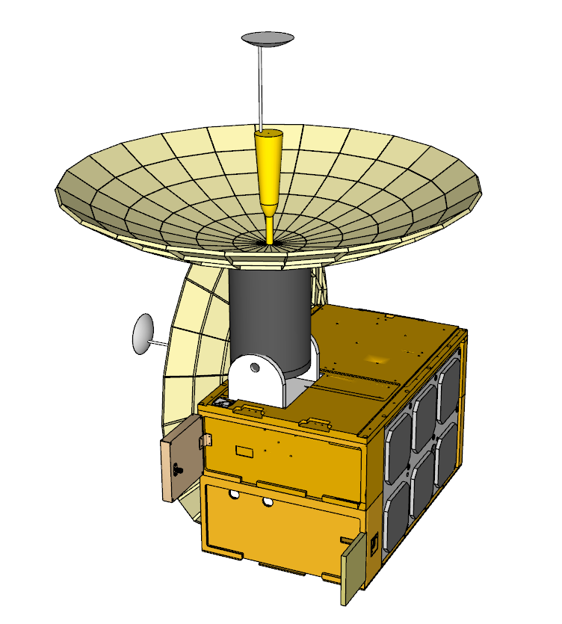
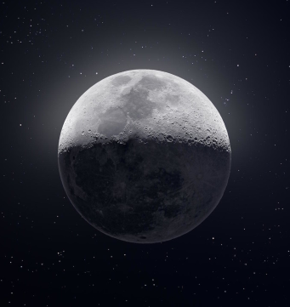
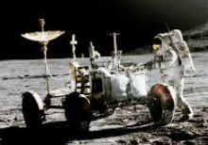
Overview of Proposed LunaNet PNT Services
GNSS weak signal Rx
Lunar Orbiters
Direct-from-Earth (DFE) Rx
P2P
RF System
Proximity Signals*
SAR, SSA,
PNT Message &
Services,
1-Way Doppler
Pseudo-range
Time-transfer
Onboard Navigation FSW System
Message
Manager
Optical Nav
Delay feedback
AFS Signal
EVA/Surface Users
LunaNet
Crosslinks
Crosslink Signal
  Accelerometer IMU
Stable Time and Frequency Reference Source
LunaNet Node n
*Software-defined for flexibility and adaptability
LunaNet Node Onboard PNT Subsystem

Slide 11
LunaNet S-Band AFS Service
AFS Service Signal Requirements (RF Based for larger FOV)
PN code AFS (CDMA, CCSDS 415.1-B-1), code unique to each LunaNet node
Constant transmit center frequency
PN chip rate coherent with transmit frequency to form rationale time base
Measure PN code epoch at the 1PPS mark and identify time-stamp with respect to UTC
User
AFS Service Supports
Space Situational Awareness
Search and Rescue (SAR)
Network Access Parameters
Ranging → FWD 1-way ranging
Doppler → FWD 1-way Doppler
Time-transfer
Wide FOV
(±22° from 4750 km altitude covers lunar diameter ±200km)
User A
LunaNet Node AFS
Needs on user end for enabling¹
Spread-spectrum multi-channel receiver
Capable of acquiring and synchronizing to PN code
Tracking carrier dynamics, for example by implementing frequency control for Doppler compensation
Master stable reference frequency and time source, provides 1PPS, accurate time synch and stamping
Receiver accurately time-stamps PN epoch receipt
Receiver outputs accurately time-stamped Doppler from carrier tracking loop
Demodulate and interpret LunaNet messages
Onboard Navigation Software for estimating position/velocity/clock state
User C
User B
AFS Service Messages
LunaNet Messages
  Space Situational Awareness (e.g., Space weather, conjunction messages, etc.)
  Search and Rescue Alerts
  Network Access Information (e.g., link schedule, relay availability, etc.)
  Science Alerts
PNT Messages
  Time-transfer, via PN epoch at specific transmit time-tags, related correction values
  Orbit state / or orbit ephemeris of LunaNet Node(s)
  Attitude state / or attitude ephemeris of LunaNet Node(s)
1: Capabilities already available in industry

Slide 12

LunaNet S-Band AFS Service
Users can acquire AFS signals from different LunaNet sources simultaneously (like GNSS)
User D
Service can reach beyond the lunar limbs
LunaNet Node 1 AFS
User A
User C
User B
LunaNet Node 2 AFS
LunaNet Node 4 AFS
LunaNet Node 3 AFS

Slide 13
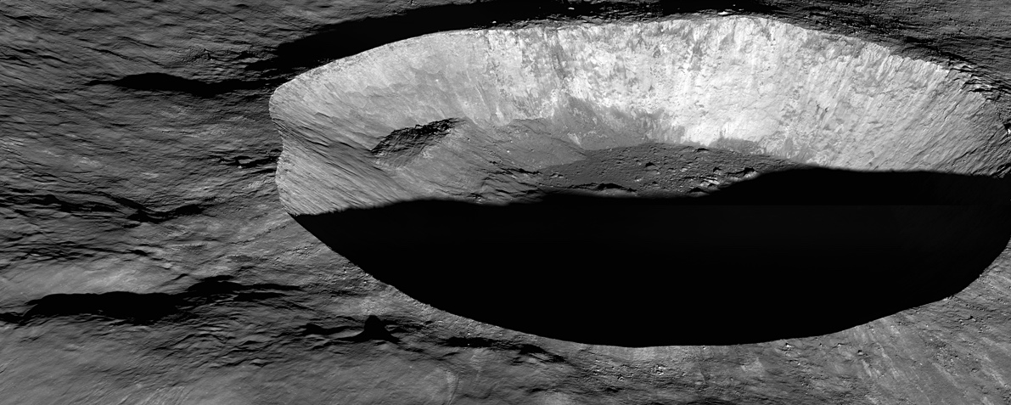
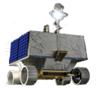

Surface Navigation
LunaNet Node 1
LunaNet Node 2
LunaNet Node n
AFS
LunaNets
Integrated Nav payload on LunaNet Spacecraft allows for autonomously derived orbit solutions
LunaNets relay, via AFS, ephemerides and rendered maps on a GNSS-like signal
Surface User positioning achieved by measuring pseudorange and Doppler from multi-lateral LunaNet nodes AFS
Surface User

Slide 14
Peer-to-peer PNT Services (RF Only)
LunaNet Node
PNT Source
P2P 1-Way PNT Reference Services
User Need Deltas with AFS
S-Band → Same as AFS
Ka-Band
  Non-spread Ka-Band receiver
  Support for CCSDS 414.1-B-2 type PN codes (non-spread)
User A
Service Supports
S-Band → Same as AFS
Ka-Band → [future] Doppler Only, potential for Ranging and Time-transfer using GMSK and simultaneous PN codes (CCSDS 414.1-B-2 and 413.1-G-1).
LunaNet Node
PNT Source
P2P 1-Way PNT Measurement Services
Not IOC
User A
Service Supports
S-Band → [future] Needs as for Relay 1-way ref services.
Ka-Band → [future] Doppler Only, potential for Ranging and Time-transfer using GMSK and simultaneous PN codes (CCSDS 414.1-B-2 and 413.1-G-1).
User Need Deltas with AFS
S-Band → Needs as for Relay for 1-way reference services.
Ka-Band → Needs as for Relay for 1-way reference services.
LunaNet Node
PNT Measurement
P2P 2-Way Relay-Initiated PNT Services
User Need Deltas with 1-Way Service
Relax need for frequency and timing references on-board
Does not require need to accommodate accurate measurements.
Need to incorporate transponder, capable of coherently turning received frequency and PN code.
User A
Service Supports
S-Band → 2-Way range and Doppler measurements
Ka-Band → [future] 2-Way Doppler, potential for 2-Way Ranging using GMSK and simultaneous PN codes (CCSDS 414.1-B-2 and 413.1-G-1).
Turn-around
Transponder
LunaNet Node
As Transponder
Turn-around
Transponder
P2P 2-Way User-Initiated PNT Services
Not IOC
User A
Service Supports
[future] Lunanet Relay coherently transponds received signal
[future] User performs 2-Way measurements
PN codes as with services above
User Need Deltas with AFS
Ability to perform 2-way measurements

Slide 15

LunaNet Crosslinks
Crosslinks between LunaNet Nodes provide pseudorange, Doppler, and ephemeris to inform lunar-local orbital knowledge, and high precision time transfer.
Serves the comprehensive network and maintains synchronization.
User D
LunaNet Node 1
Relays data from far side to other LunaNet relays and/or DTE
LunaNet Node n
User A
User C
User B
Distributes Messages (e.g., Detection Alerts, SAR) throughout lunar environment.
Enables User Initiated Services
LunaNet Node 2
LunaNet Node 4
Crosslinks
LunaNet Node 3
DTE Trunk Line

Slide 16
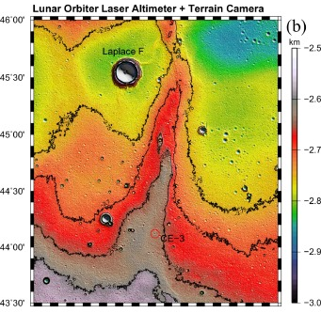
Lunar Reference System
Lunar reference ephemeris and orientation maintained by NASA/JPL, distributed through the publicly available Dynamic Ephemeris files via NAIF [Principal Axis]
Lunar longitude/latitude grid identified by the LRO science team [Mean Earth/Rotation Axis]
Lunar gravity potential model defined by GRAIL mission, degree and order 1500x1500, lower D/O available and adequate for most nav scenarios [Principal Axis]
Current lunar maps, SLDEM2015, informed by LRO (Laser Altimetry) and JAXA’s SELENE (stereo Terrain Camera) [Mean Earth/Rotation Axis]
Currently, there is a multi-year effort underway under NASA STMD’s Game Changing Demonstration to develop high-resolution lunar maps suitable for optical navigation in orbit, through EDL, and on surface
Users will need to apply coordinate transforms to align the information (available via Ancillary Message)
The lunar reference frame, grid, potential, and maps must be consistent.
Reference System
Ref Ephem
Lunar Grid
Potential Model
DEMs

Slide 17
LunaNet CPNT Messages Overview
Suite of Standardized Messages
Concept is adaptable to new messages/
changing needs
S=single
M=multi

Slide 18
LunaNet Message Concept

Slide 19
LunaNet Status as of 10/19/2021
Interoperability Specification: draft available to public
  https://esc.gsfc.nasa.gov/projects/TEMPO?tab=lunanet
Interop Standards WG being established (kickoff Oct 5, 2021) (ESA, industry)
  Signal structure definition for PNT metric tracking from communication signals
  LunaNet Message definitions
  Expect draft Standards for multi-lateral review and feedback by early CY22
NASA developing Design Reference Mission to inform the Agency on support requirements for Artemis III and beyond
  Procurement sensitivity will limit what can be covered in the Q&A session
Beyond LunaNet: Lunar surface assets (“beacons”) for PNT are TBD

Slide 20
LSIC PNT Q&A
Will LunaNet interoperability standards be amended to include recommended orbital distances for providing PNT services, or to include information about power levels at different distances? If satellites are providing signals from significantly different distances, there won’t be a “one size fits all” end user receiver due to differences in signal power, Doppler, etc.
  Appendix C of the interoperability has a placeholder for that consideration: “The signal power provided by LunaNet AFS sources will be dynamically adjusted to represent a minimum power of TBD and a maximum power of TBD at the lunar surface. The target location is specified as the nearest lunar surface location to the LunaNet source providing the signal, i.e., nadir point.” – This will be further refined as part of the current working group effort with ESA
Has NASA decided on operating frequencies and preferred signal formats for lunar GNSS pseudolites?
  LunaNet PNT services are not envisioned to cover L-band and while provision is given to serve multiple users, the services extend beyond what GNSS currently support
  Draft signal operating frequency ranges and format are defined in the released LunaNet Interoperability Standard
Does NASA plan to coordinate the use of PRN IDs by lunar GNSS pseudolites?
  Lunanet is an architecture supported by NASA, US industry and International agency and partners. Coordination will be done at an international level
What power limitations would be imposed on lunar GNSS pseudolites to avoid interference with weak GNSS signals from Earth?
  There are currently no restriction for weak GNSS signal as LunaNet PNT services are provided in S-band frequencies
Has NASA decided on a dedicated reference frame for Lunar PNT?
  This is work in-progress with many stakeholders
What are LunaNet's requirements or targets for PVT accuracy?
  This information is procurement sensitive
What are LunaNet's requirements or targets for cold-start PVT resolution time (from start of the device to PVT resolution)?
  This information is procurement sensitive
The current LunaNet ConOps tries to avoid the need for a dedicated lunar positioning system by sharing information between assets. This puts significant burden on all lunar users who will have to host complex, computation- and communication-intensive sensor fusion systems. In the meanwhile, GPS-like lunar positioning systems have been shown feasible by ESA and are already pursued by them and by several private companies. Is it possible that NASA will revise the LunaNet's PNT concept to incorporate GPS-like systems?
  The nominal approach for PNT services will be met by the AFS Reference signal and associated messages. The intent of LunaNet is to ease the user burden by extracting metric tracking observables from a ubiquitous communications signal.
  As the number of LunaNet provider nodes increases, the system approaches a more uniform distribution of AFS signals to provide the geometry needed at any epoch.

Slide 21
LSIC Frequency Management Q&A
Frequency management
  Other than some recommended frequencies for PFS 5/6 signal definition, there are no recommended frequencies in the draft interoperability standard. Did we miss something? If in fact there aren’t any frequency recommendations, why is that? The Space Frequency Coordination Group Recommendation SFCG 32-2R2 COMMUNICATION FREQUENCY ALLOCATIONS AND SHARING IN THE LUNAR REGION could provide a starting point for discussion around frequencies, though the radio telescope community has requested that any proposed lunar comms or PNT satellites stay out of the frequencies below 2000 MHz to avoid negatively impacting radio astronomy.
  Frequencies are being worked as part of the follow-on working group
  The current draft LunaNet Interoperability standards state that the PFS 5/6 Signal Definition will use S-band between ~2031 MHz and ~2105 Mhz. These signal types will be used by LunaNet service providers and end users to send each other a limited set of message types, including health and ephemeris data. Why were these frequencies selected?
  Frequencies chosen to be compliant with IOAG

Slide 22
LSIC Comm Q&A
Is the decision to use HPE/PPM/SCPPM scheme for LunaNet's optical links final?
Do you see sufficient industrial offering of LCTs using HPE standard compared to O3K and HDR?
Should LunaNet and its users implement AOS as the data link protocol or better go directly for USLP?
Is there a plan for an update and reconciliation of the recommendation for lunar spectrum use (SFCG 32-2R2, IOAG, ICSIS, CCSDS) on which LunaNet is based? (Currently there are some errors, omissions, and inconsistencies among them.)

Slide 23
Benefits of LunaNet PNT Services
Many users in the cislunar space service volume or on the Moon:
  Must address highly dynamic systems in near-real time
  Cannot afford round-trip light time delay
  Challenged with unavailable Direct-to-Earth when occulted by the Moon
  Need to address lighting conditions which affect camera measurement ability
Position, Navigation and Timing (PNT) services via LunaNet
  Decrease reliance on over-subscribed ground stations for navigation purposes without impacting data rates
  Ensure essential capability for PNT, situational awareness, and Search and Rescue
    Service coverage, especially on the far side of the Moon
    Navigation solution robustness & resiliency
    Provide accurate time-transfer services alternative or supplement to GNSS
  Includes messages for standard & common information exchange between participating elements
    Share position/orbit information directly within lunar elements, avoiding moon-earth-moon latencies.
    Receive relevant notifications such as conjunction, weather/radiation alerts, or updated surface maps.
  Prove out concepts for Mars operation and beyond
  Users relying on LunaNet for communications and PNT may be able to avoid larger RF systems and additional PNT sensors, making cubesat / smallsat more feasible
Compels those users toward autonomous systems

