Slide 1

Study of Fallout Metrics for Contamination Analysis
Elaine Stewart
NASA Goddard Space Flight Center
Code 546 Contamination and Thermal Coatings Engineering Branch

Slide 2

Definition of the Problem
Definition of Problem
Scope of Effort
Efforts to Date
Findings
Future Work
A challenge present for many projects, including James Webb Space Telescope (JWST), is predicting contamination fallout for the various orientations possible for surfaces such as optics and instruments.
Relevance: The vertical to horizontal fallout ratio is critical for contamination requirements and allocations to identify money and resources necessary for project mission objectives. This has been an ongoing issue in contamination engineering for years.
Goal: determine an accurate ratio or method for vertical to horizontal fallout that can be applied in future contamination analytics
Notes:
Handbook value for vertical to horizontal fallout is 10%. Vertical wafers will accumulate less fall out due to orientation and surface interactions of the particles. The comparison trend between vertical vs. horizontal will fluctuate, but can be determined with reasonable error long term.
Issue identified: There is not sufficient data to validate the best practice assumption to quantify particle build up on vertical surfaces as approximately 1/10 of horizontal surfaces. Since many spacecraft can be in various orientations, this variable has significant effect on predictions for end of life mission goals.

Slide 3
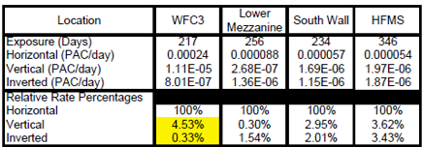
Definition of the Problem
Definition of Problem
Scope of Effort
Efforts to Date
Findings
Future Work
Currently, vertical particle build up is quantified as approximately 1/10 of horizontal surfaces (Tribble, A., et al. “Contamination Control Engineering Design Guidelines for the Aerospace Community - Results.” Space Programs and Technologies Conference, 1996, doi:10.2514/6.1996-4375). There is not sufficient data with accuracy to support this assumption.
Previous studies:
1) Limited fallout studies in Spacecraft Systems Development and Integration Facility (SSDIF)
  4 studies prior to 2005 that did not properly account for:
    Integration and testing (I&T) levels, duration of exposure, percent area coverage (PAC) levels lower than typical literature values
2) SSDIF Fallout Study for JWST in 2005-2006
  Inconclusive results for the effect of
  orientation on fallout
3) Verifying rule of thumb predictions for Integrated Science Instrument Module (ISIM) sensitive surfaces (varying orientations) for JWST
In all cases, results were not reproducible
Hasegawa, Mark. “Applying SSDIF Particle Fallout Rates to the JWST Program”. 2007
Notes:
Issue identified: There is not sufficient data to validate the best practice assumption to quantify particle build up on vertical surfaces as approximately 1/10 of horizontal surfaces. Since many spacecraft can be in various orientations, this variable has significant effect on predictions for end of life mission goals.

Slide 4
Scope of Effort
Definition of Problem
Scope of Effort
Efforts to Date
Findings
Future Work
1. Vertical to horizontal fallout study (short and long term exposure)
2. Camera imaging of sensitive surfaces
Issues to address:
  Investigate effect of orientation on spacecraft fallout
  Imaging sensitive hardware surfaces directly
Restrictions:
  Timeline: 6 months-1 year
  Minimal funding
Goals:
  Vertical to horizontal ratio and tolerance
  Photography capabilities to use in conjunction with Image Analysis (IA)

Slide 5
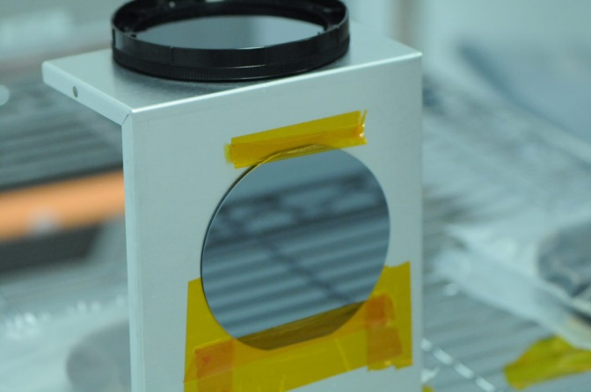
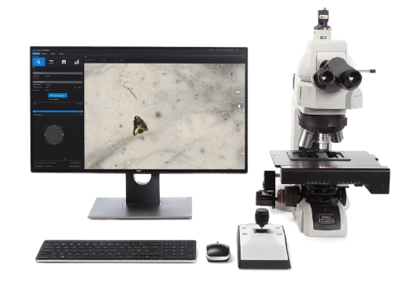
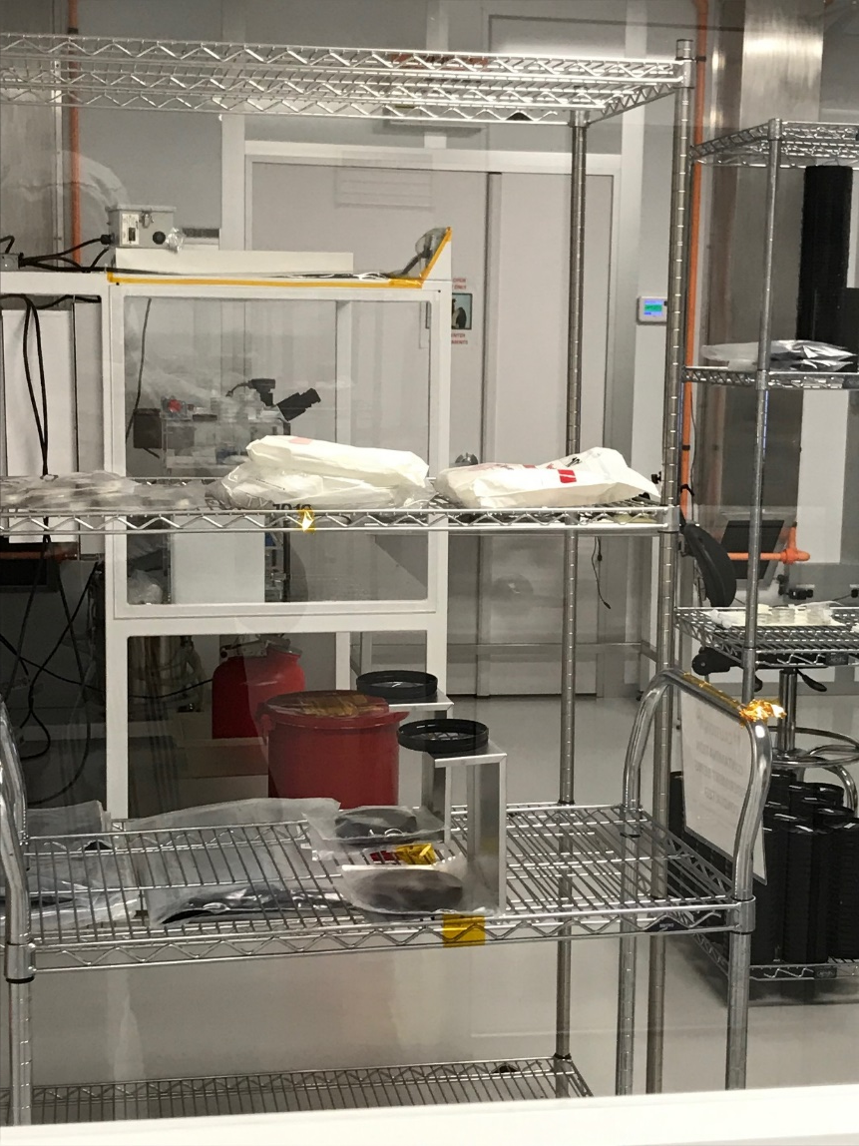
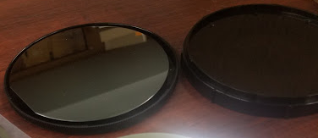
Vertical-Horizontal Study Setup
Definition of Problem
Scope of Effort
Efforts to Date
Findings
Future Work
After being deployed for a determined amount of time, the wafers are read on an Image analysis (IA) system to determine the percent area coverage (PAC) and counts of particles and fibers
Silicon wafers are used to determine fallout and represent sensitive surfaces of flight hardware
4 wafers: 2 vertical and 2 horizontal set up in three low activity locations:
BATCAVE (BC)
SSDIF
SCA
Bldg 7 BC facility setup

Slide 6
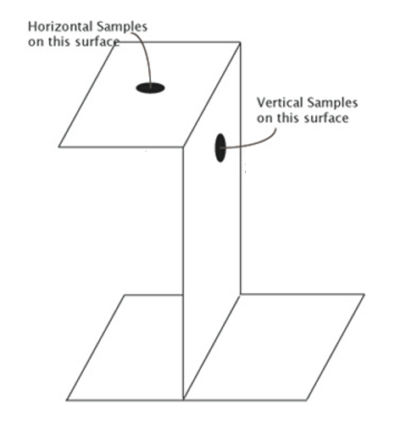
GSFC Facilities
Definition of Problem
Scope of Effort
Efforts to Date
Findings
Future Work
BC
SSDIF
SCA
Classification: 10 K, ISO7
Flow: Top Down
Activity Level: Very low, Lab activity
Classification: 10 K, ISO7
Flow: Horizontal Laminar unidirectional
Activity Level: Low
Classification: 10 K, ISO7
Flow: Horizontal Laminar unidirectional
Activity level: Low

Slide 7


GSFC Facilities PAC/day each month
Definition of Problem
Scope of Effort
Efforts to Date
Findings
Future Work
V:H 5%
V:H 10%
V:H 29%
V:H 143%
V:H -2%
V:H 446%
Reproducible vertical to horizontal ratios NOT observed after 3 months of deployment for each PAC/day read. This could be due to the low work activity load.
V:H 169%
V:H 0%
V:H 117%
Examine particle size distributions to identify vertical to horizontal fallout per bin size.
*Note: wafers deployed in September 2019. Cumulative wafers were redeployed after each read. No wafers replaced.

Slide 8
Particle Size Distribution, BC
Definition of Problem
Scope of Effort
Efforts to Date
Findings
Future Work
Ratio of vertical to horizontal not consistent among bin sizes
Activity level:
very low, lab activity
 | 5 ≤ L < 15 | 15 ≤ L < 25 | 25 ≤ L < 50 | 50 ≤ L < 100 | 100 ≤ L < 250 | 250 ≤ L < 500 | 500 ≤ L < 750 | 750 ≤ L < 1000
October Vertical: Horizontal % | 19 | 12 | 8 | 10 | 6 | 0 | 0 | 0
November Vertical: Horizontal % | 40 | 14 | 8 | 15 | 5 | 0 | 0 | 0
January Vertical: Horizontal % | 38 | 15 | 9 | 17 | 15 | 0 | 0 | 0
Standard Error | 7 | 1 | 0 | 2 | 3 | 0 | 0 | 0

Slide 9
Particle Size Distribution, SSDIF
Definition of Problem
Scope of Effort
Efforts to Date
Findings
Future Work
Ratio of vertical to horizontal not consistent among bin sizes.
Vertical samples appear to have higher fallout due to turbulence caused by being in the wake of airflow.
Activity level:
very low
 | 5 ≤ L < 15 | 15 ≤ L < 25 | 25 ≤ L < 50 | 50 ≤ L < 100 | 100 ≤ L < 250 | 250 ≤ L < 500 | 500 ≤ L < 750 | 750 ≤ L < 1000
October Vertical: Horizontal % | 1261 | 522 | 220 | 400 | 0 | 0 | 0 | 0
November Vertical: Horizontal % | 286 | 145 | 69 | 117 | 200 | 0 | 0 | 0
January Vertical: Horizontal % | 1394 | 414 | 153 | 211 | 600 | N/A | 0 | N/A
Standard Error | 349 | 112 | 44 | 83 | 176 | 0 | 0 | 0

Slide 10
Particle Size Distribution, SCA
Definition of Problem
Scope of Effort
Efforts to Date
Findings
Future Work
Ratio of vertical to horizontal not consistent among bin sizes.
Vertical samples appear to have higher fallout.
Activity level:
very low
 | 5 ≤ L < 15 | 15 ≤ L < 25 | 25 ≤ L < 50 | 50 ≤ L < 100 | 100 ≤ L < 250 | 250 ≤ L < 500 | 500 ≤ L < 750 | 750 ≤ L < 1000
October Vertical: Horizontal % | 1153 | 1033 | 446 | 243 | 40 | 0 | 0 | 0
November Vertical: Horizontal % | 287 | 259 | 157 | 68 | 7 | 0 | 0 | 0
January Vertical: Horizontal % | 184 | 149 | 114 | 79 | 29 | 0 | 0 | 0
Standard Error | 307 | 278 | 104 | 57 | 10 | 0 | 0 | 0
Note: these samples have been moved due to project work

Slide 11
GSFC Study Findings
Definition of Problem
Scope of Effort
Efforts to Date
Findings
Future Work
For short duration exposures (~3 months), particle build up on vertical surfaces can NOT be approximated as 1/10 of horizontal surfaces.
  PAC/day each month vertical to horizontal ratios were variable
  Vertical to horizontal fallout not consistent among bin sizes
    What other factors could be affecting this vertical to horizontal ratio besides wafer orientation to gravity?

Slide 12
Minitab Statistical Analysis of GSFC Study
Definition of Problem
Scope of Effort
Efforts to Date
Findings
Future Work
Facility | Orientation wrt to airflow | Orientation with airflow degrees | PAC/day
1 | 0 | 90 | 0.0000029
1 | 0 | 90 | 0.0000229
1 | 1 | 0 | 0.0002200
1 | 1 | 0 | 0.0003171
2 | 0 | 180 | 0.0000250
2 | 0 | 180 | 0.0000028
2 | 1 | 90 | 0.0000111
2 | 1 | 90 | 0.0000083
3 | 0 | 90 | 0.0000946
3 | 0 | 90 | 0.0000378
3 | 1 | 90 | 0.0000108
3 | 1 | 90 | 0.0000676
1 | 0 | 90 | 0.0000280
1 | 0 | 90 | 0.0000000
1 | 1 | 0 | 0.0000240
1 | 1 | 0 | 0.0002480
2 | 0 | 180 | -0.0000160
2 | 0 | 180 | 0.0000120
2 | 1 | 90 | 0.0001800
2 | 1 | 90 | 0.0000160
3 | 0 | 90 | -0.0000077
3 | 0 | 90 | 0.0000077
3 | 1 | 90 | 0.0001038
3 | 1 | 90 | 0.0001077
1 | 0 | 90 | 0.0000361
1 | 0 | 90 | 0.0000653
1 | 1 | 0 | 0.0001342
1 | 1 | 0 | 0.0002175
2 | 0 | 180 | 0.0000188
2 | 0 | 180 | 0.0000677
2 | 1 | 90 | 0.0000130
2 | 1 | 90 | 0.0000064
3 | 0 | 90 | 0.0001607
3 | 0 | 90 | 0.0000116
3 | 1 | 90 | 0.0000627
3 | 1 | 90 | 0.0000849
Variables:
Facility
Orientation with respect to gravity
Orientation with respect to airflow
using the angle with respect to force of airflow
1 BC
2 SSDIF
3 SCA
Using Minitab software, the statistical significance of each variable on PAC/day was investigated.
0 Vertical
1 Horizontal
180 degrees | Wake
90 degrees | Parallel
0 degrees | Perpendicular
0°
90°
180°

Slide 13
Samples with respect to airflow and gravity
Definition of Problem
Scope of Effort
Efforts to Date
Findings
Future Work
Orientation with respect to gravity
Orientation with respect to air flow
Orientation with respect to gravity
Orientation with respect to air flow
Facility
Facility
Vertical
Parallel
BC
SCA
Wake
SSDIF
Perpendicular
Implement in SSDIF and SCA
Implement in SCA
Horizontal
Parallel
SCA
Wake
Not possible
Perpendicular
SSDIF
BC
BC top down flow
SSDIF and SCA horizontal flow

Slide 14
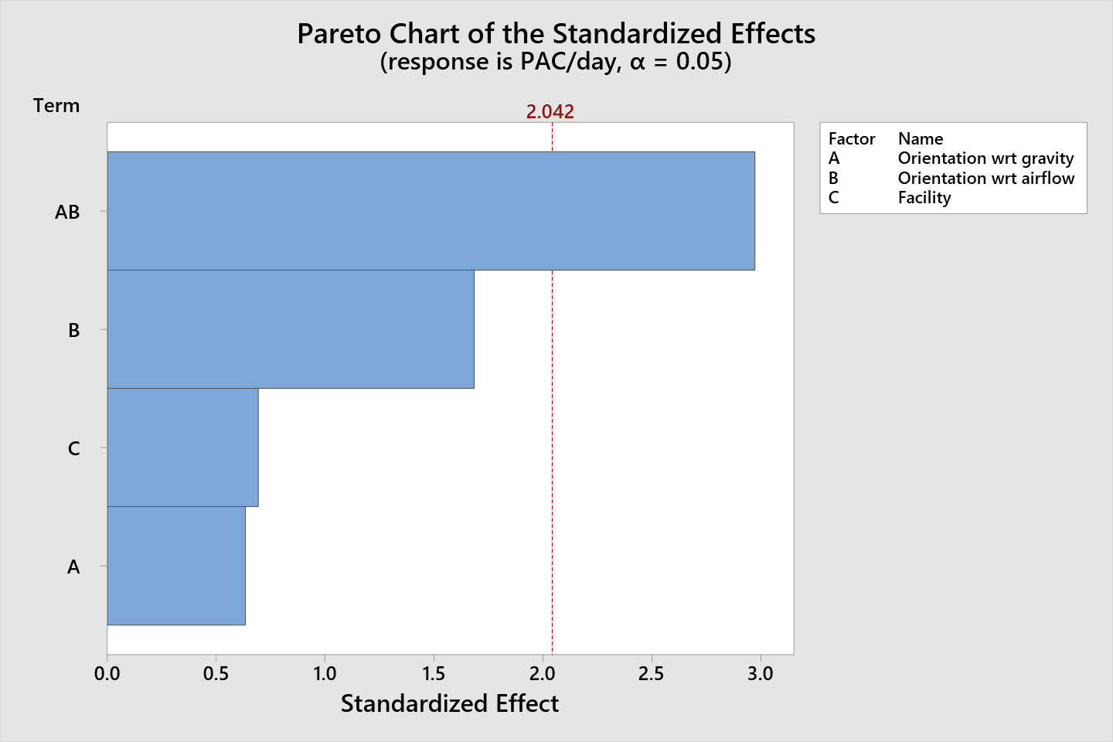
Pareto Chart for GSFC Study
Definition of Problem
Scope of Effort
Efforts to Date
Findings
Future Work
Full response factorial run with a 95% confidence interval
Orientation wrt to gravity interaction with orientation wrt to airflow is statistically significant

Slide 15
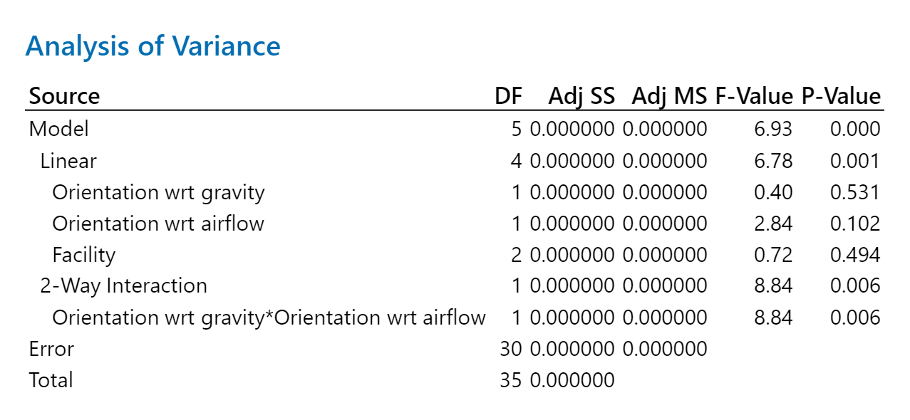
Analysis of Variance for GSFC Study
Definition of Problem
Scope of Effort
Efforts to Date
Findings
Future Work
Orientation wrt to airflow has a larger effect than the facility.
The orientation with respect to gravity is the least significant factor.

Slide 16
Particle Adhesion
Definition of Problem
Scope of Effort
Efforts to Date
Findings
Future Work
Typically, molecular and electrostatic interactions adhere particles to a surface
  These interactions include forces such as: capillary, van der Waals, electrical double layer, ionic attraction, gravity
    van der Waals forces likely dominate for small particles
Material, size and shape of the particles directly influence the adhesion
Humidity can also influence adhesion greatly
Micron size particle adhesion is not well understood for cleanrooms
M. B. Ranade (1987) Adhesion and Removal of Fine Particles on Surfaces, Aerosol Science and Technology, 7:2, 161-176, DOI: 10.1080/02786828708959155
https://www.rdworldonline.com/microelectronics-cleaning-the-cleanroom-qa/

Slide 17
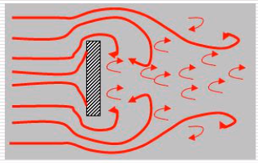
Object in the wake of airflow
Definition of Problem
Scope of Effort
Efforts to Date
Findings
Future Work
An object obstructing air streamlines results in a pressure gradient
Upstream: higher pressure
Downstream: lower pressure
What affect could this turbulent flow have on particulate adhered to vertical samples?
Buch, J.D. and Barsh, M.K., “Analysis of particulate contamination buildup on surfaces”, Optical SystemContamination: Effects, Measurement, Control, SPIE Vol. 777, (1987), pp. 43-54
https://ntrs.nasa.gov/archive/nasa/casi.ntrs.nasa.gov/19690024397.pdf
https://slideplayer.com/slide/4569109/

Slide 18
Vertical and Horizontal Fallout Findings
Definition of Problem
Scope of Effort
Efforts to Date
Findings
Future Work
2 sets of vertical and horizontal wafers, analyzed monthly, have been deployed in the BC, SSDIF, and SCA at GSFC
Assumption of 1/10 vertical to horizontal fallout that has been used for many years as common practice IS NOT APPLICABLE to all cases
  For short term exposure, one value for a vertical to horizontal ratio cannot be identified.
  Vertical to horizontal ratio to apply for future contamination predictions is still being investigated.
New issue identified: the orientation with respect to airflow for samples needs to be considered
1/10 vertical to horizontal fallout assumption can not be applied as a universal factor
Ability to accurately predict saves project funds and schedule
Project success depends on understanding these concepts
Notes:
Contamination control for project

Slide 19
Recommendations
Definition of Problem
Scope of Effort
Efforts to Date
Findings
Future Work
  Projects can NOT rely on the 1/10 approximation for vertical to horizontal fallout
  For sensitive hardware, do not keep the surface in the wake of airflow. Instead, the surface should be parallel or perpendicular to airflow
  These wafer set ups should be used to monitor the facility where hardware will be for a time period prior to the start of sensitive hardware arriving
    These are easy and cost effective to implement and can inform the effect of orientation on fallout
Notes:
Contamination control for project

Slide 20
Future Studies
Definition of Problem
Scope of Effort
Efforts to Date
Findings
Future Work
Samples need to be deployed in all orientations with respect to airflow in each facility
Facility variable needs to be further specified by air changes, air velocity, and work activity levels
Goal: a handbook value for vertical vs horizontal fallout
Notes:
IA study: repeatability of IA output
-Specifically in 5-15 micron bin sizes for vertical samples

Slide 21
Camera ImageJ Analysis (CIJA)
Definition of Problem
Scope of Effort
Efforts to Date
Findings
Future Work
Predictions for contamination are limited, as shown in the vertical horizontal study.
For samples that cannot be sampled directly(tape lift or rinse), a direct measurement of the surface would be ideal.
A more accurate representation of a surface of interest could be a picture that is processed through ImageJ software to verify contamination requirements.
Thesis: CIJA can be used as an alternative to IA with an associated error.
Goal: Determine a setup and processing procedure that is comparable to the current IA process.

Slide 22
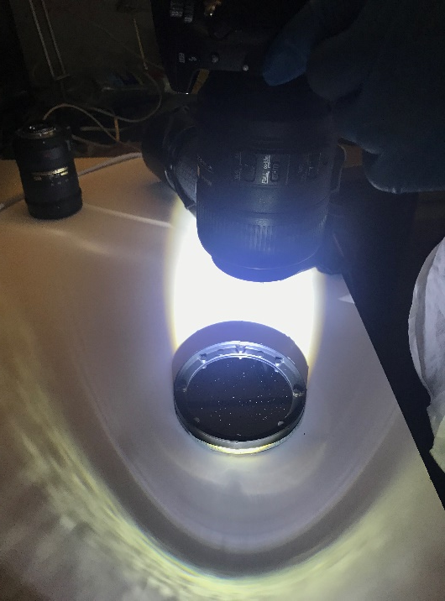
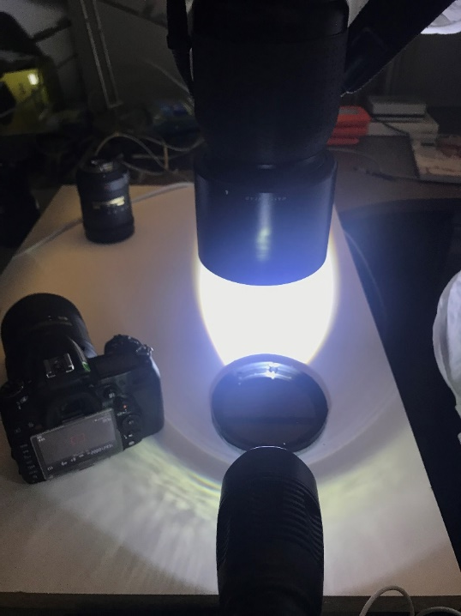
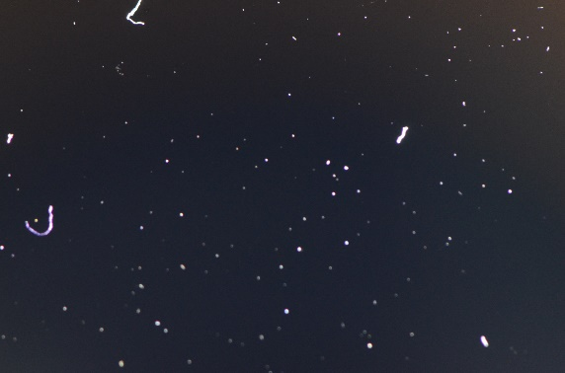
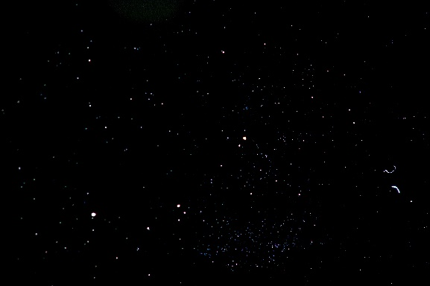
Initial Efforts
Definition of Problem
Scope of Effort
Efforts to Date
Findings
Future Work
Chris Gunn(NASA Photographer Code 443) assisted with an initial experiment for particulate resolution through cameras.
Nikon D700 Camera
Nikon f/2.8 105mm lens
PAC(ImageJ): 0.004
Hasselblad camera, 50 megapixels
PAC(ImageJ): 0.004
Determined 1:1 ft best setting for capturing particulate
To minimize shaking from human factor with handheld camera, a camera stand should be acquired

Slide 23
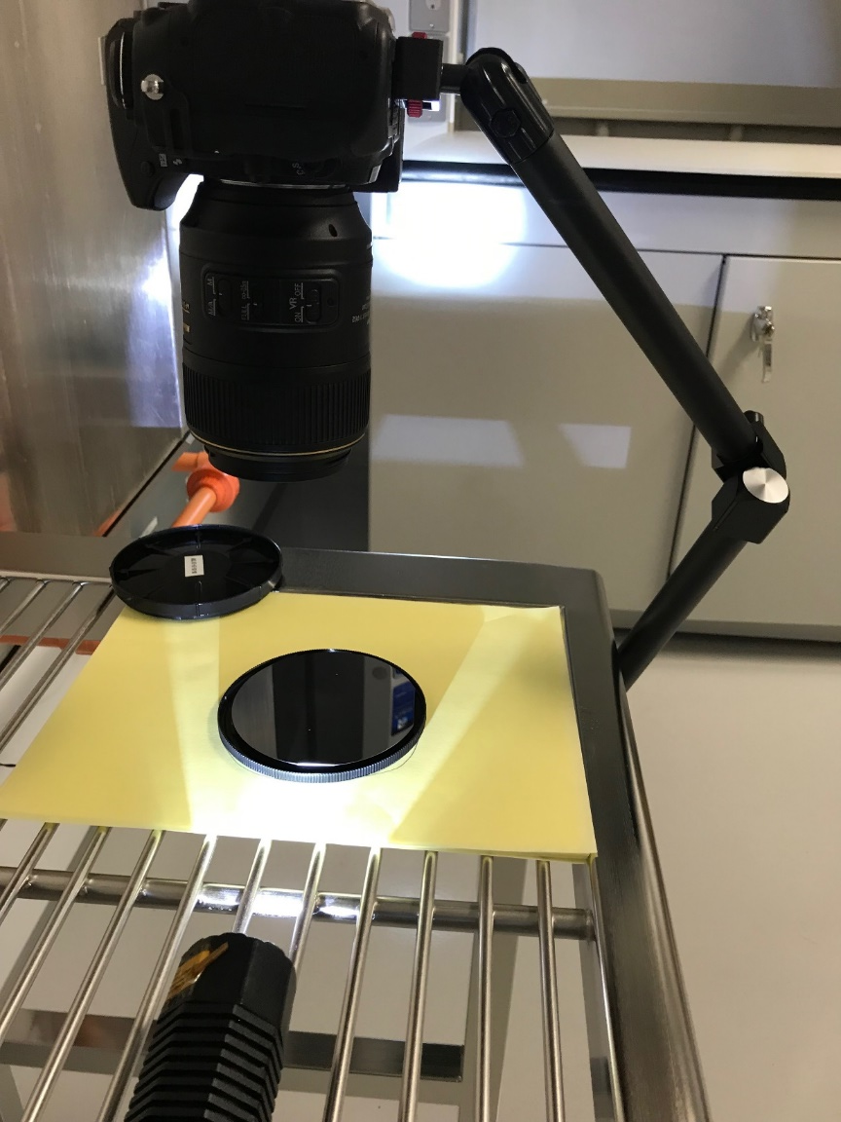
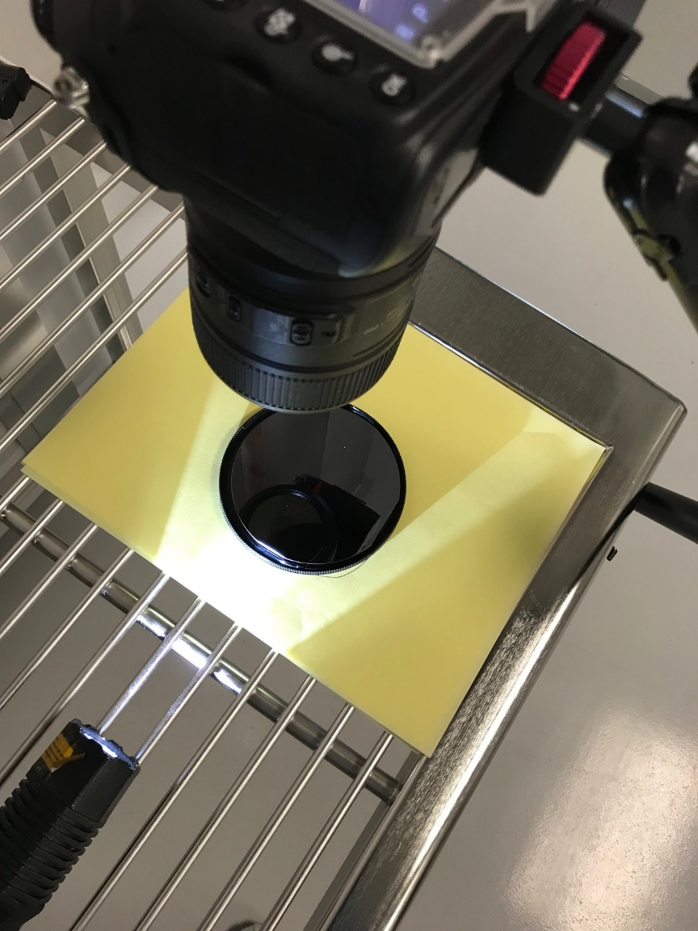
CIJA Set up
Definition of Problem
Scope of Effort
Efforts to Date
Findings
Future Work
Tripod purchased that has capability to take orthogonal images of wafers
Camera: Nikon D300
Nikon f/2.8 105mm lens
1:1 ft magnification
~ 6 in focus distance
23.5x15.6 mm image size
Oblique angle light source

Slide 24
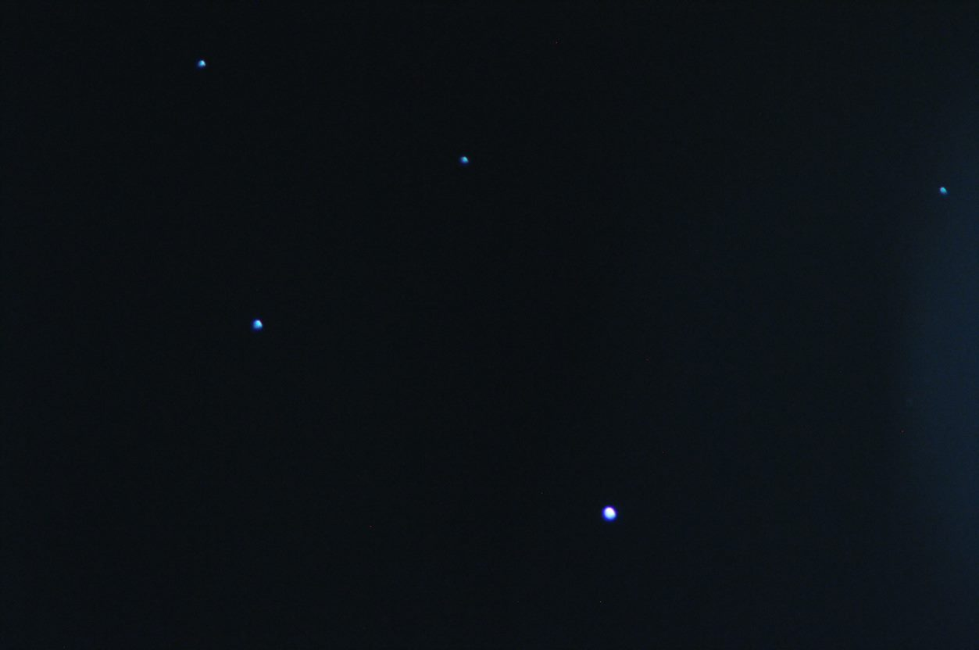
Issues addressed to date and future work
Definition of Problem
Scope of Effort
Efforts to Date
Findings
Future Work
Setup:
  Tripod: While more stable than just a human holding, minimal movements can affect the image taken.
  Image: I am not able to track well where I am on the wafer. I have looked for laser grids but have not found a product suitable yet.
  Lighting: Ring light shows reflection into wafer. Variable lighting can affect particle size in wafer images
    Develop a stand for two lights at oblique angles across the wafer?
Processing:
  Image taken 1:1 is 366.6 mm
  IA area is 4.71E09 mm
  Can I scale the CIJA image PAC? I assumed that PAC could be comparable even though the areas between CIJA and IA varies.
  Need to further work on the output to Excel from ImageJ
  Ability to get the size distribution of particles through ImageJ software. Will it be comparable to IA output?

Slide 25
Acronym List
JWST | James Webb Space Telescope
SSDIF | Space Systems Development and Integration Facility
SCA | Spacecraft Checkout Area
I&T | Integration and Testing
IA | Image Analysis
PAC | Percent Area Coverage
ISIM | Integrated science instrument module
CIJA | Camera ImageJ Analysis
BITSE | Balloon-borne Investigation of Temperature and Speed of Electrons
CODEX | COronal Diagnostic Experiment

Slide 26
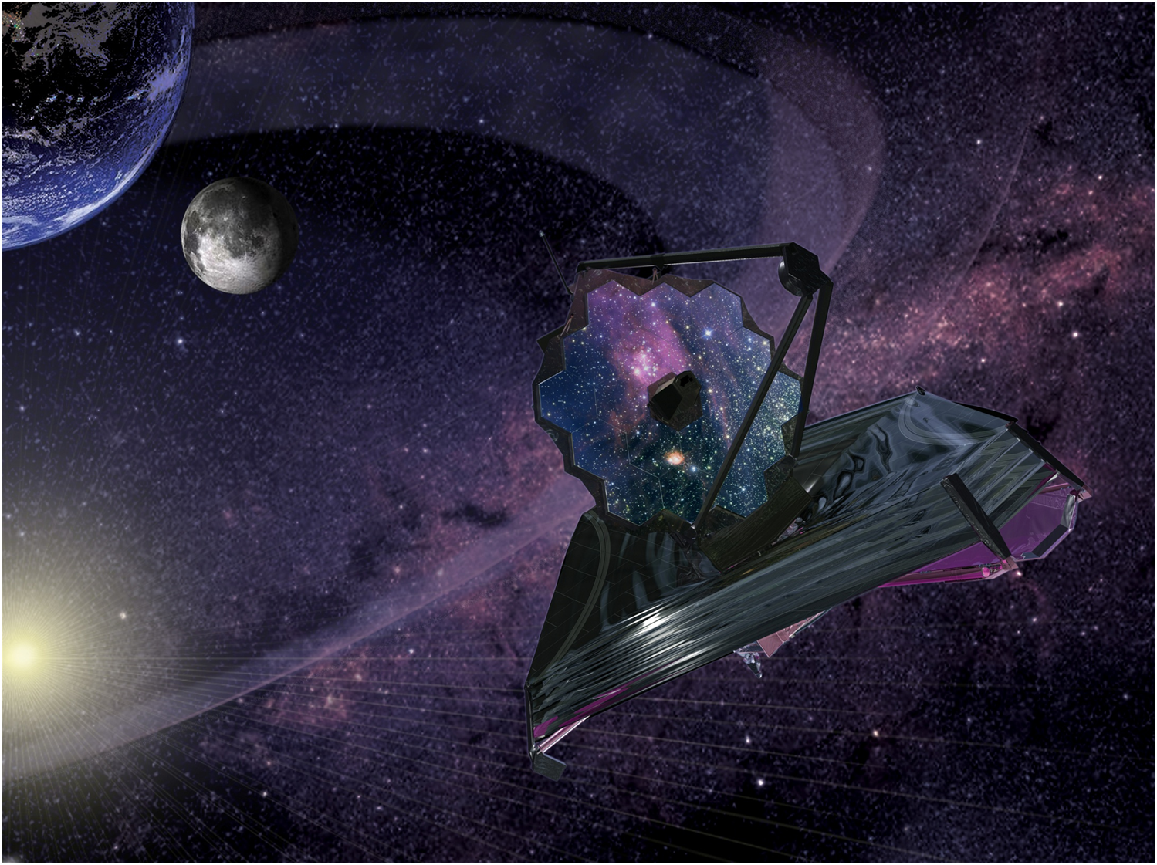
Acknowledgements
Eve Wooldridge
Randy Hedgeland
Kristina Montt de Garcia
Mark Secunda
Nancy Carosso
David Hughes
Alan Abeel
Jillian Pulia
Kelly Henderson-Nelson
Joe Ward
Nithin Abraham
Edwin Goldman
Jim Heaney
Erin Lalime
Michael Woronowicz
Craig Jones
Drew Uhl
Christopher Gunn
Jolearra Tshiteya
Jerron Jackson
Jim Loughlin
Code 546
Code 551
Code 443
JWST
BITSE
CODEX

