Slide 1
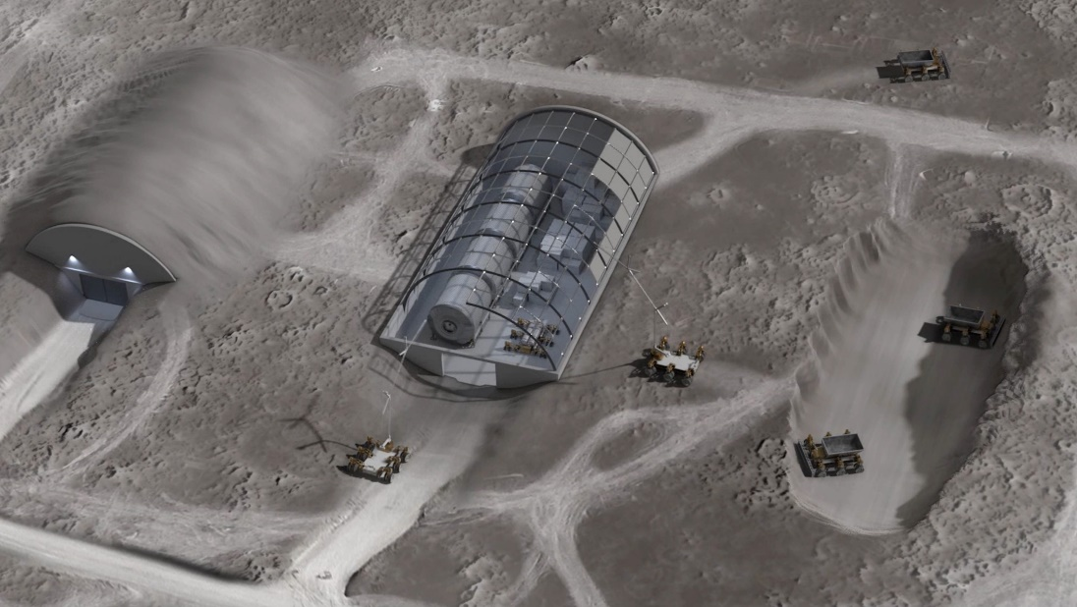
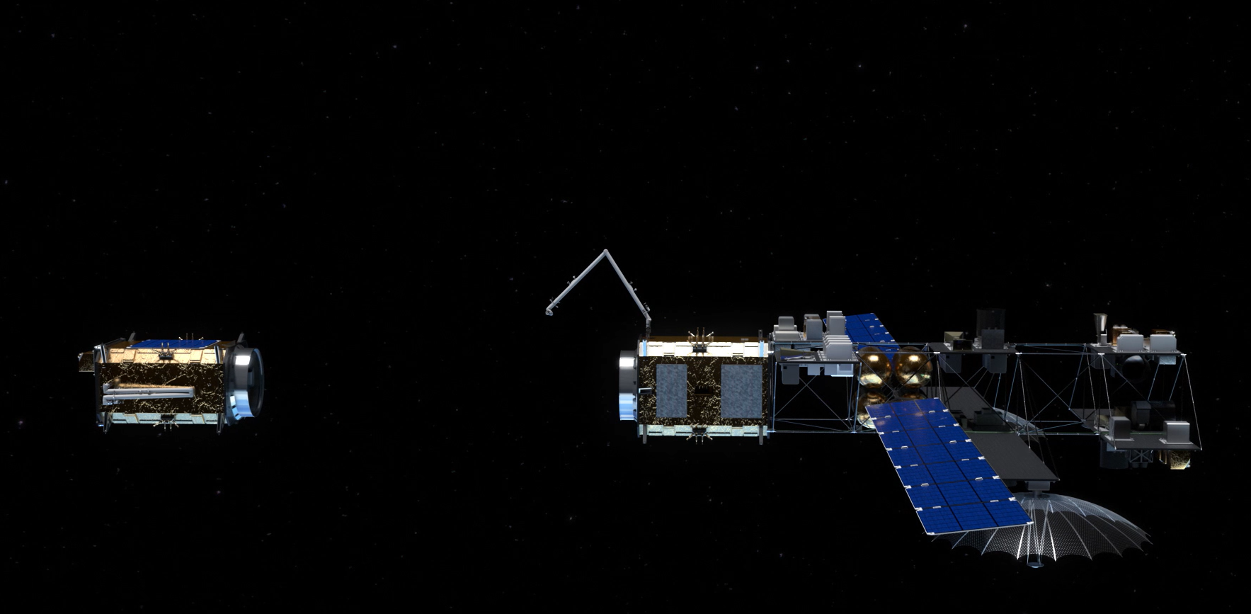
OSAM: A Catalyst for Space Infrastructure
Dale Arney
Chief Architect, OSAM National Initiative
AIAA ASCEND
November 15, 2021
Image Credit: NASA
Image Credit: NASA

Slide 2
Space Infrastructure Built on OSAM
NASA Science
NASA Exploration
Department of Commerce
Department of Interior
CIVIL
SECURITY
Department of
Defense
Intelligence
Community
Repair
Upgrade
Refuel
Relocate
Assemble
Construct
Reconfigure
Manufacture
Coat
Polish
Recycle
COMMERCIAL
Fleet Owners and Operators
Service Providers
Satellite Manufacturers
Insurance Companies
Notes:
These capabilities are not only necessary for civil space – national security and commercial space are relying on these capabilities to perform their ambitious missions as well
I am going to focus on civil space applications

Slide 3
Enables Persistence in Space
Image Credit: NASA
Notes:
Persistent assets that can grow, adapt, and evolve over time – immortal spaceships
Technology demonstration
Persistent observation
Robust, resilient systems
Source: NASA RAMSES https://youtu.be/FK8gD5PY-Ng

Slide 4

Enables New Discoveries
Image Credit: NASA
Notes:
Build systems larger and more capable than previously feasible within the launch constraint
Large telescope that could search for Earth-like exoplanets
Solar arrays
Communications antennas

Slide 5
Foundation for Sustainable Lunar Exploration
Image Credit: NASA
Notes:
Maintain and protect crew and systems on the surface
Refuel and maintain landers
Autonomous operations without crew
Provide a way to use resources found on the Moon
Source: VIDEO…

Slide 6
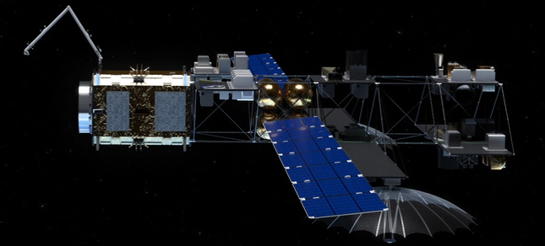
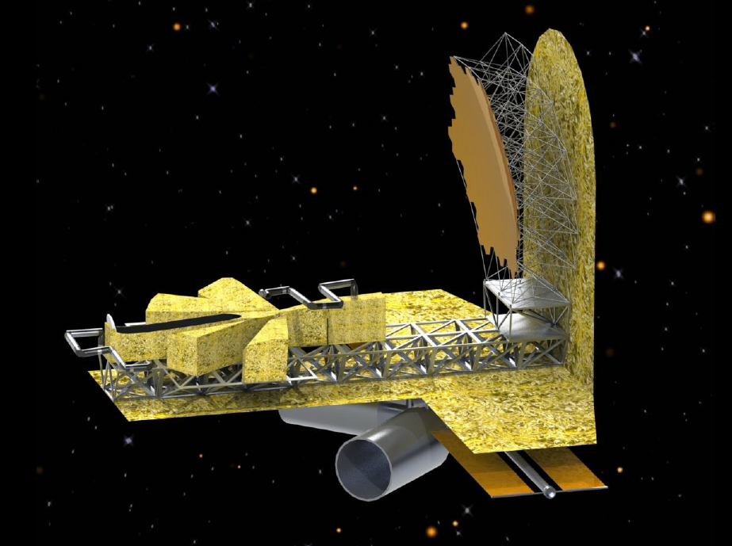
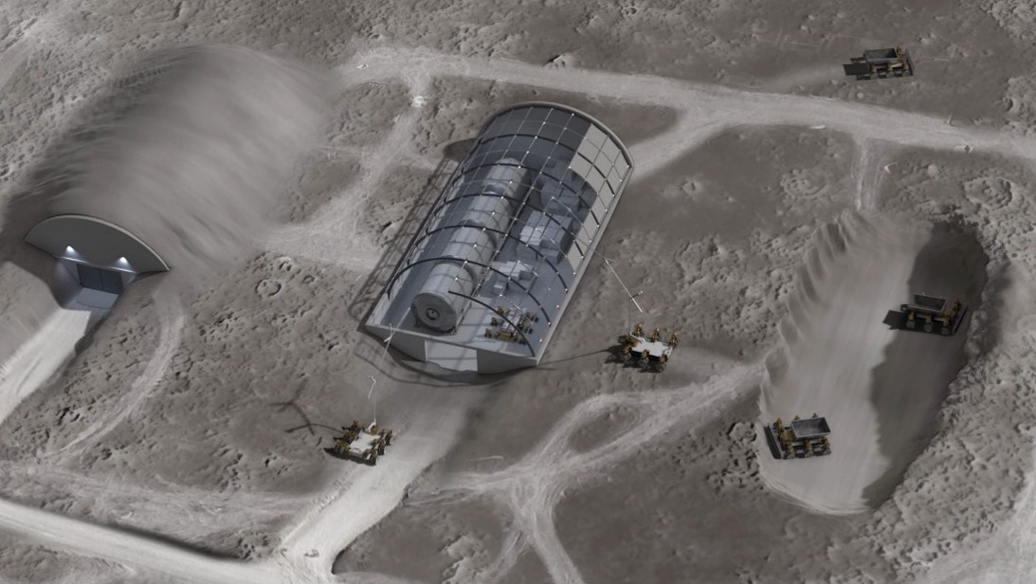
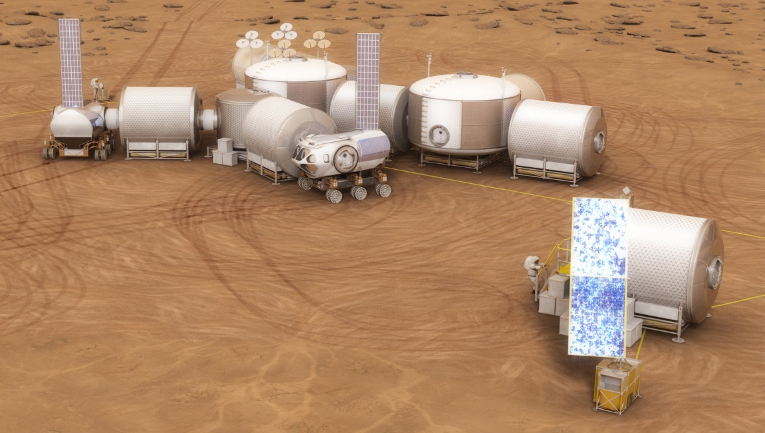
A Future Built Around OSAM
Create an ecosystem of future capabilities that make humanity a spacefaring civilization
Image Credits: NASA
Notes:
OSAM capabilities are the foundation for sustainable exploration and operations: refueling, maintenance, repair, assembly, spares manufacturing, ISRU
Create an ecosystem of future capabilities that make humanity a spacefaring civilization
NASA’s vision for the future in human exploration and science will rely on space infrastructure and OSAM capabilities

