Slide 1


Performance and Accuracy Assessment of Line Marching Algorithm Computations Utilizing GPUs Within a Predictive GNSS Quality Service
Julian Gutierrez, Evan Dill, NASA Langley Research Center
David Kaeli, Pau Closas, Northeastern university
SciTech Forum, January 2022

Slide 2

Motivation
Line marching algorithms are used in a wide range of applications
  Within the GNSS realm, we can use them to process sky-plot information
Sky-plots are a useful tool in diagnosing problems encountered when processing GPS data
  Simple visualization tools that display GPS satellite trajectories, referenced to a specific position on the ground
  They provide an intuitive feel for satellite movement patterns, as well as reveal the impact of obstructions on satellite visibility
An analysis was completed to evaluate algorithms that provide different computing characteristics to obtain an adequate representation of the sky-plot for the analysis within a GNSS quality service framework

Slide 3
Outline
Horizon Sky-plots
Line Marching Algorithms
Results
Conclusions

Slide 4
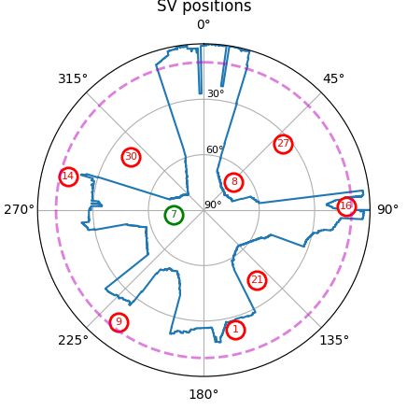

Horizon Sky-plots
Sky-plots are used to map the visibility of the sky
The horizon is a trace or line, which defines the visibility of the sky
  Defined by objects in the surroundings of a location
  Natural and anthropogenic obstacles such as buildings and trees can dramatically impact sky visibility
Satellites close to the natural horizon (usually at elevation angles ≤ 10) are less helpful in resolving the GNSS position
Notes:
due to additional atmospheric distortions, high blockage probabilities, or higher chances of being affected by multipath propagation

Slide 5
Horizon Sky-plots
To achieve an accurate representation of the horizon sky-plot, we require:
  An up-to-date digital surface model (DSM) representing the terrain altitude (e.g., buildings, trees, mountains, etc.),
  Prediction of the trajectories and locations of the satellites in the sky, and
  An accurate way to traverse the map to obtain the elevation angles at which the sky is visible
Notes:
due to additional atmospheric distortions, high blockage probabilities, or higher chances of being affected by multipath propagation

Slide 6
Horizon Sky-plots
General Algorithm
  Select a location for the analysis, commonly referred to as the point of interest (POI) on the map,
  Compute the satellite locations in the sky
  Divide the azimuth space into small angles and trace a line starting at the POI in the direction of each angle
    At each step along the line, we compute the maximum elevation angle formed between the POI and the current location along the line, based on the altitude where the grid cell intersects the line

Slide 7


Horizon Sky-plots

Slide 8
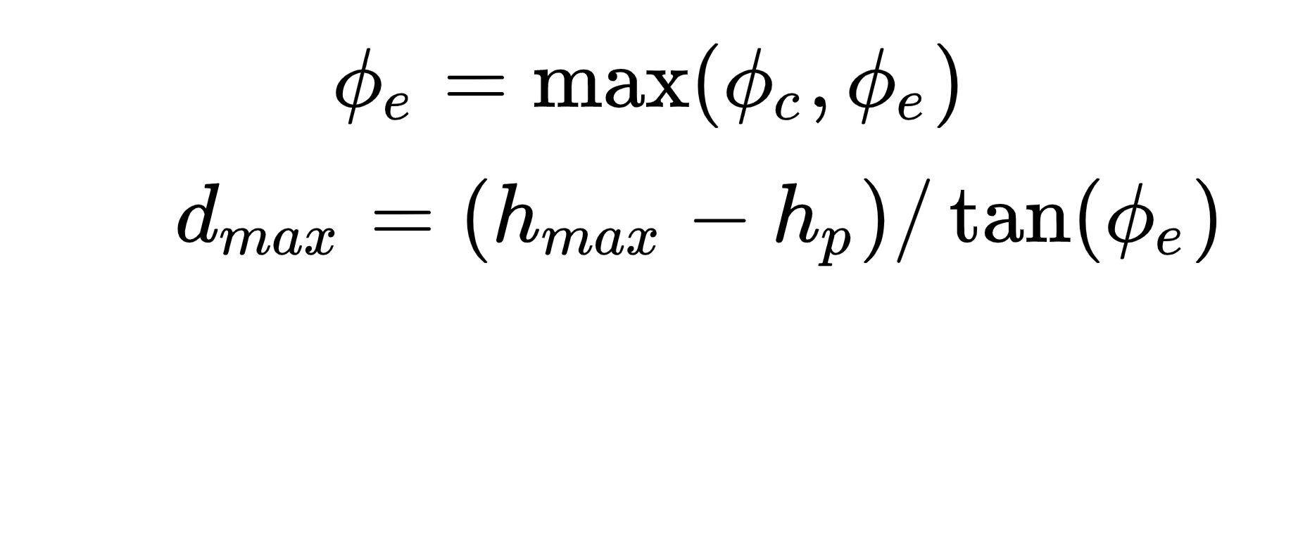
Horizon Sky-plots

Slide 9
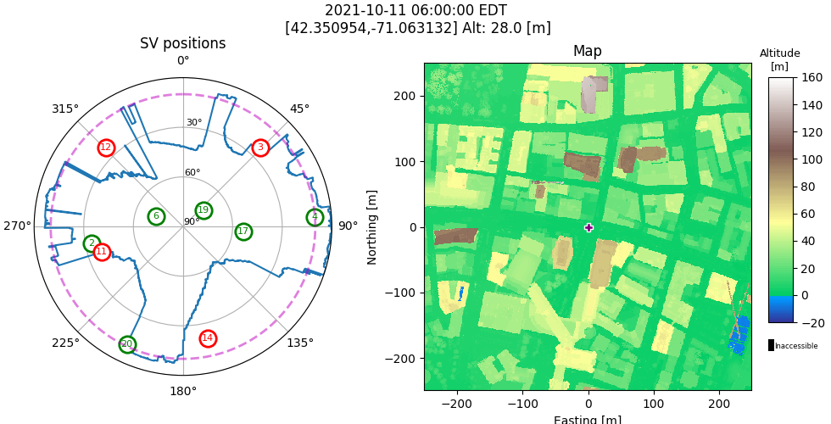
Horizon Sky-plots

Slide 10
Horizon Sky-plots

Slide 11
Horizon Sky-plots
A common way to improve the performance of this algorithm is to limit the distance needed to travel along the line
  One way to accomplish this is to implement a stopping condition that limits the total distance traveled
We present a new dynamic stopping condition that can drastically improve performance in most scenarios by dynamically adjusting the maximum distance traversed along the line, based on the maximum elevation angle observed at the POI

Slide 12
Horizon Sky-plots – Stopping Condition
Scenario 1

Slide 13
Horizon Sky-plots – Stopping Condition
Scenario 1

Slide 14
Horizon Sky-plots – Stopping Condition
Scenario 2

Slide 15
Horizon Sky-plots – Stopping Condition
Scenario 2

Slide 16
Horizon Sky-plots – Stopping Condition
Scenario 2

Slide 17
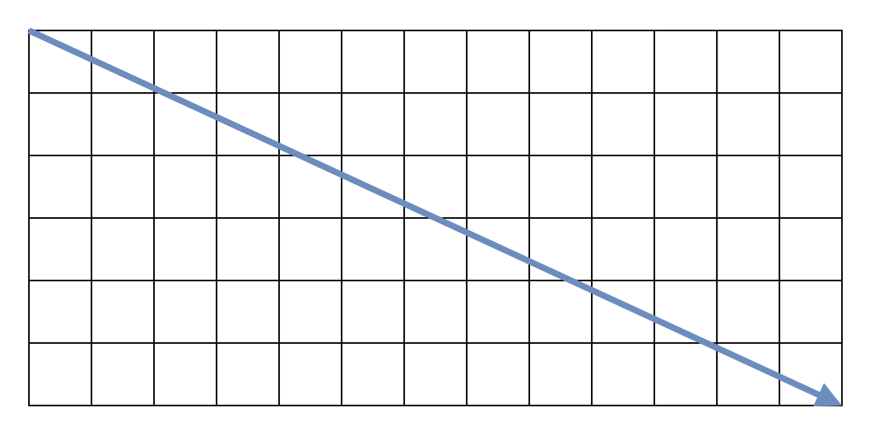
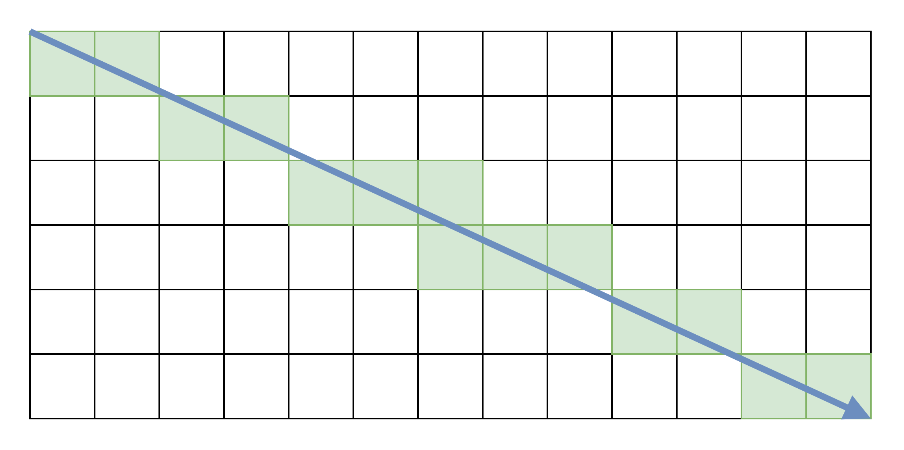
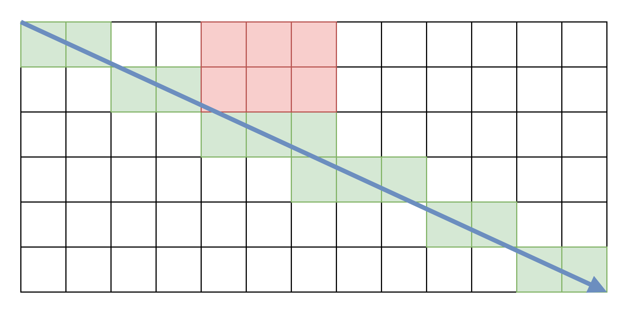
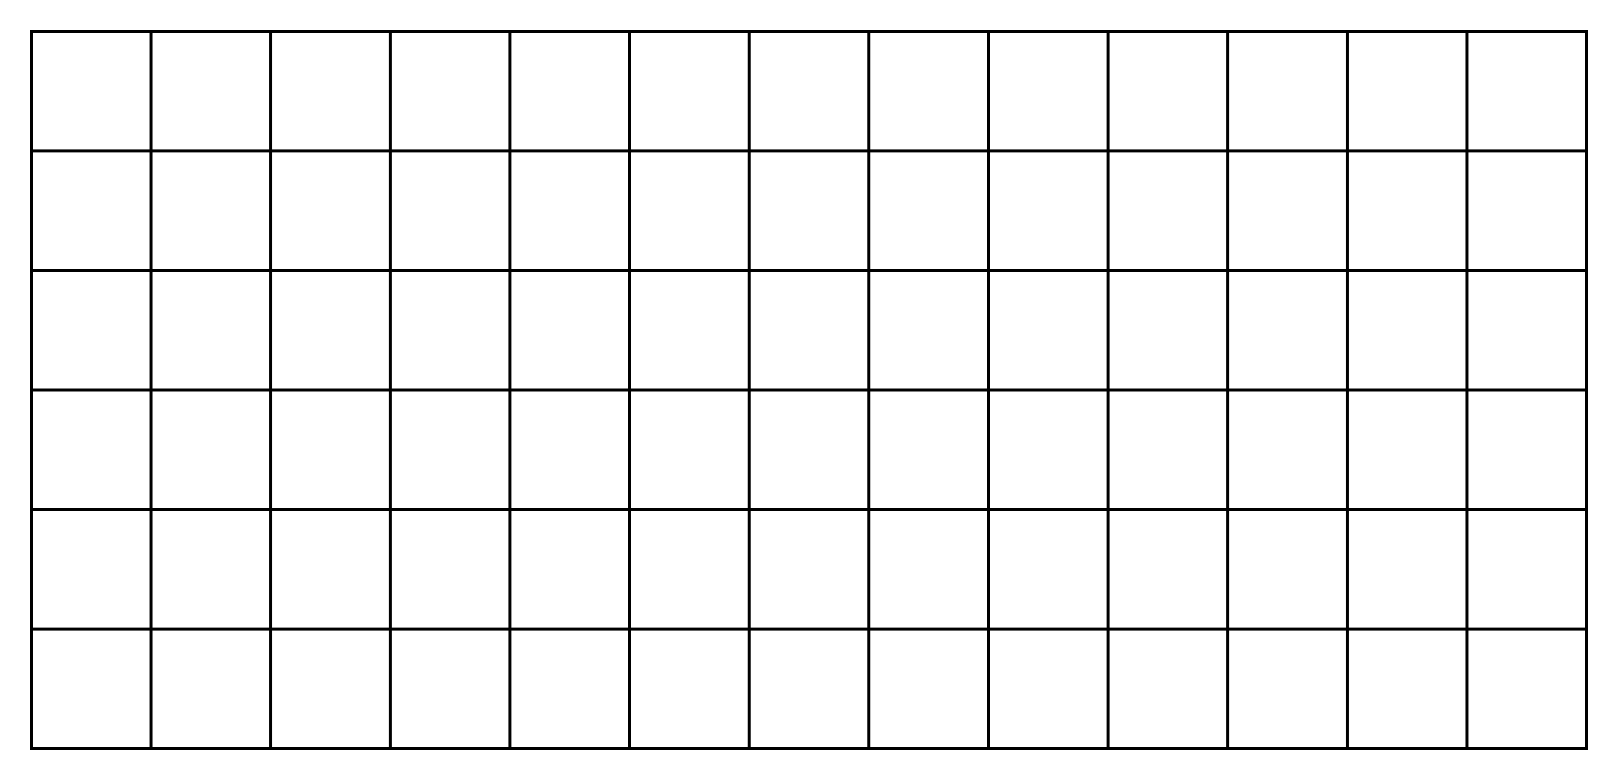
Line Marching Algorithms

Slide 18
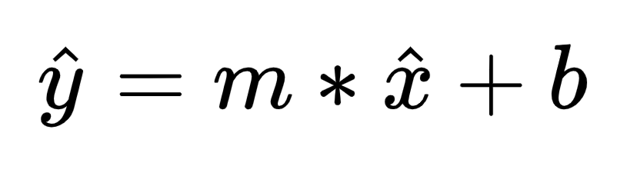
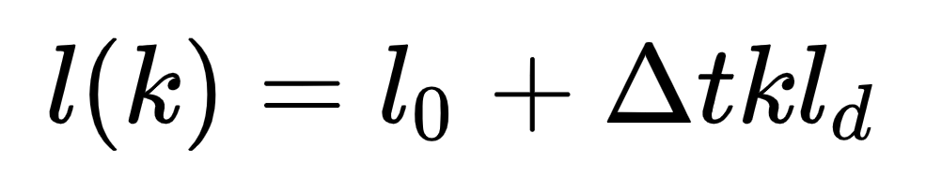
Line Marching Algorithms
Direct Scan Conversion (DSC)
Digital Differential Analyzer (DDA)
Dynamic DDA (DDA-D)
Max Pooling DDA (MP)
Bresenham (BRE)
Notes:
Explaining each of the algorithm in a bit of detail

Slide 19
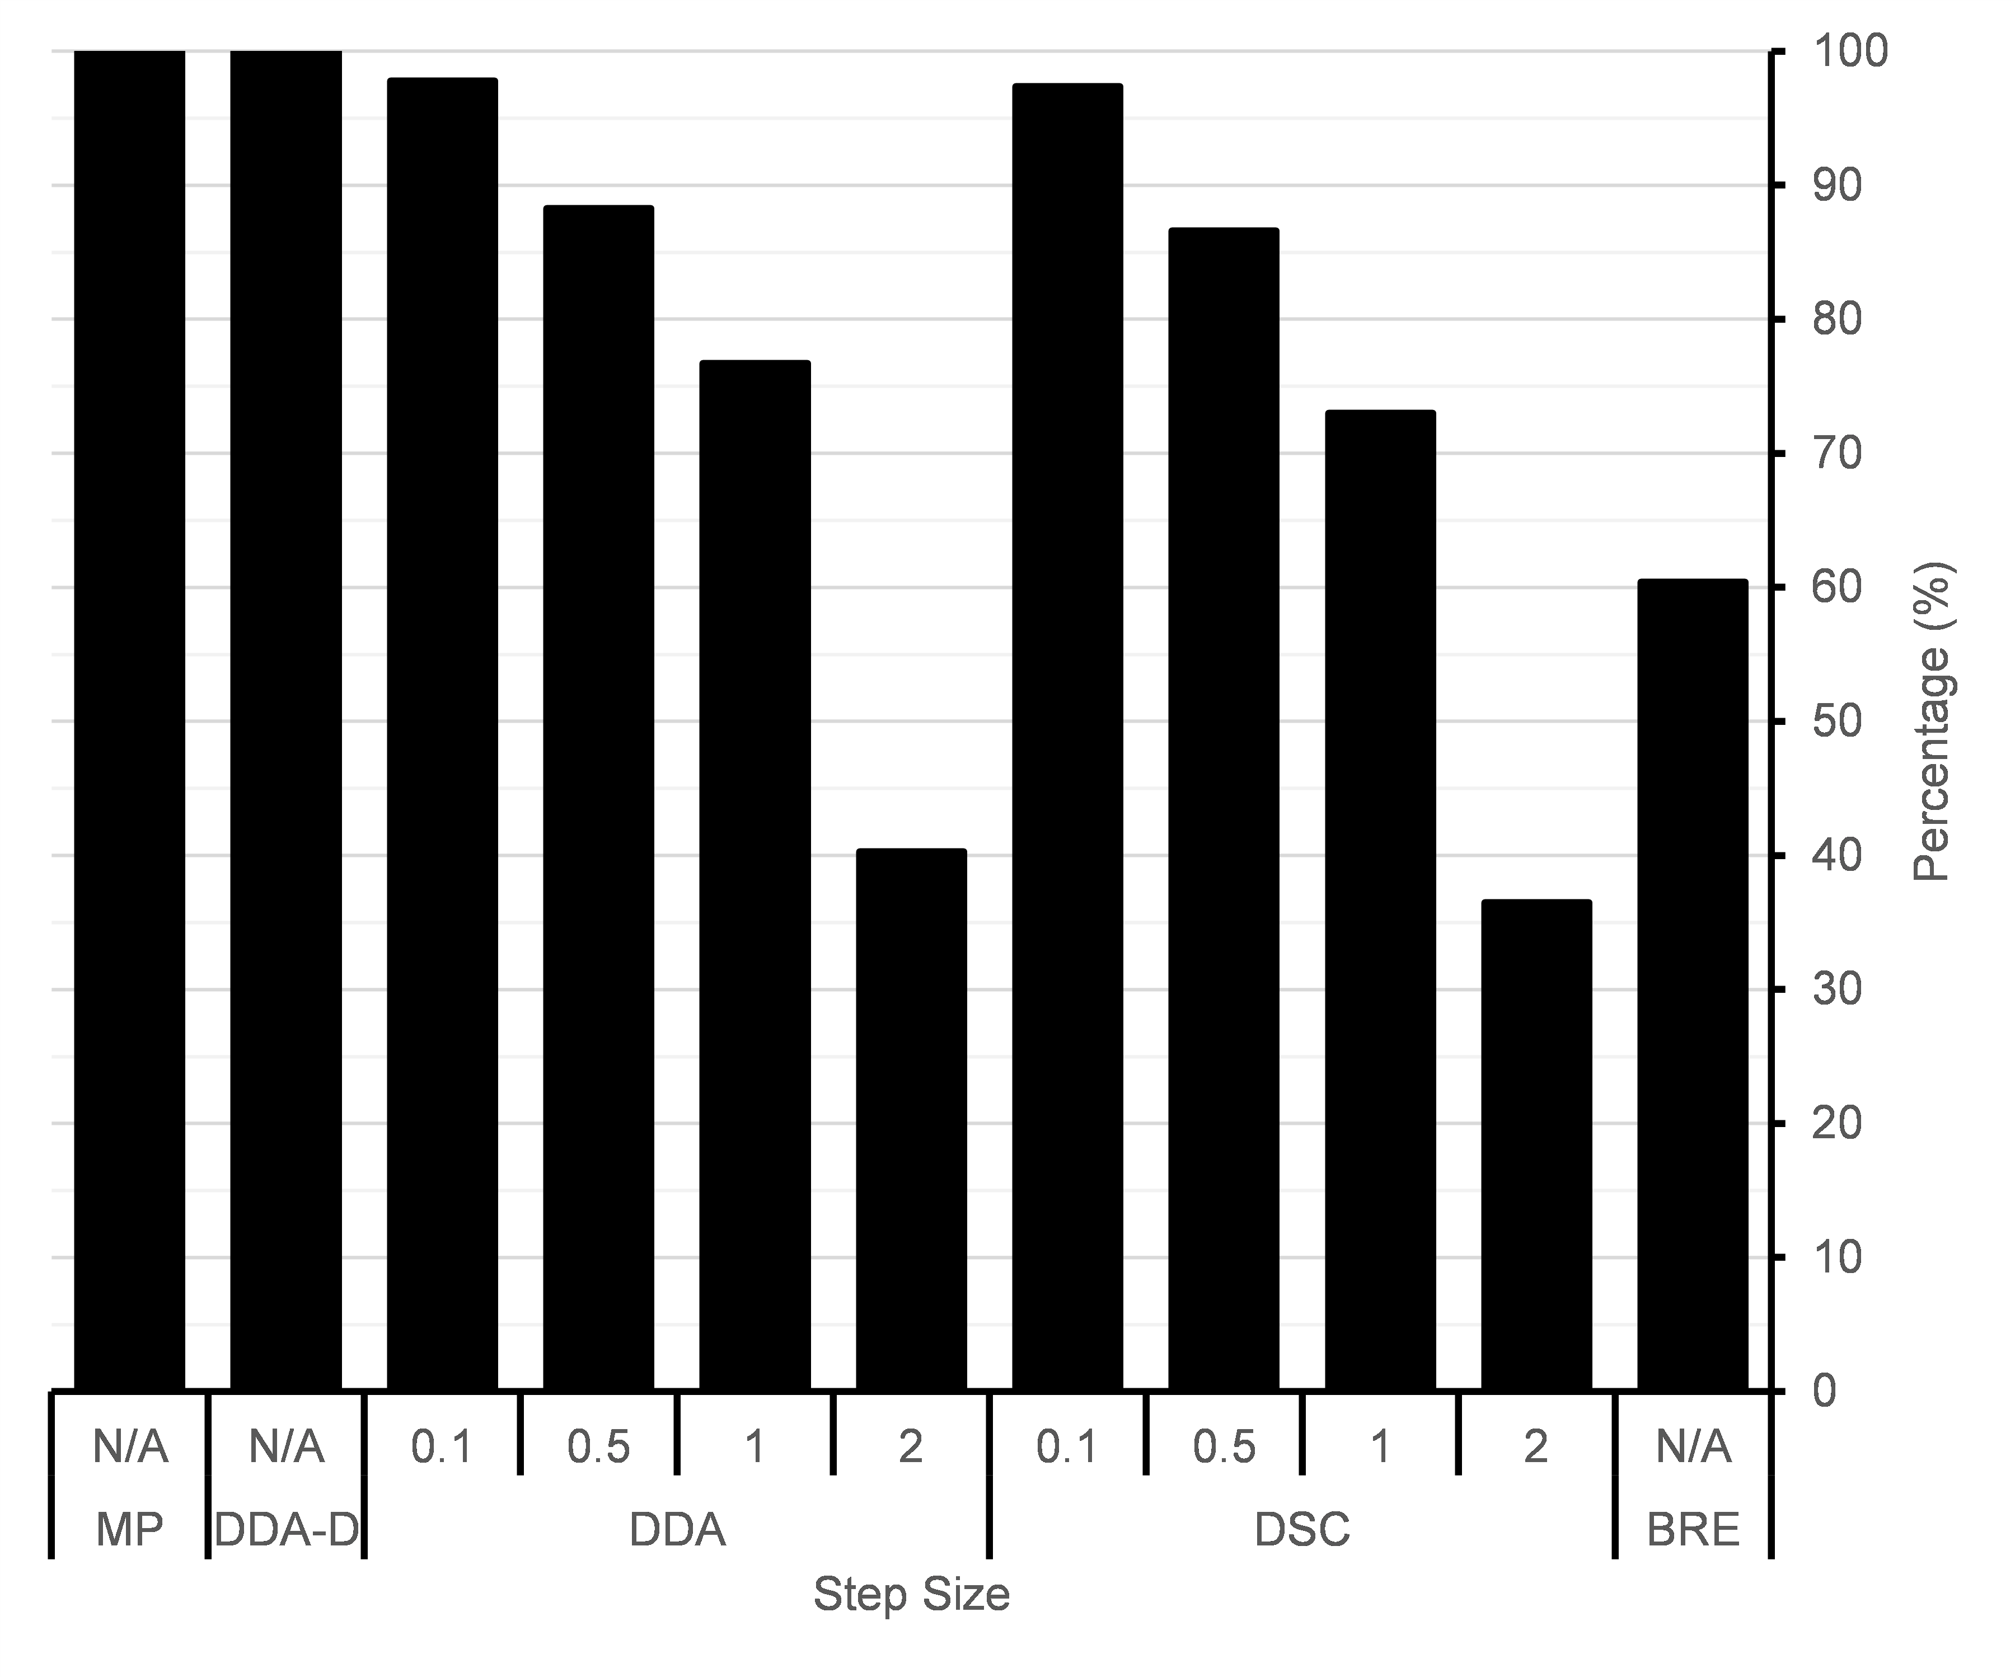
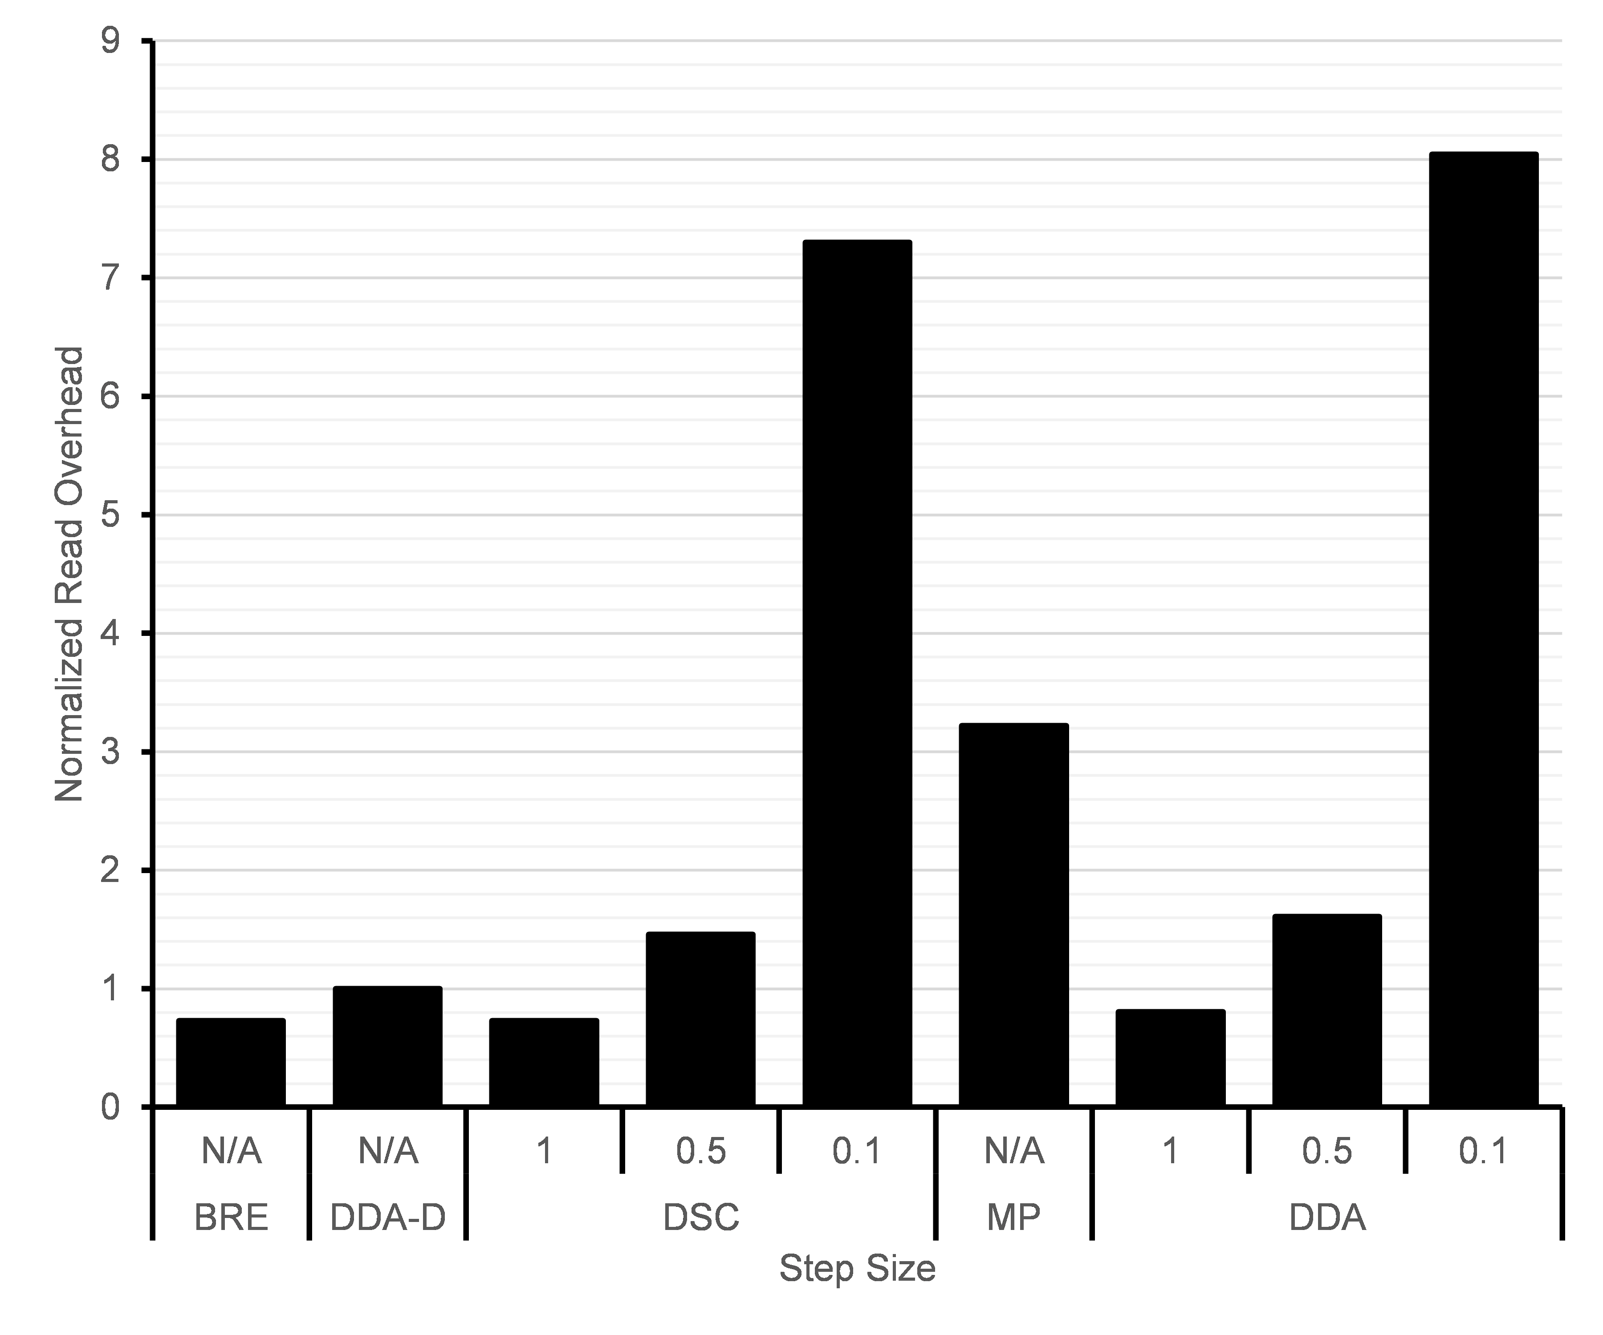
Results
Line coverage and read overhead

Slide 20
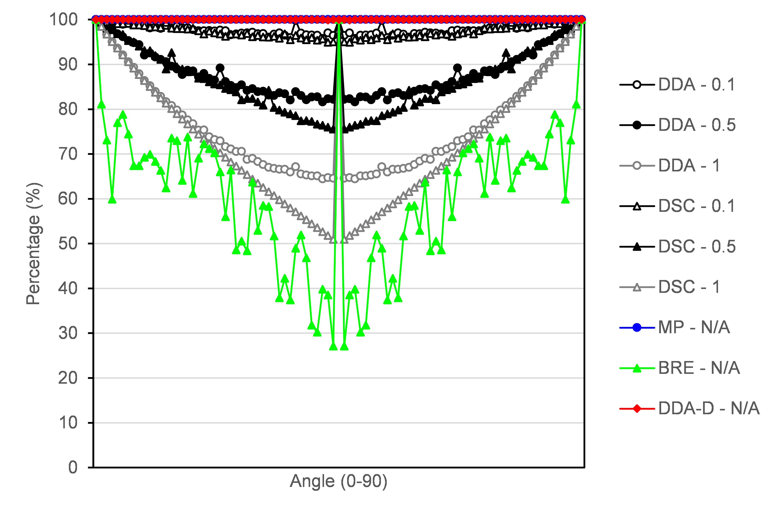
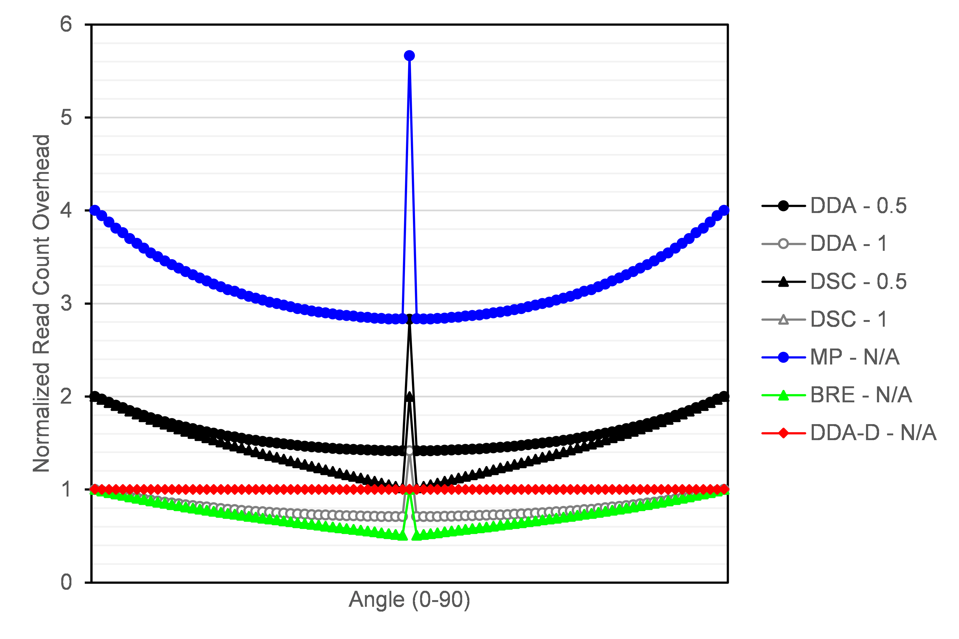
Results
Line coverage and read overhead as a function of the angle

Slide 21
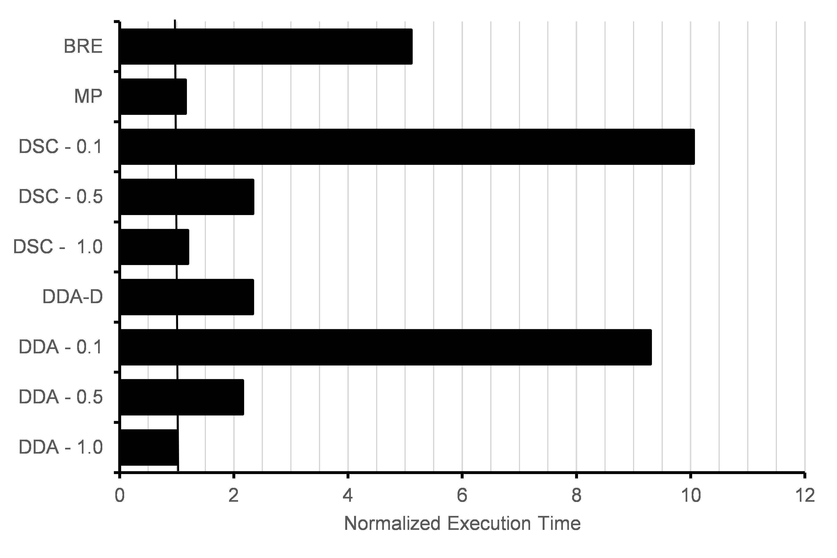
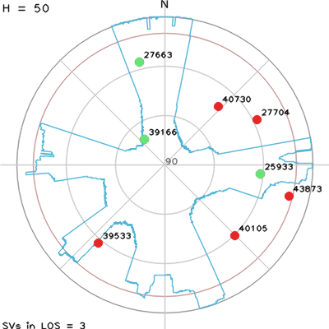
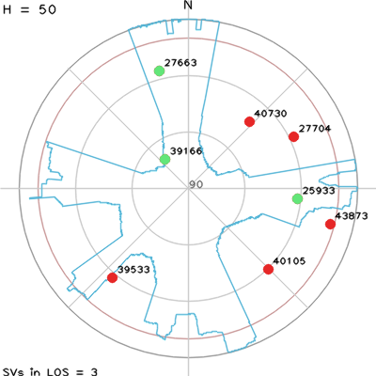
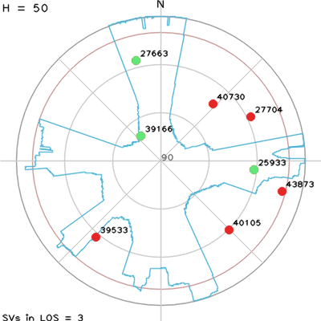
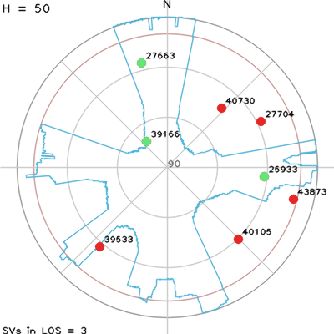

Results
Performance Analysis
  We used a GTX 1080 for the analysis
  We compare the average execution time of the kernel executing each algorithm

Slide 22
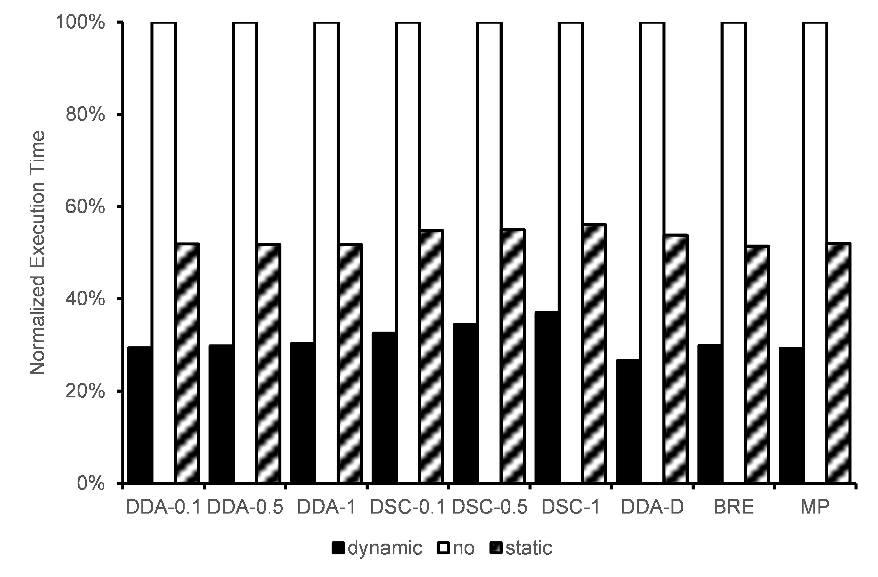
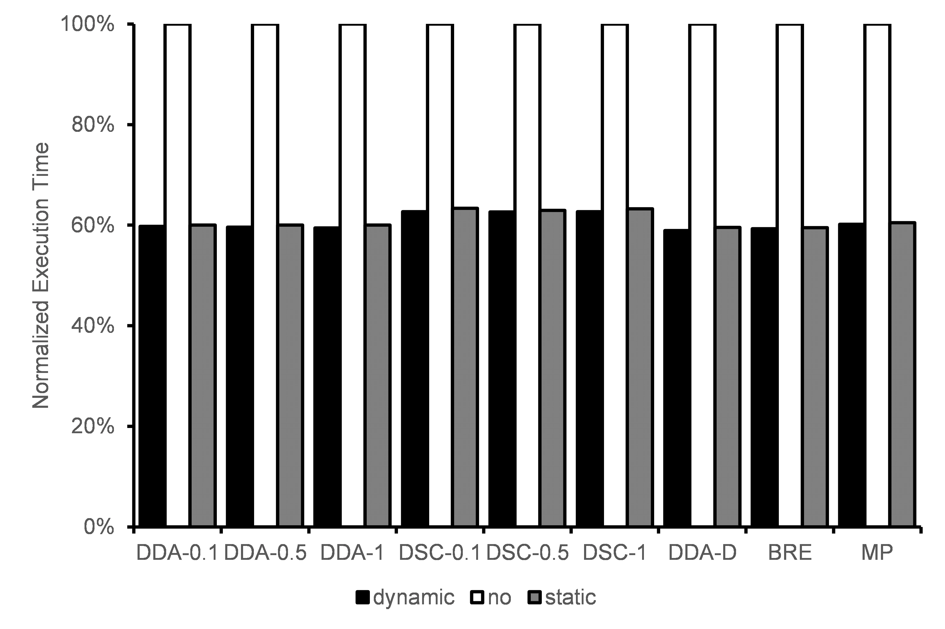
Results
Performance of the proposed stopping condition
Urban Canyon
Open Space

Slide 23
Conclusions
The performance and accuracy characteristics of 5 different line marching algorithms used in the context of a sky-plot application were evaluated.
It was found that DDA and DSC deliver similar performance, but the DDA implementation is straightforward and simpler to implement
  Decreasing the step size for these two algorithms is needed to obtain good line coverage, especially with angles close to the diagonals in the sky-plot
DDA-D is a very effective algorithm if correct line coverage is required, without impacting the performance significantly
If performance is important and a worst-case scenario is useful, MP is the best option, as it guarantees full line coverage and negligible performance impact compared to DDA
The correctness of the implementation can be critically important, dependent on the application: There is a clear trade-off between performance and accuracy

Slide 24
Thanks!
Any questions?

