Slide 1
CARA Presentation for Fall 2021 Mission Operations Working Group (MOWG)
CARA Operations

Slide 2
Agenda
CARA Status
  NASA Interim Directive (NID) to NASA Procedural Requirements (NPR) status
Large Constellation/ Secondary Owner/Operator (O/O) Status
  Starlink and OneWeb Event Stats
  Known large constellations
  Recent Completed Work
  Summary of CARA Concept of Operations (CONOPS)
    Starlink
    OneWeb
    Other
  Challenges
  Future work
CARA Stats

Slide 3
Cara status

Slide 4
CARA on Cloud
Successful release of cara.nasa.gov in August 2021
  Used internally for CARA operators only at this time
  First release that ushers CARA Operations move to the cloud
Work continues to move CARA Operations to the Cloud
  Thanks to all missions who have finalized Cloud SFTP Connections
    If your mission has not set-up and tested cloud connection, please do so!
  Operations on Cloud will allow for streamlined data processing and better ground system redundancy
    Sets up ability to support larger screening volume and expanded MTS runs
  Reports, tools, and other features on cara.nasa.gov will be made available to mission users at TBD date after operations has moved to the cloud
As Cloud deploy date is finalized and SFTP transition determined missions will be notified via email and Users Forum

Slide 5

NID Status
Per OCE Office:
  "NID is currently in effect, and will be extended to remain in place until the final NPR is issued (CY2022)“
  Link to document: https://nodis3.gsfc.nasa.gov/OPD_docs/NID_7120_132_.pdf

Slide 6
Large constellation/ secondary o/o status

Slide 7
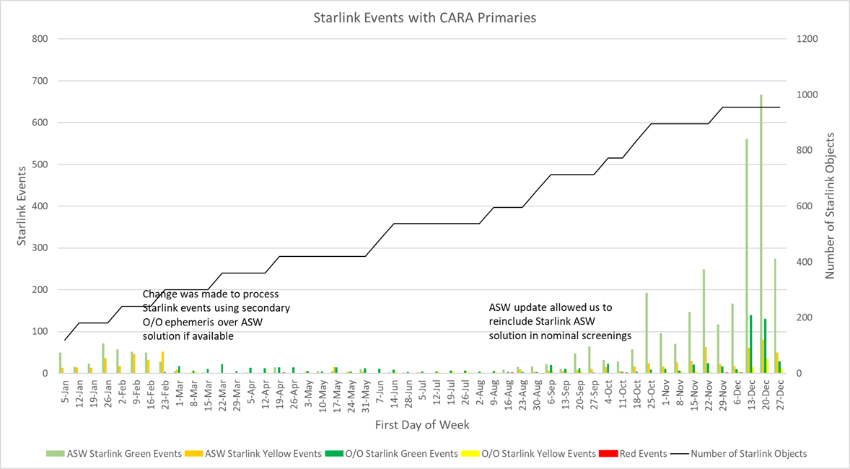
Starlink Event Stats
2020
As of September 2020, Starlink ASW solution added to nominal screening due to improved OD solve on-orbit
Increased ASW events driven by Starlink ascent to final orbit
Small number (< 10) of red events observed
2020 Red Threshold = 4.4E-4
2021 Red Threshold = 1E-4

Slide 8
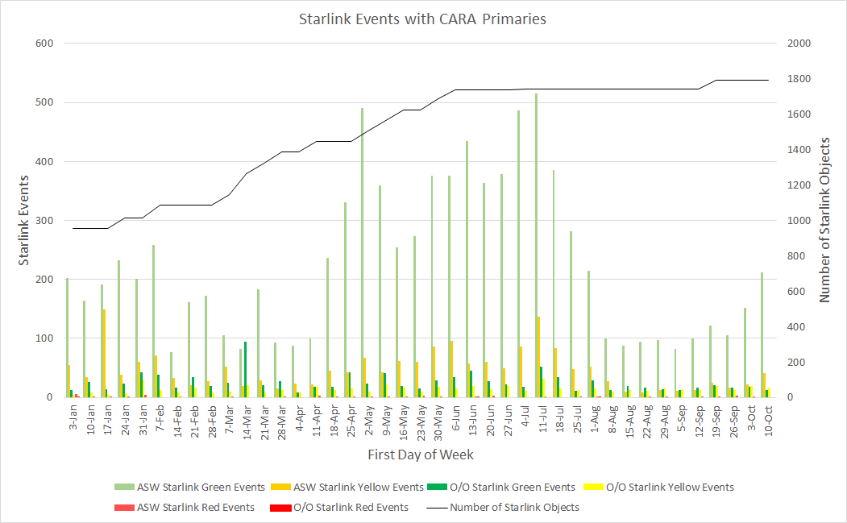
Starlink Event Stats
(2021 YTD)
SpaceX continued to have frequent Starlink launches with 16 launches YTD in 2021
  Including Transporter launches
1672 Active Starlink payloads
65 Dead/Inactive payloads on orbit
52 Payloads have reentered
3 Launches planned by end of year (Unknown dates at this time)
2020 Red Threshold = 4.4E-4
2021 Red Threshold = 1E-4

Slide 9
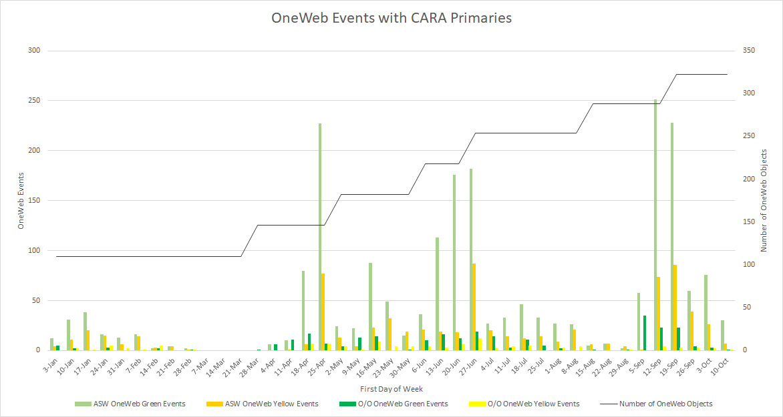
OneWeb Event Stats
(2021 YTD)
OneWeb resumed monthly launches in early 2021
Each launch has 36 payloads that ascend through many CARA assets to their final orbit at 1,200 km
CARA continues to meet bi-weekly (every other week, Wednesdays) with the OneWeb operations team to discuss any conjunction events identified
OneWeb team modifies ascent maneuvers to mitigate events
No high-risk and few moderate-risk events have been identified thus far
358 Active OneWeb spacecraft currently on-orbit

Slide 10
Flock Events
Flock spacecraft are capable of differential drag changes.
CARA developed and briefed flock CONOPS at August 2021 Users Forum
CARA Operators coordinate with Flock team when high interest events are identified

Slide 11
SpaceBEE Events
SpaceBEE sold to Starlink
Limited number of spacecraft maneuverable (testing capability)

Slide 12
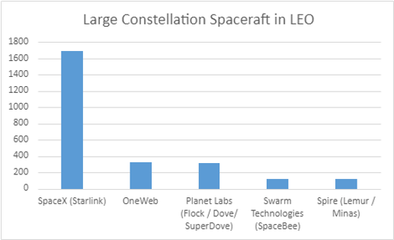
Status of Known Large Constellations on Orbit
LEO
Data Current as of 14 October 2021

Slide 13
Future LEO Outlook
NAME | ON ORBIT | PLANNED (>80) | TARGETTED COMPLETION DATE | SPACECRAFT TYPE | NATION
SpaceX (Starlink) | 1694 | 41493 | 2021 (int.) 1000+/year | smallsat | USA
Planet Labs (Flock) | 312 | unknown (in flux) | unknown (in flux) | 3U Cubesat | USA
OneWeb | 358 | 648 | 2022 | smallsat | UK
Swarm Technologies (SpaceBee) | 120 | 150 | unknown | 0.25U-1U Cubesat | USA
Spire (Lemur) | 121 | unknown (in flux) | unkown (in flux) | 3U Cubesat | USA
Chang Guang (Jilin-1) | 29 | 138 | 2030 | Full Size Satellite | China
Satellogic (NUSAT) | 22 | 90 | unknown | Microsat | Argentina
Kepler Communications | 15 | 140 | 2022 | 3U,6U+ Cubesat | Canada
Astrocast | 10 | 100 | 2024 | 3U Cubesat | Switzerland
Fleet Space | 6 | 100 | unknown | 1.5U, 3U, 6U, 12U Cubesat | Austrailia
Lacuna Space | 2 | 240 | unkown | 3U, 6U Cubesat | UK
Hongyun / Xingyun (Xinyung-2) | 2 | 80 | 2025 | Smallsat | China
ADASPACE (Tianyan 05 / Xingshidai-10) | 2 | 192 | unknown | Microsat, Cubesat | China
ZeroG Lab (Lingque, Magpie) | 2 | 132 | unknown | 6U Cubesat | China
Aistech (DANU, HYDRA) | 2 | 150 | unknown | 2U, 6U Cubesat | Spain
Telesat | 2 | 298 | 2023 | Smallsat | Canada
Future Navigation | 2 | 120 | unknown | Microsat | China
KLEO | 2 | 300 | unknown | smallsat, microsat | Germany
Stara Space | 2 | 120 | 2023 | PocketQube | USA
Canon | 1 | 100 | unknown | Microsat | Japan
Hongyan (CASC) | 1 | 320 | 2023 | Full Size Satellite | China
SatRevolution (REC/STORK) | 2 | 1024 | 2026 | 2U, 6U Cubesat | Poland
Lynk | 1 | 1000 | 2023 | Hosted or Cubesat | USA
Lishui | 1 | 120 | unknown | Cubesat? | China
NSL Comm | 1 | 80 | unknown | 6U Cubesat | Isreal
AST&Science (SpaceMobile) | 0 | 243 | unknown | Microsat | USA
Galaxy Space (Yinhe) | 1 | 1000 | unknown | smallsat | China
Sateliot (Prototype name: 3B5GSAT) | 1 | 100 | 2022 | 3U Cubesat | Spain
Astrome (Spacenet) | 0 | 198 | unknown | Microsat | India
Omnispace | 0 | 200 | unknown | 12U Cubesat | USA
OroraTech (Walker-Star) | 0 | 100 | 2024 | 3U Cubesat | Germany
Skycraft (Foundation) | 0 | 210 | unknown | Microsat | Austrailia
Space JLTZ (Gemini) | 0 | 200 | unknown | 6U Cubesat | Mexico
Innova Space (Libertadores de America) | 0 | 100 | unknown | PocketQube | Argentina
Saab | 0 | 100 | unknown | 3U Cubesat | Sweeden
Array Labs | 0 | 10000 | unknown | unkown | USA
Mangata Networks | 0 | 791 | unknown | Full Size Satellite | USA
Hanwha Systems | 0 | 2000 | 2030 | unknown | South Korea
Amazon (Project Kuiper) | 0 | 3236 | unknown | Microsat | USA
Guo Wang | 0 | 12992 | unknown | unknown | China
CurvaNet | 0 | 240 | unknown | smallsat | USA
Orbit20 | 0 | 3000 | unknown | smallsat | USA
Space Development Agency / Space Force | 2 | 400 | 2026 | COTS Smallsat | USA
TGI / Theia | 0 | 112 | unknown | Smallsat | USA
Yaliny | 0 | 135 | unknown | Cubesat? | Russia
CINNAMON-217 and CINNAMON-937 | 0 | 327,320 | unknown | Smallsat? | Rwanda
409812* Planned By 2030**
*Recent Addition of Rwanda ITU filing
**Based on FCC, FAA, ITU filings and other news information; number of spacecraft identified may not be realized operationally thus this is a worst-case outlook

Slide 14
Recent Completed Work
Sent Secondary O/O questionnaire on Large Constellations CONOPS to
  Amazon Kuiper
  Space Development Agency
Established CONOPS with multiple Secondary O/Os
  To Include SpaceX crewed missions

Slide 15
Summary of Large Constellation CONOPS
For known ascending missions such as identified Starlink and OneWeb, CARA defers to the O/O ephemeris reflecting ascent maneuvers
For non-maneuverable Starlink payloads, CARA will recommend/assist in maneuver planning
  Identified via Space-Track Maneuverability Flag
  If a Starlink payload has “Unknown” maneuverability per Space-Track, CARA will reach out to determine status
Daily Starlink email sent to all CARA missions with latest Space-Track active/maneuverable flag information

Slide 16
Summary of Large Constellation CONOPS
CARA utilizes the Automated Maneuver Screening (AMS) script
  Allows automatic repeated screenings of special maneuver ephemerides every 8 hours
  Only needed for maneuvers planned and executed within 24 hours i.e., emergency situations for missions within Starlink ascent or final orbit altitudes (~280 – 570 km)
CARA Supports routine meetings with OneWeb team to discuss conjunction events
  OneWeb team replans ascent maneuvers as needed
Secondary Payload Contact procedure used for high interest events
  CARA reaches out to secondary payloads on behalf of supported missions
  Determines further maneuverability and ephemeris information directly from O/O whenever possible

Slide 17
Challenges
Large effort to coordinate with numerous large constellation operators and secondary O/Os in general
Each O/O has their own CONOPS and have various levels of CA CONOPS sophistication
O/O ephemeris quality evaluation is important in order to determine the efficacy of the O/O solution for decision-making
Need to continue nominal operations while incorporating new large constellation and other secondary payload evaluation and work

Slide 18
Future Work
Continue dialog with Starlink and OneWeb teams to identify any potential issues and develop mitigation strategies as needed
  CONOPS are revisited and updated every 6 months as necessary
Work with future secondary O/O missions to understand their CONOPS and how CARA can continue to support and protect NASA missions
  CARA sends a questionnaire to the owner operator
  Works with their team to create a CONOPS
CARA reviews all Federal Communications Commission (FCC) and Federal Aviation Administration (FAA) licenses and provides feedback where applicable as part of the standard review process
  CARA provides technical comments but cannot require CONOPS and/or propulsion
Mission Cheat Sheet
  Guide to mission personnel on what to look for when evaluating HIEs with specific Secondary O/Os

Slide 19
CARA Stats

Slide 20
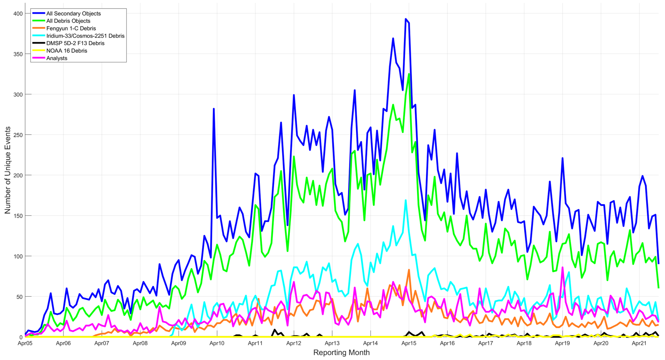
Number of Conjunctions with ESC Missions
Unique Events within 0.5x5x5-km Volume by Object Type
Note: Plot includes data for all historical ESC missions

Slide 21
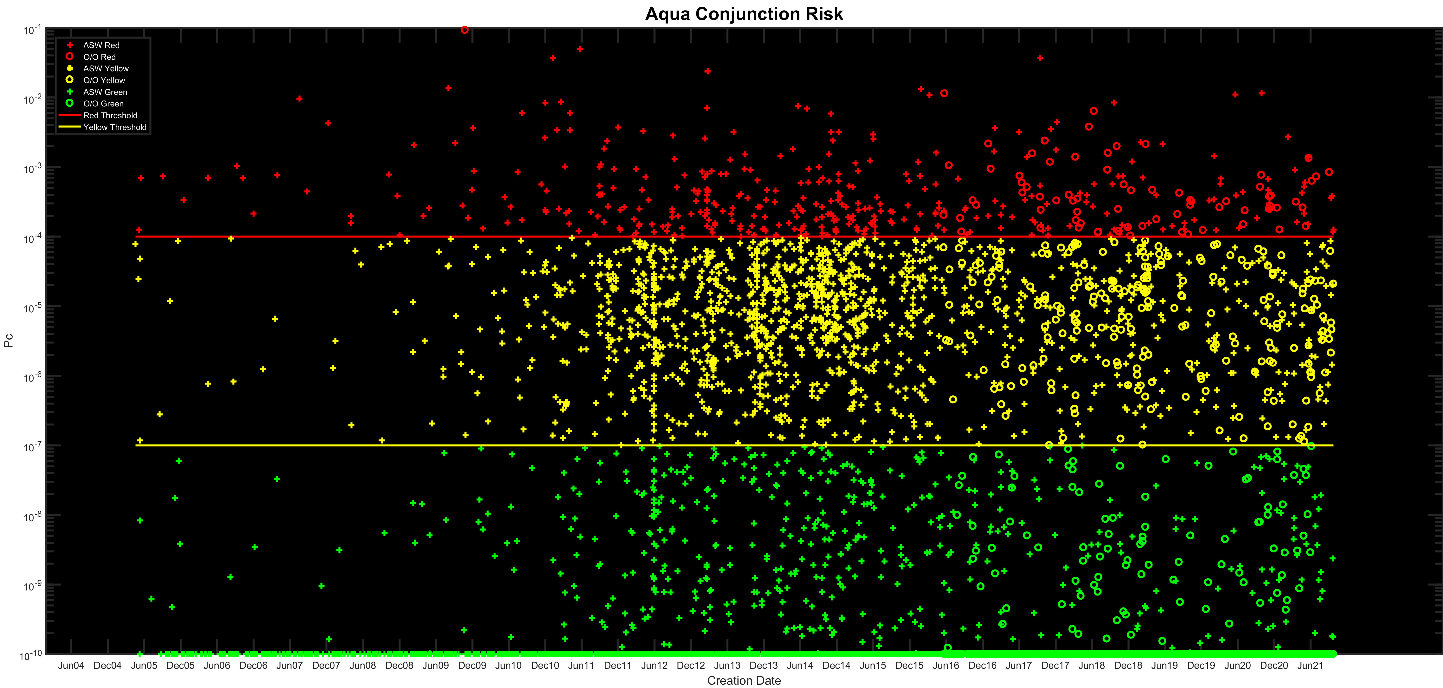
Representative Historical Events by Risk Category
1
2
3
4
5
6
7
Fengyun 1-C event, 11 JAN 2007
Iridium-Cosmos event, 12 FEB 2009
First screening volume update ca. Fall 2010
Added second LEO screening, 1 MAR 2014
CONOPS, 1 NOV 2014
OneWeb Operational Launches begin, Feb 2020
NID Published, 9 Dec 2020

Slide 22
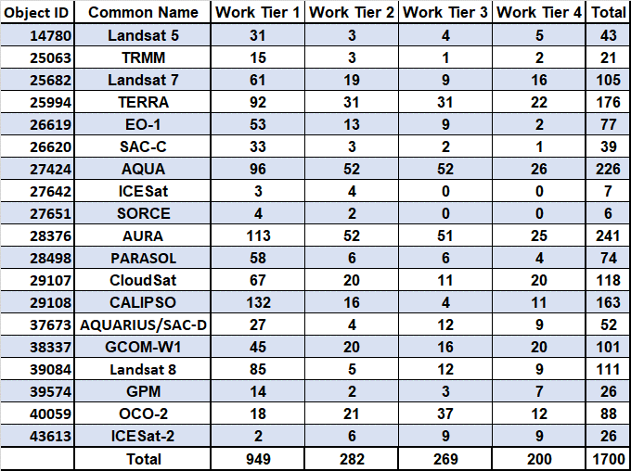
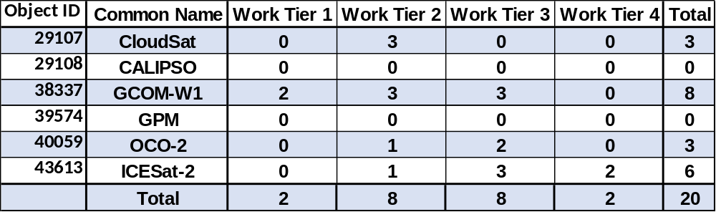
Cumulative Work Tier Stats
Historical Work Tiers*
Work Tier Definitions
1 – Email or phone notification
2 – HIE briefing, MTS, or Sensor Coverage
3 – Maneuver Screening
4 – Execute Maneuver or Waive/Re-plan existing maneuver
2021 YTD - CARA Supported Missions
*Note that Tier 1 statistics are incomplete for Jan. 2005 – Aug. 2010. They were compiled using all past records on file and do not account for all events monitored during this time period.
**Note that Aqua, Aura, Terra are operating under Devolution Parallel Operations since March 26, 2020 after which CARA WTs no longer apply

Slide 23
High Interest Events:
1 Nov 2020 through 1 Oct 2021
Work Tier | # of Events
1: Notify O/O (Email/phone call) | 5
2: Brief O/O (HIE package, MTS, etc.) | 10
3: Maneuver Options Screened | 6
4: Execute mitigation action (RMM/Waive or Replan maneuver) | 0
Total | 21
MOWG date | Work Tier 4 (RMM)
Spring&Fall 2021 Nov 2020 – Oct 2021 | 2 events
Spring&Fall 2020 Nov 2019 – Oct 2020 | 1 event
Spring&Fall 2019 Nov 2018 – Nov 2019 | 9 events
Spring&Fall 2018 Nov 2017 – Nov 2018 | 7 events
Spring&Fall 2017 Aug 2016– Oct 2017 | 14 events
Totals are for 4 of CARA’s ~65 missions
  Total CARA work tier events: 94 (of which 21 are ESC)
  Total CARA work tier 3 & 4: 27 (of which 6 are ESC)

Slide 24
New WT4 for 705-km Constellations
(1 Nov 2020 to 1 Oct 2021)
There were no new Work Tier 4 events for the constellation satellites GCOM-W1, CALIPSO, CloudSat, and OCO-2 between 1 Nov 2020 and 1 Oct 2021

