Slide 1


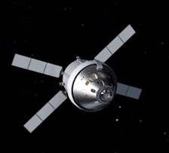
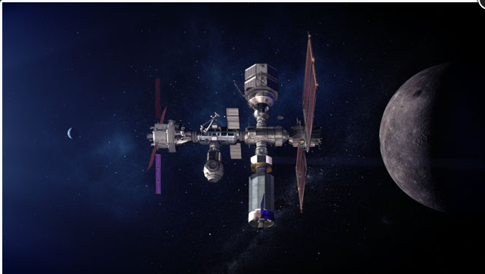

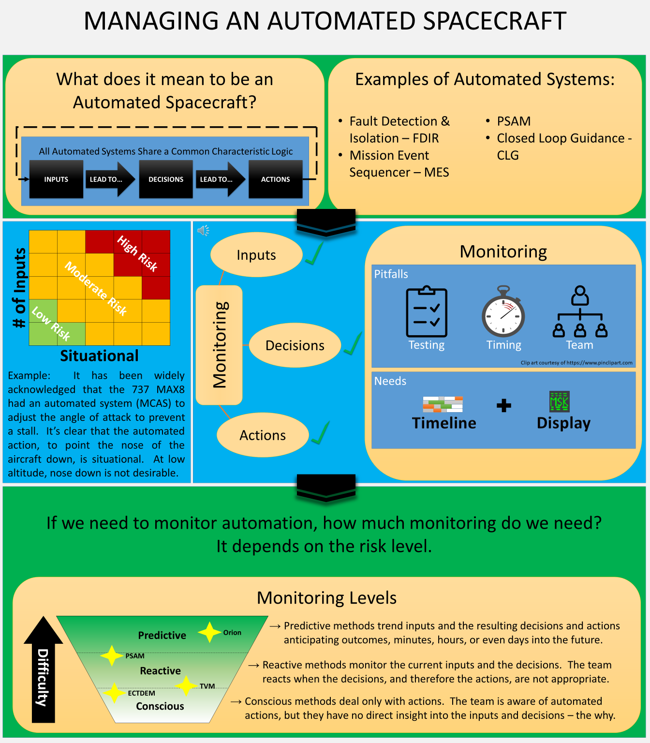
Artemis Flight Plan Evolution
National Aeronautics and Space Administration
Johnson Space Center (JSC) / White Sands Test Facility (WSTF) 2021 JSC Technology Showcase: FY21 CIF IRAD
David Lantz / david.c.Lantz@nasa.gov, Matt Healy, Patty Horn, Kelly Goodyear
Technology Taxonomy Area (TX): 10.3.1 Joint Knowledge and Understanding though information integration; 10.3.2 Behavior and Intent by making it easier for human response to critical autonomy functions; 10.3.3 Goal and Task Negation by integration with mission expectation versus mission actual; and 10.3.4 Operational Trust Building by providing insight and easy access to the automated systems’ inputs and available decisions.
TRL: start 4 / current 6
FY21 IRAD PROJECT Overview
This project has evolved from pursuing a dynamic application designed to track and display a singular spacecraft’s automation to a much broader scope of layering key preflight and real-time data into the integrated Artemis Flight Plan to provide both crew and ground operators with accurate insight into planned versus actual performance during Artemis missions. These products and capabilities will be used for execution and situational awareness by the crew and FCT, including the end-to-end planning process for all phases of flight.
INNOVATION
This project will establish a plan for the cross-program evolution of existing FOD planning and Flight Data File (FDF) tools, including the OPTIMIS tool suite, other Flight Control Team displays, and MCC tools, using the early Artemis/Orion missions as a testbed.
Current capabilities and processes are insufficient to confidently meet mission objectives given the complexity of humans on the ground and on-orbit working with different automated vehicles. This project aims to reduce risk of human error by providing a consolidated, human-digestible, source of information that can be used in pre-mission through mission execution by all team members involved in spaceflight.
FOD is planning investments beyond the IR&D phase to mature capability for Gateway, HLS, and Lunar Surface Operations relying on automation and autonomy to provide an operations steppingstone to future Mars missions.
Outcome
Teams recently held a retreat to discuss what an optimal Artemis Flight Plan looks like. There was a tremendous exchange of knowledge as well identification of several areas that require further investigation before a viable ops concept can be defined.
Infusion Space / Earth
HLS
INFUSION SPACE / EARTH
The Flight Plan developed will be used by on-orbit crew and the ground Flight Control Team to stay in sync and successfully complete mission objectives.
This technology will be applied to multiple missions and vehicles as well as act as a test bed for Lunar and Mars operations.
PARTNERSHIPS / collaborations
Work on the project will continue in close partnership with all FOD Disciplines, Artemis Programs, and Artemis Industry Providers.
We will also be investigating a partnership with other NASA Centers to leverage their expertise in presenting human-digestible spacecraft automation data in planning products, including the ARC/Planning & Scheduling Team.
Future Work
Flight Planning is quickly increasing in complexity with the addition of new automated vehicles, new partners and the need to fly multiple different vehicles simultaneously. The number of inputs and potential number of sources to be managed in flight introduce risk to mission success. By creating a consolidated Flight Plan that can display a large amount of information in a digestible format will help ensure mission success by keeping ground and space teams in sync.
Future work will begin by defining current capabilities and limitations with stakeholders and identifying a viable operational concept for an Artemis Flight Plan. The team intends to pursue functional and process improvements to facilitate the creation of an Artemis Flight Plan that is human-digestible within the time-scale permitted by operations and maximizes the probability of mission success.
N/A
20210023829
DAA# ___________________

