Slide 1
EXCLAIM:
Experiment For Cryogenic Large-Aperture Intensity Mapping
Presented By: Tatsat Parekh

Slide 2
A Little About Me
Tatsat Parekh
Bachelor’s Degree in Mechanical and Aerospace Engineering from Rutgers University
Belleville High School Alumnus
Mechanical Engineer for the EXCLAIM TEAM

Slide 3
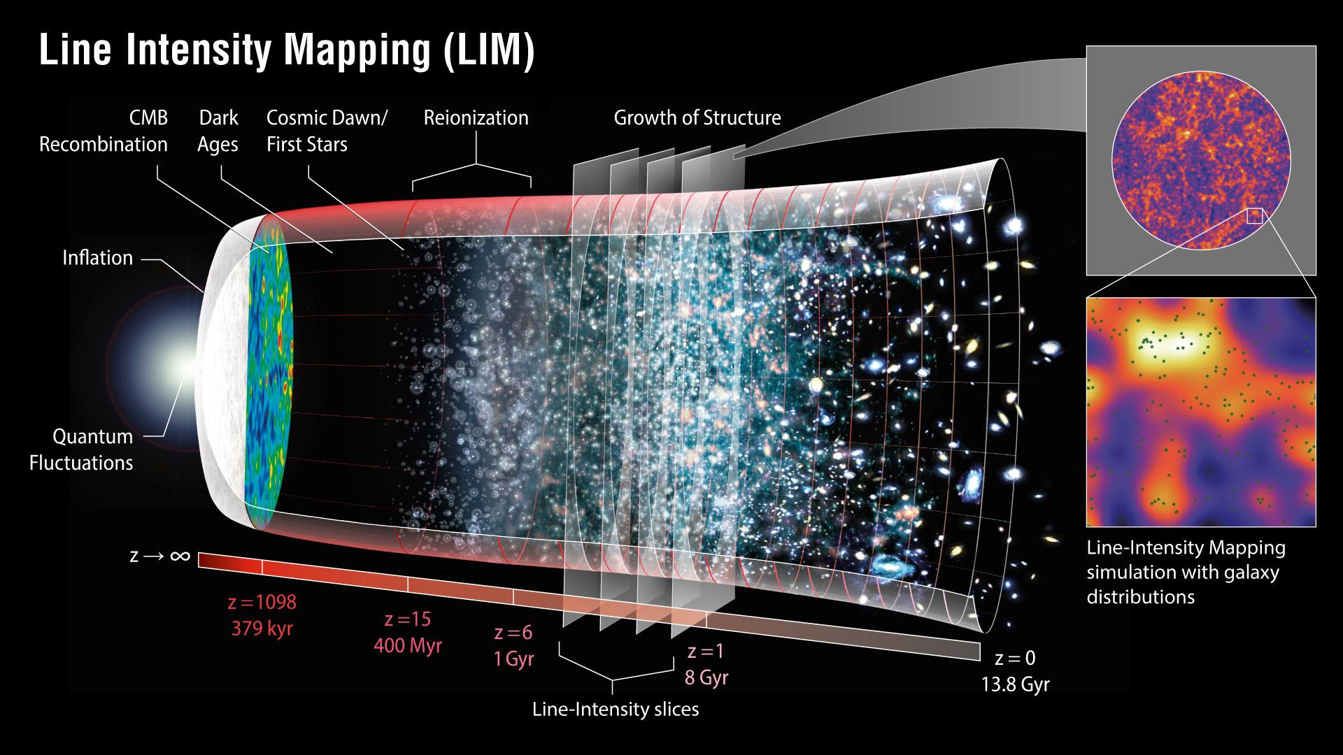
How did we get here?
Pivotal era: How did matter organize from a highly homogeneous hydrogen/helium gas to the rich universe that we inhabit today?

Slide 4
EXCLAIM Team
NASA Goddard
Eric Switzer (PI)
Tom Essinger-Hileman (DPI, Instrument lead)
Giuseppe Cataldo (Mission SE)
Emily Barrentine (Spectrometer lead)
Chris Anderson (Map analysis, JHU coop)
Alyssa Barlis (SECP, optical test design)
Berhanu Bulcha (Resonator design)
Paul Cursey (Machinist)
Negar Ehsan (Antenna design)
Jason Glenn (Receiver, MKIDs)
James Hays-Wehle
Larry Hess (Fabrication)
Amir Jahromi (ADR)
Mark Kimball (ADR)
Mona Mirzaei (Fabrication)
Alan Kogut (Gondola)
Luke Lowe (Flight Electronics)
Omid Noroozian (MKID design and test)
Tatsat Parekh (Mechanical)
Samelys Rodriguez (Wirebonding)
Thomas Stevenson (Spectrometer)
Ed Wollack (Spectrometer)
Interns (spring 2021): Jim Fouquet (ISAE-SUPAERO), Alberto Martinez Gonzalez (ISAE-SUPAERO), Trevian Jenkins (UMD), Mathias Ramirez (ASU)
NYU/CCA: Simulation and interpretation
Anthony Pullen (Science Lead)
Rachel Somerville
Eli Visbal
Shengqi Yang
Aaron Yung (starting at GSFC)
Patrick Breysse
UMD:
Alberto Bolatto (Galactic field, interpretation)
Carolyn Volpert (grad, spectrometer test, survey)
ASU: (Readout)
Phil Mauskopf (Readout Lead)
Adrian Sinclair
Ryan Stephenson
Cody Roberson
UWisc: (MKID modelling, forecasting)
Trevor Oxholm, Gage Siebert
Peter Timbie
CITA: Simulation and interpretation
Ue-Li Pen
U Chicago: (Silicon lens AR) Jeffrey McMahon
Cardiff: (Filters) Peter Ade, Carole Tucker
NIST: Jake Connors

Slide 5
My Role
My role on the team is to help design, fabricate, and test parts related to the project
Design
  As the lead for mechanical design, my job is to make sure all parts are created in a way that can last within the boundaries of our experiment
Fabricate
  Fabrication involves creating drawings and work with our on-site machinist to physically make the parts, often, parts are sent out to machine shops
  One key element to fabrication is integration, which involves creating a build plan to assure parts are put together in the proper order
Test
  Once parts have been created, certain systems must be tested in order to assure that they won’t fail during flight
    For example, the receiver must go through cryogenic testing

Slide 6
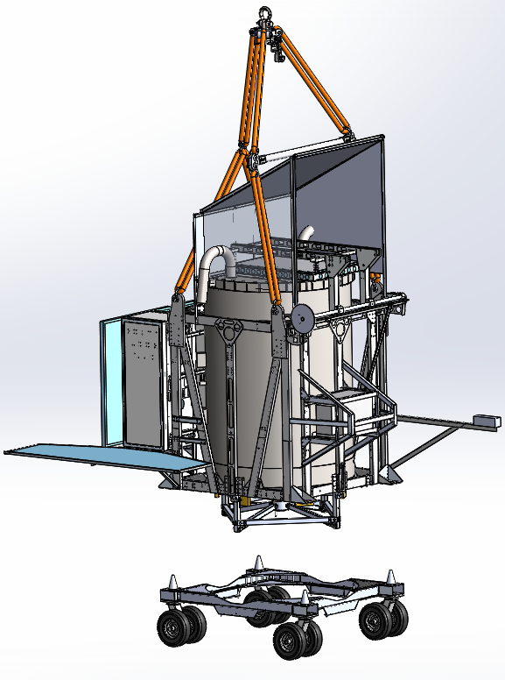
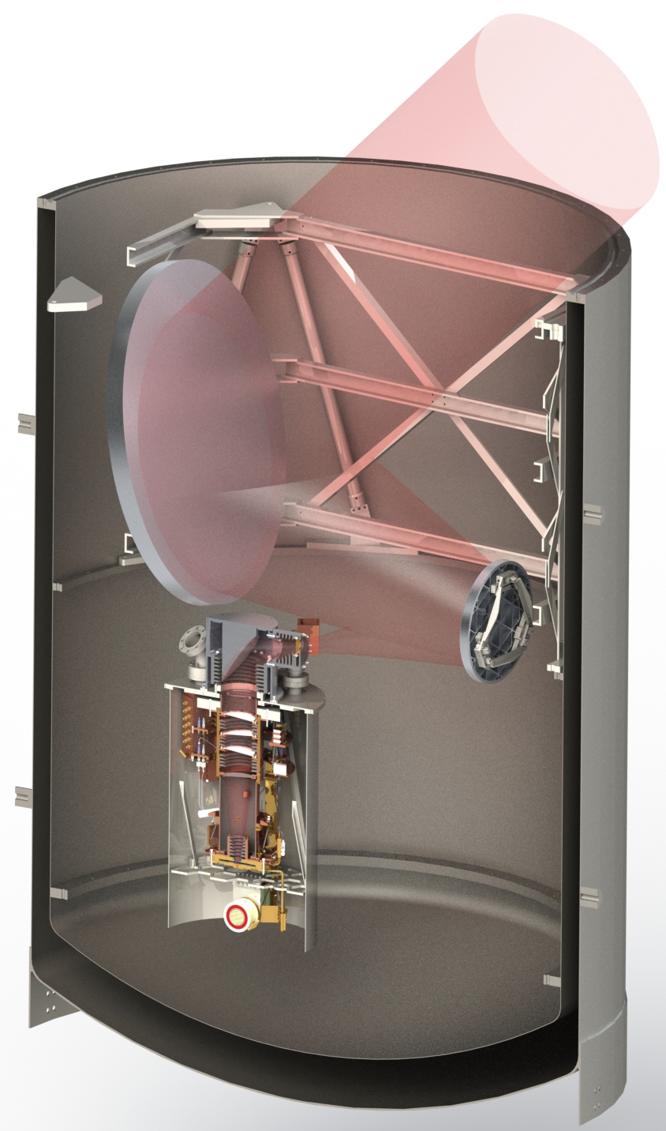
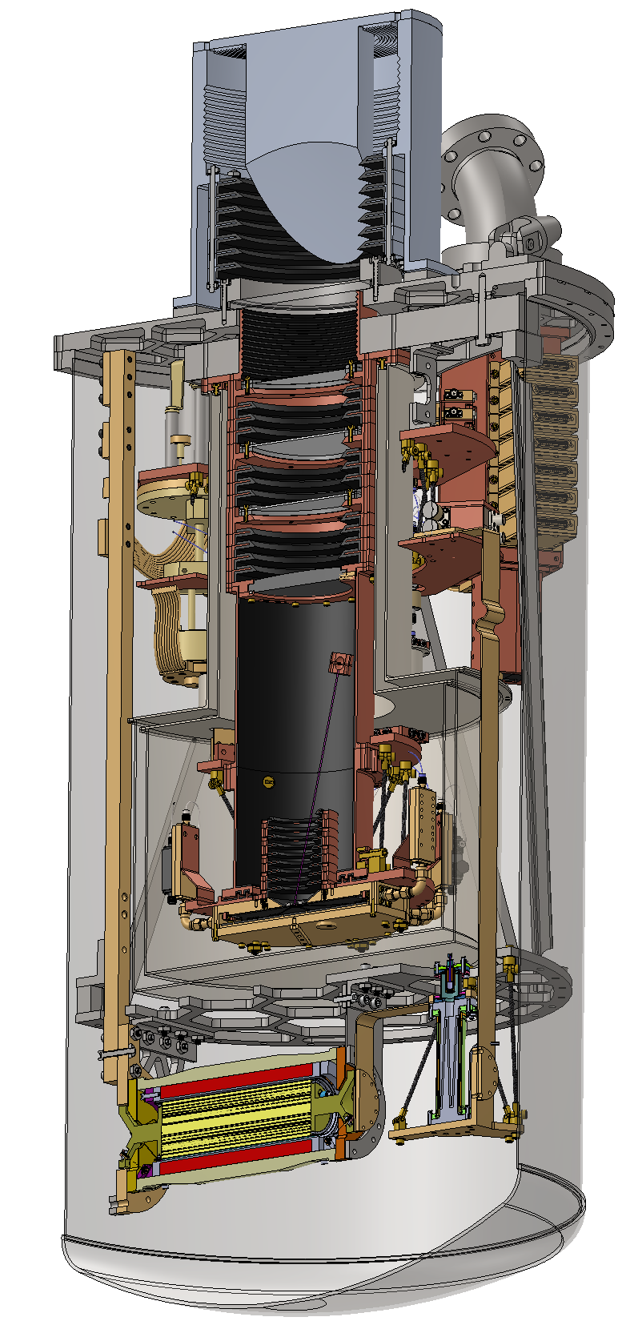
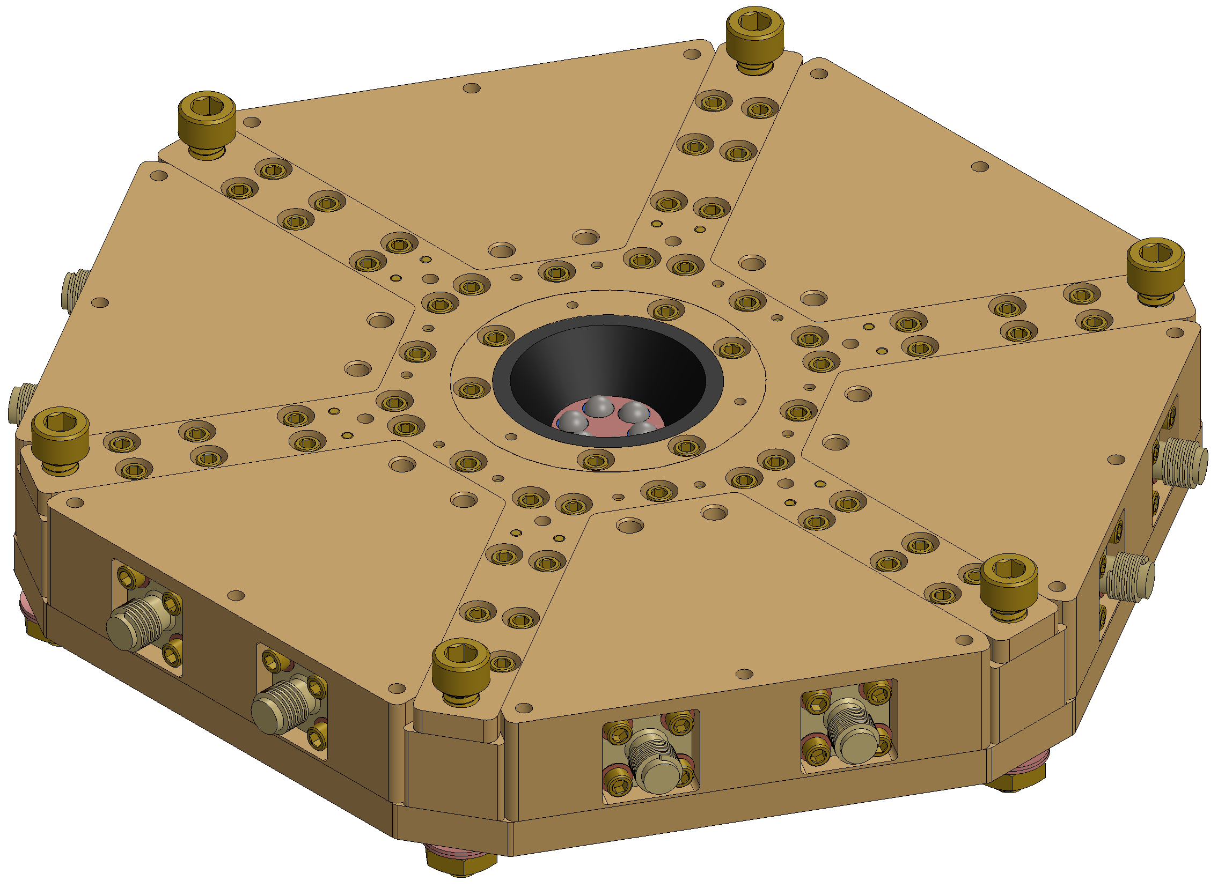
Mission System Overview
Receiver
Balloon-borne cryogenic telescope
On-chip MKID spectrometer

Slide 7
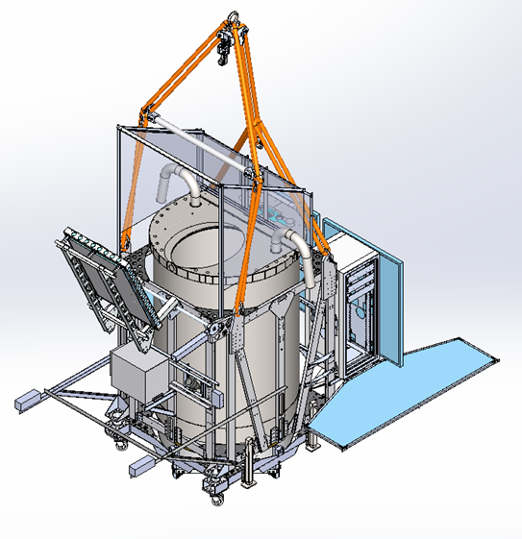
Components
3-point rotator
Electronics
Sun shield
Hatch cover
CIP
Star camera
Earth-IR shields
Dewar

Slide 8
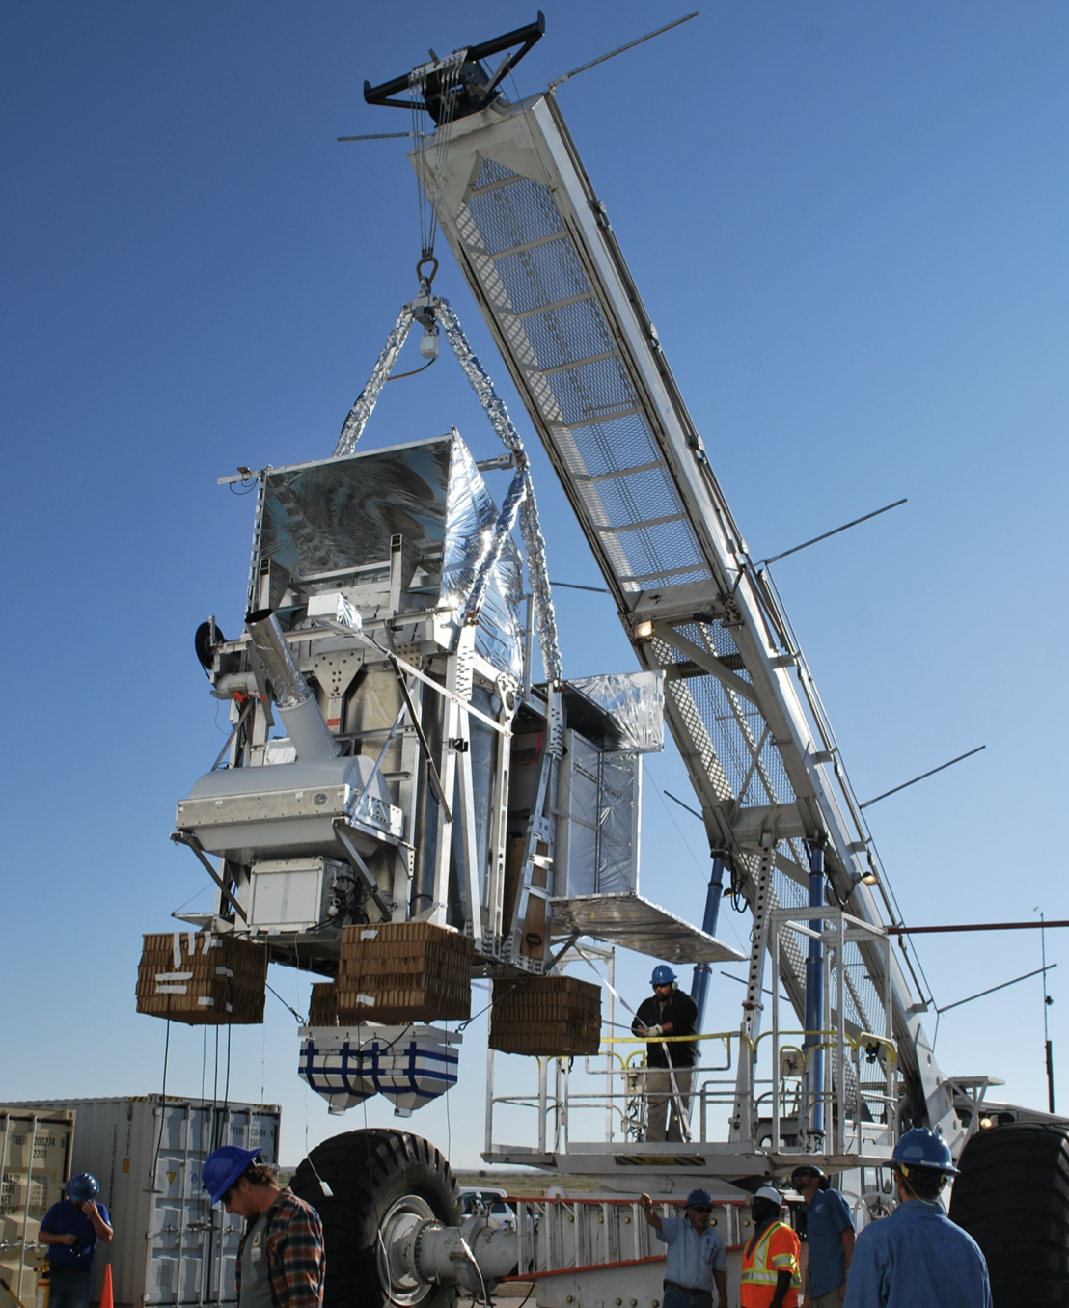
Rigging connections
Straps
Spreader bar
Payload attachment
Wire rope
Foam Earth-IR shields

Slide 9
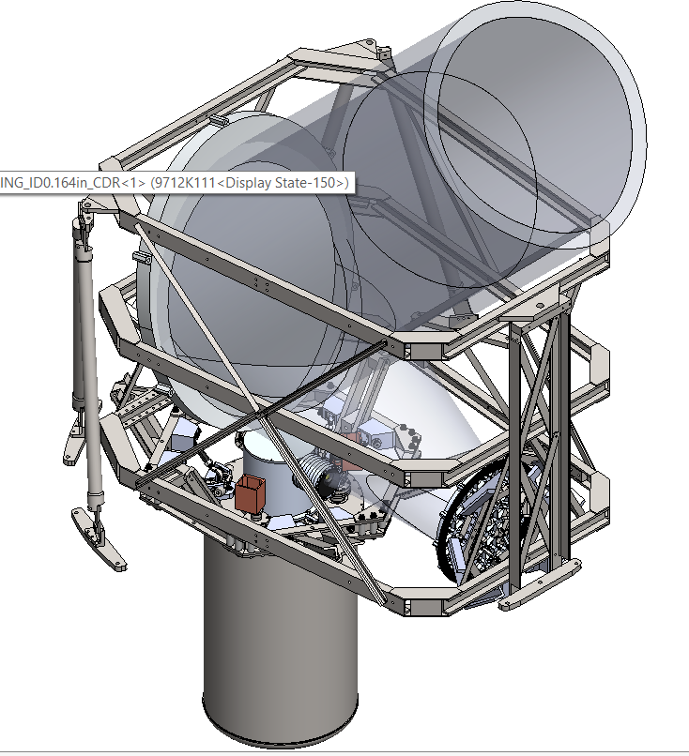
Telescope
The telescope, one of the most important components in the mission, is integrated inside the Dewar where a beam is reflected outwards towards space

Slide 10
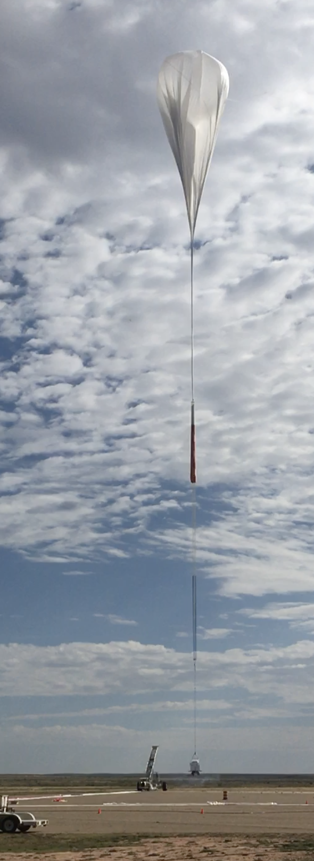
CSBF: Columbia Scientific Balloon Facility
The Columbia Scientific Balloon Facility is the governing entity for the scientific balloon projects
Balloons are relatively thin: about .002cm ( roughly .0008in) thick, about the same thickness as a regular plastic bag
These balloons are filled with helium and sent off to the edge of space to answer some of science’s most difficult questions
BOBCAT mission launches on a NASA scientific balloon - YouTube

Slide 11
Your Task
Your task is to pick the Flight Crew!
Rules:
  Must be made of polyester
  Must be able to fit inside a battery box
    8x4x6” battery box dimension limits
  Must have negligible mass
    No beans/ sand filling
  Character/ Item Details
    Power Point or Word Document
    Explain why you picked the character
    Mass of actual polyester item
    Dimensions of character
    Analysis (explained in later slide)
  Must be appropriate
  Will be approved by Exclaim Team prior to flight
  Due Date: 1/31/2022

Slide 12
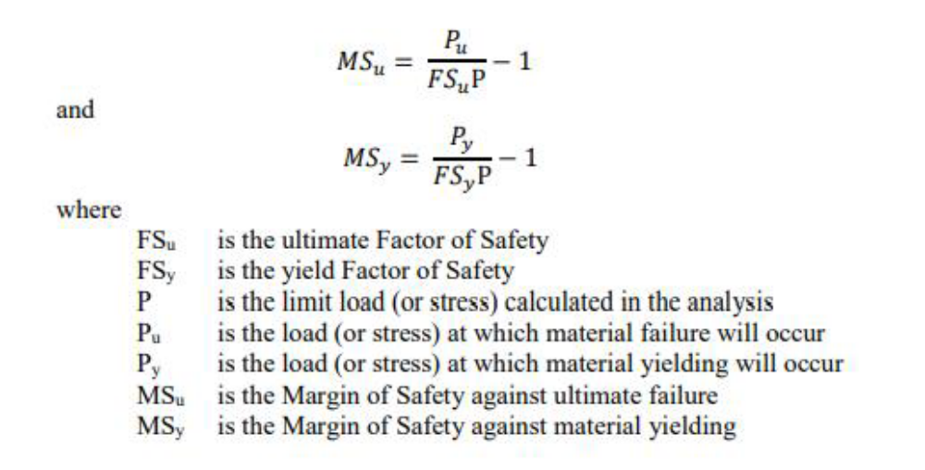
Calculations and Analysis
One of the primary tasks for engineers is to determine how parts react under forces greater than gravity as well as forces at various angles
As a safety measure, we use the concepts of factor of safety and margin of safety to determine HOW safe the part is under given gravity conditions
Task:
  Determine the stress the polyester character will endure under the following gravity conditions
    1G Pointed downwards
    4G Pointed downwards
    8G Pointed downwards
    4G Pointed at 45 Deg angle
  Determine the factor of safety and margin of safety given that the allowable margin of safety is 1.2 for yield and 1.4 for ultimate

Slide 13
Rules for Calculations and Analysis
Show free body diagram and all calculations in presentation format
Must show resources
  Cannot use Wikipedia
  Suggest using textbooks and reputable websites/ data bases
Extra Credit
  Create a computer simulated/3D model of character with same dimensions
  Show stress of character using the 3D model

Slide 14
Thank you for your time!

