Slide 1
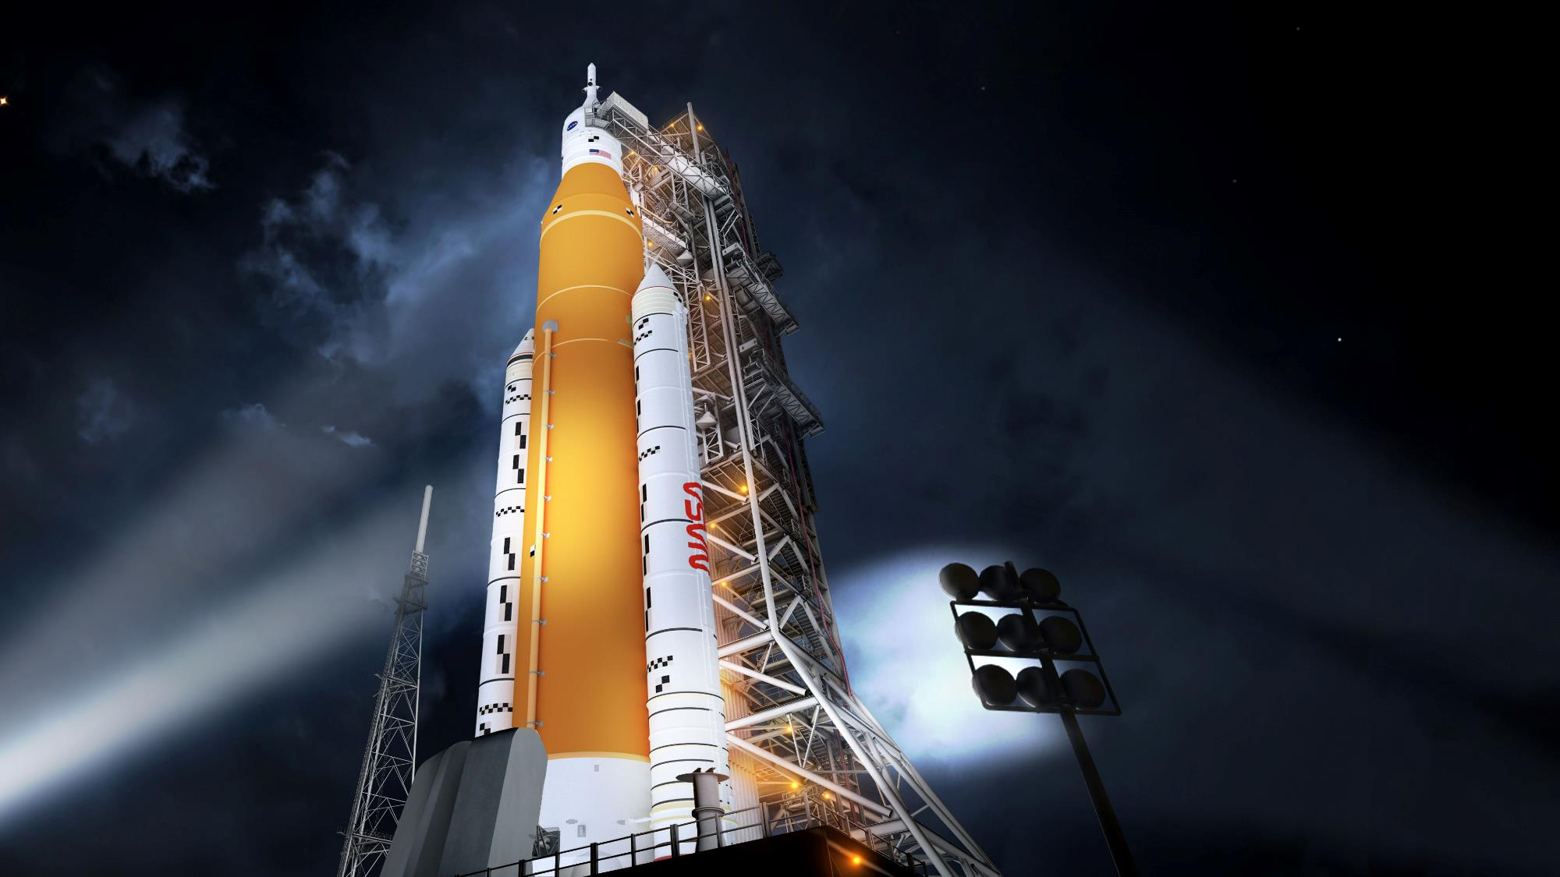

Space launch System rideshare opportunities to cislunar space
18 November 2021
Robert Stough
SLS Utilization Manager

Slide 2

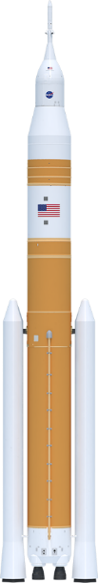
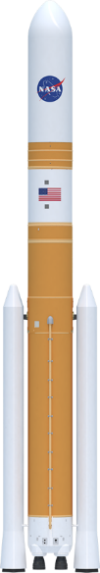



The power of sls
Foundation for a generation of deep space exploration
Payload to LEO
95 t (209.4k lbs)
95 t (209.4k lbs)
105 t (231.4k lbs)
105 t (231.4k lbs)
130 t (286.6k lbs)
130 t (286.6k lbs)
Payload to TLI/Moon
> 27 t (59.5k lbs)
> 27 t (59.5k lbs)
38 t (83.7k lbs)
42 t (92.5k lbs)
> 43 t (94.7k lbs)
> 46 t (101.4k lbs)
Payload Volume
516 ft³ (14.6 m³)
8,118 ft³ (229.9 m³)
10,100 ft³ (286 m³)**
21,930 ft³ (621.1 m³)
10,100 ft³ (286 m³)**
34,910 ft³ (988 m³)
Low Earth Orbit (LEO) represents a typical 200 km circular orbit at 28.5 degrees inclination
Trans Lunar Injection (TLI) is a propulsive maneuver used to set a spacecraft on a trajectory that will cause it to arrive at the Moon. A spacecraft performs TLI to begin a lunar transfer from a low circular parking orbit around Earth.
The numbers depicted here indicate the mass capability at the Trans-Lunar Injection point.
** Not including Orion/Service
Module volume
SLS Block 1 Crew
SLS Block 1 Cargo
SLS Block 1B Crew
SLS Block 1B Cargo
SLS Block 2 Crew
SLS Block 2 Cargo
Maximum Thrust
8.8 M lbs
8.8 M lbs
8.9 M lbs
8.9 M lbs
9.5 M lbs
9.5 M lbs
Notes:
The First 3 Artemis missions will use the block 1 configuration.

Slide 3


STACKING THE ARTEMIS I VEHICLE

Slide 4
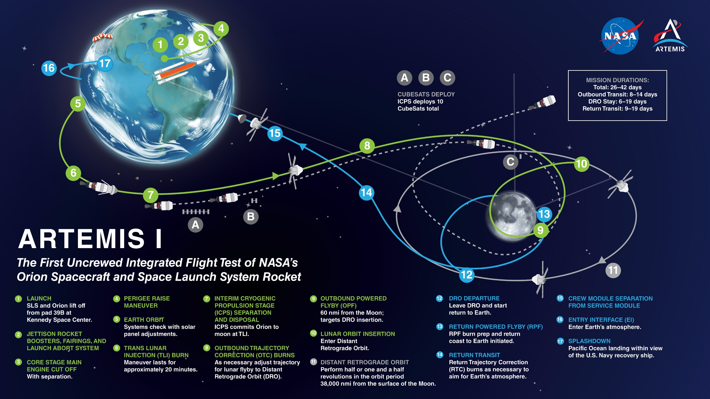
10/7/2021
Notes:
Version Control
MAP DATE: OCT 2021
POC
Aimee Crane
aimee.c.crane@nasa.gov

Slide 5
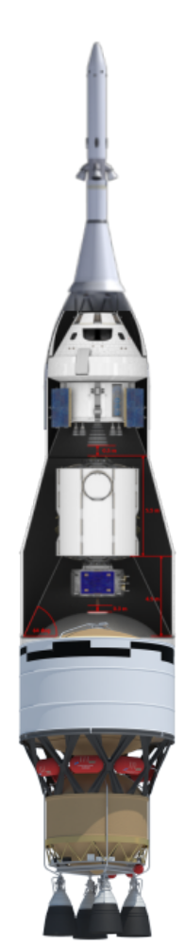

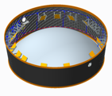
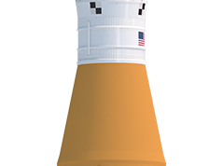
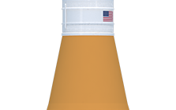

BLOCK 1 PAYLOAD ACCOMMODATIONS
SLS Block 1
Crew
SLS Block 1
Cargo
CubeSats
Orion
Spacecraft
5m
Fairing
6U
14 kg
12U
20 kg
Integrated Spacecraft/Payload
Element
(ISPE)
ISPE
Primary
Payload
Payload Adapter
Orion Stage Adapter (OSA)
Interim Cryogenic Propulsion Stage (ICPS)
Booster
Booster
Booster
Booster
Launch Vehicle Stage Adapter (LVSA)
Up to 17 places ≤ 12U
229 m³ available volume
Stages (Core)
Stages (Core)
Notes:
Available volume in 5 m fairing = 229 cubic meters

Slide 6
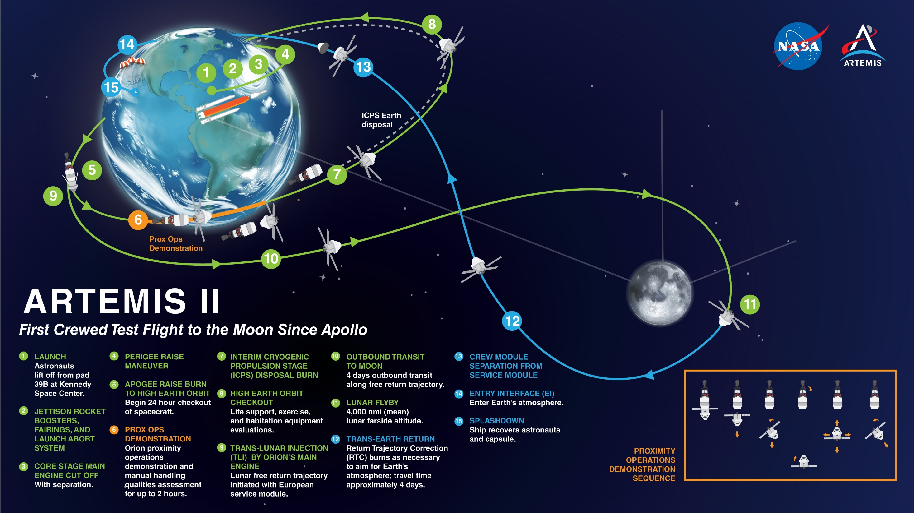
10/7/2021
Notes:
Version Control
MAP DATE: OCT 2021
POC
Aimee Crane
aimee.c.crane@nasa.gov

Slide 7
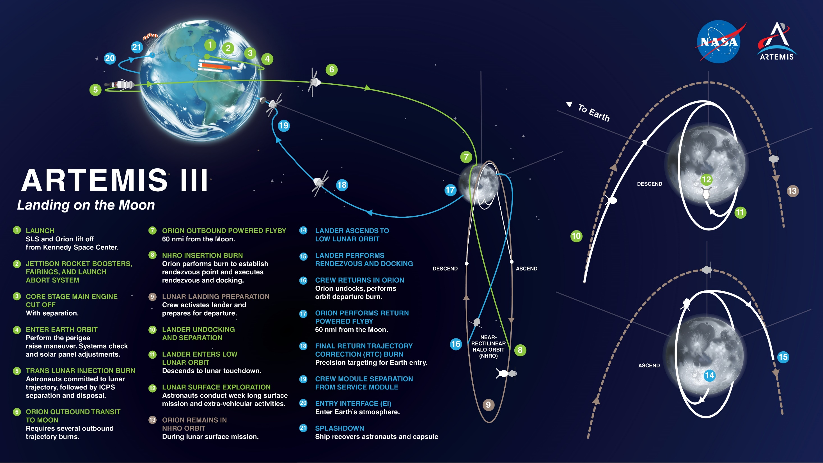
10/7/2021
Notes:
Version Control
MAP DATE: OCT 2021
POC
Aimee Crane
aimee.c.crane@nasa.gov

Slide 8
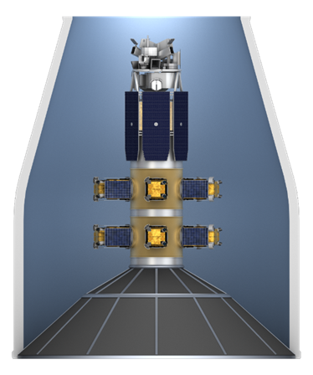
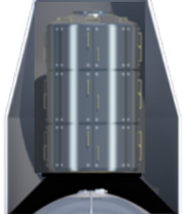
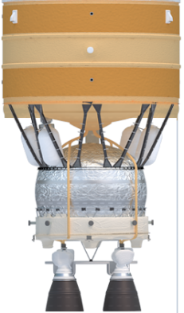

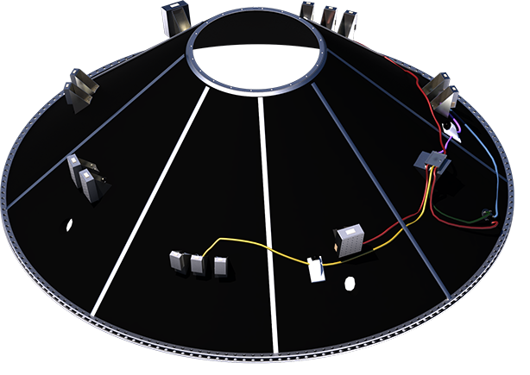
BLOCK 1B/2 PAYLOAD ACCOMMODATIONS
SLS Block 1B
Crew
SLS Block 1B
Cargo
Orion
Spacecraft
Fairing diameter x length | Available volume
8.4 m x 19.1 m | 621 m³
8.4m x 27.4 m | 988 m³
Ring-class smallsats
8.4m Fairing
Stages (EUS)
Stages (EUS)
Co-Manifested Payload
Primary Payload
Universal
Stage Adapter (USA) 286 m³,
≤10 t lbm
CubeSats
Up to 7 places, ≤12U
Payload Adapter (PLA)
CubeSats
Up to 21 places ≤12U
Booster
Booster
Booster
Booster
Stages (Core)
6U
12U
Stages (Core)
Notes:
For Block 1B and Block 2 payloads, space is available in the Universal Stage Adapter in the crew configuration
Available volume in USA = 286 cubic meters
Available volume in 8.4 m x 19.1 m fairing = 621 cubic meters
Available volume in 8.4 m x 27.4 m fairing = 988 cubic meters
B1B can also potentially accommodate CubeSats, up to 27U, on a payload adapter
Possibly even ESPA-class payloads or a propulsive ESPA ring may be included in future missions
Vehicle planners are still keeping a 10 m-diameter payload fairing as an option. Lengths are the same as the 8.4 m fairing – 19.1 m and 27.4 m.

Slide 9
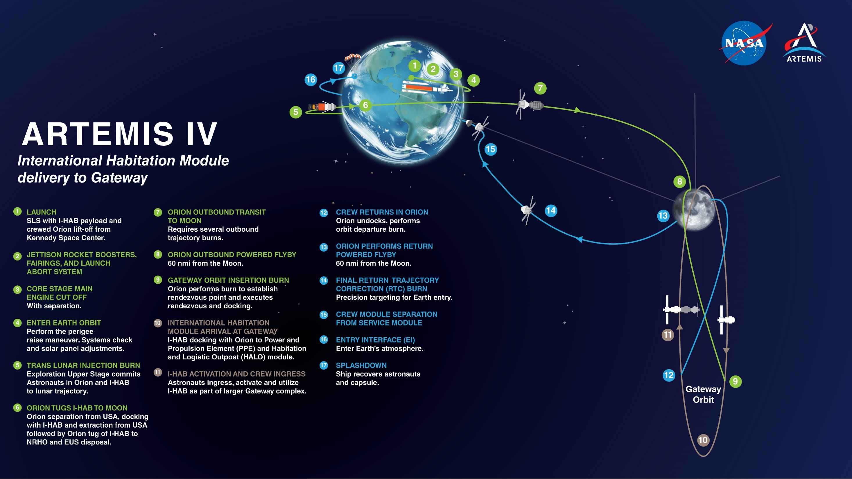
10/7/2021
Notes:
Version Control
MAP DATE: OCT 2021
POC
Aimee Crane
aimee.c.crane@nasa.gov

Slide 10
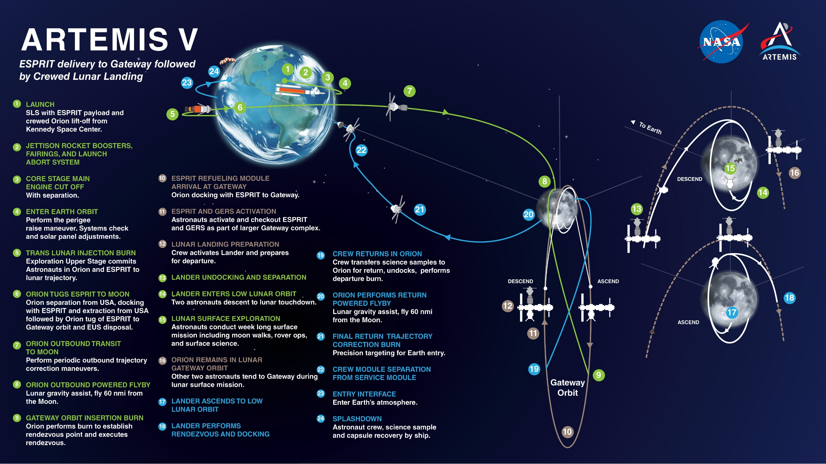
10/7/2021
Notes:
Version Control
MAP DATE: OCT 2021
POC
Aimee Crane
aimee.c.crane@nasa.gov

Slide 11
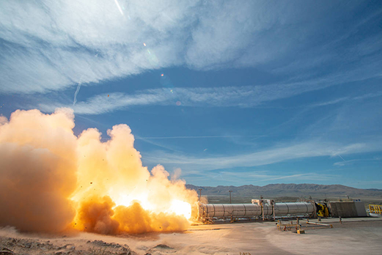
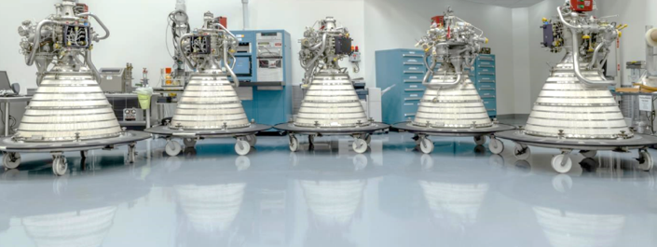
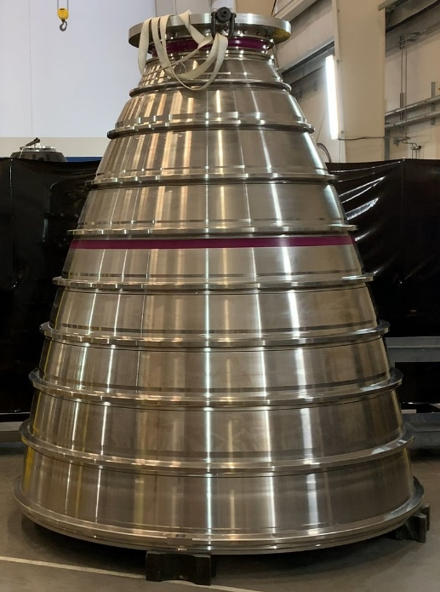
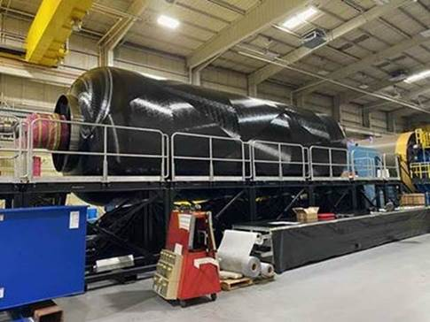
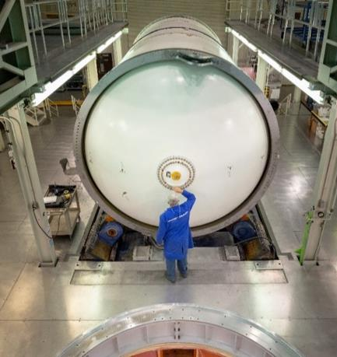
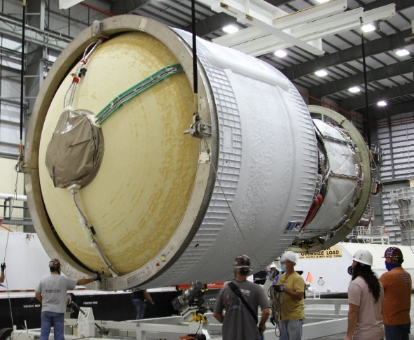
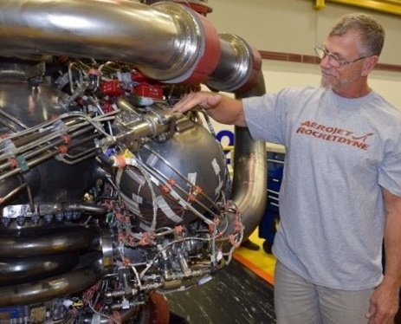
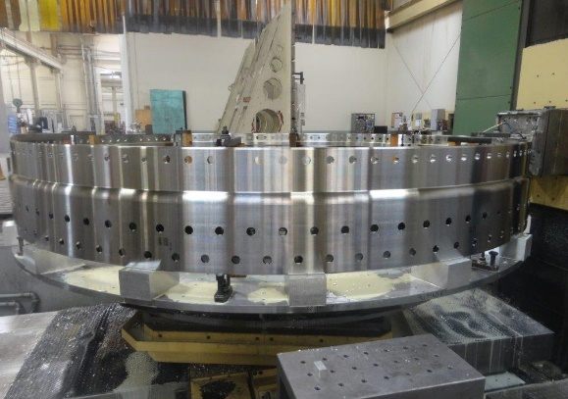
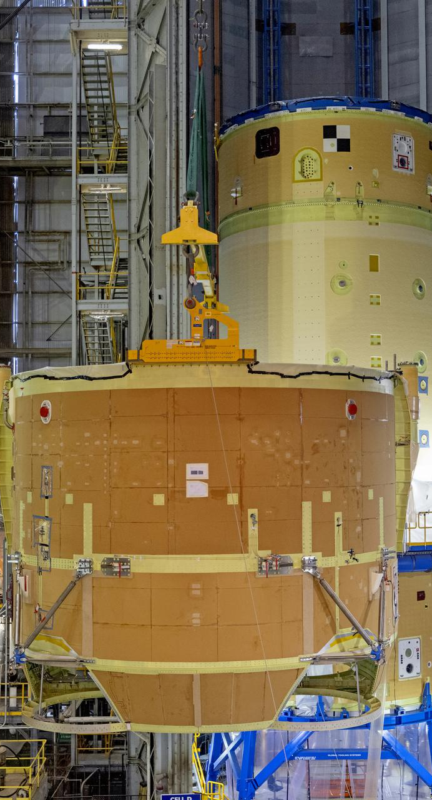
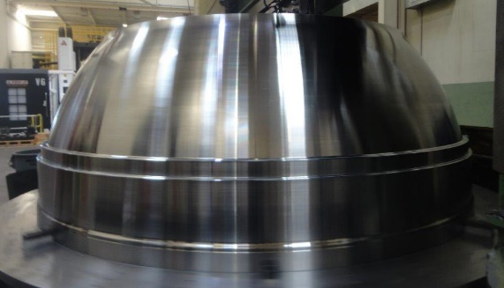
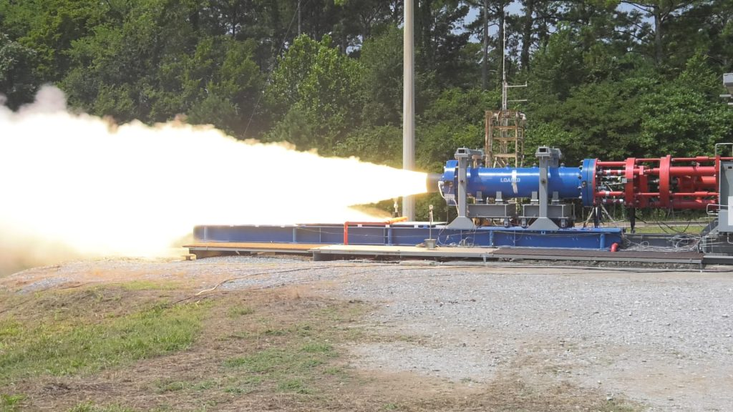
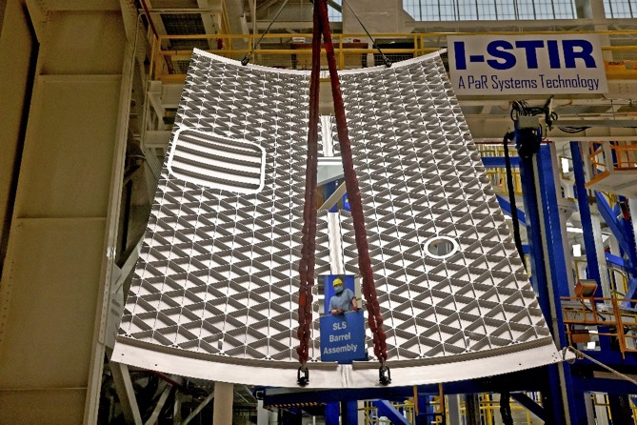
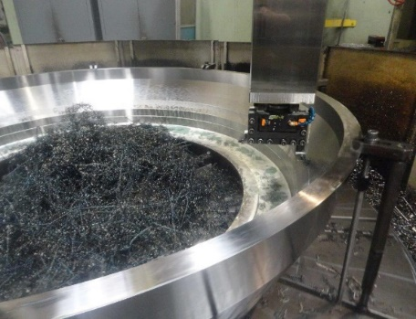
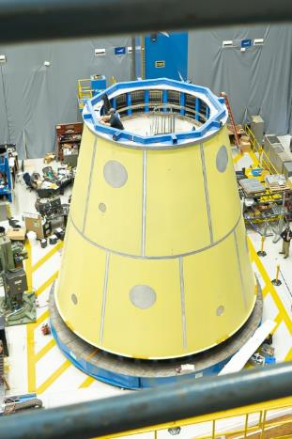
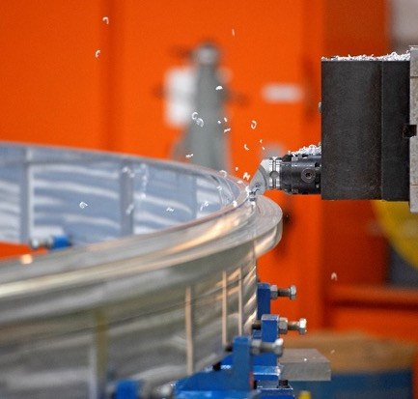
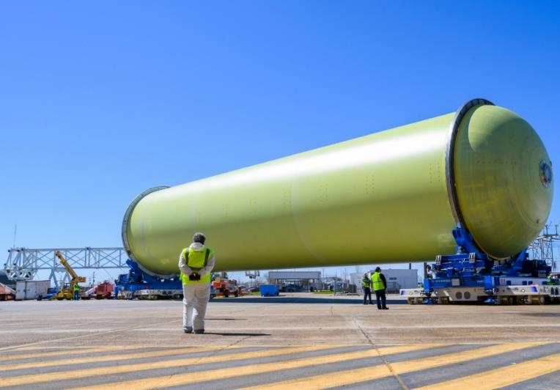
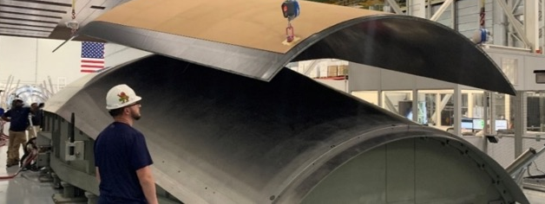
SPACE LAUNCH SYSTEM ARTEMIS PROGRESS

Slide 12
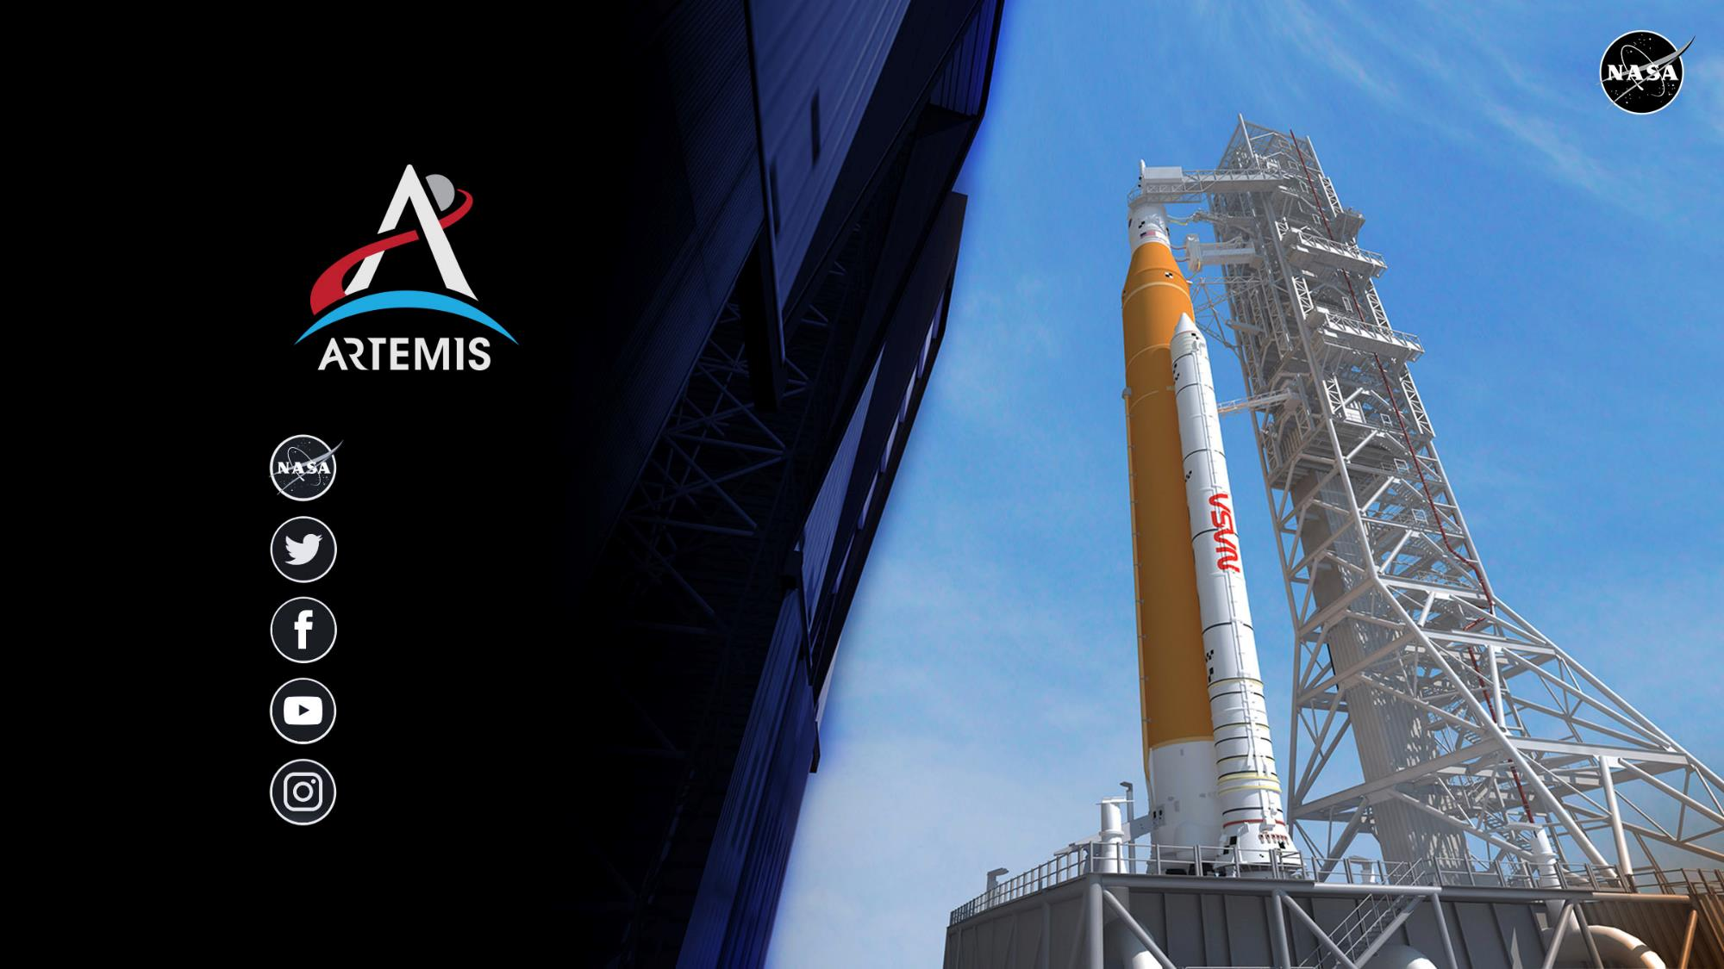
nasa.gov
images.nasa.gov
@NASA_SLS
NASASLS
youtube.com/nasa
@NASAArtemis
Notes:
You can follow developments with SLS, Ground Systems, Orion – and the overall Artemis program by through our social media platforms.
We are proud of this community and honored to do the work we do.
And, we know, as they say, that we are standing on the shoulders of giants.
We don’t take that lightly – nor do we take this mission lightly.
We have delivered the rocket for Artemis I – and we are going.

