Slide 1
Simulating the SLS Solid Rocket Booster Plume-Water Induced Environment
Travis Rivord – CFD Research Corporation, Jacobs Space Exploration Group, NASA MSFC-ER42
Brandon Williams – ER42, NASA MSFC-ER42

Slide 2
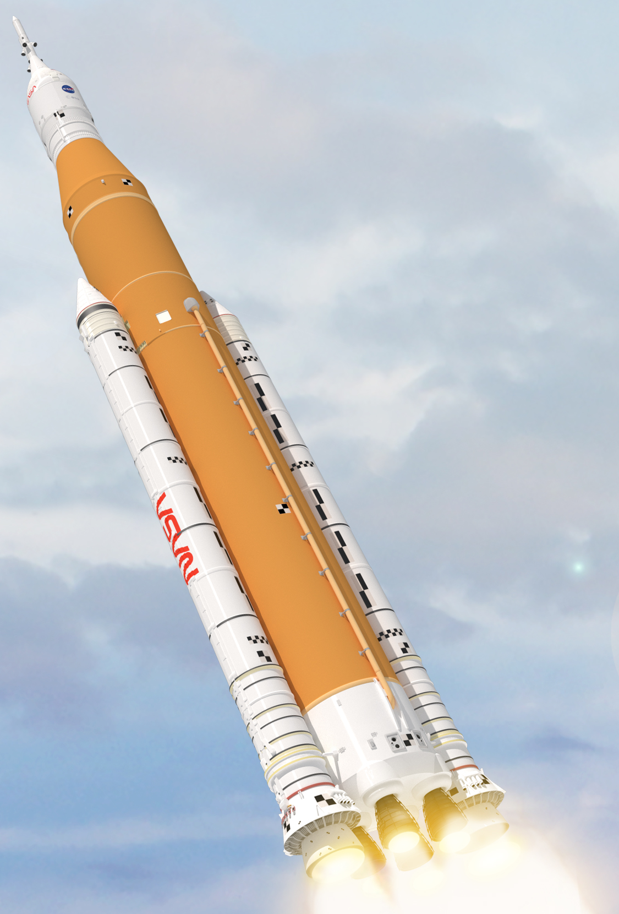
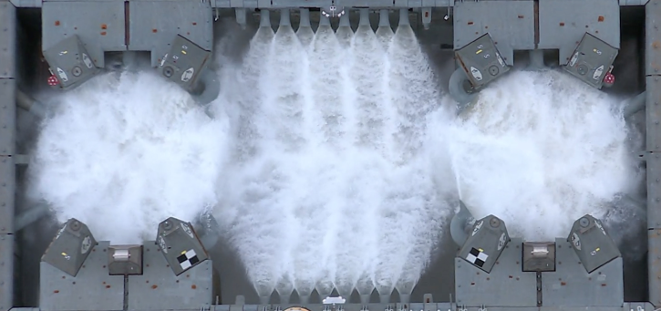
SLS Background
NASA’s Space Launch System (SLS) will soon send astronauts back to the Moon
  The two solid rocket boosters (SRBs) provide 75% of the total thrust at launch
  Ignition of the powerful SRBs generate significant ignition overpressure (IOP) waves
If unmitigated, these waves can damage the vehicle
  To protect against these waves, the SLS design includes a sound suppression water system
  The water forms a dense and chaotic layer close to the SLS nozzles

Slide 3
SRB Operational Environment
The chaotic splashing water can project upwards into the SRB nozzles
  If present at ignition, the water can cause large asymmetric nozzle side loads
Some data is available from tests of individual systems
  Water system operation data obtained from the ISVV-14 test series
  Nozzle side load data obtained from FSB-1 static test fire
Currently, the SRB operational environment is unknown
  Both tests lack key physics of the full SLS launch
  No integrated testing will be available prior to the Artemis I launch
The only means of gaining insight is computational fluid dynamics (CFD) modeling
Water System Test
FSB-1 Test

Slide 4
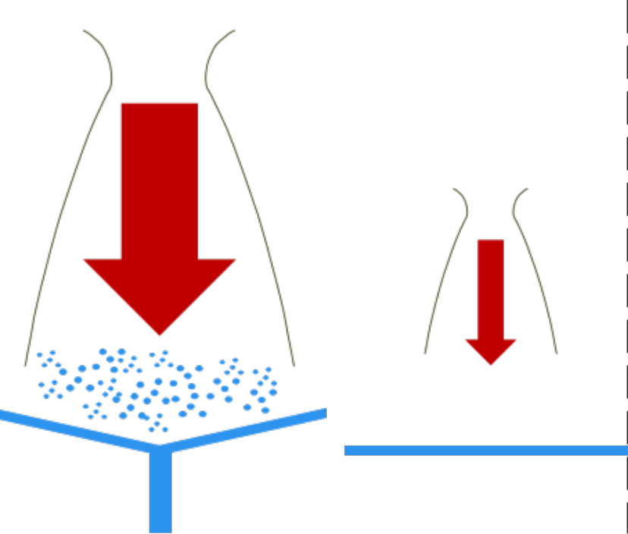
Modeling Challenges
Modeling the SLS launch environment involves incredibly challenging physics, including
  Multiple supersonic plumes
  Multiphase flow (gas and liquid)
  Large length scales (super heavy launch vehicle)
  Small length scales (droplet formation and break up)
  Long time scales (over 10 seconds)
  Small time scales (supersonic plumes)
These simulations
  Are conducted on thousands of processors
  Take weeks to months to execute
  Require terabytes of storage
SRB Plume
Liquid Plume
Sound Suppression Water

Slide 5
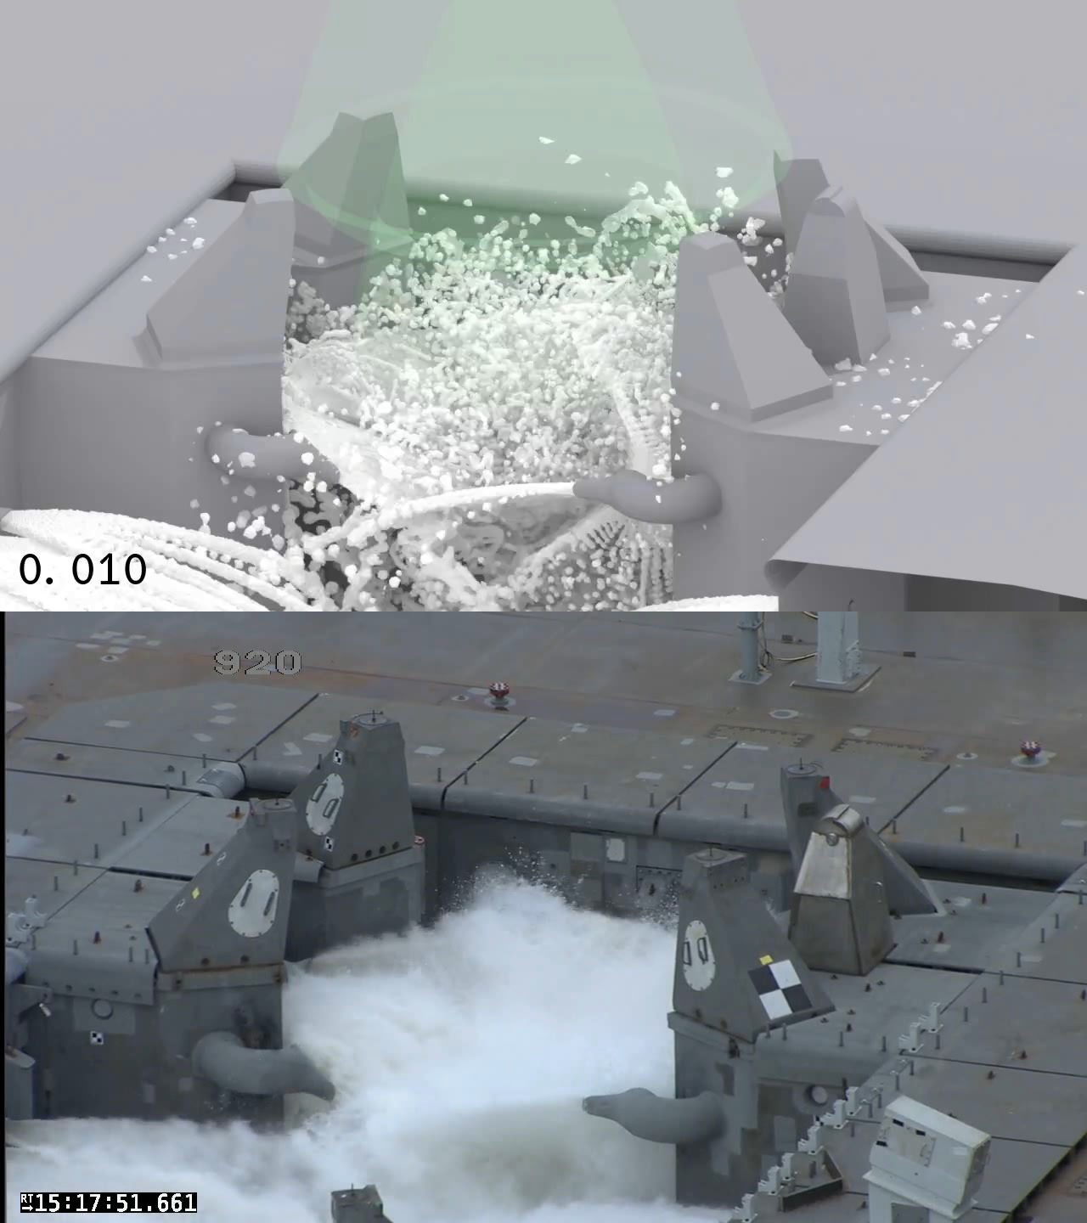
ISVV-14 Validation: View LT2B-V1
Engineers at NASA’s Marshall Space Flight Center (MSFC) have fielded CFD to understand the integrated SLS configuration for launch
  Used the Loci/STREAM-Volume of Fluid (VoF) multiphase CFD solver
  Initial efforts focus on validating CFD predictions
  Enables future more complex simulations
Water system validation completed by comparing the CFD solution to ISVV-14 test footage
  The first view is camera LT2B-V1
The CFD simulation qualitatively captures many features seen in the test
  Water sheets emitted from the water nozzles
  Sheets interact and create splashing
  Splashes are irregular and unsteady

Slide 6
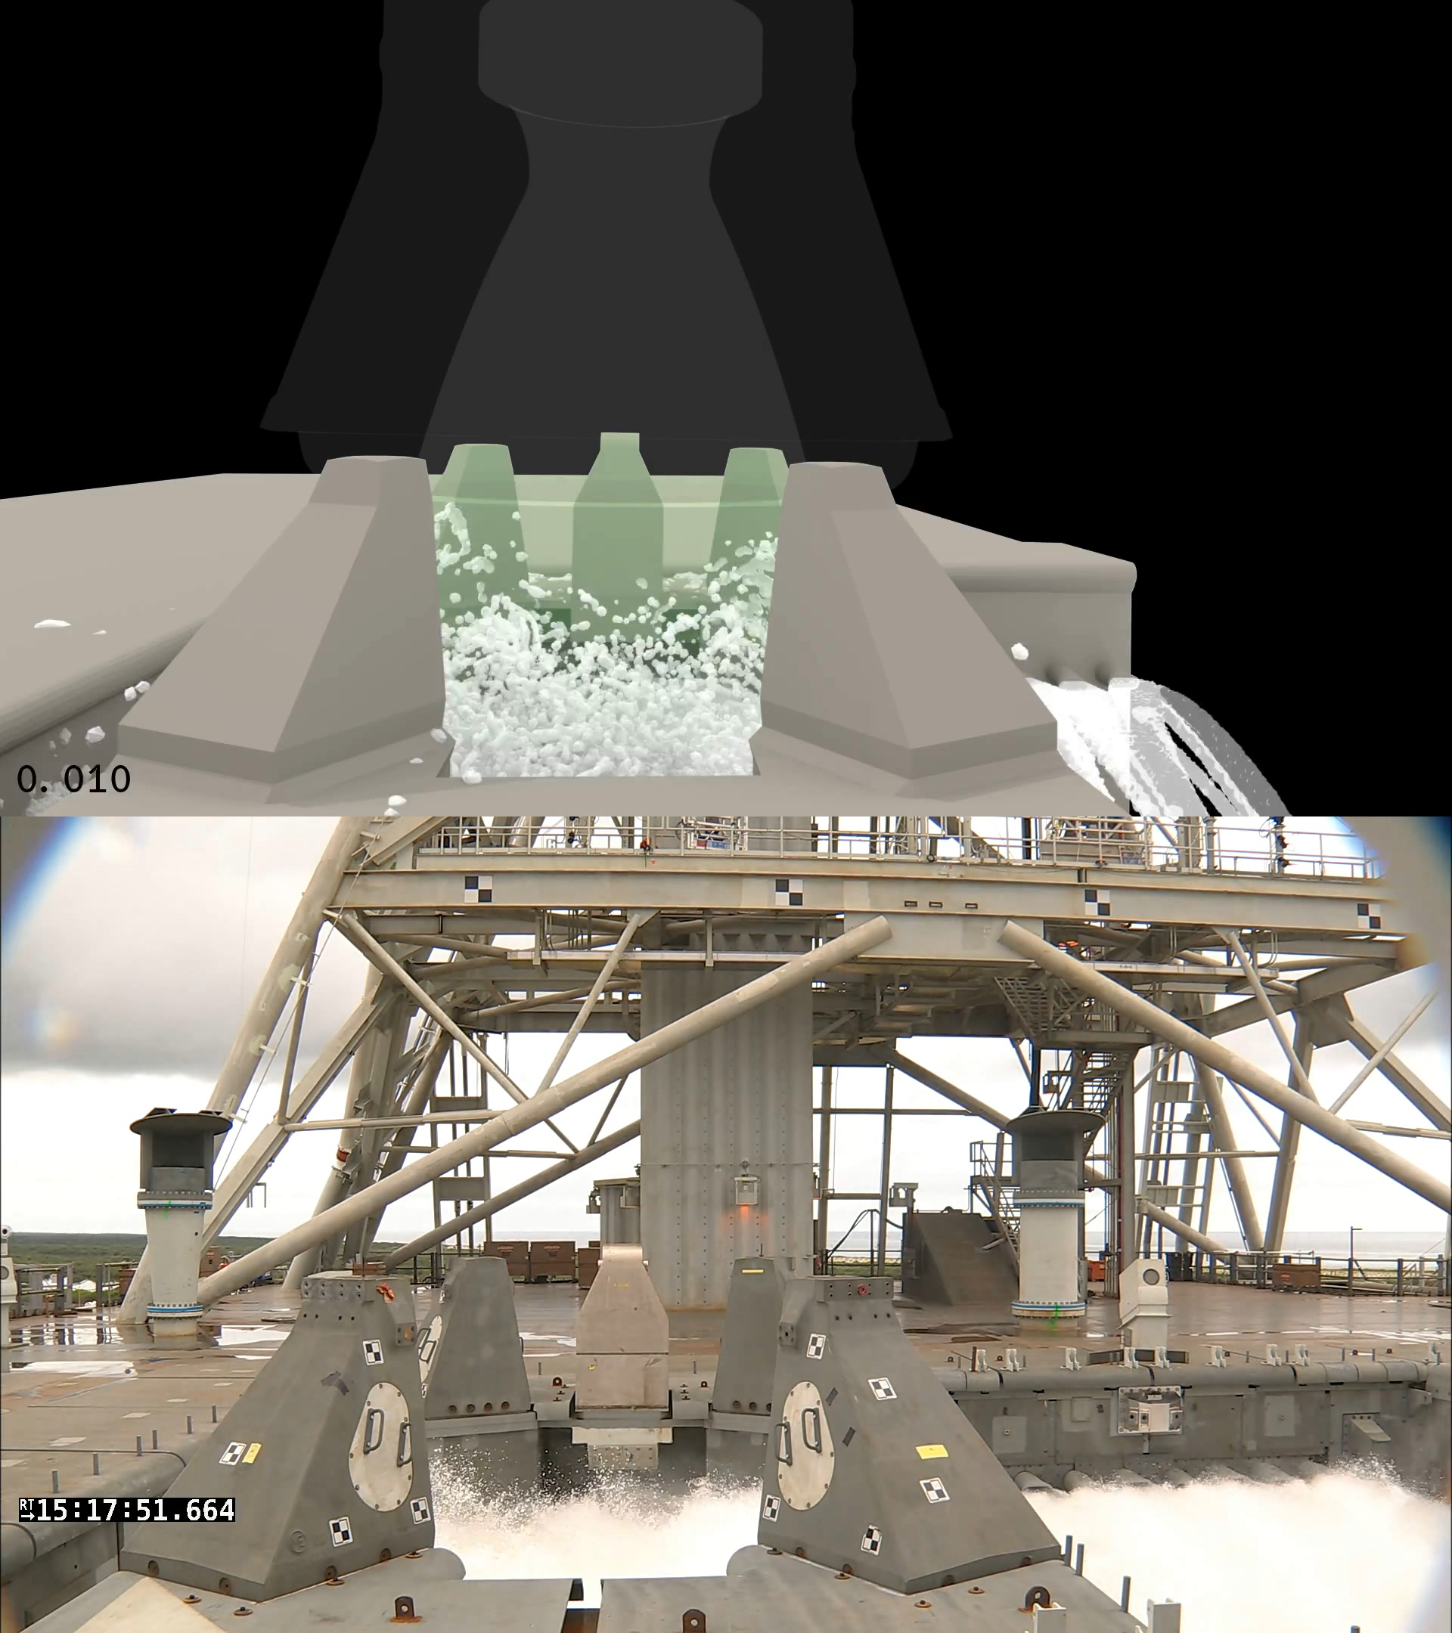
ISVV-14 Validation: View A-V3T
ISVV-14 camera view A-V3T reveals additional details
Again, the CFD simulation qualitatively captures many features seen in the test
  Splashes of water travel both left to right and right to left
  Splash timing and frequency is similar
  Some splashes are high enough to enter the SRB nozzle
The water system operation validation is considered successful
  Enables prediction of water near the SRB nozzle prior to liquid engine ignition

Slide 7
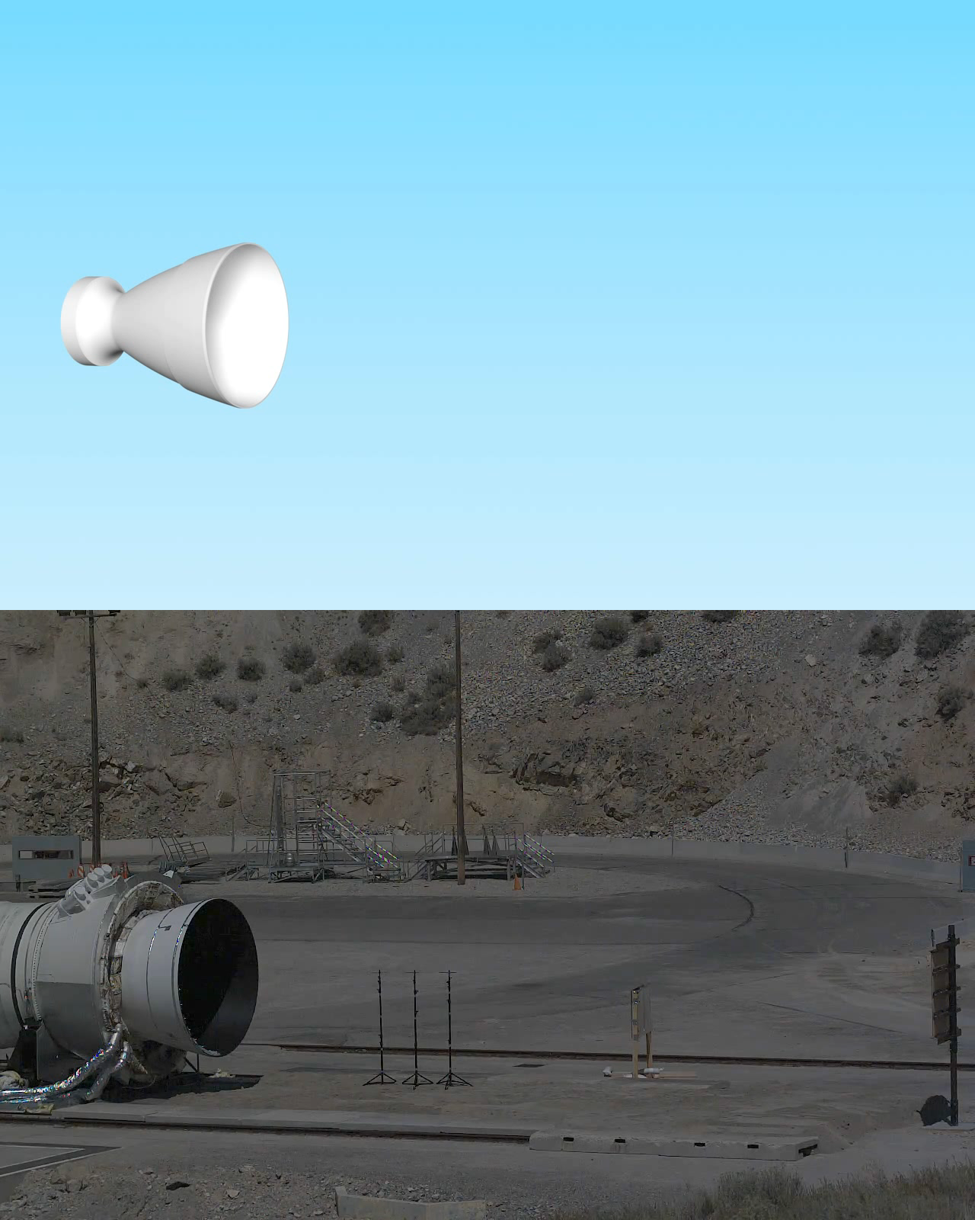
FSB-1 Side Load Validation: Qualitative
The FSB-1 static test fire placed water inside the nozzle prior to ignition
  This water resulted in large asymmetric side loads
The FSB-1 test was reproduced in the MSFC CFD simulation
The CFD qualitatively captures the same features as the test
  The plume initially passes the water with little effect
  As the plume fills the nozzle, the water evaporates
  The water vapor obscures the plume from the camera
  Eventually, the water is pushed out of the nozzle, revealing the plume once again
Qualitative validation of the water induced nozzle side load is considered successful

Slide 8
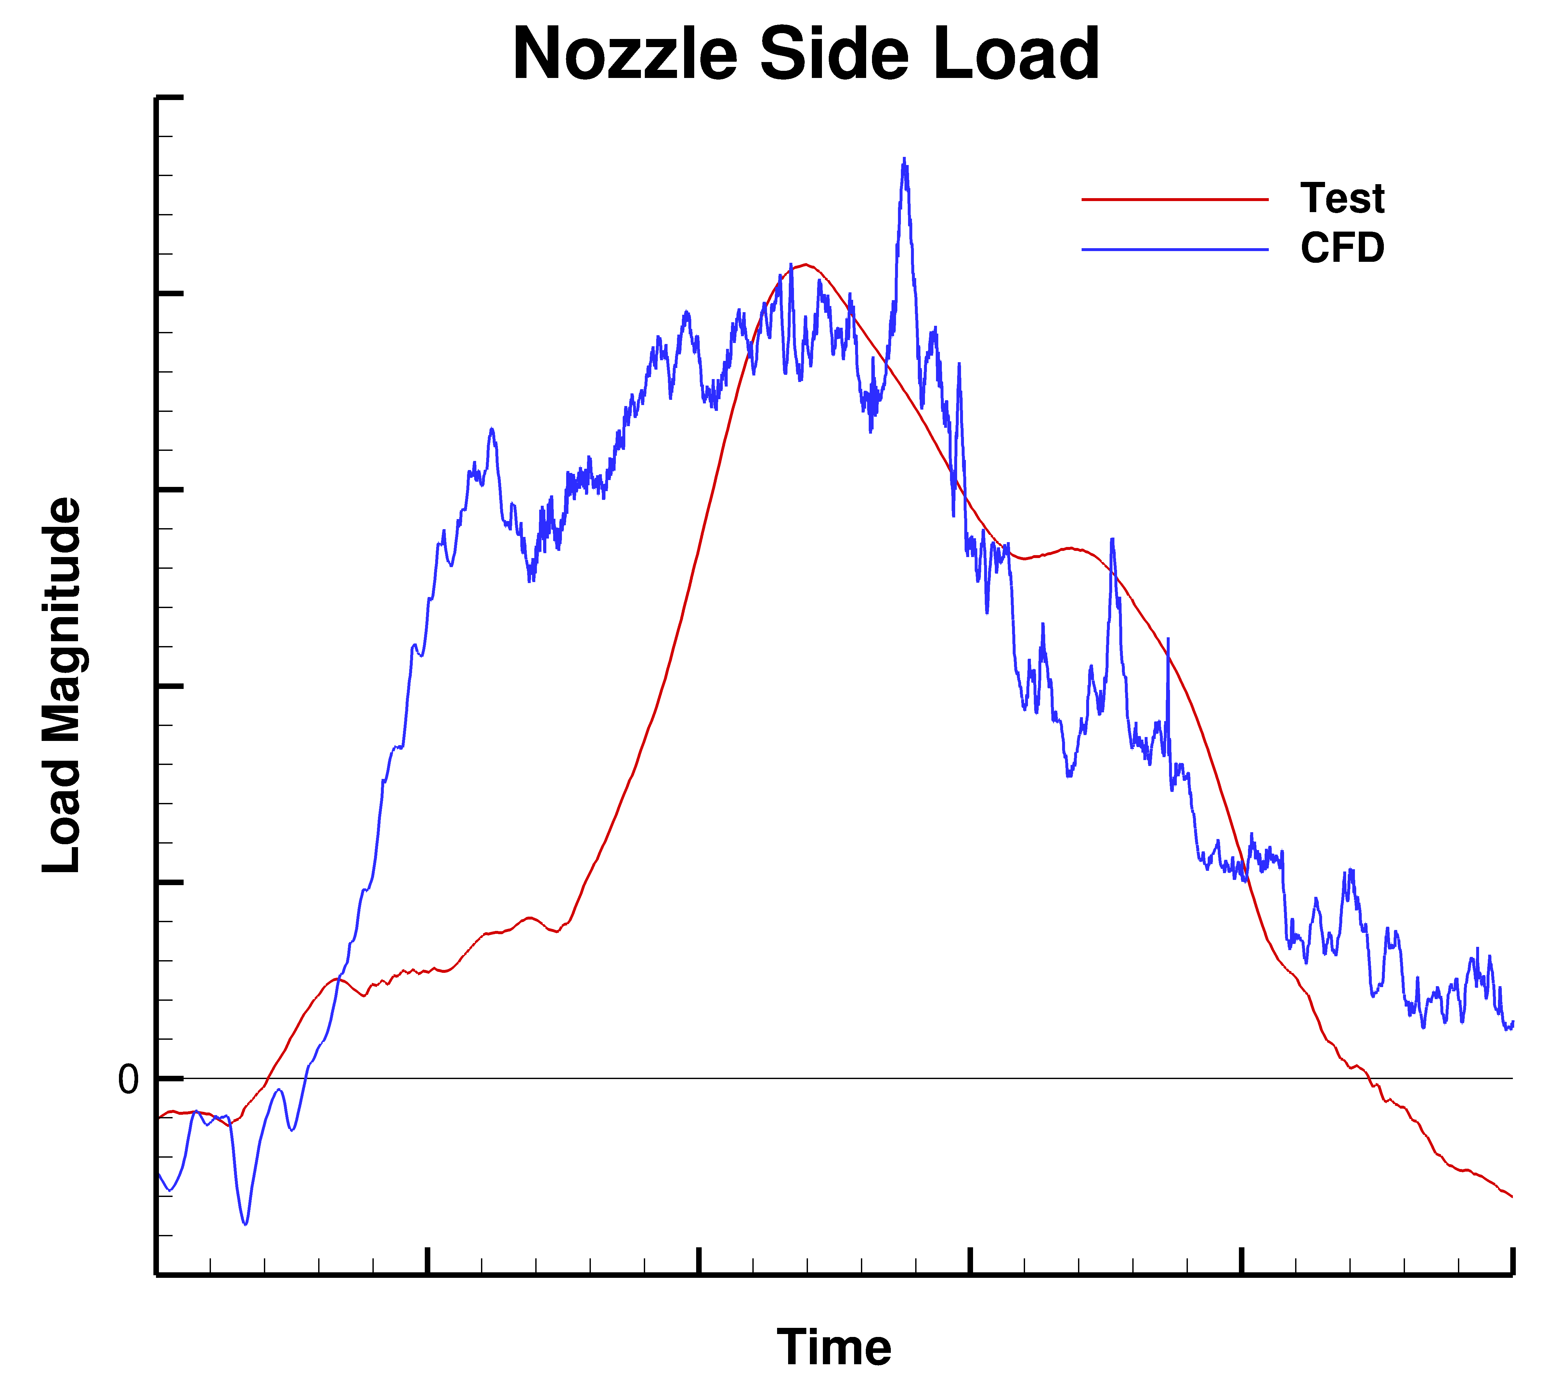
FSB-1 Side Load Validation: Quantitative
Provided is a comparison of the CFD predicted nozzle side load to the test stand measurement
The CFD predicted load compares excellently to the test data
  Timing and peak magnitude of the load is very similar
  Some timing discrepancies are attributed to the structural response of test stand
  Both the CFD and test agree that as the water is evacuated from the nozzle, the load drops

Slide 9
Conclusions and Forward Work
First of their kind validation simulations of the SLS water system and water induced SRB side loads were successfully completed
  These cutting-edge simulations push the boundaries of CFD modeling capabilities
  NASA MSFC now has the capability to predict large scale water system operation and plume-water interaction induced side loads with confidence
Future simulations will focus on including increasing fidelity into the CFD simulations
  First, additional SRB simulations can be conducted with varying water quantities and locations to obtain a sensitivity of side load response
  Next, simulations can be conducted to judge the effect the SLS liquid core stage engines have on the water near the SRB nozzle
  Lastly, all-inclusive simulations of the SLS launch, including the water system, liquid engine plumes, then SRB ignition, will provide a deep understanding of the launch environment
These future simulations can then be compared to the data collected during the Artemis I launch
  This will provide valuable decision-making insight for the first manned SLS flight, Artemis II

