Slide 1
Power and Energy Technology for Lunar Surface Infrastructure
CLB.PNL-49: Infrastructure to Stay – Moon
AIAA ASCEND
16 November 2021

Slide 2
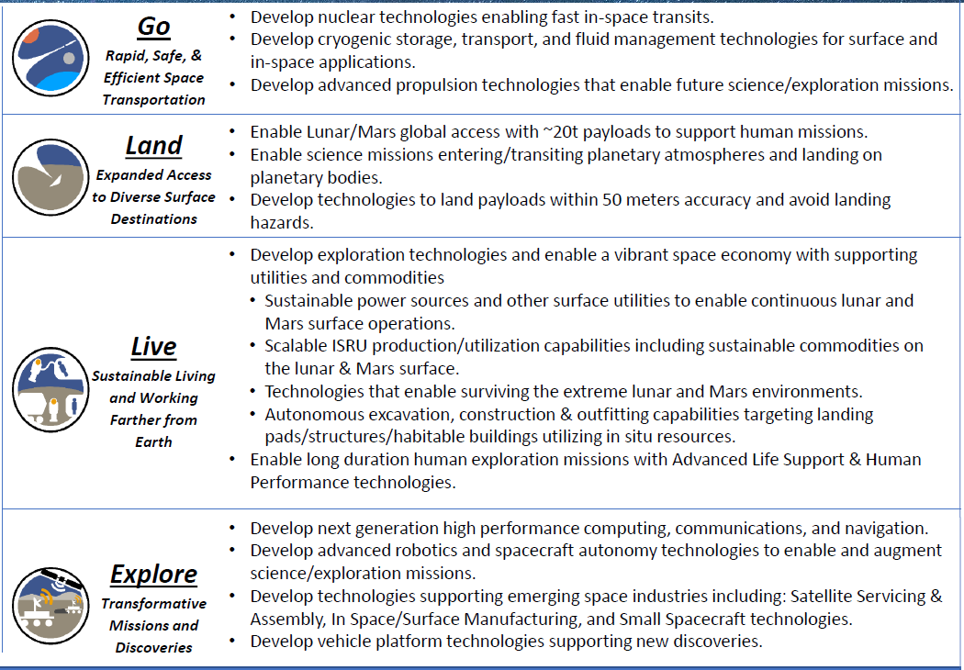
NASA SpaceTech Strategic Thrusts/Outcomes
CLB.PNL-49: 16 November 2021

Slide 3
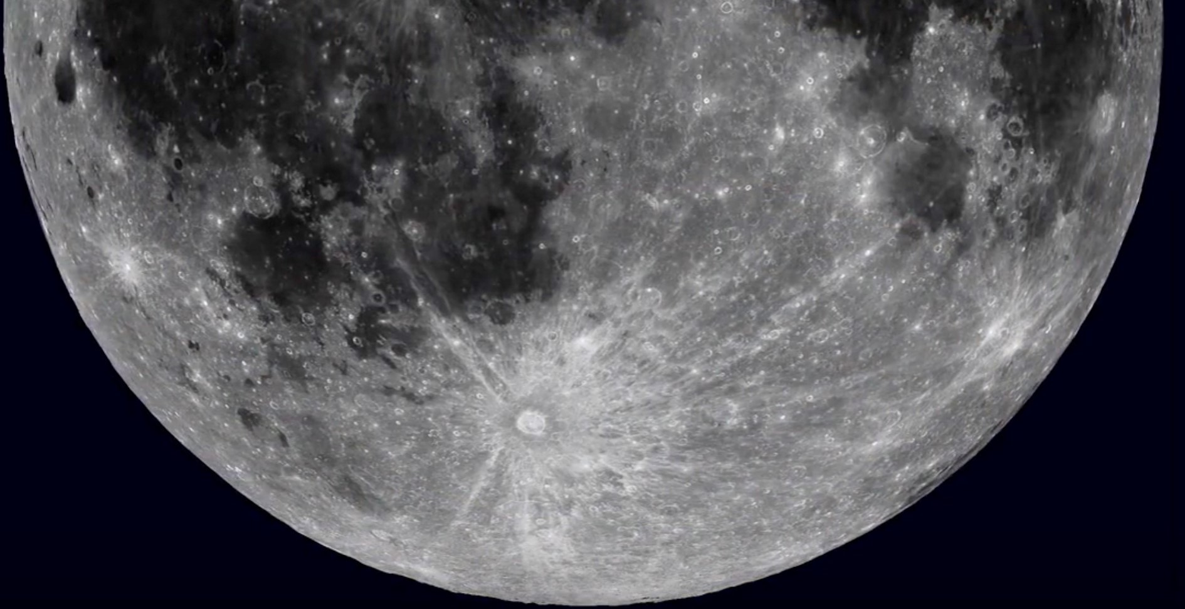
POWER
The key commodity needed to exploit the Lunar Surface
Equatorial Illumination Limits
Cyclical periods of 14 days illuminated, 14 days dark
Consistent
Polar Illumination Limits
Intermittent with up to 100 hours darkness
Highly dependent on location/elevation
Illumination
The scarce resource needed to produce power
CLB.PNL-49: 16 November 2021

Slide 4
Power demand will increase as surface exploitation grows from initial Artemis installations at the South Pole to intensive industrial and settlement development across the Lunar surface
Lower Latitude power technology (2040+?)
Earth-sourced generation assets “bootstrap” production of generation and storage assets from regolith
Up to GW_{e} demand as science exploration and industrial/settlement activities expand
Ultimate Artemis Polar power technology (2030+):
ISRU for O₂/H₂ is primary demand driver
  Crewed outpost
  Science exploration “survive the night”
Up to multi-MW_{e} demand
CLB.PNL-49: 16 November 2021

Slide 5
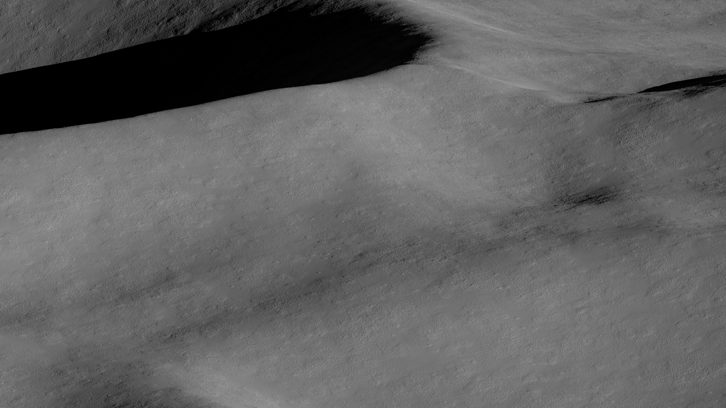
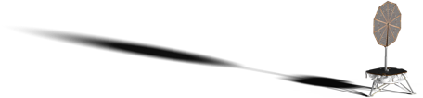
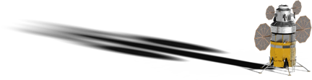
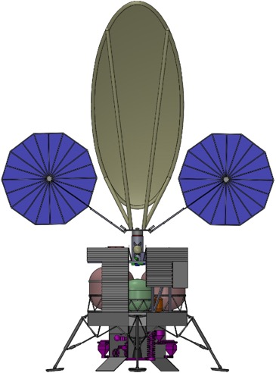
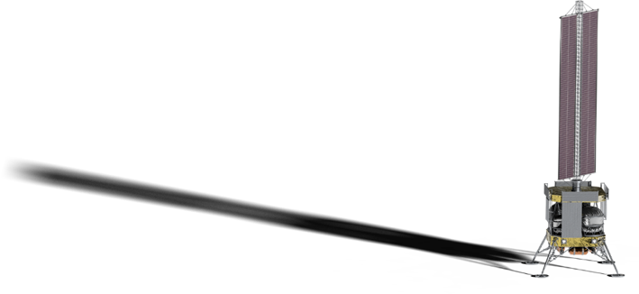
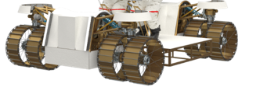

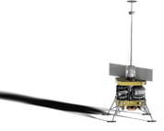
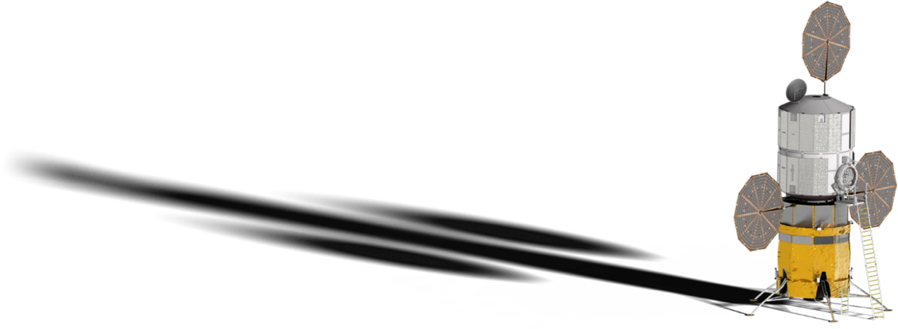
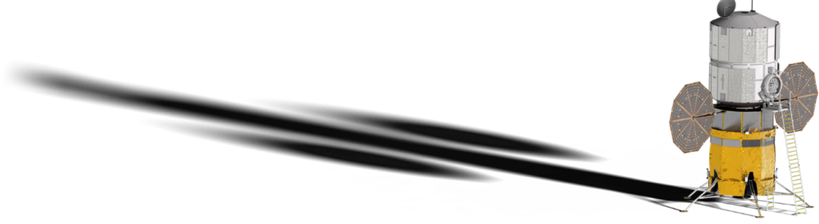
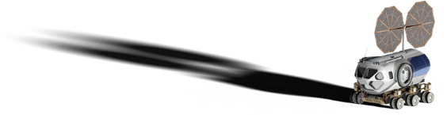
Building Block Power Technology Options for Artemis South Pole “Base Camp” (2030+)
Human Landing System
Generation: 500 W_{e} radioisotope power
H₂/O₂-Ice in PSR
O₂-Regolith ISRU
Add 3 charts on site to show where solar arrays are
Add zoom for the fsp to base connection
Storage: 50 kWh battery modules w/150 Wh/kg at 1 kW discharge over 500 cycles at 235 K
Distribution & Management : Rad-hard power electronic circuits with 99% reliability over 10 years exposure
Lunar Terrain Vehicle
Generation: 40 kW_{e} mobile fission power plant
Generation: 50 kW_{e} increment PV arrays (vertical or horizontal/reflector, > 200 V, > 200 W_{e}/kg BOL, < 10 % degradation over 10 years
Foundation Surface
Habitat
Distribution: Cables & Spools @ 10 kW_{e} scale and 1000V with < 3% loss per km.
Storage: 1 MWh increment RFC @ 10 kWe discharge with 50,000 hr/500 cycle durability
Lab
Distribution: Power Beaming @ 10 kW_{e} scale < 80% loss over 5 km.
Human Mobility
Platform
CLB.PNL-49: 16 November 2021
5

Slide 6
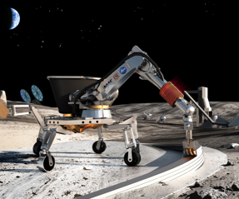
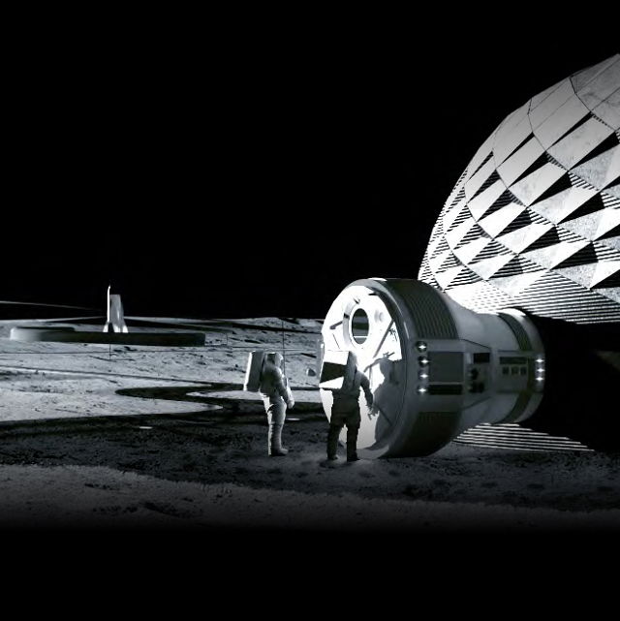
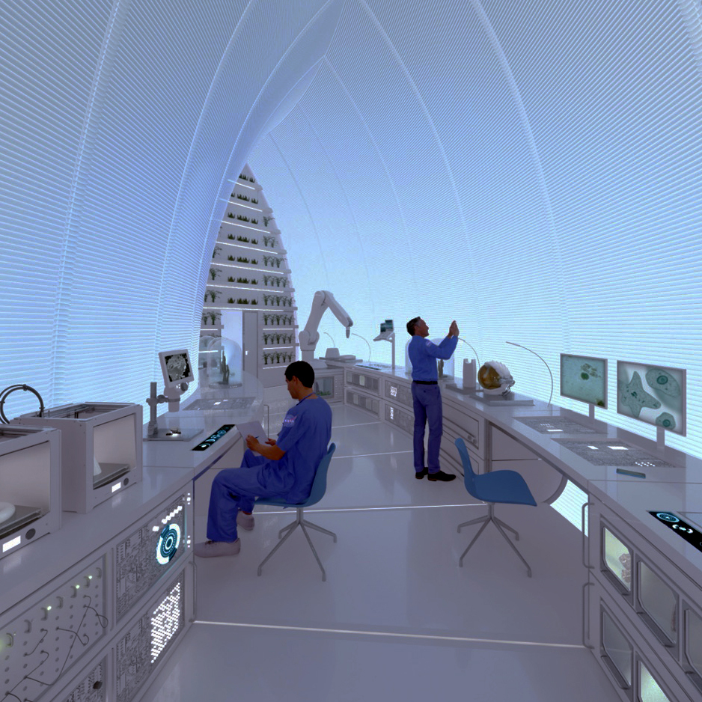
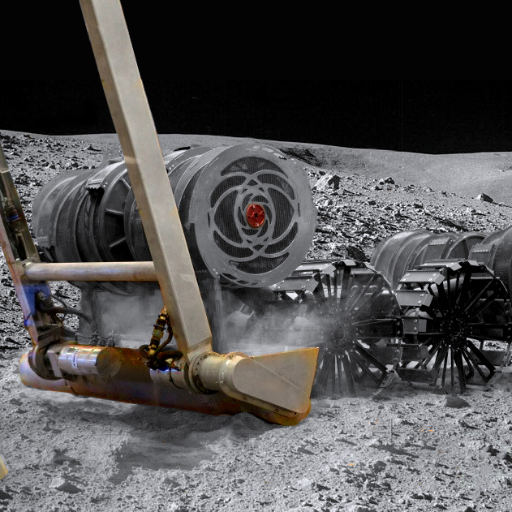
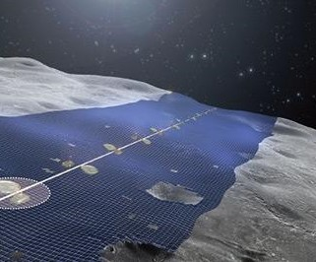
Polar Building Block Power Technologies Can Bootstrap Generation, Storage and Distribution at Lower Latitudes (2040+)
Generation: 50 kW_{e} increment PV arrays (vertical or horizontal/reflector, > 200 V, > 200 W_{e}/kg BOL, < 10 % degradation over 10 years
Distribution: Cables & Spools @ 10 kW_{e} scale and 1000V with < 3% loss per km.
Add 3 charts on site to show where solar arrays are
Add zoom for the fsp to base connection
Distribution: Power Beaming @ 10 kW_{e} scale < 80% loss over 5 km.
Generation: 500 W_{e} radioisotope power
Storage: 50 kWh battery modules w/150 Wh/kg at 1 kW discharge over 500 cycles at 235 K
Distribution & Management : Rad-hard power electronic circuits with 99% reliability over 10 years exposure
Storage: 1 MWh increment RFC @ 10 kWe discharge with 50,000 hr/500 cycle durability
Generation: 40 kW_{e} mobile fission power plant
  Landing pads and protective structures
  100’s to 1000’s metric tons of regolith-based feedstock for construction projects
  10’s to 100’s metric tons of metals, plastics, and binders
Mobile Fission Power drives equipment to print photovoltaic generation, electrochemical, storage, and thermal storage from regolith
Lunar Terrain Vehicle
Human Landing System
Surface
Habitat
Human Mobility
Platform
Lab
CLB.PNL-49: 16 November 2021
6

Slide 7
Power demand will increase as surface exploitation grows from initial Artemis installations at the South Pole to intensive industrial and settlement development across the Lunar surface
Ultimate Global Exploitation
Initial Polar Region Exploitation
CLB.PNL-49: 16 November 2021

Slide 8
Path Forward
The immediate focus is on advancing TRL for power system components brought from Earth, defining the performance which surface system architects can assume when designing sustainable exploitation systems for the Moon and Mars.
  The future priority should be advancing the technology to manufacture power system components from in-situ Lunar resources. Such production bootstrapped with power systems brought from Earth.
CLB.PNL-49: 16 November 2021

Slide 9
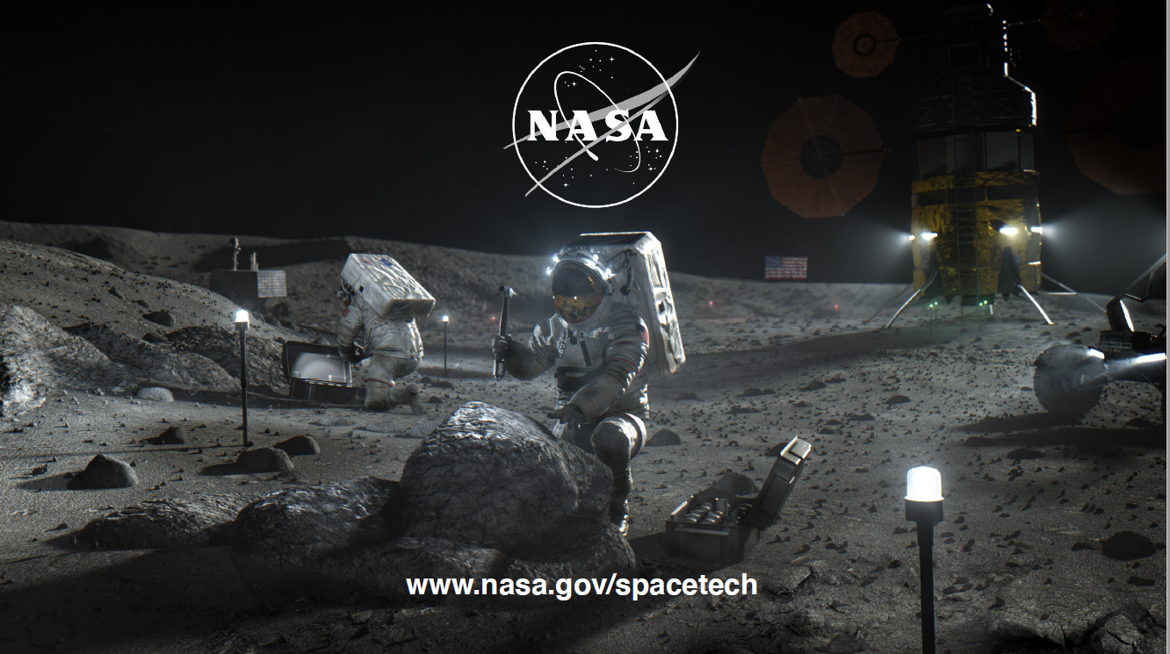
CLB.PNL-49: 16 November 2021

