Slide 1
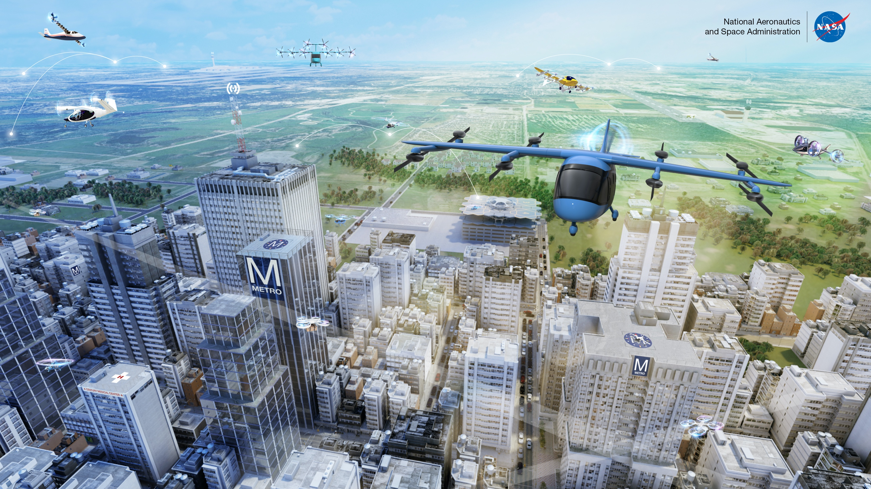
REVOLUTIONARY VERTICAL LIFT TECHNOLOGY (RVLT) PROJECT
Project Manager: Susan Gorton
Deputy PM: John Koudelka
Associate PMs: Dr. Noah Schiller (Technical Challenge Integration)
Carl Russell (Partnerships)
Dr. Eric Kreeger (Special Topics)
Dr. Gloria K. Yamauchi (Sr. Technical Advisor)
November 18, 2021

Slide 2
Outline
NASA Aeronautics Strategic Thrusts and Organization
Advanced Air Mobility Mission and Urban Air Mobility
Revolutionary Vertical Lift Technology (RVLT) Project
  Vision
  Major research areas, resources, facilities
  Focus for FY21-22
RVLT Technical Team

Slide 3

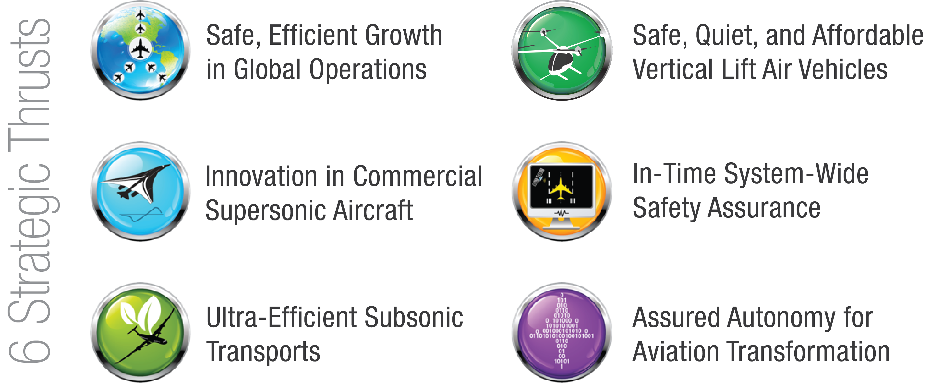
NASA Aeronautics – Vision for Aviation in the 21st Century
ARMD continues
to evolve and
execute the
Aeronautics Strategy
https://www.nasa.gov/aeroresearch/strategy
U.S. leadership for a new era of flight
Notes:
Three primary drivers continue to shape the global aviation industry –
We are facing global challenges – the aviation industry is global in scope and impact, and demand for mobility will continue to grow
The aviation system must be sustainable and safe
Aviation continues to transform our economy and society through innovation, leveraging convergent technologies inside and outside the aviation sector
NASA plays a critical role in leading the transformation of global aviation, with efforts focused in strategic thrusts

Slide 4
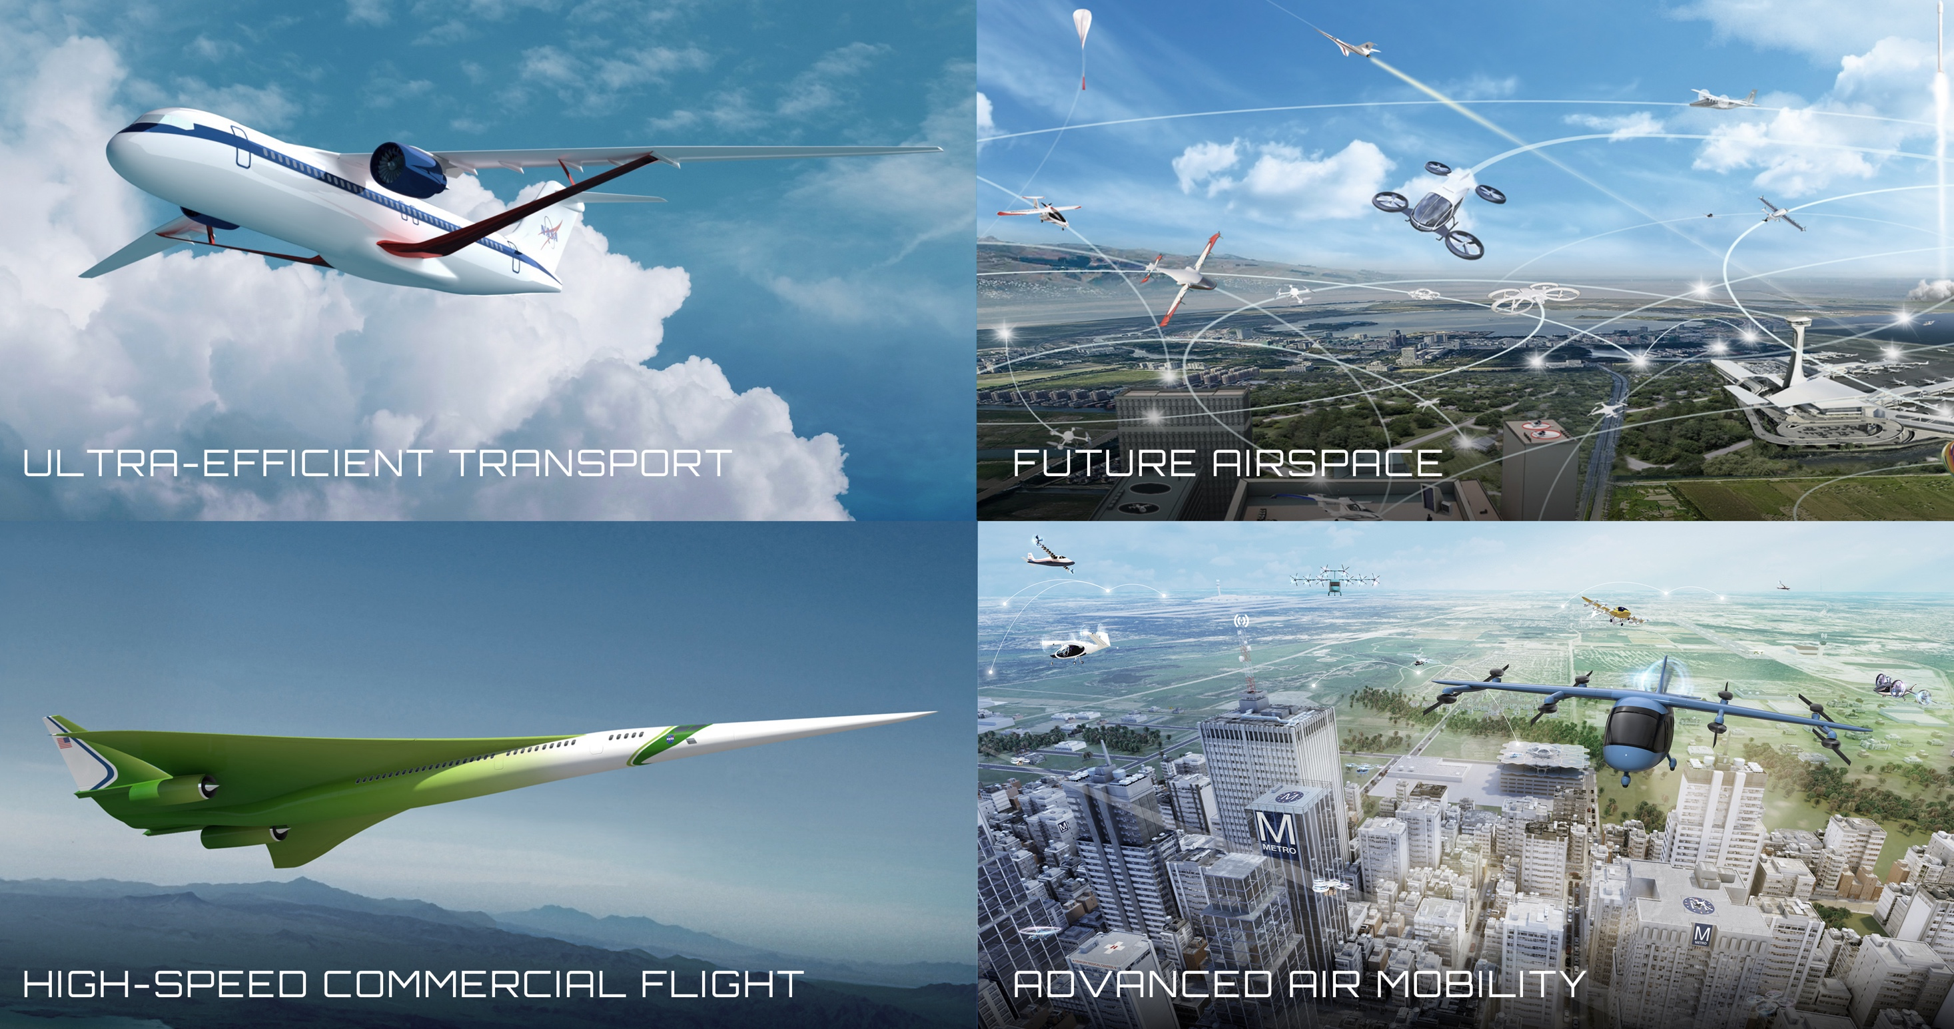


Four Transformations for Sustainability, Greater Mobility, and Economic Growth
Notes:
NASA is leading transformation of aviation in several ways:
Locally - through Advanced Air Mobility, Unmanned Aircraft Systems, and use of electric Vertical Takeoff and Landing – we are transforming the way people and goods move through aviation. We’re rallying emerging markets to tackle the challenges of creating an air transportation system featuring all-electric, autonomous, efficient and safe systems operating over the most rural countryside to the densest, skyscraper-filled urban environment.
Across the nation – we are enabling transformative improvements in the efficiency of commercial aviation, with particular focus on the single aisle fleet – Boeing 737 size – through developing and demonstrating integrated electric propulsion in small to large aircraft, advanced materials, advanced propulsion systems, and new ways to design and build aircraft.
Globally – we are sustainably connecting the world through high-speed commercial flight. We are removing barriers to commercial supersonic flight over land by proving that we can get rid of the sonic boom, tackling the next challenges in local noise and emissions, and investigating the potential of even higher speed flight.
System wide – we are transforming the efficiency and safety of the entire global aviation system through future airspace tools and system design that supports all of these users
Right now we’re creating the DNA of an aviation system that is transformed. NASA explores technologies that reduce aircraft noise and fuel use, get you gate-to-gate safely and on time, and transform aviation into an economic engine at all altitudes.
Each of these transformations is taking place grounded in a mindset of sustainability, enabling global mobility and economic growth.
In the emerging markets, environmental sustainability will be a key constraint in the development of low boom supersonic aircraft and short range, electrified vertical take-off and landing (eVTOL) aircraft for Advanced Air Mobility missions.
And we’re creating the fundamental building blocks of knowledge and capability to enable these transformations.

Slide 5



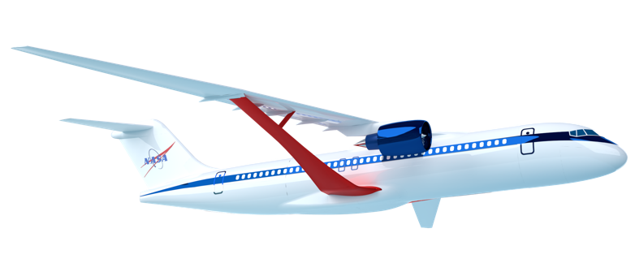
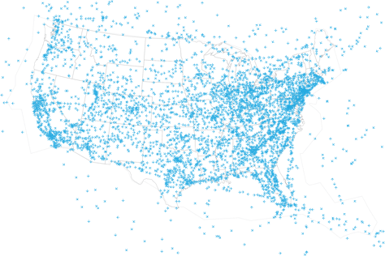

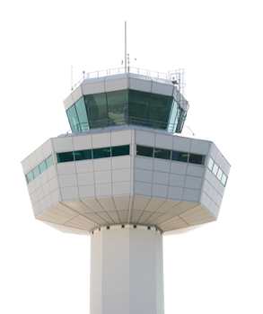
Aviation Industry Pillars for a Sustainable Future
Global Aviation Industry’s GOAL: 50% reduction in carbon emissions by 2050 relative to 2005 and possible net zero emissions by 2060 through these three means
NASA = Primary Role
NASA = Supporting Role
NASA = Primary Role
www.nasa.gov |
5
Notes:
The global aviation community has established the aggressive goals of a 50% reduction in carbon emissions by 2050, and possible net zero emissions by 2060 through these three means - what we fly, how we fly, and the fuels we use to fly. This 50% reduction from 2005 levels is a very aggressive goal, because fleet growth outpaced fleet efficiency improvements since 2005. Even though the operational fleet has become 2% more efficient each year, the total amount of carbon emitted annually in 2018 (912 Mt) is 40% higher than it was in 2005 due to overall traffic growth.
These aggressive goals for overall carbon emissions are focused today on commercial aviation, as that is the predominant form of aviation today. As new aviation sectors develop and flourish, they must do their part to contribute to the sustainability of aviation – they have to be green from the outset.
NASA’s primary contribution and largest investment is in R&D of technologies for low emissions and low noise aircraft.
NASA plays a primary role with significant investment in R&D of operational concepts and technologies deployed by the FAA and on aircraft flight decks. NASA does not have research related to airport infrastructure.
NASA plays a supporting role in characterizing the environmental impact of sustainable aviation fuels, and possibly via use in NASA flight research operations.
The aviation community also has stated a role for market based measures such as carbon offsets, where NASA has no role to play.

Slide 6

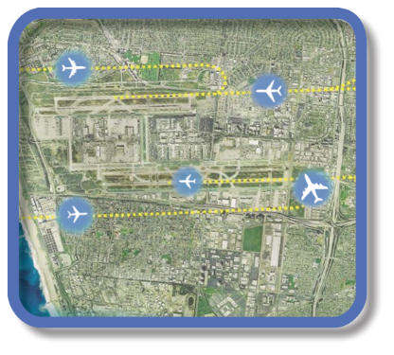

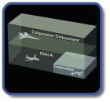


Evolution of Airspace Operations and Safety
+ Complexity, scalability,
and dynamic adaptation
+ Service-oriented architecture for tailored missions-oriented services
+ Efficiency and proactive planning
S-curves
Highly-Automated
Collaborative
Trajectory
Digital Transformation of Air Traffic Management
Automated in-time safety monitoring and alerting services
Integrated predictive risk mitigation across domains
Automatically-assured adaptive
in-time safety management
(Today)
(~2035)
(~2045)
Notes:
NASA has developed the concepts and tools that have enabled dramatic improvements in operational efficiency of the national air transportation system.
NASA tools have enabled the shift to trajectory based operations, characterized by efficiency and proactive planning across the entire flight route and optimized fleet operations.
NASA is now enabling the next evolution of Airspace management to a collaborative model based on a service oriented architecture, and eventually a highly-automated system that seamlessly manages complexity, scalability, and dynamic adaptation of a diverse set of users.
Attributes of future system:
Scalable
Accessible to all
Integrated safety
Environmentally friendly
Robust and resilient

Slide 7
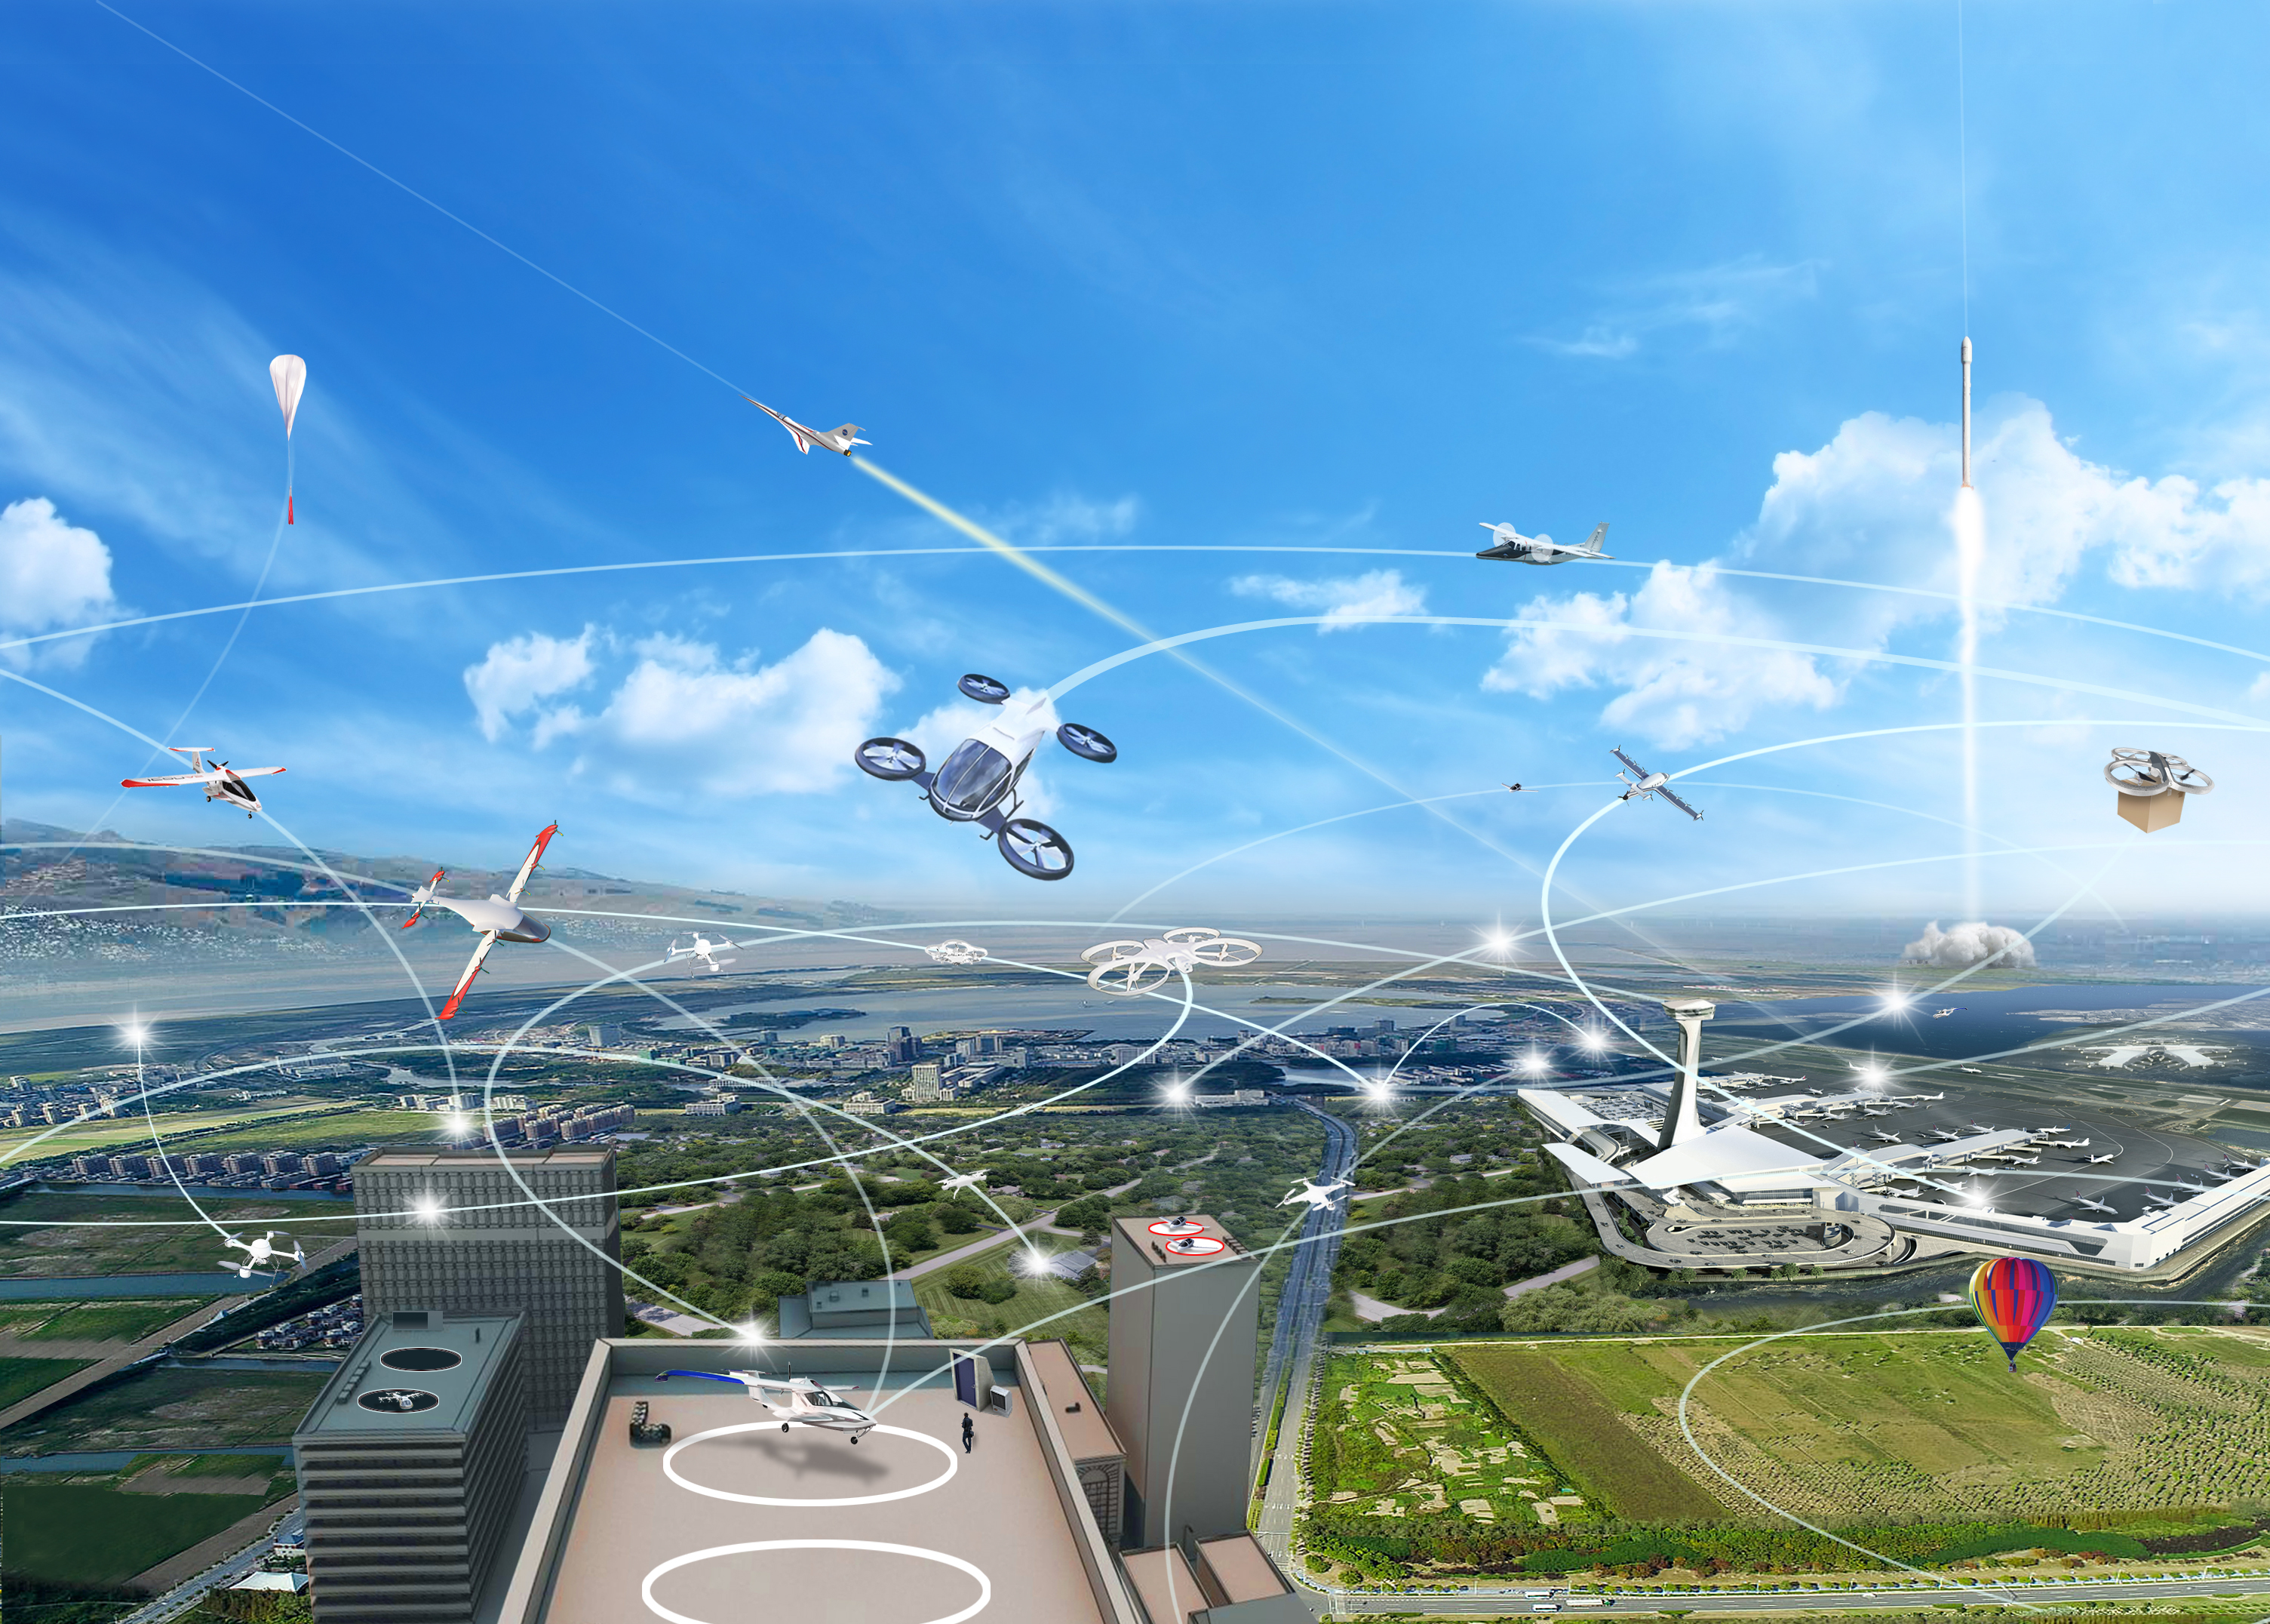
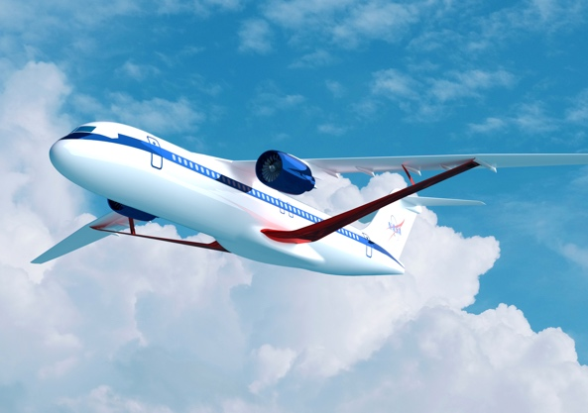
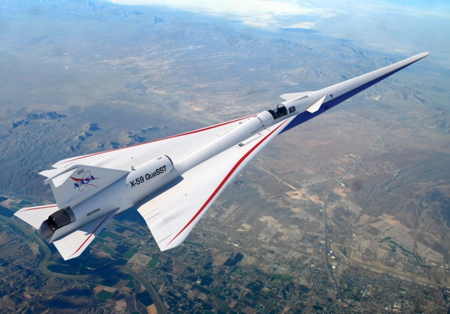












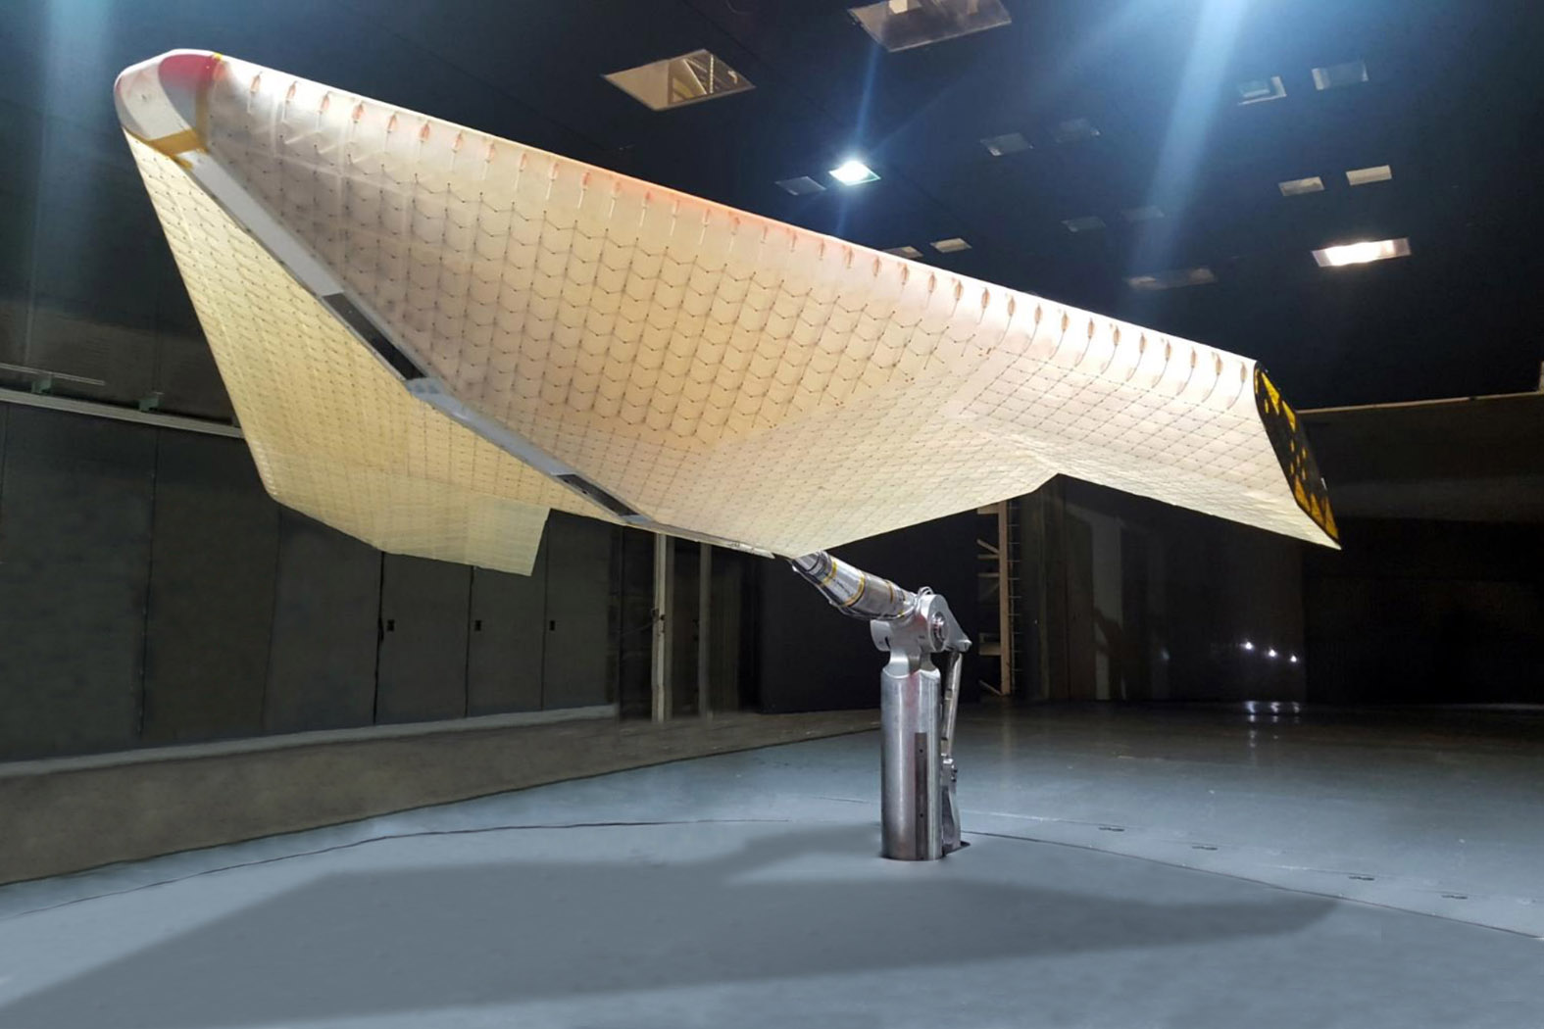
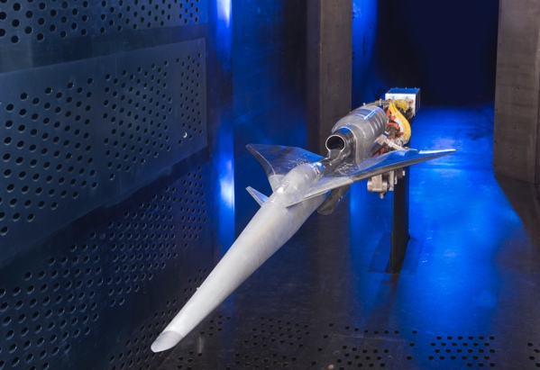









Airspace Operations and Safety Program
Advanced Air Vehicles
Program
Integrated Aviation Systems Program
Transformative Aeronautics Concepts Program
Aerosciences Evaluation and Test Capabilities Portfolio
ARMD PROGRAMS
Notes:
ARMD programs contribute to strategic thrusts
ARMD’s programs and projects are all cross center and cross discipline. We leverage the best people from across the NASA enterprise to enable us to be agile in our execution.
[elaborate]

Slide 8

NASA Aeronautics Research Mission Directorate
Aeronautics Research Mission Directorate
Airspace Operations and Safety Program
Aerosciences Evaluation & Test Capabilities Portfolio Office
Advanced Air Vehicles Program
Integrated Aviation Systems Program
Transformative Aeronautics Concepts Program
Advanced Air Transport Technology Project
Commercial Supersonic Technology Project
High-Rate Composite Aircraft Manufacturing
Hybrid Thermally Efficient Core Project
Hypersonic Technology Project
Revolutionary Vertical Lift Technology Project
More information about:
ARMD: https://www.nasa.gov/aeroresearch
ARMD Programs: https://www.nasa.gov/aeroresearch/programs
RVLT Project: https://www.nasa.gov/aeroresearch/programs/aavp/rvlt

Slide 9
RVLT FY22 Project Structure
Project Manager: Susan Gorton
Deputy PM: John Koudelka
Associate PM for Technical Challenge Integration: Noah Schiller
Associate PM for Partnerships: Carl Russell
Associate PM for Special Topics: Eric Kreeger
PROJECT
Senior Technical Advisor
Gloria Yamauchi
Project Liaison Interface to Centers
AFRC: Robert Navarro
ARC: Bob Kufeld / Gina Willink
GRC: Peggy Cornell
LaRC: Benny Lunsford
Business unit
Lead Analyst: Angela Williams
Center Analysts: Eric Lee, Meredith Irwin, April Jungers
Scheduler: Joyce Moran
SIP/ RVLT RESEARCH THEME
Clean and Efficient Propulsion
ModSim and Test Capability
Efficient and Quiet Vehicles
Safety, Comfort, Accessibility
eVTOL Propulsion Subproject
SPM: Peggy Cornell
SPTL Tim Krantz, Mark Valco, Linda Taylor
Design, Simulation and Validation Subproject
SPM: Bob Kufeld/ Gina Willink
SPTL Chris Silva, Brian Allan, Norm Schaeffler, Tom Norman
eVTOL Noise, Safety and Comfort Subproject
SPM: Benny Lunsford
SPTL Doug Boyd, Noah Schiller, Justin Littell, Eric Kreeger, Carlos Malpica
SUB-PROJECT
Electrical Power Systems
Conceptual Design
Source Noise and Community Response
Safety and Environment
ELEMENT
Electro-Mech Powertrain Systems
High-fidelity Modeling
Thermal Management and Materials
Validation Test Campaigns
National Campaign Acoustics
Ride Quality
TC.UAM.Electric.1 Reliable and Efficient Propulsion Components for UAM
TC.UAM.NOISE.1 Urban Air Mobility (UAM) Operational Fleet Noise Assessment
TECH CH
TC.UAM.NOISE.2 Tools to Explore the Noise and Performance of Multi-Rotor UAM Vehicles
Sept 2021

Slide 10









ARMD Six Strategic Thrusts and Community Visions
Safe, Efficient Growth in Global Operations
Achieve safe, scalable, routine, high-tempo airspace access for all users
Innovation in Commercial Supersonic Aircraft
Achieve practical, affordable commercial supersonic air transport
Ultra-Efficient Subsonic Transports
Realize revolutionary improvements in economics and environmental performance for subsonic transports with opportunities to transition to alternative propulsion and energy
Safe, Quiet, and Affordable Vertical Lift Air Vehicles
Realize extensive use of vertical lift vehicles for transportation and services including new missions and markets
In-Time System-Wide Safety Assurance
Predict, detect and mitigate emerging safety risks throughout aviation systems and operations
Assured Autonomy for Aviation Transformation
Safely implement autonomy in aviation applications
RVLT targets
Strategic Thrust 4
Strategic Implementation Plan (released 2020) at: https://www.nasa.gov/aeroresearch/strategy
National Academies Study (2020) at: https://www.nap.edu/catalog/25646/advancing-aerial-mobility-a-national-blueprint

Slide 11
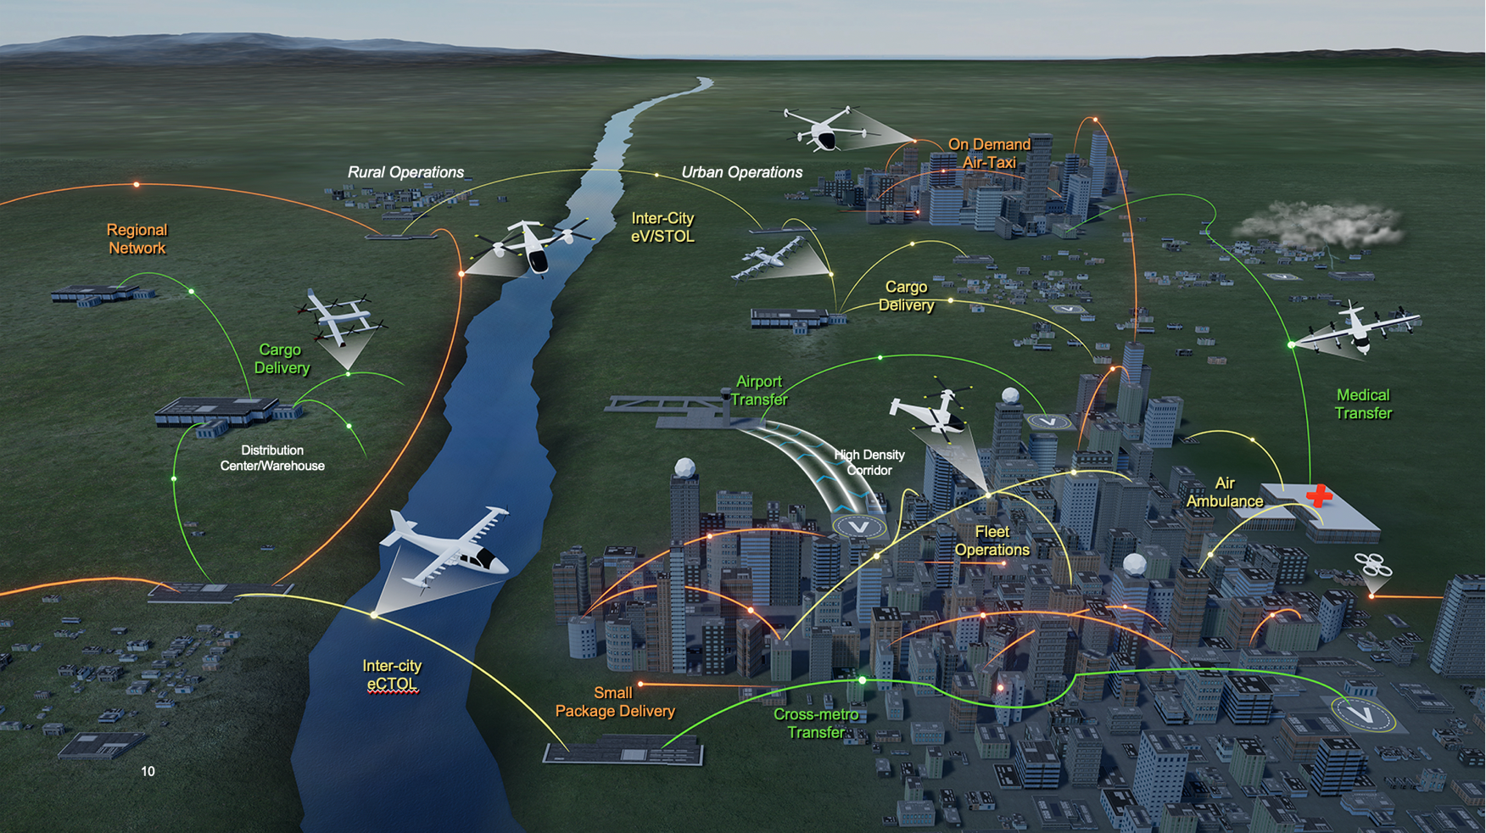
Advanced Air Mobility and Urban Air Mobility
NASA Focus is on Advanced Air Mobility (AAM) Missions
  AAM missions characterized by
  < 500 nm range
  Vehicles require increased automation and are likely electric or hybrid-electric
  Rural and urban operations are included
  Missions can be public transportation, cargo delivery, air taxi, or emergency response
  Urban Air Mobility (UAM) is a subset of AAM and is a segment that is projected to have high economic benefit and be the most difficult to develop
    UAM requires an advanced urban-capable vehicle
    UAM requires an airspace system to handle high-density operations
RVLT is one of the seven projects that support the AAM Mission
https://www.nasa.gov/aam-studies-reports/

Slide 12
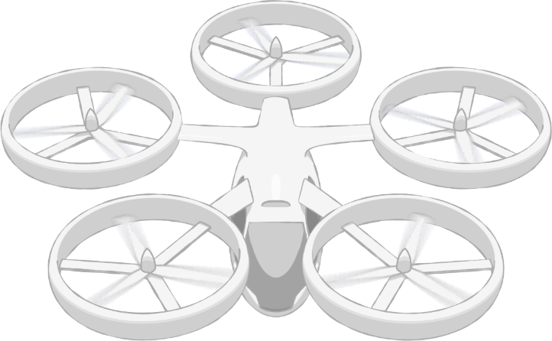
NASA Advanced Air Mobility (AAM) Mission Priorities
Human Response to Noise
Regional M&S Capabilities, & Supply Chain
Community Integration
xTM Architectures
Operational Rules, Roles, & Procedures
Comm, Nav, Surveillance, Information
UAM Supplemental Data Services
In-time Aviation Safety Management System
Community Integration
Airspace System Design & Implementation
Airspace & Fleet Operations Management
Vehicle
Development & Production
Individual Vehicle Management & Operations
Source and Fleet Noise
Vehicle Propulsion Reliability
Environmental and Failure conditions
Distributed Electric Propulsion
Automated Flight and Contingency Management
m:N, Pilots to Operators
Assured Automated Architectures
High Density Vertiplex
National Campaign
Aircraft & Aircrew Barriers
Airspace Barriers
Community Integration Barriers
www.nasa.gov |
12
Systems and Architecture Requirements

Slide 13
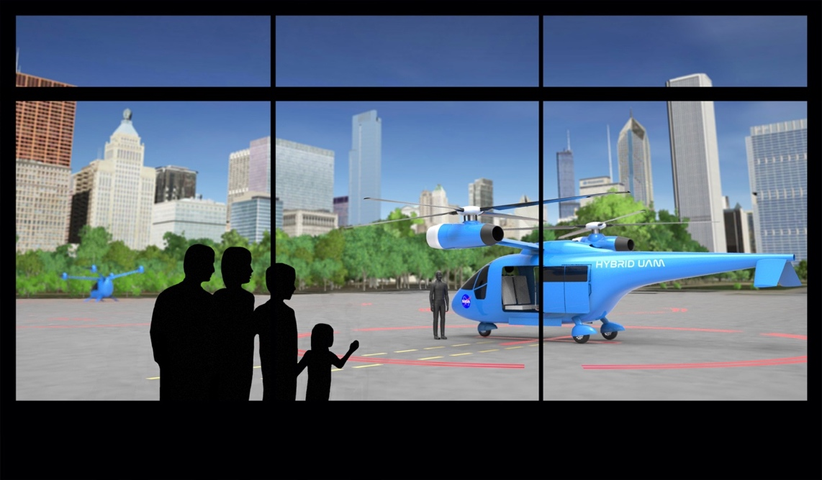
Revolutionary Vertical Lift Technology Project
  Develop and Validate Tools, Technologies and Concepts to Overcome Key Barriers for Vertical Lift Vehicles
  Vision
Our vision is to create a future where VTOL configurations operate quietly, safely, efficiently, affordably, and routinely as an integral part of everyday life.
  Scope
Technologies that address noise, safety, environment, and efficiency
Non-conventional light and medium vertical lift configurations

Slide 14
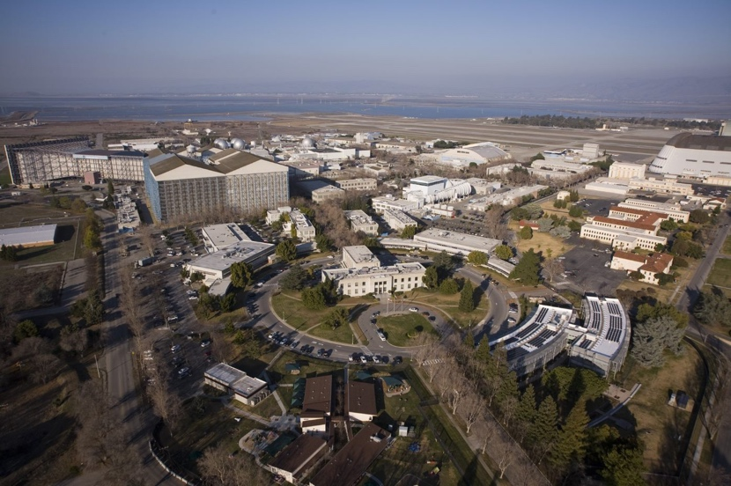
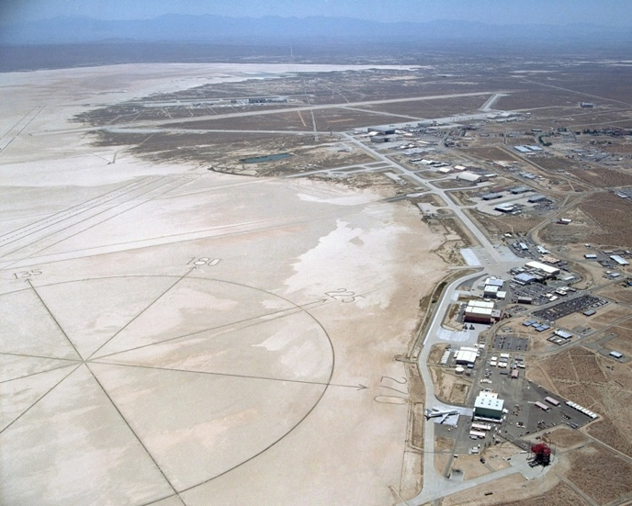
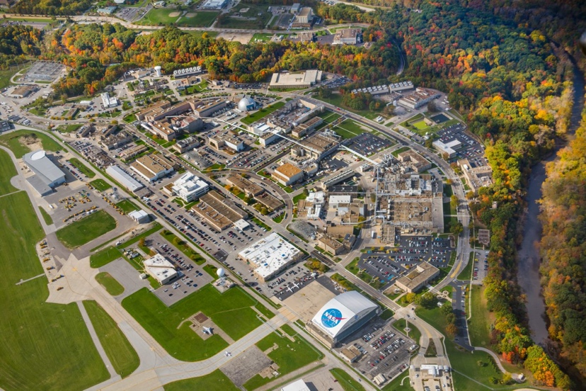
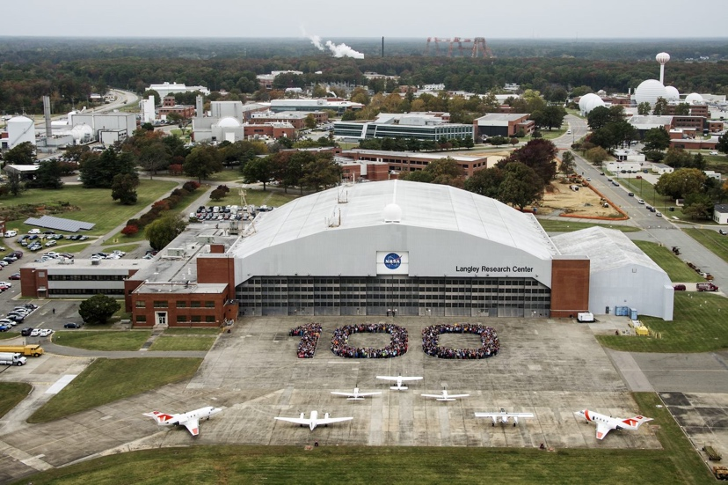
RVLT Project Research Areas, FY21-22
Ames Research Center
Aeromechanics
System Analysis
Computational Methods
Experimental Capability
Flt Dyn & Ctrl
Acoustics
Armstrong Flight
Research Center
eVTOL Handling Quality and
Ride Quality
eVTOL System Integration
and Analysis
Glenn Research Center
Hybrid/ Electric Systems
Electro-Mech Powertrains
Icing
System Analysis
Impact Dynamics
Acoustics
Langley Research Center
Acoustics
Computational Methods
Impact Dynamics
Aeromechanics
Experimental Capability
System Analysis
14

Slide 15
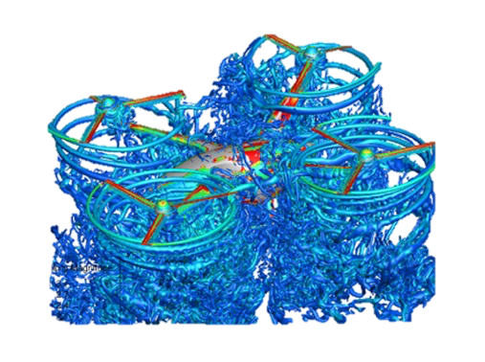

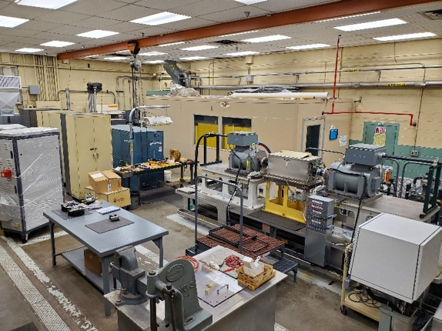
Resources and Facilities
FY21/FY22 RVLT Summary
~91/102 Civil Service
Workforce
~ $31M/36M per year
(includes salary)
Ames Research Center
Armstrong Flight
Research Center
National Full-Scale Aerodynamics Complex (NFAC)
Supercomputing Complex (NAS)
Simulators
Test Hardware
Vertical Motion Simulator
Glenn Research Center
Langley Research Center
Power, Motor and Transmission Test Facilities (ERB)
Icing Research Tunnel
14- by 22-Foot Subsonic Tunnel
Transonic Dynamics Tunnel
Landing and Impact Research
Mobile Acoustic Facility
Low-Speed Aero-acoustic Wind Tunnel
Exterior Effects Synthesis & Sim Lab

Slide 16

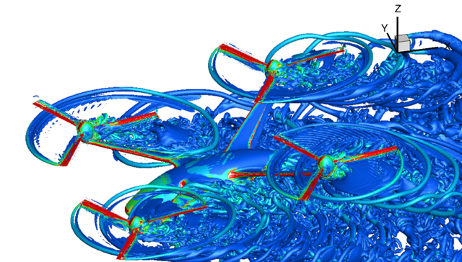
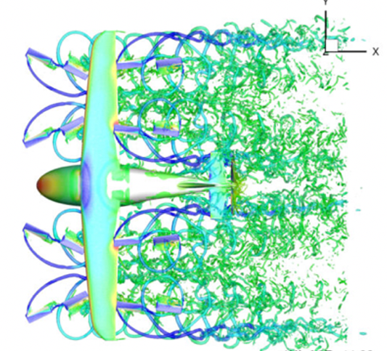
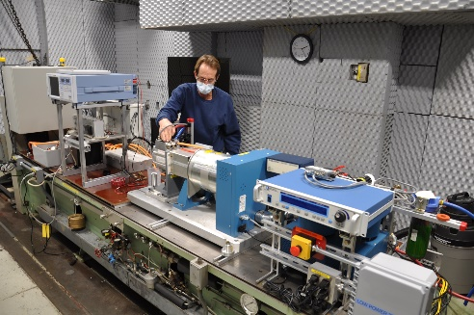
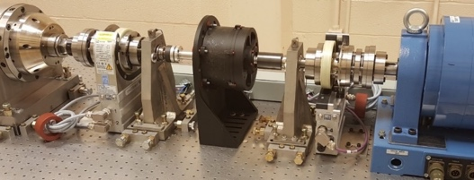
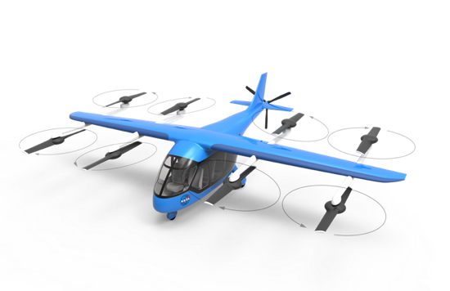
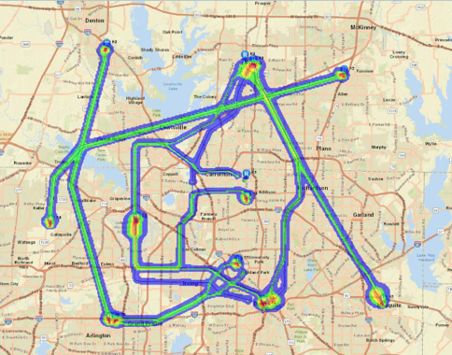
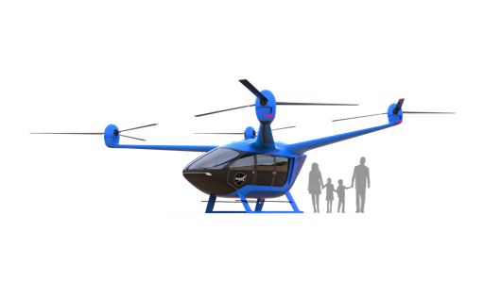
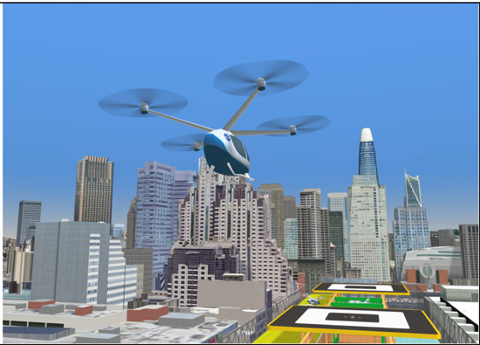
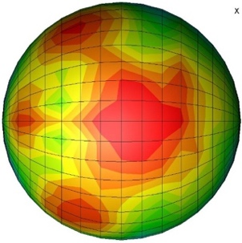
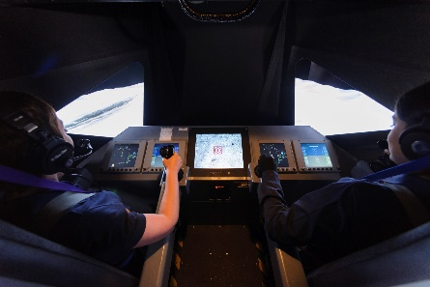
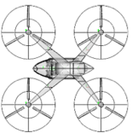
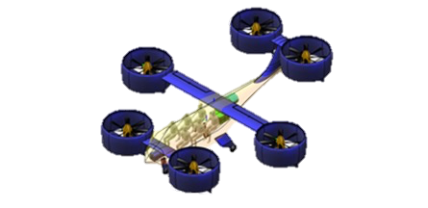
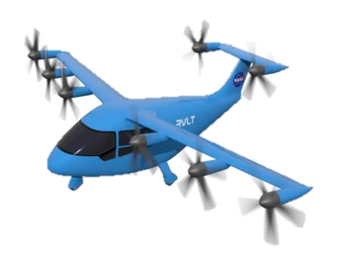
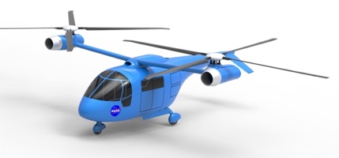
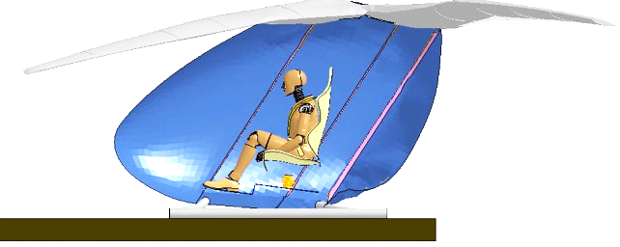
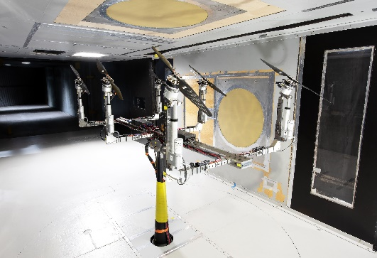
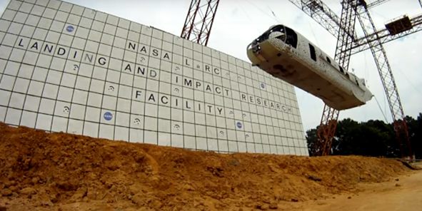
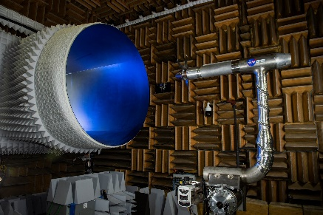
RVLT Concept Vehicles for UAM:
Integrates Research Across Disciplines
Electric Powertrain Reliability
Vehicle Modeling Tools
Handling & Ride Qualities
Fleet & Vehicle Noise
UAM Concept
Vehicles
Crash Safety
Validation Testing
16

Slide 17
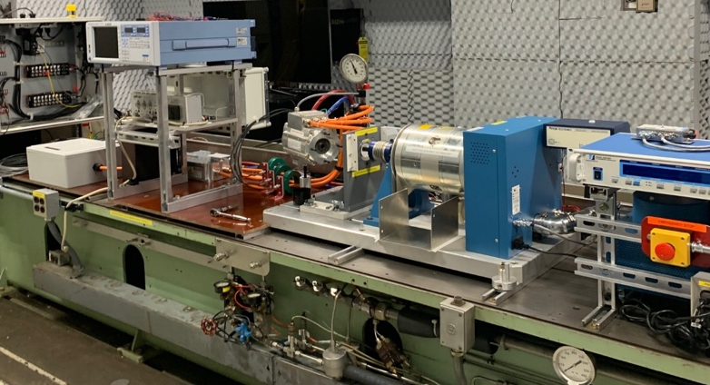
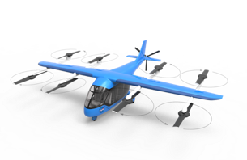
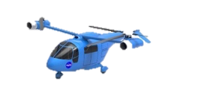
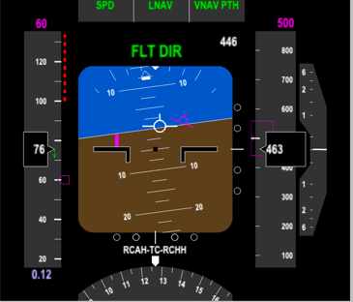
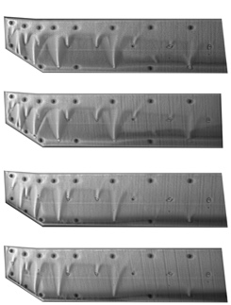
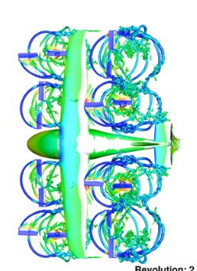
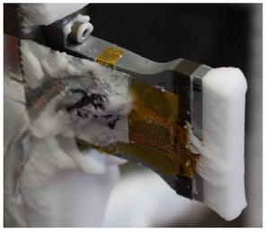
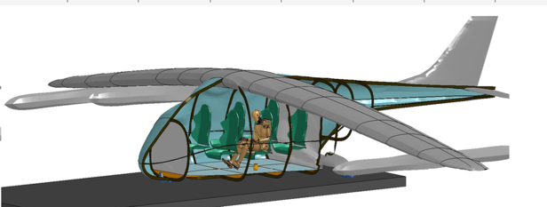
RVLT Technical Challenges
Technical Challenge Attributes:
Supports the ARMD Strategic Implementation Plan and Thrust 4 in particular
Have well defined objectives that address gaps/needs of internal and external stakeholders
Have metrics to measure progress and can be accomplished in 3-5 years
RVLT TC: Tools to Explore the Noise & Performance of Multi-Rotor UAM Vehicles
RVLT TC: Reliable & Efficient Propulsion Components for UAM
RVLT TC: UAM Operational Fleet Noise Assessment
Acceptable Handling and Ride Qualities for Urban Air Mobility (UAM) Vehicles
UAM Crashworthiness and Occupant Protection
emerging
Technical Challenges
eTCs
drafted
Technical Challenges
(FY22 tollgate)
CFD & exp methods
Icing/ Weather
17

Slide 18

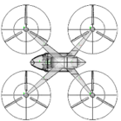
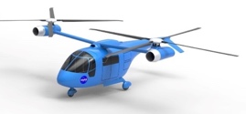

Revolutionary Vertical Lift Technology (RVLT) Near Term Focus for Research
FY21-FY23
Tech Challenge: Reliable and Efficient Propulsion Components for UAM
Vehicle Propulsion Reliability
Re-configure laboratories for electric propulsion testing
Conduct initial single string tests
Develop tools to assess motor reliability
Develop high reliability conceptual motor design
Tech Challenge: UAM Operational Fleet Noise Assessment
UAM Fleet Noise
Generate Noise Power Distance (NPD) database for several Urban Air Mobility (UAM) reference configurations and trajectories
Conduct fleet noise assessments
Initiate psychoacoustic testing to assess human response to UAM vehicles
Tech Challenge: Tools to Explore the Noise and Performance of Multi-Rotor UAM Vehicles
Noise and Performance
Plan and conduct validation experiments
Improve efficiency and accuracy of conceptual design tools
Conduct high-fidelity configuration CFD for validation and reference
Improve community transition and training for analysis tools
Safety and Acceptability
Targeted Research in These Areas for Future Tech Challenges
    UAM crashworthiness and occupant protection
    Acceptable handling and ride qualities for UAM vehicles
    Ice accretion and shedding for UAM
Notes:
Chart shows a high-level snapshot of major piece of work in the portfolio and anticipated next steps.
18

Slide 19


Slide 20


Slide 21


