Slide 1
BHUTAN
Agriculture
Developing a Crop Mask for Rice and Creating a Data Collection Protocol Utilizing Remotely Sensed Data in Bhutan
Yeshey Seldon, Kusal Khandal, Sherab Dolma, & Wangdrak Dorji
Alabama – Marshall
Notes:
Yeshey :
Hello everyone! We are NASA DEVELOP's Bhutan Agriculture team of Yeshey Seldon, Kusal Khandal, Sherab Dolma, and Wangdrak Dorji. In this ten week program, we developed a crop mask for rice and created a data collection protocol utilizing remotely sensed data in Bhutan. Over the course of this presentation we will introduce you to our study area and partners and discuss our data used and results.

Slide 2
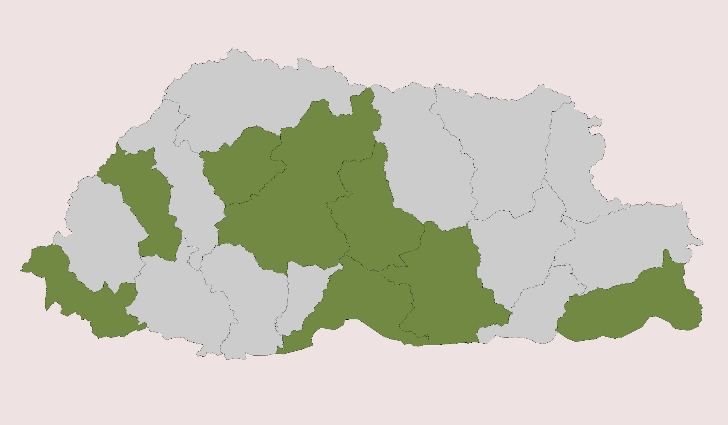
STUDY AREA & PERIOD
STUDY AREA
Eight districts in the country of Bhutan:
Paro
Punakha
Samdrup Jongkhar
Samtse
Sarpang
Trongsa
Wangduephodrang
Zhemgang
STUDY PERIOD
2020
(June 1st – November 30th)
China
Districts of Interest
Bhutan
Punakha
Paro
Wangdue-
phodrang
Trongsa
Samtse
Zhemgang
Samdrup-Jongkhar
Sarpang
N
India
1 100 km
Notes:
Yeshey:
The team used the country of Bhutan as a study area with a focus on eight districts, namely: Paro, Punakha, Samdrup Jongkhar, Samtse, Sarpang, , Wangduephodrang, and Zhemgang, to assist in creating a crop mask for rice and developing a data collection protocol.
- Our study year is 2020 focusing on the months from June 1st to November 30th, which is the duration from rice transplant to harvesting.
------------------------------Figure Information Below ------------------------------
• Team generated figure for study area.

Slide 3
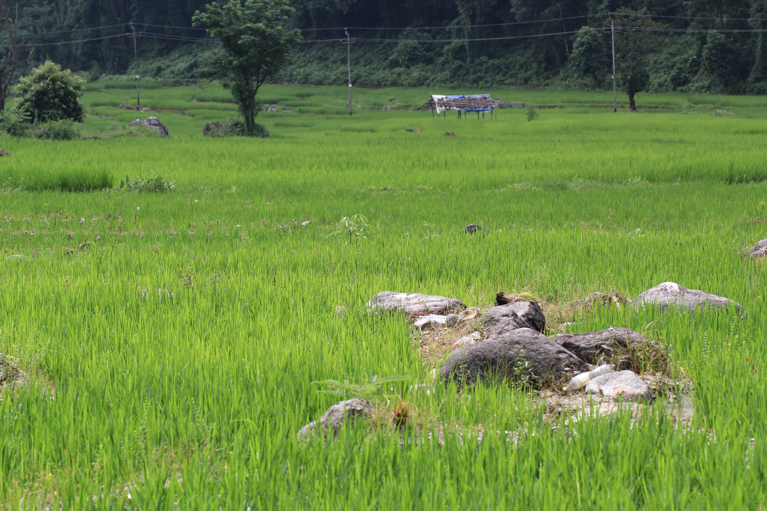
PARTNERS
End User
Department of Agriculture of Bhutan (DoA)
Bhutan Foundation
Ugyen Wangchuck Institute for Conservation and Environmental Research (UWICER)
Collaborators
Credit: Nidup Dorji / DOA
Notes:
Yeshey:
Our End-User for the project is Bhutan’s Department of Agriculture whose main mission is to achieve food and nutrition security, and agricultural transformation through innovative and sustainable technologies.
Our Collaborators are the Bhutan Foundation and the Ugyen Wangchuk Institute for Conservation and Environmental Research (UWICER). The Bhutan Foundation bases its project support decisions and priorities outlined in the Bhutan 12th Five Year Plan (FYP).
The integration of more diverse remote sensing approaches within the methodology of the department to report and develop planning efforts would help increase the rate of agricultural assessments and aid in their decision-making.
Image credit: Nidup Dorji
Image source: Department of Agriculture
Image license: Permission to use

Slide 4
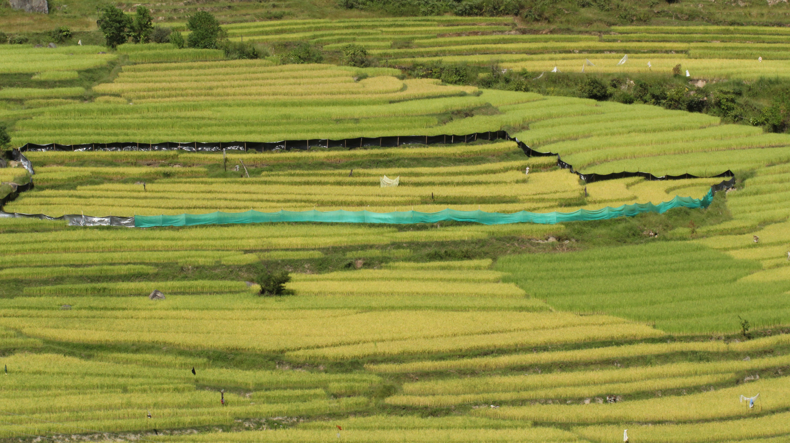
OBJECTIVES
Investigate the distribution of rice from June 1st to November 30th, 2020 by developing a crop mask.
Generate a remote sensing-oriented data collection protocol and methods tutorial.
Credit: Nidup Dorji / DOA
Notes:
Kusal:
The main objective of this term was to
Investigate the distribution of rice from June by developing a rice mask for identifying rice agriculture using Landsat 5 TM, Landsat 7 ETM+, and Landsat 8 OLI.
The team also wanted to generate a remote sensing-oriented data collection protocol and methods tutorial for Collect Earth Online (CEO) and Google Earth Engine (GEE) to enable partners to use NASA Earth observations for land-use planning.
Image credit: Nidup Dorji
Image source: Department of Agriculture
Image license: Permission to use

Slide 5
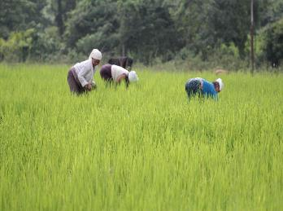
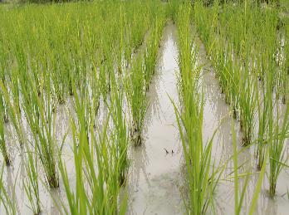
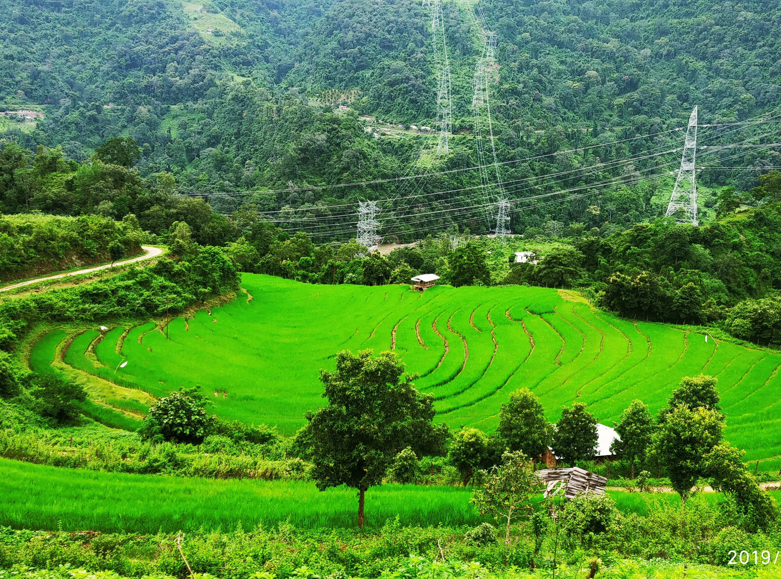
COMMUNITY CONCERNS
Small-scale subsistence farming makes it vulnerable to natural disasters.
Bhutan has been experiencing the effects of climate change on crops, including increasing outbreaks of pests and diseases.
The subsequent shift in farming patterns calls for the need to incorporate Earth observations with pre-existing field surveying methods.
Credit: Nidup Dorji / DOA
Notes:
Kusal:
Due to the mountainous topography of Bhutan, she experiences series of climate change impacts, such as low soil fertility and soil erosion lacking excess crop production and compelling the farmers to practice subsistence farming. This issue further leads to land fragmentation and nutrient loss making it prone to natural disasters.
Bhutan has been experiencing the effects of climate change on crops, including increasing outbreaks of pests and diseases as well.
As climate change continues to impact agriculture globally, the subsequent shift in farming patterns is making field surveys less efficient, thus leaving Bhutan’s Department of Agriculture lacking in crop monitoring options. So our system will hopefully improve the efficiency.
_ _ _ _ _ _ _ _ _ _ _ _ _ _ _ _ _ _ _ _ _ _ _
Image 1,2, and 3 credit: Nidup Dorji
Image source: Department of Agriculture
Image license: Permission to use

Slide 6
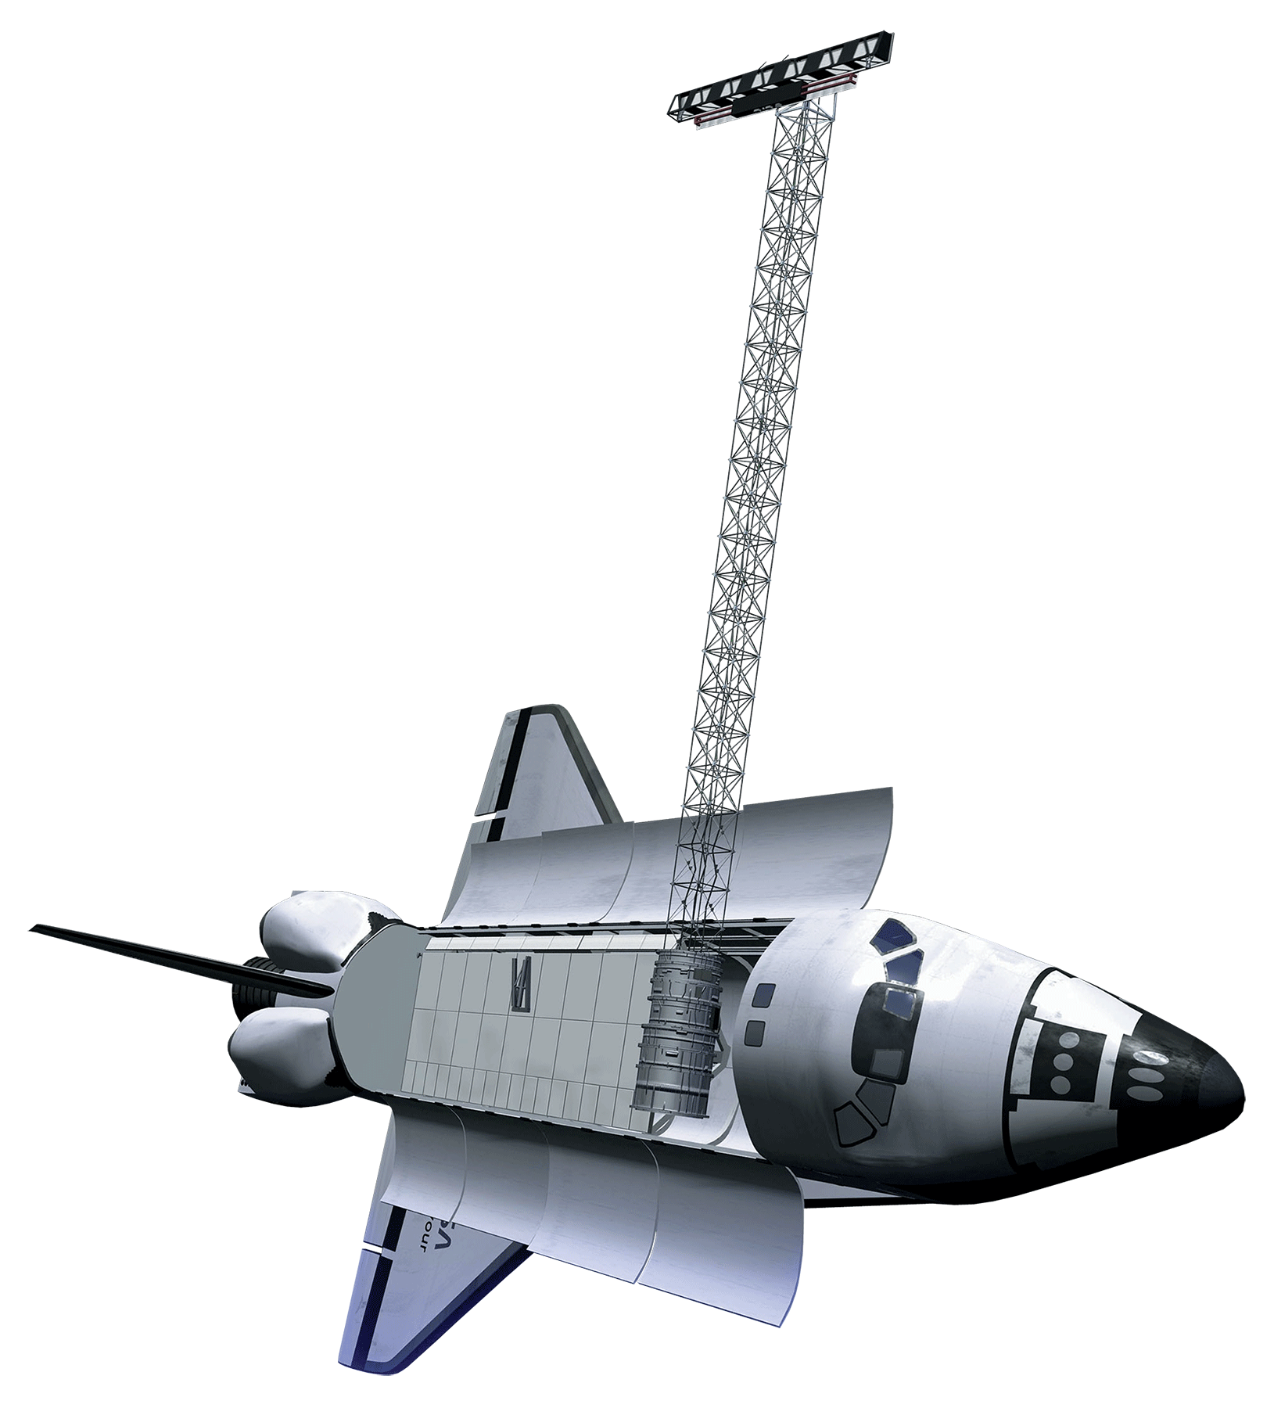
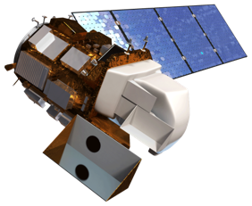
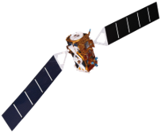
EARTH OBSERVATIONS
Shuttle Radar Topography Mission (SRTM)
Landsat 8 Operational Land Imager (OLI)
Sentinel 1 C-band Synthetic-Aperture Radar (C-SAR)
Image Credit: NASA and ESA
Notes:
Sherab:
For our project, the data from these satellites helped to compute the various indices which were used to help generate the crop mask.
Landsat 8 OLI provides moderate-resolution measurements (15 m–100 m, depending on spectral frequency) of the Earth's terrestrial and polar regions in the visible, near-infrared, short wave infrared, and thermal infrared. Landsat 8 provides continuity with the more than 40-year long Landsat land imaging data set.
The Shuttle Radar Tomography (SRTM) obtains Earth surface data which is converted into height data called a Digital Elevation Model (DEM) and was utilized to generate a more precise three-dimensional map of larger observation area of the Earth from February 11-22, 2000.
Sentinel-1 carries a C-band synthetic-aperture radar instrument which provides a collection of data in all-weather, day or night at a spatial resolution of down to 5 m and a swath of up to 400 km. The data is used for sea and land monitoring, emergency response due to environmental disasters, and economic applications.
Image Landsat 8 credit: NASA
Image Source: http://www.devpedia.developexchange.com/dp/index.php?title=List_of_Satellite_Pictures
Image License: Public Domain
Image Sentinel 1 credit: NASA
Image Source: http://www.devpedia.developexchange.com/dp/index.php?title=List_of_Satellite_Pictures
Image License: Public Domain

Slide 7
METHODOLOGY
INPUT DATA
PROCESSING AND ANALYSIS
ANALYSIS
Point Data
(Department of
Agriculture, Earth Engine)
Train and test
split data
COLAB
Google Earth Engine
ArcGIS Pro
QGIS
Define Variables
Optical Indices: NDVI, NDWI, NDMI, SAVI, Slope, Elevation (Landsat 8 OLI and SRTM)
Greenness index from Tasseled Cap transformation(Landsat 8 TOA)
SAR Polarization Indices(Sentinel-1 C-SAR)
Sampling points/training data
(from Collect Earth Online)
RESULTS
Independent Validation in COLAB
Develop crop mask for rice
Build tutorial for methods and remote sensing capacity
Generate Random Forest
And CART classifier
Notes:
Kusal Khandal:
The rice points provided by the end user, Department of Agriculture, and also collected using Google Earth Engine Satellite View and were used as the input data for the project.
These data were then imported into the Collect Earth Online (CEO) platform and used to develop 30-meter plots with 25 gridded samples to be classified manually into agriculture, non-agriculture, rice, and non-rice.
For the data processing and analysis, the input data from CEO was imported to Google Earth Engine where the team computed the various indices to aid in the classification by the random forest model to distinguish between areas with rice and without rice. These include elevation and slope values from SRTM. The Normalized Difference Vegetation Index (NDVI), Normalized Difference Water Index (NDWI), Soil-Adjusted Vegetation Index (SAVI), and Normalized Difference Moisture Index (NDMI) were computed using the Landsat 8 OLI data. The tasseled cap of greenness was performed on the Landsat 8 TOA data. Synthetic Aperture Radar (SAR) polarization indices from the Sentinel-1 data.
The final steps involve creating the crop mask for identifying rice in Bhutan using the Random Forest classifier as our primary model and a Classification And Regression Trees(CART) model a baseline model to compare to.
To analyze the result, the team used COLAB, Google Earth Engine , ArcGIS Pro and QGIS.

Slide 8
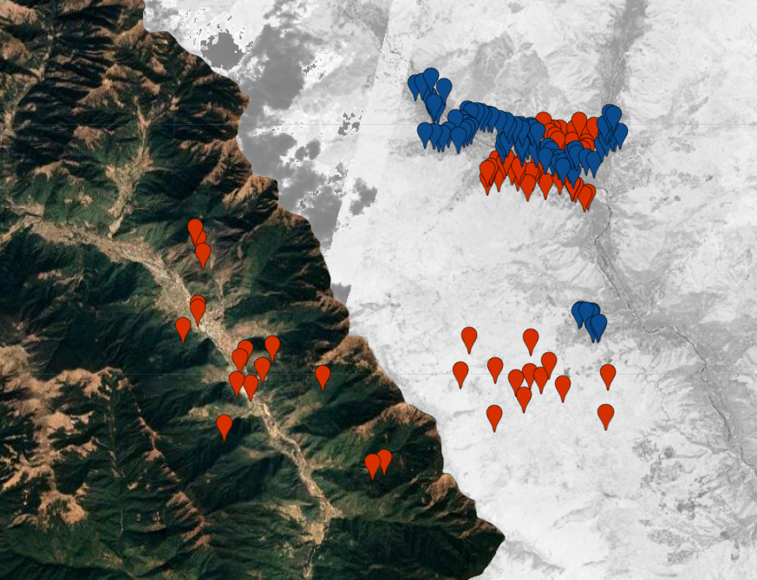
DATA COLLECTION PROCESS
Collect Earth Online Sample Plot Design
Is this sample point agriculture?
No
Yes
Is this agriculture point rice crop?
Sample Point Generation in Google Earth Engine
Collected using indices including NDVI on Landsat 8 Tier 1 Surface Reflectance Imagery and SERVIR’s RLCMS Crop Classification
No
Yes
Notes:
Kusal Khandal:
For the data collection process, the 82 rice plots provided by the Department of Agriculture and additional 260 rice sample plots generated from the Google Earth Engine using the Regional Land Cover Monitoring System (RLCMS) were imported to the Collect Earth Online for further data processing.
RLCMS is an operational system that produces high quality regional land cover maps and identifies land cover changes. Plots derived using NASA SERVIR’s RLCMS dataset are displayed above over Landsat-8 imagery, with non-rice data points being red and rice data points being blue.
The image on the right shows the Collect Earth Online sample plot design. PlanetScope imagery was used to generate the land cover maps which has 3-5 meters per pixel resolution. The yellow box represents the 30 meter square plot with 25 points inside it. With the help of survey questions in CEO, each of the 25 points inside a single plot was analyzed and determined whether it was agriculture or non-agriculture. The agriculture points were represented by blue dots and non-agriculture by pink dots.
In the next step, we determined whether the agriculture points were rice crops or not. Similarly, the rice crop points were represented by blue dots and non-rice points by pink dots. Using these steps, a total of 8,550 sample points were analyzed using the Collect Earth Online platform. These manually-classified plots were then exported and brought into Google Earth Engine to provide training data for the classification models.
Image credit: SERVIR team

Slide 9
DATA COLLECTION
Data provided by the partner: Department of Agriculture:
82 plots
Across the whole country
Data collected using NASA SERVIR’s RLCMS dataset:
260 plots
Focusing on the Southern region of the country
N
In-situ data Remotely sensed data
1 100 km
Notes:
This picture displays all the Rice plots provided by Bhutan’s Department of Agriculture in yellow, and red dots are the ones generated from the Google Earth Engine using the RLCMS by the SERVIR team.
DOA provided us with 82 in-situ rice plots and the SERVIR team helped generate 260 more plots. Furthermore, our team manually created polygons over the satellite maps of the country in the GEE, marking each polygons as rice or non-rice. These were the three different sets of rice sample data used for the rice classification algorithm.
These 3 data set were split as either training data or testing data, with 70% of the samples dedicated to training the classification models and 30% of the samples reserved as validation data for accuracy testing after classification. The samples from the DOA and the RLCMS were used as the testing data while the samples created by the team using the polygons were used as the training data for our rice classification model.

Slide 10
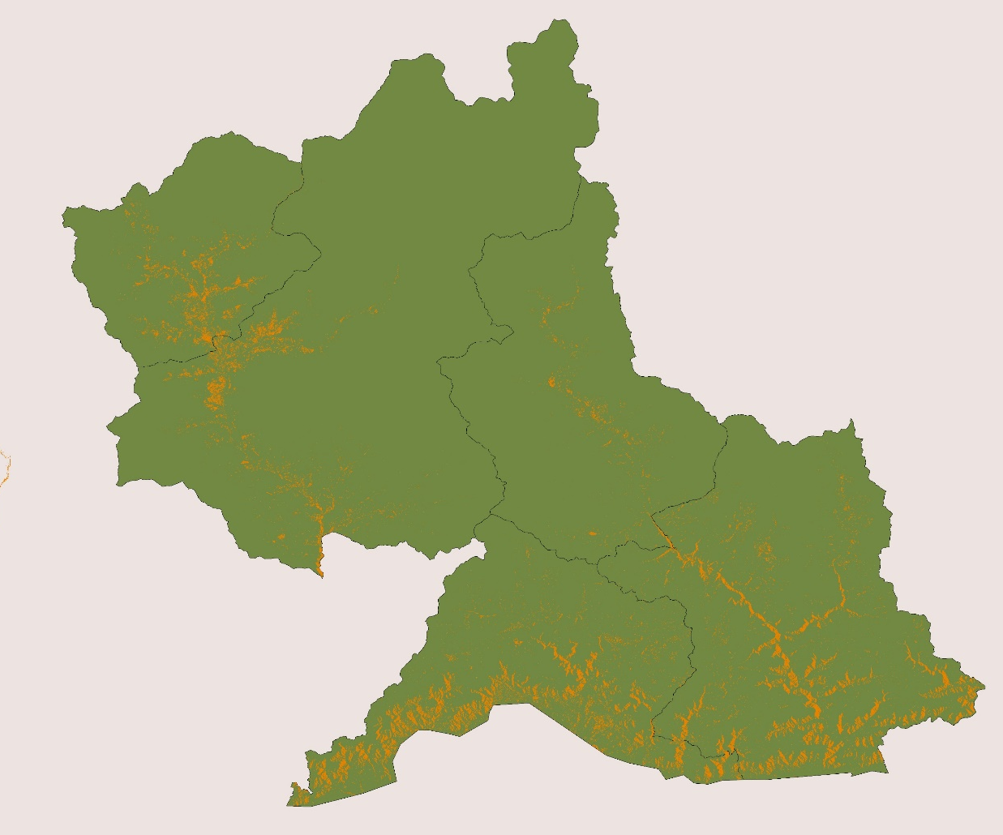
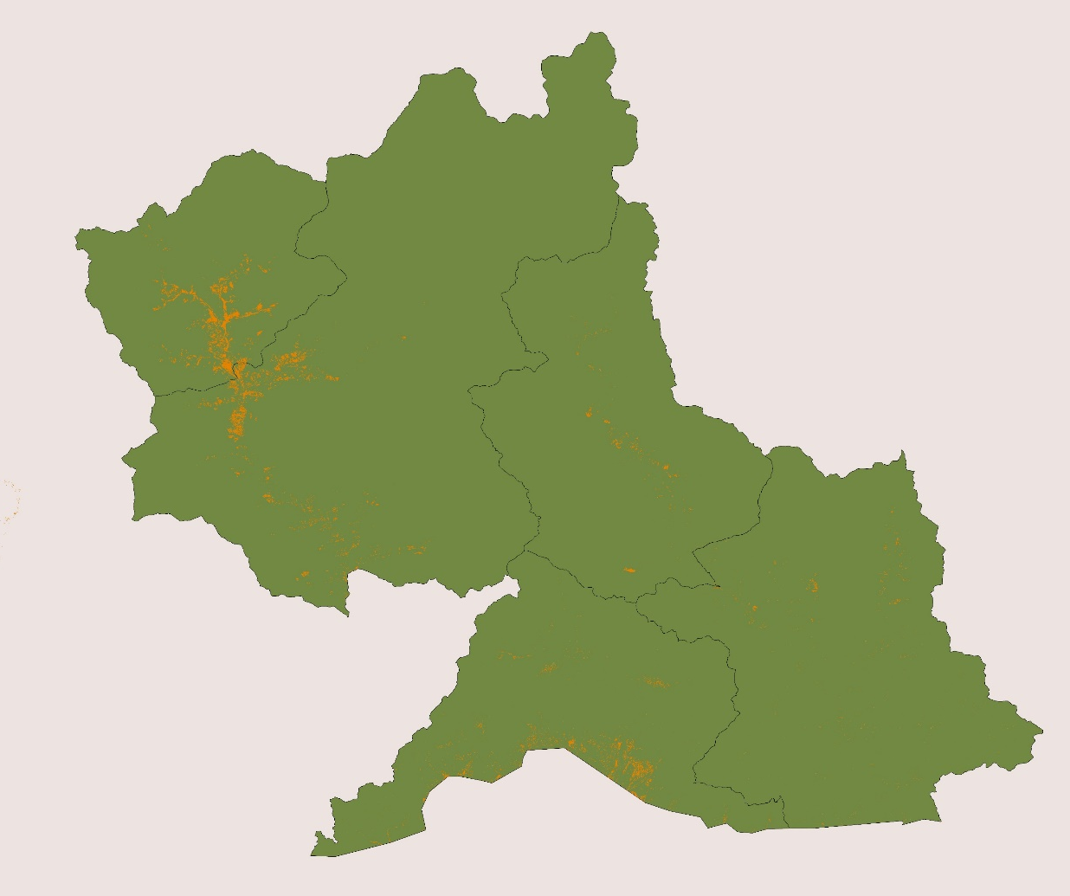
RESULTS
CART Model
Random Forest Model
Punakha
Punakha
Wangdue-
phodrang
Wangdue-
phodrang
Trongsa
Trongsa
Zhemgang
Zhemgang
Sarpang
Sarpang
Rice Mask
Districts of Interest
Bhutan
N
1 100 km
Notes:
Sherab:
In the Google Earth Engine, the team developed two different models of rice mask classification: the Random forest classifier and the Classification and Regression Trees (CART model).
The image to the left is the CART model and the one to the right is the RF model, it is displayed on five of our study districts in the Central Bhutan.
A random forest is a machine learning technique that is used to solve regression and classification problems. It utilizes ensemble learning, which is a technique that combines multiple decision trees. While on the other hand, the CART classifier consists of a single decision tree.
The orange dots here represents the rice paddy fields picked up by each model so called rice mask. Rice mask is a layer that identifies rice areas on ground using satellite images and mathematical classification techniques combined with ground sampled data. We can observe that the CART model is over predicting the rice area as compared to the RF model meaning if we zoom into an area, we would observe that the cart model has identified more non-rice areas as rice.
-------------------------------
Team generated figures for comparison of two models

Slide 11
CONFUSION MATRICES RESULTS
Random Forest Training Data
CART Training Data
– 120
– 120
Rice
130
7
Rice
123
14
– 100
– 100
– 80
True Label
– 80
True
Label
– 60
– 60
Not Rice
17
138
– 40
Not Rice
36
119
– 40
– 20
– 20
Rice
Not Rice
Rice
Not Rice
Predicted Label
Predicted Label
Notes:
Wangdrak:
These confusion matrices were generated in the COLAB by testing the classification of our model against points from DOA. A confusion matrix is a summary of prediction results on a classification problem. The number of correct and incorrect predictions are summarized with count values and broken down by each class.
According to these matrices, the CART model on average picked up more false positive and false negative values than the RF model.
--------------------------
Team generated figures for comparison of two models

Slide 12
GRAPHICAL ANALYSIS
45
40
35
30
Importance
25
20
15
10
5
Slope
NDMI
NDVI
NDWI
SAVI
Elevation
Greenness
ascChangeVH
ascChangeVV
descChangeVH
descChangeVV
RF CART
Classification Variables
Notes:
Wangdrak:
The above graphs represent what were the level of importance of the variables i.e. the spectral indices which were perceived by the model in generating the crop mask. This included the Normalized Difference Moisture Index, the Normalized Difference Vegetation Index, the Normalized Difference Water Index, the Soil Adjusted Vegetation Index, changes in the VV and VH Sentinel 1 C-SAR bands, elevation, Greenness derived from the Kauth-Thomas Tasseled Cap Transformation, and slope.
Displayed in Orange histogram is RF and blue is CART model. The CART model picked up on elevation as a key driver in the classification problem which may have led to the results to be skewed by the elevation values. In contrast, the RF model distinguished each point based on a more equal level of importance between the various indices. As there is no specific index for rice identification, we can see that our model uses an integration of various other indices as displayed in the second graph.
-------------------------------
Team generated histogram for comparison of two models

Slide 13
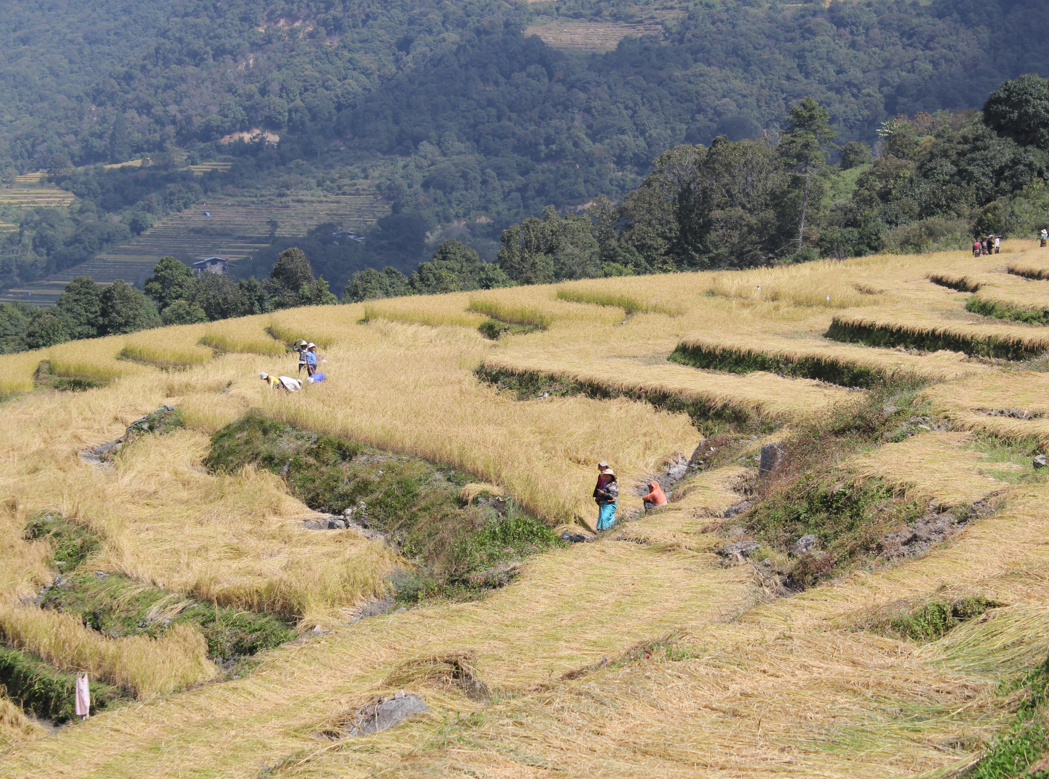
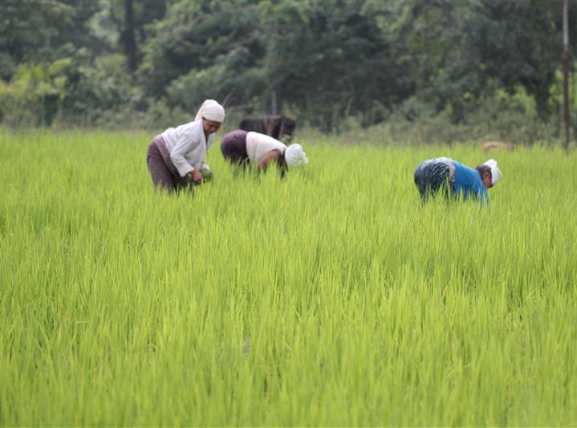
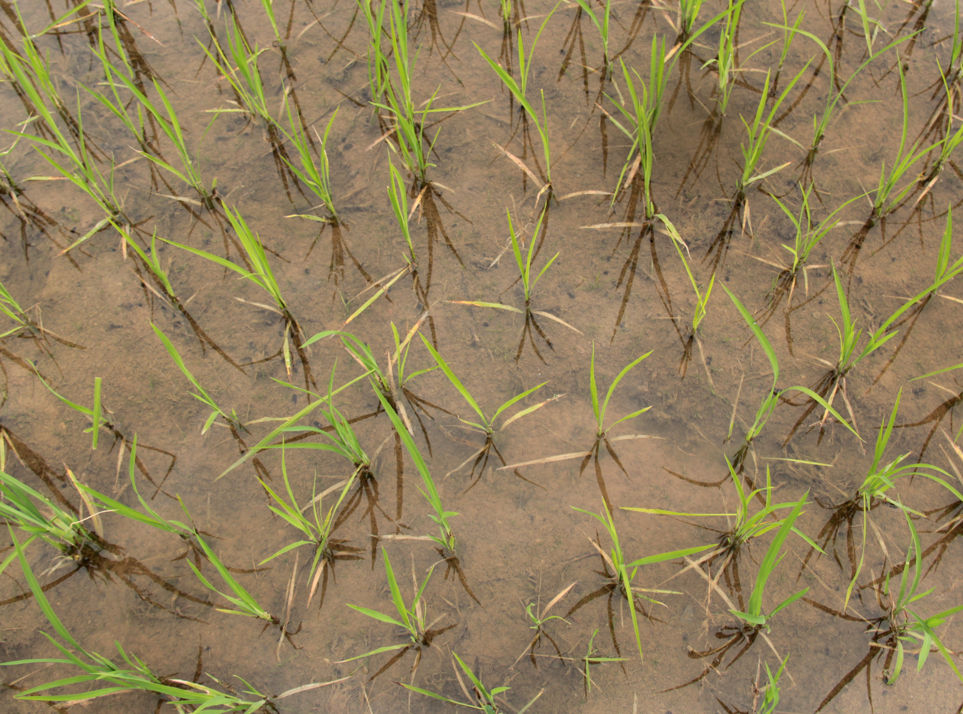
STATISTICAL ACCURACY MEASUREMENTS
Statistic Method | Random Forest | CART
Accuracy Score | 0.917808 | 0.828767
Cohen Kappa Score | 0.835686 | 0.659404
F1 Score | 0.92000 | 0.826389
Credit: Nidup Dorji / DOA
Notes:
Wangdrak:
To test the validity of our crop mask, a number of statistical measurements were calculated for the crop mask using the prediction results from the confusion matrices.
Using the points from the DOA as our validation set, we found that we can be fairly confident that our model is successful in distinguishing rice and non-rice areas with an accuracy score of 91.8%.
The model has a Cohen’s Kappa score of 83% which is a more strict quantitative measure of reliability for two observers that are rating the same thing.
The F score was found to be 92% which is another accuracy statistic combining the precision and recall of the model.
In all the statistical measurements, the CART model which is our baseline model to compare to, performs fairly well but has a lower score showing the robustness of the Random Forest Model as a tool in classification.
--------------------------
Team generated table for comparison of two models
----------------------------
_ _ _ _ _ _ _ _ _ _ _ _ _ _ _ _ _ _ _ _ _ _ _
Image 1,2, and 3 credit: Nidup Dorji
Image source: Department of Agriculture
Image license: Permission to use

Slide 14
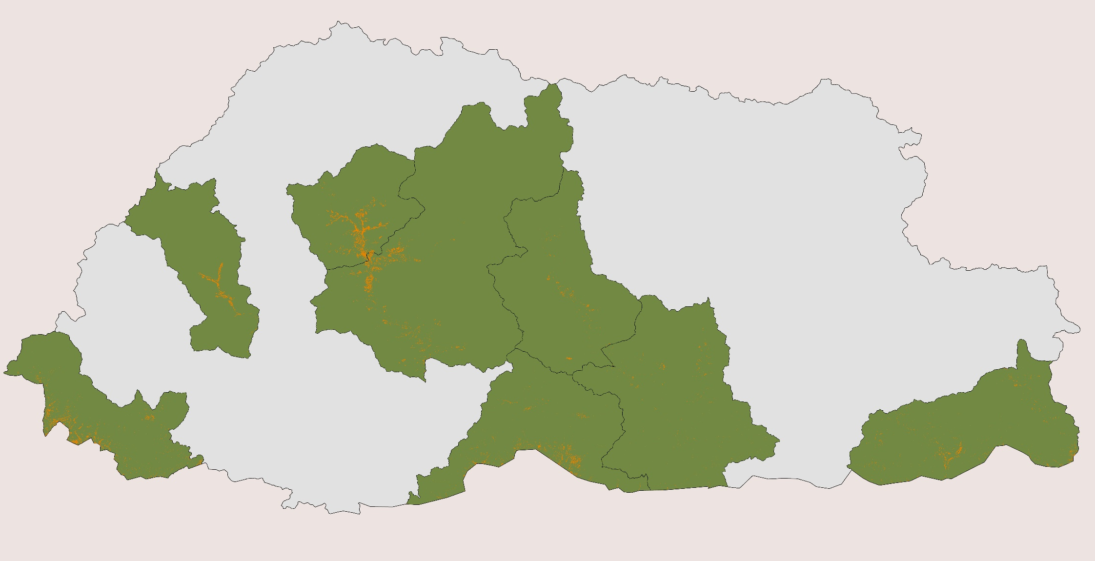
RICE MASK: RANDOM FOREST MODEL
Rice Mask
Districts of Interest
Bhutan
N
1 100 km
Notes:
Sherab:
After all these comparisons, the team concluded that the RF model proved to be a better classifying algorithm for creating the rice mask for Bhutan.
As the final result, the team generated separate rice mask for each of the eight districts.

Slide 15
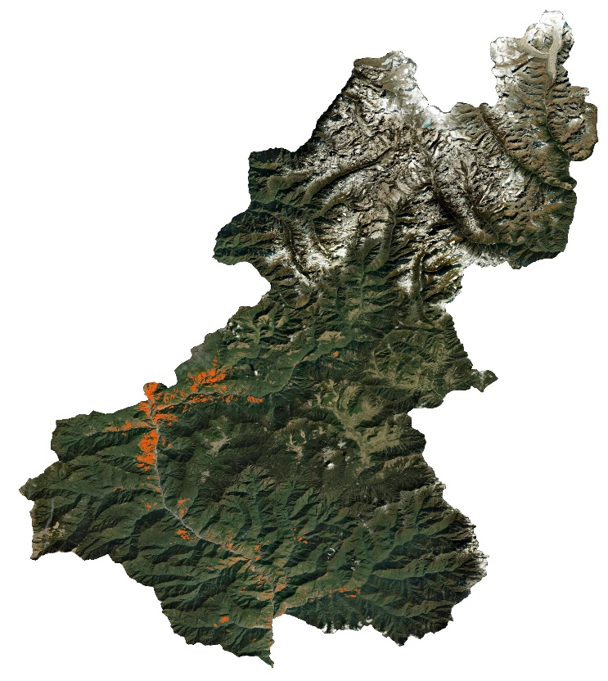
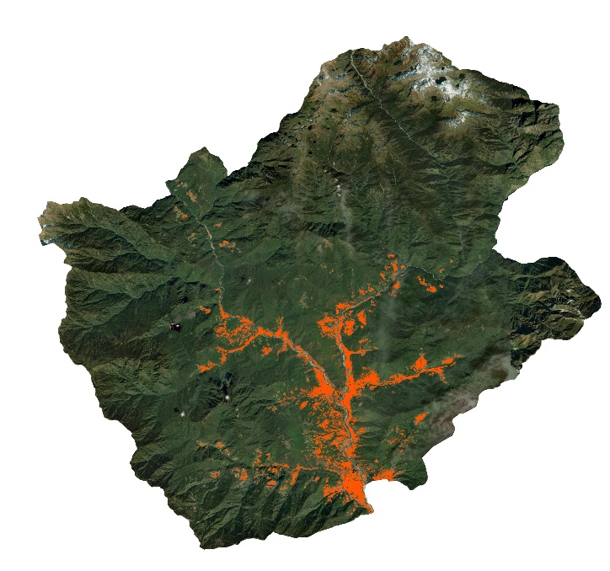
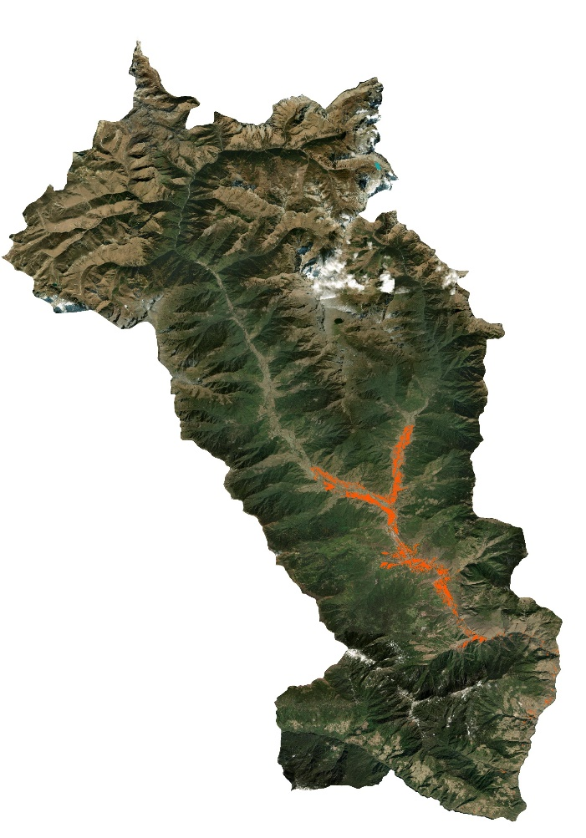
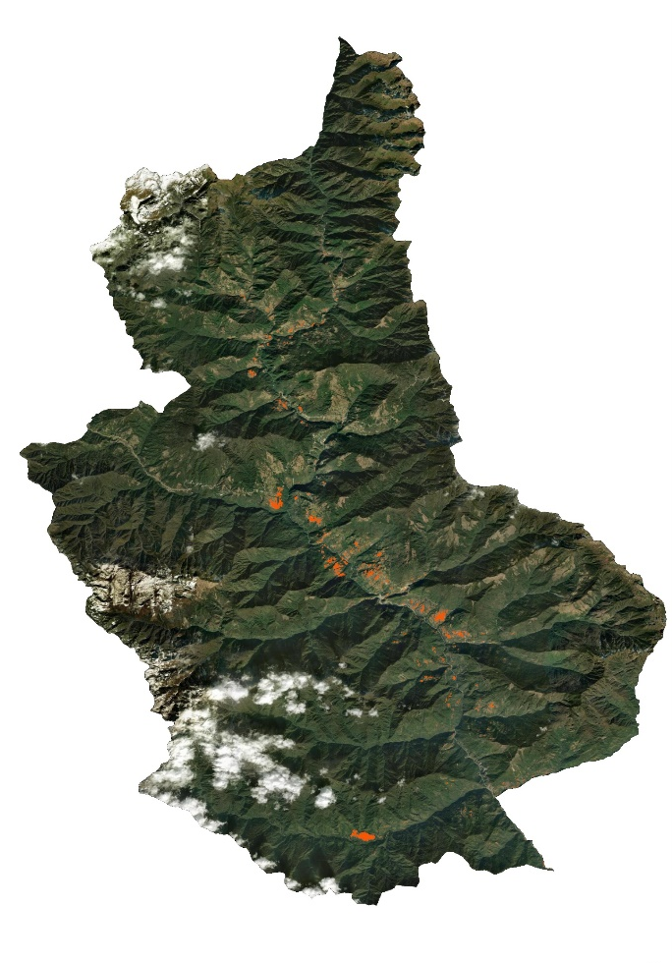
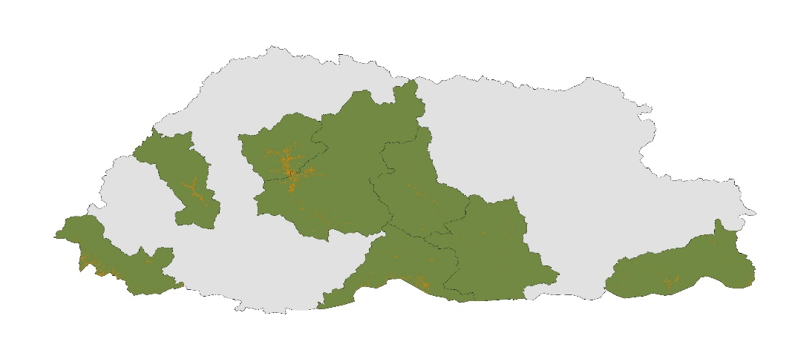
Rice Mask
Districts of Interest
Wangduphodrang
Punakha
Paro
Trongsa
N
1 100 km
Notes:
Sherab:
The districts elaborated here are Paro, Punakha, Wangduephodrang and Trongsa with it’s respective crop mask for rice. The crop masks for rice were displayed over satellite image that gives us an idea of topography and location of most rice farms, i.e., on mountain hill and/or between foothills of mountains.
Most rice cultivation was identified in and around the central regions of the country.
--------------------------
Team generated figures for crop mask

Slide 16
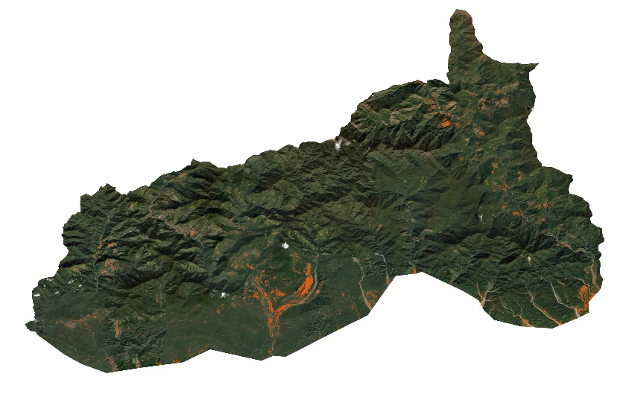
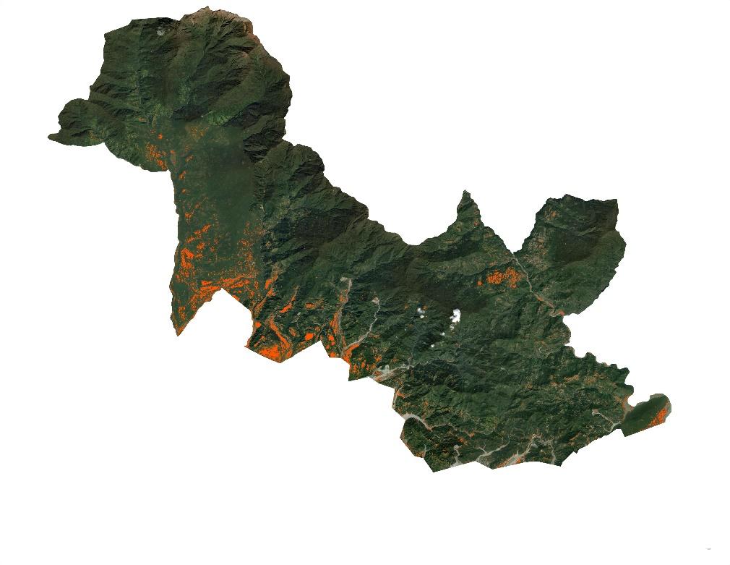
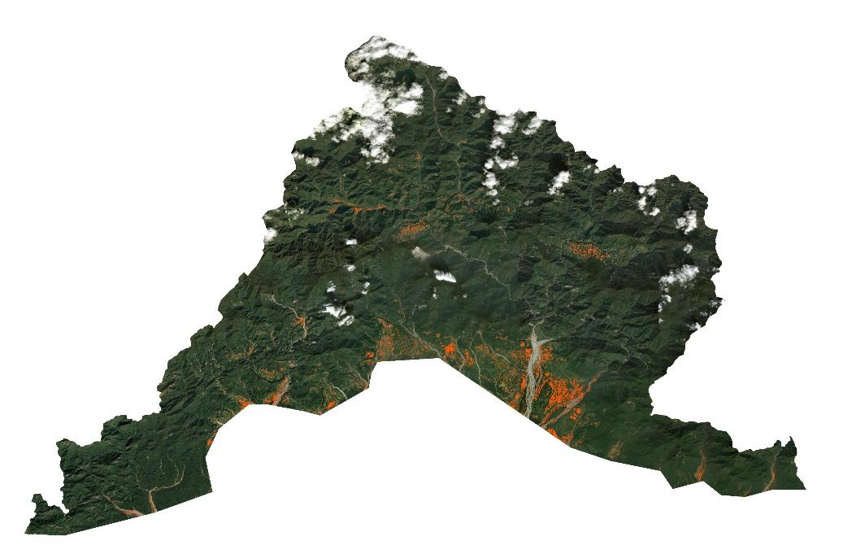
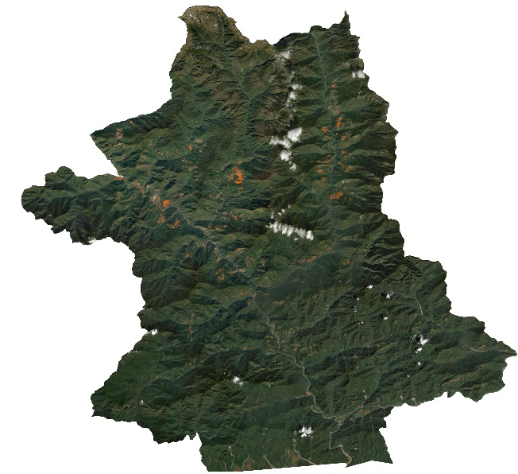
Rice Mask
Districts of Interest
Samdrup Jongkhar
Zhemgang
Samtse
Sarpang
N
1 100 km
Notes:
Sherab:
The districts from Southern Bhutan where the rice cultivation were identified were in Samtse, Sarpang, Zhemgang, and Samdrup Jongkhar. Fewer rice cultivation were observed in South than the central Bhutan. However, location of rice farms remain consistent.
--------------------------
Team generated figures for crop mask

Slide 17
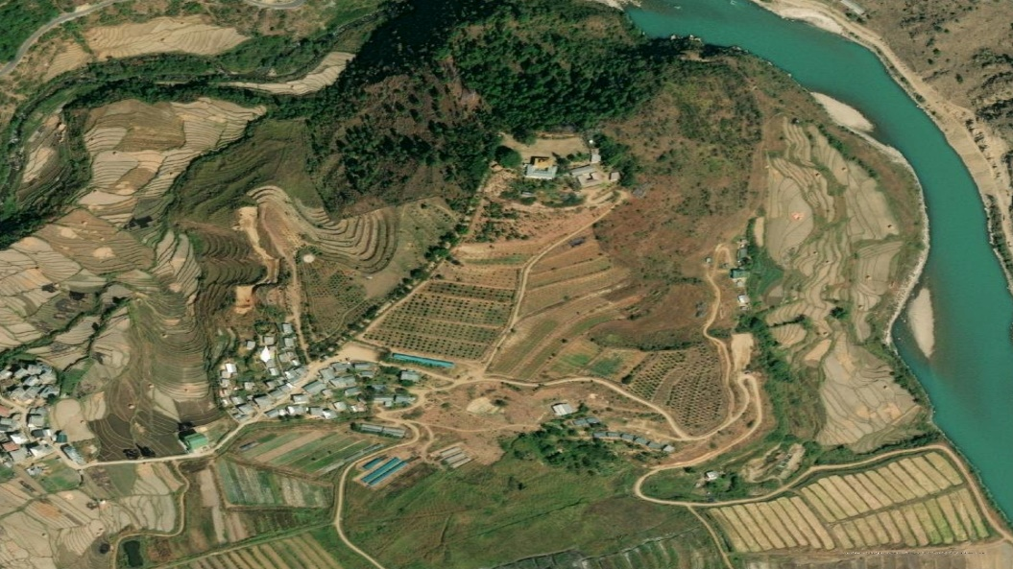
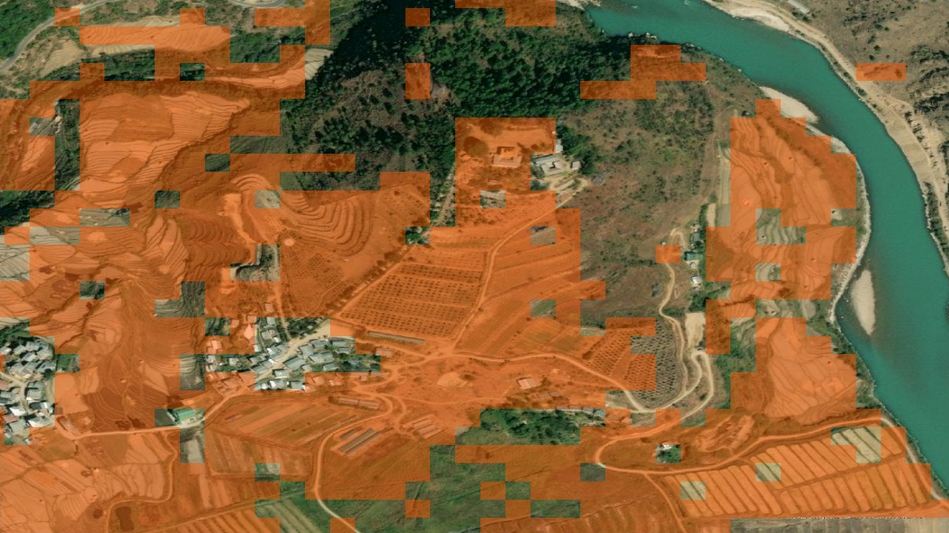
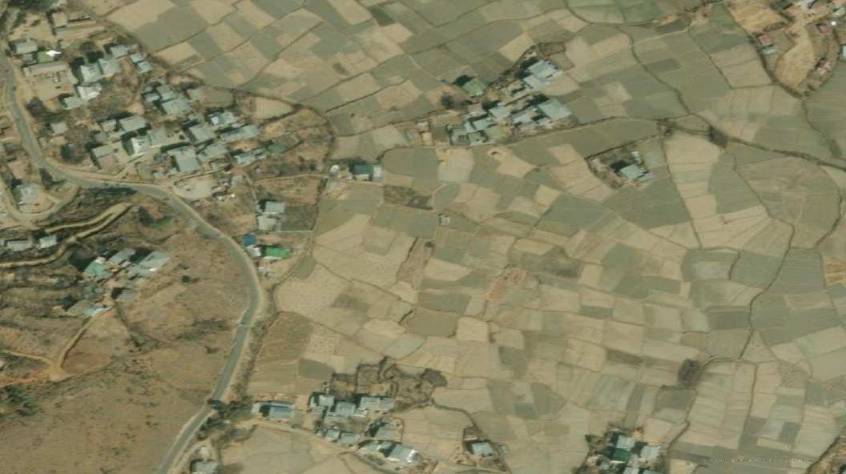
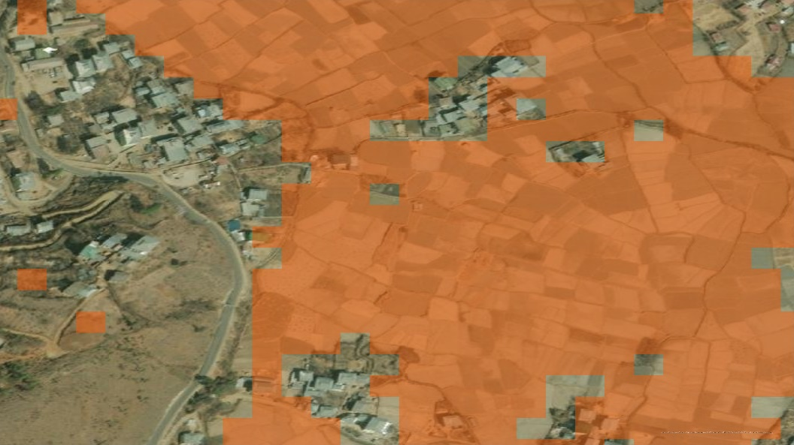
APPLYING THE RANDOM FOREST MODEL
R
I
R
I
BUSHES
V
BUSHES
V
E
E
BUSHES
R
BUSHES
R
URBAN
URBAN
Rice Mask
BUSHES
BUSHES
URBAN
URBAN
URBAN
URBAN
URBAN
URBAN
N
URBAN
URBAN
1 1000 km
Notes:
Sherab:
To give a better view of how well the random forest model works, we randomly zoomed into some of the study regions.
The images to the left shows the satellite view of zoomed area and the image to the right is same area but with our random forest model. Our model highlights all the paddy fields in that area with orange shades saying that those area are rice. On the other hand, the model is ignoring non-rice areas such as the water bodies – river, sands, buildings, roads and some bushes in between the paddy fields.
--------------------------
Team generated figures for crop mask

Slide 18
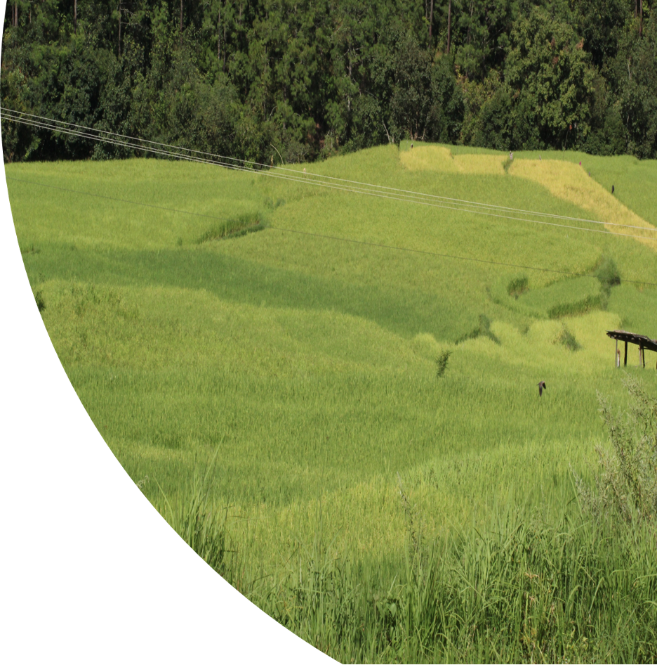
CONCLUSION
Developed crop mask for rice using the random forest classifier.
As compared to the CART model, the random forest model proved to be more precise and accurate.
Various indices were given equal importance in RF model
The RF model was 91.8 % accurate.
Credit: Nidup Dorji/DOA
Notes:
Yeshey:
- The team successfully developed the crop mask for rice using the random forest classifier for the eight districts of Bhutan.
- Visually, our random forest model has proved to be more accurate and precise than the CART model as the result being more robust using the RF classifier.
- The RF model gave equal level of importance between the various indices which includes the optical indices, polarization indices and the Tasseled cap.
- Statistically, our Random Forest model was 91.8% accurate while on the other hand, the CART model was only 82.9% accurate. The differences between the statistical values could be explained by various errors and uncertainties.
Image credit: Nidup Dorji
Image source: Department of Agriculture
Image license: Permission to use

Slide 19
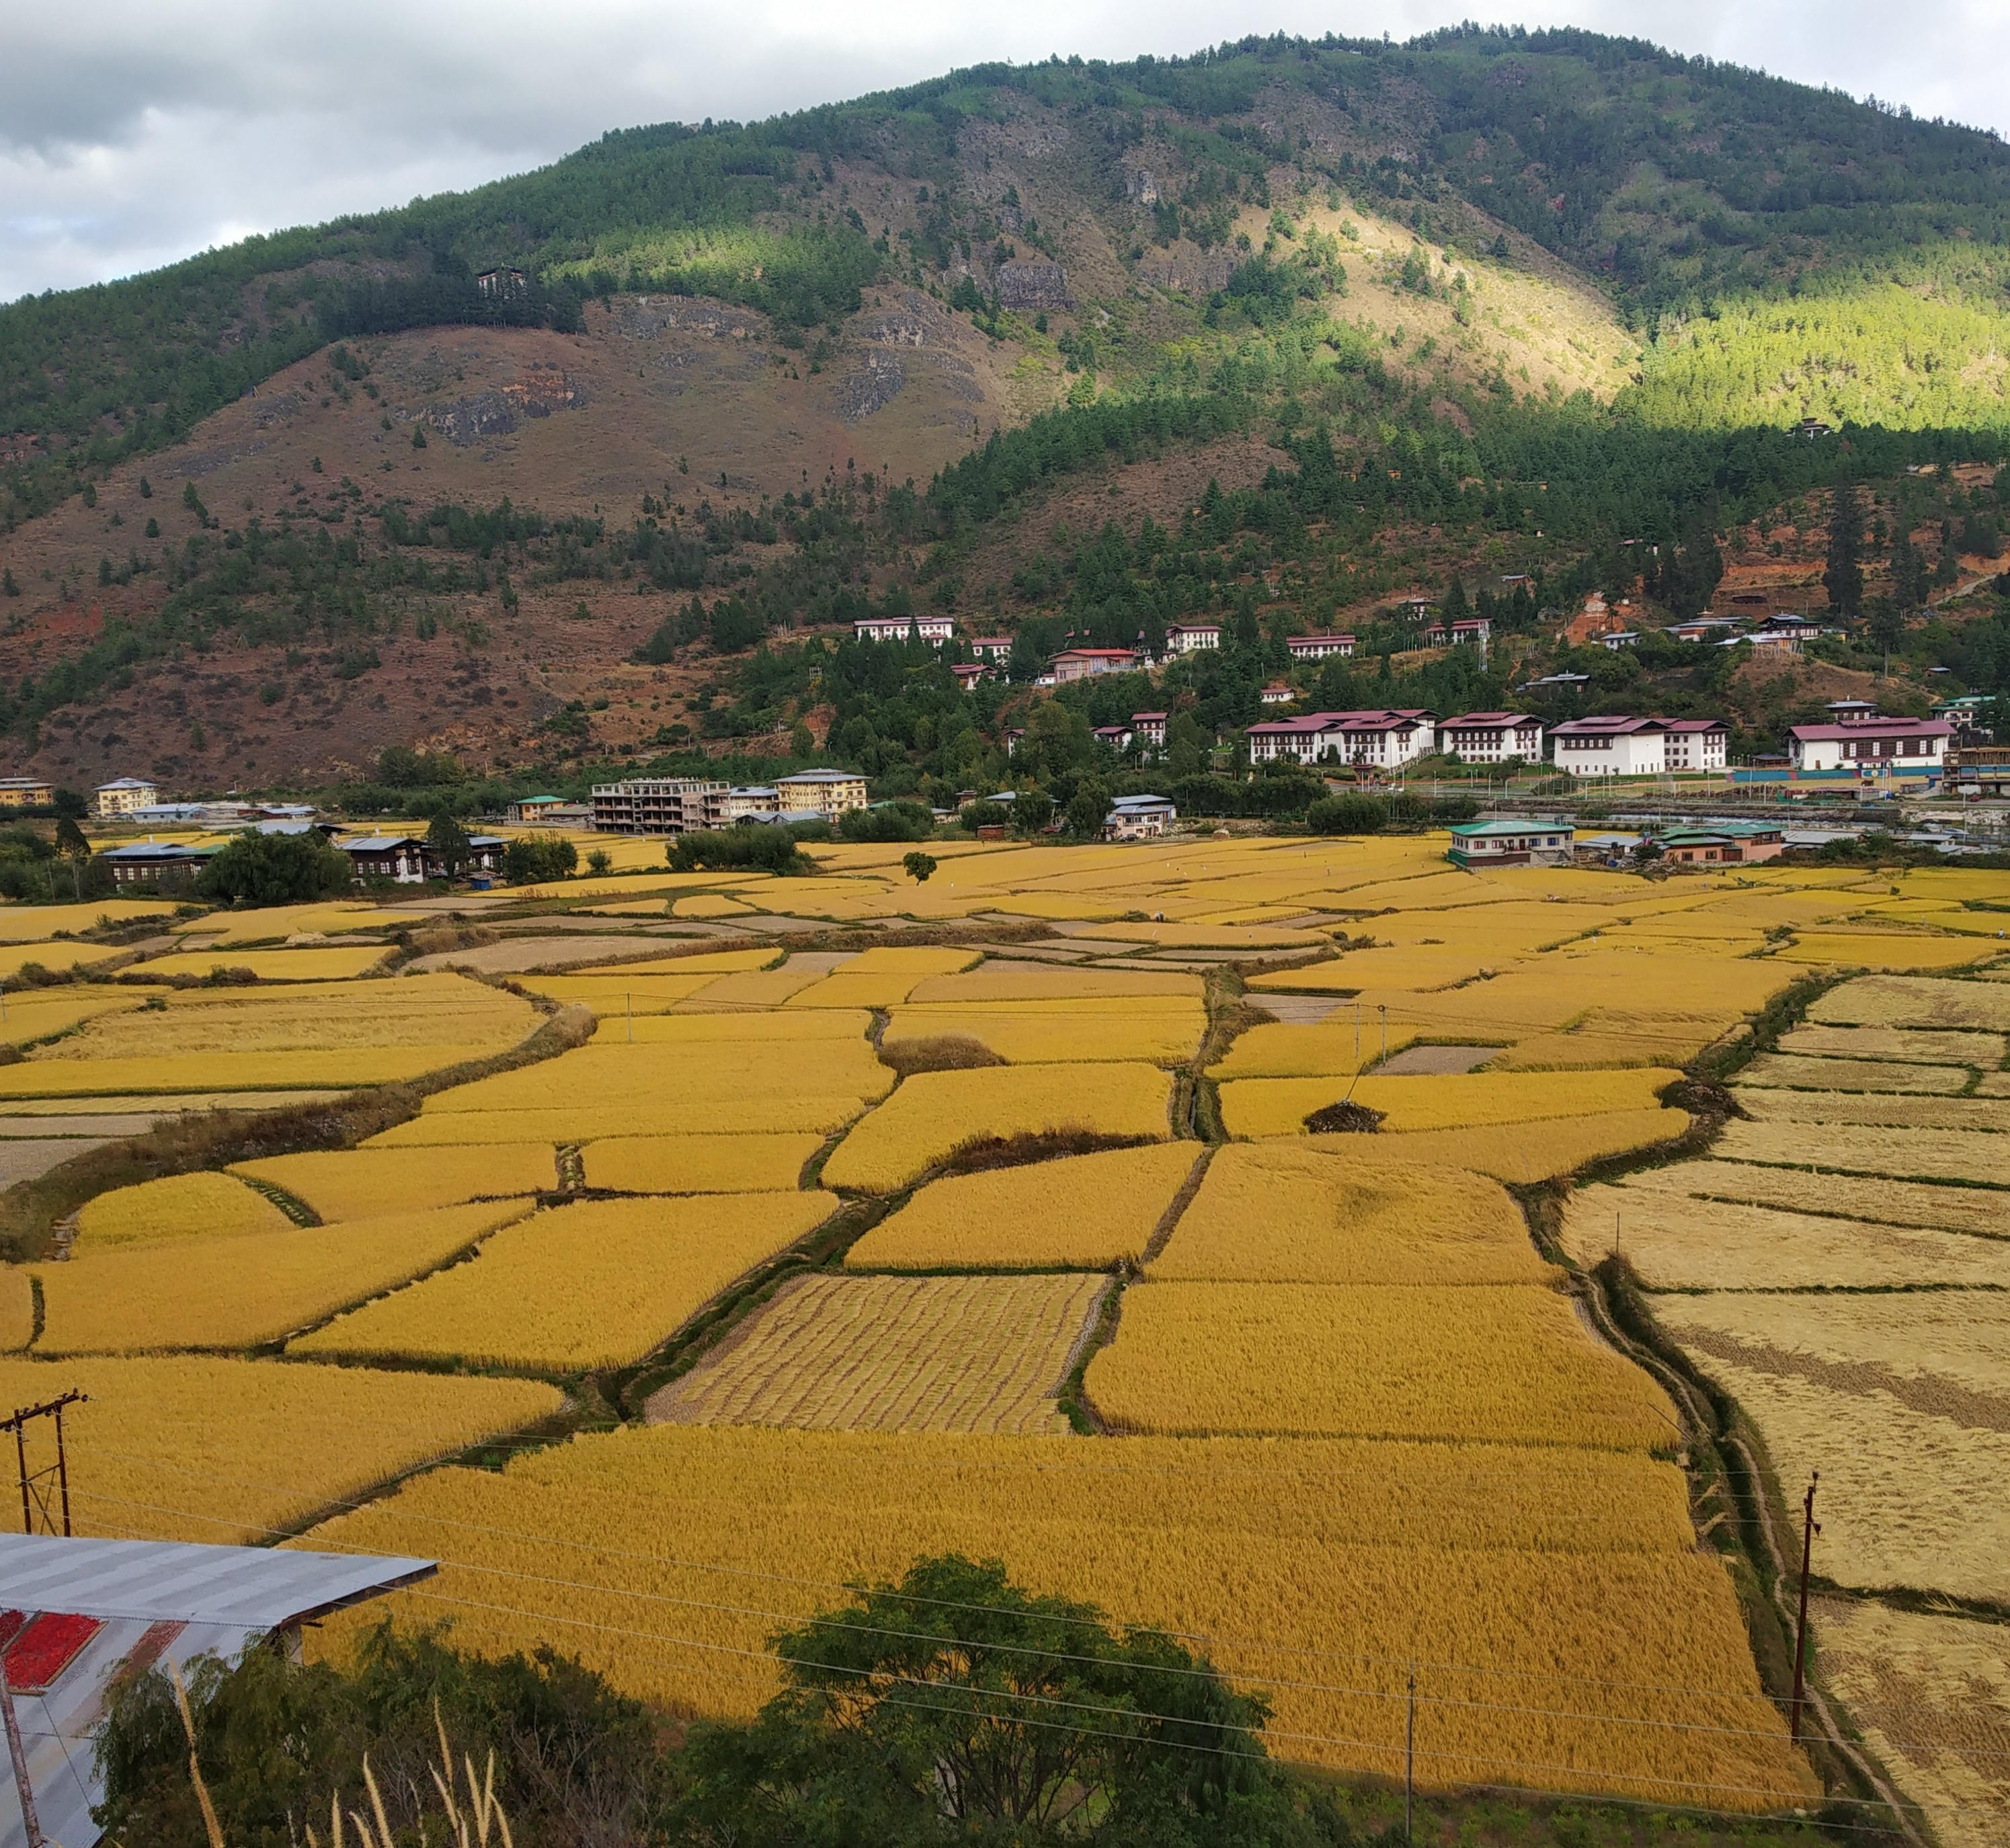
ERRORS & UNCERTAINTIES
Variation in elevation and slope influences how the satellite and ground data are measured
Diversity on the appearance of rice fields, which are at different stages of development in different districts
Human errors such as biases and random errors
Limitations of the RF model as it can only classify based on data that it has come across
Difficult to isolate variable significance for rice classification
Credit: Nidup Dorji/DOA
Image Credit: Living + Nomads
Notes:
Wangdrak:
Every satellite has its limitations, and the highly mountainous terrain makes it more difficult for the images to be processed in our data for rice classification. Also, the images and information of rice fields captured by the satellite are not uniform. Depending on the general environment of the district and also when the image was captured, these introduce diversity on what the random forest model considers to be rice.
In collection of rice plots, it is very likely that there were human errors such as biasness and random errors. The RF model's accuracy, especially in a classification problem like ours, is dependent on the randomness introduced into the training set so it is heavily dependent on the initial rice points which we feed into the model.
The random forest model is an ensemble of multiple decision trees which suffers interpretability as it is primarily a measure of statistical significance. It is difficult to isolate a single study variables from a collection of many and determine the significance of each variable for rice classification.
The RF model's is only as powerful as the amount and variation of data that it has been trained on, hence, further work is needed to validate the significance of the findings

Slide 20
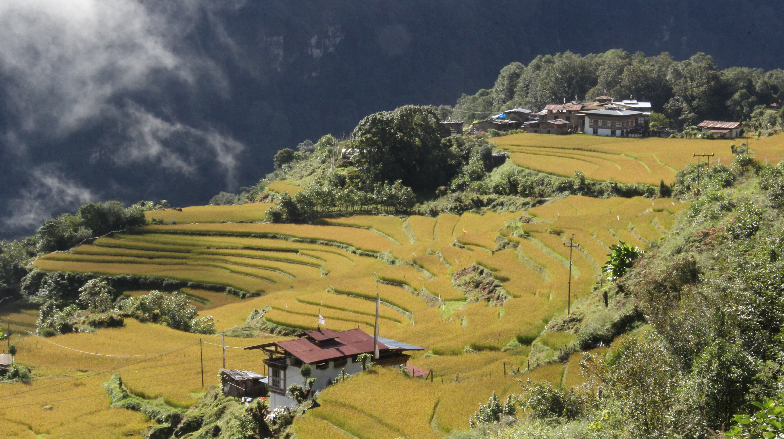
FUTURE WORK
Consider expanding area of interest assessed in Bhutan for the current sampling methodology and crop mask
Incorporate additional crop types into the crop mask protocol
Determine the healthiness of crop varieties
Generate a tutorial to replicate these sampling methods and utilize NASA Earth observations in the future
Credit: Nidup Dorji/ DOA
Credit: OGOP
Notes:
Yeshey:
The second term of this project will build upon the first term’s sampling methodology and crop mask to expand the overall area assessed in Bhutan.
It will also incorporate additional crop types into the crop mask protocol and determine the healthiness of crop varieties within the region.
The continuation project will also provide a video tutorial so partners can replicate these sampling methods and utilize NASA Earth observations in the future.
These end products will help partners meet their goal of remotely defining agricultural regions in Bhutan.
Image credit: Nidup Dorji
Image source: Department of Agriculture
Image license: Permission to use

Slide 21
Science Advisors
Tim Mayer (NASA SERVIR Science Coordination Office)
Dr. Kenton Ross (NASA Langley Research Center)
Sean McCartney (NASA Goddard Space Flight Center)
Dr. Robert Griffin (The University of Alabama Huntsville)
Dr. Jeffrey Luvall (NASA Marshall Space Flight Center)
Filo Gomez-Martinez (NASA SERVIR Science Coordination Office)
Meryl Kruskopf (NASA SERVIR Science Coordination Office)
Partners
Fellow
Tshering Wangchen (Department of Agriculture)
Nidup Dorji (Department of Agriculture)
Tshewang Wangchuk (Bhutan Foundation)
Tshering Yangzom (Bhutan Foundation)
Changa Tshering (UWICER)
Paxton LaJoie (NASA DEVELOP – MSFC)
Additional Support
Dr. Kevin Mwenda (Brown University)
This material contains modified Copernicus Sentinel data (2000- 2019), processed by ESA.
Notes:
Yeshey :
Lastly, we would like to thank our science advisors, partners, and project fellow for their influence in our work.

Slide 22
INDICES USED
OPTICAL | POLARIZATION | TASSLED CAP
Normalized Difference Vegetation Index (NDVI) Normalized Difference Water Index (NDWI) Normalized Difference Moisture Index (NDMI) Soil Adjusted Vegetation Index (SAVI) Slope Elevation | - Changes in Synthetic Aperture Radar (SAR) polarization | Greenness
Notes:
Backup slides.

