Slide 1
EVA Suit Evolution
Sudhakar Rajulu

Slide 2
Why do we need a Space Suit?
Space is a hazardous environment
  Lack of Oxygen
  Very Little Atmospheric Pressure
  Extreme Temperatures
  Radiation
Humans can survive for barely 15 seconds.
  During launch and reentry, humans need additional protection.
  Space work outside of the vehicle in Low Earth Orbit (LEO) or on the moon or on another planet such as Mars, requires protection.
Besides protection, space suits also provide water, oxygen, temperature control, and physiological and environmental monitoring controls
There are different kinds of protective space suits:
  Launch and Entry suit, Microgravity suit, and planetary space suit.

Slide 3
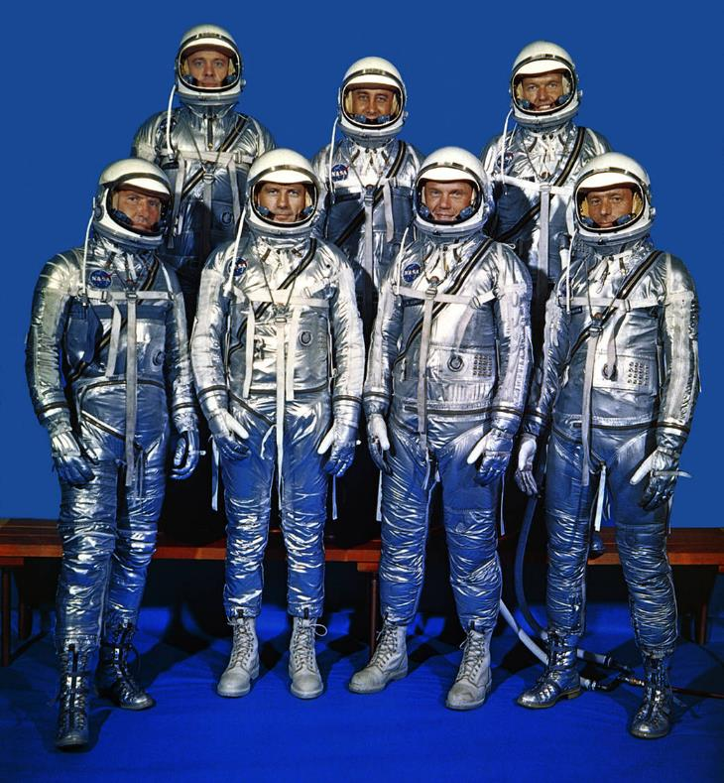
Early Space Programs: Mercury, Gemini and Apollo
Mercury space suit allowed for manning the spacecraft around Earth and to investigate man's ability to function in space
Mercury space suit was adapted from Navy Mark IV flight suit (open loop vs. closed loop breathing system)
In the early days of the US space program, NASA recruited astronauts from a pool of exclusively male military pilots
5’11” was the selection height limit, which was set due to the small size of the Mercury capsule
The ‘Mercury 7’
Notes:
Image Source: Mercury 7 Astronauts, April 1959 | NASA

Slide 4
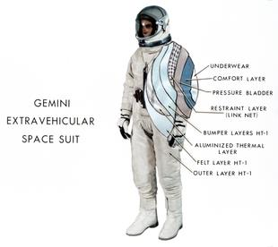
Gemini Program – the First US EVAs
The Gemini program saw the first US Extra-Vehicular Activity (EVA)
Gemini suits were primarily soft, and custom tailored to the wearer, with sizing adjustments available in the arms and legs for any additional customization after construction
EVA activity was minimal, and primarily focused on determining if it was even feasible
Due to the very high workloads associated with moving the stiff suit away from its neutral posture, as well as challenges with EVA restraints and helmet fogging, several Gemini EVAs were aborted early
Gemini EV Suit
Notes:
Image Source: Gemini Spacesuit Image Gallery | NASA

Slide 5
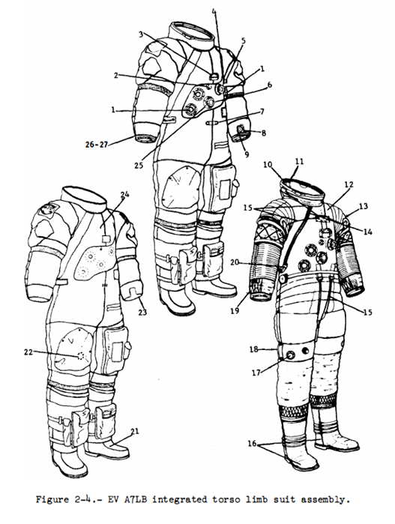
Apollo A7LB – Walking on the Moon
The Apollo A7LB, the lunar walking suit, was custom tailored to each astronaut, but with certain limitations
  One of the crewmembers had interferences between his biceps and the standard arm disconnect size. He also had to have a custom-sized elbow convolute built for his suit, since the standard convolute was too long
  One crewmember had to have a custom helmet built, because the standard helmet size did not fit his head
Even with highly standardized crewmember body shapes and sizes, and custom tailoring of suits, there were suit fit issues
EV A7LB
Notes:
Image Source: Apollo Operations Handbook, Extravehicular Mobility Unit. EMUp2-16.gif (2544×3300) (nasa.gov)

Slide 6
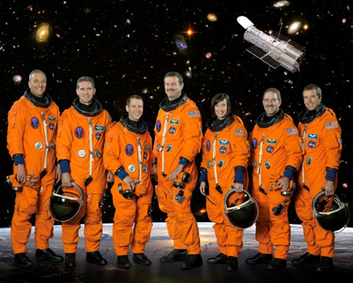
The Space Shuttle Program
The Space Shuttle program saw a much wider ranges in body dimensions, as selection requirements were relaxed to include females and to allow the astronaut office to represent a more diverse cross section of the population
Because of the large number of EV crewmembers, and because of their diversity in size, NASA had to take a different approach to building EVA suits for their new astronaut corps
STS-125 Crew
Notes:
Image Source: NASA - STS-125

Slide 7
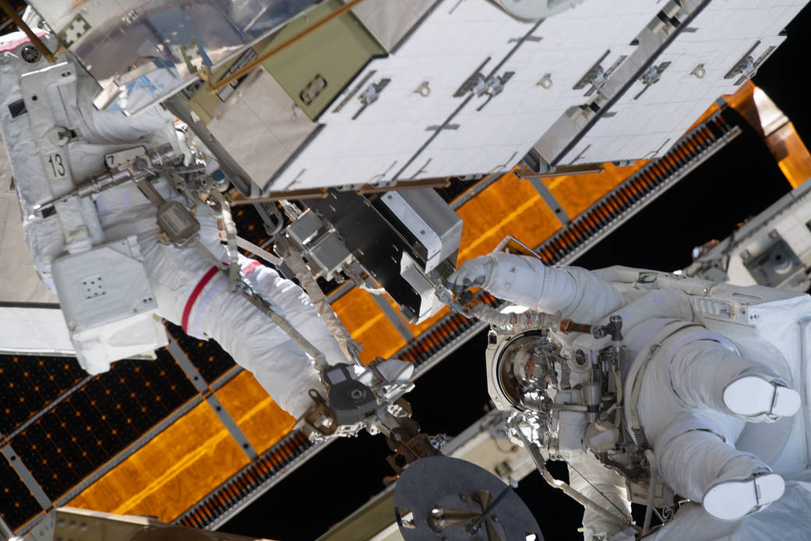
The Space Shuttle EMU and the First All-Female EVA
The Space Shuttle Extravehicular Mobility Unit (EMU) was designed with separable components that could be swapped out to allow resizing and customization, enabling a wider range of crewmembers to perform EVA than ever before
On October 18th, 2019, the first all-female EVA was successfully completed by the team of Jessica Meir and Christina Koch
NASA astronauts Jessica Meir (left) and Christina Koch (right)
Notes:
Image Source: Astronauts Jessica Meir and Christina Koch pictured during a spacewalk | NASA

Slide 8

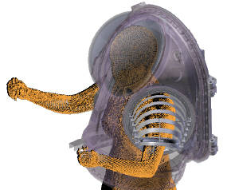

xEMU: Design for a Wide Range of Population Accommodation
Following the retirement of the space shuttle, NASA began a development program to create a spacesuit that would attempt to accommodate an even wider range of body shapes and sizes
The new suit would have advanced mobility features to allow astronauts to walk on the lunar surface or efficiently perform EVAs in microgravity
3D models of the human body were used early in the design process to confirm hardware size and shape, and functional testing in 3D printed mockups was used to assess accommodation for small to large sized subjects.
Virtual fit testing of the xEMU HUT (Left)
Analysis of Multiple Component Interactions (Right)
Notes:
Image Source (L): A Next Generation Spacesuit for the Artemis Generation of Astronauts (nasa.gov)
Image Source (R): EVA Exploration Workshop, February 2020

Slide 9
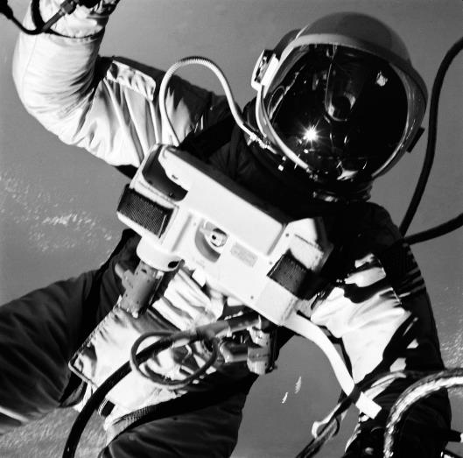
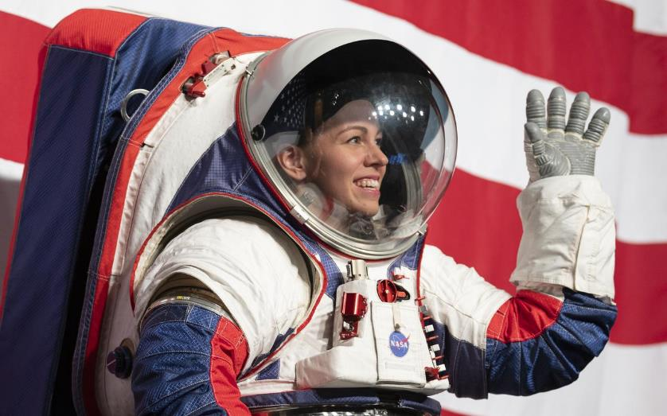
Conclusion
Since the 1960s, EVA spacesuits have progressed from soft fabric enclosures tailored to fit a small number of men, to highly capable systems that are designed to fit a large portion of the population
Gemini IV EVA
Artemis Generation Spacesuit Event
Notes:
Image Source (L): EVA - ASTRONAUT EDWARD H. WHITE II - MISC. - OUTER SPACE | NASA Image and Video Library
Image Source (R): Artemis Generation Spacesuit Event | NASA Image and Video Library

Slide 10


