Slide 1
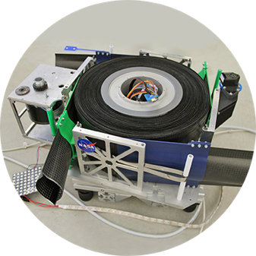
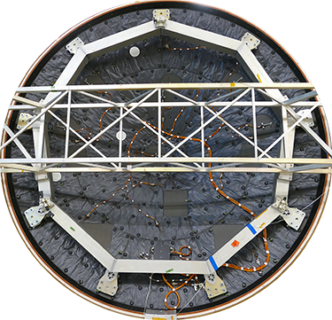
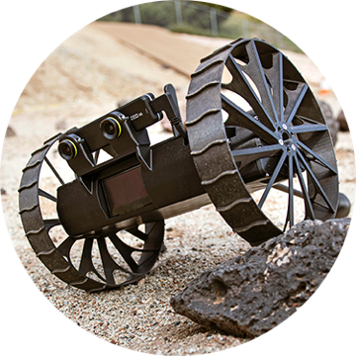
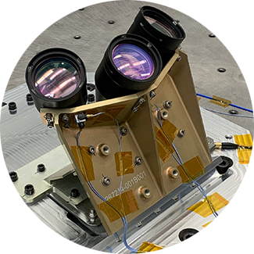
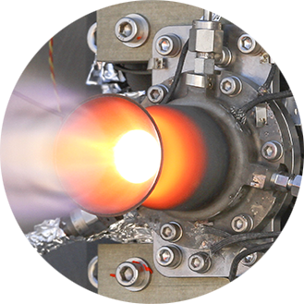
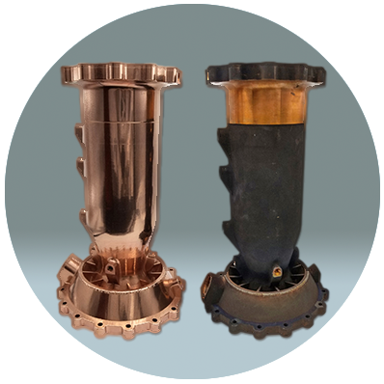
Space Technology Mission Directorate
Game Changing Development Program
Amanda Cutright, GCD Chief Engineer | Jeff Antol, GCD Lead Systems Engineer | Kevin Kempton, GCD Program Element Manager (PEM) | Risky Space Business Challenge

Slide 2
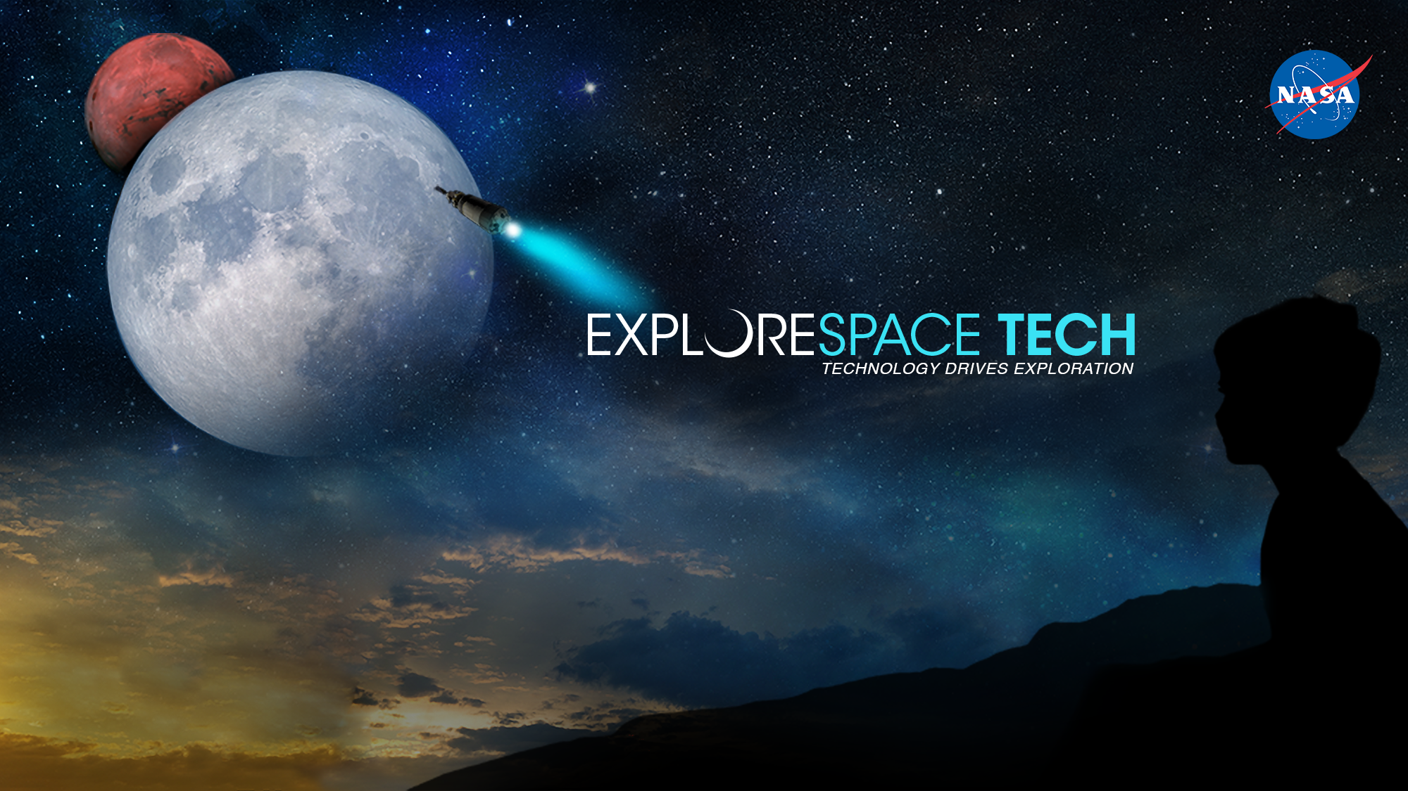

Slide 3
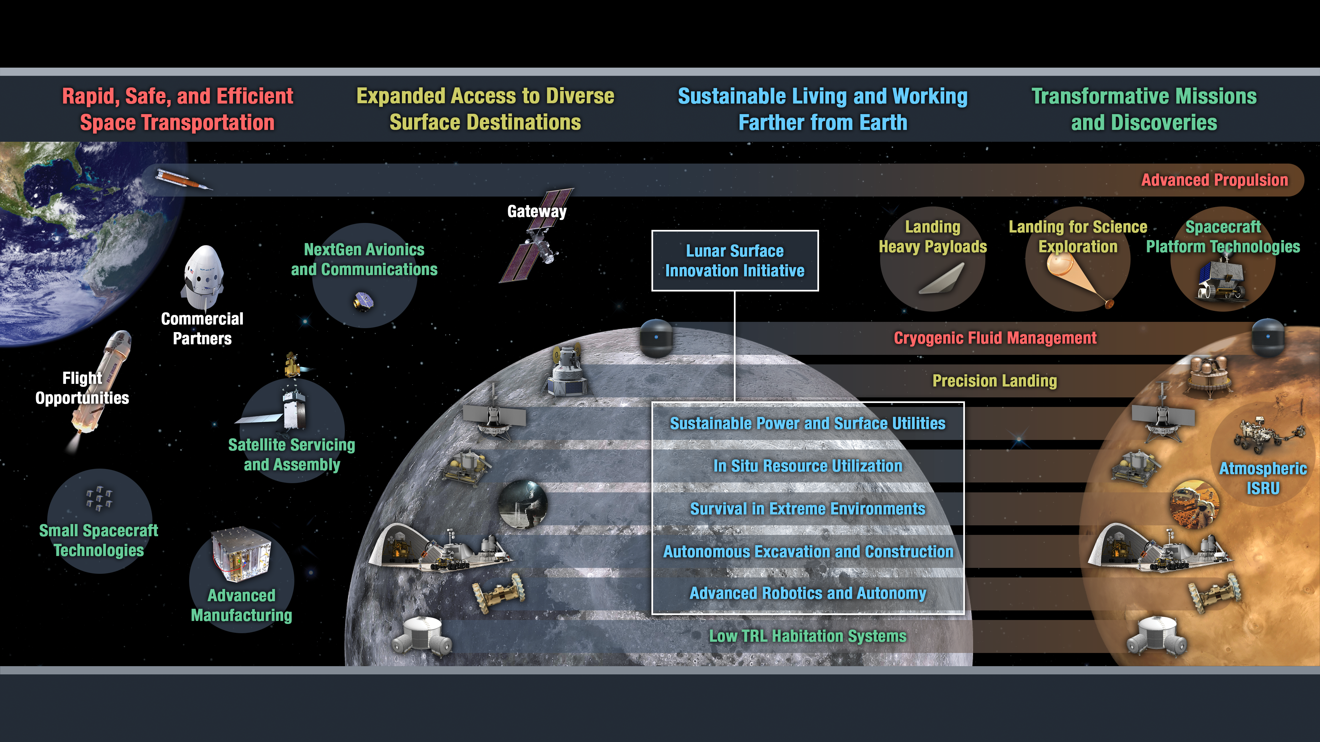
Space Entry, Descent Sustainable Discover and
Transportation and Landing Exploration Explore
Technology Drives Exploration

Slide 4
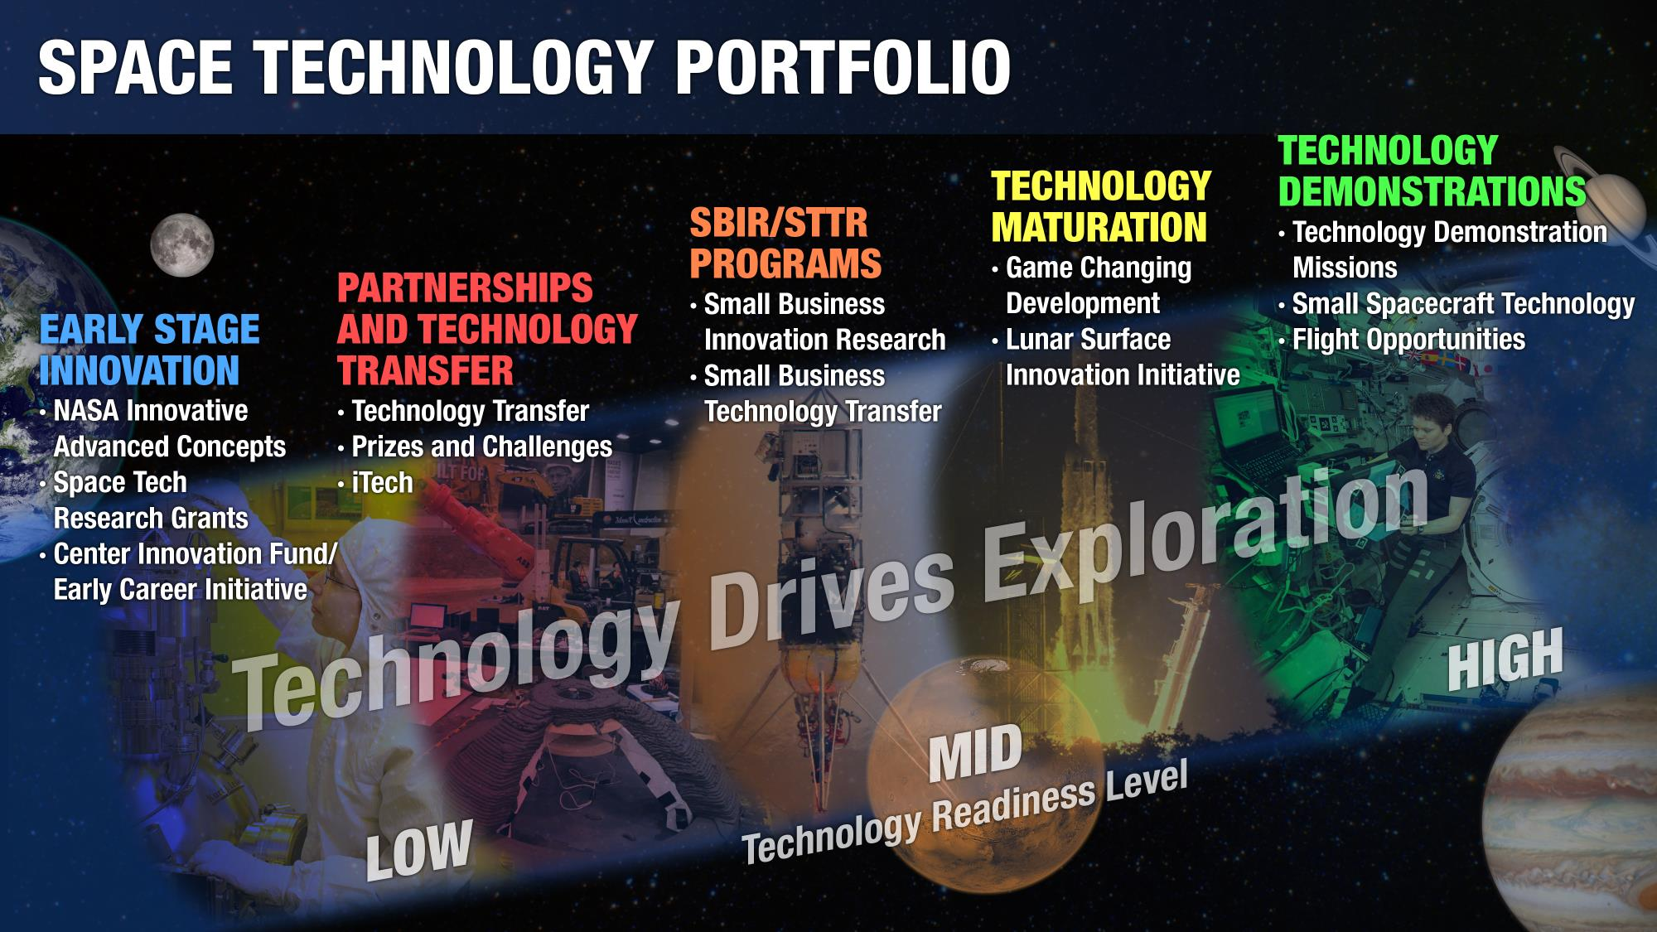
Notes:
Anthony Calomino – Space Nuclear Technologies
Moving to TDM – CFT, NTP,

Slide 5
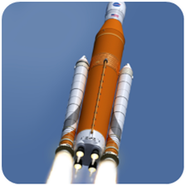
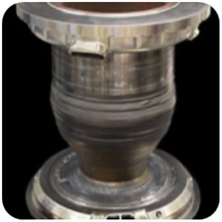
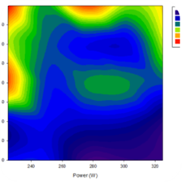
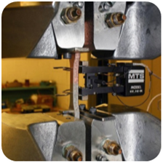
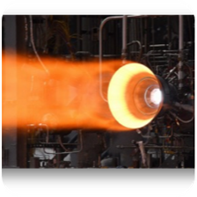
Technology Assessment Process Examples
Identify critical “Technical Elements” to be assessed
List technical objectives
List technology challenges – technical elements
Identify knowledge gaps
Steps to address knowledge gaps
Impact of development on technical elements
Characterize readiness levels (RL) of each element (ex. technical, manufacturing, software)
TRL 2
Technology Concept
TRL 3
Proof of Concept Demonstration
TRL 4
Breadboard
Validation in Laboratory Env.
TRL 5
Component/Brassboard Validated in Relevant Environment
TRL 6
(Sub)System/Prototype Demonstration in Relevant Environment
.
Characterize the advancement degree of difficulty (AD²) required to advance readiness levels
AD² 4
Low degree of difficulty
Requires new development, but similarity to existing technology
Confidence high with single development path
AD² 5
Moderate degree of difficulty
High confidence with dual development paths
AD² 6
High degree of difficulty
Experience in some critical areas
Moderate confidence with two development paths
AD² 7
High degree of difficulty
Little experience in some critical areas
Multiple development paths required
AD² 8
Very high degree of difficulty
Fundamental unknowns
Significant technical risk even with multiple development paths
Notes:
Updated as of 4/30/2021

Slide 6
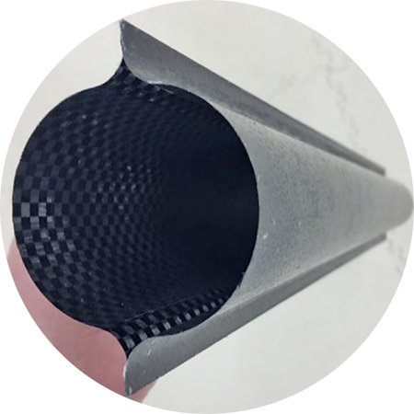
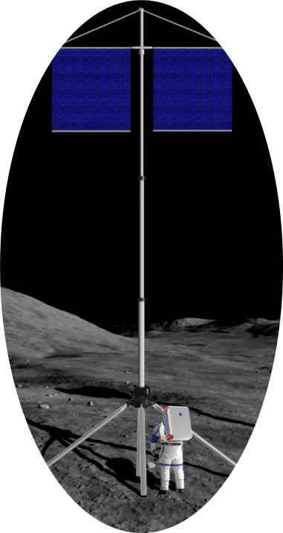
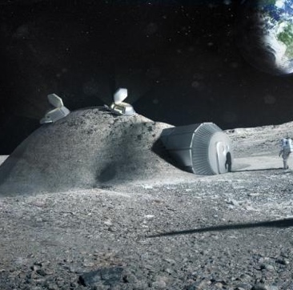
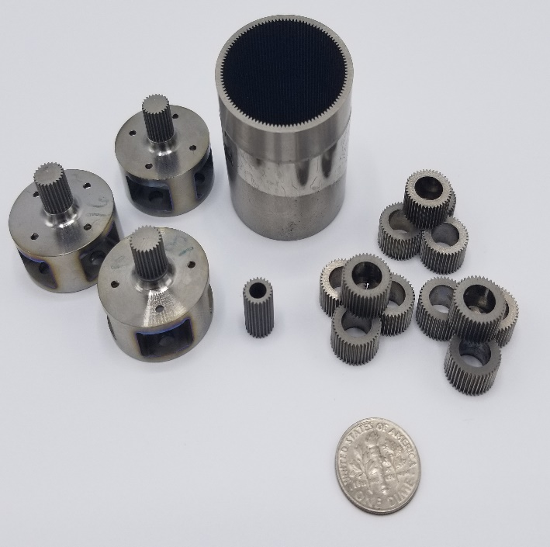
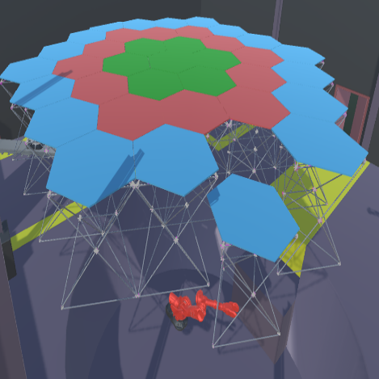
Game Changing Development (GCD) Program
Currently over 100 projects across many technical disciplines in GCD
  Significant program growth over the last couple of years!
  Drives need for efficiencies and solutions to save time and help ensure mission implementation successes
  Desire for efficient, predictive, and informed decision making
  A Risk Digital Assistant (RDA) solution could be scaleable and adaptable for other uses cases at NASA!
  https://www.nasa.gov/directorates/spacetech/game_changing_development/index.html

Slide 7
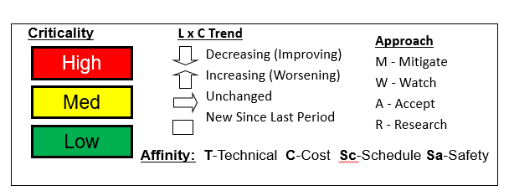
Risk Example
L
I
K
E
L
I
H
O
O
D
5
Risk ID | Affinity | Description/Status | Proposed Mitigation | Trend
ID#
4
3
2
1
1
2
3
4
5
CONSEQUENCES

Slide 8

Risky Space Business Challenge
Develop a Risk Digital Assistant (RDA) using Machine Learning and/or Artificial Intelligence tools to help GCD program management with efficient, predictive, and informed decision making
Improve risk identification and mitigation efforts (with associated resource planning or have threats to schedule or technical performance) for the program’s technology development portfolio
  Exploring AI and ML solutions that could help supplement the current risk management process by reaching into documented ‘lessons learned’ and cross referencing those insights with future project plans
  A capability that can data mine to help identify risks, forecast trends of risks materializing, suggest solutions for feasible risk mitigations, or discover other out-of-the-box risk management solutions!

