Slide 1
Summary of the First AIAA Stability and Control Prediction Workshop
2022 AIAA SciTech Forum
January 5, 2022
Tom Chyczewski (Penn State Applied Research Lab)
Andrew Lofthouse (Air Force Life Cycle Management Center)
Lie-Mine Gea (The Boeing Company)
Aurelia Cartieri (ONERA, The French Aerospace Lab)
Brett Hiller (NASA Langley Research Center)

Slide 2
Background
Motivation
  Stability and Control (S&C) issues continue to be exposed during flight tests which incur cost and schedule penalties and possibly envelope limitations
Objectives
  Long Term:
    Establish community consensus on the strengths and weaknesses of existing CFD prediction capabilities applied to S&C analysis and derive optimal paths toward state-of-the-art enhancements
  Current Work:
    Establish a baseline S&C prediction capability for a relatively simple test case
Approach
  Workshops
    Provide a relatively controlled environment to gather prediction statistics for common cases

Slide 3
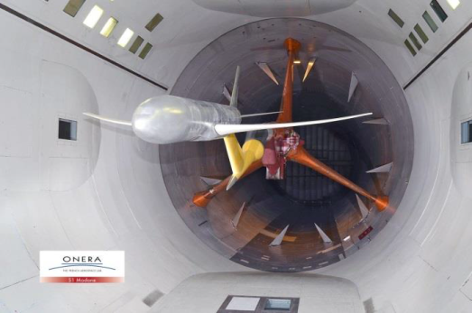
Geometry and Wind Tunnel Test
ONERA Large Reference Model (LRM)
  Same geometry as the Common Research Model (fuselage, aerodynamically loaded wings and horizontal tail) plus a vertical tail designed by ONERA
ONERA wind tunnel sting
Tested in ONERA’s S1MA wind tunnel
Conditions:
  Re_{MAC} = 5 million
  β = 0⁰
    0.30 ≤ Mach ≤ 0.95
    -3.0⁰ ≤ α ≤ 10.0⁰
  β = ±1⁰
    0.70 ≤ Mach ≤ 0.90
    3.0⁰ ≤ α ≤ 4.5⁰
Data
  Forces and moments
  Surface pressure
  β = ±1⁰ data are unpublished

Slide 4
Test Case Descriptions
2D NACA Airfoil Verification - Used to verify solver converges to documented solutions, (results are not included here)
Grid Convergence Study – Mach 0.83, Re_{MAC} = 4.56 million, C_{L} = 0.5, β = 1⁰ (nose left)
  Wind tunnel sting on
  Predictions from coarse, medium and fine grids (defined in next slides) required
Mach Effect on Static Stability – Mach 0.7019, 0.8325, 0.853, 0.8749, 0.9050 (Re_{MAC} range: 4.24 to 4.68 million)
  Wind tunnel sting on
  Medium grids
Wind Tunnel Sting Increments – Mach 0.83, Re_{MAC} = 4.56 million, C_{L} = 0.48 and 0.52, β = 0⁰
  Wind tunnel sting on and off
  Medium grids
Alternative Stability Derivative Calculation (optional) – Intended to give participants an opportunity to use their best practices instead of the central difference scheme used here
  Not enough submissions to warrant presentation
β Sweep (optional) – Mach 0.83, Re_{MAC}=4.56 million, C_{L} = 0.5, β = 1⁰, 3⁰ and 5⁰ (nose left)
  Wind tunnel sting on
  Medium grids
Reported Data:
  Stability axis forces and moments for total CRM, port wing, stbd wing, fuselage, tail
  Wing and tail surface pressure profiles (Case 3 only)

Slide 5
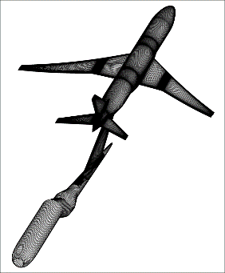
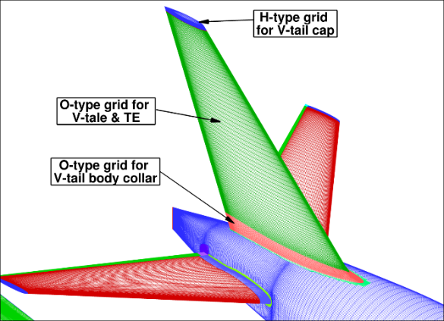
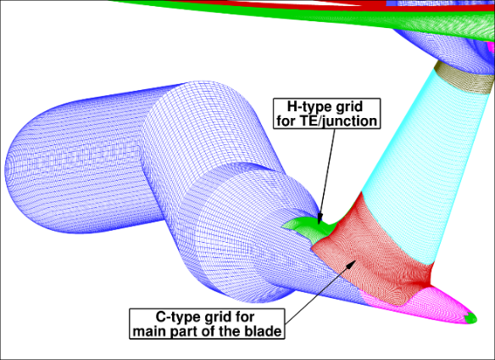
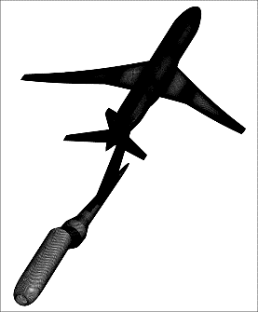
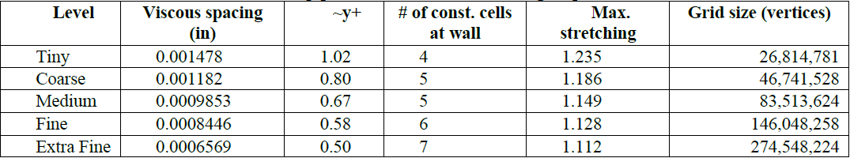
Grid Generation: Workshop Structured Overset
Structured overset grids from previous workshops were used here where possible
  DPW6: Aerodynamically loaded wings, fuselage
  DPW4: Horizontal tail
  These were scaled to wind tunnel scale and mirrored about y=0 to generate the full geometry
New grids were created for the vertical tail and the wind tunnel sting following the guidelines published for DPW6
Tiny
H-type grid for V-tail cap
Extra Fine
O-type grid for V-tail & TE
H-type grid
for TE/junction
O-type grid for
V-tail body collar
C-type grid for
main part of the blade

Slide 6
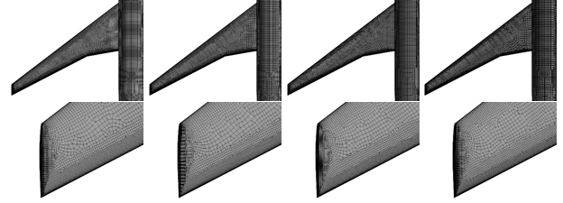
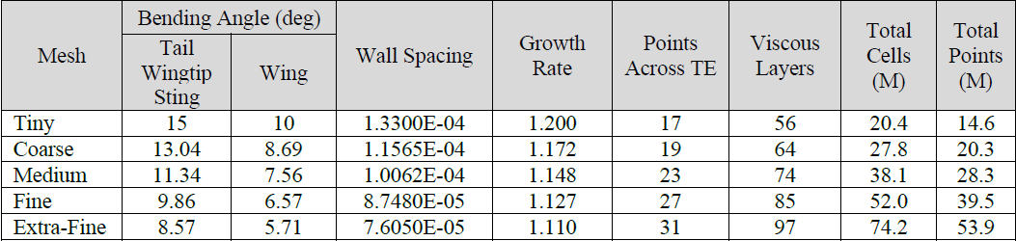
Grid Generation: Workshop Unstructured
Generated with Pointwise
Quad-dominant surface meshes with spacing controls:
  cell edge lengths near sharp edges in the geometry
  max (bending) angle between adjacent surface faces (see table below)
Surface meshes anisotropically extruded into layers of prisms and hexahedra
  Wall spacing, growth rate and # layers given in the table
Isotropic tetrahedral are fit between the outer layer and the farfield boundary
Coarse
Medium
Fine
Extra Fine

Slide 7
Grid Generation: Revisions
Participants uncovered issues with both the overset structured and the unstructured grids while working the test cases:
  Structured Overset Grids:
    The vertical tail grid surface was faceted and did not have enough leading edge resolution
  Unstructured Grids:
    Overresolution of the trailing edges at the expense of midchord resolution
    Port/Starboard asymmetries that can lead to asymmetric solutions at β = 0⁰
Revisions to resolve the issues were made by participants and made available to the community
  Structured Overset
    NGC: Pointwise and Chimera Grid Tools
  Unstructured:
    USAF AFLCMC: Pointwise
    NASA LaRC: HeldenMesh
The participants were asked to rerun Case 3 (Mach sweep) with the new grids

Slide 8
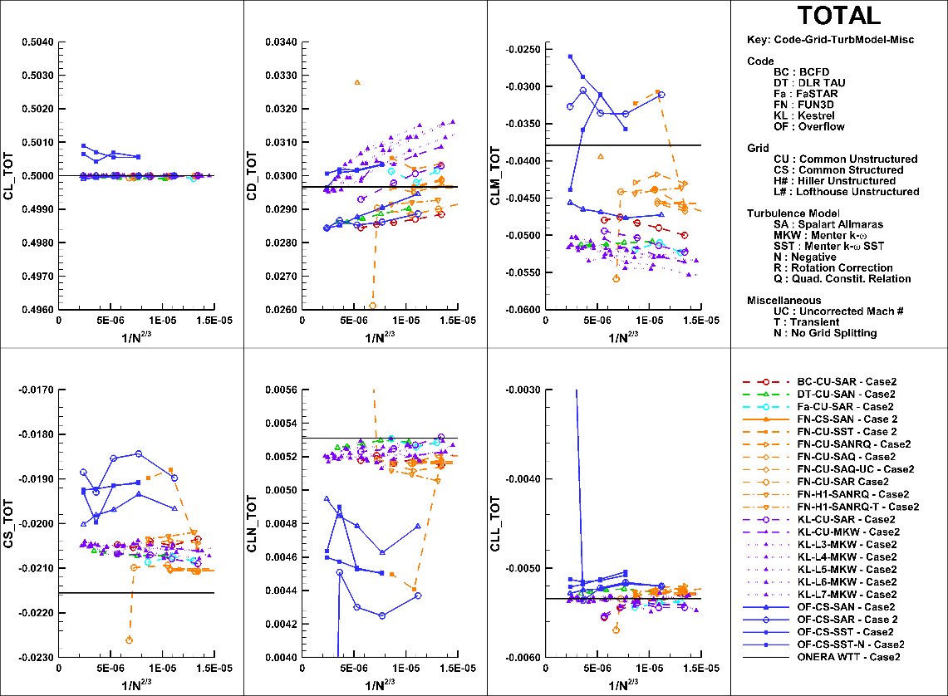
Results: Case 2 – Grids Refinement Study
Lift Coefficient:
  A target lift coefficient was specified for the problem, so the agreement should be good
  One participant solution converged to within 0.2% of the target only
Drag Coefficient:
  Good grid convergence trends
  Converged values spread is about 5% of the Wind Tunnel Test (WTT) data
Pitching Moment Coefficient
  Reasonable grid convergence
  A lot of scatter in the converged values
Side Force and Yawing Moment Coefficients:
  Good grid convergence trends except for the results obtained with the structured overset grids (recall issue with vertical tail grids)
  Good agreement between grid converged values
Rolling Moment Coefficient:
  Good grid convergence, little scatter among converged values and good agreement with WTT data

Slide 9
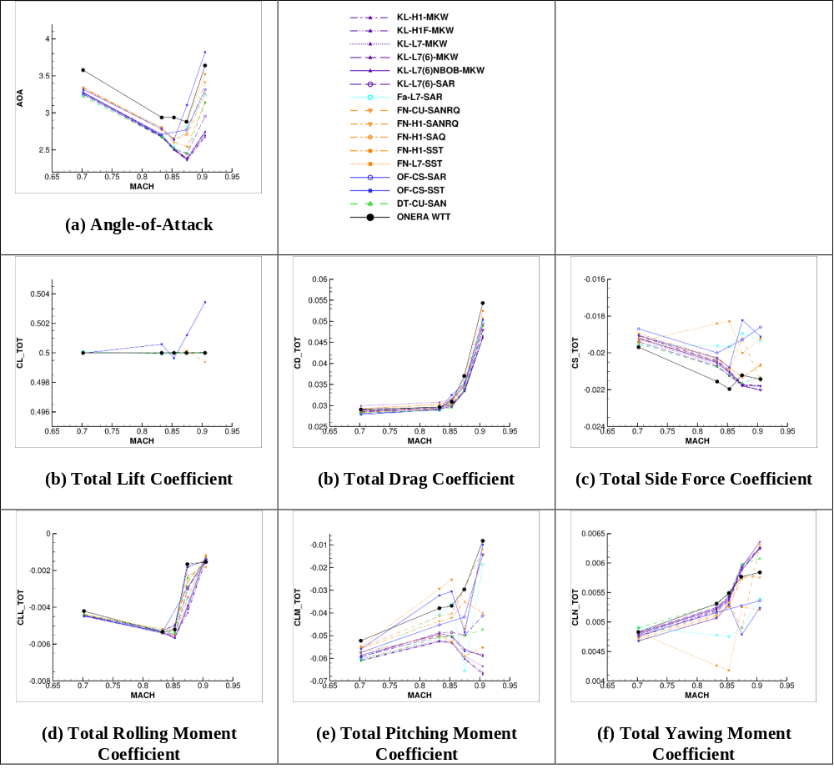
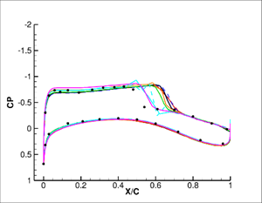
Results: Case 3 – Mach Sweep
Lift Coefficient:
  Reasonable convergence to the target lift
Drag Coefficient:
  Good agreement between all CFD predictions and WTT data at low Mach
  Agreement deteriorates as the Mach number increases with the predictions consistently below the WTT data
Pitching Moment Coefficient
  Marginal agreement at low Mach that deteriorates with increasing Mach number
  Agreement with WTT data is poor in general
Side Force Coefficient
  Reasonable agreement between predictions at low Mach, deteriorates w/ increasing Mach
  Consistently underpredicts WTT data at low Mach
Mach 0.87
73% Span of Upwind Wing
(key not illustrated)
Yawing Moment Coefficient
  Very similar to side force coefficient predictions, except better agreement w/ WTT data
Rolling Moment Coefficient
  Very little scatter in the predictions except at Mach 0.87 (shock location?)
  Good agreement with WTT except at Mach 0.87

Slide 10
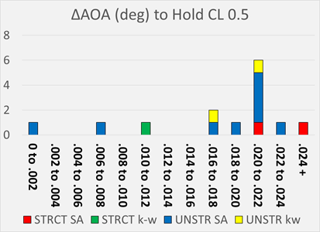
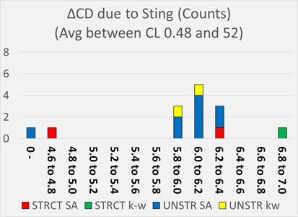
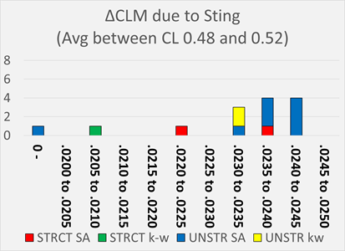
Results: Case 4 – Wind Tunnel Sting Increments
Histograms show the number of predictions (y-axis) in each bin of wind tunnel sting increment (x-axis)
No test data to compare against
ΔAOA to Hold C_{L}=0.5
  Well defined peak in the 0.020 to 0.22 degree bin, dominated by the UNSTR SA results
ΔCD due to Sting
  Excluding outliers, normal-looking distribution centered at the 6-6.2 count bin
ΔCLM due to Sting
  Flatter distribution, but still reasonably well clustered with the exception of a few outliers
STRCT – Structured Overset Grids
UNSTR – Unstructured Grids
SA – Spalart Allmaras Turbulence Model
kw – k-ω Turbulence Model, w/ and w/o SST

Slide 11
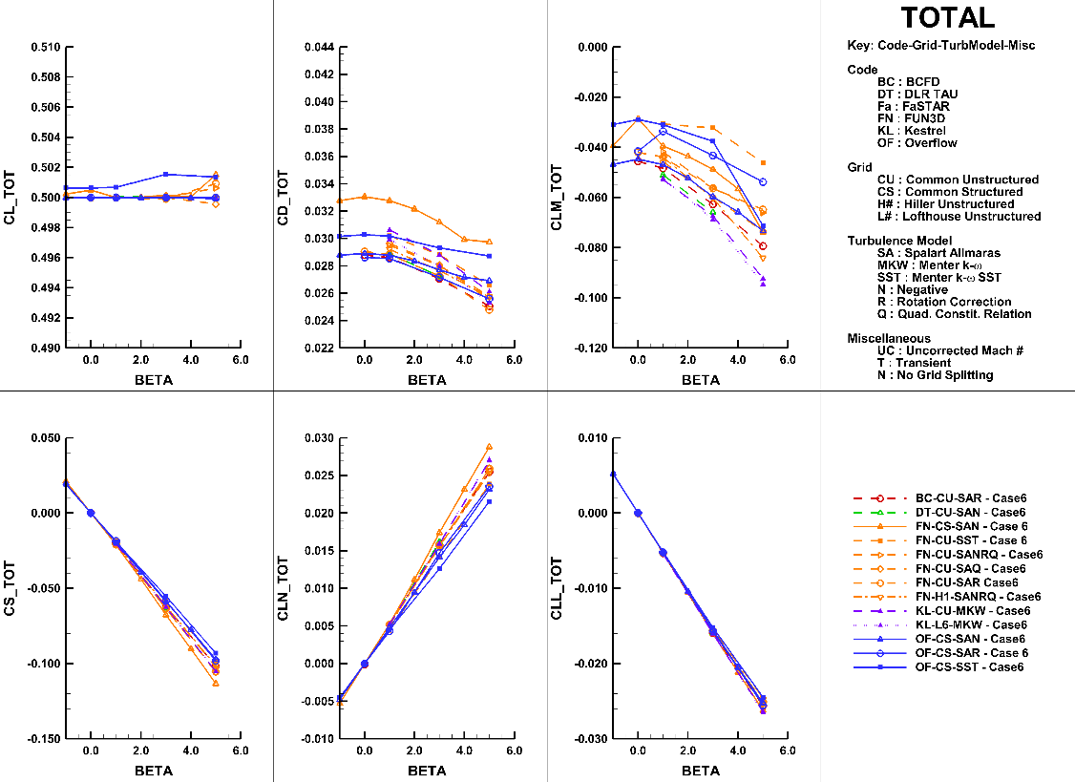
Results: Case 6 – Sideslip Sweep
No test data to compare against except at β=1⁰
Lift Coefficient:
  Reasonably good convergence to the target lift coefficient
Drag Coefficient:
  FN-CS-SAN result is an outlier
    First attempt by participant to use FUN3D w/ structured overset grids
  Spread between predictions is about the same as the variation with β up to 5⁰
    However, spread is a bit tighter if the structured overset grid results are removed (original grids used)
WTT Data
Pitching Moment Coefficient:
  Similar story as drag coefficient except a little worse
    Structured overset vertical tail grids unlikely a culprit for the pitching moment coefficient
Side Force and Yawing Moment Coefficients:
  Very good agreement at lower sideslip angles
  Spread at higher angles likely due to structured overset vertical tail grid issues
Rolling Moment Coefficient:
  Very good agreement between the predictions across β sweep.

Slide 12
Summary and Conclusions
Results from the First AIAA Stability and Control Prediction Workshop were presented
  Geometry: CRM w/ ONERA designed vertical tail
  Test cases focused on small sideslip conditions and a wind tunnel sting increment estimation
In general, except for the pitching moment coefficient, there is good agreement between the predictions and the wind tunnel test data at low Mach numbers
  Pitching moment coefficient predictions are unsatisfactory across all conditions
  Development of a 2D test case (CRM slice at 50% horizontal tail span) is underway in an attempt to improve understanding of the source(s) of the pitching moment coefficient problems
Assessment by S&C SMEs:
  Too much scatter in pitching moment coefficient to be useful
  Other force and moment coefficient predictions at low Mach may contribute to OML decisions or be useful in flight simulations

