Slide 1

NASA’s Human Research Program (HRP)
Space Radiation Element (SRE)
Janice A. Zawaski, Ph.D.
Space Radiation Deputy Element Scientist
NASA Human Research Program

Slide 2

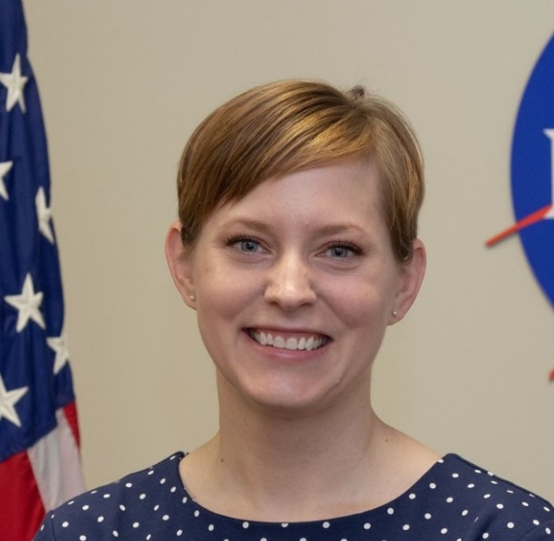
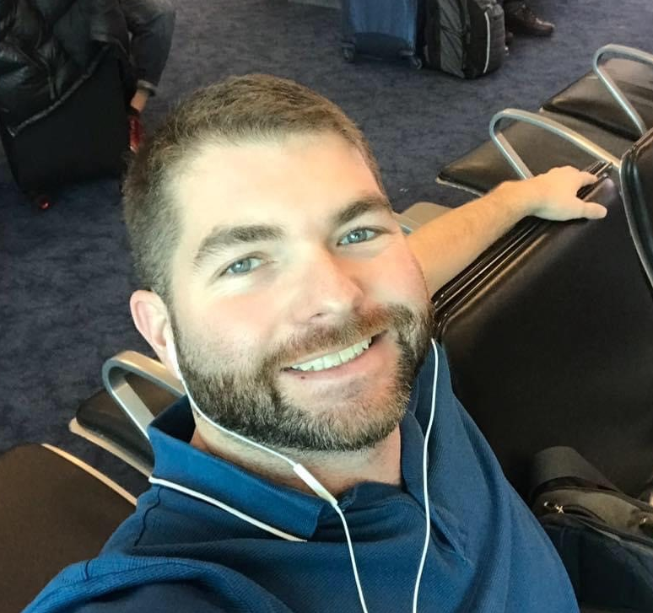


Space Radiation Element Team
Mission: Characterize and facilitate the management of the human health outcomes associated with space radiation exposure to protect astronaut health and wellbeing to enable human spaceflight
Science
S. Robin Elgart Ph.D., Element Scientist
Janice Zawaski Ph.D., Deputy Element Scientist
Gregory Nelson Ph.D., CNS Discipline Lead
JP Saha Ph.D., Degenerative Tissues Discipline Lead
Brock Sishc Ph.D., Cancer Discipline Lead
Management
Jason Weeks M.S., Element Manager
Nicholas Meyer M.S., Deputy Element Manager
Lisa Stephenson M.B.A., P.M.P., Science Integrator
jsc-hrp-space-radiation-element@mail.nasa.gov
Robin
Janice
Brock
Greg
JP

Slide 3
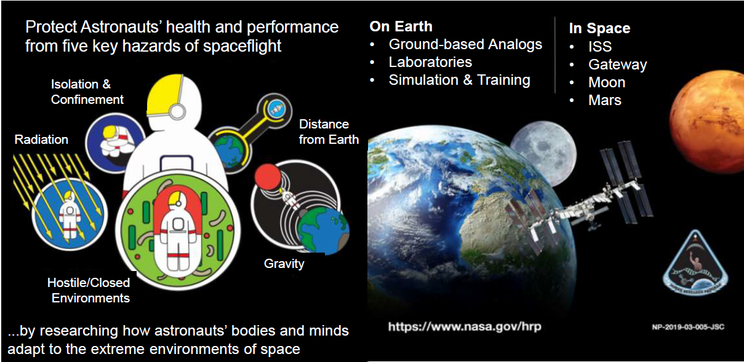
Human Research Program

Slide 4
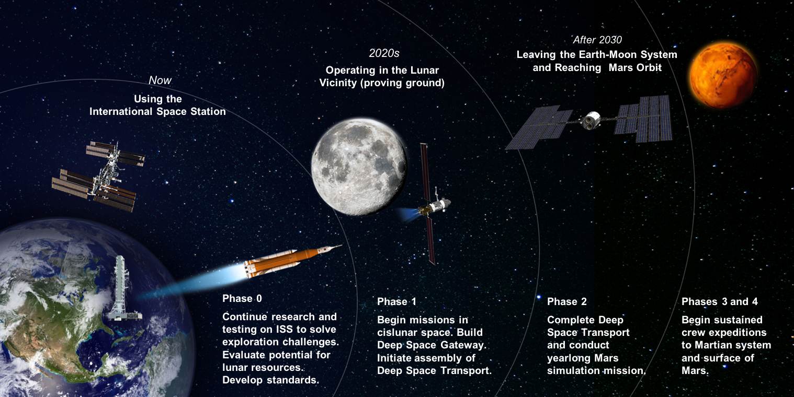
Planned Exploration Activities

Slide 5
Translating Basic Science to Applications (Example in Biomedicine)
Space Biology
Human Research
Basic
Translational Research
Applied
Study how life responds, adapts, develops, interacts and evolves in the space environment and across the gravitational continuum
Cell and Molecular Biology
Microbiology
Animal Biology
Plant Biology
Developmental and Reproductive Biology
Space Biology provides science data and findings that foster research and development
Animal Research
Cells and Tissues
Immunology
Wound Healing and Fracture repair
Bone and Muscle
Radiation/Micro-g Interactions
Microbiome of the Built environment
Identify, characterize and mitigate the risks to human health and performance in space
Exercise and Physiological Countermeasures
Space Radiation Biology
Behavioral Health and Performance
Space Human Factors and Habitability
Exploration Medical Capability
Environmental Monitoring
Basic Science
Medical Operations
Science Exploring
the Unknown
Science Addressing
the Known Risks

Slide 6
What Do we Do? Space Radiation Element Research
Three primary health risks:
Carcinogenesis
Cardiovascular & Immune
Central Nervous System
Formally Degenerative Tissues now listed under the Cardiovascular (CVD) or Immune (IM) Risks
Integrated into the Behavioral Medicine (BMed) Risk
Characterization |  | Mitigation
Dose and Dose Rate Effects | Biomarkers | Countermeasure Identification
Radiation Quality | Individual Susceptibility | Countermeasure Validation
Species Translation | Combined Stressors
https://humanresearchroadmap.nasa.gov/

Slide 7
Funding Opportunities - https://nspires.nasaprs.com
Human Exploration Research Opportunities (HERO)
Flagship (NRA)
Proposal must answer topic and required deliverables, 10 pages step-2.
Varying budget and length (allowed to submit a proposal for a shorter time).
Fund ~1-2 proposals / topic, dependent on budget.
Omnibus & Omnibus – New Investigators to NASA
Proposal is not restrained by topics, 5 page step-2.
Projects that are suitable are typically short-term investigations or technology development projects that provide innovative approaches to any of the risks and associated knowledge gaps https://humanresearchroadmap.nasa.gov/ contained in the Integrated Research Plan https://humanresearchroadmap.nasa.gov/
Budget $150K (inclusive) for 1 year.
Number of funded applications is variable.
For flagships and Omnibus:
Applicants do not have to be faculty.
  Open to all career levels
  Submitters must be from a U.S. institute
  Must submit a step-1, essentially a LOI, and be invited back to submit a Step-2
New investigator: Have not had NASA funding as a PI in 10 years. (fellowships and being a collaborator on a NASA grant are not exclusions)
Early Career Investigator must be within 10 years of terminal degree (remember to check the box if an ECI)

Slide 8
Submission Process https://nspires.nasaprs.com
(HERO: Flagship, Omnibus)
HERO Time Schedule*
HERO Release | March | July | November
Step-1 Due | April 30th | September 1st | January (1st week)
Step-2 Due | July 30th | December 1st | April (1st Week)
Awarded Notice | December | April | September
*note these dates are based on past HEROs and future exact due dates may differ
Cancelled 2021
HRP relevancy
review
NRESS – Scientific Peer Review
HRP – Scientific Relevance Review
NASA
NSPIRES
Announcement
Step - 1 due
(1-page)
Invitation
Step-2 Due
(5 pages Omnibus or
10 pages Flagship)
Award Announcement
(~5 months post Step-2 due date)
Proposer
Timeline of Submissions (months)
Notes:
NASA Solicitation and Proposal Integrated Review and Evaluation System (NSPIRES)
NASA Research Education Support Service (NRESS)

Slide 9
Space Radiation/HRP Application Tips
Start
Seek Mentoring
Set-up NSPIRES account to get notices and verify affiliation
Contact Program Officer
  Note that during an open funding cycle the SR element cannot discuss potential research ideas (this means you need to plan ahead)
Familiarize yourself with SR (see more resources slide)
  Literature
  Priorities
  Current and past funded work (NASA Task book)
Key tips are in red font
Preparing/Writing
Read funding opportunity carefully
Reach out to potential collaborators (may want to initiate this at the start phase)
Make sure to address required deliverables or the novelty of proposal
State the significance of the proposed results and how it will advance Space Radiation science/knowledge
Do not recycled grants we know
Plan out budget (hints):
  NSRL shipping/housing
  If funded required to attend HRPs’ Investigators Workshop yearly in Galveston, TX
  Salaries are not capped like NIH
Get critiques from others
Submit
Allow ample time
Step-1 and Step-2 must go through institutes Sponsored Programs Office (or equivalent)
Keep an eye out for invitation post Step-1 submission
If declined, either Step-1 or Step-2 ,send EMAIL to Program Officer (you must initiate contact we cannot reach out to you) to discuss.
  If we don’t answer back in ~3-4 days email us again

Slide 10
Questions?
jsc-hrp-space-radiation-element@mail.nasa.gov

Slide 11
More Resources
Space Radiation Element https://www.nasa.gov/hrp/elements/radiation
NASA Human Research Roadmap – link to risks, gaps, and funding priority (green = low, red = high)
https://humanresearchroadmap.nasa.gov/
www.nasa.gov/hrp/research
NASA Task book – Summaries of current and previously funded projects
https://taskbook.nasaprs.com/tbp/welcome.cfm
Life Science Data Archive – Can request past data and search tissue repository
https://lsda.jsc.nasa.gov/
https://lsda.jsc.nasa.gov/Biospecimen
Instructions - https://www.nasa.gov/hrp/elements/radiation/tissue-sharing
NASA GeneLab – Space-related omics database. Users can upload, download, share, store, and analyze spaceflight and spaceflight-relevant data from experiments. https://genelab.nasa.gov/
The Health Risks of Extraterrestrial Environments (THREE) – Open access space radiation literature
https://three.jsc.nasa.gov/#section=main

Slide 12



Other Opportunities
Translational Research Institute for Space Health
https://www.bcm.edu/academic-centers/space-medicine/translational-research-institute/funding
Mailing list: go.pardot.com/l/777423/2019-06-27/5z8
Space Biology
https://nspires.nasaprs.com/external/
Minority University Research and Education Project
https://www.nasa.gov/stem/murep/home/index.html
Established Program to Stimulate Competitive Research (EPSCoR)
(Alabama, Alaska, Arkansas, Delaware, Guam, Hawaii, Idaho, Iowa, Kansas, Kentucky, Louisiana, Maine, Mississippi, Montana, Nebraska, Nevada, New Hampshire, New Mexico, North Dakota, Oklahoma, Puerto Rico, Rhode Island, South Carolina, South Dakota, U.S. Virgin Islands, Vermont, West Virginia and Wyoming.)
https://www.nasa.gov/stem/epscor/about/index.html
Small Business Innovative Research (SBIR) (No topics for 2021)
https://www.nasa.gov/directorates/spacetech/sbir_sttr/index.html

Slide 13
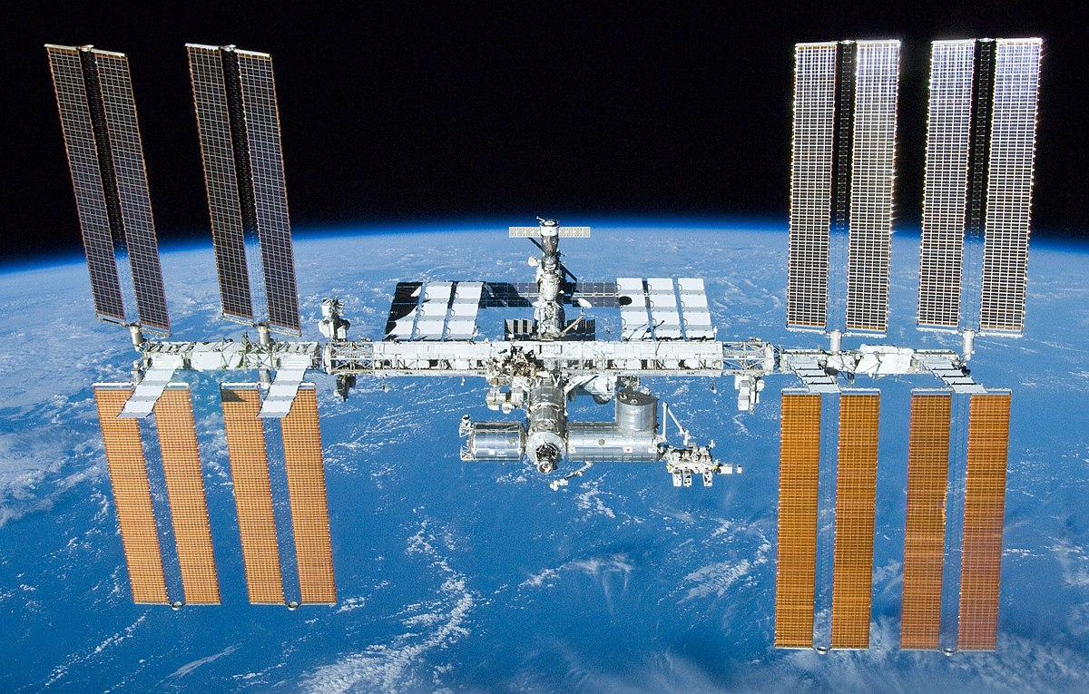
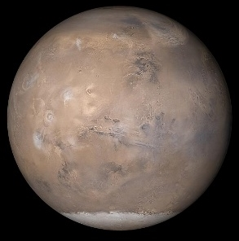
What’s Out There? The Space Radiation Environment
Exposure Type | ISS (51.6⁰ inclination) | Beyond Leo Earth Orbit
Galactic Cosmic Rays (GCR) | Limited to polar regions Fractionated low dose-rate ~ 87% protons, 12% Helium, 1% HZE | Continuous Chronic low dose-rate ~ 87% protons, 12% Helium, 1% HZE
Trapped Radiation | South Atlantic Anomaly (SAA) Fractionated low dose-rate Protons | Transit through Van Allen Belts Quasi-acute Protons
Solar Particle Events (SPEs) | Limited to polar regions Fractionated low dose-rate Protons | Full Event Quasi-acute Protons
Neutrons, Secondary Radiation | Shielding Chronic low dose-rate | Shielding Planetary (albedo) Chronic low dose-rate

