Slide 1
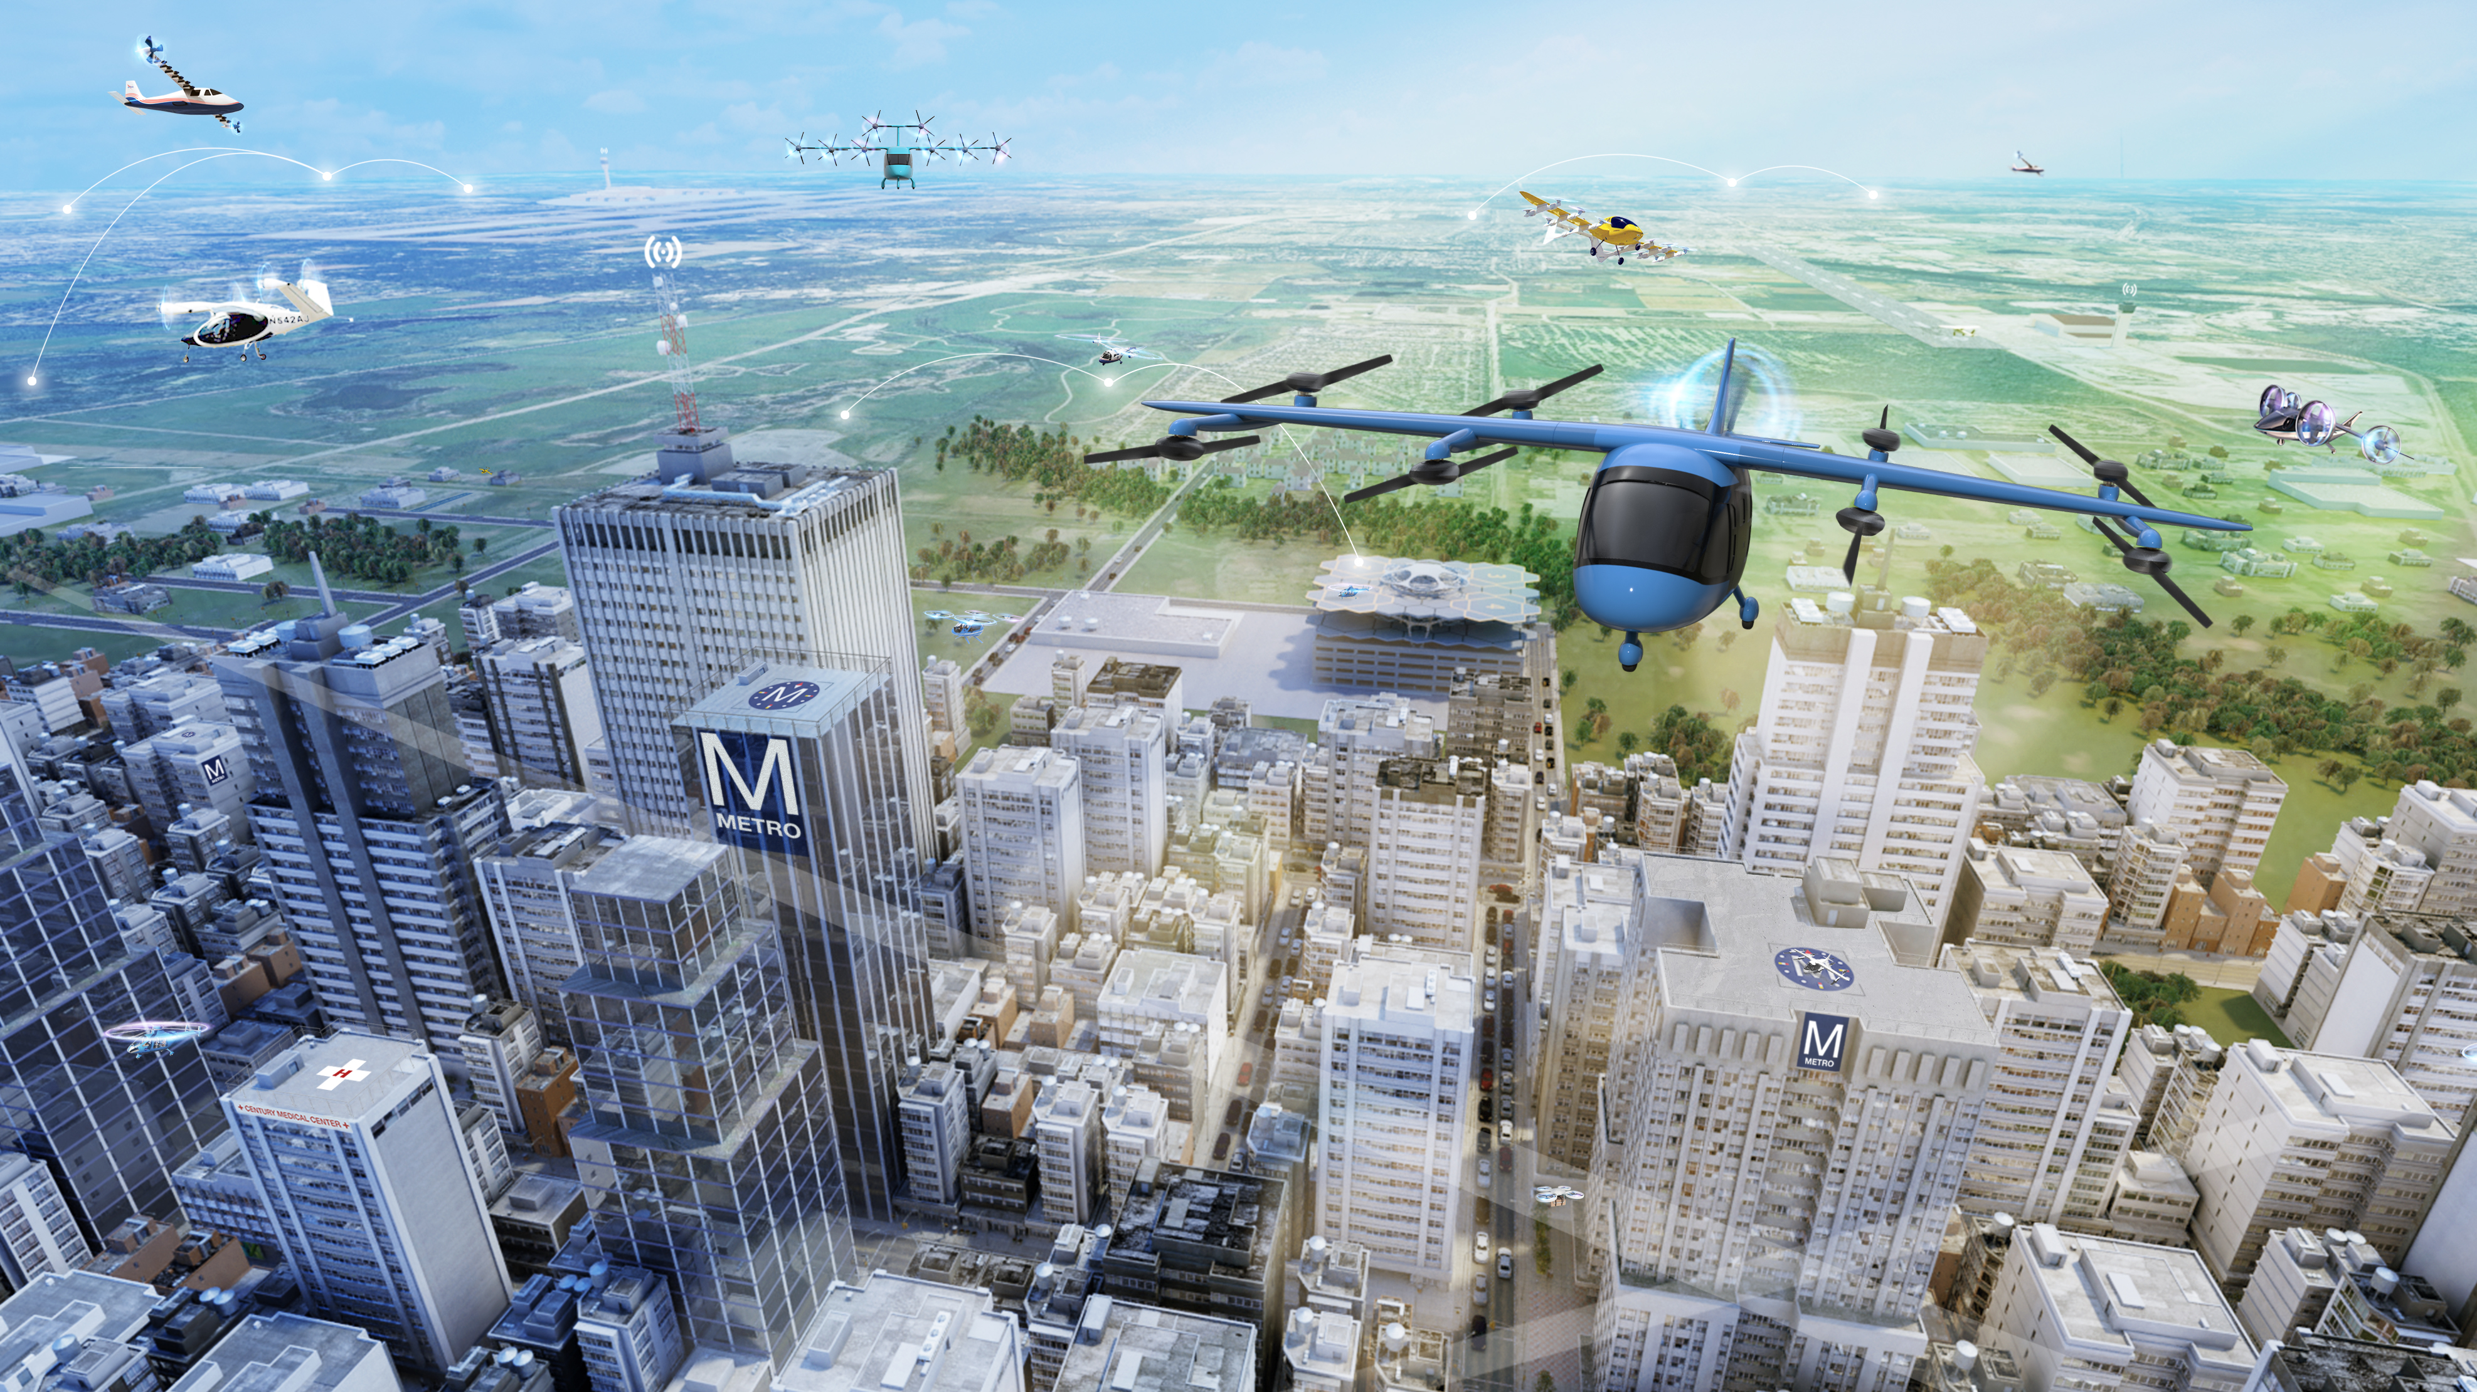
Breaking Down Barriers to Operationalization:
NASA’s AAM Ecosystem Approach
November 17, 2021

Slide 2
Presentation Flow
AAM Scope
AAM/UAM Decomposition
Ecosystem Engagement/Partnerships

Slide 3
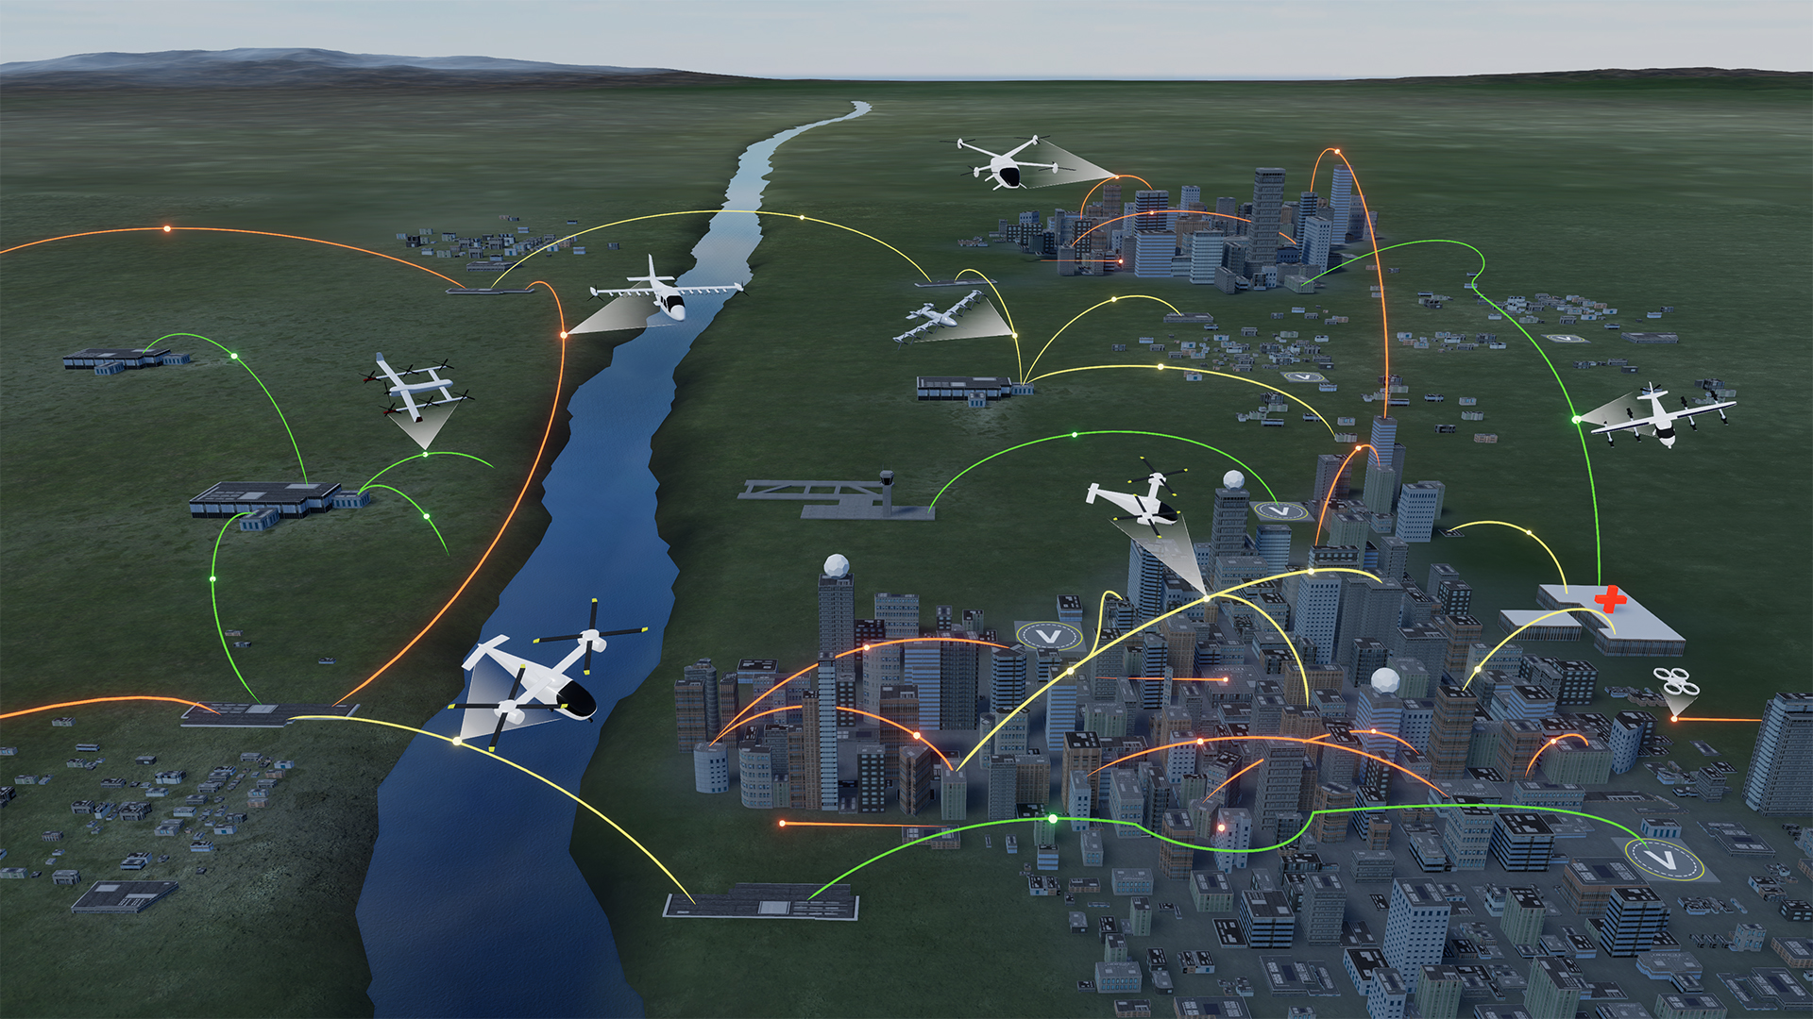
UAM Maturity Levels (UML)
Advanced Air Mobility (AAM) Mission
UML-4 Medium Density/Complexity, collaborative and responsible automated systems
UML-3 Low Density, Medium Complexity, comprehensive safety assurance automation
UML-2 Low Density/Complexity, assistive automation
UML-1 Conforming prototypes
On Demand
Air-Taxi
Rural Operations
Urban Operations
Regional
Network
Inter-City
eVTOL
Cargo
Delivery
Cargo
Delivery
Airport
Transfer
Medical
Transfer
Distribution
Center/Warehouse
High Density
Corridor
Air
Ambulance
Fleet
Operations
Inter-city
eVTOL
Small
Package Delivery
Cross-metro
Transfer
Safe, sustainable, affordable, and accessible aviation for transformational local and intraregional missions
3
Notes:
Includes “rural” and “urban” applications
Cargo transport, pax-carrying, aerial work, etc.
eVTOL, sUAS, eCTOL, hybrid-electric, etc.
Urban Air Mobility (UAM) as a challenging use-case with high benefit
Enabled by electrification and automation
Does not include:
Supersonic or hypersonic transport
Existing hub-and-spoke air service with large transport aircraft

Slide 4
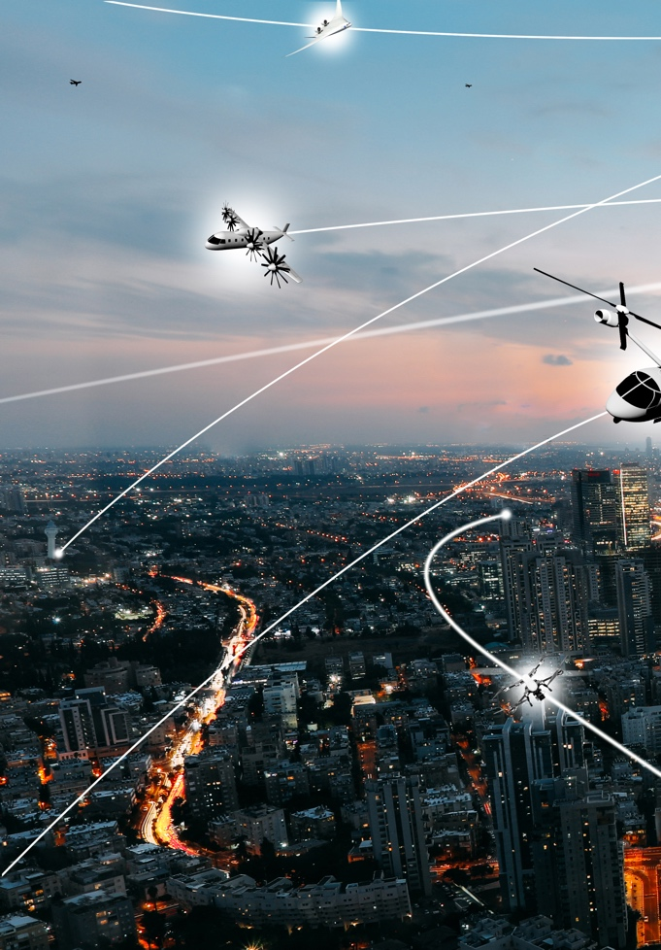
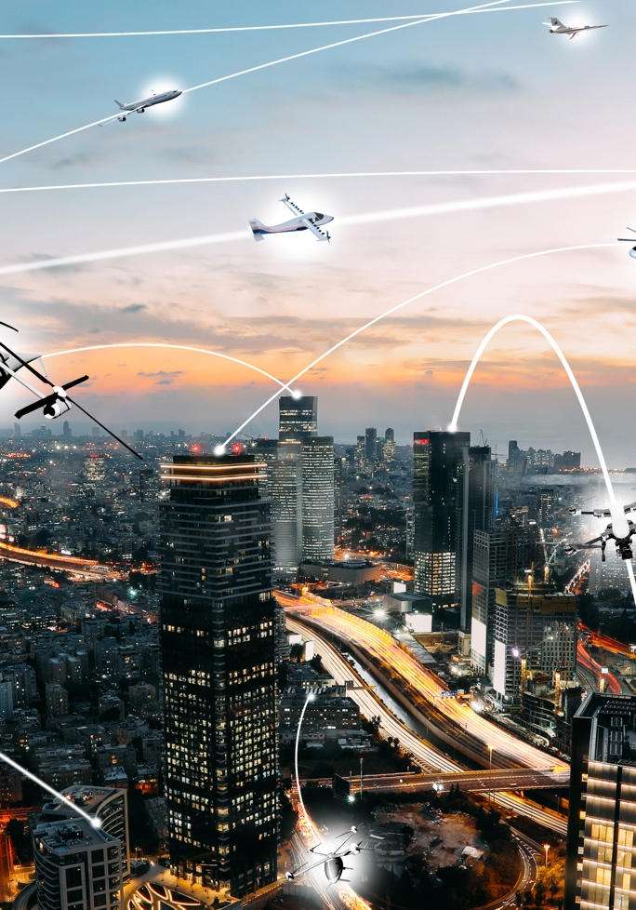
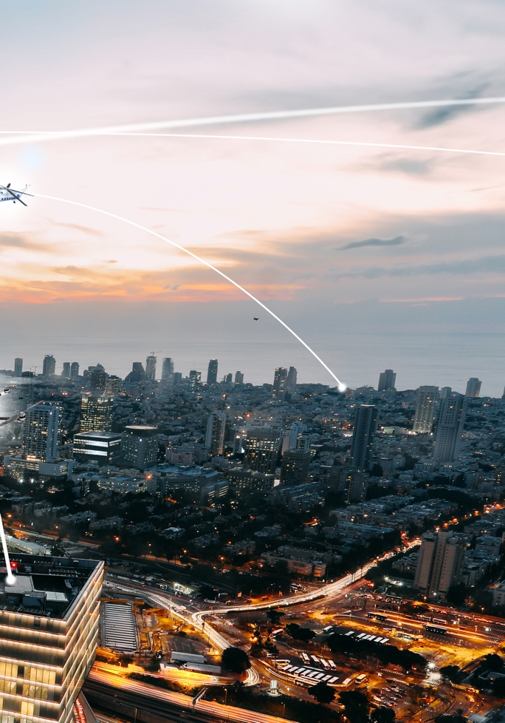
NASA Role to Address AAM Challenges
Vehicle Development and Operations
Airspace Design and Operations
Community Integration
NASA and key partners are collectively taking on the most difficult mission challenges to enable industry to flourish by 2030
Research and Development Portfolio
AAM National Campaign Series
Robust Ecosystem Partnerships
NASA to deliver long term technical solutions and architecture requirements for the industry and regulatory communities

Slide 5
Urban Air Mobility (UAM) Ecosystem Goals¹
#
UML-#
Overarching
Vehicles
Airspace
Community
Industry Operational Capability
CY2020
CY2021
CY2022
CY2023
CY2024
CY2025
CY2026
CY2027
CY2028
CY2029
CY2030
Initial UAM ConOps Development
High Capacity UAM Ports
3
Integration of
Automated Systems
1
4
3
Integrated system-wide safety tools & methods
Piloted UAM aircraft cert. basis
1
Secured Systems Architectures
3
Conforming prototypes
1
Automated Flight and Contingency Management
2
4
1st Type Cert awarded
2
Advanced urban capable aircraft
3
Initial pilot training & licensing
Scaled vehicle production
4
Initial operational approvals
2
Separation Standards
3
2
Low volume airspace operations
Procedures for high-capacity corridors
3
Integrated Weather Tolerant Airspace Operations
4
CNSi Architectures
3
UAM Airspace Architectures and 3rd Party Services
3
Early adopter locations
Local regulations enacted
Multi-Modal Integration
1
3
4
Initial Infrastructure Deployment
3
Operational safety demonstrations
1
Initial commercial operations
2
High-capacity corridors in early adopter cities
3
Scalable weather-tolerant urban ops
4
CNSi: Communication, Navigation, Surveillance, Information
UML: UAM Maturity Level
¹ Based on a range of publicly available industry projections; not a consensus view; aggressive
Notes:
Got rid of “unlock”
Now called the goal slide
Validation may cause us to update – e.g. vice 1 CNSi Goal, we’d have a Comm’s Goal, a Navigation Goal and a Surveillance Goal. Or a Goal we didn’t think.

Slide 6
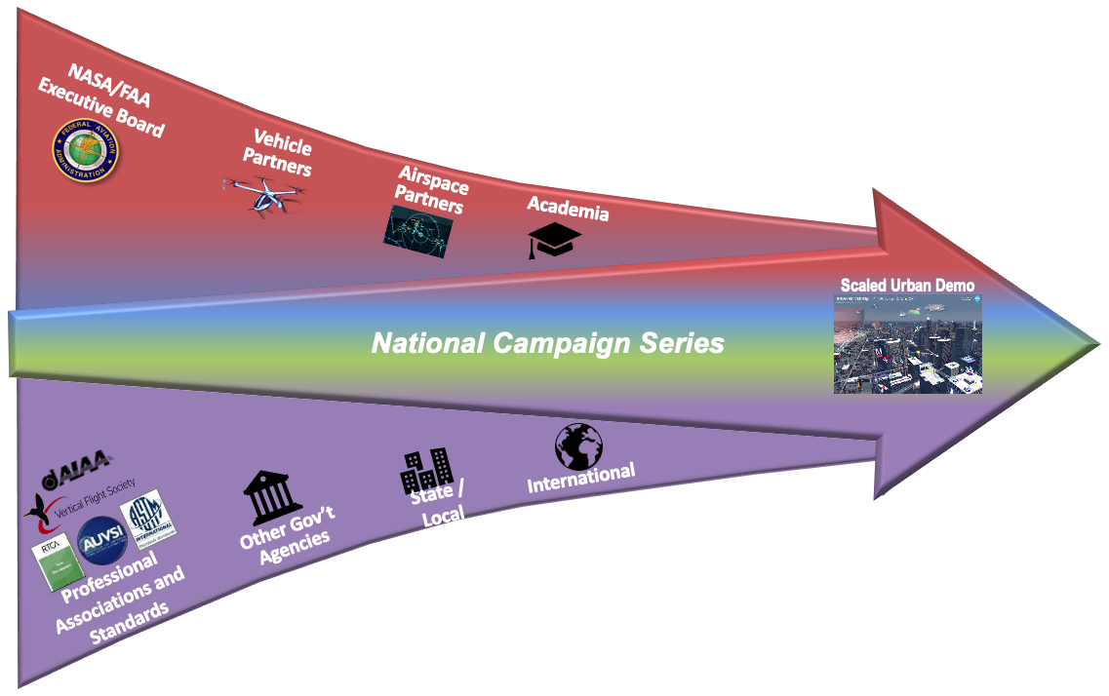
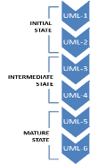
NASA UAM Ecosystem Partnership Approach
NASA intends to establish partnerships with government, industry and academia to collaborate on the critical enabling technologies and vital research relevant to UAM.
Foundational research partnerships in existence and developing
NASA/FAA AAM WGs are beginning formal execution
Project Research Partnerships
Community Outcome
System Architectures and Requirements for UML-4
Continue to Leverage NC as a centerpiece of the partnership strategy
AAM Ecosystem Working Groups (AEWG) are providing a valuable opportunity space for localities, international, and standards organizations
NASA must have a focused ecosystem-wide partnership strategy to enable UML-4
UAM Community Integration Partnerships
NASA plans to partner with Federal/State/Local authorities as well as international & professional associations to develop the policies, regulations and standards necessary to enable the UAM market.

Slide 7
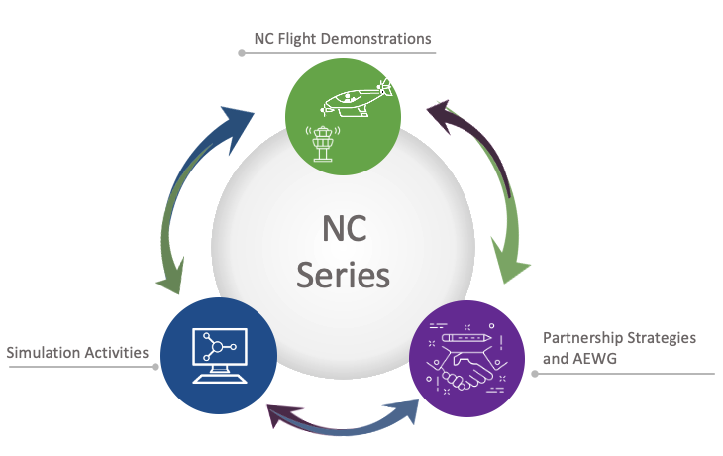
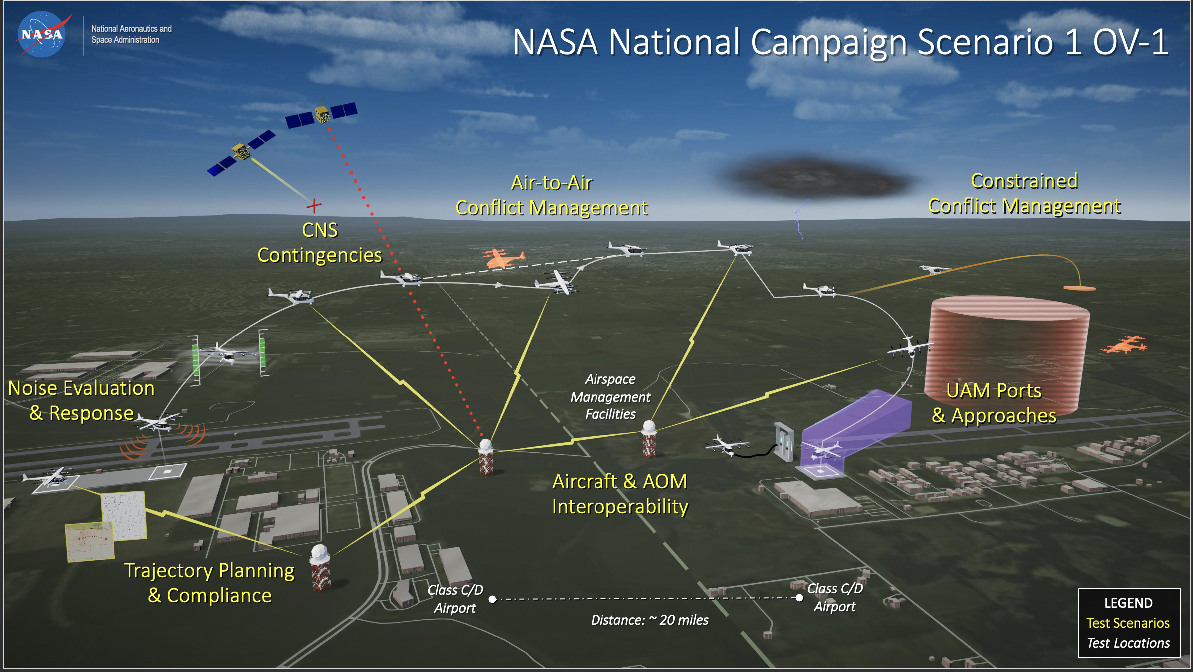
National Campaign Series Fundamentals
Emphasis on Operational Scenarios and Remaining Flexible to Industry Needs
Anchor and Evolve…
NC-DT assesses the readiness of external ranges and partners to collect comprehensive data in support of NC-1 Operational Scenarios
NC-1 scenarios will move participants closer to operations by baselining operational expectations and identifying gaps in AAM
NC-2-4, and associated developmental testing, will progressively mature advanced UAM vehicle configurations and automation research

Slide 8
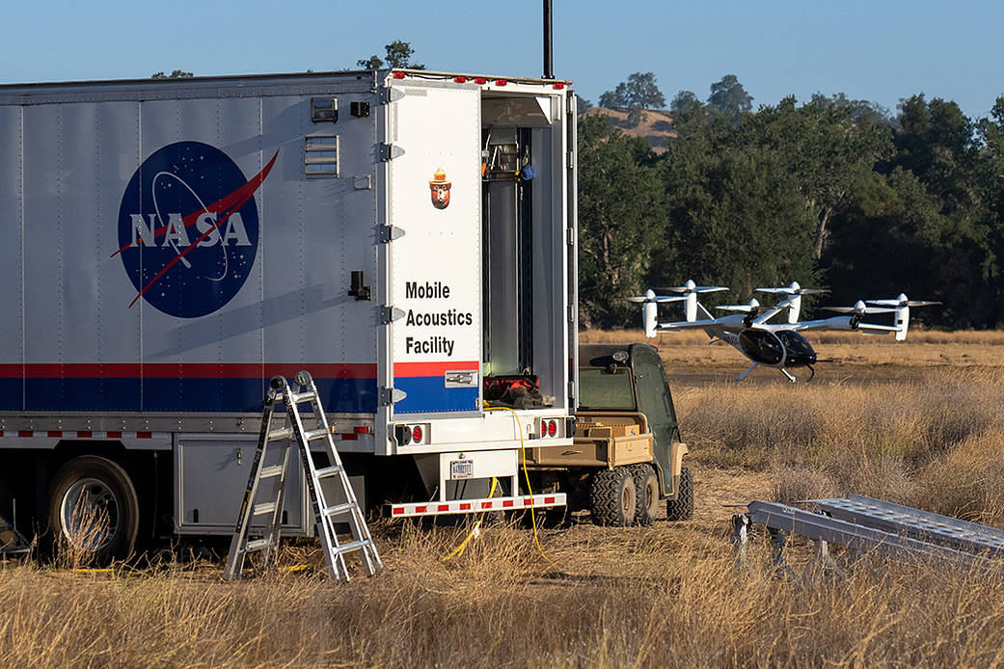
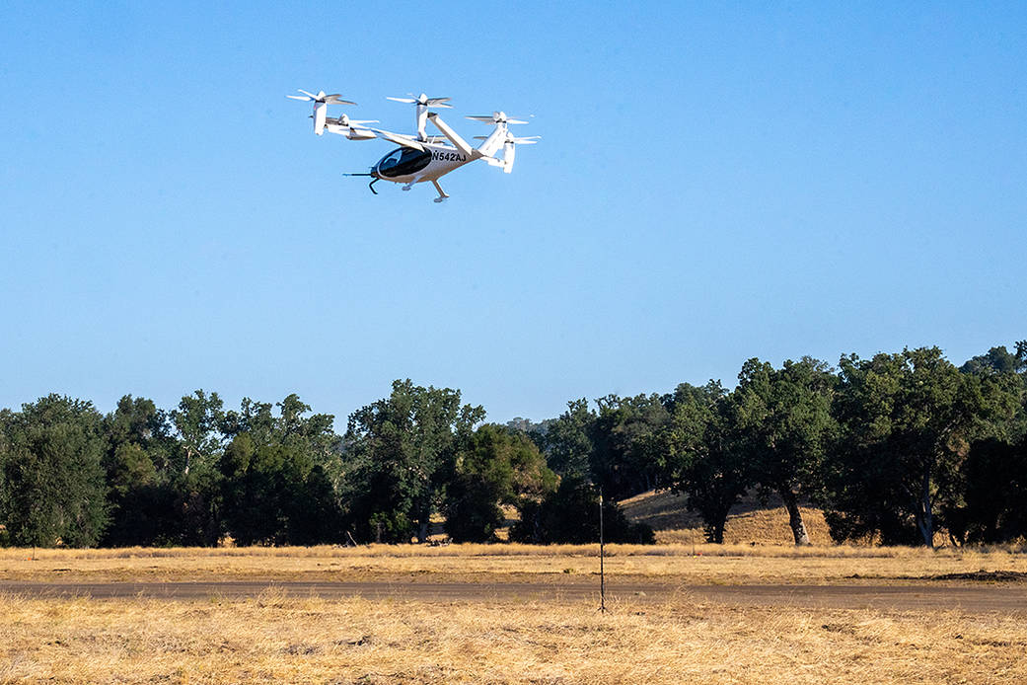
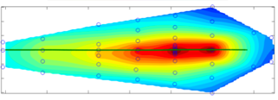
NC-DT Noise Data Collection
Mobile Acoustics Facility along with an array of 58 microphones helped the NC team measure the acoustic profile of Joby’s aircraft
Example Ground Noise Contour from previous helicopter test
Image credit: Joby Aviation

Slide 9
NASA AAM Mission Partnership Agreements NC Announcement of Collaborative Opportunity (ACO) focused
NC Series (NC-2+) and
Ecosystem-wide
Agility Prime
ACO-1 Annex
Community
Crash
ACO-2 Annex
NC-2 AFCM/IAS
ACO-3 Annex
NC-2 Info Exchange
Specific Agreement
AEWG
CNSI
ACO4
NC-1
NC-1 Range
Vehicle Information Exchange
NC-1 infrastructure
NC-DT
NC-1 Flight Vehicle
Flight Vehicle Partners)
NC-DT
NC-1
NC2-DT (IAS)
NC-2+
…
NASA CC
Airspace Simulation Partners
NC-1 Airspace Simulation
Feb 2020
January 2021

Slide 10
AAM Ecosystem Working Groups
Align on a common vision for AAM
Collectively identify and investigate key hurdles and associated needs
Learn about NASA’s research and planned transition paths
Develop AAM system and architecture requirements
Adopt a strategy for engaging the public on AAM
Support regulatory and standards development
Form a connected stakeholder community
See https://nari.arc.nasa.gov/aam-portal/ for more information
Accelerate the development of safe and scalable AAM flight operations by bringing together the broad and diverse ecosystem
Notes:
Federal Advisory Committee Act (FACA) regulations do not apply
FACA statutes are not evoked since the intent of the AEWG is to obtain information or viewpoints from individual attendees as opposed to advice, opinions or recommendations from the group acting in a collective mode
Execution
Fully virtual during pandemic using MS Teams and YouTube Livestream platforms
Mix of virtual and in-person meetings planned for 2022 and beyond
Function similarly to open workshops with specific topics based on attendee feedback serving to focus discussions
Consistent cadence
Each Working Group meets monthly
Collaborative Environment
The working groups use breakouts, panel discussions, and instructional/educational session to share diverse expertise, research and development priorities, and concepts that may enable AAM operationalization
Transparency
All meetings open to the public
All meeting recordings and documented findings/lessons learned are archived on the AAM portal https://nari.arc.nasa.gov/aam-portal/

Slide 11
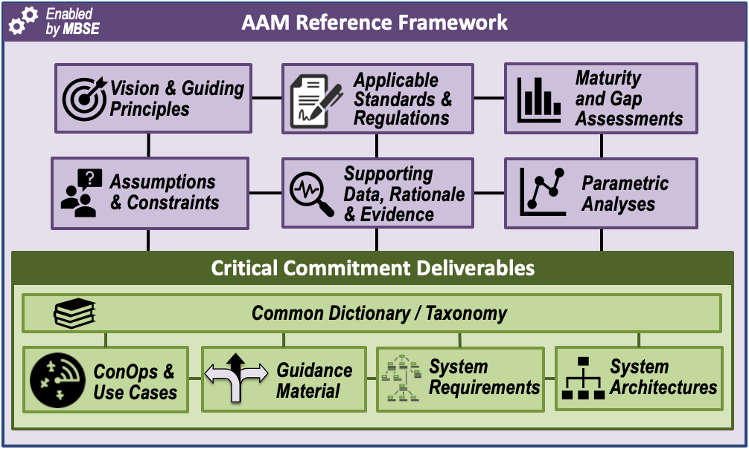
NASA AAM MBSE Framework
NASA is using a Model-based System Engineering approach to capture and organize the elements of a medium density/complexity “Book of Requirements and Guidelines (BoRG)”
AAM System and
Architecture Requirements
AAM Mission Critical Commitment:
Based on NASA research and activities, the AAM Mission will deliver validated system architectures and recommended requirements for aircraft, airspace, and infrastructure systems to enable sustainable and scalable medium density advanced air mobility operations
Notes:
NASA to deliver long term technical solutions and architecture requirements for the industry and regulatory communities
Update CC?

Slide 12
NASA AAM Ecosystem Approach
AAM including UAM, public good missions
Decomposing AAM/UAM system into build-up series of goals
Building ecosystem of government, industry, community, academia to collectively address goals
Developing MBSE Reference Framework to share results with Ecosystem

Slide 13
Backup

Slide 14
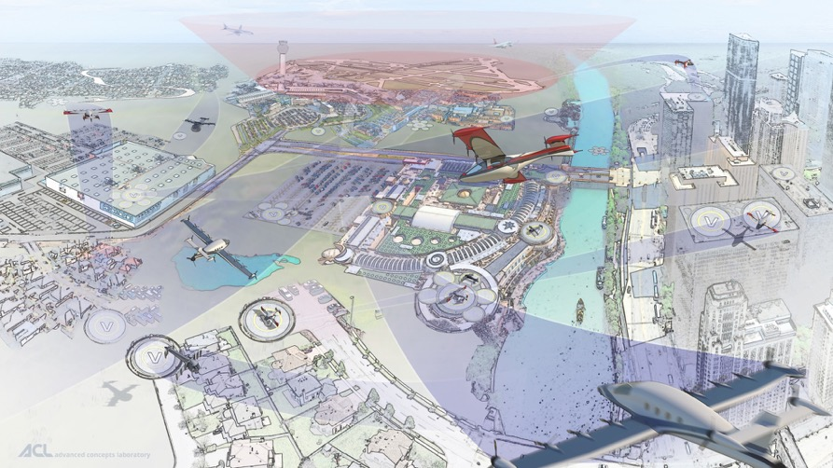
Advanced Air Mobility (AAM)
Safe, sustainable, affordable, and accessible aviation for transformational local and intraregional missions
Local mission < ~75nmi, and intraregional mission < ~500nmi
Includes “rural” and “urban” applications
Cargo transport, pax-carrying, aerial work, etc.
eVTOL, sUAS, eCTOL, hybrid-electric, etc.
Urban Air Mobility (UAM) as a challenging use-case with high benefit
Enabled by electrification and automation
Does not include:
Supersonic or hypersonic transport
Existing hub-and-spoke air service with large transport aircraft

Slide 15
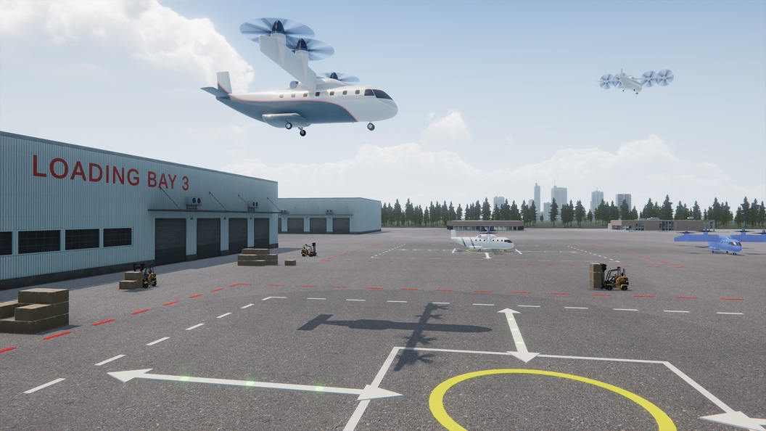
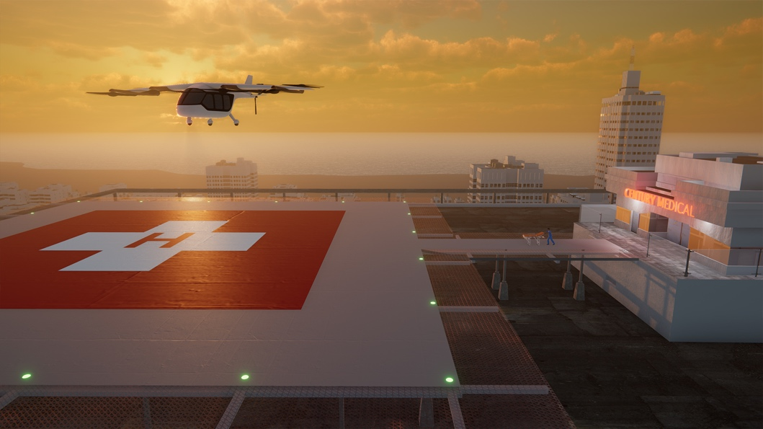
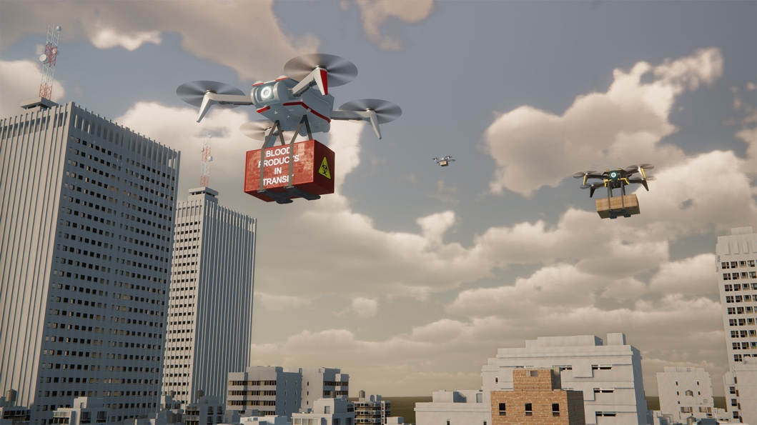
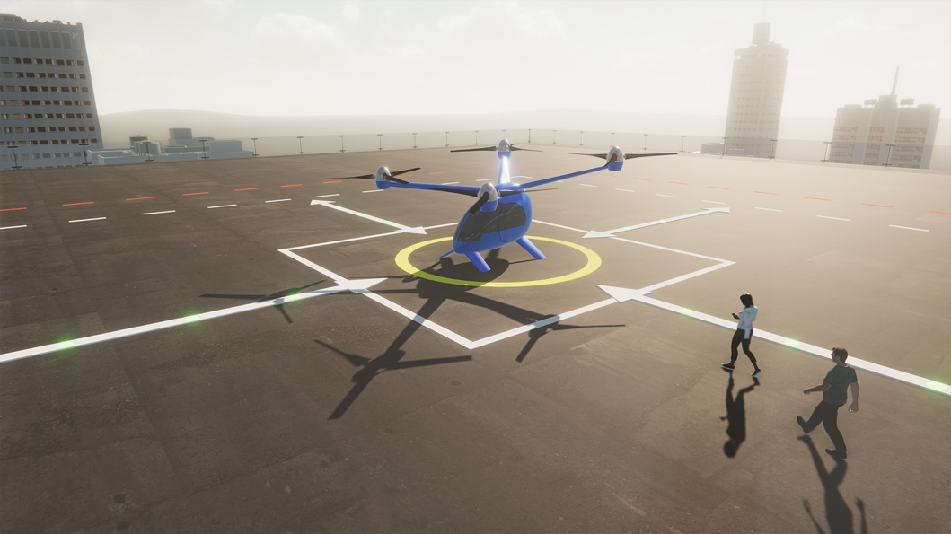
Advanced Air Mobility is Emerging
REGIONAL PASSENGER AND CARGO
TRANSPORT
PUBLIC GOOD
CONSUMER/ ENTERPRISE GOODS AND SERVICES
PASSENGER TRANSPORT
Latest studies show an annual estimated market of $115B by 2035

Slide 16
16

