Slide 1
Advanced Manufacturing at MSFC
Chris Protz
NASA Marshall Space Flight Center
16 November 2021
Presented to: UA Space Days

Slide 2
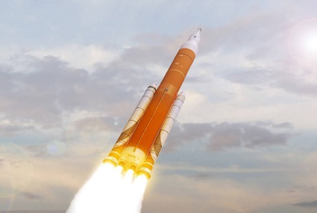
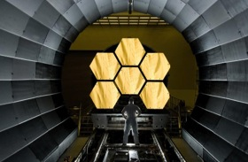
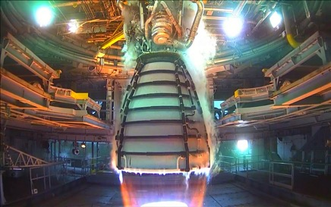
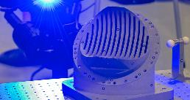
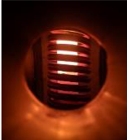
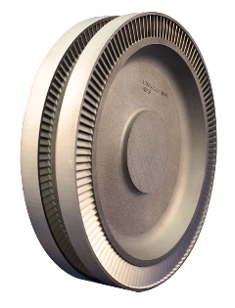
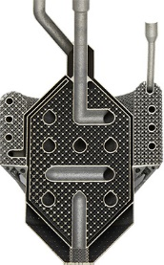
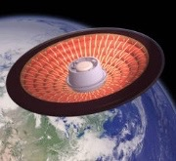
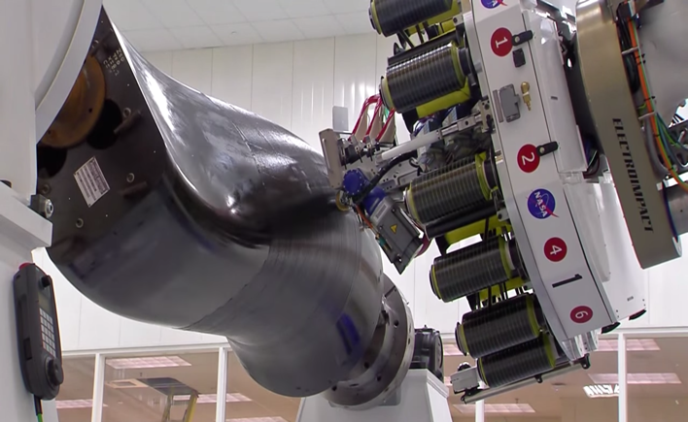
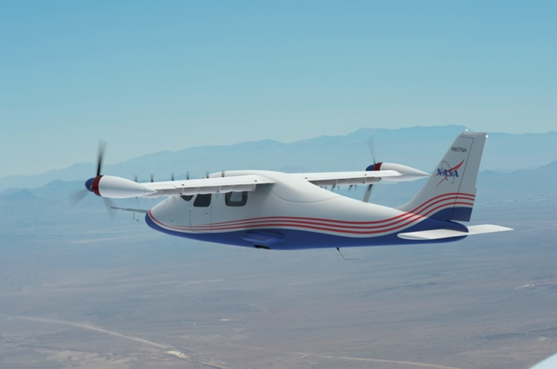
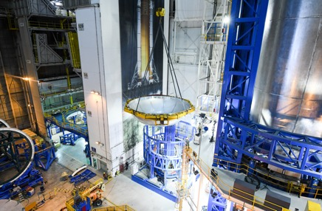
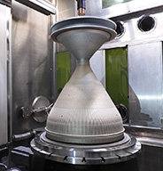
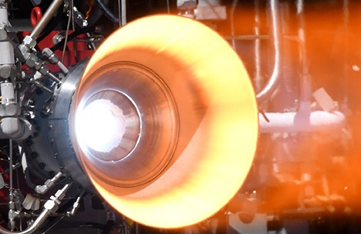
NASA Manufacturing Is……

Slide 3
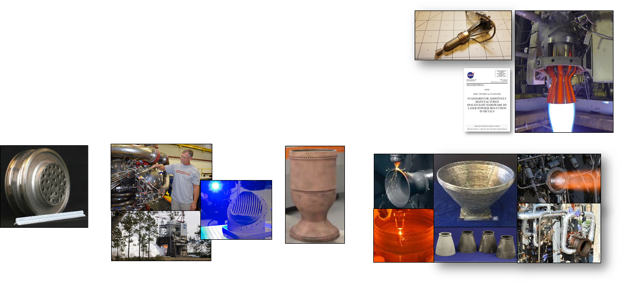
MSFC Additive Manufacturing
AM and innovative designs can help reduce manufacturing cost and schedule and improve affordability
MSFC AM major efforts include:
  Implementation of AM components for next generation rocket engines
  Characterization of applicable alloys in powder bed fusion systems
  Flight certification rationale for NASA and our vendors
  Risk reduction and data sharing in pursuit of smart vendor base
  Development of new alloys for AM processes (eg. copper and nickel-based)
  Free form system evaluation for large scale hardware (eg. Directed Energy Deposition)
Tungsten Thrusters
AM Standards
Morpheus Lander Demo
Injector Development
Copper Development
AM in RS25 Liquid Rocket Engine
Large Scale Directed Energy Deposition

Slide 4
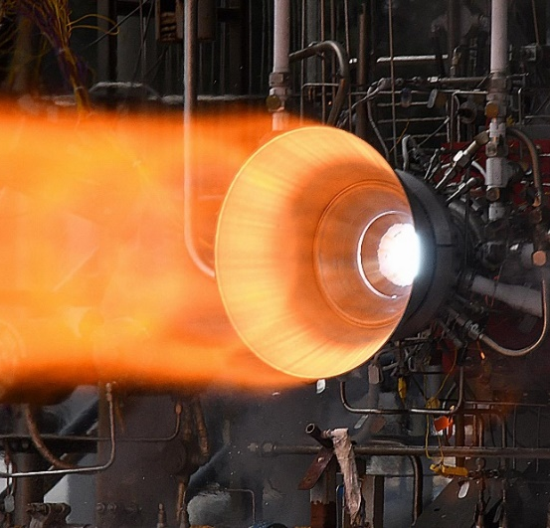
The Case for Additive Manufacturing in Propulsion
Metal Additive Manufacturing (AM) provides significant advantages for lead time and cost over traditional manufacturing for rocket engines
  Lead times reduced by 2-10x
  Cost reduced by more than 50%
Complexity is inherent in liquid rocket engines and AM provides new design and performance opportunities
Materials that are difficult to process using traditional techniques, long-lead, or not previously possible are now accessible using metal additive manufacturing
Part Complexity
Metal Alloys
Processing
Time

Slide 5
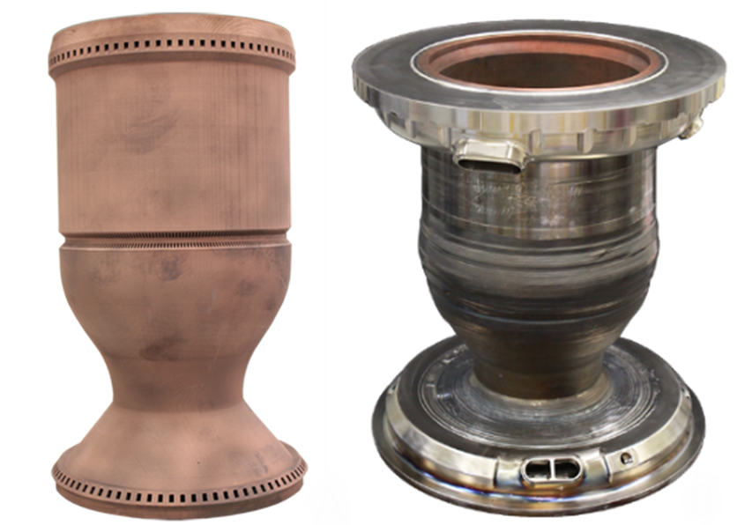
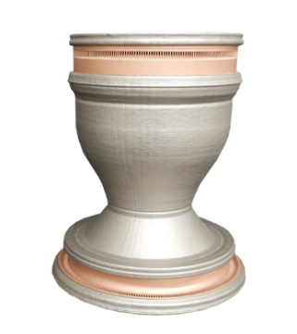
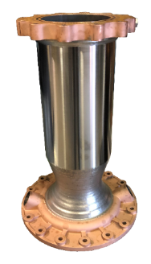
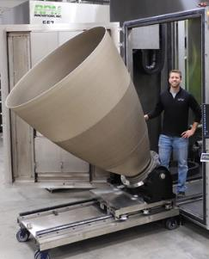
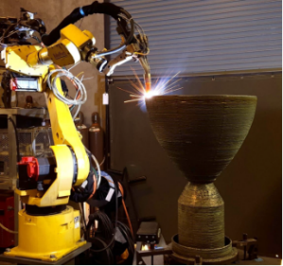
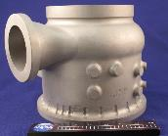
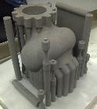
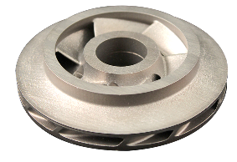
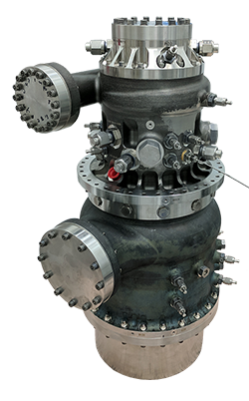
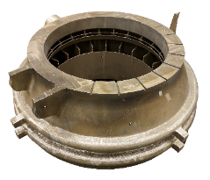
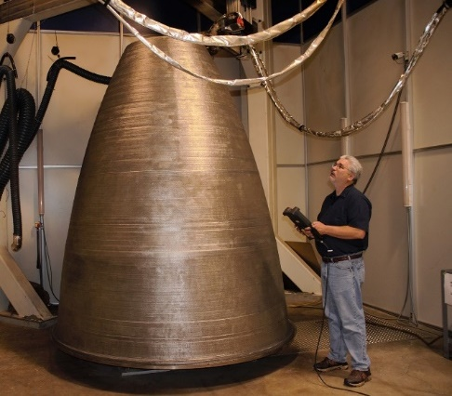
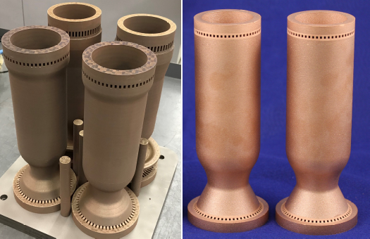
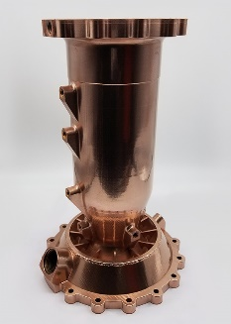
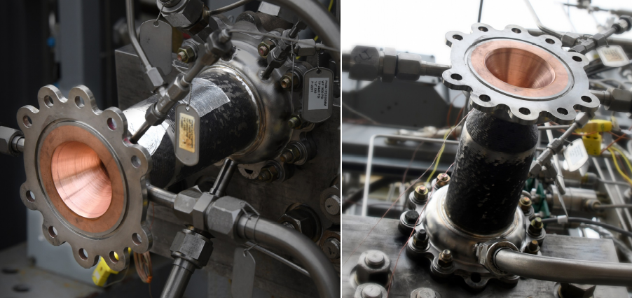
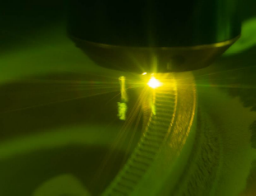
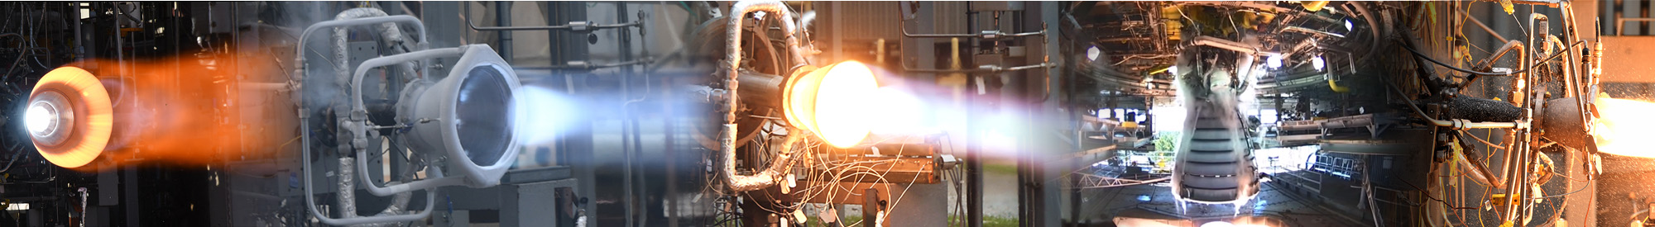
Additive Manufacturing (AM) Development at NASA for Liquid Rocket Engines
Laser Powder Bed Fusion (L-PBF)
Copper Alloys combined with other AM processes to provide bimetallic
L-PBF of complex components, new alloy developments for harsh environment
Directed Energy Deposition

Slide 6
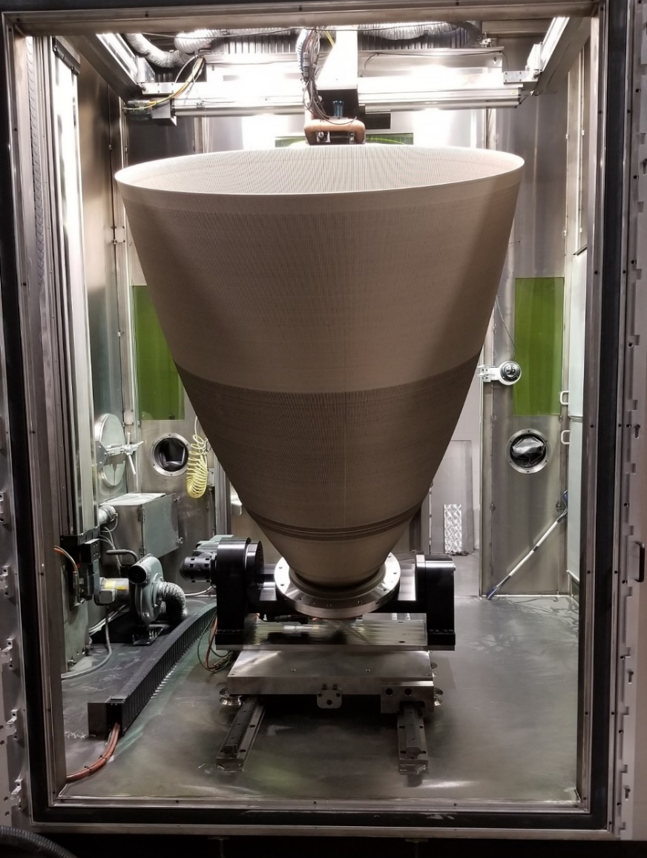
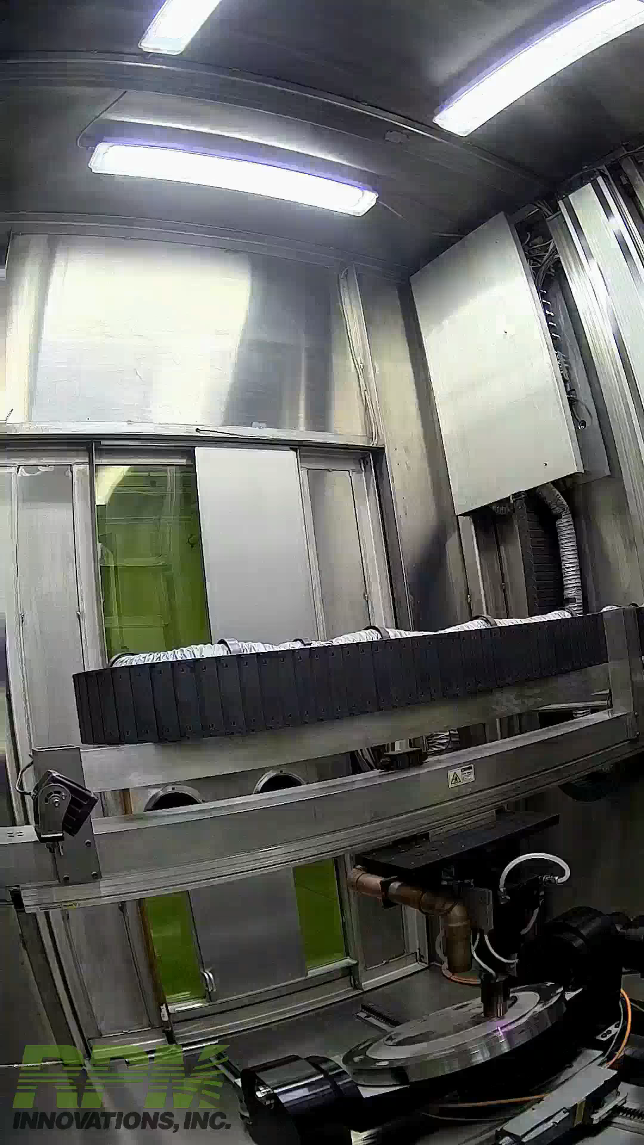
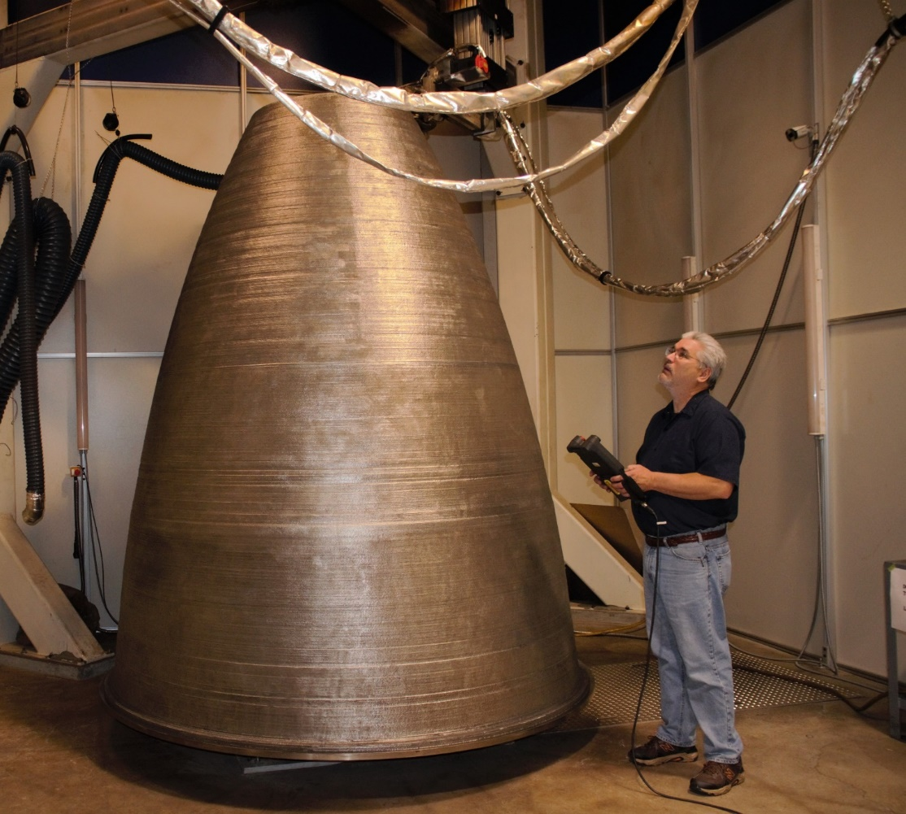
Laser Powder Directed Energy Deposition (LP-DED) Large Scale Nozzles
95” (2.41 m) dia and 111” (2.82 m) height
Near Net Shape Forging Replacement
60” (1.52 m) diameter and 70” (1.78 m) height with integral channels
90 day deposition
Reference: Gradl, P. R., Teasley, T. W., Protz, C. S., Garcia, M. B., Ellis, D., & Kantzos, C. (2021). Advancing GRCop-based Bimetallic Additive Manufacturing to Optimize Component Design and Applications for Liquid Rocket Engines. AIAA Propulsion and Energy 2021, 1–28. https://doi.org/10.2514/6.2021-3231

Slide 7
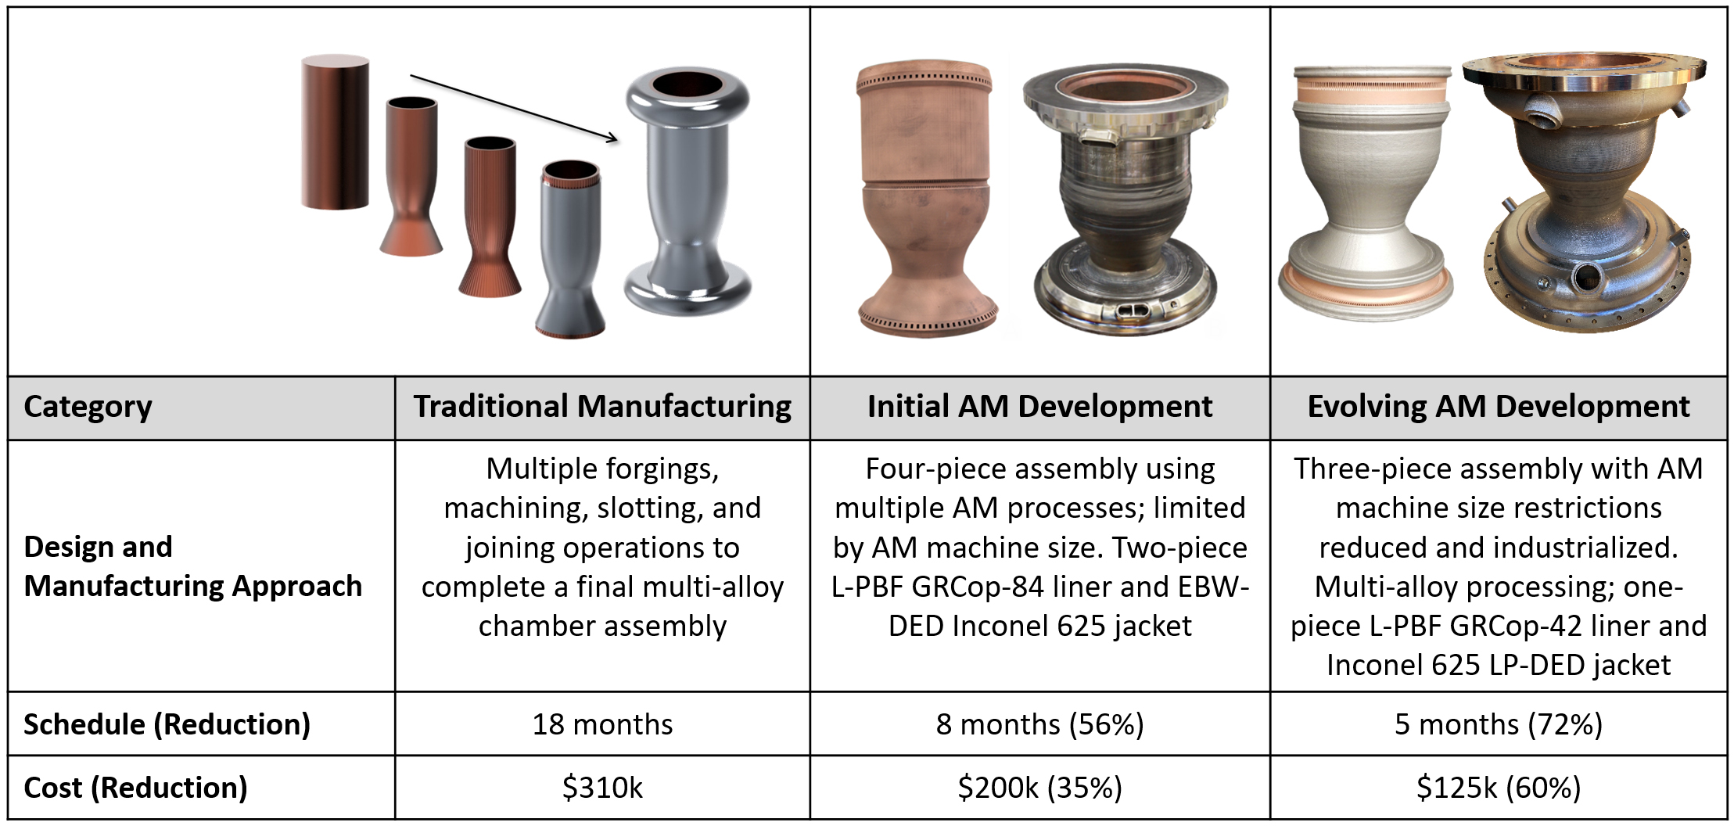
Propulsion Case Study for AM
As AM process technologies evolve using multi-materials and processes, additional design and programmatic advantages are being discovered

Slide 8
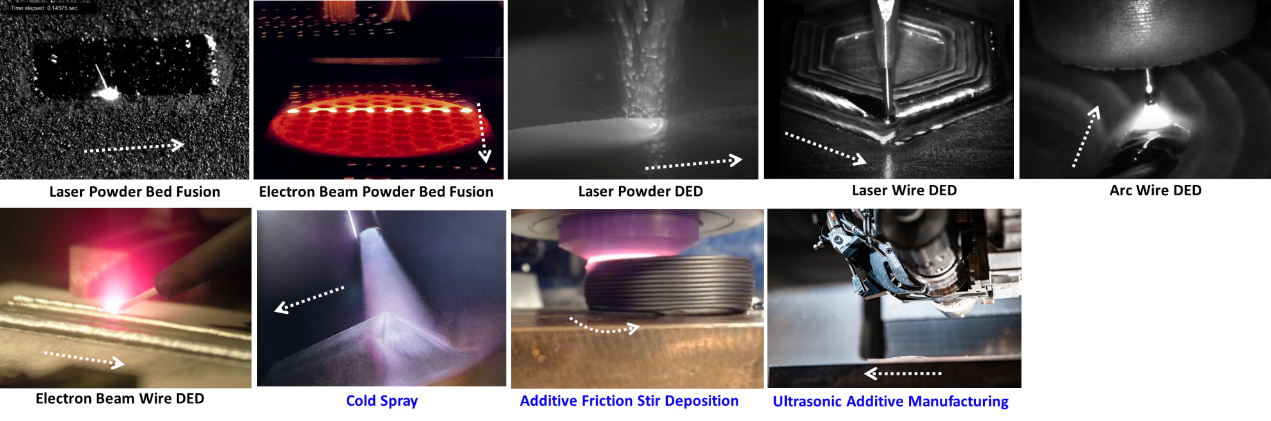
AM Processes for various applications
A) Laser Powder Bed Fusion [https://doi.org/10.1016/j.actamat.2017.09.051], B) Electron Beam Powder Bed Fusion [Credit: Courtesy of Freemelt AB, Sweden], C) Laser Powder DED [Credit: Formalloy], D) Laser Wire DED [Credit: Ramlab and Cavitar], E) Arc Wire DED [Credit: Institut Maupertuis and Cavitar], F) Electron Beam DED [NASA], G) Cold spray [Credit: LLNL], H) Additive Friction Stir Deposition [NASA], I) Ultrasonic AM [Credit: Fabrisonic].
Reference: Gradl, P., Tinker, D., Park, A., Mireles, P., Garcia, M., Wilkerson, R., Mckinney, C. (2021). “Robust Metal Additive Manufacturing Process Selection and Development for Aerospace Components”. (Journal Article In Review)

Slide 9
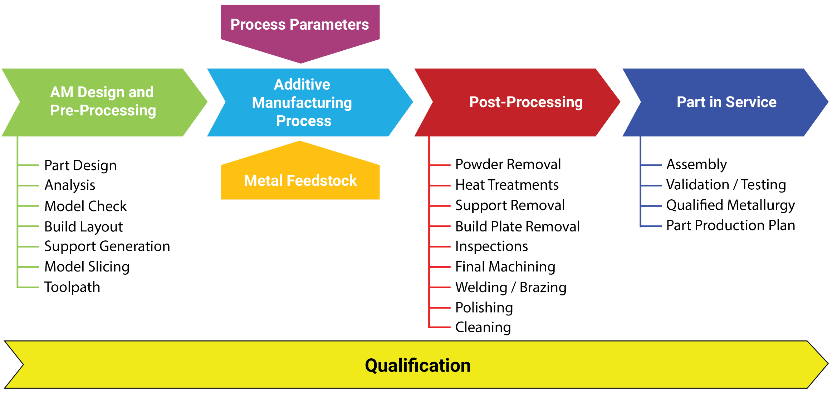
Additive Manufacturing Typical Process Flow
Proper AM process selection requires an integrated evaluation of all process lifecycle steps

Slide 10
Some AM Thoughts
It’s all welding, so same physics apply
Additive manufacturing is not a solve-all; consider trading with other manufacturing technologies and use only when it makes sense
Complete understanding of design process, build-process, and post-processing critical to take full advantage of AM
Various processes exist each with unique advantages and disadvantages
Additive manufacturing takes practice!
Standards and certification of the processes in-work
AM is evolving and there is a lot of work ahead

Slide 11
Emerging Areas of Development, AM for Propulsion
Maturing each of the AM processes and understanding of microstructure, properties, build limitations, and methods for design and post-processing
Ongoing development for large scale AM using DED and other processes
Continuous hot-fire and component testing to advance various combustion chambers, injectors, nozzles, ignition systems, turbomachinery, valves, lines, ducts, in-space thrusters
Polishing (surface enhancements internally) and post-processing development
Combining various AM processes for multi-alloy solutions
Advancement of commercial supply chain for unique alloys (GRCop-42, NASA HR-1, JBK-75)
New alloy development (Refractory, Ox-rich environments, AM-specific alloys)
Material database of metal AM properties to allow for conceptual design – tensile, fatigue and thermophysical
Composite overwrap AM thrust chambers for reduced mass
Transpiration-cooling of injector faces
Transition from development to production

Slide 12
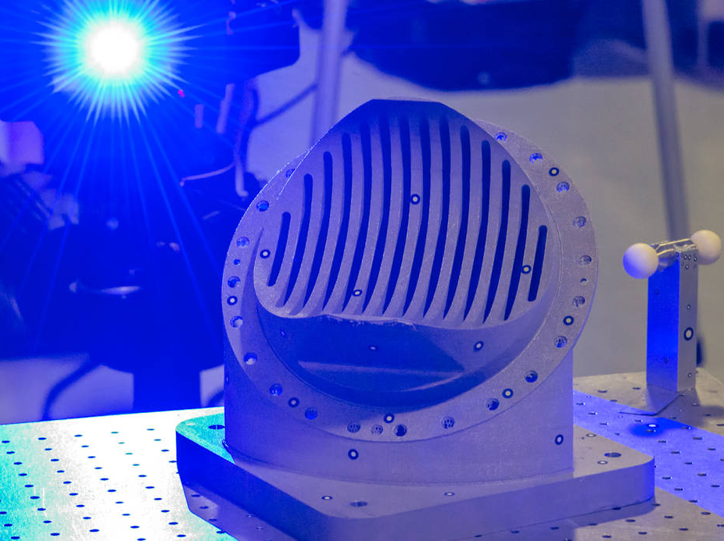
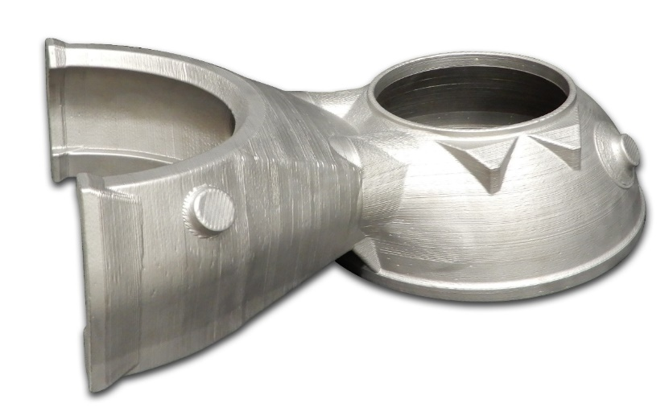
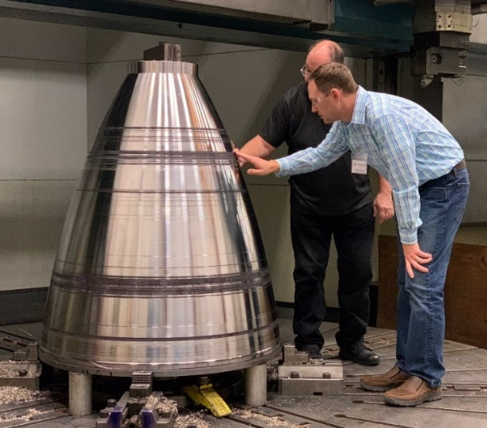

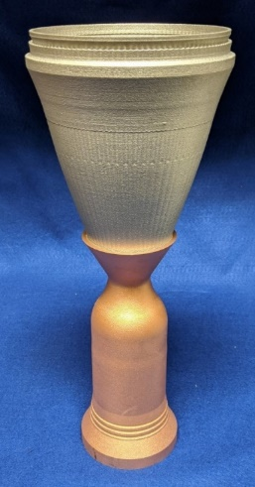
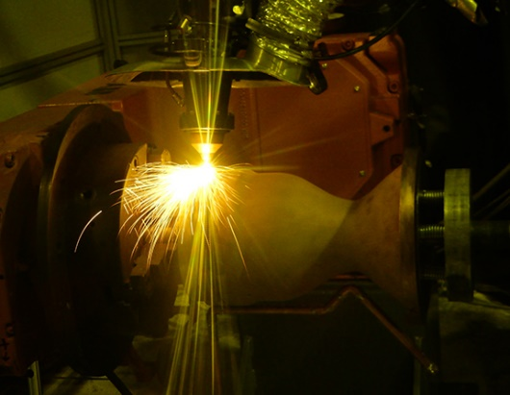
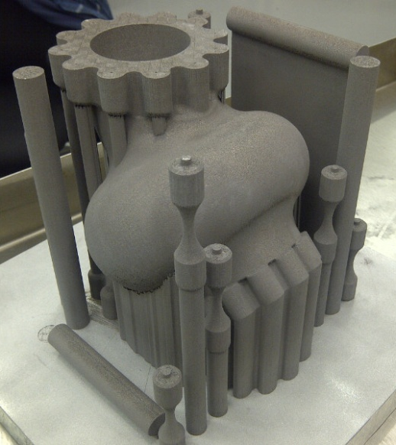
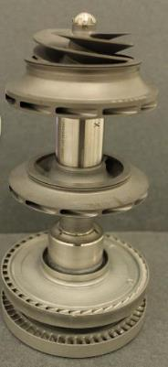
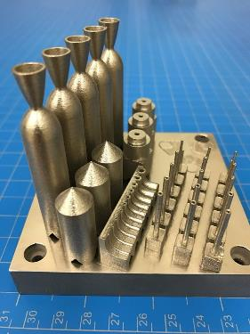
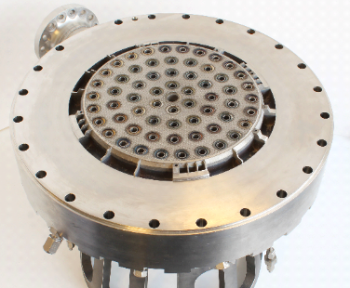
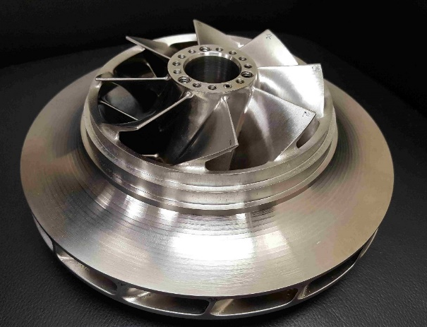
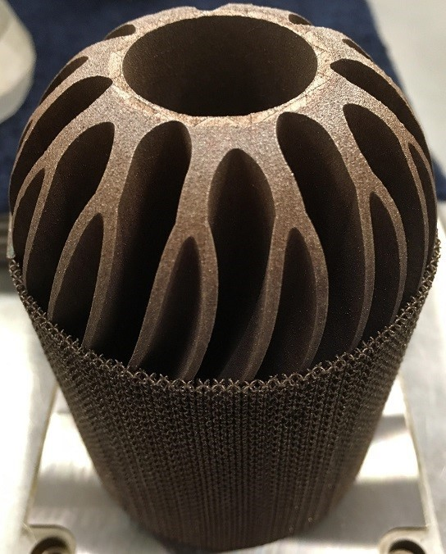
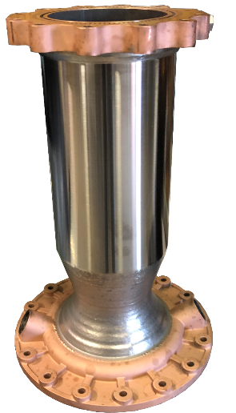
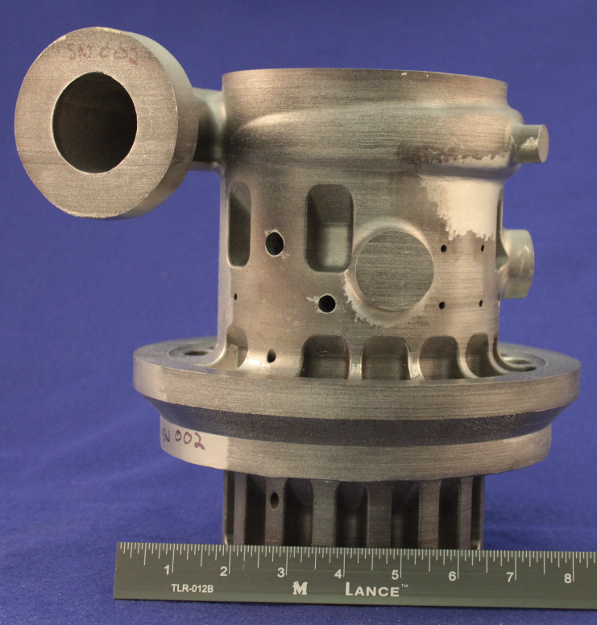



Examples of Propulsion Applications
Image courtesy SWRI
12

Slide 13


Emerging Areas in Advanced Manufacturing
EXPLORE: Develop technologies supporting emerging space industries
Target advanced manufacturing impacts and outcomes aligned with space industry trends that will shape the course of translational research over many years
3D Printing/Additive Manufacturing
In-Space Manufacturing and Space Infrastructure
> 50% Mass reduction, > 99% 3D printer readiness. A catalyst for space infrastructure and economic opportunities.
> 50% Cost reduction, 12 months instead of five years, Parts reduction >100 to 1
Manufacturing of the Future - Digital Twins and Artificial Intelligence
Lightweight Composites Spacecraft
More intelligent and more accurate predictions and capabilities, > 50% of physical resources replaced with virtual
30% - 50% More payload, equipment and experiments
All activities depicted not currently funded or approved. Depicts “notional future” to guide technology vision.
13
Notes:
Four broad areas of emerging technology.

Slide 14


Contact:
Chris Protz, Ph. D.
NASA MSFC
Christopher.S.Protz@nasa.gov

Slide 15

Various Metal AM Processes
Many AM processes exists and must be traded (along with traditional techniques) to optimize

Slide 16
References
P. Bidare, I. Bitharas, R.M. Ward, M.M. Attallah, A.J. Moore, Fluid and particle dynamics in laser powder bed fusion, Acta Mater. 142 (2018) 107–120. https://doi.org/10.1016/j.actamat.2017.09.051.
B. Blakey-Milner, P. Gradl, G. Snedden, M. Brooks, J. Pitot, E. Lopez, M. Leary, F. Berto, A. du Plessis, Metal additive manufacturing in aerospace: A review, Mater. Des. 209 (2021) 110008. https://doi.org/10.1016/j.matdes.2021.110008.
S.C. Altıparmak, B. Xiao, A market assessment of additive manufacturing potential for the aerospace industry, J. Manuf. Process. 68 (2021) 728–738. https://doi.org/10.1016/j.jmapro.2021.05.072.
R. Liu, Z. Wang, T. Sparks, F. Liou, J. Newkirk, Aerospace applications of laser additive manufacturing, Laser Addit. Manuf. Mater. Des. Technol. Appl. (2017) 351–371. https://doi.org/10.1016/B978-0-08-100433-3.00013-0.
A. Uriondo, M. Esperon-Miguez, S. Perinpanayagam, The present and future of additive manufacturing in the aerospace sector: A review of important aspects, Proc. Inst. Mech. Eng. Part G J. Aerosp. Eng. 229 (2015) 2132–2147. https://doi.org/10.1177/0954410014568797.
P.R. Gradl, S.E. Greene, C. Protz, B. Bullard, J. Buzzell, C. Garcia, J. Wood, K. Cooper, J. Hulka, R. Osborne, Additive manufacturing of liquid rocket engine combustion devices: A summary of process developments and hot-fire testing results, in: 2018 Jt. Propuls. Conf., AIAA, 2018. https://doi.org/10.2514/6.2018-4625.
F. Kerstens, A. Cervone, P. Gradl, End to end process evaluation for additively manufactured liquid rocket engine thrust chambers, Acta Astronaut. 182 (2021) 454–465. https://doi.org/10.1016/j.actaastro.2021.02.034.
B. Barroqueiro, A. Andrade-Campos, R.A.F. Valente, V. Neto, Metal additive manufacturing cycle in aerospace industry: A comprehensive review, J. Manuf. Mater. Process. 3 (2019) 1–21. https://doi.org/10.3390/jmmp3030052.
T.A. Rodrigues, V. Duarte, R.M. Miranda, T.G. Santos, J.P. Oliveira, Current status and perspectives on wire and arc additive manufacturing (WAAM), Materials (Basel). 12 (2019). https://doi.org/10.3390/ma12071121.
A. Vafadar, F. Guzzomi, A. Rassau, K. Hayward, Advances in Metal Additive Manufacturing: A Review of Common Processes, Industrial Applications, and Current Challenges, Appl. Sci. 11 (2021) 1213. https://doi.org/10.3390/app11031213.
S. Negi, A.A. Nambolan, S. Kapil, P.S. Joshi, M. R, K.P. Karunakaran, P. Bhargava, Review on electron beam based additive manufacturing, Rapid Prototyp. J. 26 (2020) 485–498. https://doi.org/10.1108/RPJ-07-2019-0182.
S.A.M. Tofail, E.P. Koumoulos, A. Bandyopadhyay, S. Bose, L. O’Donoghue, C. Charitidis, Additive manufacturing: scientific and technological challenges, market uptake and opportunities, Mater. Today. 21 (2018) 22–37. https://doi.org/10.1016/j.mattod.2017.07.001.
Gradl, P., Tinker, D., Park, A., Mireles, P., Garcia, M., Wilkerson, R., Mckinney, C. (2021). “Robust Metal Additive Manufacturing Process Selection and Development for Aerospace Components”. (Journal Article In Review)
Gradl, P. R., Teasley, T. W., Protz, C. S., Garcia, M. B., Ellis, D., & Kantzos, C. (2021). Advancing GRCop-based Bimetallic Additive Manufacturing to Optimize Component Design and Applications for Liquid Rocket Engines. AIAA Propulsion and Energy 2021, 1–28. https://doi.org/10.2514/6.2021-3231
Gradl, P., Mireles, O., Andrews, N. (2021). Introduction to Additive Manufacturing for Propulsion and Energy Systems. AIAA Propulsion and Energy Forum 2021. August. 10.13140/RG.2.2.29815.55209

Slide 17












Composites Manufacturing
Automated Fiber Placement (AFP) – eg. Payload Attach Fitting
Filament Winding – eg. COPVs, struts
Tape Wrapping – eg. nozzle ablators
Hand Layup – eg. out of autoclave parts
Autoclaves / Ovens / Presses
Clean rooms
Thermal isolation struts for
cryo-tank support
18 ft x 20 ft Autoclave
MPCV Stage Adapter Diaphragm Installation
SLS Payload Attach Fitting
17

Slide 18


Modular Tooling
Traditional manufacturing tooling is complex, expensive, schedule intensive and configuration specific.
Modular tooling was developed at MSFC as a simpler, cheaper, faster and highly adaptable alternative to traditional tooling approaches.
Modular tooling is composed of custom manufactured arrays of columns, shelves and adjustable shoes.
Components have common interfaces so they can be quickly and easily assembled into custom configurations – “LEGO approach”
Advantages
  Flexibility
    Heights and diameters are easily adjustable
    Don’t have to wait for final hardware drawings
  Greatly reduced cost
  Easily repurposed for multiple projects
  Quick set up and break down
  Majority of components already exist
  Minimum space required for storage
  Minimal weight
  Smaller facilities footprint required
MSFC matured the friction-stir and plug welding processes for SLS tank production at MAF
  Environmentally Controlled High Bay Facility
  180 ft x 126 ft, two 90 ton bridge cranes each w/ two 45 ton hoists, 75 ft hook height
18

Slide 19
Weld Development & Large Scale Manufacturing
Develop manufacturing techniques for small- to large-scale metallic components using spin forming, forging, rolling, casting, and powder metallurgy.
Specialize in solid state and fusion welding: friction stir, ultrasonic, variable polarity plasma arc (VPPA), gas tungsten arc (GTAW), electron beam welding, and brazing.
Develop manufacturing processes for large space flight propellant tanks and primary vehicle structures including recent work on toroidal tanks for human landers systems.
Welding Systems:
  Robotic Weld Tool (RWT) – Complex curved welds – 30 inch to 36 ft diameter weld envelope, 20 ft high
  Process Development System (PDS) –Panel weld development
  Vertical Weld Tool 2 (VWT2) –Longitudinal FSW welder - barrels up to 40 ft in diameter, 25 ft high
  Friction Pull Plug welder (FPPW) 1 & 2 – weld close out and repair process
  Vertical Assembly Tool (VAT) – 18 ft diameter Circumferential welds
  AMET Fusion Weld System – Automatic VPPA and GTAW system with 15 ft high x 8 ft long working envelope.
MSFC matured the friction-stir and plug welding processes for SLS tank production at MAF
  Environmentally Controlled High Bay Facility
  180 ft x 126 ft, two 90 ton bridge cranes each w/ two 45 ton hoists, 75 ft hook height

Slide 20




Thermal Protection System (TPS) Development
Evaluate/develop environmentally compliant TPS materials and processes
Characterize materials and provide data on equipment and processing parameters to support large-scale TPS applications (eg. at MAF)
TPS Facility provides the ability to apply both paints/primers and spray on foam insulation (SOFI) materials to large-scale test articles
  30- × 30- × 85-ft Class I Div I rated spray cell
  Provides 65 – 130 °F with 5% – 75% RH temp/humidity capability
  9-axis robotic spray and foam machining system
  Two-part foam dispense systems for robotic and
  manual sprays
  Large scale transporter along with horizontal, and vertical oriented support tooling available
Toroidal Tank SOFI Demonstration
TPS Development Facility
Large Scale Support Tooling

