Slide 1


Evaluation of Materials and Surfaces for Lunar Regolith Adherence Characterization (RAC) payload samples
Lopamudra Das¹, Christopher J. Wohl², Keith L. Gordon², Jin Ho Kang¹, Valerie L. Wiesner², Glen C. King², Samuel J. A. Hocker², and Sang H. Choi²
¹National Institute of Aerospace, Hampton VA-23666, USA
²NASA Langley Research Center, Hampton VA-23681, USA
AIAA SciTech Forum, San Diego, USA
January 3-7, 2022
*Corresponding Author: lopamudra.das@nasa.gov
**All images are credited to NASA unless otherwise indicated

Slide 2
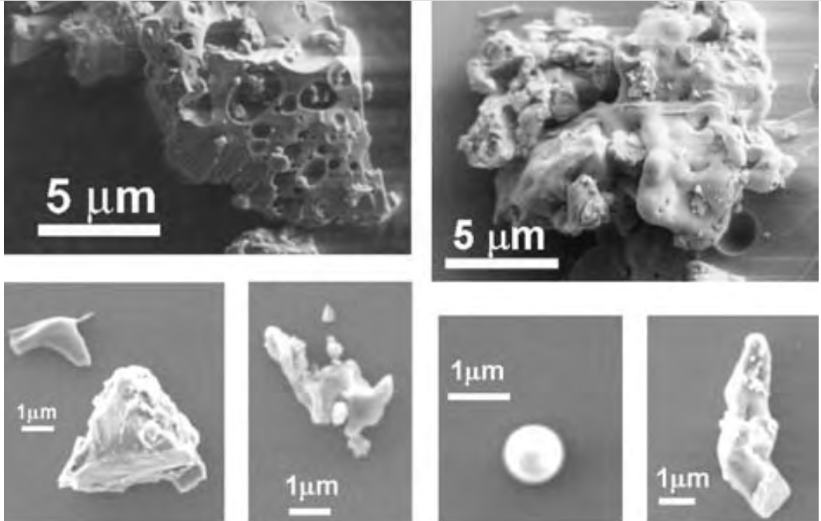
Lunar dust: challenges and opportunities
Lunar dust characteristics:
abrasive, jagged edges
chemically reactive
electrostatically charged
sometimes magnetic
strongly adheres to surfaces
Fig: SEM images of Apollo 17 lunar dust
Image credit: NASA
Image credit: NASA

Slide 3
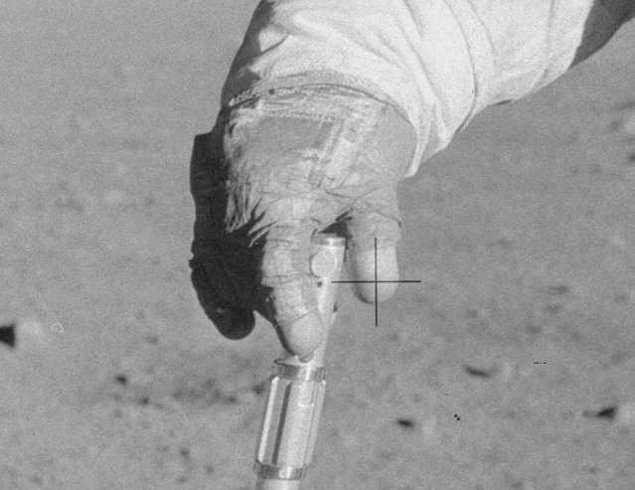
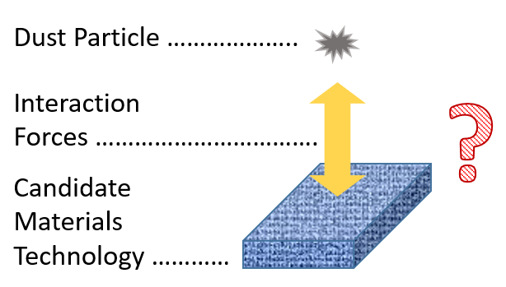
Evaluating passive dust mitigating materials
What are we trying to develop?
Materials must endure:
Extreme temperature cycles
Ultra-high vacuum
Solar radiation
High energy particle impacts
Electrostatic dust levitation
Triboelectrification
No moisture
Apollo astronaut glove covered in lunar dust.
Image credit: NASA

Slide 4
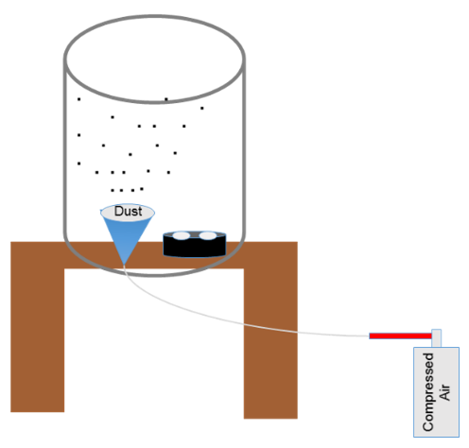
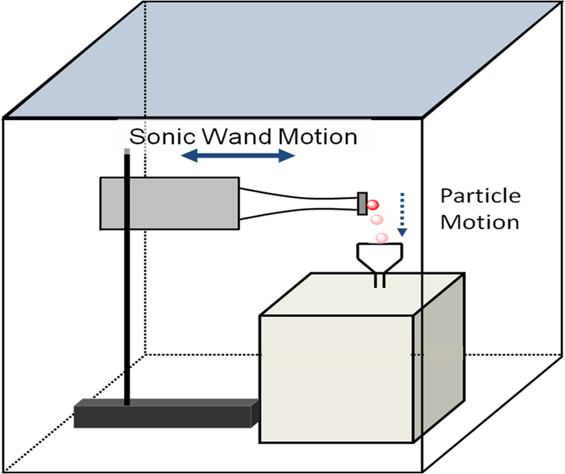
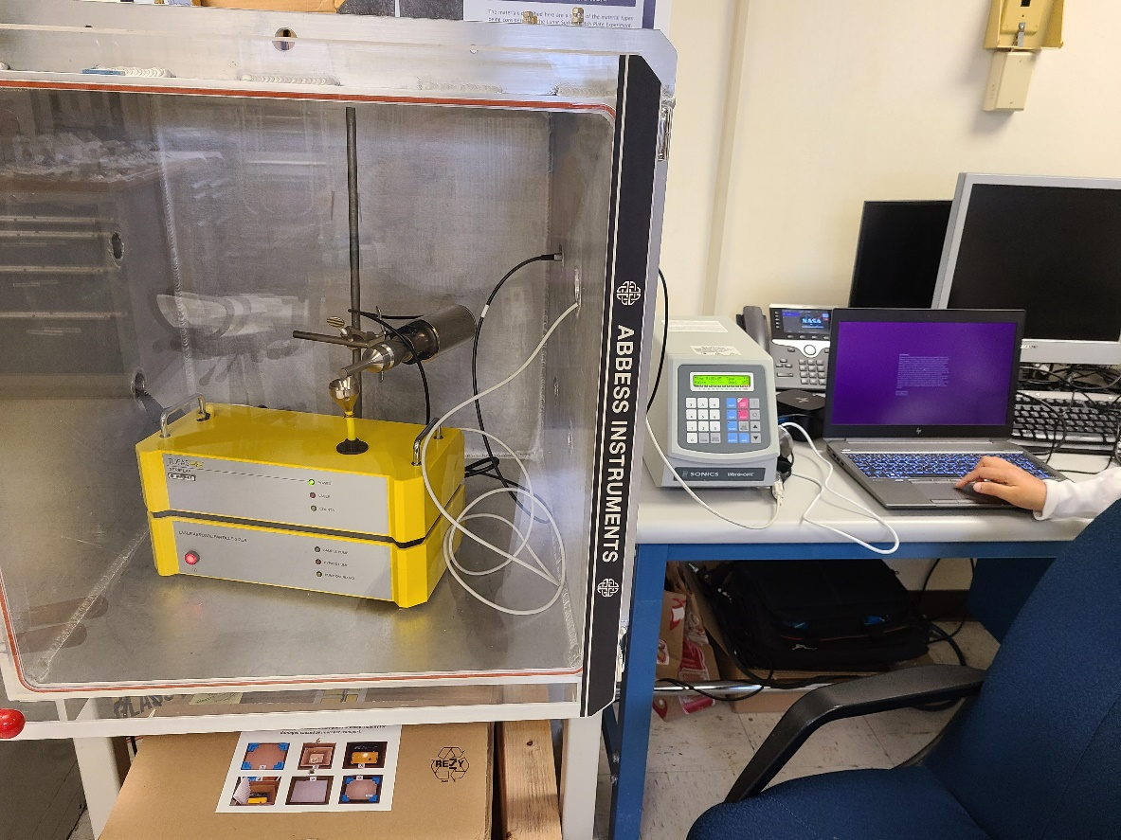
How will adhesion force be characterized?
Step 1: Lunar dust simulant contamination by aerosolization
Step 2 : Adhesion testing setup using sonic wand and optical particle counter
Step 1
Step 2
Actual Instrument

Slide 5
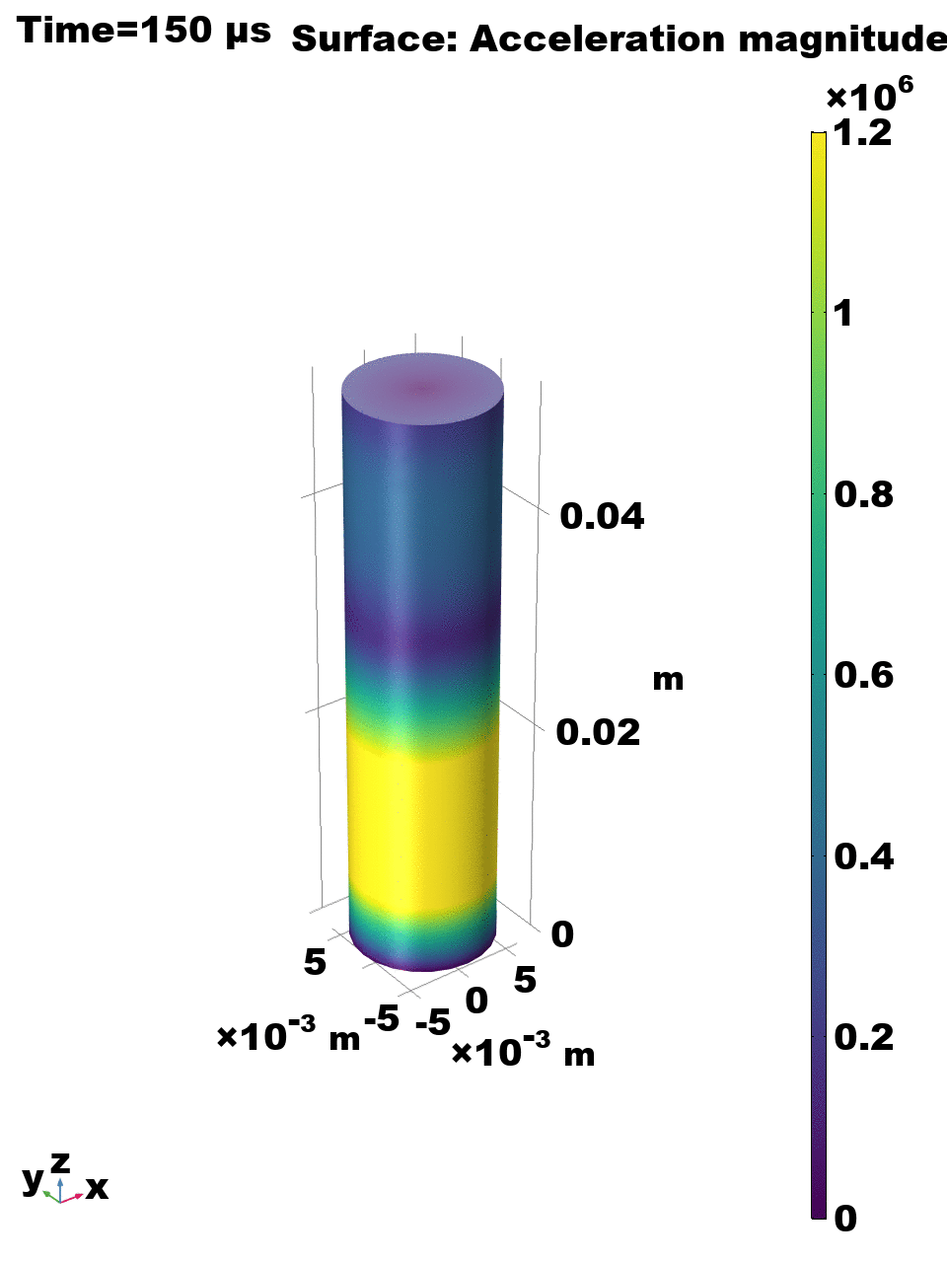
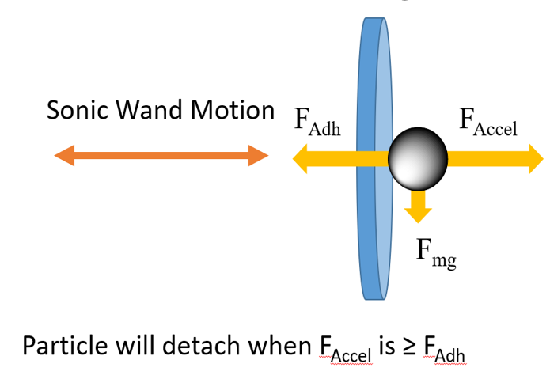
Some calculations
The displacement , Z , on the surface of the sonic wand can be modeled using a sinusoidal function as:
Z = A x sin(2 x π x f x t)
Z : the surface displacement in [um]
A : the maximum amplitude in [um]
π : 3.14159
f : the sonic wand motion frequency in Hz
t : time in seconds
Various amplitudes were used in percentages of the sonic horn maximum: 120 [um]

Slide 6
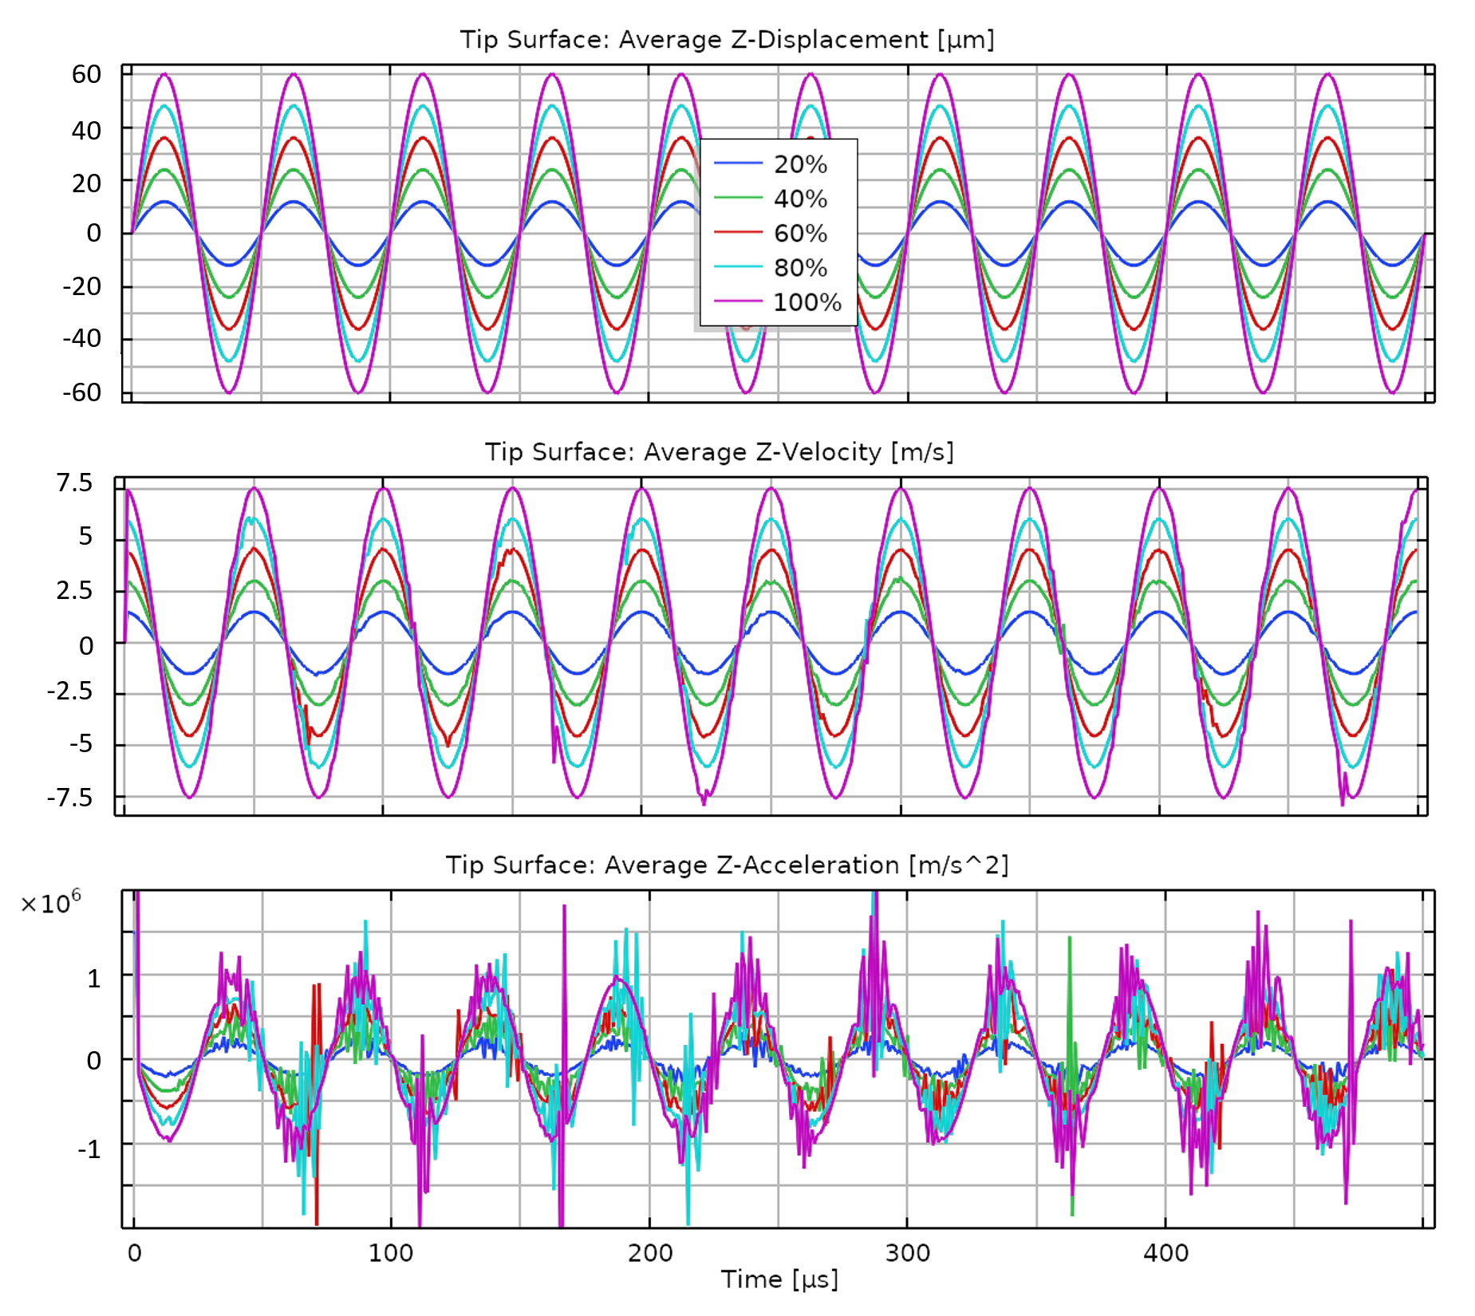
Surface motion
Second derivative amplitude = peak Z-Acceleration:
20%: 24[um]: 1.89 x 10^5 [m/s^2]
40%: 48 [um]: 3.79 x 10^5 [m/s^2]
60%: 72[um]: 0.57 x 10^6 [m/s^2]
80%: 96[um]: 0.76 x 10^6 [m/s^2]
100%: 120[um]: 0.96 x 10^6 [m/s^2]
A particle of mass m on the surface would experience an acceleration force of ~ m x 0.57 x 10^6 [m/s^2] when the wand is at 60%.
If we assume the mass of a single particle to be 1 ng,
then this equals 0.57 x 10^⁻6 N.

Slide 7
Materials evaluated, both as-received and laser patterned
Material | Primary Application
Kapton® HN (Dupont™) | Extensive space heritage, excellent thermal stability, chemical resistance, dielectric properties, radiation resistance
Teflon™ FEP | Extensive space heritage, excellent thermal stability, low energy surface, chemical resistance, UV stability, dielectric properties
Low Creep/Low Relaxation (LCLR) bismaleimide (BMI) Composite | Use in deployable structures, excellent mechanical and thermal properties
Titanium Alloy (Ti-6Al-4V) | Extensive space heritage as a material in primary structures.

Slide 8
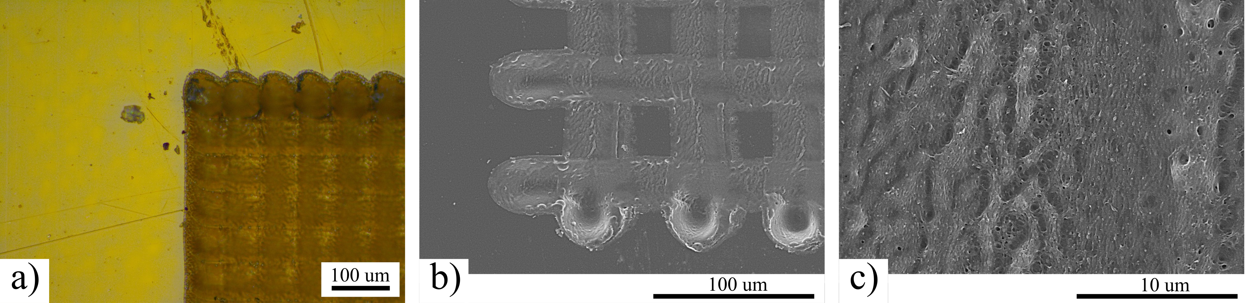
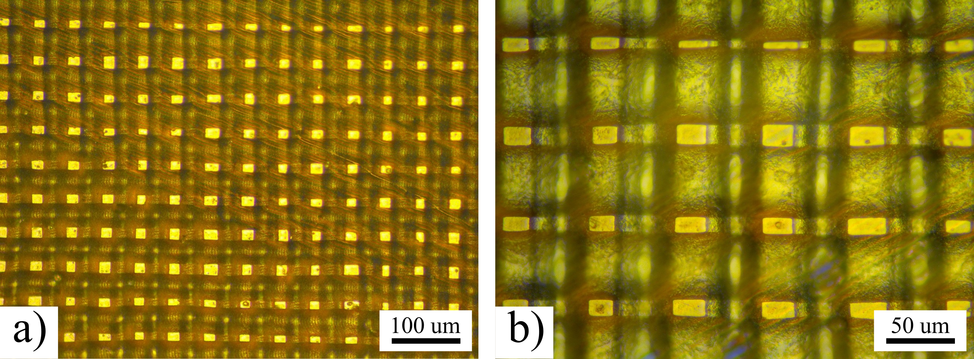
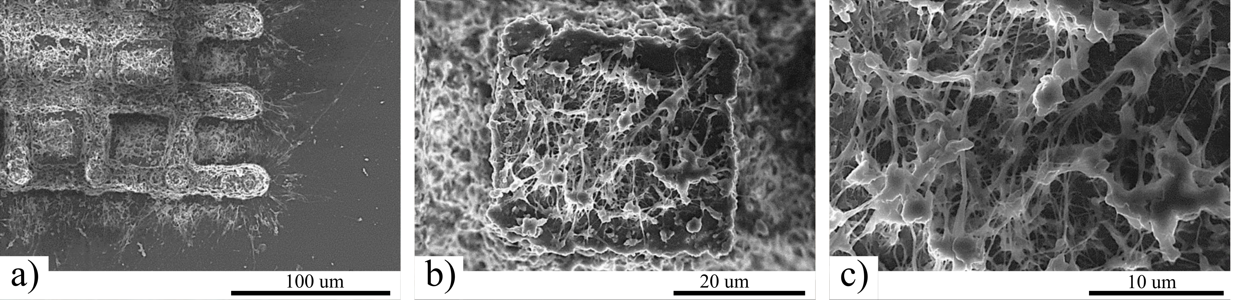
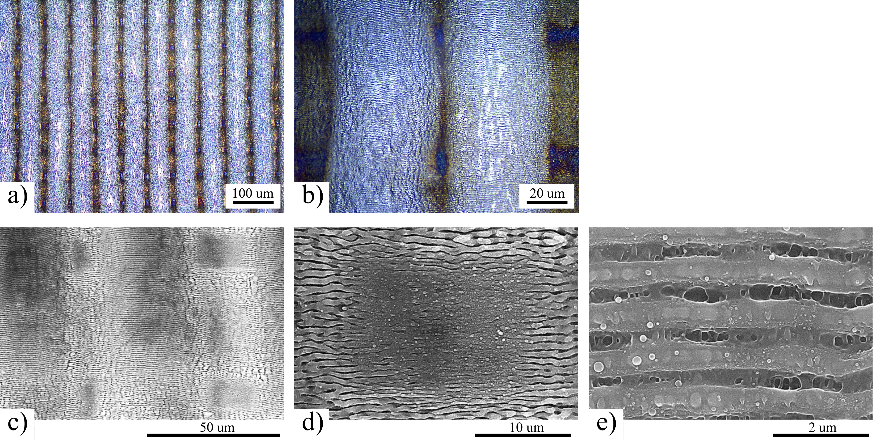
Laser patterned sample images
Kapton
LCLR
Figure: Optical (a) and scanning electron (b,c) micrographs of laser ablation patterned Kapton® HN surface.
Figure: Optical microscopy images collected on laser ablation patterned LCLR surfaces.
FEP
Ti-6Al-4V
Figure: Scanning electron micrographs collected on laser ablation crosshatch patterned FEP.
Figure: Image of Ti-6Al-4V samples at various stages of polishing. Optical (a and b) and scanning electron (c-e) micrographs collected on a laser ablation patterned Ti-6Al-4V surface.

Slide 9
Surface properties of the samples
Material | Topography | θ_{A}, ° | θ_{R}, ° | R_{a}, μm
Kapton® HN (Dupont™) | Pristine | 78±3 | 58±5 | 0.041±0.011
 | Laser Patterned | 90±1 | 75±3 | 1.759±0.112
Teflon™ FEP | Pristine | 106±7 | 95±1 | 0.022±0.005
 | Laser Patterned | 141±6 | 119±3 | 1.488±0.438
LCLR BMI composite | Pristine | 95±0.5 | 79±0.7 | 0.074±0.011
 | Laser Patterned | 81 | 66 | 1.541±0.158
Titanium Alloy (Ti-6Al-4V) | Polished | 86 | 73 | 0.043±0.002
 | Laser Patterned | 117±21 | 97±16 | 0.245±0.026

Slide 10
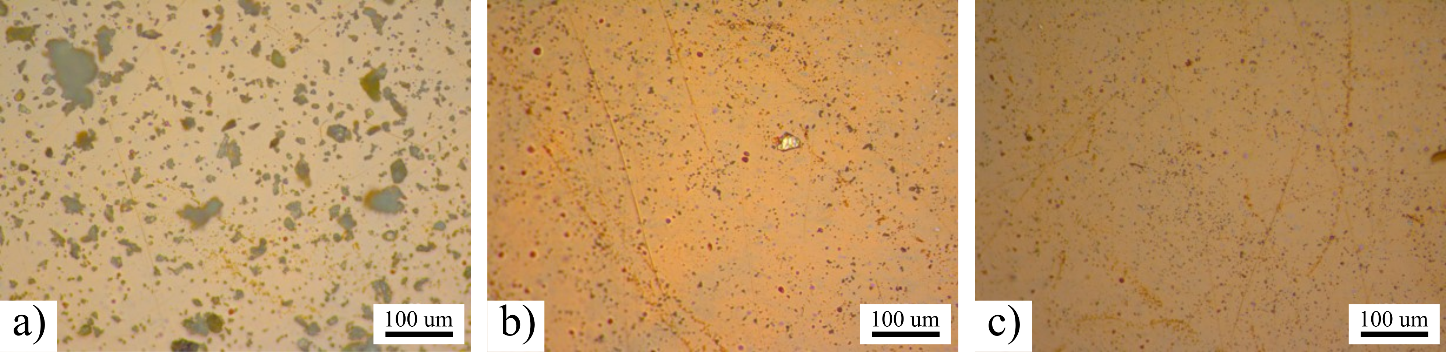
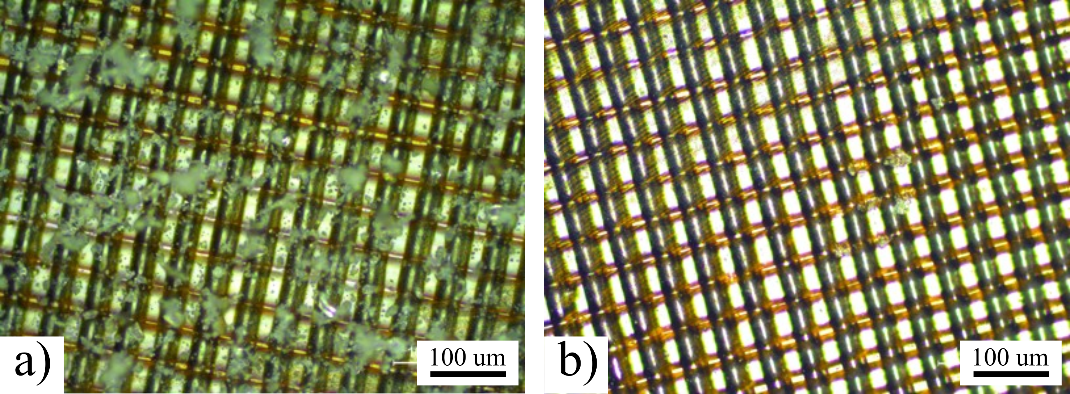
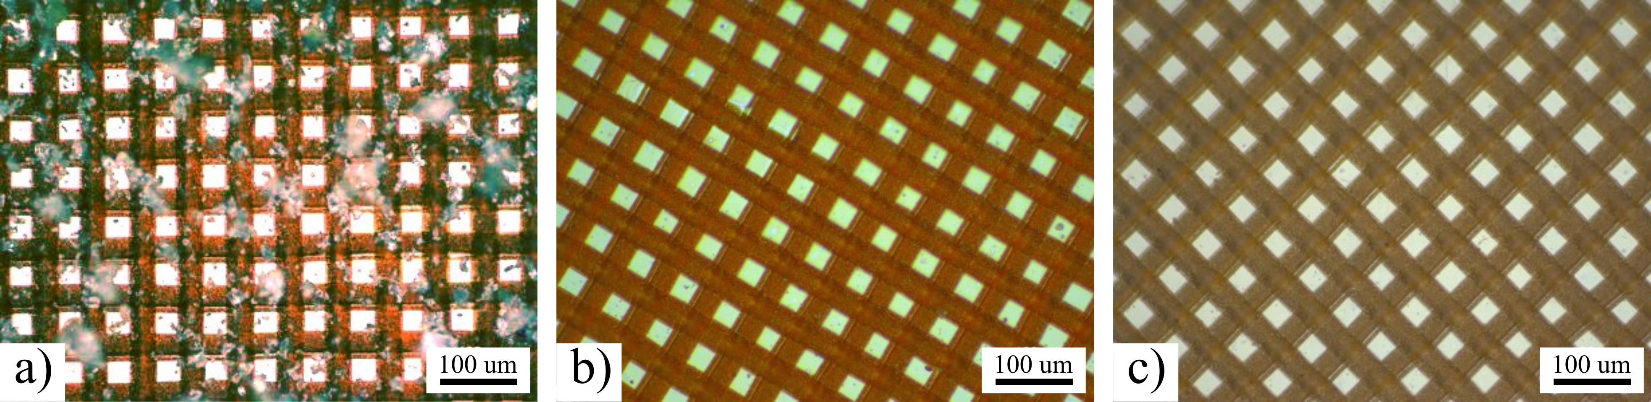
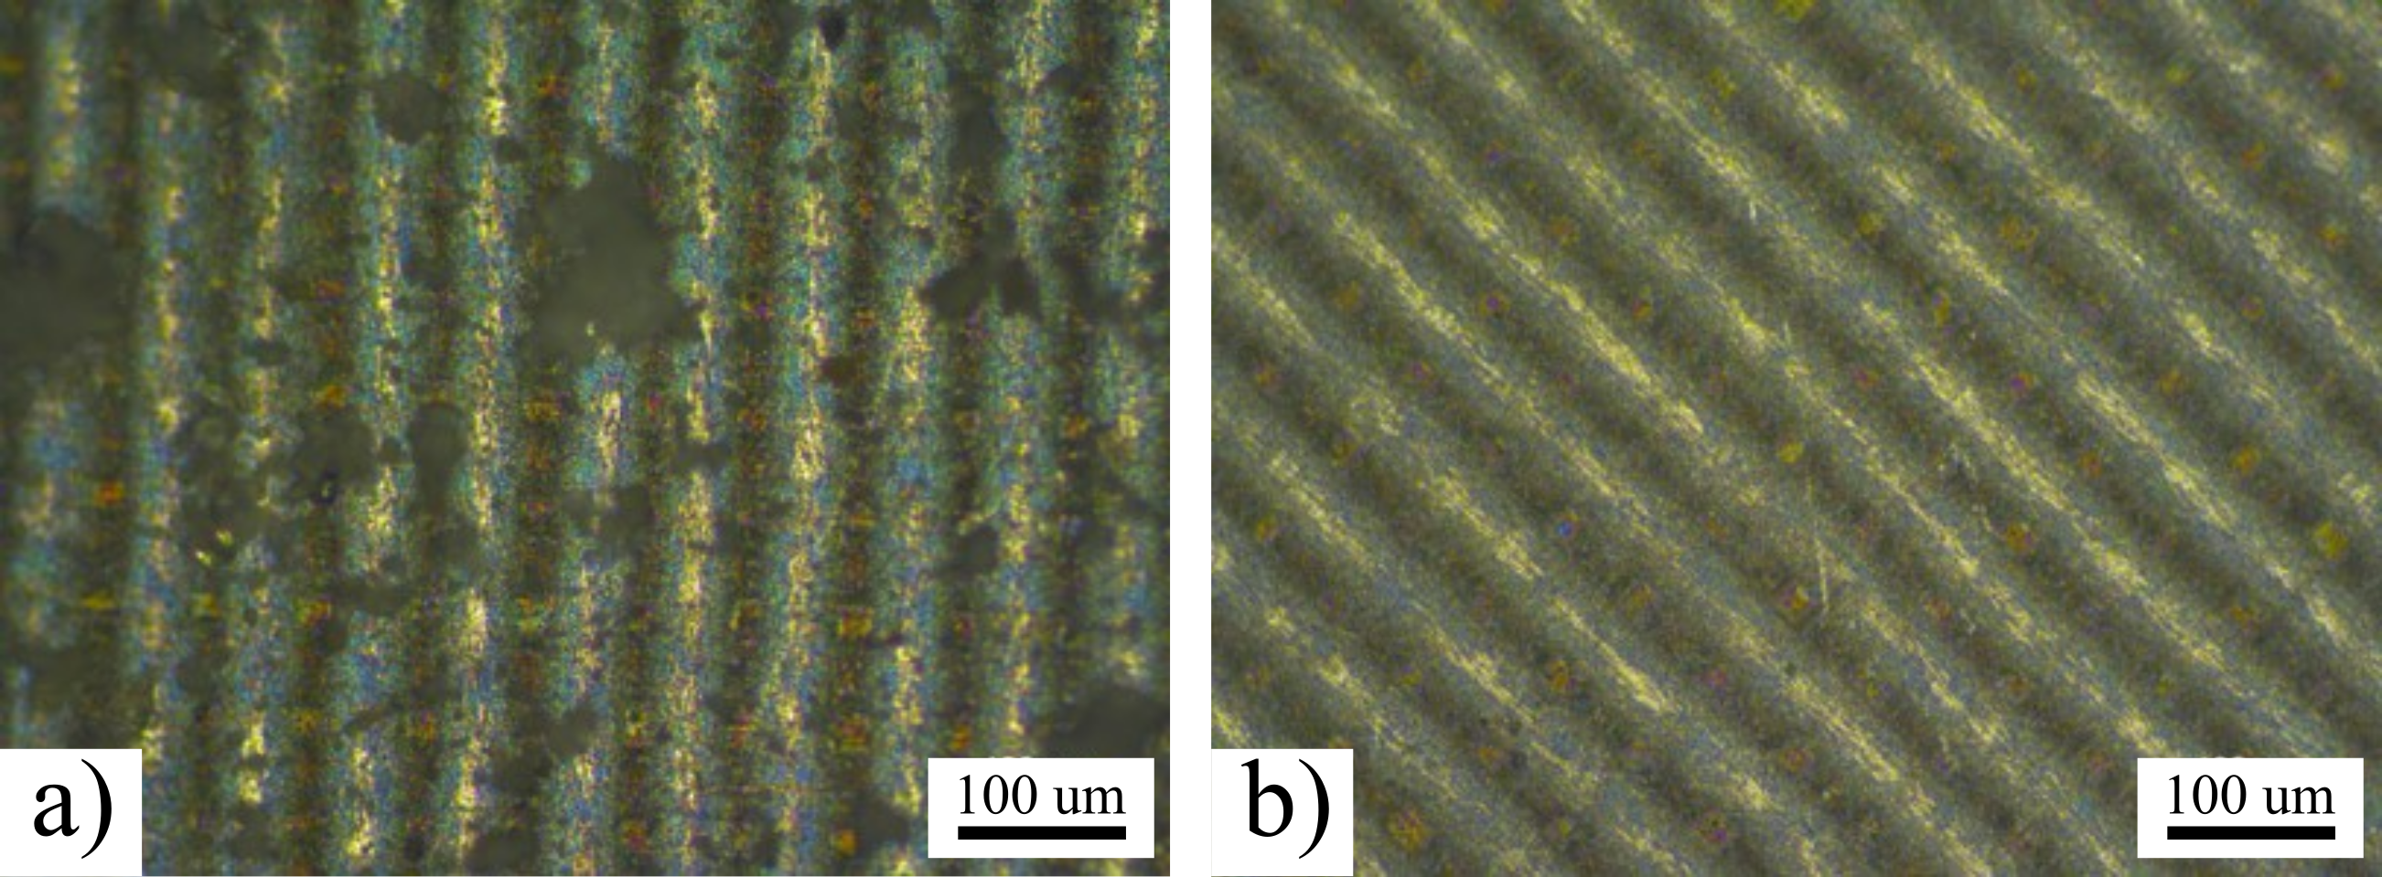
Sample optical microscopy results, 20x mag:
Figure: The as-received Kapton® HN film surface, a) lunar dust simulant contaminated b) after initial run c) at the end of the dust adhesion test.
Figure: The laser ablated Ti-6AL-4V crosshatch pattern sample surfaces a) after dust deposition and b) the initial run.
Figure: The laser ablation patterned Kapton® HN film surface, a) lunar dust simulant contaminated b) after initial run c) at the end of the adhesion test.
Figure: The LCLR-B crosshatch pattern composite sample surfaces a) after dust deposition and b) at the end of the adhesion test.

Slide 11
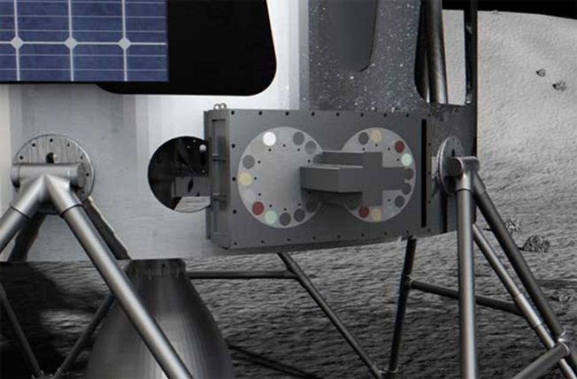
Discussion
Our present work was :
mainly qualitative in nature
to down-select suitable materials for evaluation on the lunar surface.
Done in a limited time period for reduced access to the laboratory due to the pandemic
Future work:
gain insights on dust adhesion to surfaces
compare results with RAC payload experiment on the lunar surface
ascertain the efficacy of Earth-based lunar dust adhesion characterization and testing
Schematic of the Regolith Adherence Characterization (RAC) payload being provided by Alpha Space Test and Research Alliance, LLC.
Image credit: Alpha Space Test and Research Alliance, LLC.

Slide 12
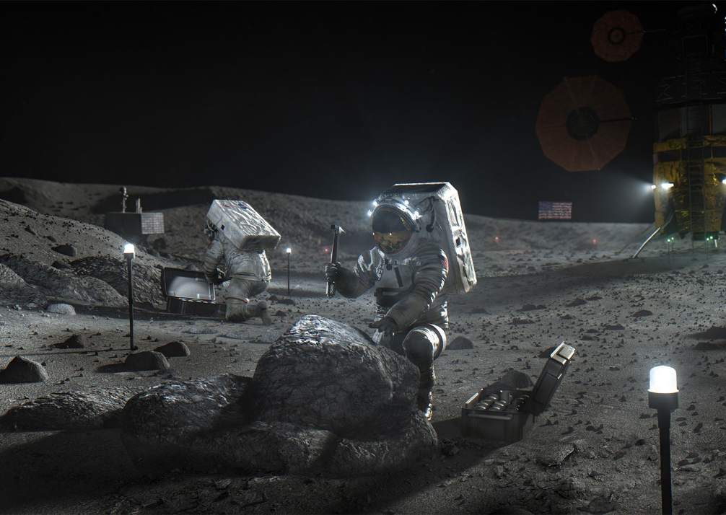
Acknowledgements
Advanced Materials and Processing Branch
John W. Connell
NASA Langley Remote Sensing Flight Systems Branch
John Hopkins, Michael Oliver, Wade Hall, and John Lowe
NASA Game Changing Development (GCD) and NASA Lunar Surface Innovation Initiative (LSII)
Niki WerkHeiser, Michael Johansen, Erica Montbach, Kristen John, Cameron Hartman
Next passive mitigation technology evaluation laboratory
Image credit: NASA

Slide 13

Thank You!!!
Questions?

