Slide 1

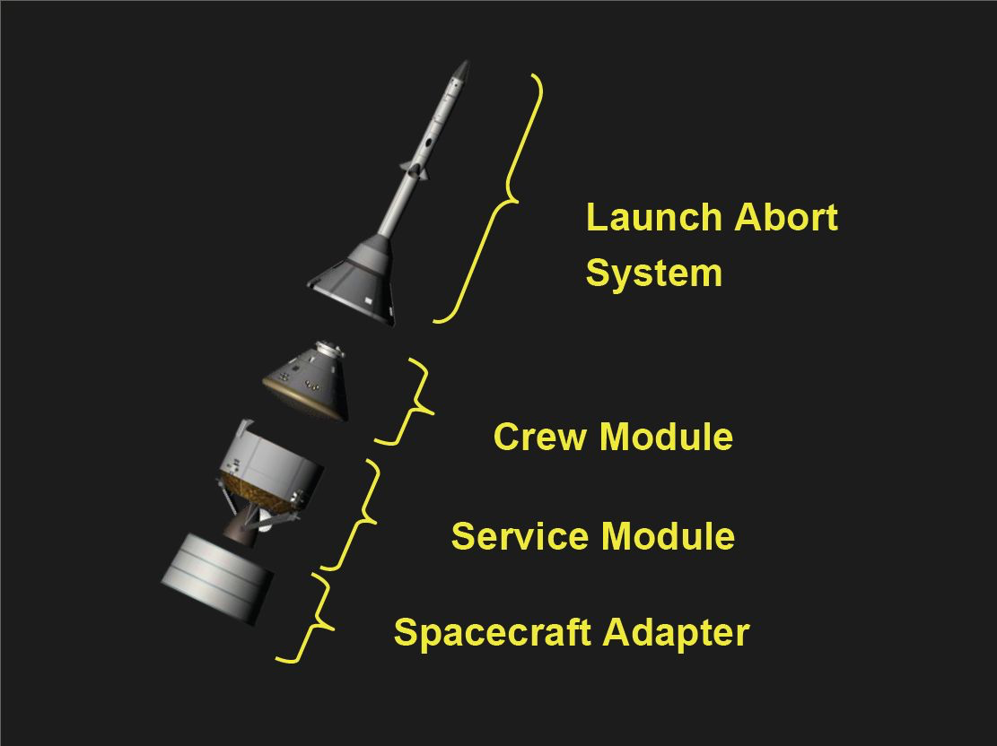
Probability Bounds Analysis Applied to
Multi-Purpose Crew Vehicle Nonlinearity
IMAC-XL
2022 (12294)
Daniel Kammer
Paul Blelloch
ATA Engineering, Inc.
Joel Sills
NASA Johnson Space Center
February 7-10, 2022
Public Domain, https://commons.wikimedia.org/w/index.php?curid=1131768

Slide 2
Background
Orion Multi-Purpose Crew Vehicle (MPCV) has significant structural nonlinearities which substantially impact primary structural response.
Nonlinearities pose a problem for Coupled Loads Analysis (CLA) using standard linear analysis methods.
A single linear MPCV model cannot be used to capture the full breadth of nonlinear response.
If linear CLA is to be performed, it is important to quantify the effect of the MPCV nonlinearities on coupled system structural response.
Hybrid Parametric Variation (HPV) uncertainty quantification combined with Second Order Propagation (SOP) can quantify impact of MPCV nonlinearities.

Slide 3
Nonlinearity Observed in MPCV Test Results
Linear MPCV models developed for low level (LL) and high level (HL) input forces based on Configuration 4 (C4) test/analysis (T/A) correlation.
HPV method used to develop uncertainty models for LL and HL MPCV, and other components.
HPV accounts for parametric and model-form uncertainty in linearized component relative to corresponding force level test data.
HPV process does not account for nonlinearity in MPCV.
MPCV nonlinearity is a model-form uncertainty – lack of knowledge.
Treat MPCV nonlinearity as an epistemic uncertainty.

Slide 4
Classification of Uncertain Variables
Aleatory uncertainty – inherently random variable – sample from corresponding probability distribution – uncertainty cannot be reduced.
Epistemic uncertainty – deterministic variable with unknown value within a known interval – represents a lack of knowledge – uncertainty can be reduced.
Cannot be represented by sampling from a probability distribution.
Cannot be combined with aleatory uncertainty into a single MC analysis.

Slide 5
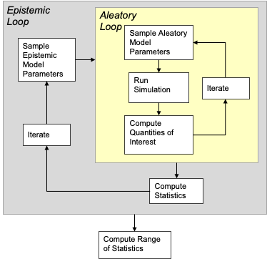
Combine Epistemic and Aleatory Uncertainty using
Second Order Propagation - SOP
Inner Loop
HPV UQ
Outer Loop
MPCV
Nonlinearity
Bailey, E., and Peterson, L., Ignorance vs. Variability: Considerations for UQ Analysis, Joint GN&C and L&D Uncertainty Quantification Workshop, Marshall Space Flight Center, January 17, 2018.

Slide 6
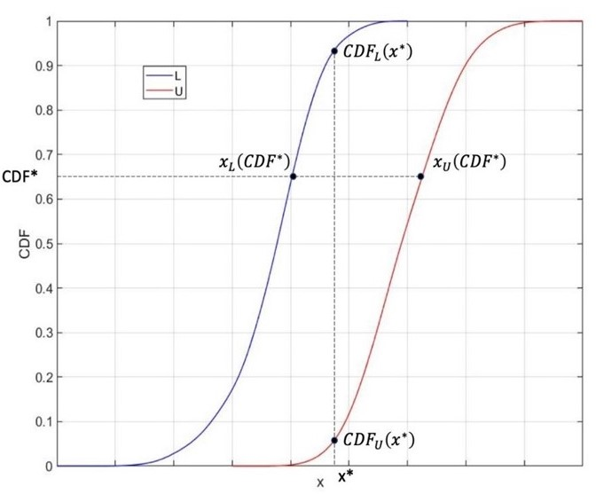
Each Sampling of Epistemic Variables (Outer Loop)
Produces a CDF for QOI from Inner Loop – Horsetail Plot
Ensemble of CDFs
Each CDF has no relative probability of occurrence, each is equally possible
Upper and lower
bound CDFs produce a P-Box
Produces intervals of
plausible probabilities
or plausible QOIs

Slide 7
Apply SOP to MPCV Nonlinearity
Outer loop represented by an ensemble of linear MPCV models.
One linear MPCV model for each component test forcing level.
Initially, only two models in ensemble, LL and HL MPCV.
LL and HL MPCV models were developed to bracket nonlinear system results, but no guarantee this is the case.

Slide 8
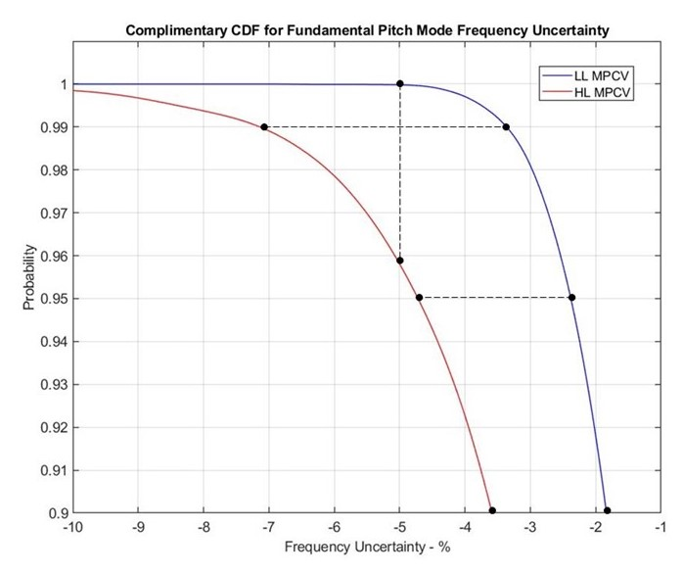
P-Box for GNC Stability Constraint on Pitch Bending
Frequency Uncertainty at T0+120 Seconds
Expanded view of complimentary CDFs (1-CDF) for percent frequency error
Plausible range of probability
at -10% uncertainty bound:
P99.8 – P100
Plausible range of probability
at -5% uncertainty:
P95.8 – P100
Probability | Range of Uncertainty - % |  | Delta - %
 | HL | LL | abs([HL-LL]/LL)
90 | -3.60 | -1.85 | 94.59
95 | -4.70 | -2.40 | 95.83
99 | -7.15 | -3.35 | 113.43

Slide 9
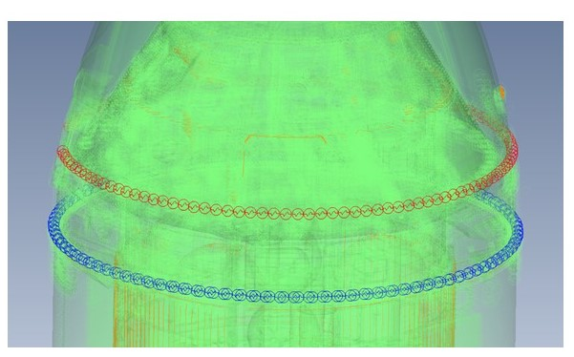
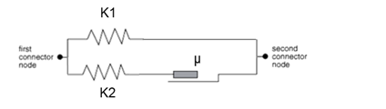
Augment C4 Test Data with Surrogate Data Based on Nonlinear MPCV Model Derived from an Abaqus Model
Transformed to Matlab model with two 1-D nonlinear springs representing:
Airfoils between crew module adaptor (CMA) and fairing
Aerodeflectors between launch abort system (LAS) and CMA
Sliding Stiffness
Friction Force
Stick Stiffness
Parameters tuned to approximately fit nonlinear behavior observed at LL (joints stuck) and HL (joints free) excitation levels.
Matlab model 600X faster than Abaqus.

Slide 10
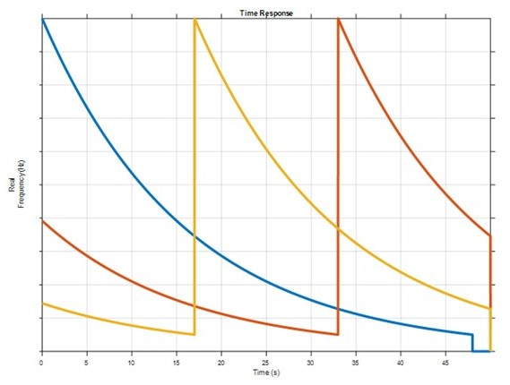
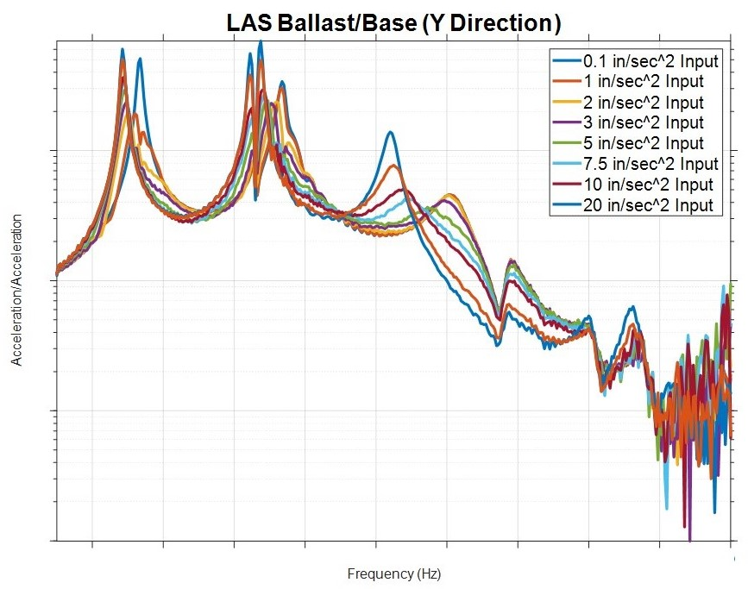
Nonlinear MPCV Model used to
Generate Surrogate Test Data
Multi-sine swept input applied as enforced acceleration at base in three directions.
Sweeps are logarithmic from 20 Hz to 1 Hz.
Results in three independent inputs - X, Y, Z.
8 sets of test data based on 8 input amplitude levels – 0.1, 1, 2, 3, 5, 7.5, 10, and 20 in/sec²

Slide 11
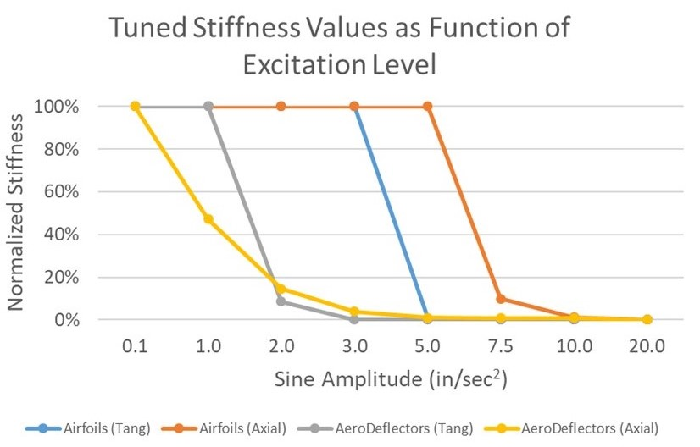
Generate Linear MPCV Models based on
Surrogate Test Modes
Used ATA’s ATTUNE software to adjust joint stiffnesses in linear FEM to best match test modes.
Adds 8 linear MPCV models to SOP outer loop ensemble, 1/load level.

Slide 12
Generate HPV Uncertainty Models for MPCV/MSA HCB
Components using Surrogate T/A Correlation Results
 | Input Level – in/sec²
Test Mode | 0.1 | 1 | 2 | 3 | 5 | 7.5 | 10 | 20
1 | 0.52% | 0.12% | 1.31% | 1.93% | 0.70% | 0.74% | 0.64% | 0.60%
2 | 0.05% | 1.51% | 1.73% | 0.22% | 0.49% | 0.03% | 0.18% | 0.11%
3 | 0.25% | 0.40% | 0.23% | 1.74% | 1.36% | 1.35% | 1.04% | 0.01%
4 | 0.99% | 0.94% | 0.43% | 2.61% | 1.87% | 1.42% | 0.96% | 0.08%
5 | 1.36% | 4.45% | 10.30% | 12.06% | 9.55% | 4.92% | 3.32% | 0.06%
6 | 1.03% | 3.33% | 8.06% | 10.22% | 9.23% | 5.42% | 3.72% | 0.04%
7 | 0.27% | 0.94% | 1.25% | 1.39% | 1.35% | 1.30% | 1.04% | 0.01%
8 | 0.36% | 0.76% | 1.20% | 2.86% | 1.04% | 0.27% | 0.42% | 0.56%
9 | 0.81% | 1.89% | 2.24% | 1.09% | 0.99% | 0.93% | 0.34% | 0.38%
Mean | 0.63% | 1.59% | 2.97% | 3.79% | 2.95% | 1.82% | 1.30% | 0.20%
Absolute % frequency error wrt FEM
T/A results assume that nonlinear MPCV model (surrogate test data) matches reality. It does not!
Results are artificially accurate.
Must adjust for difference between surrogate test results and reality.
  Described in paper.

Slide 13
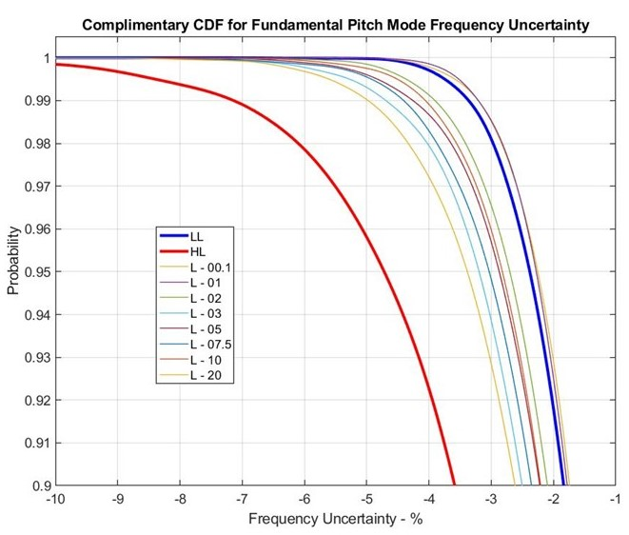
Expanded View of Horsetail Plot for Pitch Bending
Frequency Uncertainty at T0+120 Seconds
Only levels 0.1 and 1 in/sec² lie outside the region bracketed by the LL and HL model CCDFs
HL CCDF lies to the left and below all other CCDFs. Probability of exceedance is greater.
HL model is statistically more conservative than all others wrt pitch bending frequency uncertainty.

Slide 14
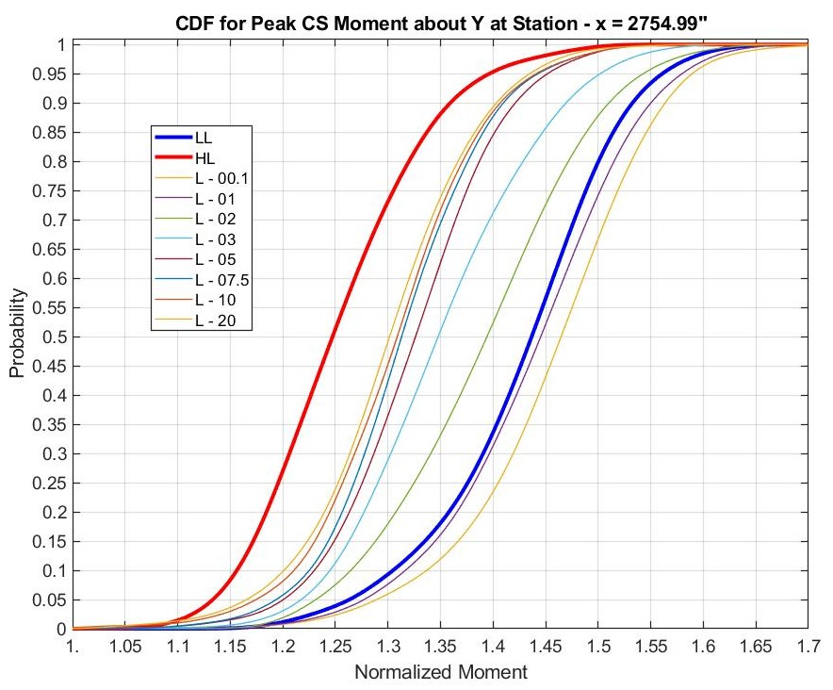
Horsetail Plot for Peak CS Moment about Y at Section
x = 2754.99 in. at T0+50 Seconds due to Buffet
Only levels 0.1 and 1 in/sec² lie outside the region bracketed by the LL and HL model CDFs
HL CDF lies to the left and above all other CDFs. Probability of exceedance is less.
HL model is statistically less conservative than all others wrt peak CS section moment about Y.

Slide 15
Conclusions
MPCV nonlinearity can be thought of as uncertainty in model form.
Model-form and random uncertainty can be combined using an SOP approach.
Outer loop in SOP represents MPCV nonlinearity, given by ensemble of linearized models, one for each forcing level.
Impact of MPCV nonlinearity is given in the form of:
  Range of the QOI that corresponds to a certain percentile
  Range of percentiles that corresponds to a specific value of the QOI
  If it can be assumed that a linear MPCV can adequately represent the nonlinear MPCV at a specific load level, then:
    LL and HL MPCVs are close to bracketing response of nonlinear MPCV and representing uncertainty due to model-form
    SOP combined with the HPV UQ method provides an effective way of assessing the impact of component nonlinearities on uncertainty in system level response

