Slide 1
Introduction to OSSEs
Nikki Privé
22 November 2021

Slide 2
What is an Observing System
Simulation Experiment?
An OSSE is a modeling experiment used to estimate the impact of
new observing systems on numerical weather prediction when actual observational data is not available.
A long free model run is used as the “truth” - the Nature Run
The Nature Run fields are used to back out “synthetic observations” from all current and new observing systems
Realistic errors are added to the synthetic observations
The synthetic observations are assimilated into a different operational model
Forecasts are made with the second model and compared with the Nature Run to quantify improvements due to the new observing system
Notes:
2
2

Slide 3
OSSEs vs. the Real World
Real world forecasts
verification
observation
DAS
Forecast model
Reality
Data
Analysis
Forecasts
background
OSSE forecasts
Nature
Run
interpolation
Synthetic
data
DAS
Forecast model
Analysis
Forecasts
background
verification
Notes:
Flowchart comparing OSSEs to operation data assimilation. The two main differences are the replacement of the actual atmosphere with the Nature Run, and the use of the NR to verify forecasts (and analyses) in the OSSE instead of self-analysis verification.

Slide 4
Why do an OSSE?
You want to find out if a new observing system will add value to NWP analyses and forecasts
You want to make design decisions for a new observing system
You want to investigate the behavior of data assimilation systems in an environment where the truth is known
Notes:
The “classic OSSE” is the first item – testing new observing system designs in a controlled framework when actual observations are not available.
A potentially valuable use is to compare design possibilities for a new instrument – for example, decisions about scan characteristics, orbits, channels, for a new satellite. This can be used to determine if a less expensive alternative design will still yield useful results in comparison to the full design.
The third point is valuable in the context of design and understanding of data assimilation systems. In the OSSE, the availability of the truth for verification allows the direct calculation of analysis errors, as well as adjoint and other observation impact metrics, to determine exactly how the ingestion of different observations affects the skill of the analysis. These calculations are not possible in the real world environment.

Slide 5
When NOT to run an OSSE
When you can’t model the phenomenon you are interested in
When you can’t simulate your new observations
When you can’t assimilate your new observations
  (Unless you want to work on development of a new operator)
Notes:
1. If you are interested in something that your available models (BOTH NR and forecast model) produce either poorly or not at all (due to resolution, improper physics, etc), you may be wasting your time with an OSSE. In some cases, you might be able to find an alternative field that the model does reproduce well, and which has a link to the actual phenomenon of interest.
2. If your NR does not produce the output needed to simulate your observations, or if you just don't know how to simulate the observations well enough, do not do an OSSE.
3. If your desired forecast model does not have suitable DAS to go along with it, or if your observations are not suitable for assimilation into NWP models, do not do an OSSE.

Slide 6
Nature Runs
Nature Runs act as the ‘truth’ in the OSSE, replacing the real atmosphere
Usually, a long free (no DAS cycling) forecast from the best model available is used as the Nature Run
  Model forecast has continuity of fields in time
  Sometimes an analysis or reanalysis sequence is used, but the sequence of states of truth can never be replicated by a model
Must be able to realistically model phenomena of interest
Ideally is “better” than and different from the operational model used for experiments to replicate model error

Slide 7
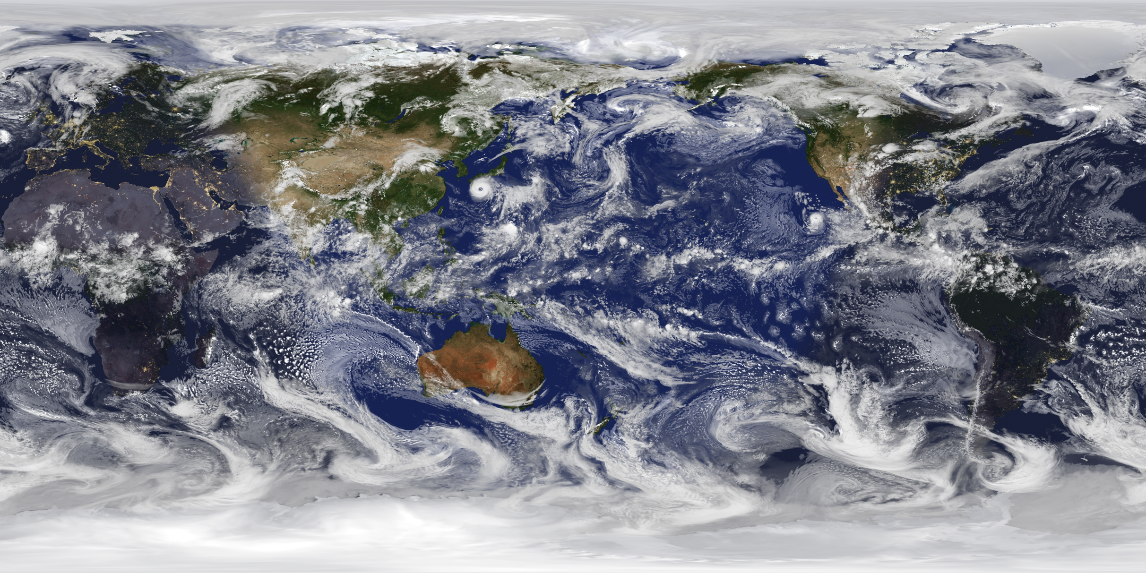
GEOS-5 Nature Run (G5NR)

Slide 8
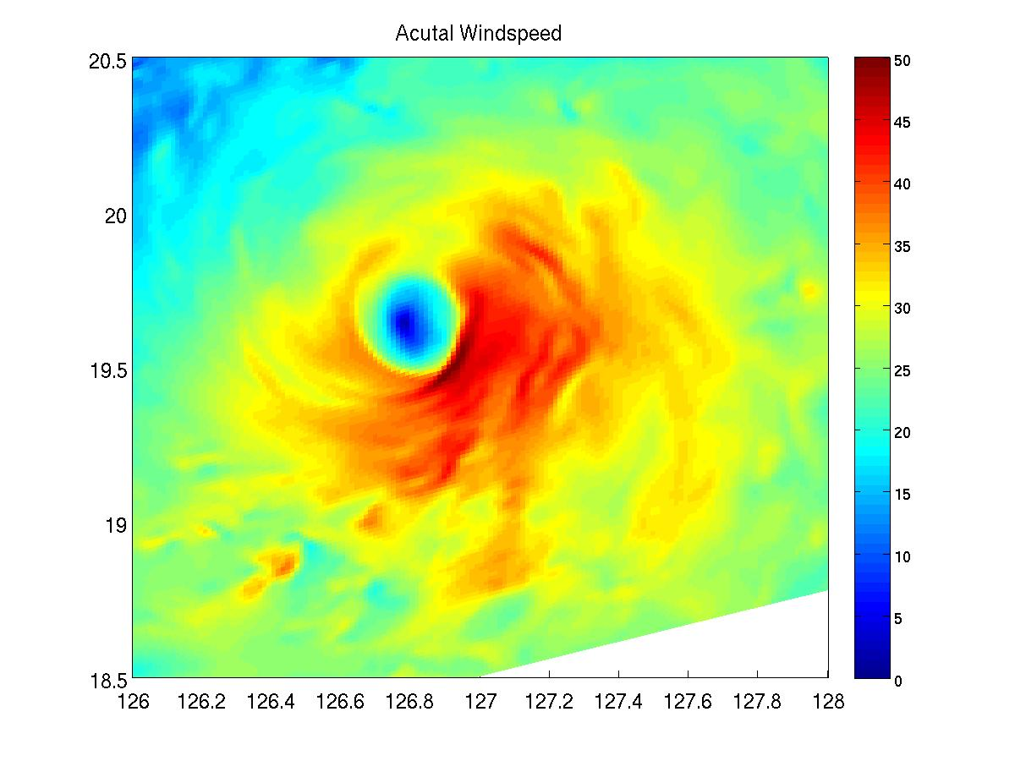
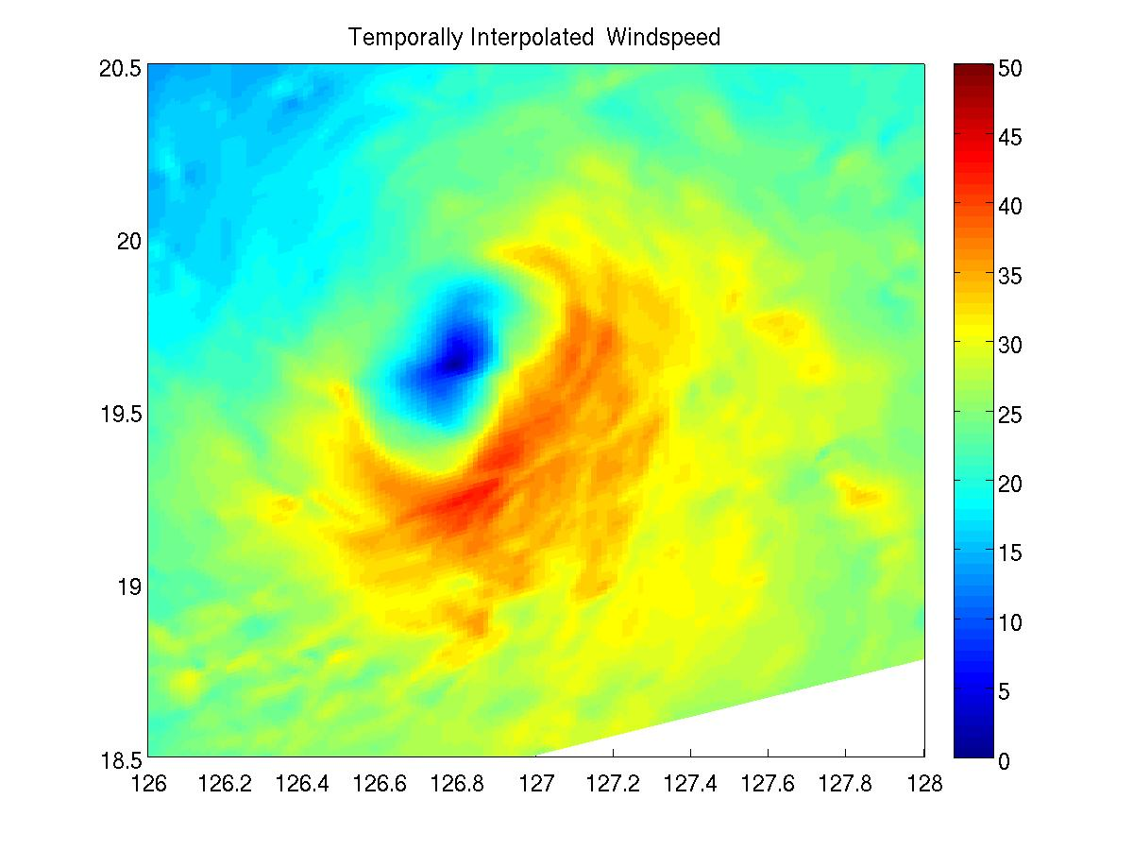
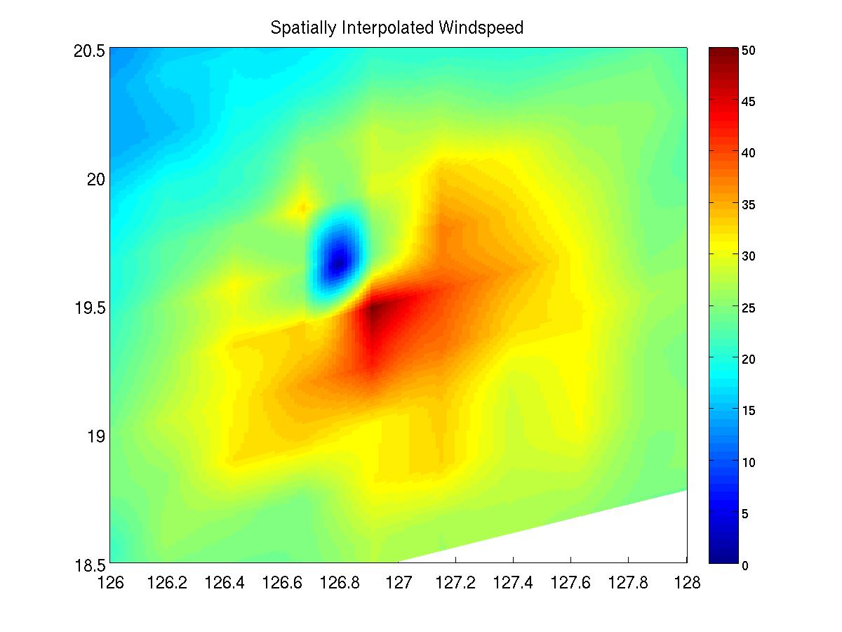
Common Problems with Nature Runs
Identical or fraternal twin – insufficient model error
Outdated by the time you get to use them
Gigantic files and huge computational resource requirements
  Massive I/O demands
  Infrequent output with high spatial resolution = trouble
Full resolution (1.5 km, 10 min)
Temporal interpolation (3 hrs)
Spatial interpolation to 27 km
Comparison of temporal and spatial
Interpolation errors compared to 1.5 km run for Typhoon Guchol (2012).

Slide 9
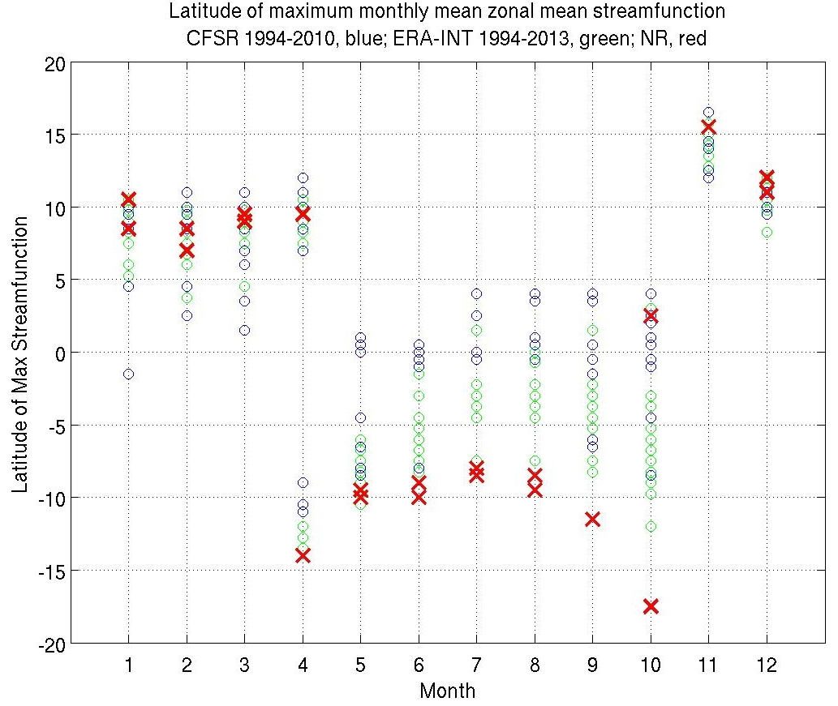
Nature Run Validation
Evaluate if NR is sufficiently realistic to yield meaningful results
NR needs to replicate fields needed to generate realistic simulated observations
Can’t validate everything – corollary – don’t expect a NR to come pre-validated for your needs

Slide 10
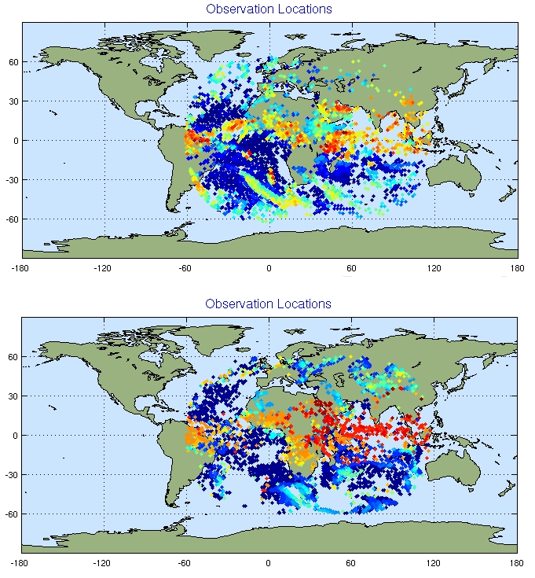
Simulated Observations
Goal: produce simulated observations that are statistically indistinguishable from real data as employed by the DAS
Real
Example of
METEOSAT AMV
observations at
0000 UTC 10 July
Simulated

Slide 11
Observation Errors
Simulated observations contain some intrinsic interpolation/operator errors, but less than real observations (usually)
Simulated observation errors are created and added to the simulated observations to compensate
Observation error is complex and poorly understood
  Error Magnitude
  Biases
  Correlated Errors

Slide 12
Calibration and Validation
Goal – match statistics of the DAS behavior in the OSSE to that of the real world observations/DAS
Choose some metric(s) to use as a basis for calibration
Run analog case with real observations
Compare the OSSE metrics to real data metrics
Adjust the OSSE framework to match the metrics
Compare other important metrics (not used for calibration) to validate your OSSE
Describe your calibration and validation in any publications

Slide 13
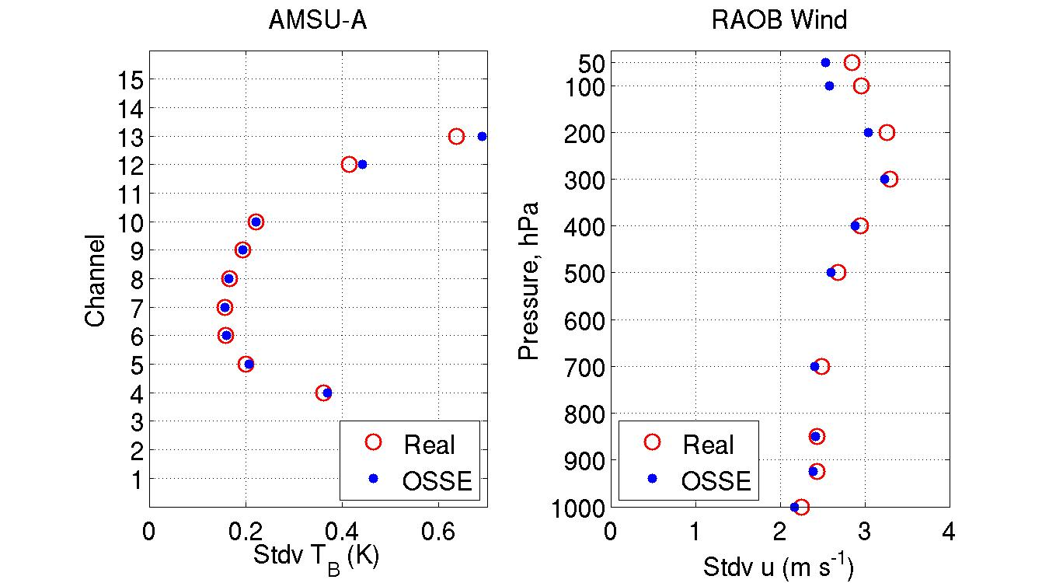
Calibration: Observation Innovation
Observation innovation (O-F) is fairly easy to calibrate because you can manipulate O directly
Be careful not to overcompensate by adding too much observation error when the background error is too small

Slide 14
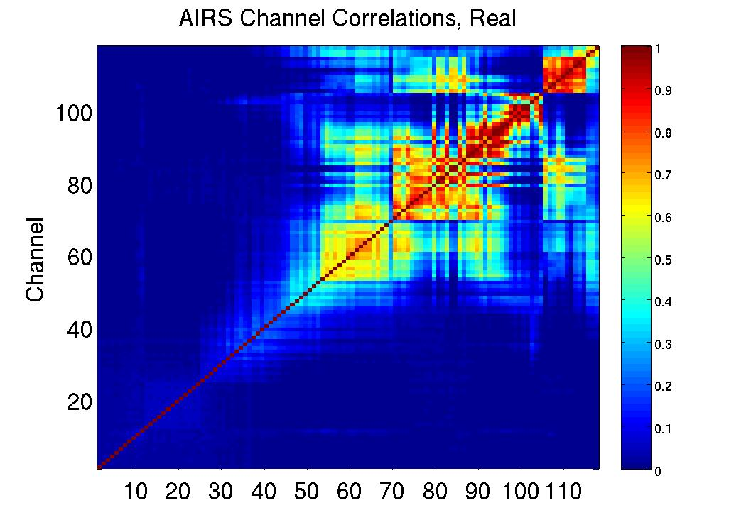
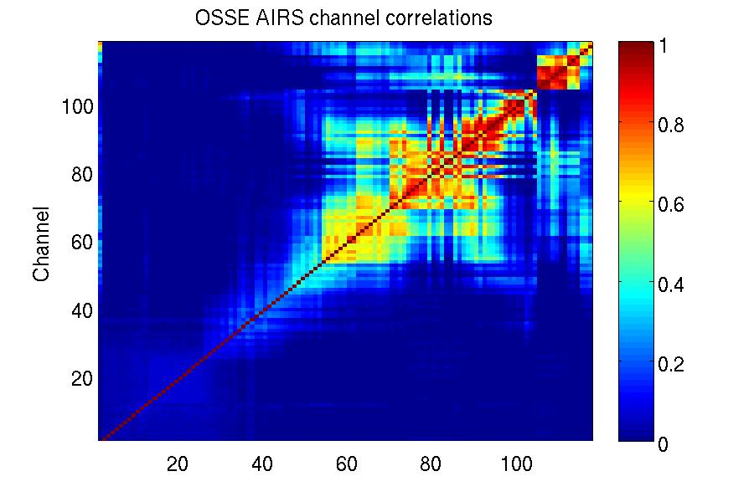
Calibration: Correlations
Some types of observation correlations are relatively easy to calibrate

Slide 15
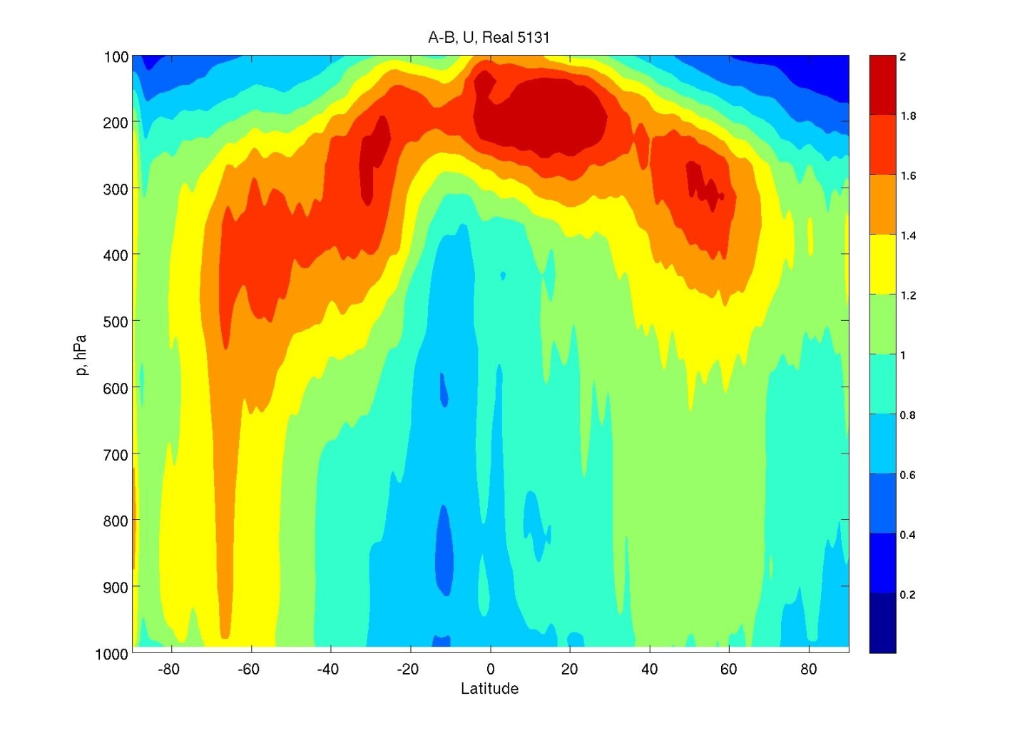
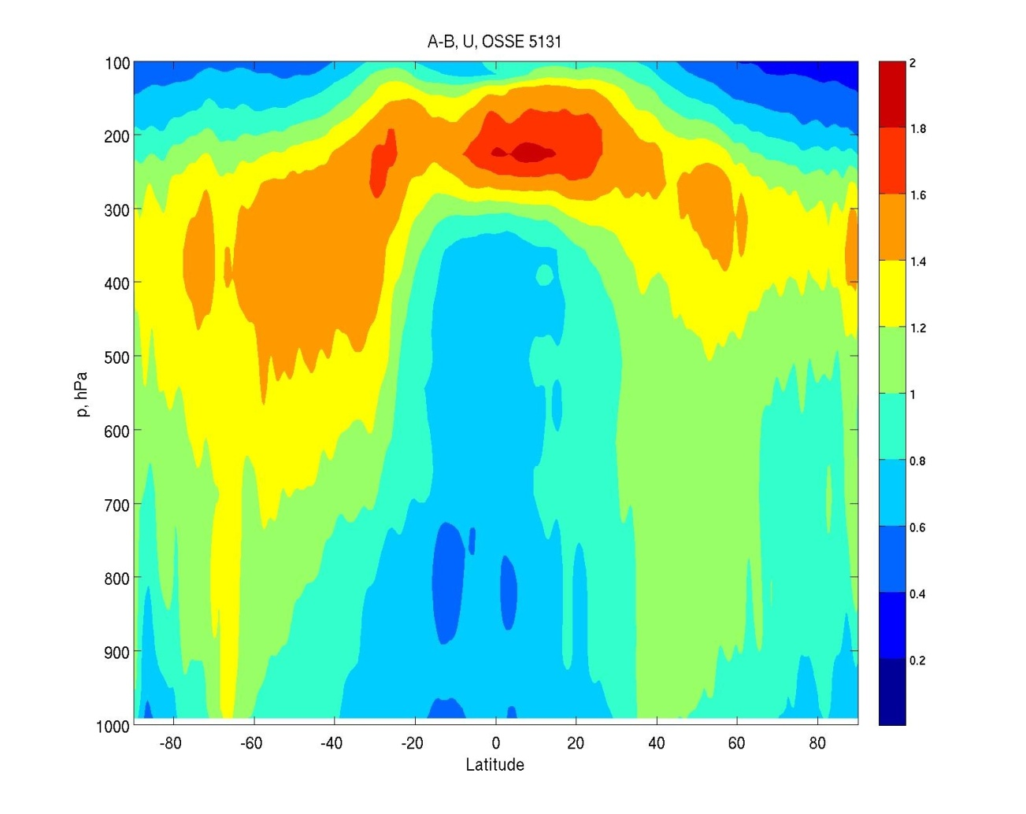
Calibration: Analysis Increment
Real
OSSE
StDev(A-B) for Temperature, K
Analysis increment (A-B) is harder to calibrate, as A and B are not directly controlled

Slide 16
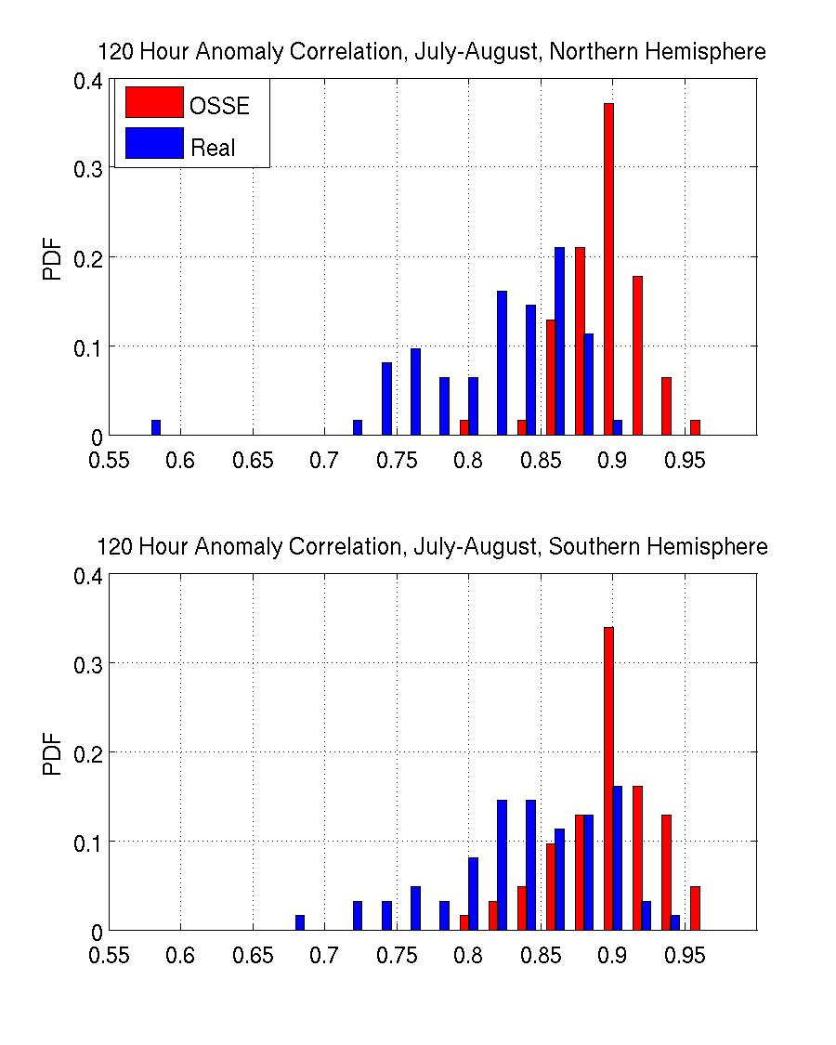
Calibration: Forecast
Model error strongly influences forecast skill in the medium/long term, so calibration is not possible (unless you want to mess up your model)
Red: OSSE
Blue: Real
500 hPa anomaly correlation of geopotential height

Slide 17
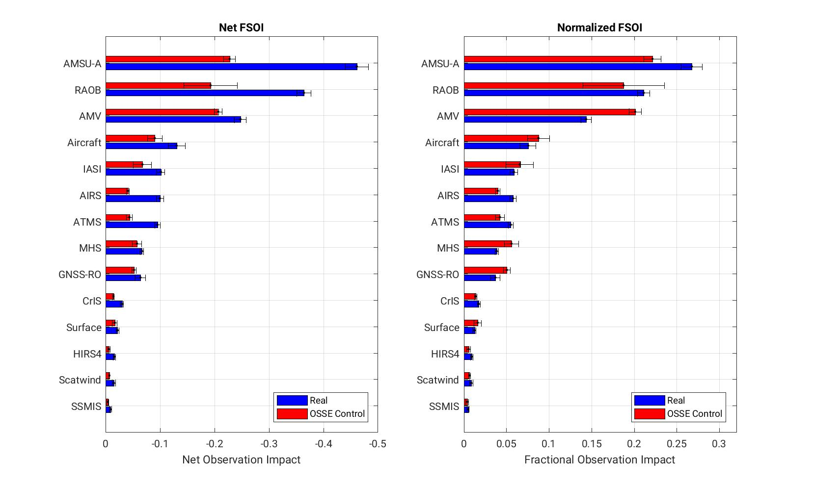
Calibration: Forecast Sensitivity to Observation Impact
Net impacts are lower in the OSSE due to insufficient model error
But new observations can be put into context relative to existing observation impacts

Slide 18
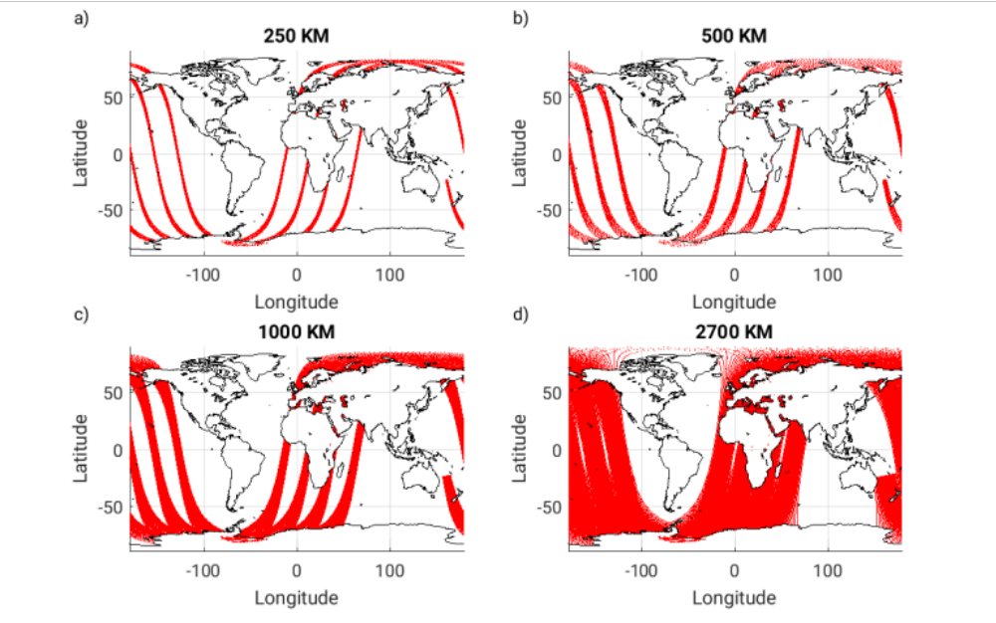
Designing an OSSE
Clearly determine the question you want to answer with your experiments
  Proof of concept?
  Realistic impact study?
  Idealized observation network?
  DAS development?

Slide 19
Designing an OSSE
Consider what to use as your Control observation network
  An idealized Control to illuminate your observation impact?
  A realistic “current” Control to replicate the existing global network?
  A potential “future” Control to emulate expected changes to the global network?
The choice of Control will in part dictate what will be learned in your experiments.

Slide 20
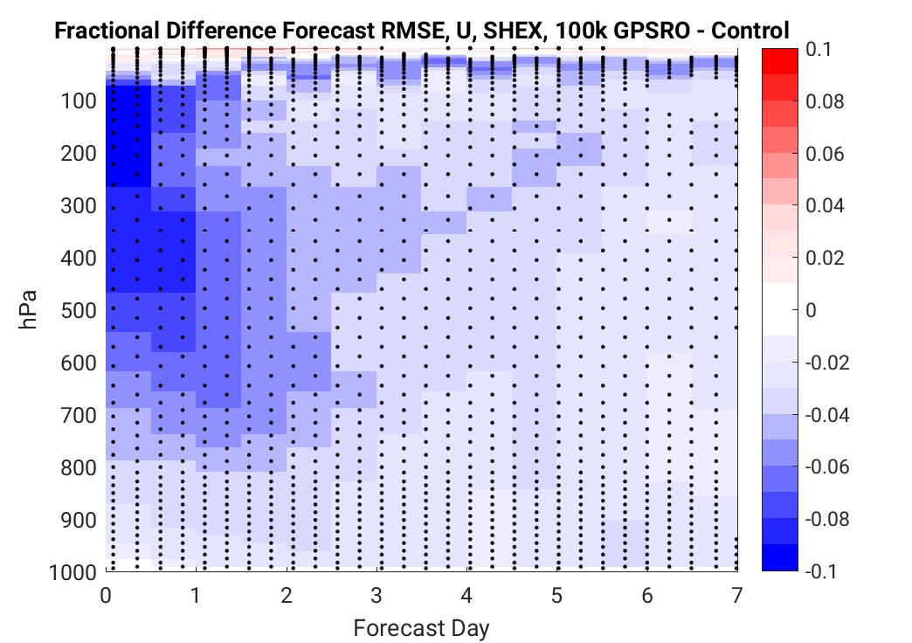
Designing an OSSE: Metrics
Decide what metrics are best suited to answer your question
  Remember that you have the “truth” available!
  Observation impacts are generally largest in the first 24-72 hours of the forecast

Slide 21
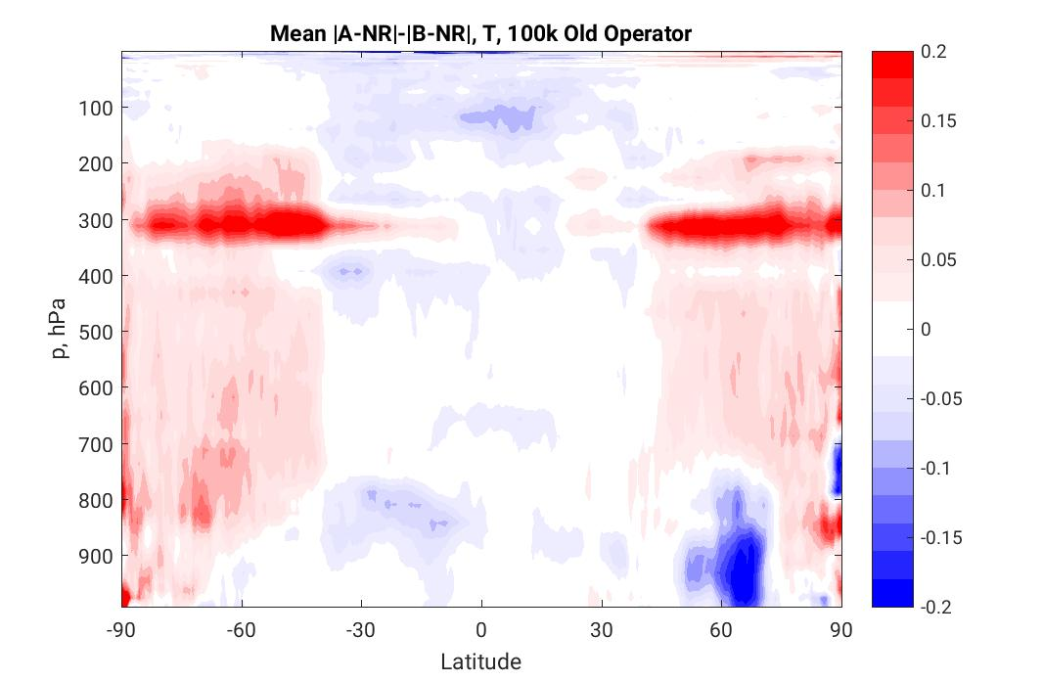
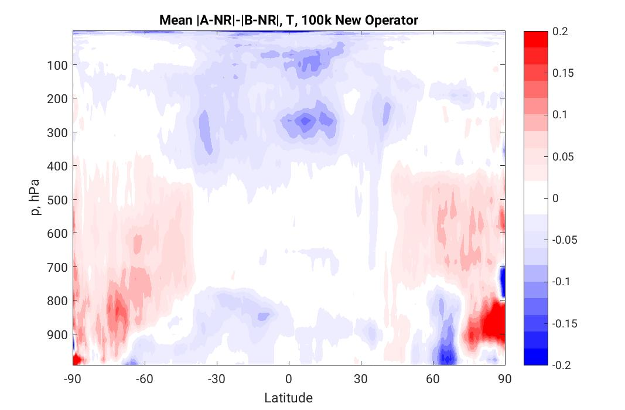
Designing an OSSE: Metrics
Remember that you have the “truth” available!
  The analysis and background errors can be precisely calculated
  You are not confined to traditional metrics used with real data – the OSSE framework gives you more (better!) options

Slide 22
Criticisms of OSSEs
Results only apply within the OSSE system – no concrete connection to the real world
Even the best OSSEs are far from perfect – incestuousness, difficulty in generating observations and errors, deficiencies of the Nature Run
OSSE DAS and model always lag behind operations
By the time the new instrument is deployed, both the global observing network and the forecast models/DAS will be different
Examples of sloppy or unsuccessful OSSEs

Slide 23
Takeaway
OSSEs can provide useful information about new observational types
OSSEs can be used in the development and testing of data assimilation systems
Careful consideration of research goals should guide each step of the OSSE process
Validate your OSSE!
OSSEs are hard, good OSSEs are harder

