Slide 1
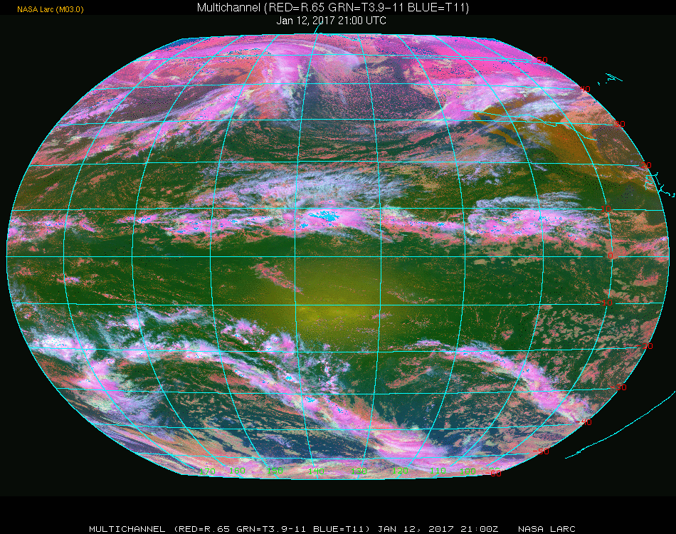
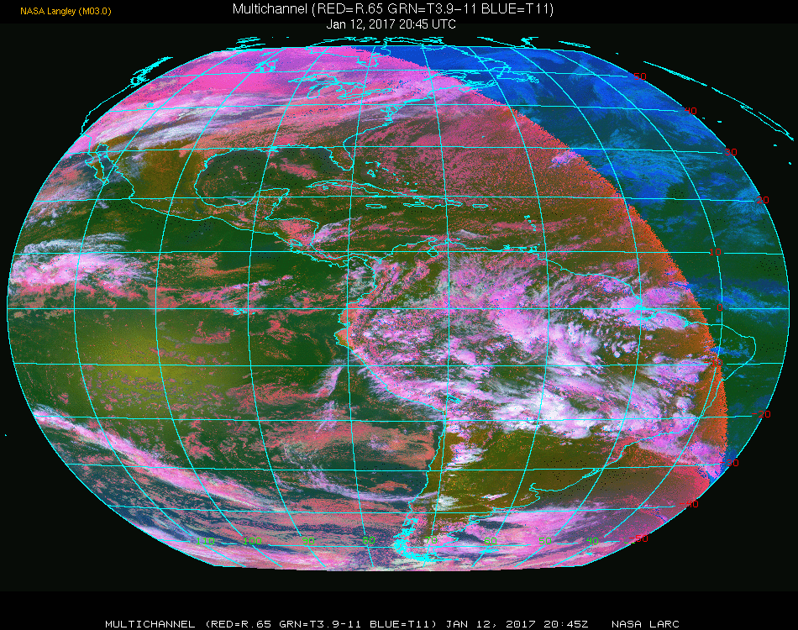
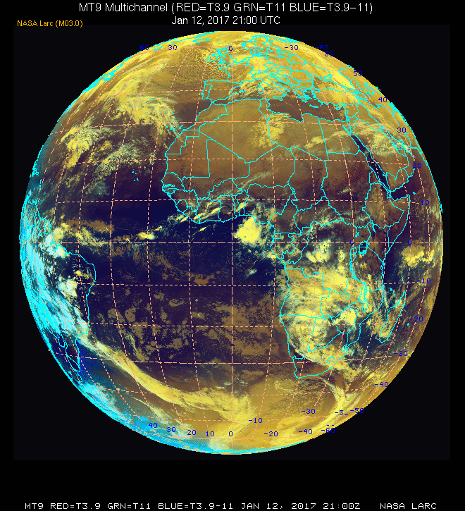
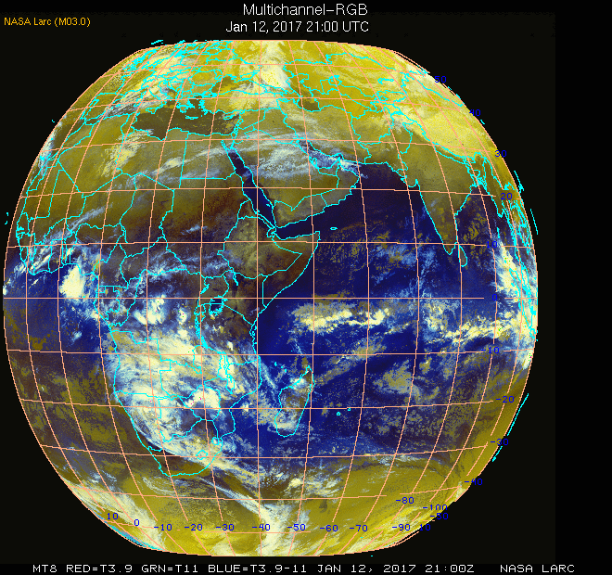
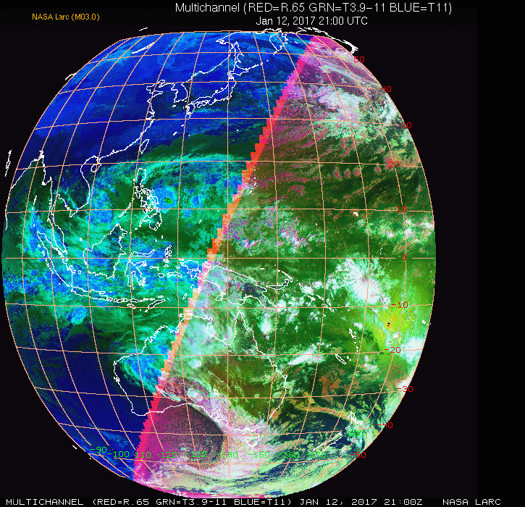
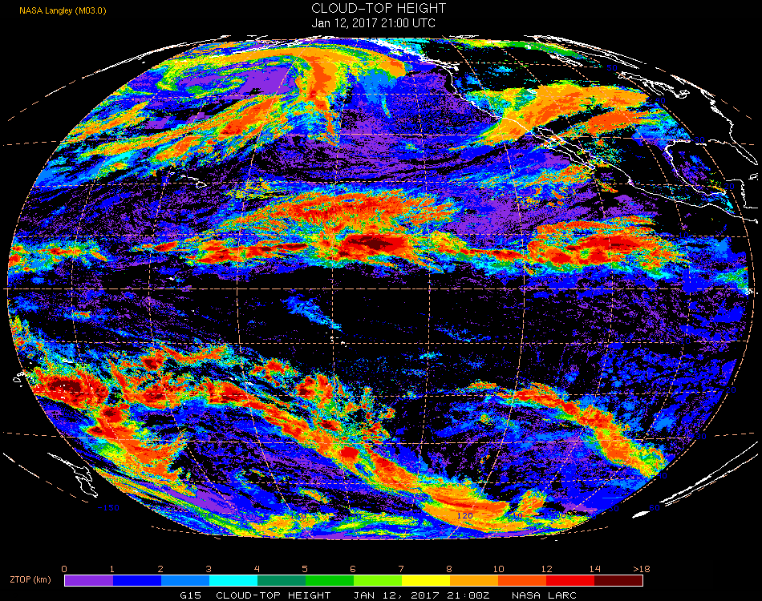
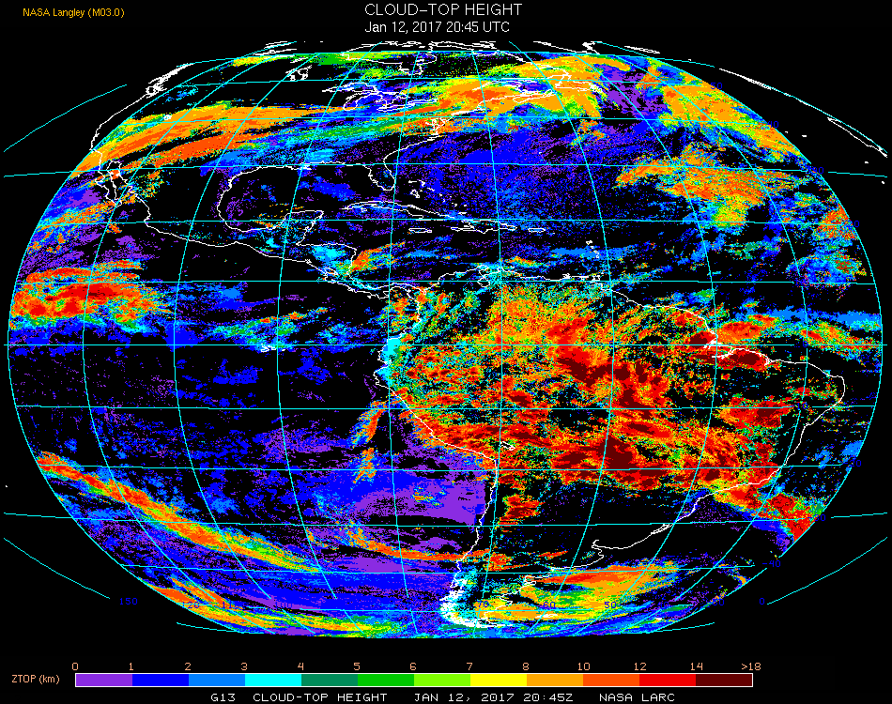
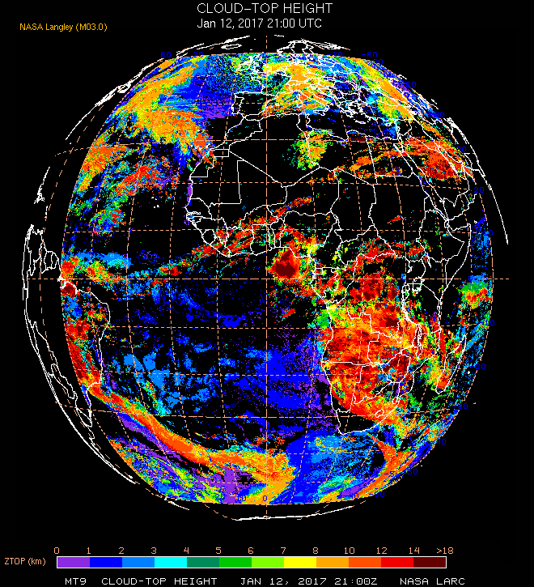
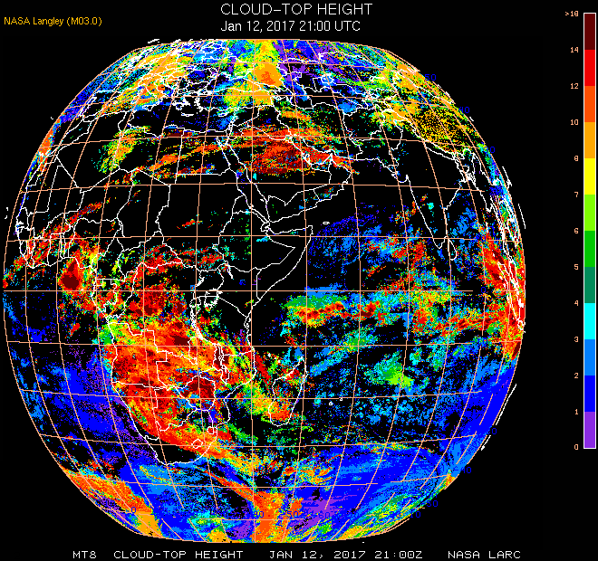
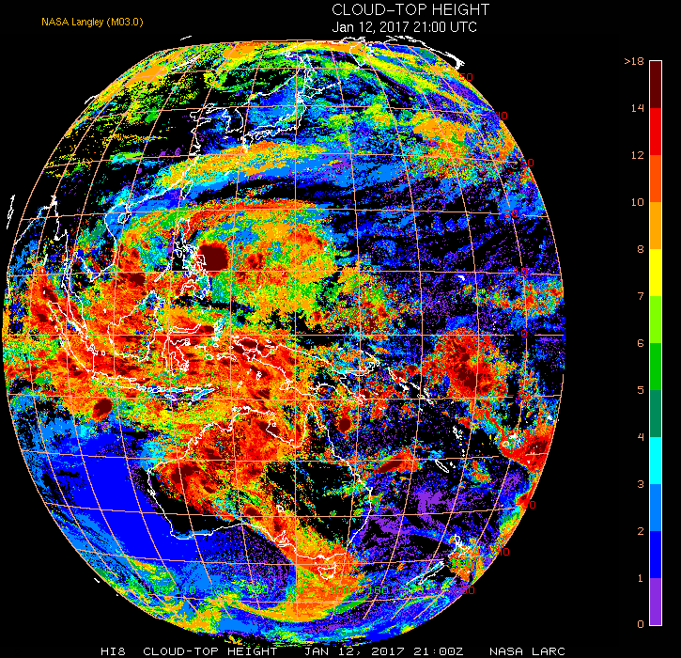
The Satellite ClOud and Radiative Property retrieval System (SatCORPS)
Global analyses of clouds for weather and climate from meteorological satellite imagers
GEO constellation (5)
Terra & Aqua MODIS
S-NPP & NOAA-20 VIIRS
AVHRR
GOES-W (17)
GOES-E (16)
MET-11`
MET-8
HIMAWARI
CTH (km)
New datasets in development
3-km gridded global composite from all satellites (30-60 min)
Regional atmospheric thermodynamics and winds from hyperspectral infrared satellite imagers (sounders)
Derived Cloud Properties
Cloud Mask, Phase
Cloud Optical Depth, COD
Droplet/crystal effective radius
Liquid/Ice Water Path, LWP, IWP
Cloud Top Temperature, Heigtt
Cloud Thickness / Bottom Height
Aviation Weather Products
Cloud Ceilings
Airframe Icing
Hazardous convection, OT’s
HIWC icing
https:/satcorps.larc.nasa.gov
Contact: William.L.Smith@nasa.gov

Slide 2
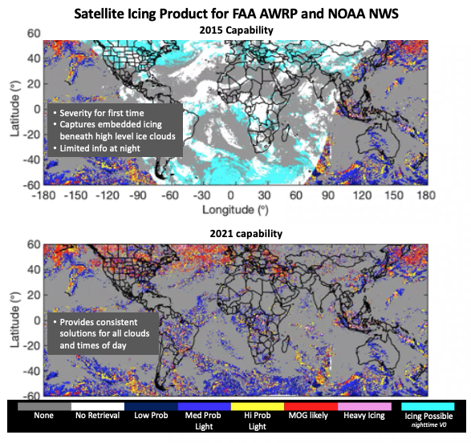

Novel Research to Improve Satellite Data Products and their Utility
Data Fusion
Develop and apply parameterizations of cloud vertical structure from active sensors, MWR, and cloud models.
Cloud water content diagnoses consistent with model parameters (assimilation of mass fields)
Icing diagnoses embedded in deep cloud systems
Combine METAR with satellite data over the U.S.
Improved high resolution cloud ceiling analyses
Combine VIS/IR with lightning data
Improves ident of hazardous convection signatures
Night
Day
Textural information
Hazardous Convection
Improved interpretation of derived products
Machine learning
Neural networks and other methods improve
cloud analyses in the more challenging conditions (e.g. in the presence of thin cirrus and multi-layered clouds, over snow and ice, nighttime)
nighttime cloud analyses and consistency with daytime analyses
detection of hazardous convection signatures, HIWC

Slide 3

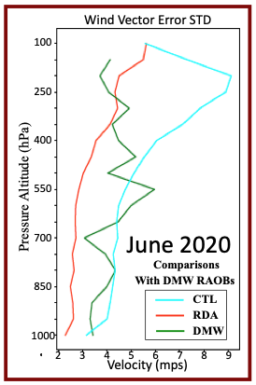
Geostationary Satellite Sounder Pathfinder Project for 4-D
Atmospheric Thermodynamics and Winds
Objectives
Implement a satellite retrieval and data assimilation capability within the NASA SatCORPS to produce high space/time resolution vertical profiles of atmospheric thermodynamics and winds
System developed in partnership with HU and UW
Exploits full information content in hyperspectral radiances from CrIS and IASI (hyperspectral sensors on LEOsats, soon GEOsats)
Operational centers are not fully exploiting these data leading to limited impacts of the satellite observations in NWP
Research plans
Evaluate impact of satellite thermodynamics profile assimilation on
Wind analyses and forecasts (impressive results so far)
Severe weather forecasting
Cloud & icing analyses and forecasts
Sustainable aviation operations
Assimilation of satellite sounding fusion data (RDA) significantly improves vertical wind profile accuracies compared to current models (CTL) and atmospheric motion tracking methods (DMW).

