Slide 1



Two Is One, One Is None:
A Discussion on Redundancy
RAMS XIII
Huntsville, AL
November 30th/December 1st, 2021
Marion Whatley, Bastion Technologies Inc.
NASA Marshall Space Flight Center (MSFC)

Slide 2
Objective
“Goldilocks” situations of redundancy:
Too Little – Single points of failure.
Too Much – More doesn’t mean better.
Just Right – The “Best” amount of redundancy

Slide 3
Concepts
In engineering, redundancy is the duplication of critical components or functions of a system with the intention of increasing reliability of the system, usually in the form of a backup or fail-safe.
A Single Point of Failure (SPOF) is a part of a system that, if it fails, will stop the entire system from working.
A Common Cause Failure (CCF) event is a failure where two or more items fail within the mission time from a common failure mechanism.

Slide 4
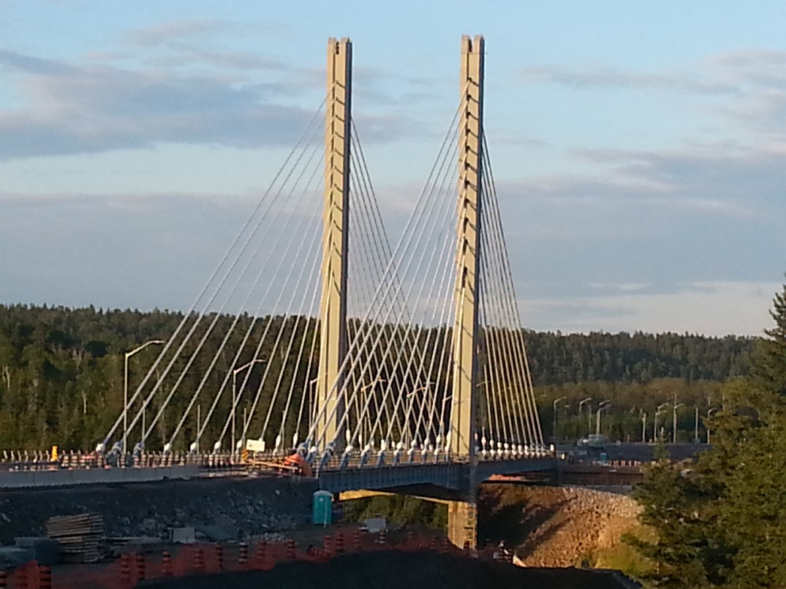
“Too Little”
The 2016 Nipigon River
Bridge Closure

Slide 5
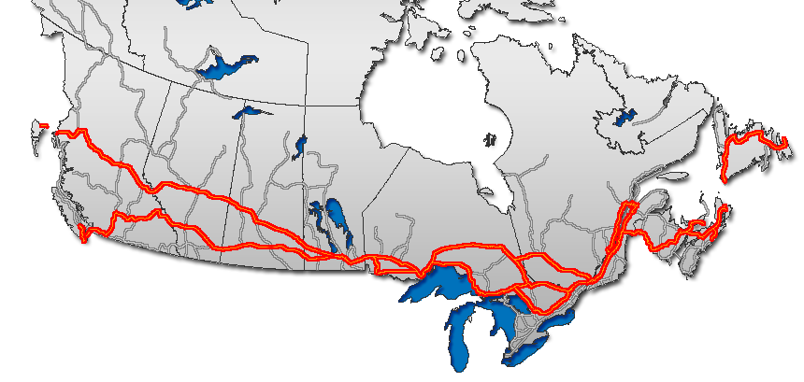
“Too Little” The 2016 Nipigon River Bridge Closure
The Trans-Canada Highway

Slide 6
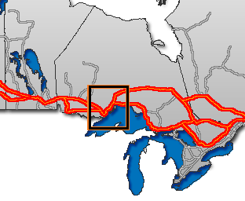
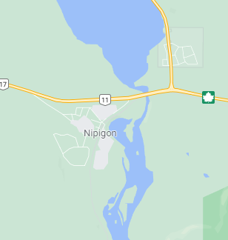
“Too Little” The 2016 Nipigon River Bridge Closure (cont.)
The Trans-Canada Highway
Nipigon, Ontario

Slide 7
“Too Little” The 2016 Nipigon River Bridge Closure (cont.)
Received winter damage January 2016, resulting in indefinite closure of the bridge.
All road traffic stopped for 17 hours, until a single lane was reopened and used for alternating traffic between directions.
As of the next day, 15-20 minute wait to cross single-lane.
Estimated over for that day over $100 million of goods within Canada delivered by truck were delayed by this closure.

Slide 8
“Too Little” The 2016 Nipigon River Bridge Closure (cont.)
The Trans-Canada Highway

Slide 9
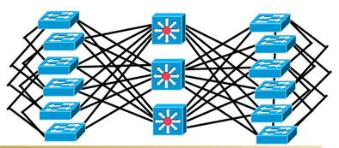
“Too Much”
Additional Redundant
Trains of Communications
on Space Vehicles

Slide 10
“Too Much” Additional Redundant Trains of Communications
From an outsider’s perspective, adding redundant trains into a system would increase the reliability of that system by a factor equal to the number of redundant trains, or does it?
The aerospace industry often has limitations on weight, space, cost, and schedule, so a better understanding of the impact that redundancy has on reliability can result in more appropriate design decisions.
2017 RAMS presentation, “How Much Redundancy is too Much Redundancy?” by Adam Harden.

Slide 11
“Too Much” Additional Redundant Trains of Communications (cont.)
Analysis utilizing redundant train combinations of communication line system on an imaginary space vehicle:
A “Success” is any one train succeeds (meets its criteria).
The reliability and probability of failure (PoF) of each combination will be determined from one up to eight trains.
Perform comparison of the different combinations to demonstrate the returns on reliability.

Slide 12
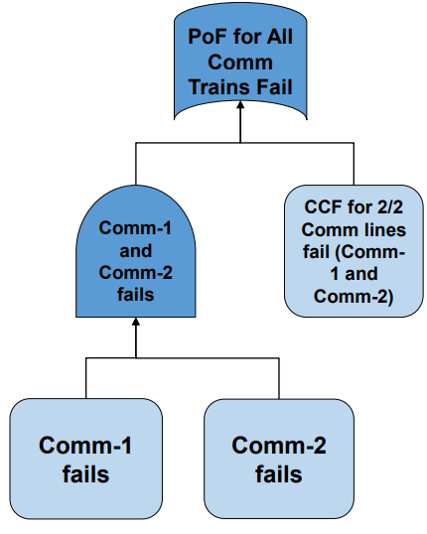
“Too Much” Additional Redundant Trains of Communications (cont.)
The fault tree to the right presents the logic for failure of comm-1 and comm-2
The PoF for the top gate is:
Common Cause Failure (CCF) for 2 of 2 Comm lines, OR
Comm-1 AND Comm-2 fail
For this example, the CCF probability is the product of the independent failure probability and the alpha factor for the failure combination 2 of 2 for generic rate based events
Similar logic is used to incorporate additional trains

Slide 13
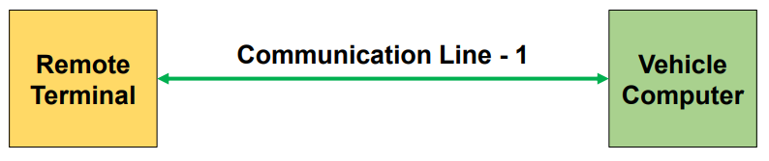
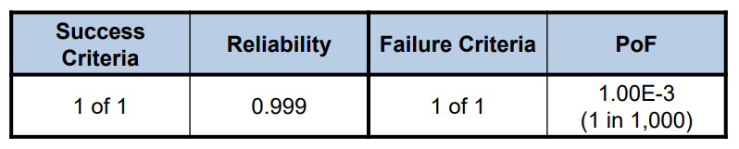
“Too Much” Additional Redundant Trains of Communications (cont.)
The below diagram shows a 1-train line system that communicates data between a space vehicle’s computer and a remote terminal connected directly to it.
The table below presents the estimated reliability and Probability of Failure (PoF) of the communication line.

Slide 14
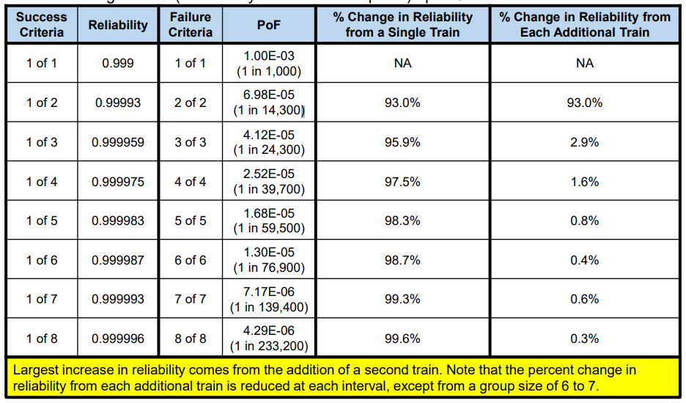
“Too Much” Additional Redundant Trains of Communications (cont.)

Slide 15
“Just Right”
The “Best” Amount
Of Redundancy

Slide 16
“Just Right?”
The “Best” amount of redundancy is always evolving.
Time - Infrastructure and systems built decades ago were sufficient at the time but with aging comes degradation of effectiveness.
Costs – A safety feature from decades ago would be too costly or bulky to make standard before, can now fit in a fraction of the space and at a fraction of the cost.
The “Human Element” – Navigate the waters.
“Make” the “Best” of it.

Slide 17

“Just Right?” (cont.)

Slide 18
Conclusion
Too Little – Infrastructure that relies heavily on truck deliveries without alternate transit points can lead to disaster.
Too Much – Adding significant redundancy does not necessarily mean significant increases to reliability.
Just Right? - Find the sweet spot.

Slide 19
Questions?
POC: Marion Whatley
Marion.E.Whatley@nasa.gov
256-544-1384

Slide 20
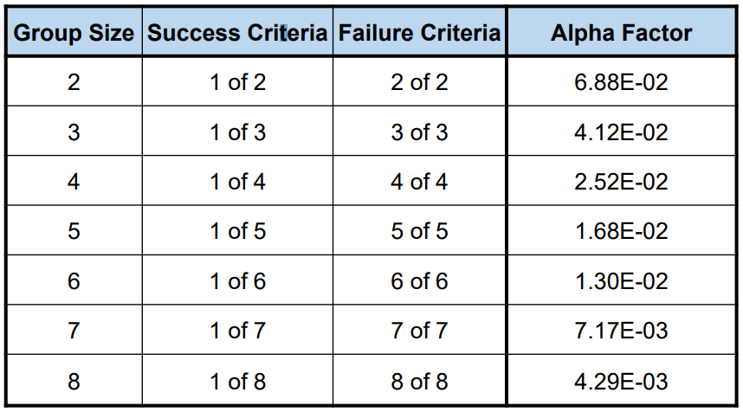
Backup Chart “Too Much” Additional Redundant Trains of Communications (cont.)
The table below presents the calculated Alpha Factor values, of specific failure combinations, for generic rate based events

Slide 21
Backup Charts (Cont’d)
BIBLIOGRAPHY
Chart 2 –
https://en.wikipedia.org/wiki/Redundancy_(engineering)
https://ntrs.nasa.gov/citations/20170012470
Chart 4 –
https://en.wikipedia.org/wiki/Nipigon_River_Bridge
Chart 5 & 6 –
https://en.wikipedia.org/wiki/Trans-Canada_Highway
https://www.google.com/maps
Chart 7 –
https://en.wikipedia.org/wiki/Nipigon_River_Bridge
https://www.cbc.ca/news/canada/nipigon-river-bridge-numbers-1.3398986
Chart 8 –
https://en.wikipedia.org/wiki/Trans-Canada_Highway
Chart 9 –
https://www.certificationkits.com/cisco-certification/cisco-ccnp-switch-642-813-exam-study-guide/cisco-ccnp-switch-high-availability-a-redundancy/
Chart 10 to 14 –
https://ntrs.nasa.gov/citations/20170012470
Chart 16 -
https://ascelibrary.org/doi/pdf/10.1061/%28ASCE%291532-6748%282002%292%3A3%2827%29
https://www.tspe.org/page/ThePEandPolitics
Chart 17 -
https://theieltsgenius.com/speaking-part-3-saying-depends/

