Slide 1
Three-Dimensional Instantaneous Flowfield Reconstruction using Planar Spectral Proper Orthogonal Decomposition
Jenna Eppink
NASA Langley Research Center
Supported by the Revolutionary Computational Aerosciences Discipline under NASA’s Transformational Tools and Technologies Project
Copyright 2022 United States Government as represented by the Administrator of the National Aeronautics and Space Administration. No copyright is claimed in the United States under Title 17, U.S. Code. All Other Rights Reserved. Published by the American Institute of Aeronautics and Astronautics, Inc. with permission.”

Slide 2
Motivation/Background
Goal: Reconstruct instantaneous 3D flowfield from nonsimultaneous 2D planes of data
Motivation
  While 3D data acquisition methods exist (e.g., tomo-PIV), there are still advantages to acquiring planar data: ease of setup, resolution, accuracy.
Existing Methods:
  The method by Chandramouli et al.¹ requires acquisition of two orthogonal planes of PIV data along with the assumption that the flow is homogenous in one direction.
  Hamdi et al.² presented a method that utilizes a series of nonsimultaneous, parallel time-resolved stereo PIV measurement planes, along with proper orthogonal decomposition (POD) reconstruction, to reconstruct the instantaneous three-dimensional structures shedding from a nozzle.
    Assumes zero phase speed in out-of-plane direction.
    Fluctuations occur at a single narrow frequency.
Current approach
  Utilizes Spectral POD and a measurement of the non-zero out-of-plane phase speed to construct the 3D modes of different frequencies.
¹Chandramouli, P., Memin, E., Heitz, D., and Fiabane, L., “Fast 3D Flow Reconstructions from 2D Cross-plane Observations,” Experiments in Fluids, Vol. 60, No. 2, 2019, p. 30.
²Hamdi, J., Assoum, H., Abed-Meraïm, K., and Sakout, A., “Volume Reconstruction of an Impinging Jet Obtained from Stereoscopic-PIV Data using POD,” European Journal of Mechanics-B/Fluids, Vol. 67, 2018, pp. 433-445.

Slide 3
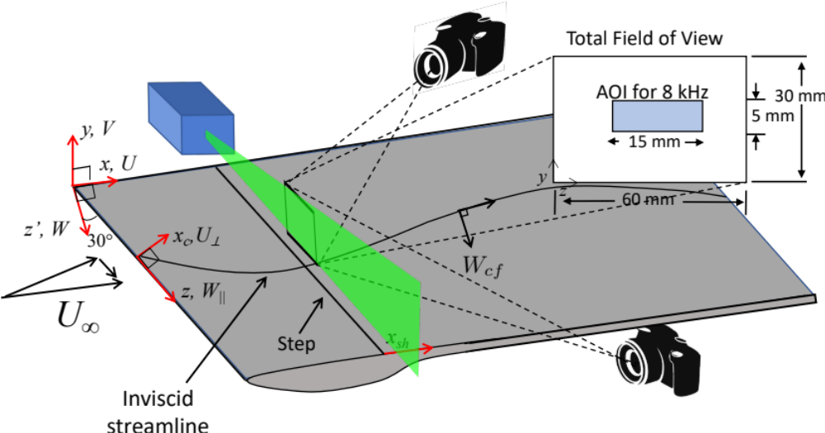
Experiment Setup
High-speed double-pulsed Nd:YLF laser.
Time-resolved (downstream) system: Two high-speed 4-megapixel cameras with 300 mm lenses .
Flow seeded downstream of the test section using an oil-based fog machine.
6,000-10,000 image pairs acquired at 4.7-8 kHz
Data processed using 32x32 pixel interrogation regions with 75% overlap.
Three-plane polynomial calibration .
All PIV hardware is mounted on a translation system that allows motion in all three directions.
Speakers located upstream of test section in settling chamber provide acoustic forcing signal for some cases.
2x3 ft tunnel at NASA Langley, U∞=26 m/s
Two backward-facing step heights presented: h/𝛿 = 0.49 and 0.73
Discrete Roughness Elements (DREs) placed near the leading edge, spaced at 11 um.

Slide 4
Data Analysis Methods

Slide 5
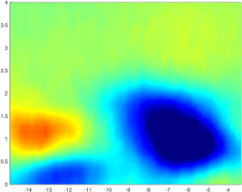
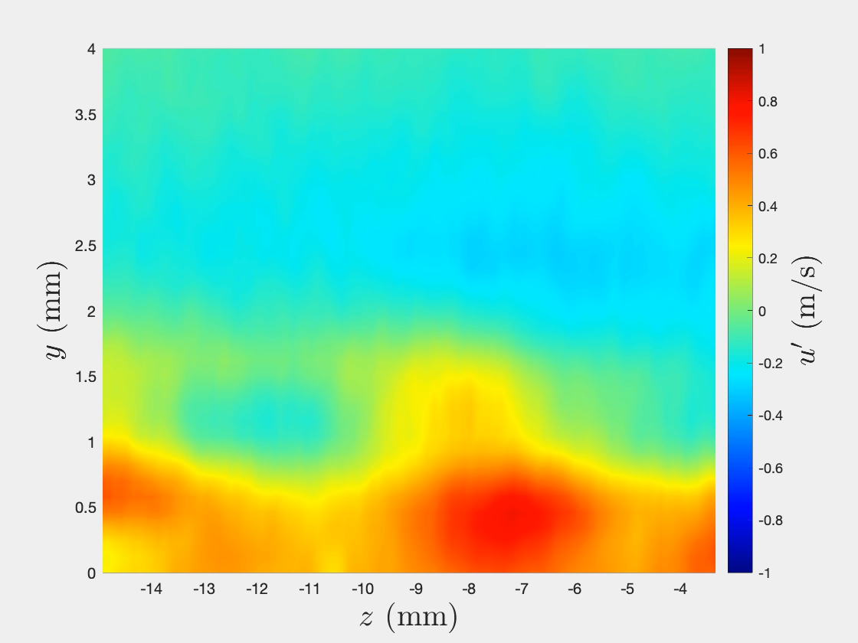
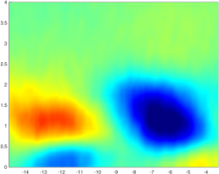
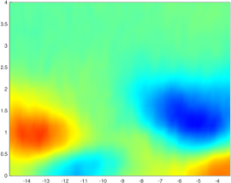
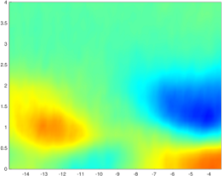
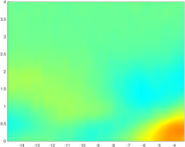
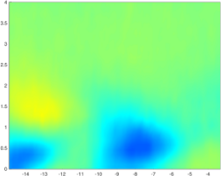
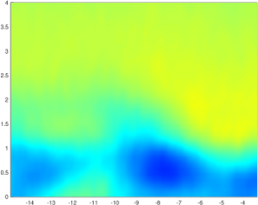
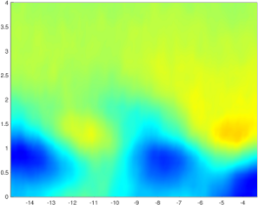
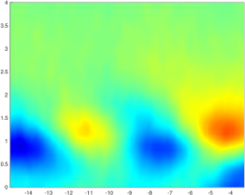
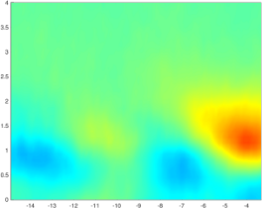
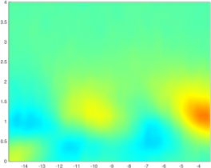
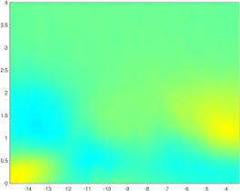
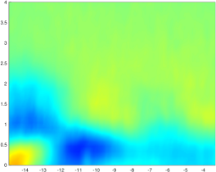
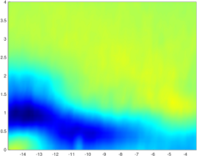
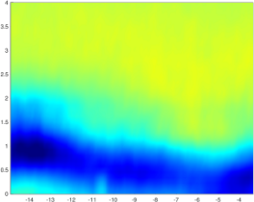
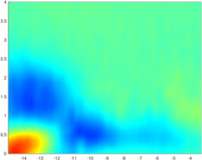
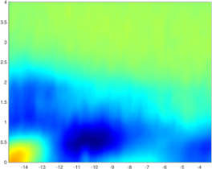
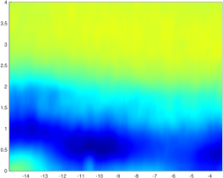
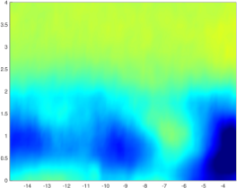
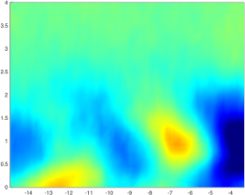
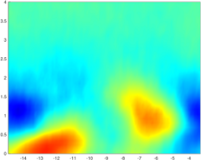
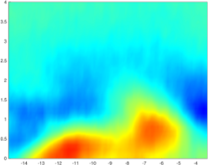
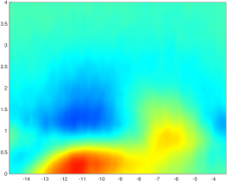
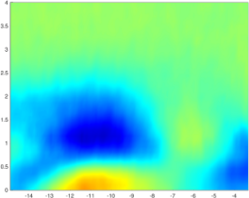
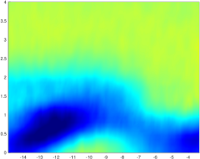
Phase Averaging
TRPIV is triggered to begin acquisition from the sine wave signal that is sent to the speakers.
Data acquired at 8 kHz, speaker signal at 500 Hz and 1000 Hz (separately).
Velocity data are broken up into blocks of 16 or 8 (depending on forcing frequency) and averaged.
y
z
Q₁
(
Q₂
+
Q_{Nblk}
t
t
+
+
)
t
/
Nblk
t

Slide 6






Spectral POD
N_{overlap}
y
Q₁
z
Q₂
POD
m
t
POD
m
Q_{Nblk}
FFT
t
Reorder by frequency
POD
m
FFT
t
m
FFT
t
m
f
f
m
f
Adapted from Schmidt and Colonius, “Guide to Spectral Proper Orthogonal Decomposition”, AIAA JOURNAL, Vol. 58, No. 3, March 2020

Slide 7


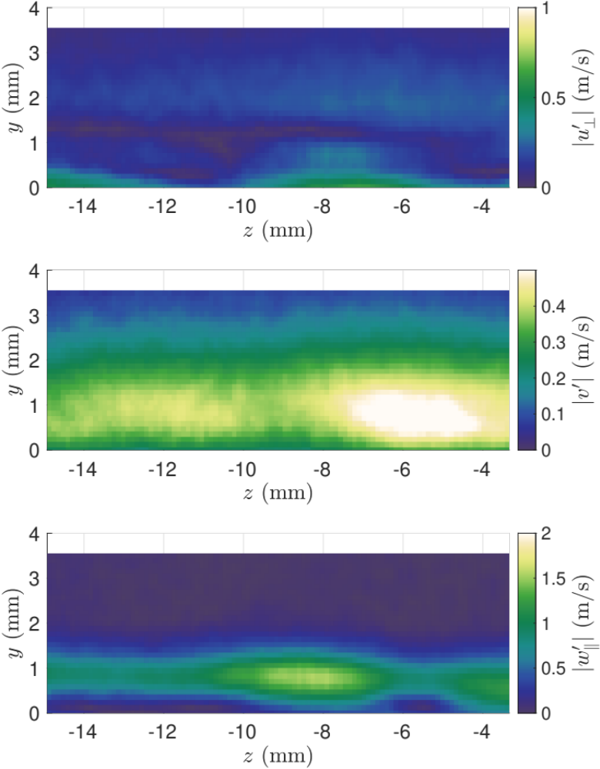
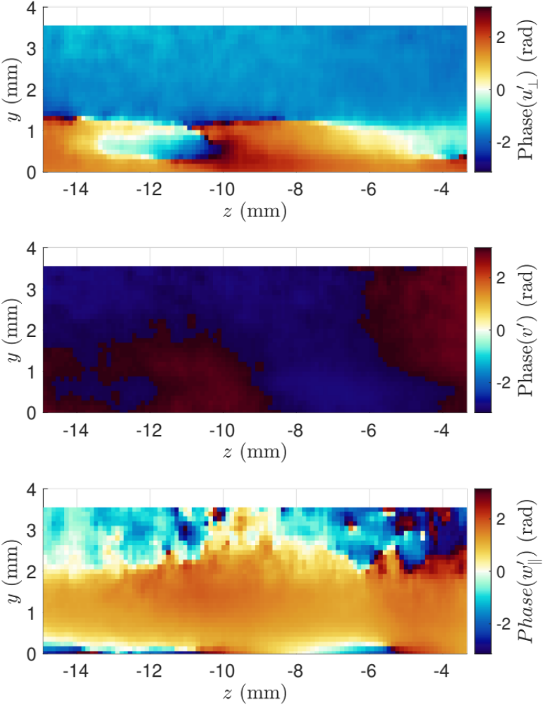
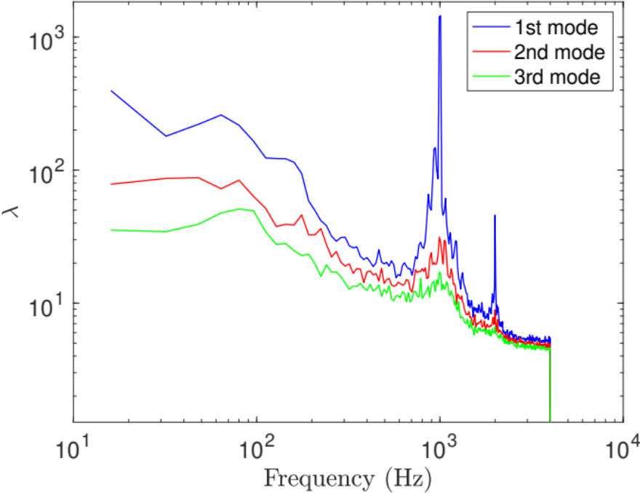
Example SPOD Results
Mode 1 Amplitude
Mode 1 Phase
SPOD Eigenvalues

Slide 8
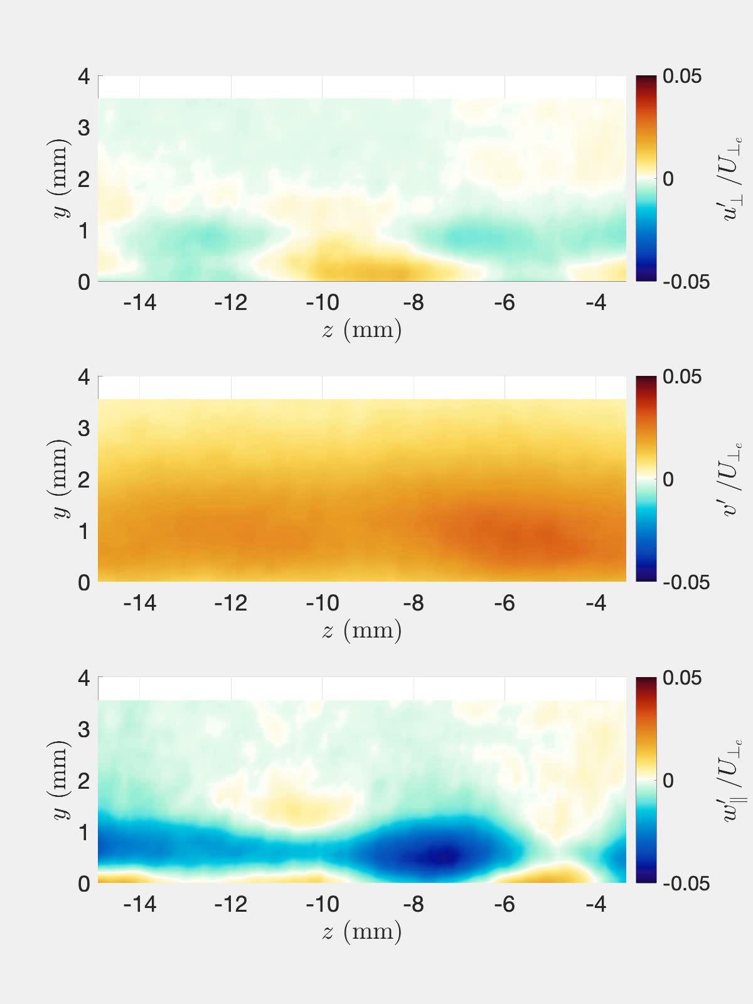

Example SPOD Results
SPOD Eigenvalues

Slide 9
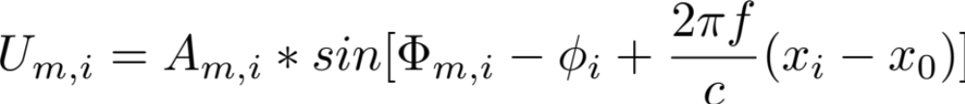
SPOD Reconstruction Process
Assuming no phase-locking, the individual planes of data have no (known) phase relationship to each other.
SPOD is performed at each station, individually, and then the phase-matching process is performed for the frequency and mode of interest, m.
The phase shift required to obtain zero phase shift between each station (𝝓_{i}) is then the cumulative sum of the phase shifts found from the previous step.
  Applying this phase shift to each station corresponds to a streamwise phase speed of 0.
Then the known streamwise phase speed (c) is used to phase-shift each station’s SPOD mode to build up the mode in 3D.
Then the t=0 velocity field at station i is:

Slide 10
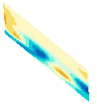
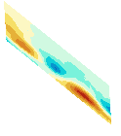

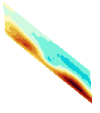

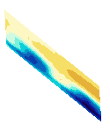
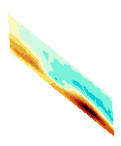
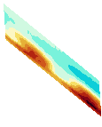

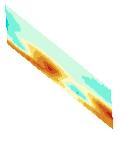
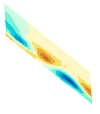
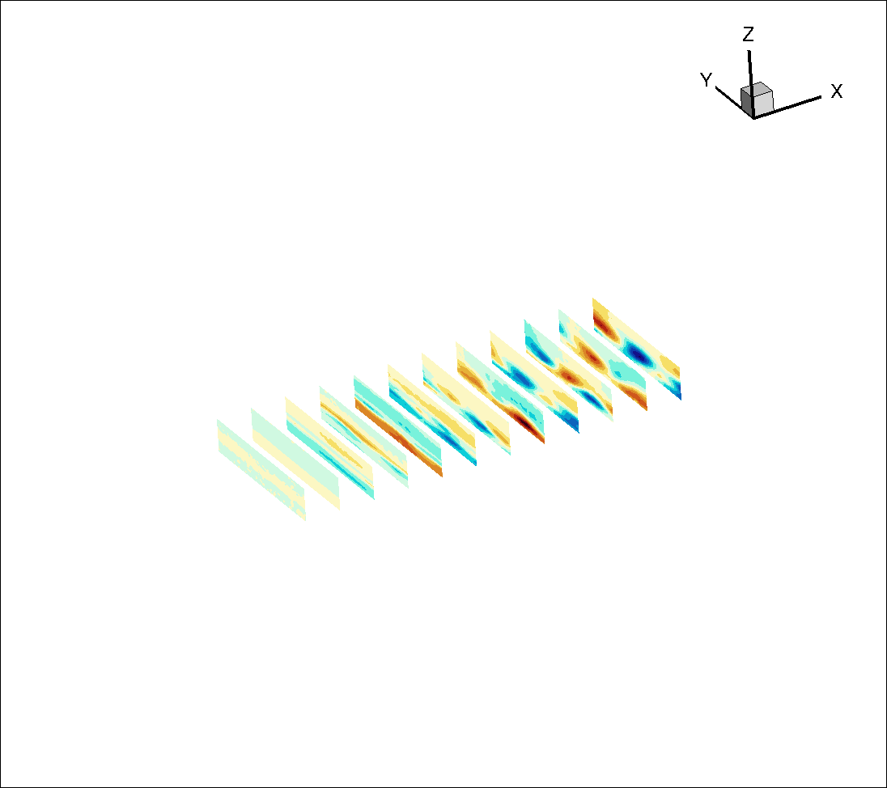

SPOD Phase-Matching Process
Best match
0
Phase
𝝅
i
i+1

Slide 11
SPOD Reconstruction Process
Assuming no phase-locking, the individual planes of data have no (known) phase relationship to each other.
SPOD is performed at each station, individually, and then the phase-matching process is performed for the frequency and mode of interest, m.
The phase shift required to obtain zero phase shift between each station (𝝓_{i}) is then the cumulative sum of the phase shifts found from the previous step.
  Applying this phase shift to each station corresponds to a streamwise phase speed of 0.
Then the known streamwise phase speed (c) is used to phase-shift each station’s SPOD mode to build up the mode in 3D.
Then the t=0 velocity field at station i is:

Slide 12
results

Slide 13


Background
 | Forced Case | Unforced Case
Step Height
Acoustic Forcing frequencies | 500 Hz, 1000 Hz (separately) | No forcing
Number of image pairs | 6,000 | 10,000
Sampling rate | 8 kHz | 4.7 kHz
Streamwise spacing of planes | 2 mm | 6.35 mm
HW measurements done at these conditions
Previous measurements and analysis resulted in identification of three different instabilities downstream of the BFS:
  f = 80 to 200 Hz: Traveling-crossflow instability, not affected by acoustic forcing
  f = 200 to 800 Hz: Tollmien-Schlichting instability, affected by acoustic forcing
  f = 800 to 1500 Hz: Shear-layer instability, affected by acoustic forcing

Slide 14
Results: Phase-locked measurements

Slide 15
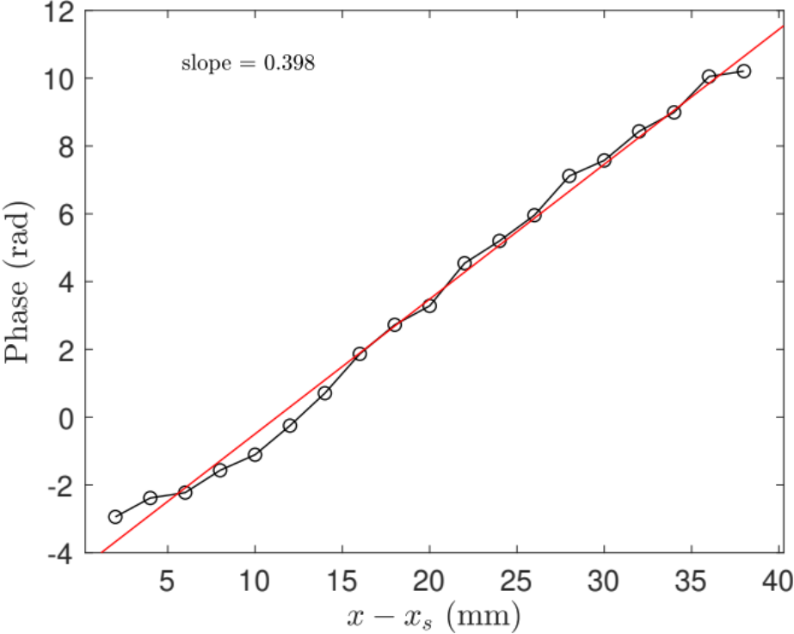
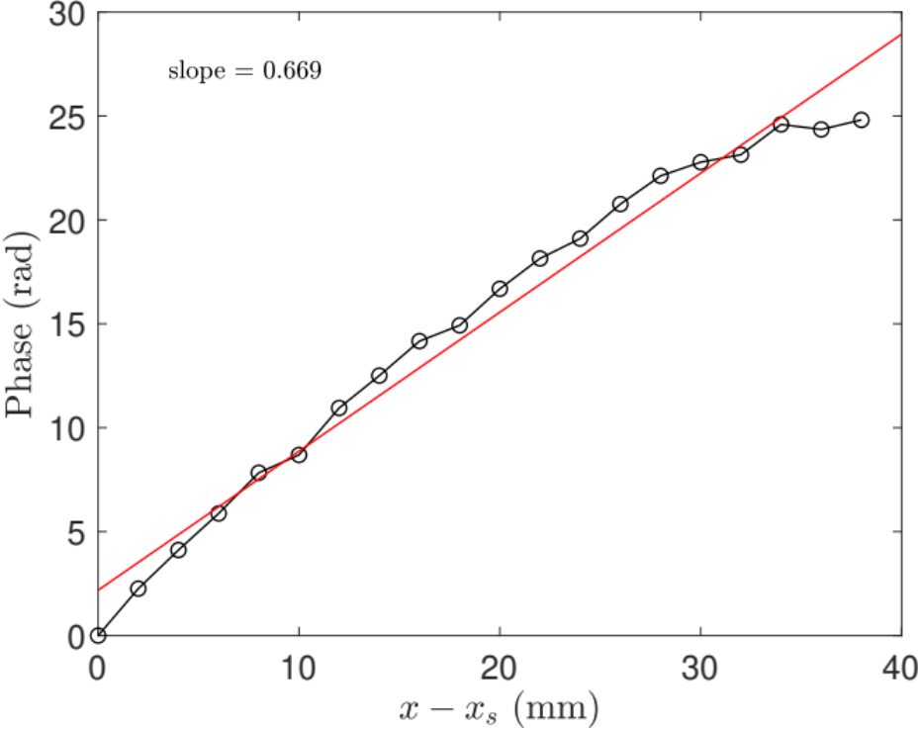
Phase-Speed Measurements
f = 500 Hz
f = 1000 Hz
From measured HW phase: slope = 0.4 rad/mm
From measured HW phase: slope = 0.65 rad/mm
Next: performed SPOD reconstructions using the HW phase speed, and using the as-measured phases (black line)

Slide 16
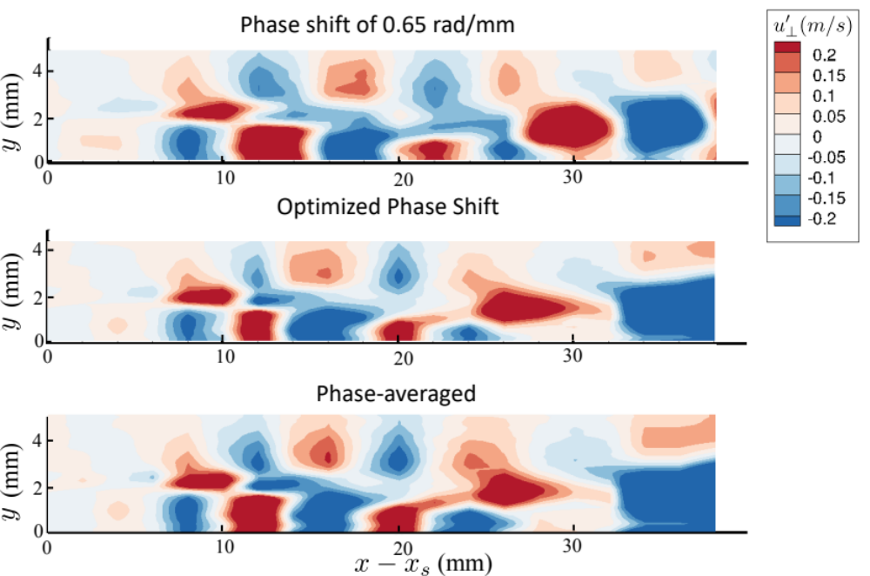
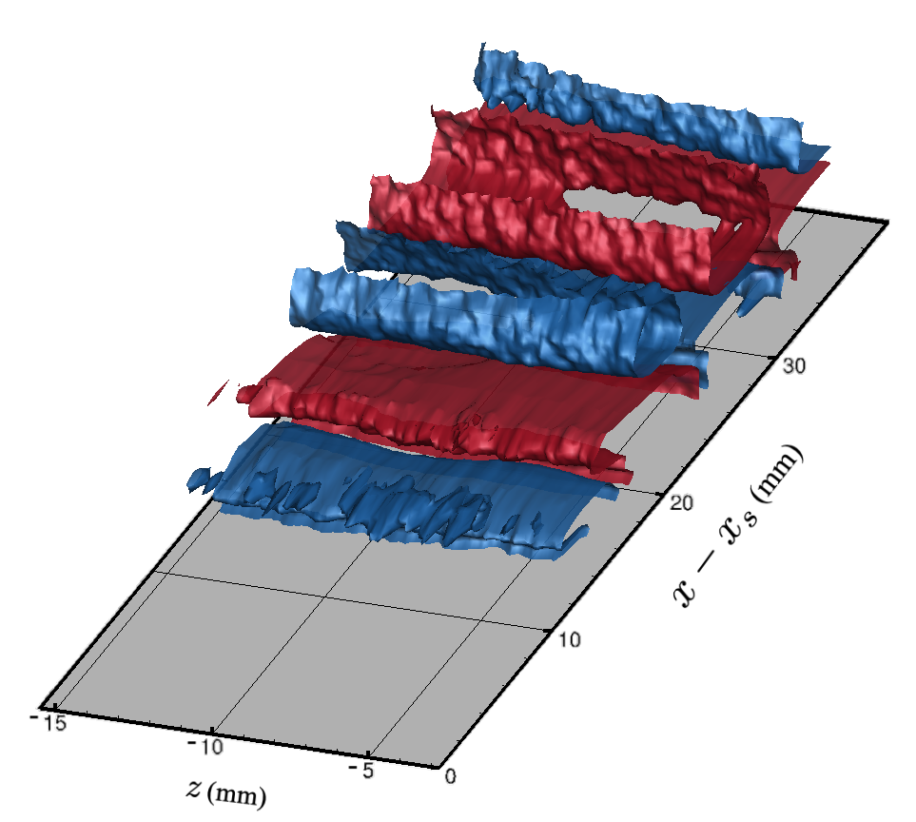
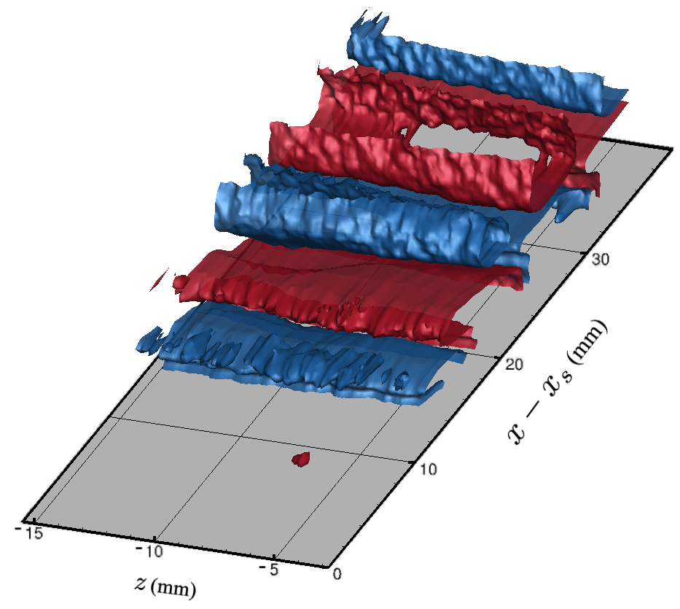
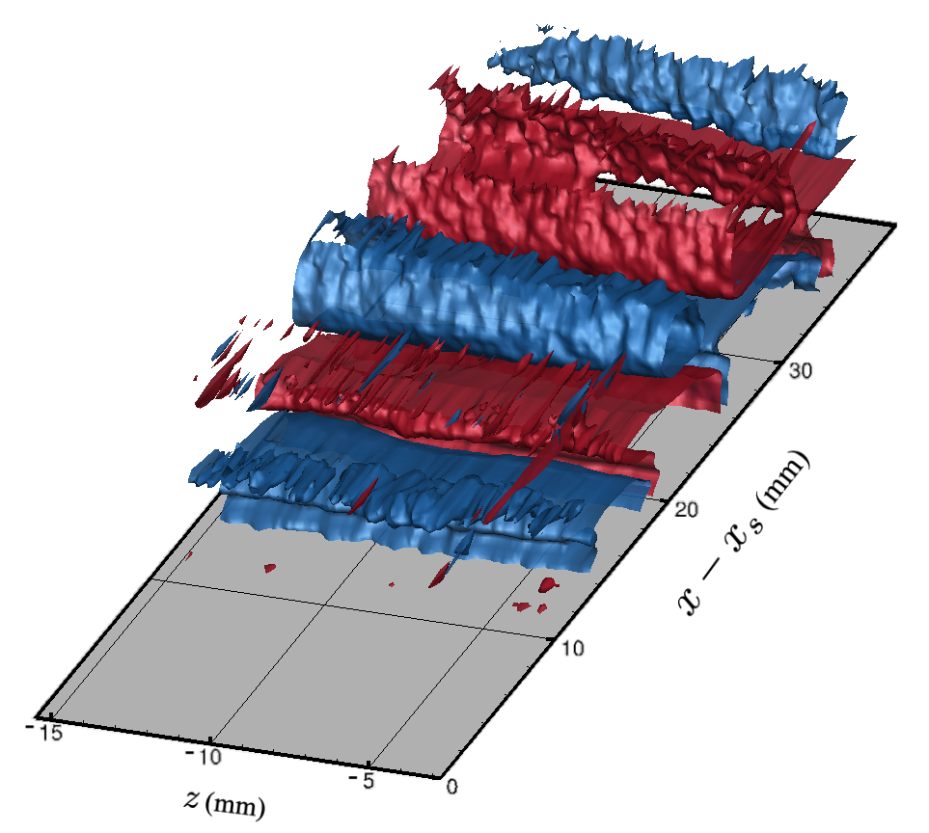
SPOD & Phase-Averaged 3D Reconstruction
500 Hz
Phase shift of 0.4 rad /mm
(Based on HW-measured phase speed)
Optimal Phase Shift
(as measured)
Phase-averaged

Slide 17
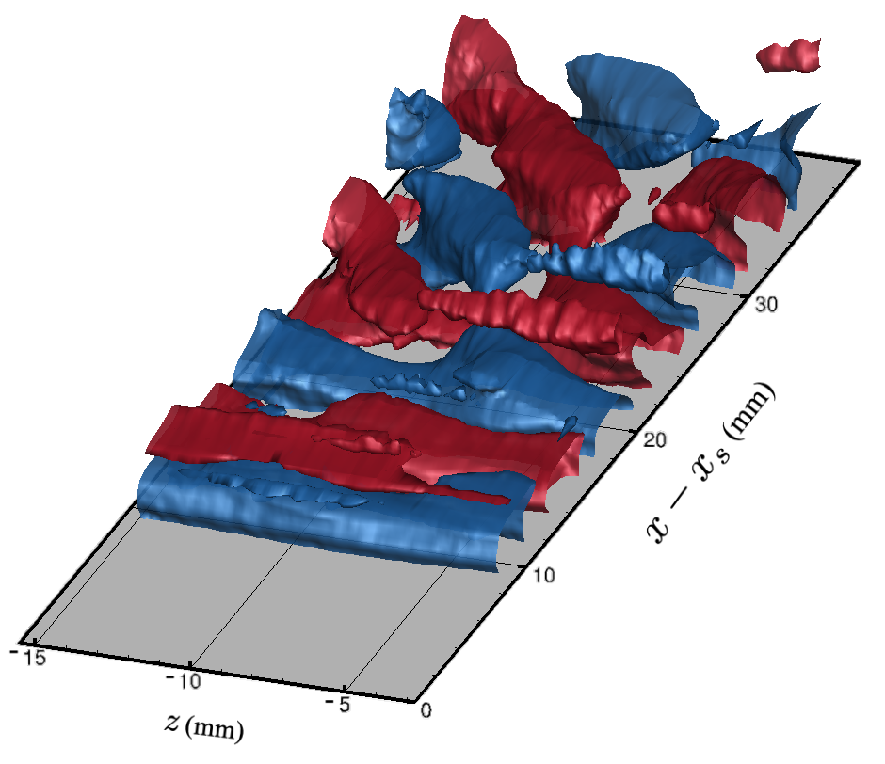
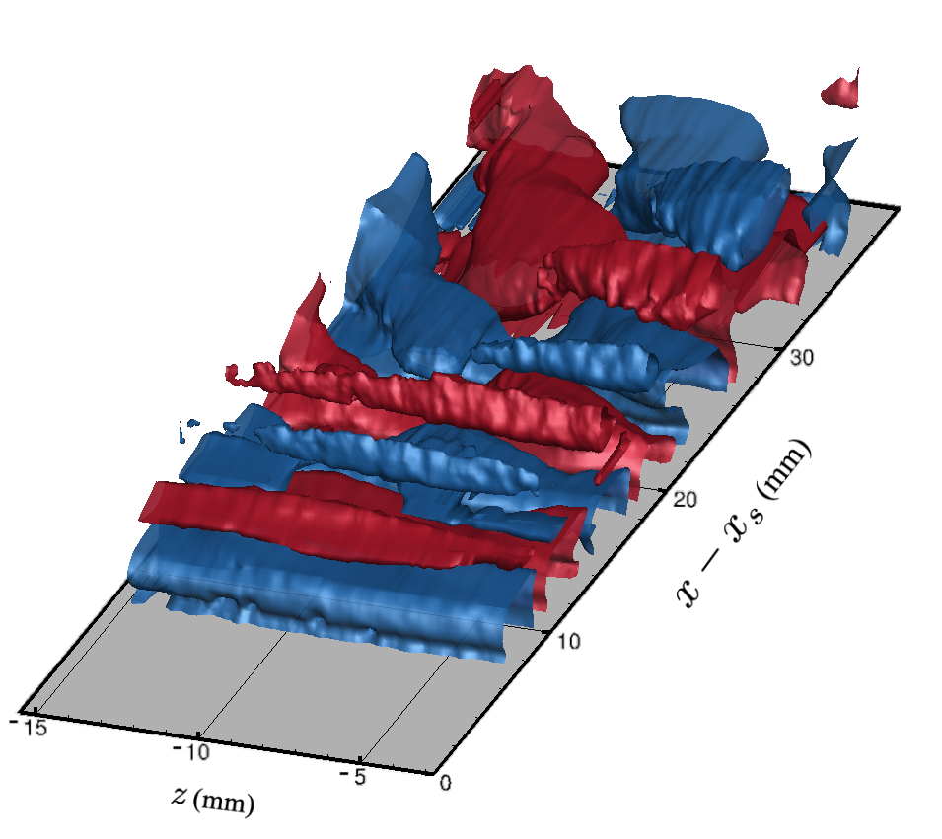
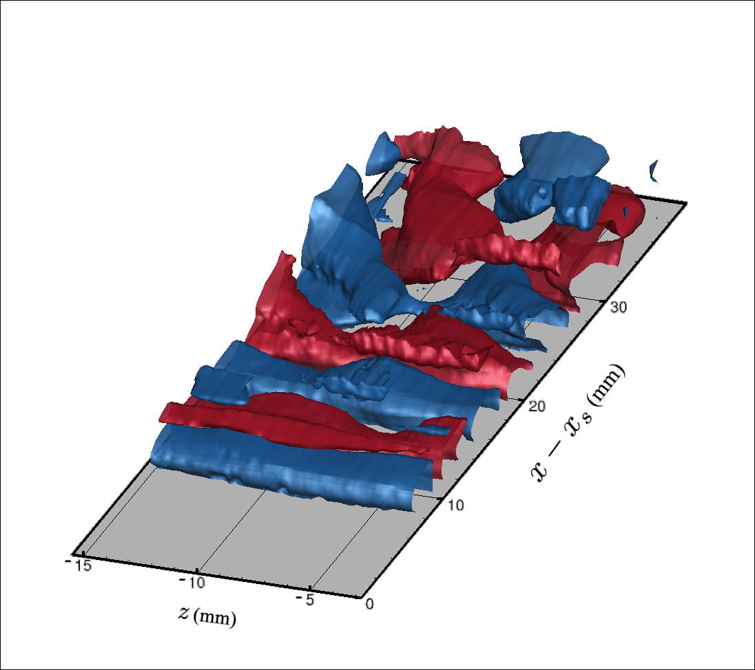
SPOD & Phase-Averaged 3D Reconstruction
1000 Hz
Phase shift of 0.65 rad /mm
(Based on HW-measured phase speed)
Optimal Phase Shift
(as measured)
Phase-averaged

Slide 18



SPOD & Phase-Averaged 3D Reconstruction
1000 Hz
Phase shift of 0.65 rad /mm
(Based on HW-measured phase speed)
Optimal Phase Shift
(as measured)
Phase-averaged

Slide 19

Streamwise Planes
500 Hz
1000 Hz

Slide 20
Results: measurements with no forcing

Slide 21



260 Hz SPOD Modes
1st Mode, 260 Hz, x-x_{s}=56 mm
2nd Mode, 260 Hz, x-x_{s}=56 mm

Slide 22

Comparison of 1000 Hz and 260 Hz second SPOD modes
1st Mode, 1000 Hz, x-x_{s}=56 mm
2nd Mode, 260 Hz, x-x_{s}=56 mm

Slide 23


SPOD 3D Reconstruction – 260 Hz Modes
First Mode
Second Mode
Hot-wire measured phase shift of 0.28 rad/mm used for reconstruction

Slide 24
SPOD 3D Reconstruction – Comparison
First Mode – 1000 Hz,
Second Mode,
Wave angle ≅ 62°
Wave angle ≅ 60°

Slide 25
Conclusions
New method for reconstructing 3D flowfields from planar TRPIV data
  Prior knowledge of the out-of-plane phase speed is necessary.
  This could be obtained from a streamwise PIV plane (if possible), from some other measurement technique (HW), from a phase-locked measurement, or estimated from computations.
With an accurate out-of-plane phase measurement, the SPOD reconstructed results match very well with the phase-averaged results.
Even with an estimated phase speed, this technique is a good way to qualitatively study the behavior of the instability in 3D.
This approach can be especially useful for broadband phenomena or cases in which multiple frequency bands are of interest.
  Allows the separation of particular frequencies of interest within those broad frequency bands without the need for any external forcing.

