Slide 1
Modeling the Soyuz Spacecraft Seat and Investigating the Effects of Restraints on Occupant Loads with a Human Body Model
Derek A. Jones, Logan E. Miller, F. Scott Gayzik,
Ashley A. Weaver, Nate Newby, Jeffrey T. Somers, Joel D. Stitzel

Slide 2
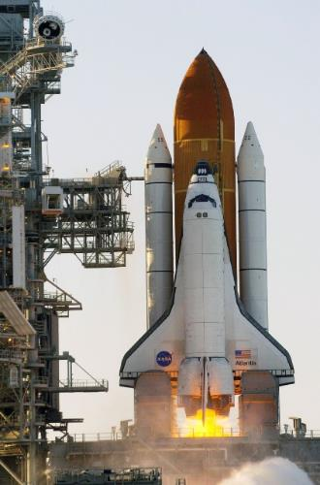
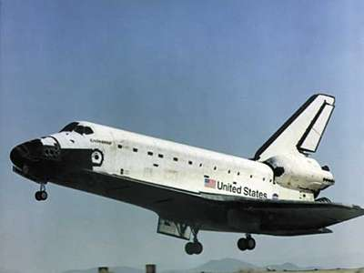
Brief History of Modern US Spaceflight
Retirement of the Space Shuttle (2011)
SpaceX Crew Dragon (2020)
Russian Soyuz spacecraft carries US astronauts to space & back (2011-2020)

Slide 3
Brief History of Modern US Spaceflight
Retirement of the Space Shuttle (2011)
SpaceX Crew Dragon (2020)
Russian Soyuz spacecraft carries US astronauts to space & back (2011-2020)

Slide 4

Brief History of Modern US Spaceflight
Retirement of the Space Shuttle (2011)
SpaceX Crew Dragon (2020)
Russian Soyuz spacecraft carries US astronauts to space & back (2011-2020)

Slide 5

Brief History of Modern US Spaceflight
Retirement of the Space Shuttle (2011)
SpaceX Crew Dragon (2020)
Russian Soyuz spacecraft carries US astronauts to space & back (2011-2020)

Slide 6


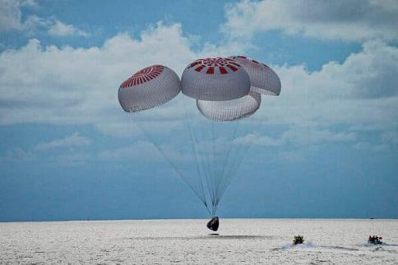
Brief History of Modern US Spaceflight
Retirement of the Space Shuttle (2011)
Russian Soyuz spacecraft carries US astronauts to space & back (2011-2020)
SpaceX Crew Dragon (2020/2021)

Slide 7
Brief History of Modern US Spaceflight
Retirement of the Space Shuttle (2011)
Russian Soyuz spacecraft carries US astronauts to space & back (2011-2020)
SpaceX Crew Dragon (2020/2021)

Slide 8
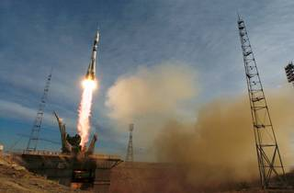
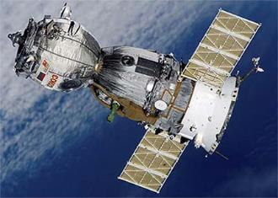
Brief History of Modern US Spaceflight
Retirement of the Space Shuttle (2011)
Russian Soyuz spacecraft carries US astronauts to space & back (2011-2020)
SpaceX Crew Dragon (2020/2021)

Slide 9
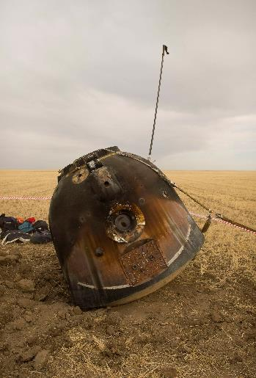
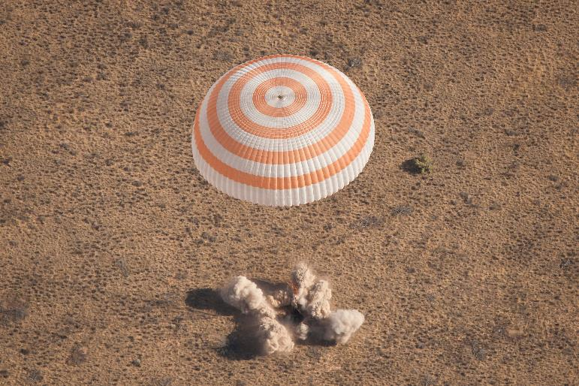
Soyuz Landing

Slide 10
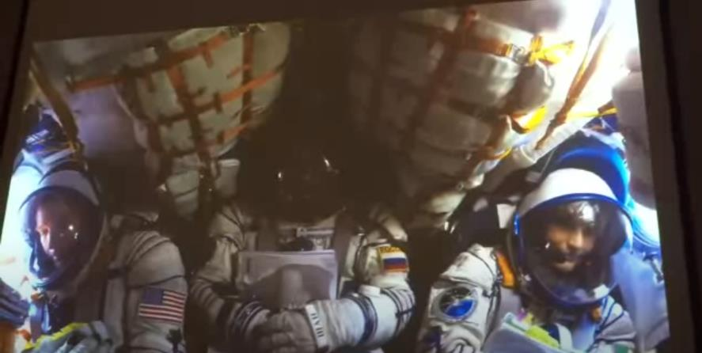
Soyuz Landing

Slide 11
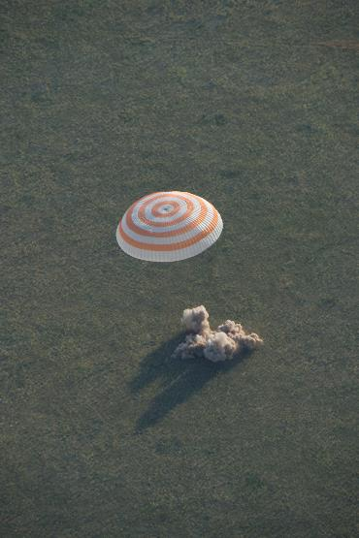
Motivation: “The injury rates in Soyuz landings are higher than future vehicle requirements”
Injury Classification (ORIS) | Injury Rate (%) | Future Vehicle Injury Rate Requirements (%)
Contusion/Abrasion | 25.8
Class I | 4.5 | <5
Class II | 4.5 | <1
Class III | 0 | 0
Class IV | 0 | 0
Newby et al., SAFE Journal 39:1-6, 2020

Slide 12
Motivation: “The injury rates in Soyuz landings are higher than future vehicle requirements”
Study Question:
Study Question: “Do the seat and restraint systems in the Soyuz vehicle account for the elevated injury rate?”
Injury Classification (ORIS) | Injury Rate (%) | Future Vehicle Injury Rate Requirements (%)
Contusion/Abrasion | 25.8
Class I | 4.5 | <5
Class II | 4.5 | <1
Class III | 0 | 0
Class IV | 0 | 0
Newby et al., SAFE Journal 39:1-6, 2020

Slide 13




Project Outline
Aim 1 Deliverables:
  Fully usable FE model of the Soyuz seat
  Quantify differences in injury risk results as a function of HBM detail
Aim 2 Deliverables:
  Quantified difference in injury risk based on the seat and restraints given matched seat acceleration profile
    Will provide insight into reason behind elevated injury rate for Soyuz crew

Slide 14
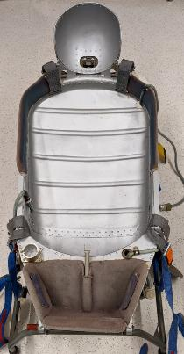
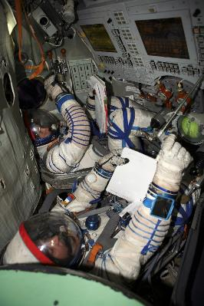
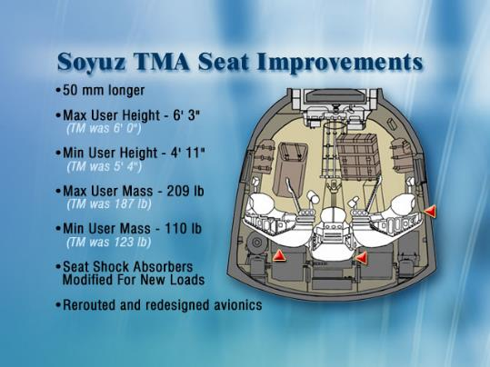
Development of the Soyuz seat model
Two “types” of scans: trainer seat (TM), in-mockup seat (TMA)
TM
TMA

Slide 15


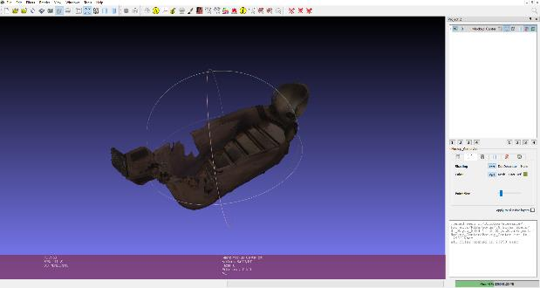
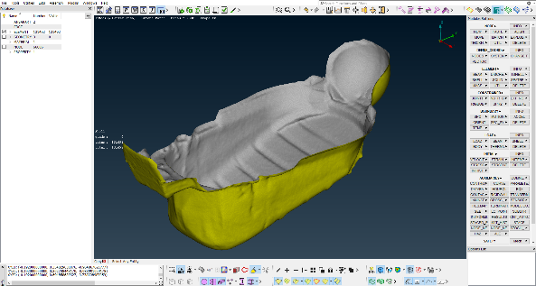
Development of the Soyuz seat model
MeshLab 2020.12
Used for “wrapping” point cloud and converting to surfaces
Used for meshing the surface, checking element quality, etc.

Slide 16
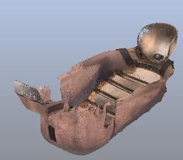
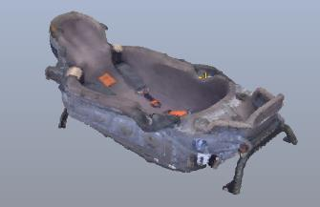
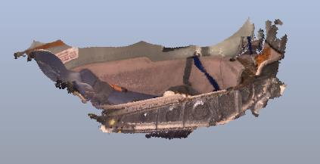
Development of the Soyuz seat model
Final Model Comprised of:
  Inner surface of TMA Center Seat scan
  Brackets from morphed TM trainer seat scan
  Side bracket from TMA Left Seat scan

Slide 17

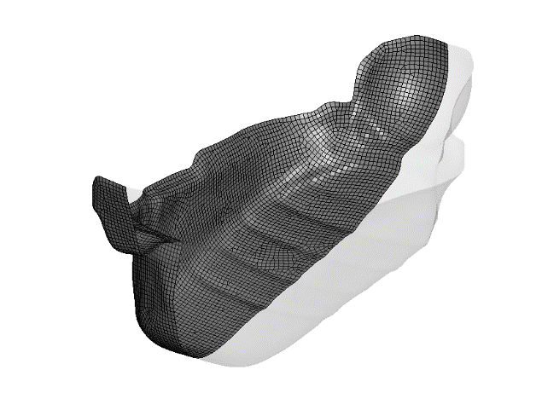
Development of the Soyuz seat model (inner surface)

Slide 18


Development of the Soyuz seat model (brackets)
morph
TM Trainer Seat
TMA Seat

Slide 19
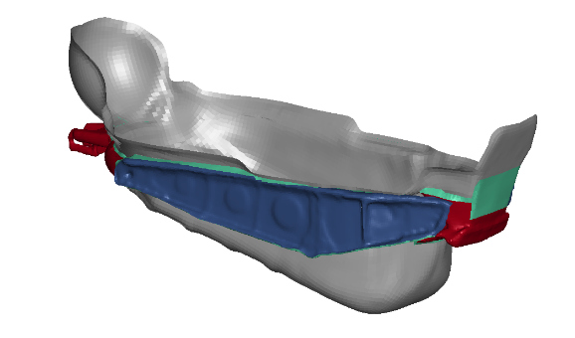
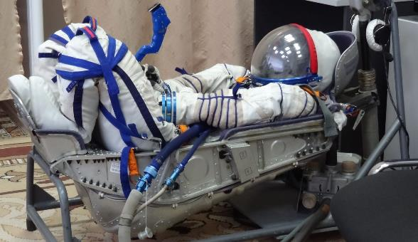
Development of the Soyuz seat model

Slide 20
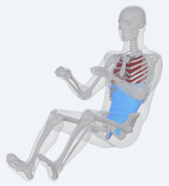
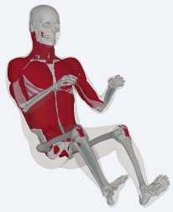

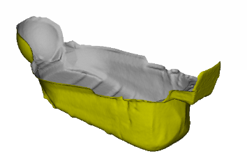
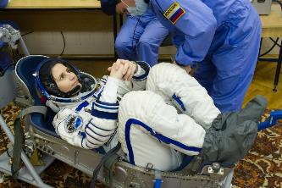
Methodology: Leveraging the Finite Element (FE) Method
Aim 1: Build an FE model of the Soyuz seat, and simulate drop tests with a detailed and simplified HBM

Slide 21
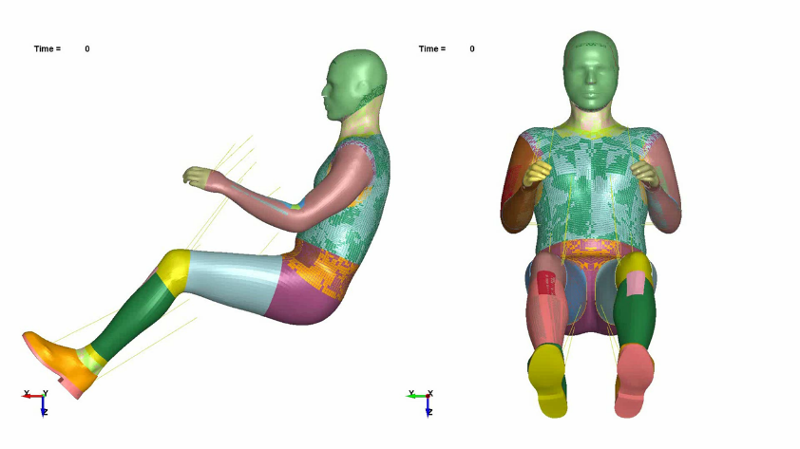
Positioning the GHBMC through Primer

Slide 22
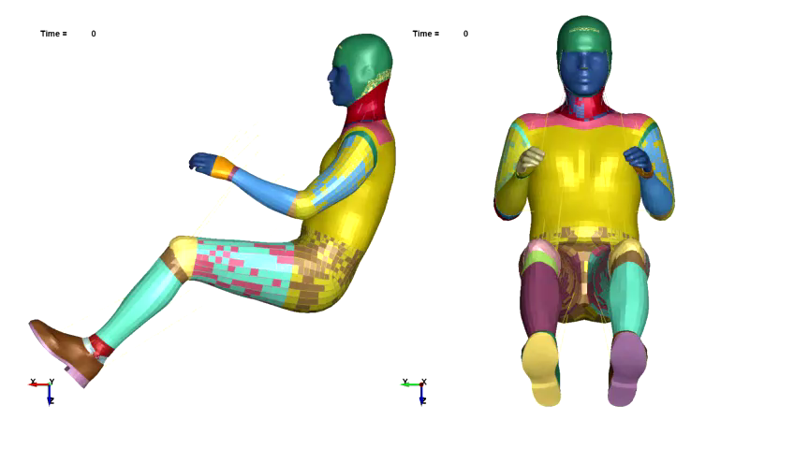
Positioning the GHBMC through Primer

Slide 23
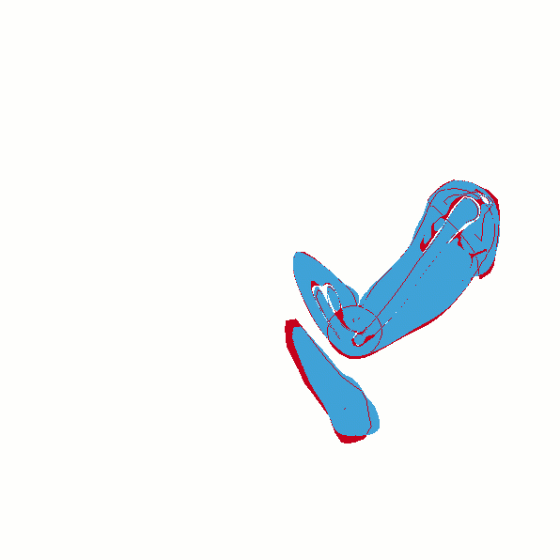
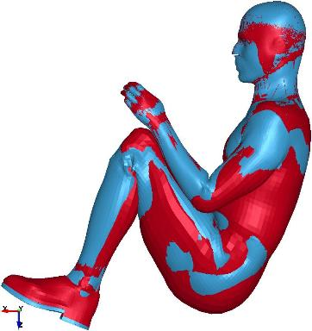
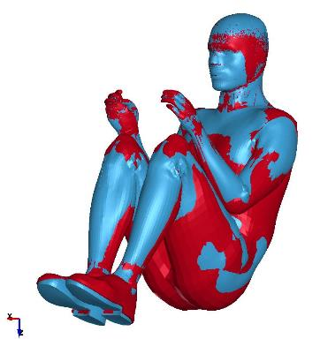
Positioning the GHBMC through Primer – Geometry Comparison
M50-O
M50-OS

Slide 24
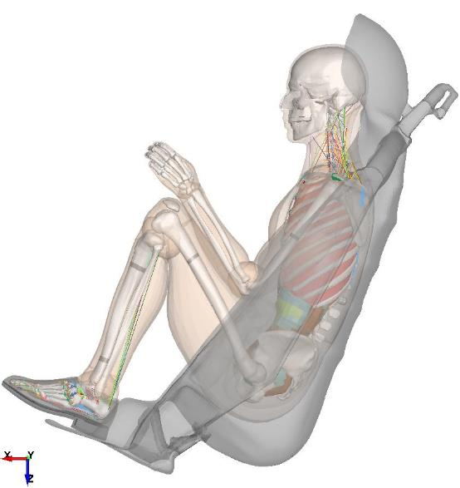
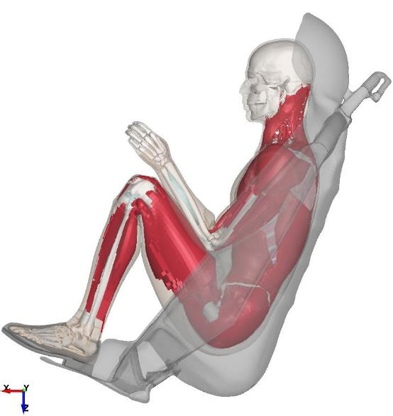
Positioning M50-OS & M50-O in Soyuz

Slide 25
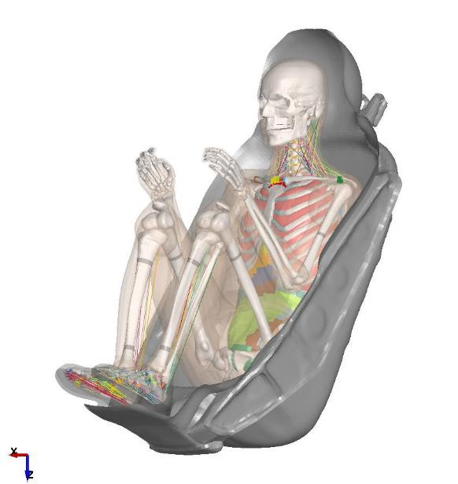
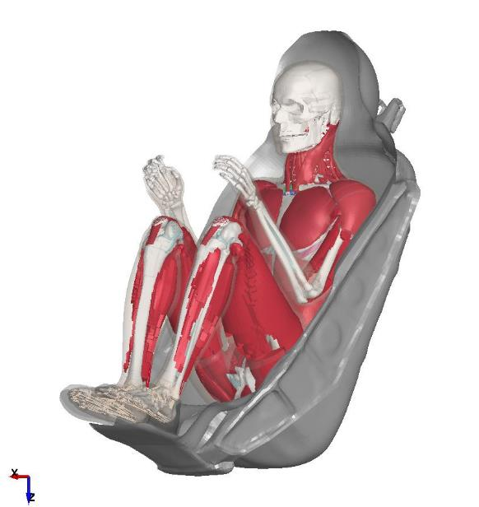
Positioning M50-OS & M50-O in Soyuz

Slide 26
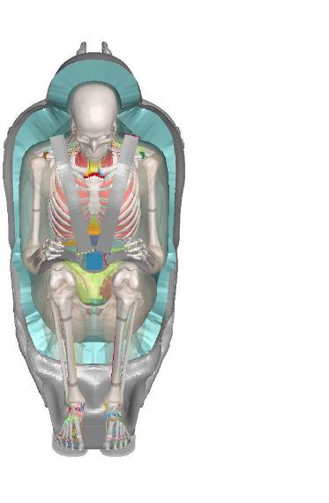
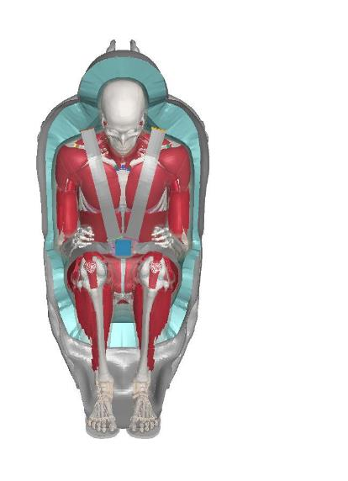
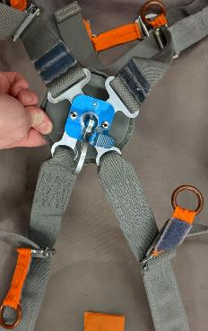
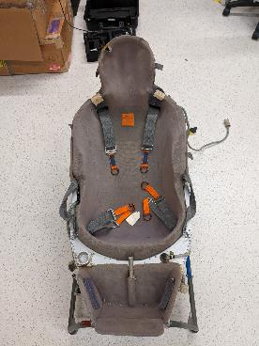
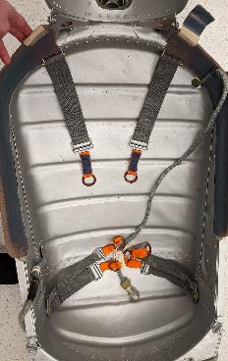
Building Belt System

Slide 27
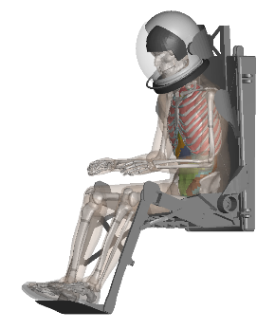
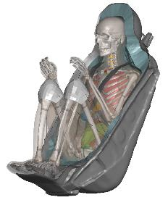
Methodology: Leveraging the Finite Element (FE) Method
Aim 2: Simulate matched dynamic events in the Soyuz seat and Commercial Crew seats using GHBMC M50-OS
?
?

Slide 28
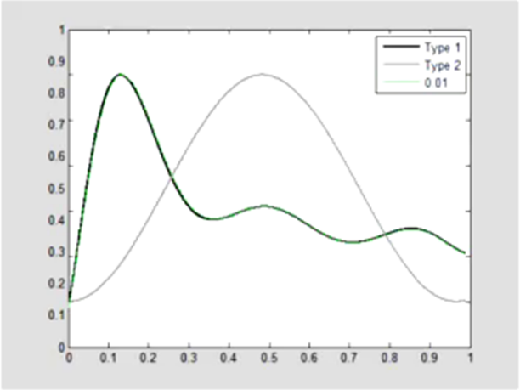
Boundary Conditions: Generic Landing Pulses
Target distribution of acceleration directions for LHD simulations
N=75 Simulations per Seat

Slide 29
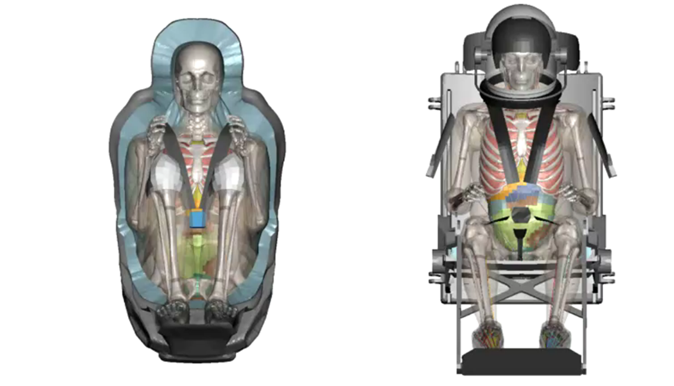
Example Cross-Vehicle Comparison

Slide 30
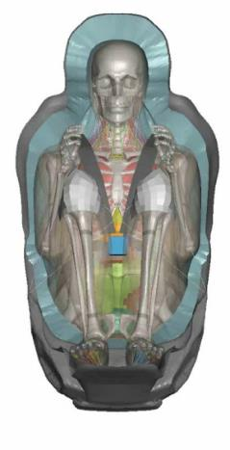
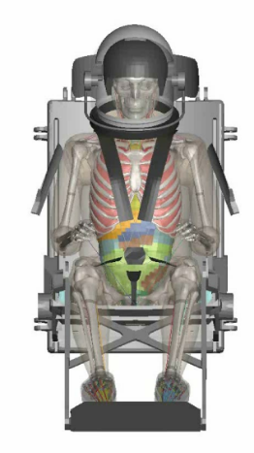
Example Cross-Vehicle Comparison

Slide 31
Project Outline
Aim 1 Deliverables:
  Fully usable FE model of the Soyuz seat
  Quantify differences in injury risk results as a function of HBM detail
Aim 2 Deliverables:
  Quantified difference in injury risk based on the seat and restraints given matched seat acceleration profile
    Will provide insight into reason behind elevated injury rate for Soyuz crew

Slide 32
Thank you!
Questions?

