Slide 1

Behavioral Health & Performance Lab
Suzanne Bell, Ph.D.
NASA Johnson Space Center, Houston, TX, USA
suzanne.t.bell@nasa.gov

Slide 2

Primary Risks for Behavioral Health & Performance Lab
BMed: Risk of Adverse Cognitive or Behavioral Conditions and Psychiatric Disorders
Team: Risk of Performance and Behavioral Health Decrements Due to Inadequate Cooperation, Coordination, Communication, and Psychosocial Adaptation within a Team

Slide 3
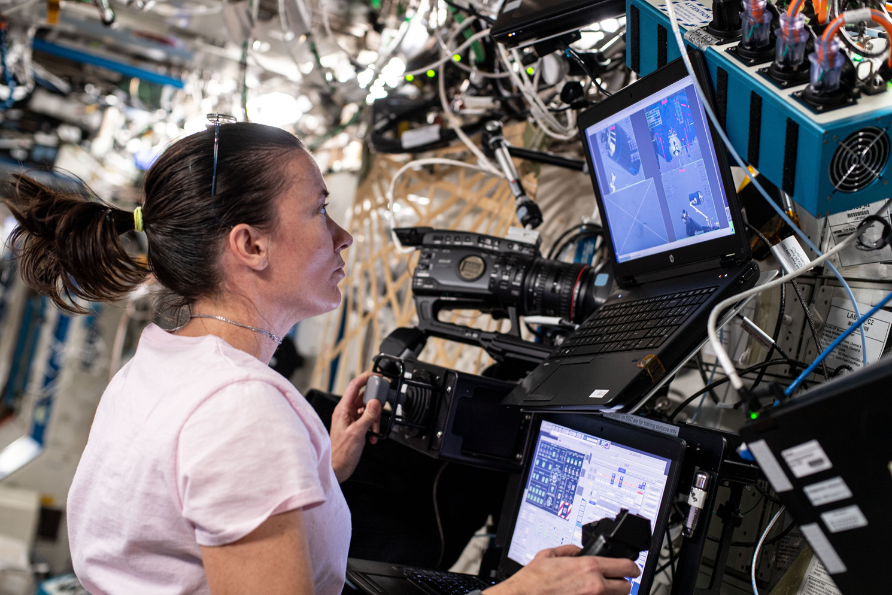
Expedition 65 Flight Engineer Megan McArthur completes ROBoT aboard the ISS. Photo credit: NASA
Notes:
For the BCM study.

Slide 4
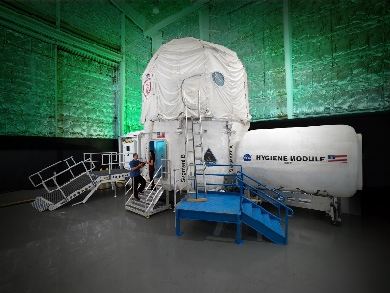
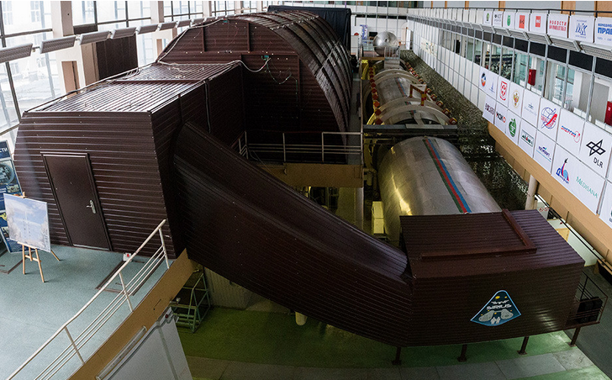


Photo credits: NASA, IBMP, United States Antarctica Program

Slide 5
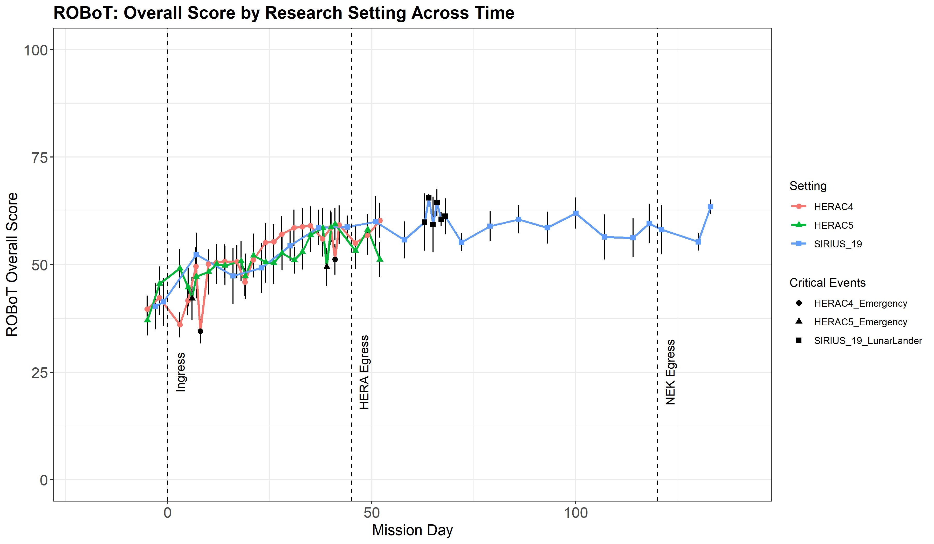
ROBoT-r, Operationally Relevant Performance Over Time

Slide 6
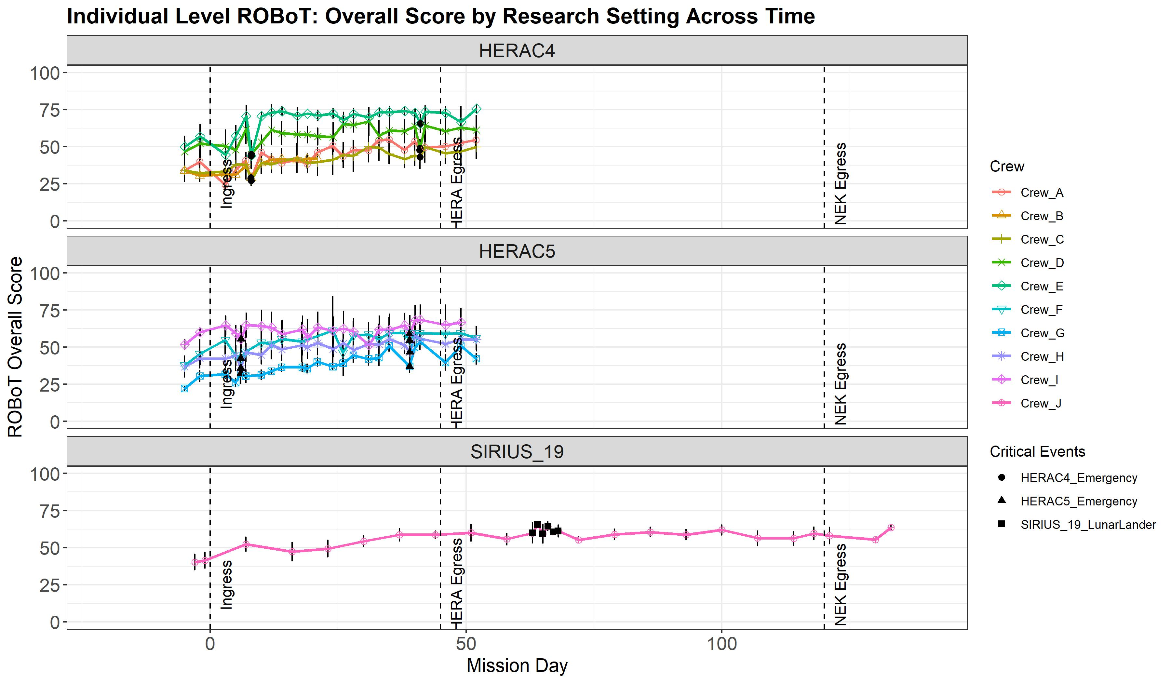
ROBoT-r, Operationally Relevant Performance Over Time

Slide 7
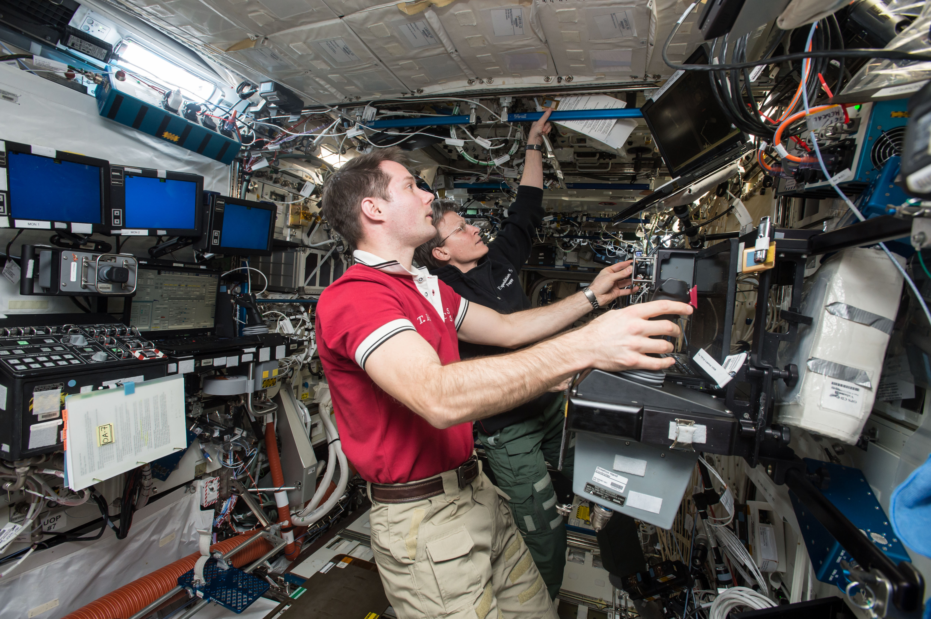
Expedition 51 Flight Engineer Thomas Pesquet and Commander Peggy Whitson use ROBoT aboard the ISS.
Notes:
For the BCM study.

