Slide 1
Abstract
This study compares two statistical modeling approaches to construct summary dose-response curves for low boom community noise surveys. NASA field survey data were used that consist of multiple responses from a survey participant. These data require an approach that accounts for the correlation among repeated annoyance observations from the same participant. A multilevel model accounts for the correlation by allowing estimated parameters to vary with each survey participant. On the other hand, a population average model utilizes generalized estimating equations and accounts for the correlation via a user-specified within-subject correlation structure. A visual comparison of the dose-response curves for these two methods reveals similar results. When comparing specific points along the summary curves, the multilevel model yields more precise confidence bounds than the population average model. The similarity between the summary curves derived from each model lends validity to both approaches for approximating a population representative summary curve.

Slide 2
Comparing two statistical models for low boom dose-response relationships with correlated responses
Aaron B. Vaughn, Will Doebler,
Kate Ballard, and Jonathan Rathsam
NASA Langley Research Center
4aNSa4
181st Meeting of the Acoustical Society of America
December 2, 2021

Slide 3
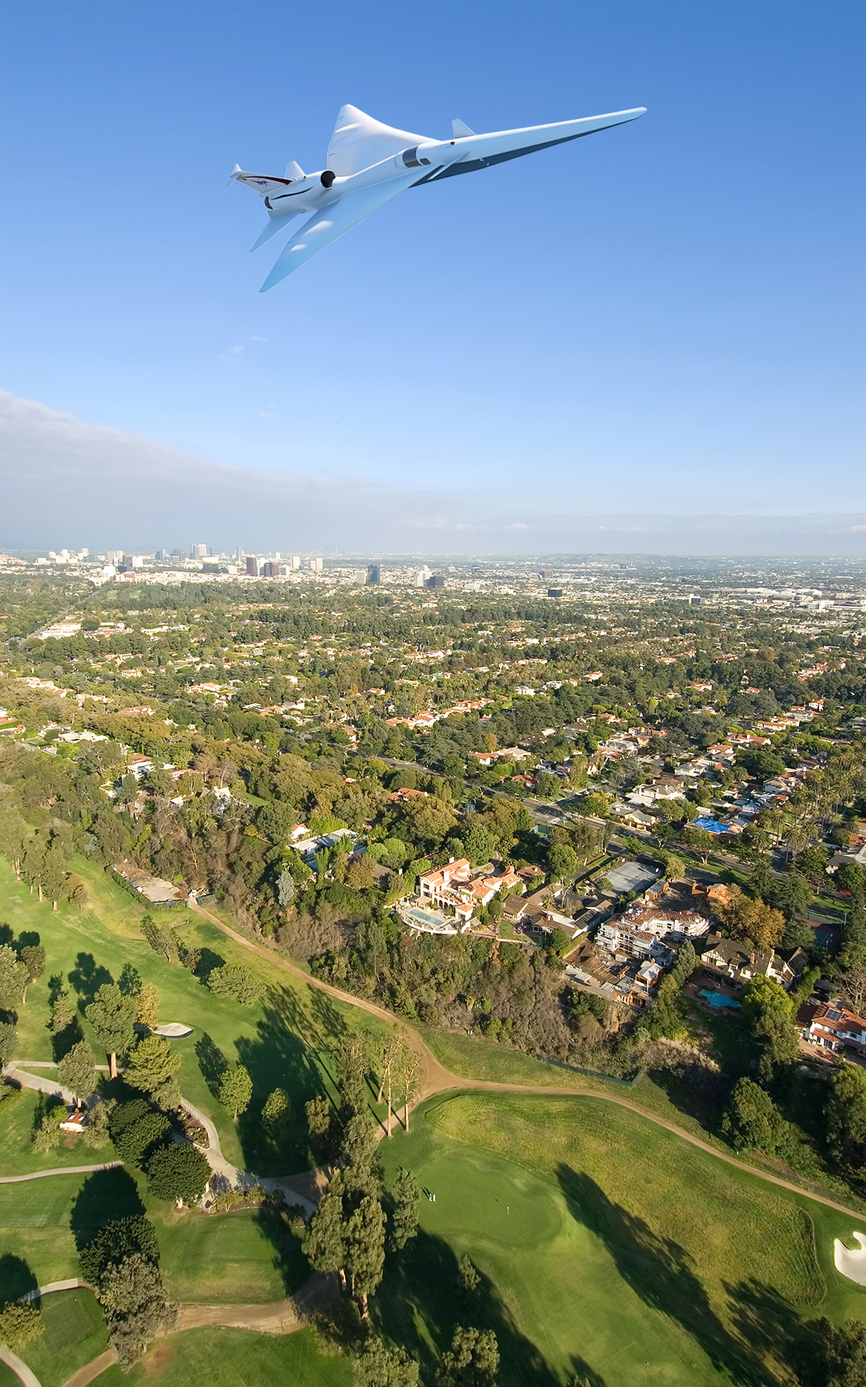
Overview
Background:
  X-59 Quiet SuperSonic Technology (QueSST) Aircraft
Objective:
  Ensure the validity and population representativeness of dose-response modelling for upcoming X-59 community tests
Research Question:
  How do two different modelling methods compare for fitting dose-response relationships with correlated responses?
Motivation:
  Lee et al. 2019 NASA TM down selects 2 models from 7 candidates
  Schaffer et al. 2017 JASA compares 2 models using community noise data
    1 model not previous considered by Lee et al.
Approach:
  Fit dose-response data from previous NASA field studies to 2 models and compare their results

Slide 4
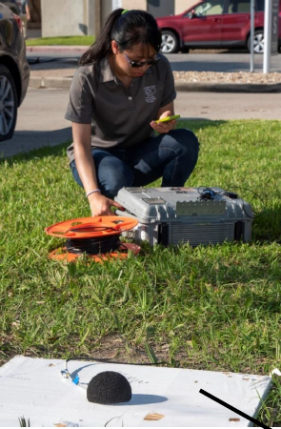
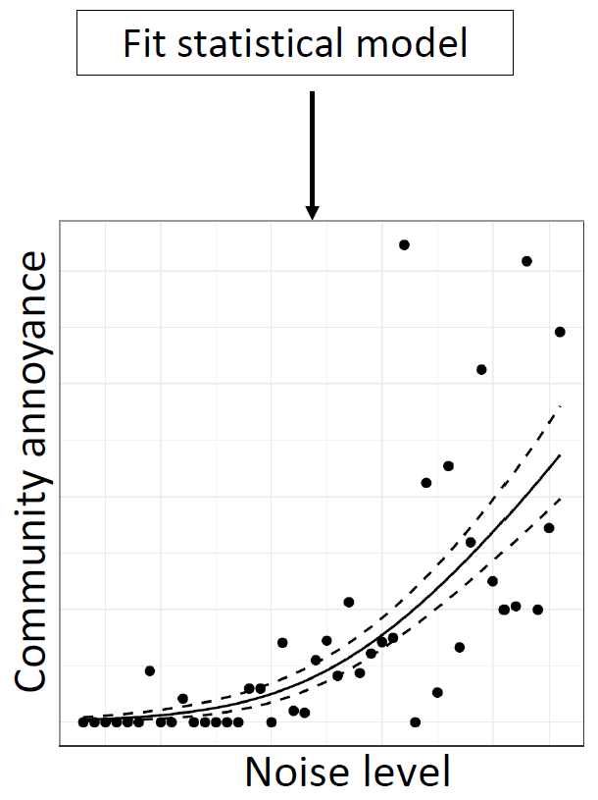
From Data to a Curve
How much did the sonic boom bother, disturb, or annoy you?
Fit Statistical Model
1 2 3 4 5
Convert to binary annoyance response
Participant ID | Boom Number | Dose (Noise Level) | Survey Response
1000 | 1 | 70 | 0
1000 | 2 | 81 | 1
1000 | 3 | 74 | 0
1001 | 1 | 72 | 0
1001 | 2 | 78 | 0
Picture and figure from Lee et al. “Bayesian statistical dose-response models,” 178th Meet. Acoust. Soc. Am., 2019

Slide 5
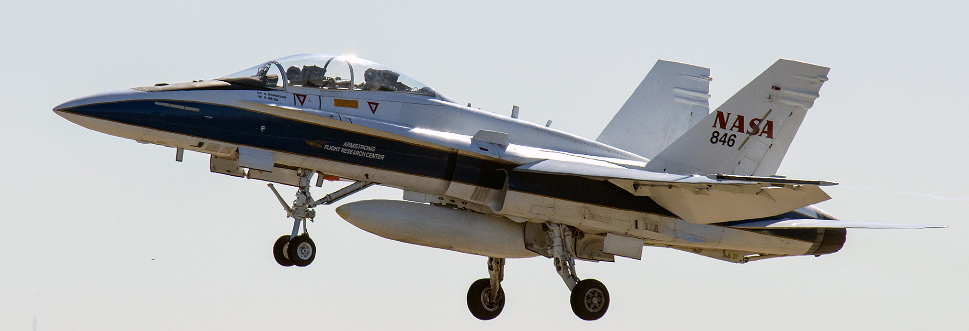
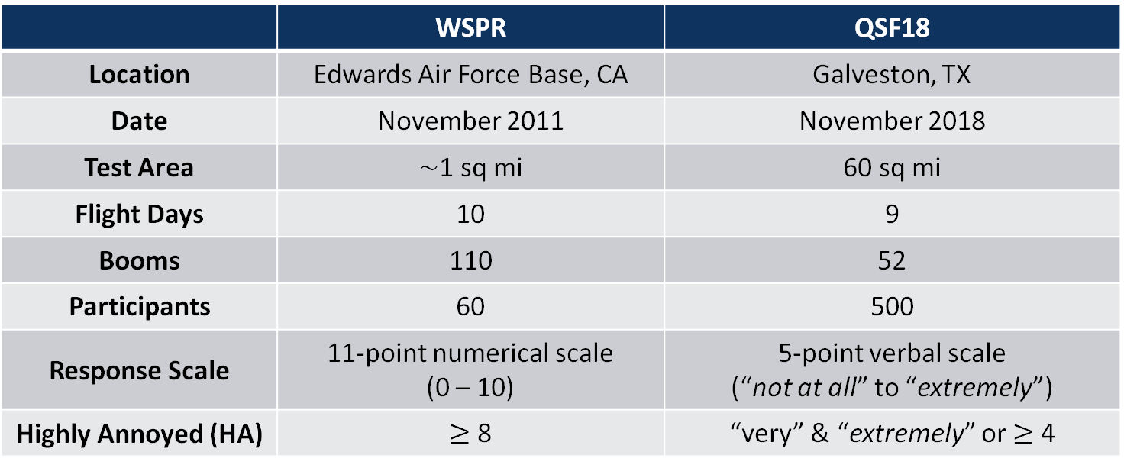
NASA Field Test Data
Two preliminary tests
  Waveforms and Sonic boom Perceptions and Response (WSPR)
  Quiet Supersonic Flight 2018 (QSF18)
Low-amplitude sonic booms via F-18 dive maneuver
 | WSPR | QSF18
Location | Edwards Air Force Base, CA | Galveston, TX
Date | November 2011 | November 2018
Test Area | $\sim$1 sq mi | 60 sq mi
Flight Days | 10 | 9
Booms | 110 | 52
Participants | 60 | 500
Response Scale | 11-point numerical scale (0 – 10) | 5-point verbal scale (“not at all” to “extremely”)
Highly Annoyed (HA) | $≥$ 8 | “very” & “extremely” or $≥$ 4
Notes:
HA in accordance with ISO/TS 15666

Slide 6
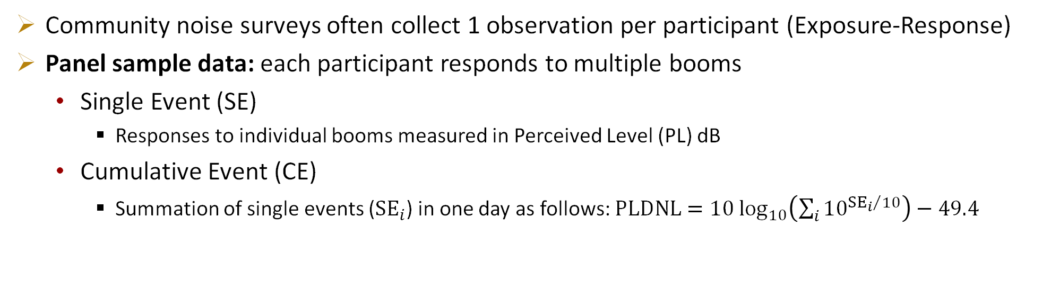
Single-Event and Cumulative-Event Dose
Community noise surveys often collect 1 observation per participant (Exposure-Response)
Panel sample data: each participant responds to multiple booms
  Single Event (SE)
    Responses to individual booms measured in Perceived Level (PL) dB
  Cumulative Event (CE)
    Summation of single events (${SE}_{i}$) in one day as follows: $PLDNL=10 \log_{10}\left(\sum_{i}{{10}^{{{SE}_{i}}/{10}}}\right)−49.4$
Participant ID | Boom Number | Dose (PL dB) | Annoyance Response
1000 | 1 | 70 | 0
1000 | 2 | 81 | 1
1000 | 3 | 74 | 0
1001 | 1 | 72 | 0
1001 | 2 | 78 | 0
Participant ID | Day | Dose (PLDNL dB) | Annoyance Response
1000 | 1 | 32.7 | 1
1001 | 1 | 29.6 | 0

Slide 7
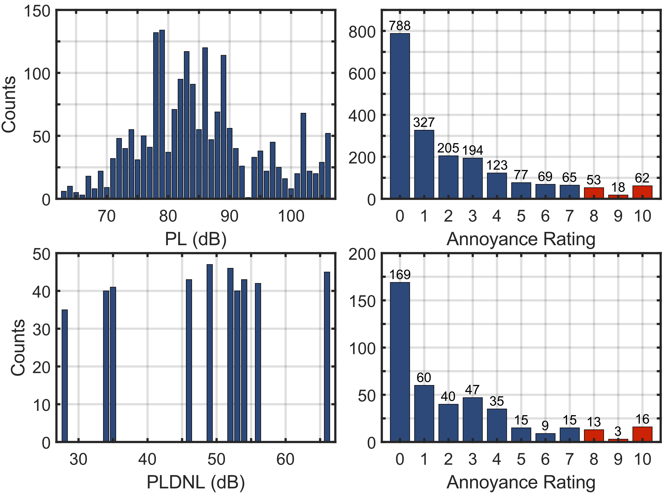
Data Summary: WSPR
Dose
Response
Single Event:
  Participants: 49
  Observations: 1,981
  Average Response Rate: 36.8%
  Dose Range: 63–106 PL dB
Cumulative Event:
  Participants: 52
  Observations: 422
  Average Response Rate: 86.1%
  Dose Range: 28.0–65.6 PLDNL dB
HA
HA

Slide 8
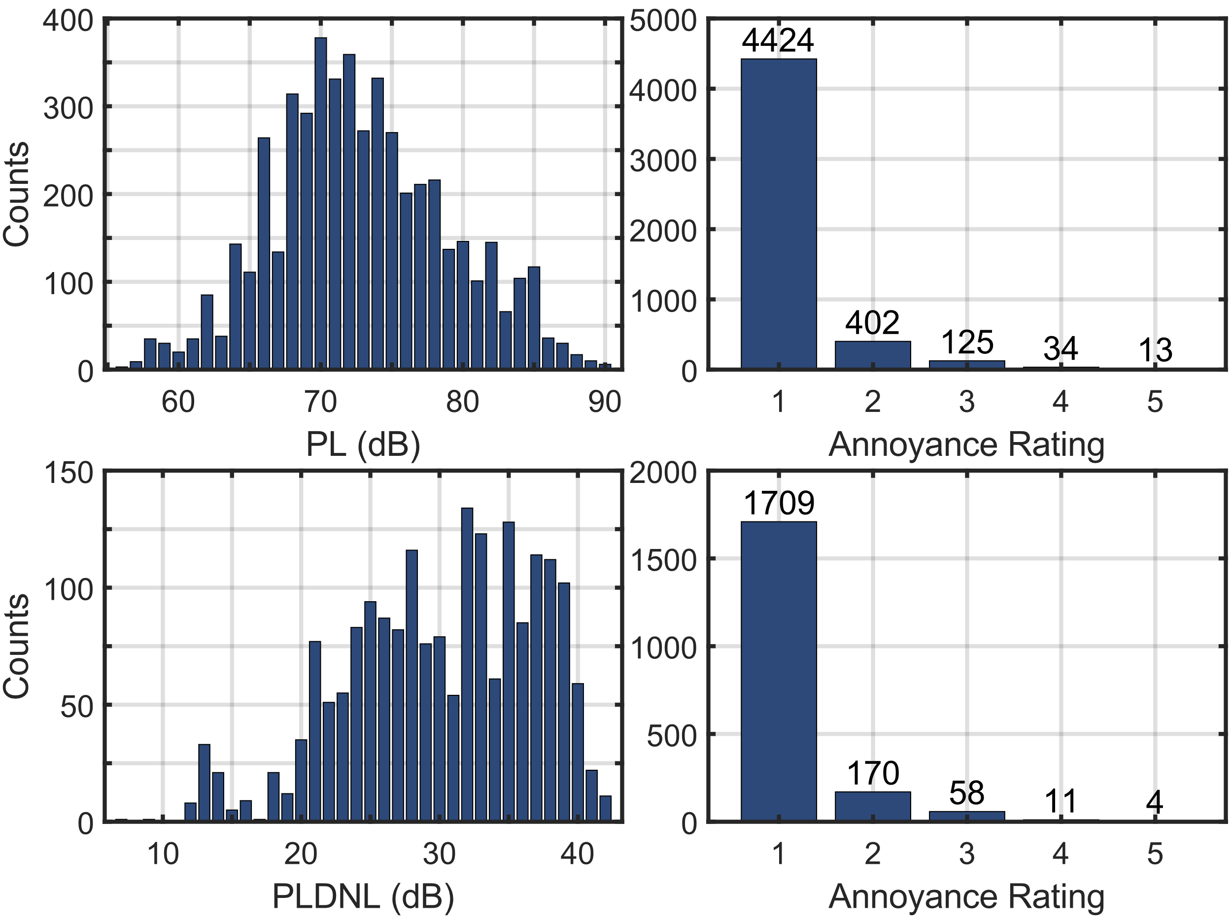
Data Summary: QSF18
Dose
Response
Single Event:
  Participants: 371
  Observations: 4,998
  Average Response Rate: 25.9%
  Dose Range: 56–90 PL dB
Cumulative Event:
  Participants: 386
  Observations: 1,952
  Average Response Rate: 56.2%
  Dose Range: 7.3–42.1 PLDNL dB
HA
HA

Slide 9
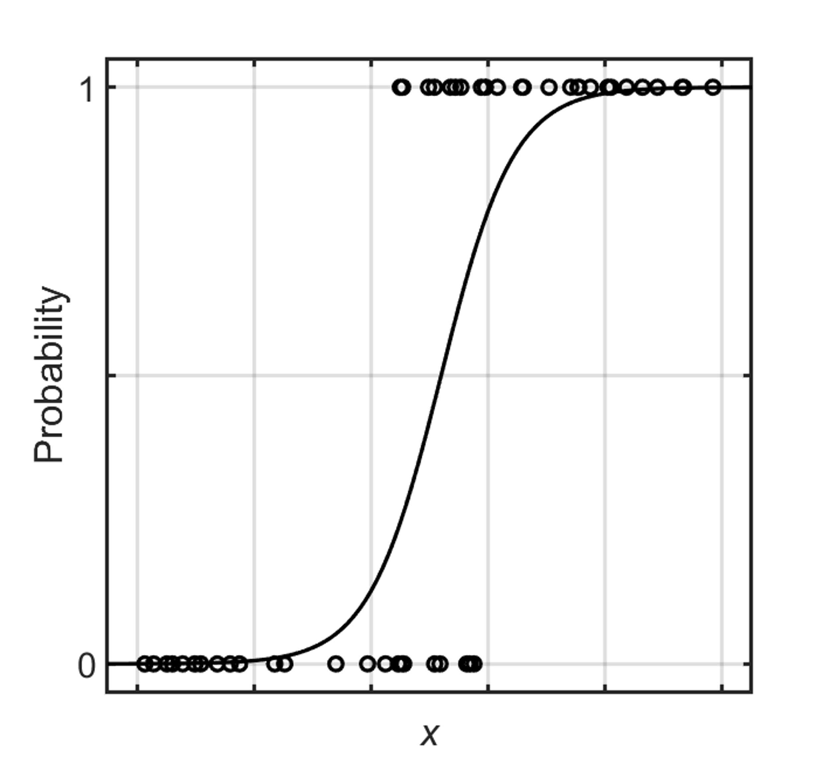
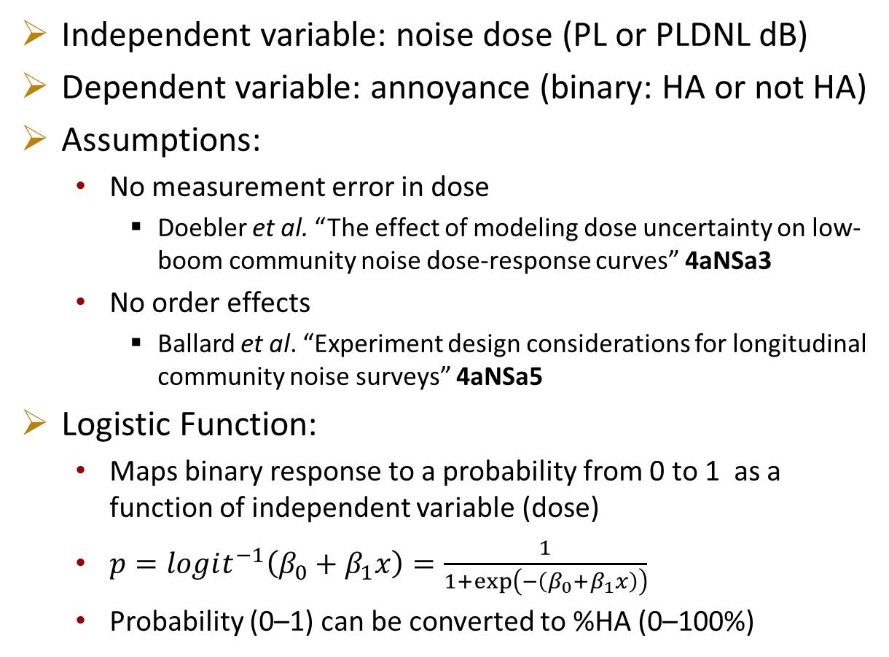

Statistical Model - Similarities
Independent variable: noise dose (PL or PLDNL dB)
Dependent variable: annoyance (binary: HA or not HA)
Assumptions:
  No measurement error in dose
    Doebler et al. “The effect of modeling dose uncertainty on low-boom community noise dose-response curves” 4aNSa3
  No order effects
    Ballard et al. “Experiment design considerations for longitudinal community noise surveys” 4aNSa5
Logistic Function:
  Maps binary response to a probability from 0 to 1 as a function of independent variable (dose)
  $p=logit^{−1}\left(β_{0}+β_{1}x\right)=\frac{1}{1+exp\left(−\left(β_{0}+β_{1}x\right)\right)}$
  Probability (0–1) can be converted to %HA (0–100%)
$$x$$

Slide 10
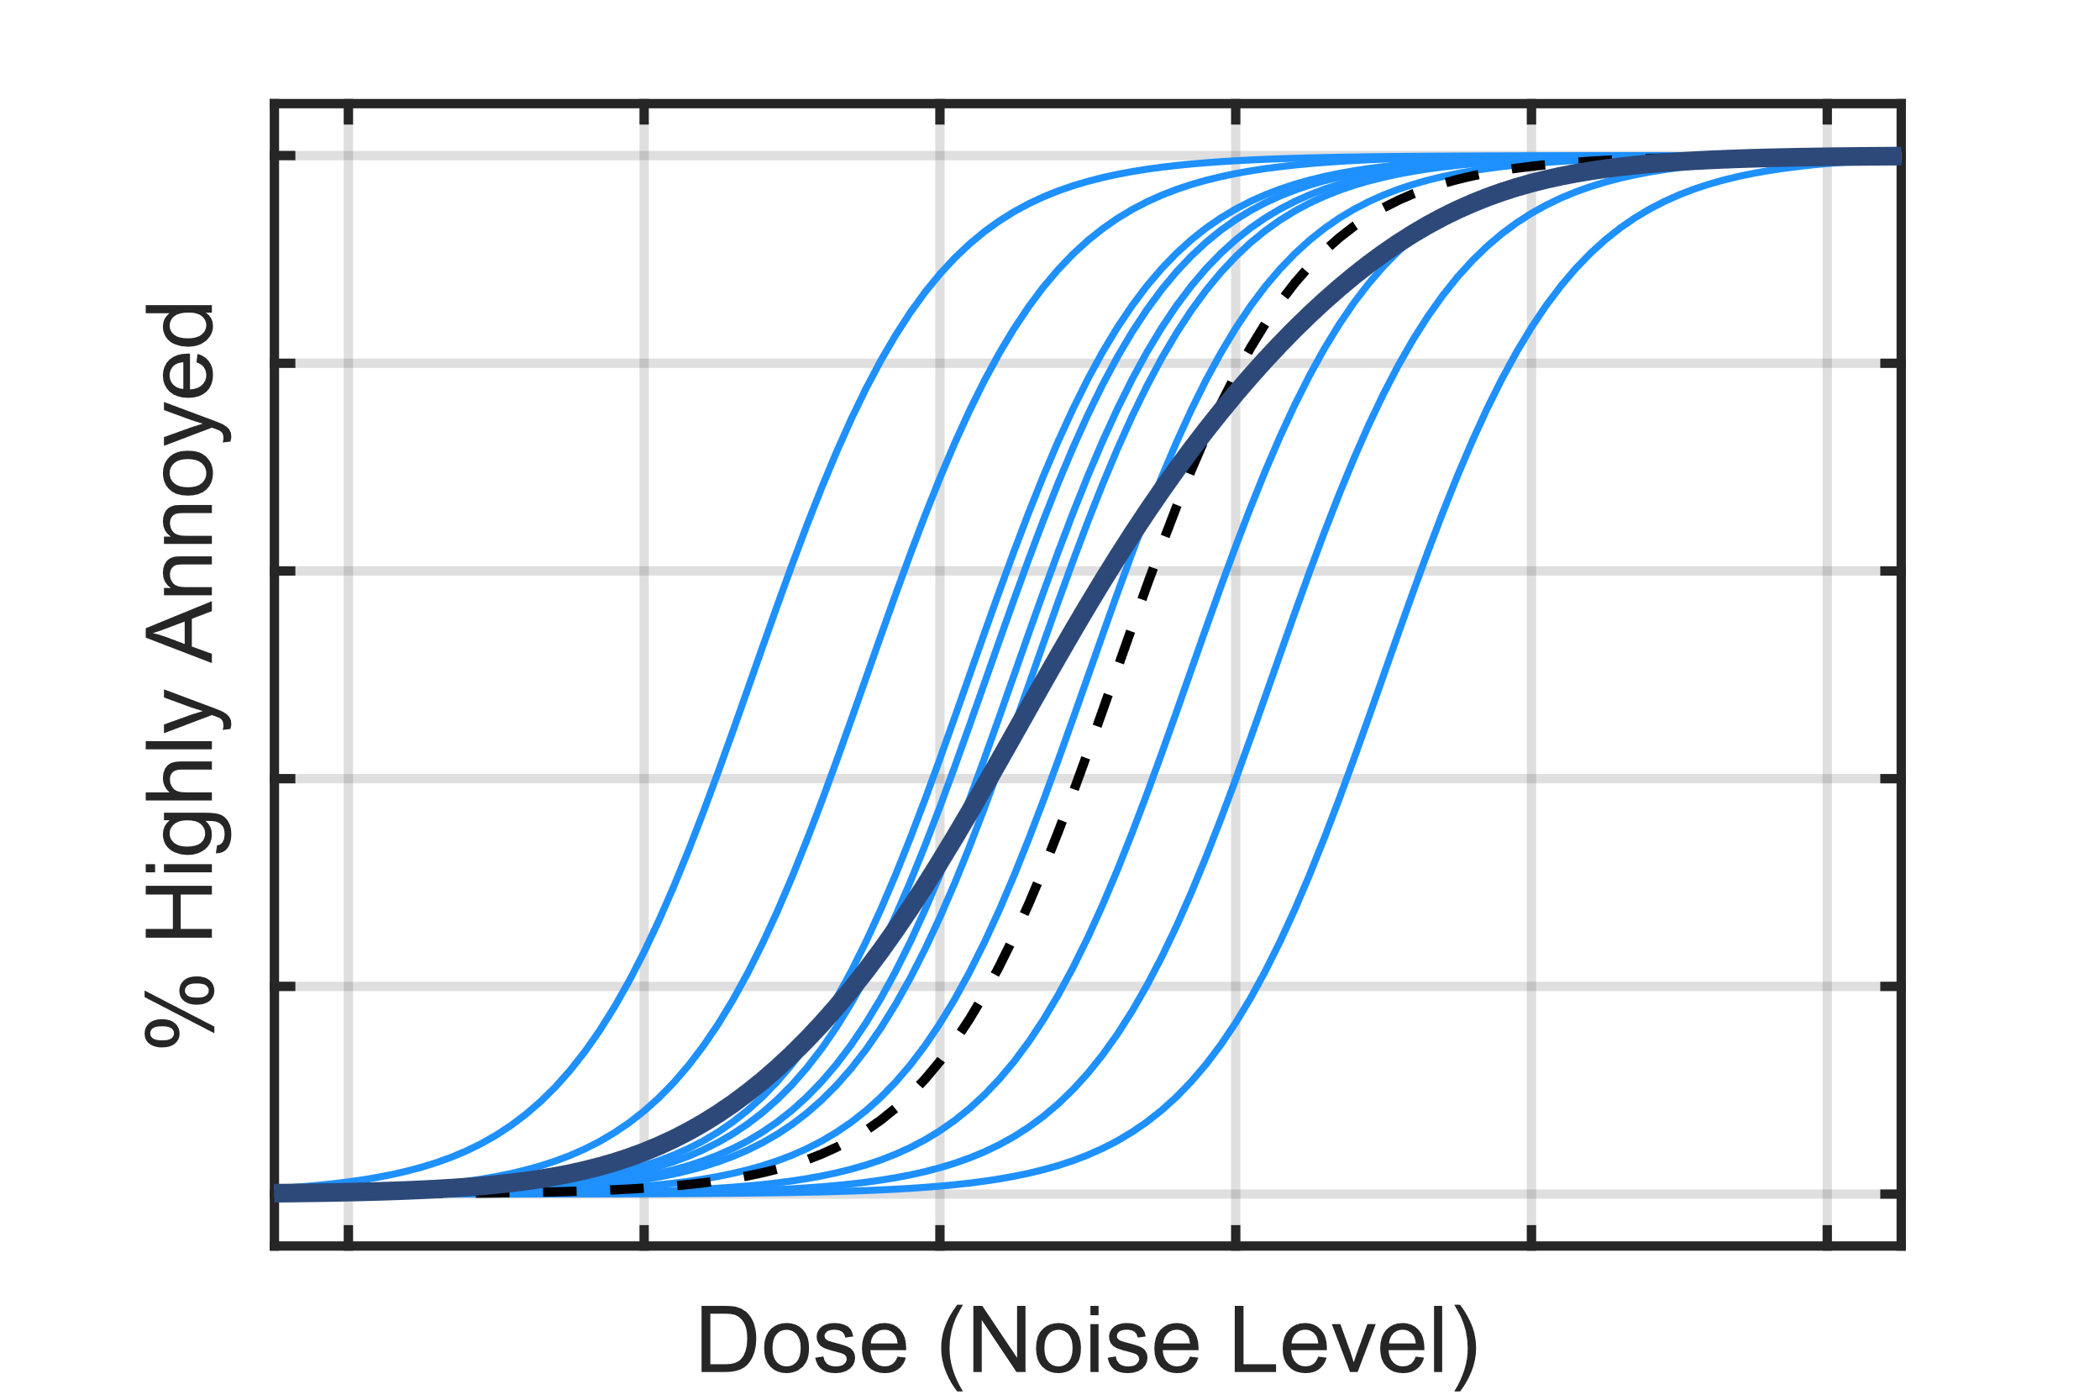
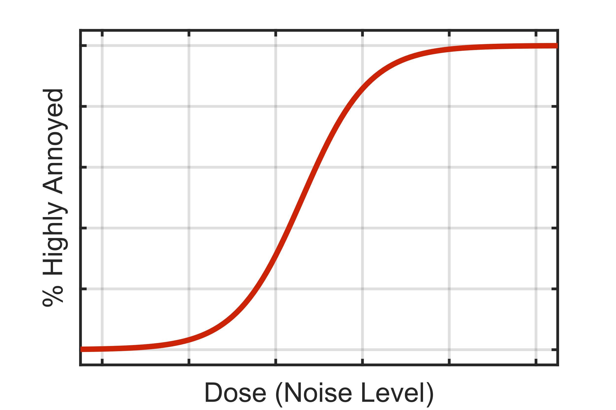
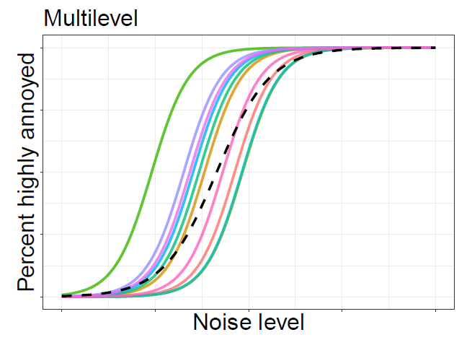
Statistical Methods
How to achieve a population summary dose-response curve?
    Fit a curve to each individual participant, then average
    Marginalize participant results to directly infer a population average result
Conditional (Subject Specific)
Marginal (Population Average)

Slide 11
Conditional Model (Subject Specific)
Multilevel Logistic Regression
  1 of 2 down-selected models from Lee et al. 2019 NASA TM
  Bayesian inference
    Computationally intensive
Within-subject correlation:
  Estimates the same slope and a unique intercept for each participant
    Assumes slope parameter is normally distributed
Population summary curve:
  Average of individual curves
    Utilizes distribution of estimated parameters
    Summary curve is no longer logistic in shape
Credible interval:
  Estimated from distribution of estimated parameters

Slide 12
Marginal Model (Population Average)
Generalized Estimating Equation (GEE)
  Estimates average response over the population
  No distributional assumptions
  Computationally efficient
Within-subject correlation:
  Exchangeable correlation structure
    All observations equally correlated
Confidence interval:
  Parametric bootstrapping

Slide 13
Conditional vs Marginal Model
Conditional Model
(Subject Specific)
Marginal Model
(Population Average)
Bayesian inference
Distributional assumptions
Estimated parameters describe subjects
Averaging of individual curves for population summary
Credible Intervals
Generalized Estimating Equations
No distributional assumptions
Estimated parameters describe population
No averaging required for population summary curve
Confidence Intervals
Same binary dataset
Logistic Function
Account for within-subject correlation

Slide 14
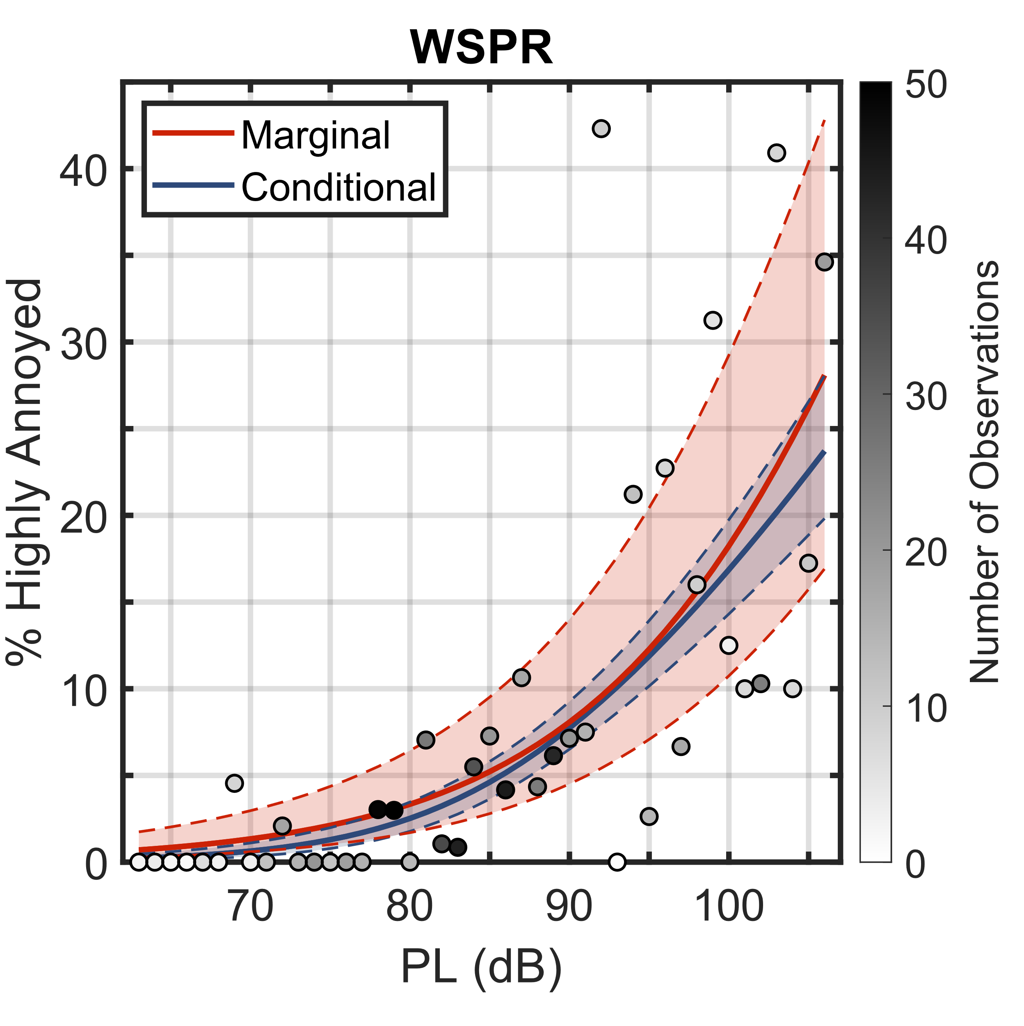

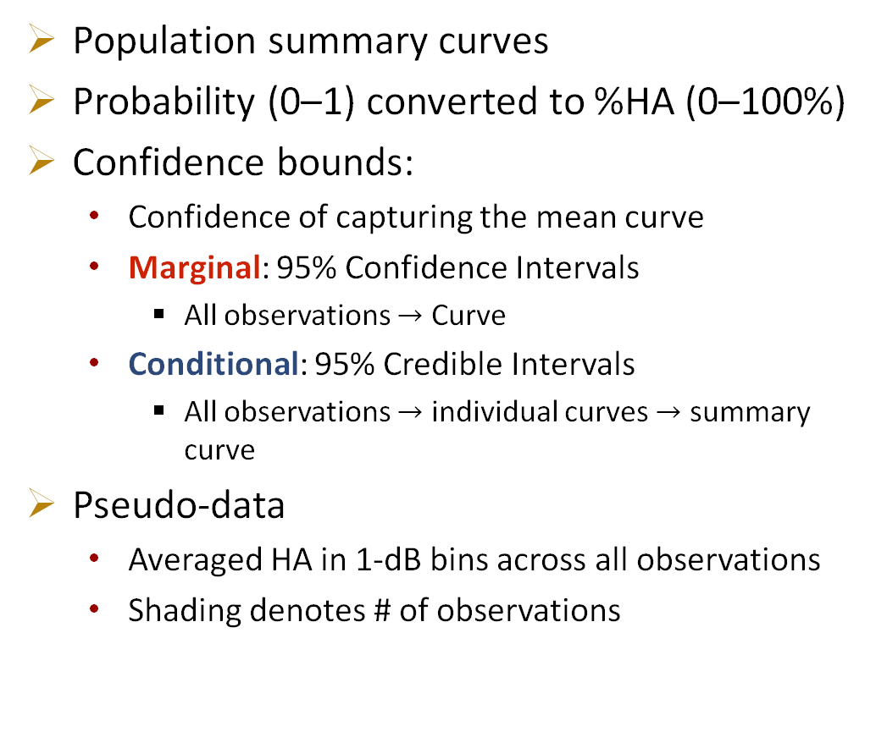
Dose-Response Curves: WSPR Single Event
Population summary curves
Probability (0–1) converted to %HA (0–100%)
Confidence bounds:
  Confidence of capturing the mean curve
  Marginal: 95% Confidence Intervals
    All observations $→$ Curve
  Conditional: 95% Credible Intervals
    All observations $→$ individual curves $→$ summary curve
Pseudo-data
  Averaged HA in 1-dB bins across all observations
  Shading denotes # of observations
WSPR
Single Event

Slide 15
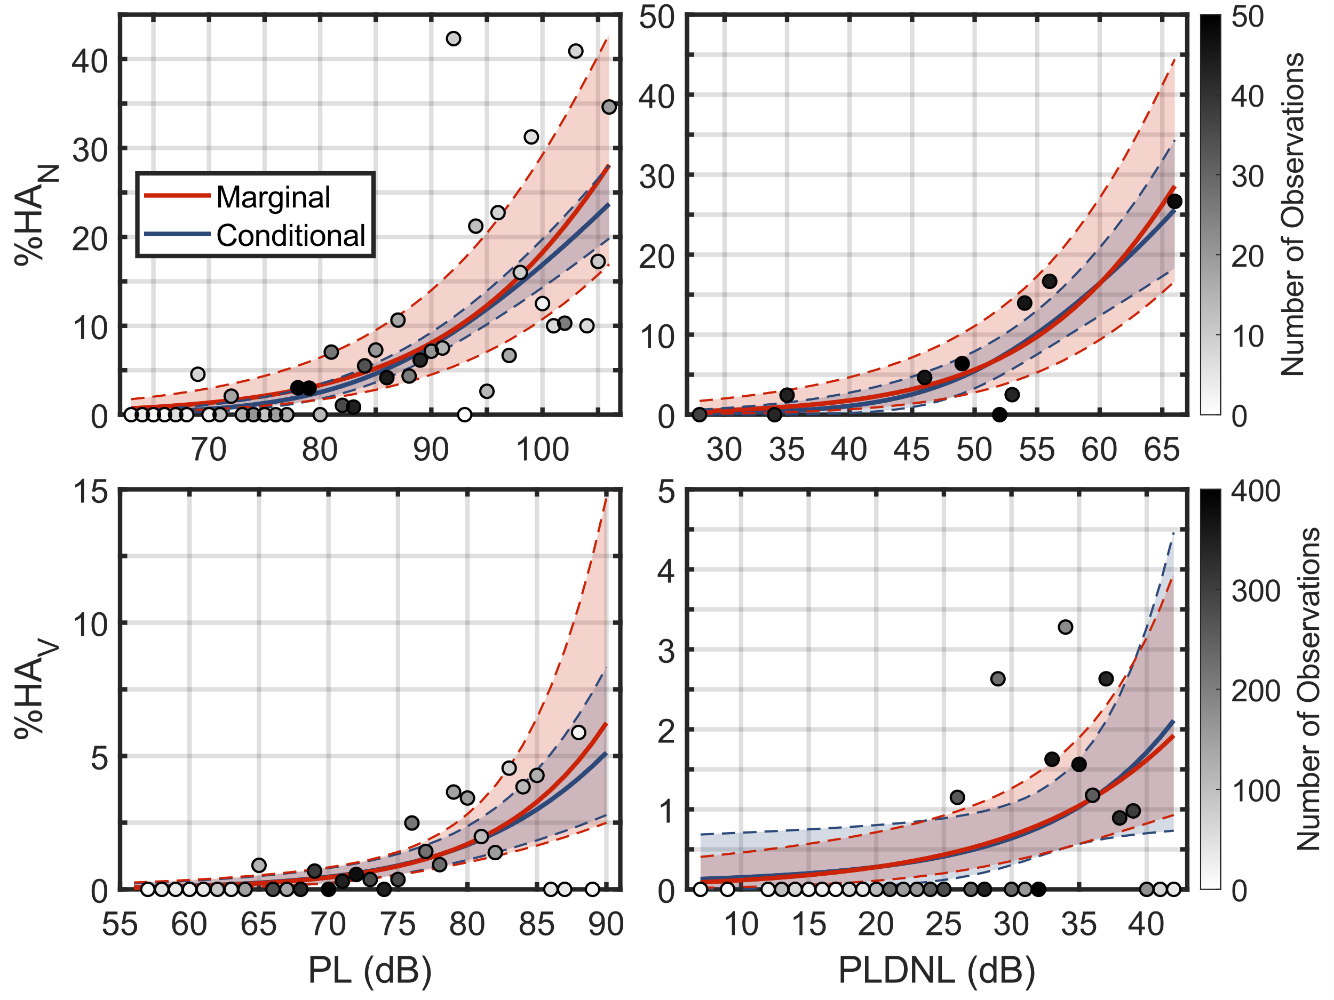
Dose-Response Curves: WSPR & QSF18 Single & Cumulative Events
Summary curves are similar
Larger confidence bounds for marginal than conditional
  Not the same type of bound
  Different for QSF18 CE
Greater %HA at high doses for marginal than conditional
  Fewer observations
  Impact of non-HA participants?
  Different for QSF18 CE
WSPR
Single Event
WSPR
Cumulative Event
QSF18
Single Event
QSF18
Cumulative Event

Slide 16
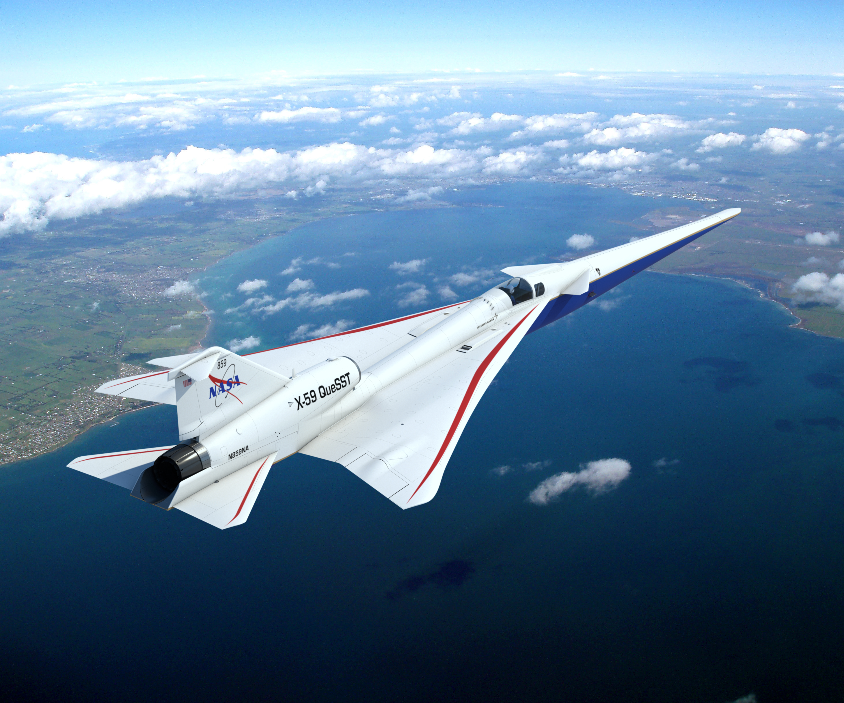
Conclusions
Summary curves are similar for both methods
  WSPR & QSF18
  Single-Event & Cumulative-Event data
Conditional model (Subject Specific)
  Requires additional step (average individual curves) to achieve summary curve
  Provides additional information regarding individuals
  Smaller confidence bounds (different interpretation)
Marginal model (Population Average)
  No distributional assumptions with GEE
  Computationally efficient (seconds instead of hours)

Slide 17
References
Lee, J., Rathsam, J., and Wilson, A. (2020). “Bayesian statistical models for community annoyance survey data,” J. Acoust. Soc. Am. 147(4), 2222–2234.
Lee, J., Rathsam, J., and Wilson, A. (2019). “Statistical modeling of quiet sonic boom community response survey data,” NASA/TM-2019-220427.
Shaffer, B., Pieren, R., Mendolia, F., Basner, M., and Brink, M. (2017). “Noise exposure-response relationships established from repeated binary observations: Modeling approaches and applications,” J. Acoust. Soc. Am. 141(5), 3175–3185.

Slide 18
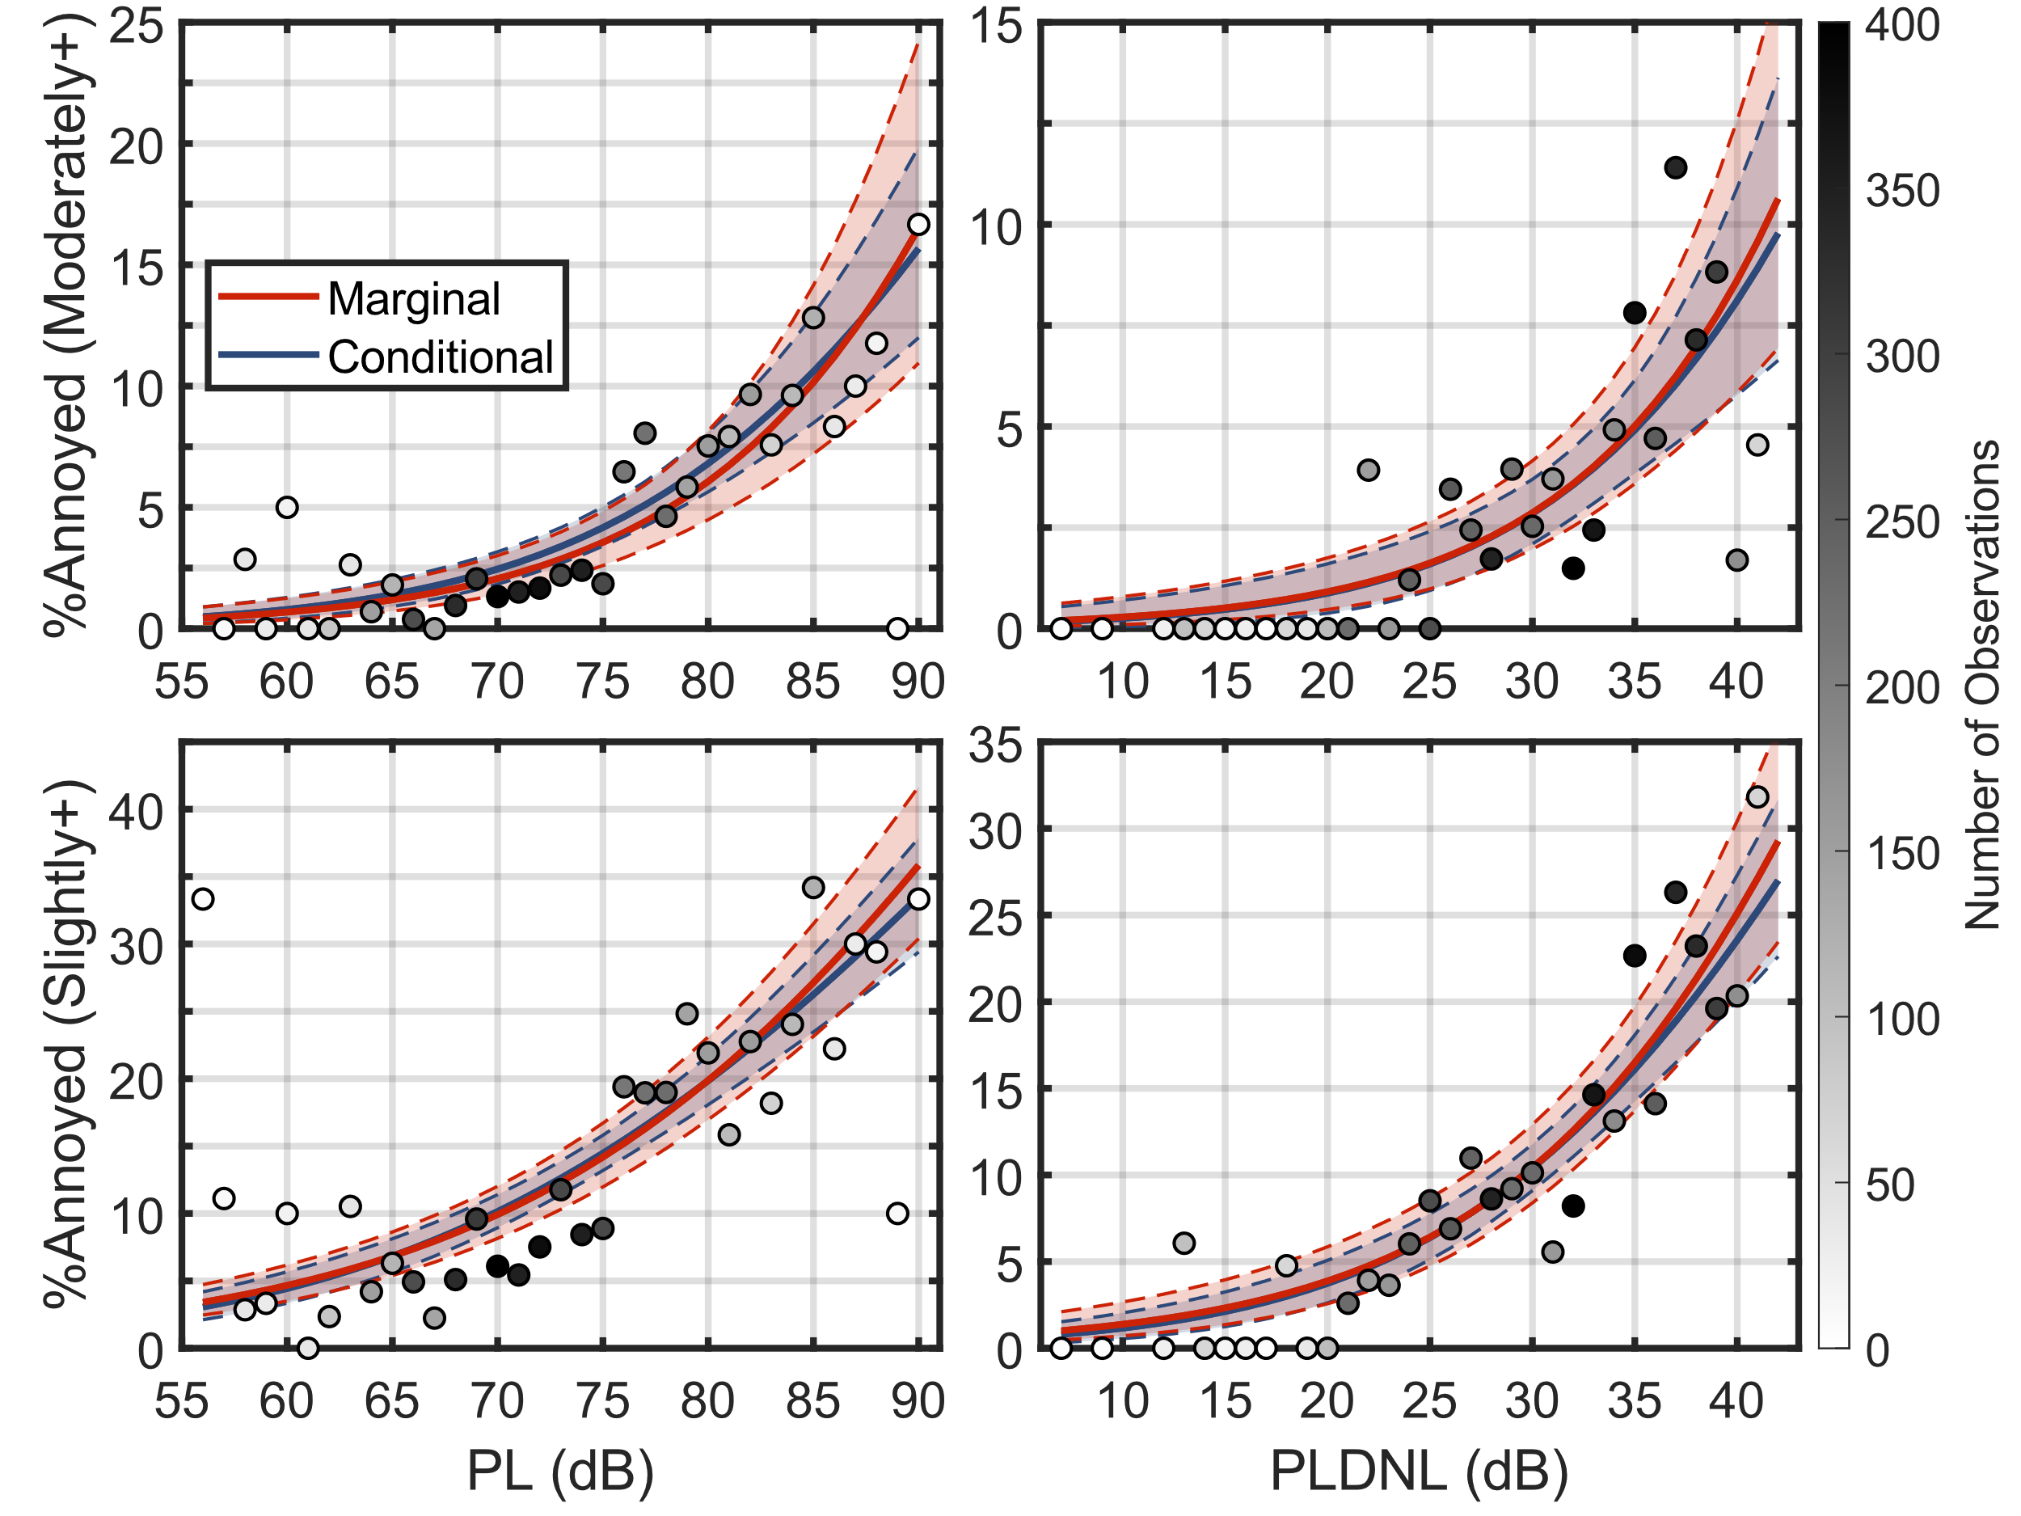

Dose-Response Curves: QSF18 Slightly+ & Moderately+ Annoyed
QSF18
Single Event
Moderately+ Annoyed
QSF18
Cumulative Event
Moderately+ Annoyed
QSF18
Single Event
Slightly+ Annoyed
QSF18
Cumulative Event
Slightly+ Annoyed

Slide 19
Data Summary: WSPR
Single Event:
  Participants: 49 (18 HA)
  Observations: 1,981 (133 HA)
  Average Response Rate: 36.8%
  Dose Range: 63–106 PL dB
Cumulative Event:
  Participants: 52 (29 HA)
  Observations: 422 (32 HA)
  Average Response Rate: 86.1%
  Dose Range: 28.0–65.6 PLDNL dB
Dose
Response
HA
HA

Slide 20
Data Summary: QSF18
Single Event:
  Participants: 371 (23 HA)
  Observations: 4,998 (47 HA)
  Average Response Rate: 25.9%
  Dose Range: 56–90 PL dB
Cumulative Event:
  Participants: 386 (12 HA)
  Observations: 1,952 (15 HA)
  Average Response Rate: 56.2%
  Dose Range: 7.3–42.1 PLDNL dB
Dose
Response
HA
HA

