Slide 1

Revisiting Building-Block Approaches for Structures
Kenneth R. Hamm Jr., NASA Ames Research Center
Dawn R. Price, NASA Marshall Space Flight Center
Kauser S. Imtiaz, NASA Johnson Space Center,
Ivatury S. Raju, NASA Langley Research Center (Ret.)
2022 AIAA SciTech Conference
San Diego, California
January 6, 2022
Special Session in Honor of Mr. H. Stanley Greenberg (STR - 24)

Slide 2
Introduction and Objectives
Building-Block Approach:
  Method for building confidence in designs and analyses
  Evolves design from lower-level components to more complex assemblies
  Knowledge gained at each step informs higher fidelity representations
  Validates results to known solutions or test data
Revisit building-block approach applied to structural design and analysis
  Demonstrate leveraging of existing information to build confidence in the design/development of analysis models
  Provide examples of analysis building-block approaches used in NASA hardware and spacecraft development
  Illustrate best practices that should be considered when developing structural analysis models
  Discuss evolving virtual testing and hybrid simulation approaches
.

Slide 3
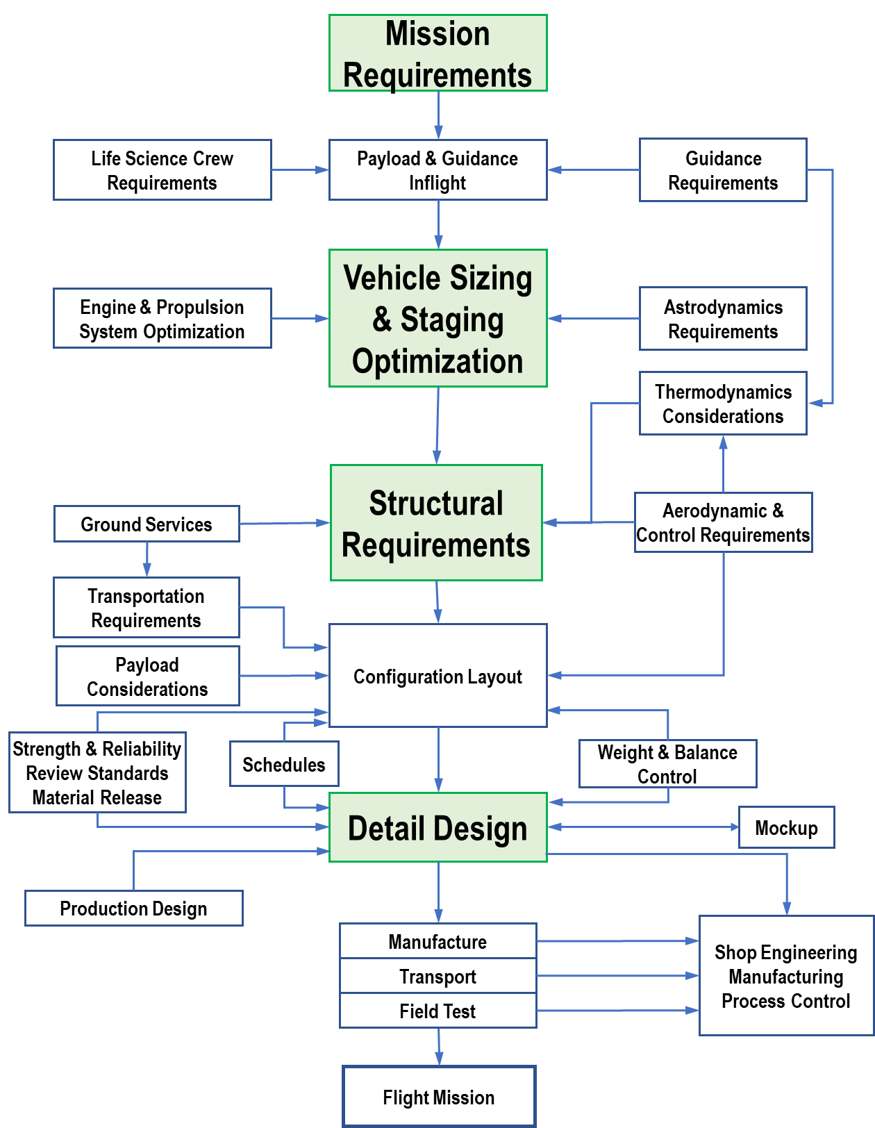
Historical Background
Tendency to develop complex analytical models far too early in the design process
NASA Guidelines for Mission Development
  Green highlighted boxes - areas where structural design/analysis is necessary
Illustrates need to build confidence and understanding of design requirements and their effects on overall structural behavior before launching into detailed design evaluations
Complex models at early stages are not necessarily high-fidelity and are certainly not always good or accurate models
Reproduced from NASA-SP-65

Slide 4
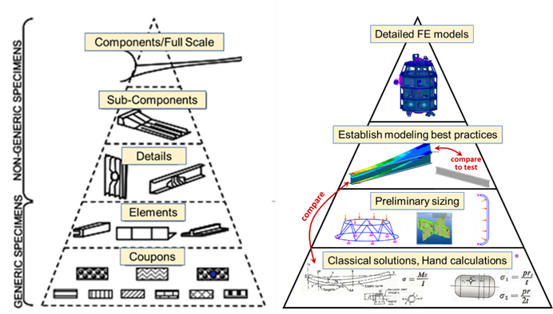
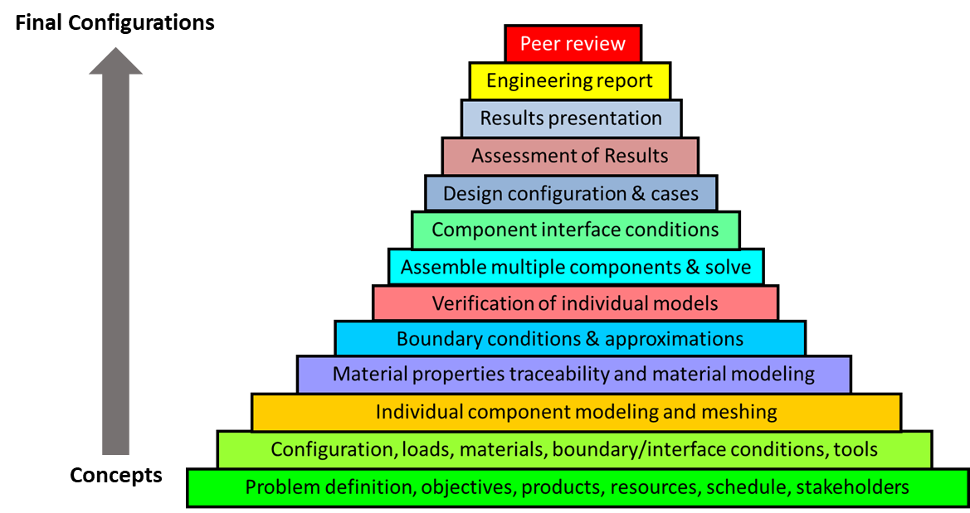
Building-Block Approaches
Ensures quality structures developed
  Requirements are met
  Hardware is validated
  Links to physical testing
Essential process for complex, lightweight built-up structures common in aerospace
Extends to development of analysis models
  Build confidence in analysis
  Use simple models early on
  Use as basis for more complex models as designs evolve

Slide 5
Building-Block Approach in Modeling
Develop understanding of key aspects to be captured in analysis
  Investigate classical/empirical solutions to gage expected ranges and magnitudes
Use appropriate model fidelity for the level of analysis needed
  Beam or Shell models may be appropriate to assess early conceptual development
  Evolve to more complex models (if appropriate) to capture more detailed behavior
Complex meshes lead to large, sometimes unwieldy models
  May give misleading answers
    (e.g., 2D/3D elements to model beam behavior)
  Sometimes difficult to validate
  Sometimes hard to interrogate
Simpler representations lead to easier understanding and visualization of behavior
  Plate/Shell element meshes may be appropriate
    Assuming simplified thru-thickness behavior
    Plane stress/plane strain assumptions hold

Slide 6
Other Modeling Strategies
Axisymmetric modeling
  Assumes structure is symmetric about central axis
  Easy to develop and solve (2D representation but 3D results)
  Allows for significant detail over a cross section
  Complex loading/BC can be applied
    assuming it meets the requirements of axisymmetric theory
Half/Quarter plate/solid modeling
  Good for representing a structure with internal symmetry
    Use symmetric/antisymmetric boundary conditions
  Allows for easier changes to geometry during design iterations
Spring/1D representations
  Simulates joints with proper load/displacement behavior
  Links back to detailed sub-component models assuring proper behavior captured
  Models inform component or system models at higher levels
  Negates the need for complex 3D representations in assembly models

Slide 7
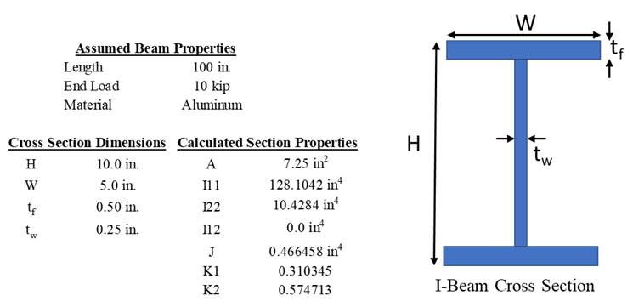
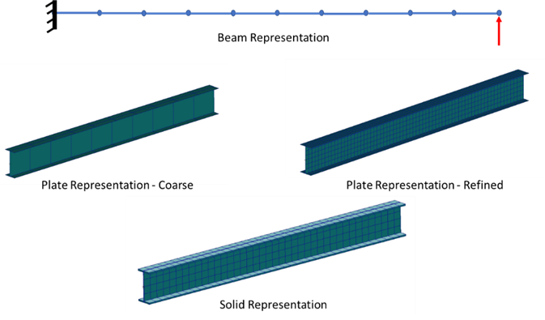
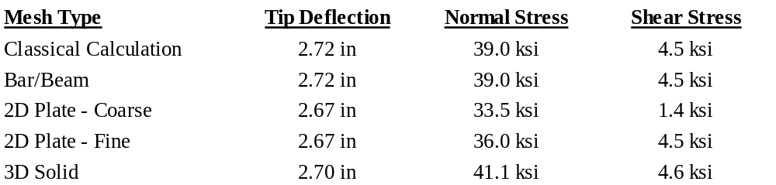
Example 1: Understanding Behavior
Differences in meshing strategy and element selection can lead to differences in results
Use simpler models or closed form solutions to study appropriate modeling strategies

Slide 8
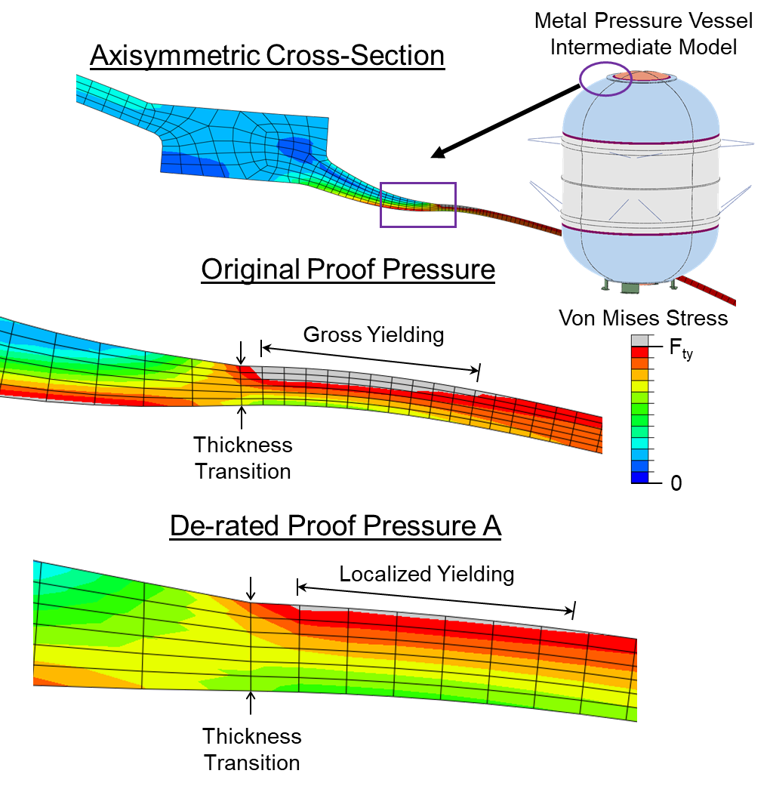
Example 2: Simplified Representations
Hardware components machined below minimum acceptable thickness
Axisymmetric modeling allowed detailed modeling in local areas of interest:
  Effects of localized yielding
  Extraction of stresses for fracture analysis
Axisymmetric modeling simplification was appropriate and adequate for information required

Slide 9
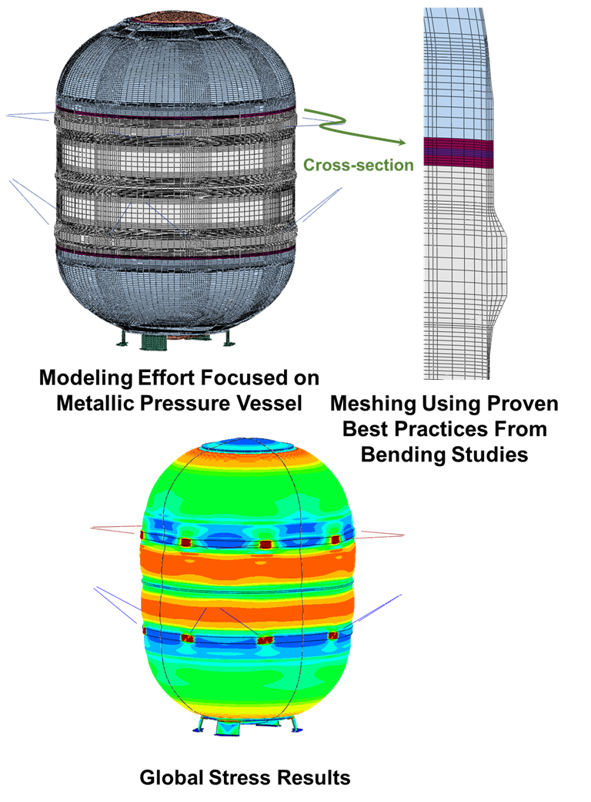
Example 3: Hybrid Modeling Approach
Strategically meshed areas of interest
  Defendable mesh fidelity
  Mesh refinement based on simple model studies
  Captured desired results
Flesh out design details
  Quick iterations to explore design space
  Important areas easily replaced with as-built hardware details
Global model validated axisymmetric assumptions

Slide 10
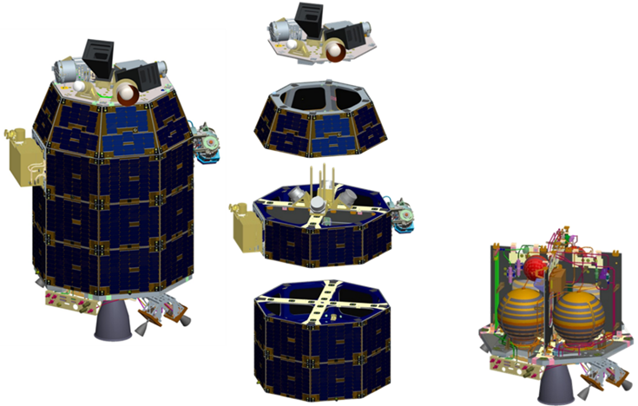
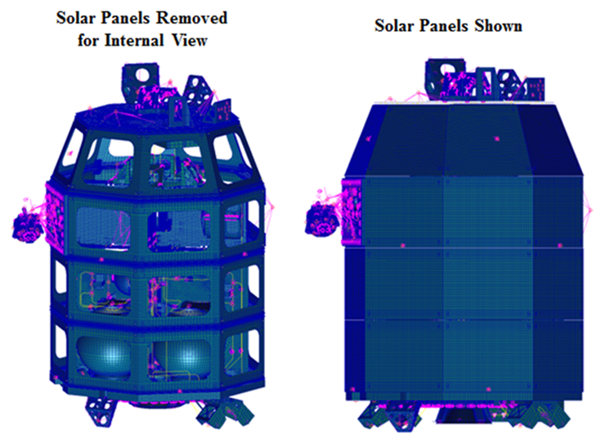
Example 4: Large Scale Implementation
?
LADEE Spacecraft
Detailed CAD Rendering
LADEE Spacecraft
Verification Model
How does one proceed from a CAD representation, perhaps with significant detail, to analytical model with simplifications (beams, springs, composite plates, mass elements, rigid connections)

Slide 11
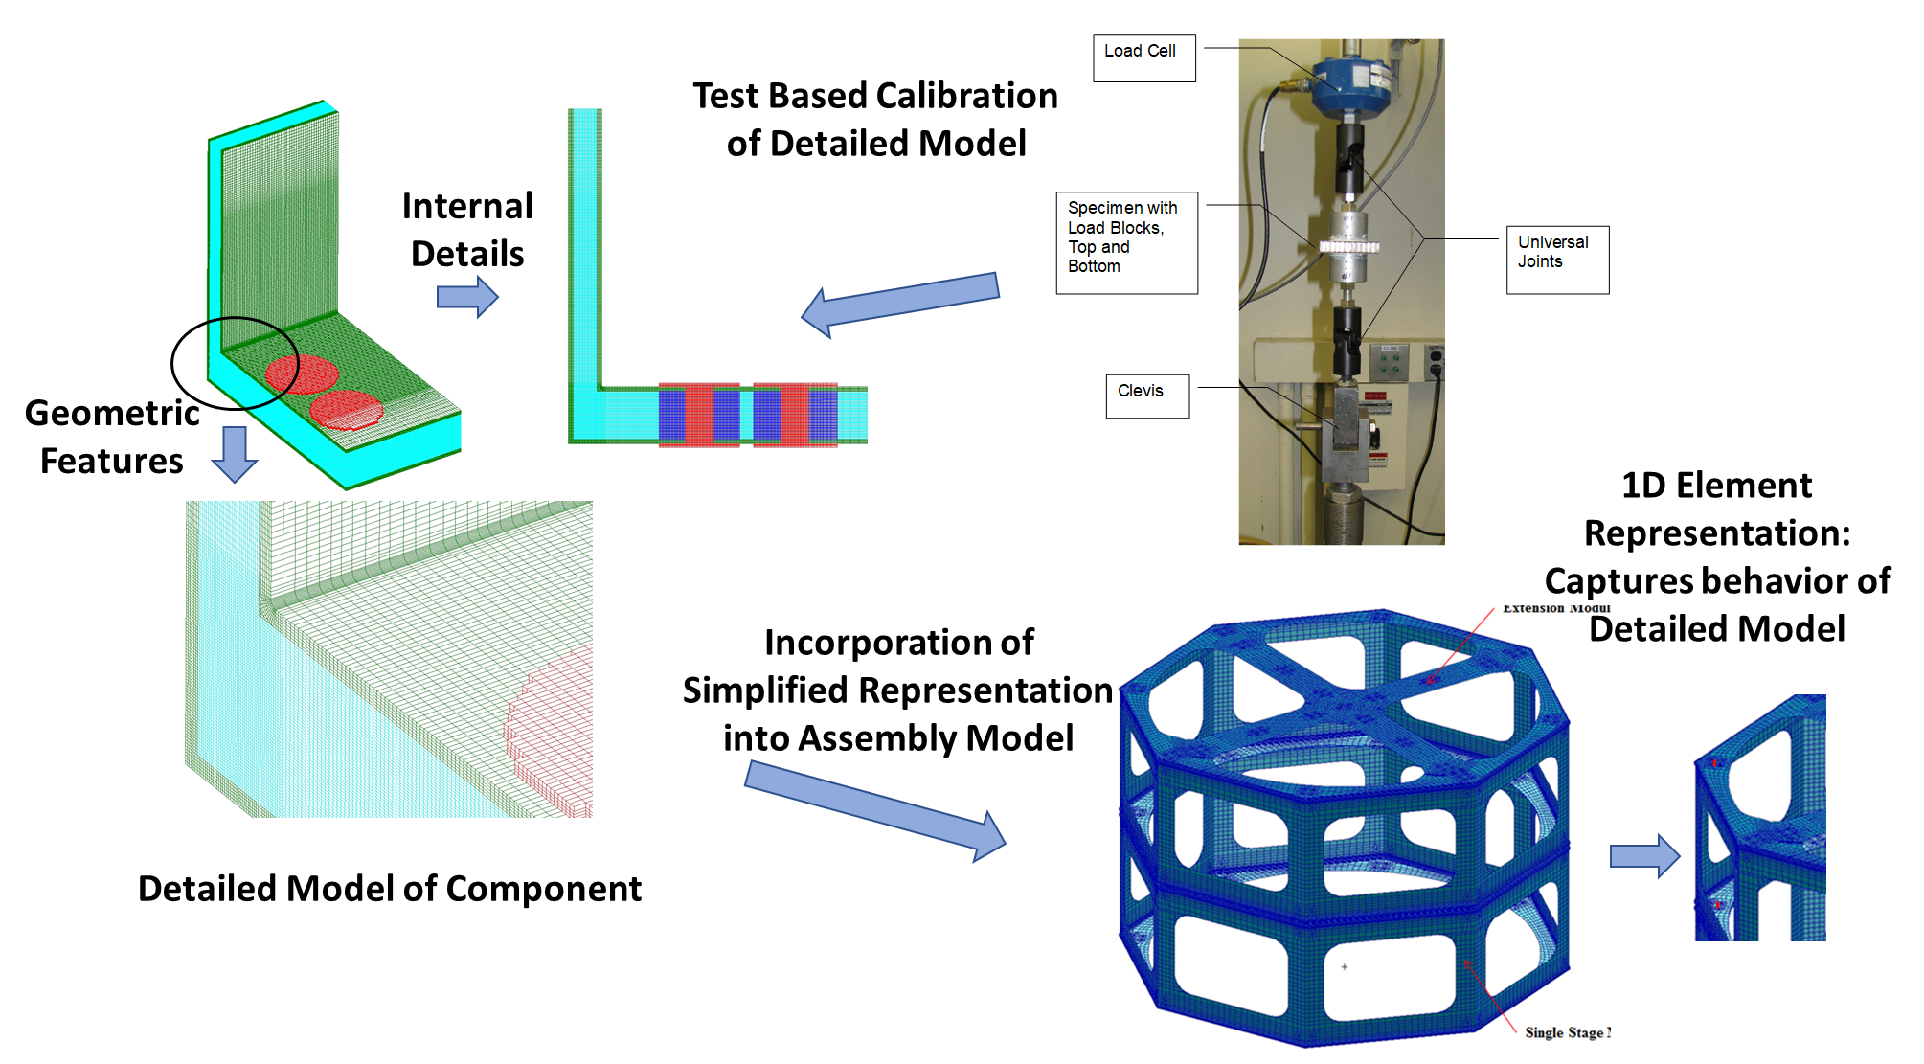
Example 4 (cont.)
Conceptual models used closed form or empirical solutions for preliminary sizing
  (Hypersizer software)
Detailed models of critical components linked to “hand” analysis or test results
Simplified representations, (non-linear springs or bars) incorporated behavior into assembly model
Assembly model output results re-inserted into component model for further analysis if needed

Slide 12
Best Practices
Use hand calculations or closed form solutions to understand effects of functional requirements (MC/I, P/A, VQ/It, pr/t, pr/2t, empirical solutions, etc.)
Use preliminary calculations to develop basic CAD models before detailed (stress) models are needed or required
Use simple models to gain understanding of modeling methods, behavior of elements, assumptions, software peculiarities, etc.
  Develop modeling practices that can be justified in more complex models. (Example 1)
Maintain simple representations where fidelity is already appropriate
  More complex meshes are harder to interrogate and validate
  e.g., to extract a bending moment from a 3D model requires adding and summing contributions at individual nodes, whereas a beam or plate element gives this information directly
Use simplified analysis techniques, such as axisymmetric modeling or symmetric/antisymmetric cuts, where appropriate (Example 2)
Consider creation of intermediate-fidelity models that are appropriate for obtaining global and some local response but are still easily modifiable (Example 3)
For complex local behavior, use detailed local models to develop characteristics which can be implemented into springs or beams for use in large assembly models (Example 4)

Slide 13
Hybrid Simulation / Virtual Testing
Virtual testing - a method that simulates lab testing using analysis software
  Coupon and sub-component lab tests done analytically, including representations of testing machines, loading, environments, etc.
  Analysis based data for stress/strain behavior, failure modes, failure loads, etc.
Hybrid Simulation - an approach of analyzing analytical models of physical structures integrated with models of test processes, combined with realistic test loading conditions and results
  Simulation of a qualification or acceptance test program on a structure through modeling and analysis instead of large number of physical tests
These type approaches open a path for reevaluation of test-based factors of safety and for streamlining certification programs

Slide 14
Conclusions
Application of building-block approaches in analysis provides a good road map for systematically analyzing a structural design
  Insight is gained on appropriate mesh density, element selection, performance aspects of the model, validation of the model form, and interactions among various parts and regions of a structure
Simplified modeling techniques can be used to gain understanding of behavior and validation of modeling assumptions
Building-Block approaches need not lead to development of full 3D representations to capture desired behavior
  Simpler representations such as 1D or 2D meshing, defeatured geometry, use of springs/bars to incorporate the stiffness and load transfer aspect of joints, and axisymmetric representations can all be used effectively and constitute an appropriate level of fidelity when used correctly
High-fidelity answers can be achieved even from simple representations

Slide 15
Thank you
Questions?

