Slide 1
Experiment Design Considerations for Longitudinal Community Noise Surveys
Kathryn Ballard, Aaron Vaughn,
Will Doebler, and Jonathan Rathsam
NASA Langley Research Center
4aNSa5
181st Meeting of the Acoustical Society of America
December 2, 2021

Slide 2

Background
X-59 Quiet SuperSonic Technology (QueSST) Aircraft
Five community tests are being planned across the US
  Community annoyance to the low-booms produced by the X-59 aircraft

Slide 3
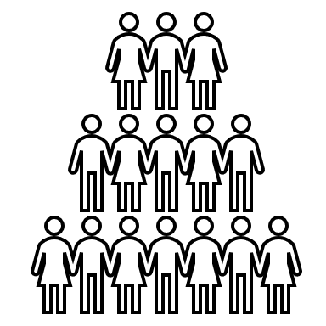

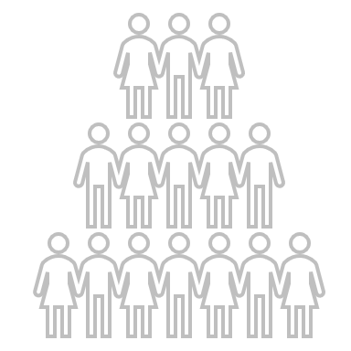

Types of Community Surveys
Cross-sectional Study
  Participants respond to one survey
  Typical community noise surveys
  Data are independent
Longitudinal (Panel) Study
  Participants respond to multiple surveys
  X-59 will make multiple overflights during the flight campaign
  Data can have dependence in measurements from the same person
Notes:
(Quickly through this slide)
Cross sectional:
Participants respond to one survey, like a snapshot in time
Typical community noise surveys (ex. FAA NES study)
Data are independent because any given data point is from a single individual responding one time, which could be somewhat less informative
Longitudinal (Panel) Study:
Participants respond to multiple surveys, which adds a time component to the data
X-59 will make multiple overflights during the flight campaign
Data can have dependence in measurements from the same person
Data for X-59 are longitudinal

Slide 4
Possible Bias in Longitudinal Studies
Carryover effect: previous stimuli affecting response to a current stimulus
Common mitigation strategy: randomize the order for each subject so that carryover effects do not confound with the effect of the treatment
Examples of potential carryover effects in community noise:
  Previous boom level affecting current response (order effect)
  Previous annoyance affecting current response (decisional carryover)
  Becoming acclimated to the low-booms over time (habituation)
  Becoming more annoyed by the low-booms over time (contrast effect)
Mitigation of carryover effects for X-59: not possible to randomize noise exposure per subject due to nature of study
Is there evidence of carryover effects in previous low-boom data?
Notes:
Because X-59 data will be longitudinal, we’re going to take a look at possible bias in longitudinal studies in the form of carryover effects
Carryover effects are where ….
Stimulus = dose, which is a sonic boom event
Carryover effects are due participants responding to multiple stimuli over time.
Common mitigation strategy is to …
Effect of the treatment, which is the dose-response relationship or annoyance to the sonic booms
Randomization difficult because same community will experience a similar dose, as the level is relatively similar across the boom carpet
Objective of this study is to analyze previous low-boom data for evidence of carryover effects in preparation for X-59 tests.

Slide 5
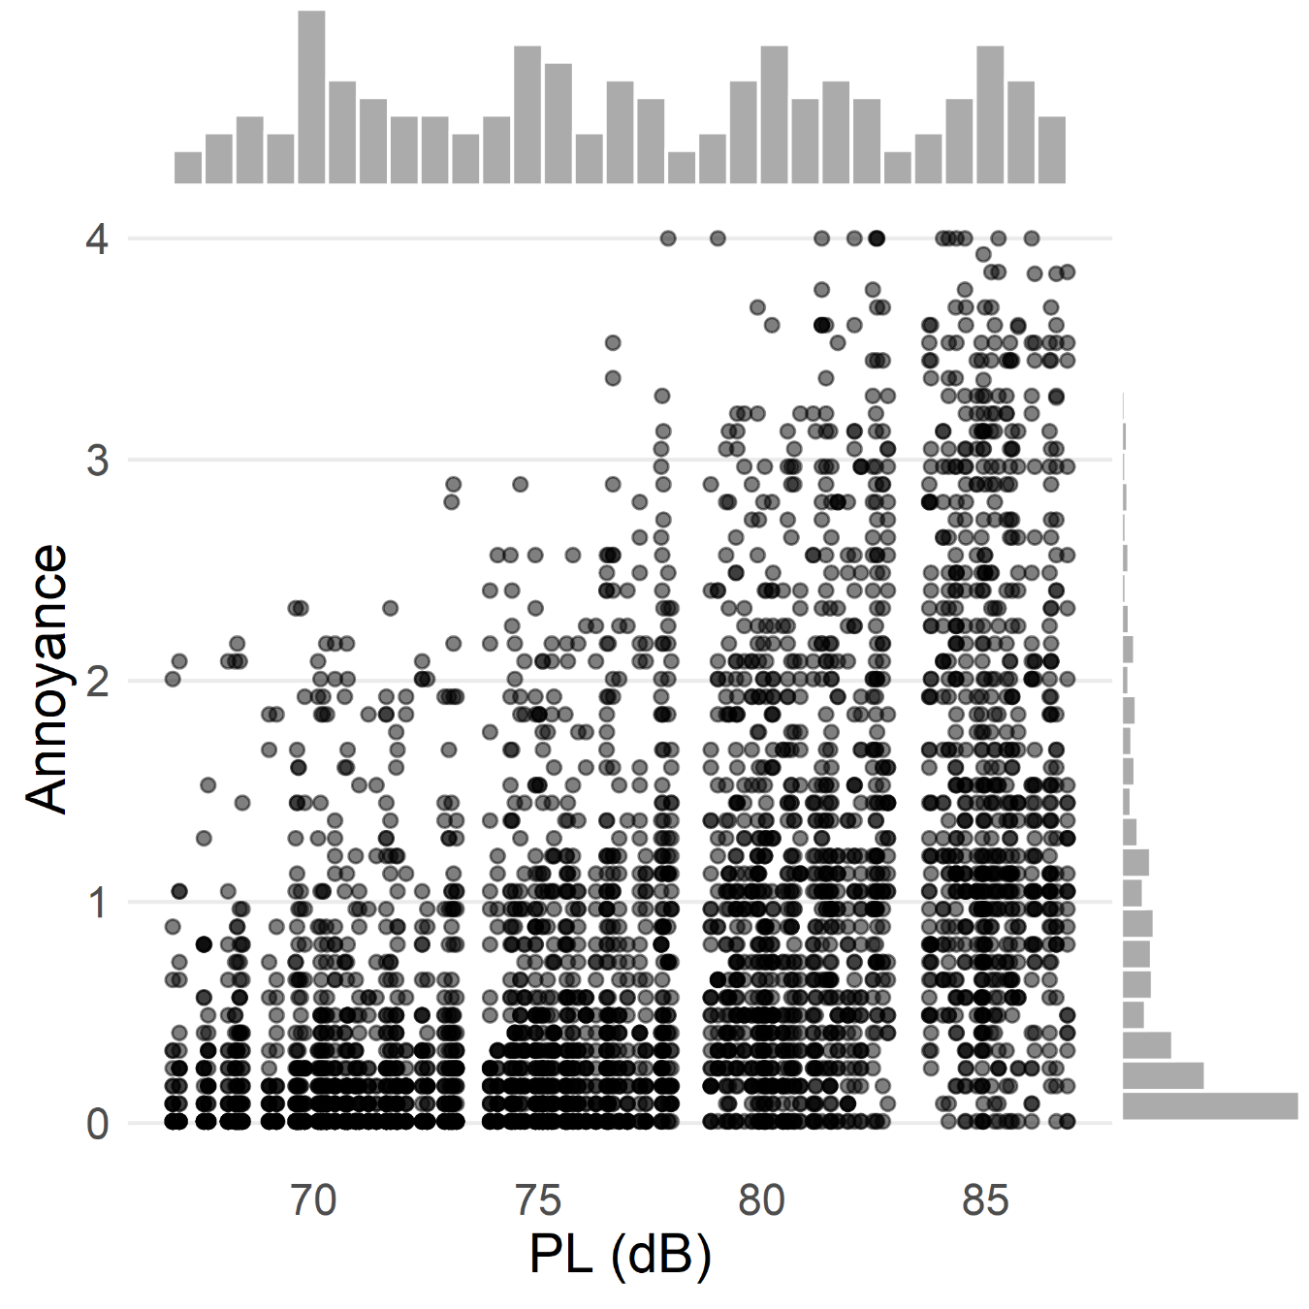
Subjective Sonic Boom Listening Test Data
Lab study conducted at NASA Langley Research Center’s indoor sonic boom simulator in 2013 (Loubeau 2015)
30 subjects
140 simulated booms (doses)
  67–87 Perceived Level (PL) dB
  10 unique order of booms
Rated annoyance on a dial:
  0 (“not at all”) to 4 (“extremely”)
Tests conducted in one sitting
  Not directly comparable to future field tests
Notes:
The dataset we are looking at comes from a lab study…
Familiarization playlist was played, and participants practiced prior to the test.
There was a break halfway through the test
3 subjects at a time
Booms were presented in somewhat quick succession
X-59 booms will be at least 15 minutes apart
Marginal histograms
Distribution of doses are somewhat random
While the annoyance responses are skewed towards 0 or “not at all” annoyed
Though this is not the same as a field test which is conducted over multiple days or weeks, it is a more controlled environment with data sufficient for analysis of carry-over effects with sonic booms as stimuli

Slide 6
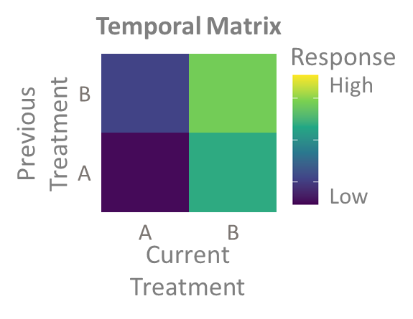
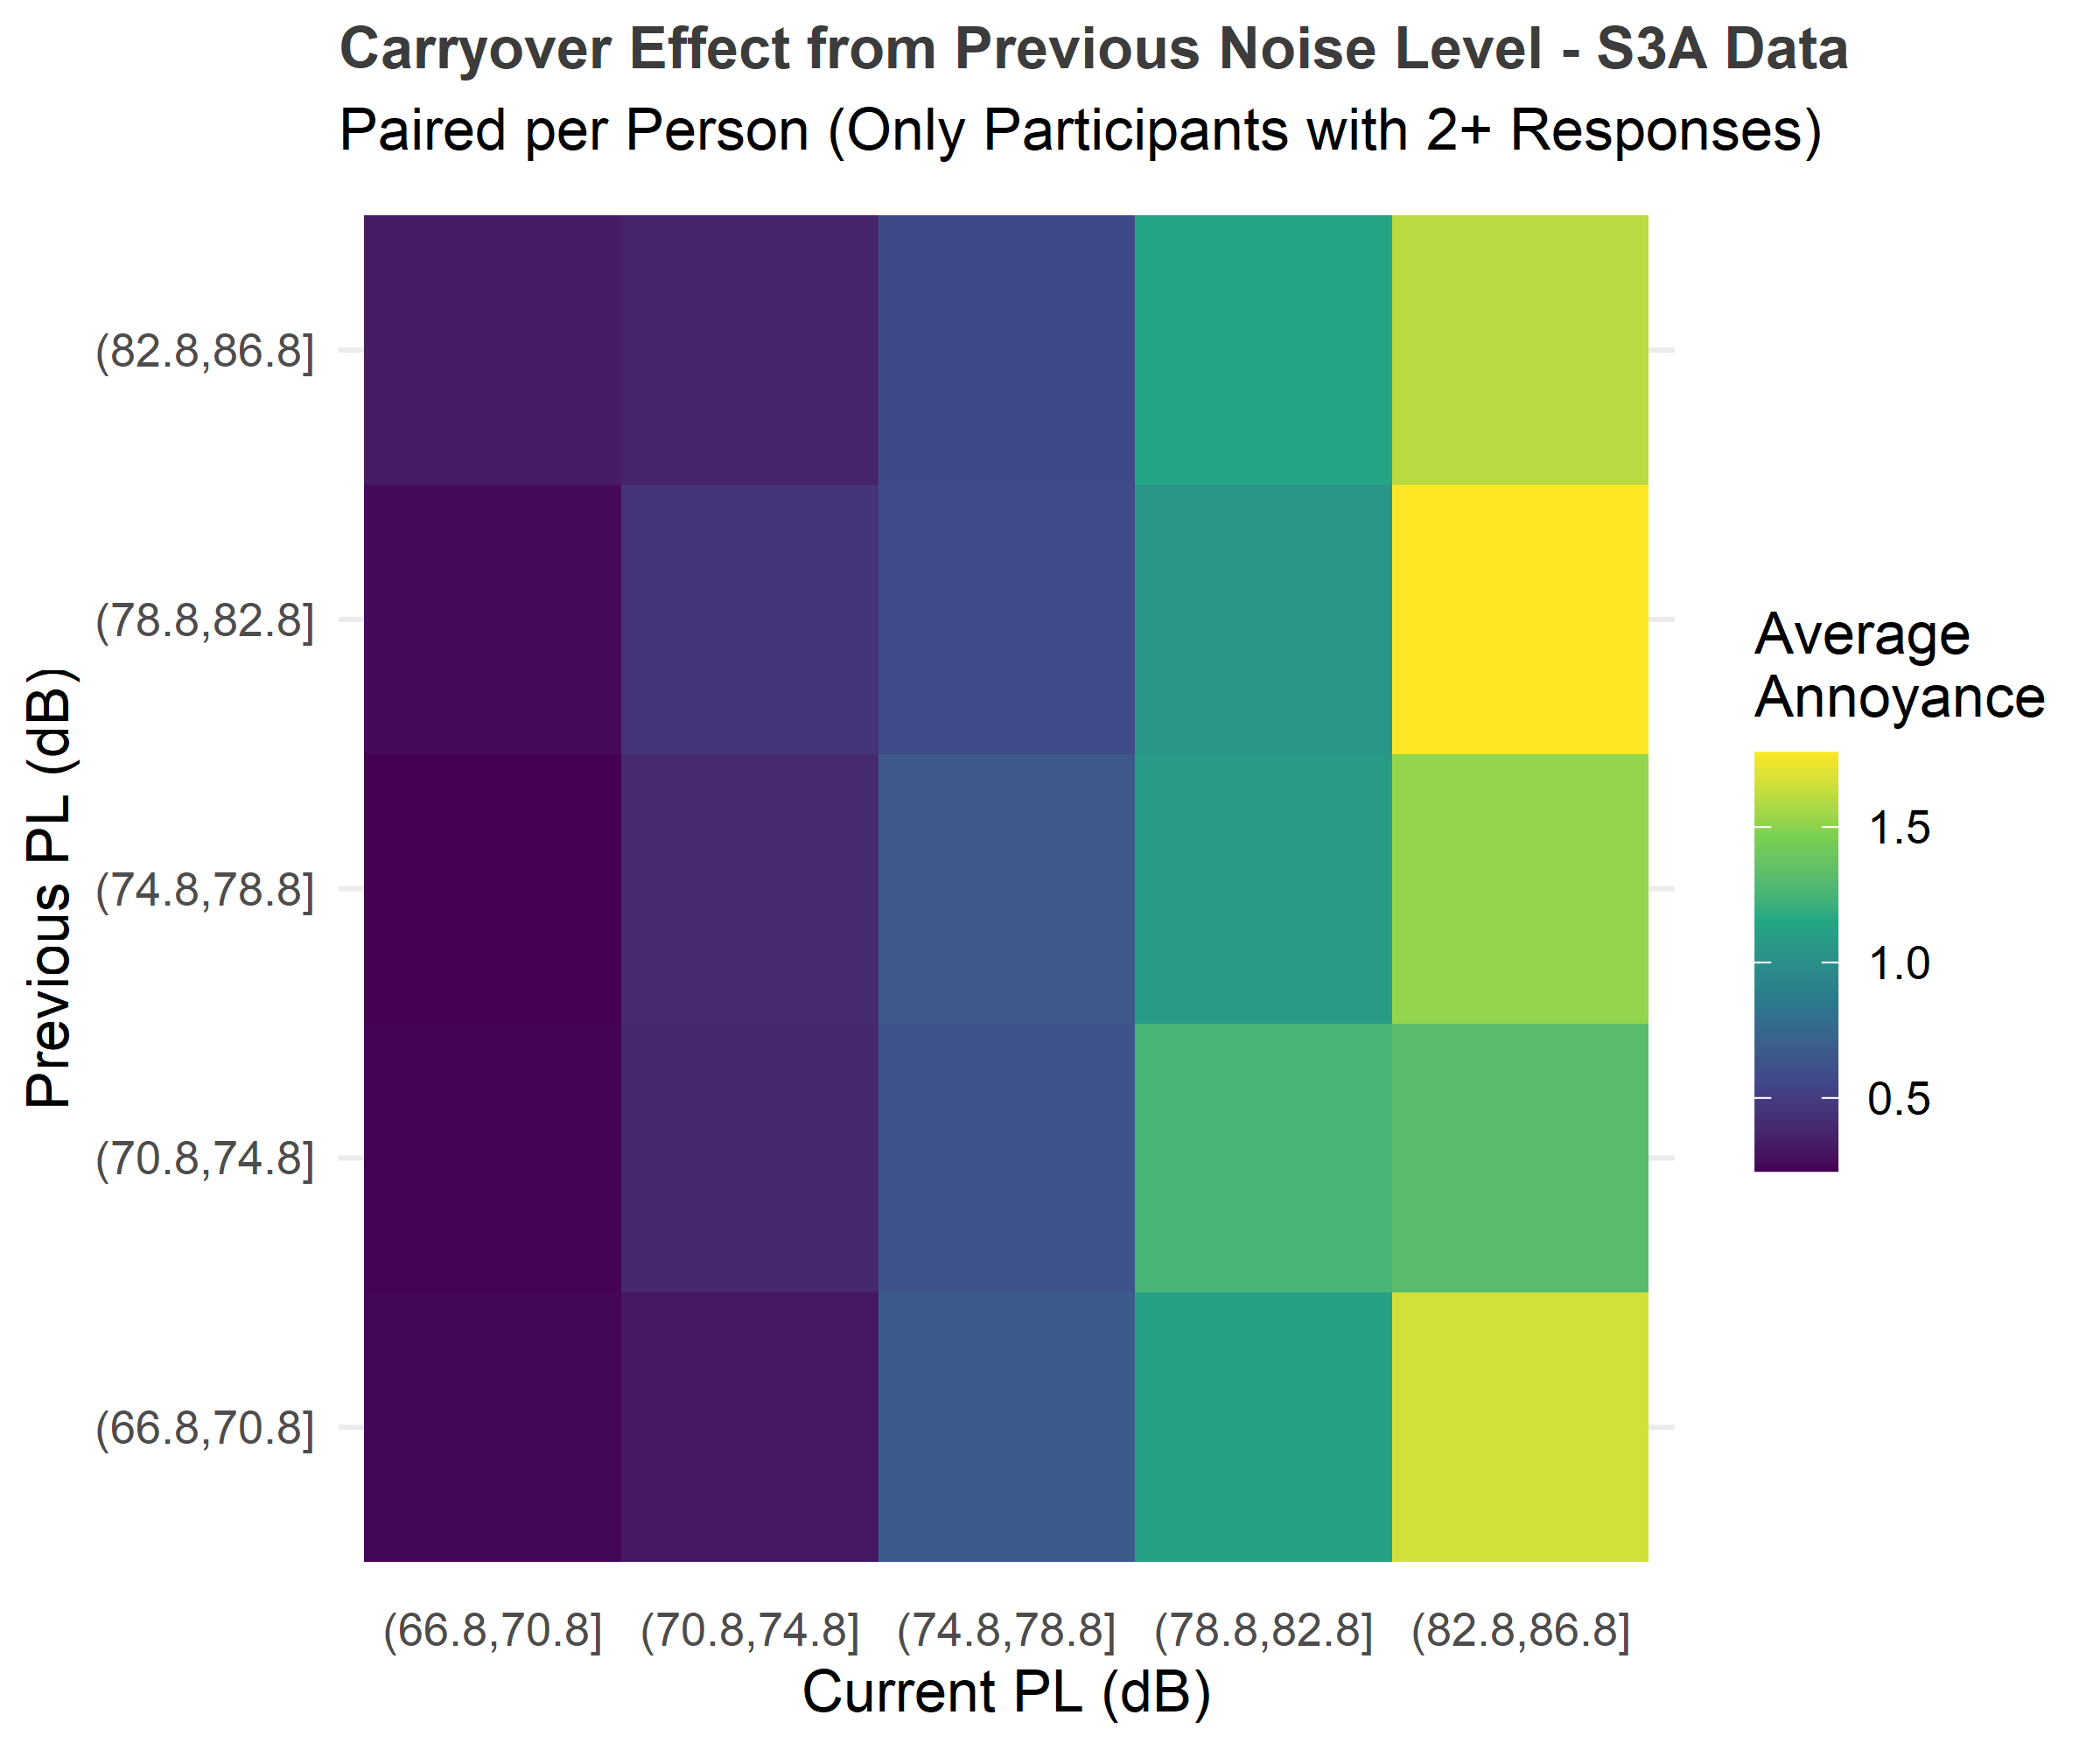
Graphical Analysis Methodology
Look for carryover effects graphically
  Wiener et al. (2014) suggested sequencing treatments with all possible orders so that direct effects can be separated from carryover effects
    Example sequence of a treatment with 2 levels, A and B: AABBA, because AA, AB, BB, and BA all occur once
    Outcomes can be plotted to show direct treatment effects and whether the previous treatment impacts the current response
Temporal Matrix
Response
B
A
 | A | B
High
Low
Previous Treatment
Current Treatment
Notes:
Our first analysis method is to look for carryover effects graphically
Wiener et al. (2014) plotted heatmaps of current outcomes by current and previous exposures
Distinguishes effect of current PL (color/annoyance increasing in columns from left to right) from any carryover effects
Direct effects = dose-response relationship
Carryover effects = impact of presentation order on dose-response relationship

Slide 7
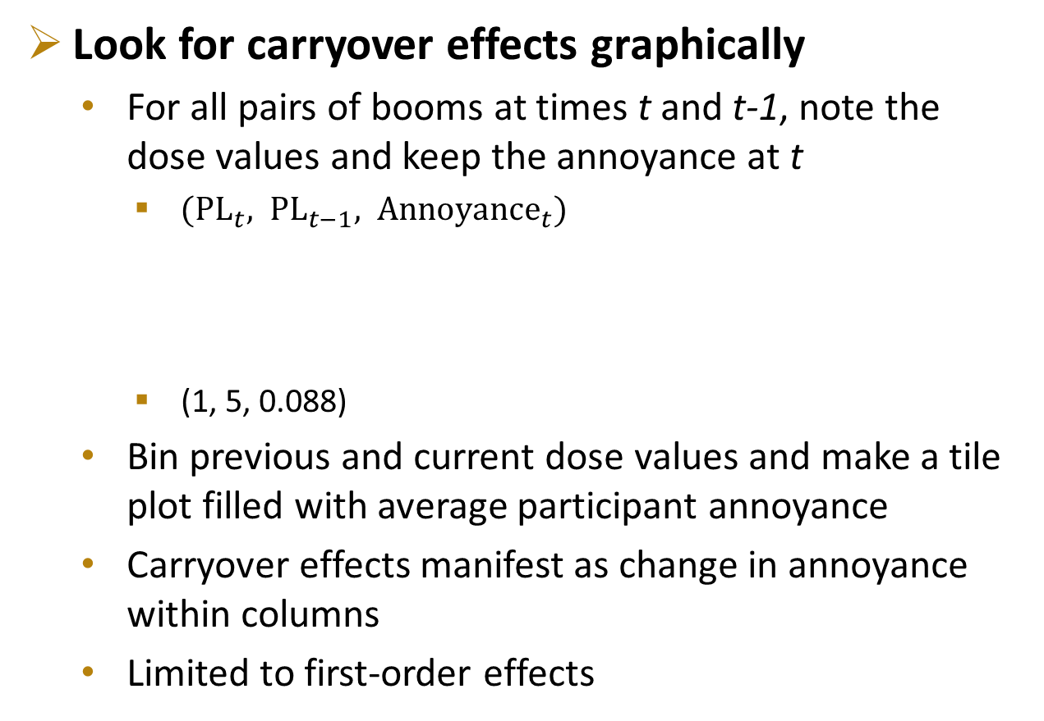
Graphical Analysis Methodology
Notional Plots
Look for carryover effects graphically
  For all pairs of booms at times t and t-1, note the dose values and keep the annoyance at t
    $({PL}_{t}, PL_{t−1}, Anno{yance}_{t})$
    (1, 5, 0.088)
  Bin previous and current dose values and make a tile plot filled with average participant annoyance
  Carryover effects manifest as change in annoyance within columns
  Limited to first-order effects
No carryover effect
Average
Current
Annoyance
5
4
3
2
1
 | 1 | 2 | 3 | 4 | 5
Previous Dose
Participant | Boom Number | Dose | Annoyance
10 | 11 (previous) | 5 | 1.288
 | 12 (current) | 1 | 0.088
Current Dose
Louder dose levels lead to higher annoyance at the next dose
5
4
3
2
1
 | 1 | 2 | 3 | 4 | 5
Average
Current
Annoyance
Previous Dose
Current Dose
Notes:
5 dose bins in temporal matrix
Average current annoyance of participants for a given previous dose, current dose pair.
Horizontal is direct effect
Vertical is carryover effect
Lab data better than field data (QSF18/WSPR) because those don’t have enough data to fill in the matrix and see trends by column

Slide 8
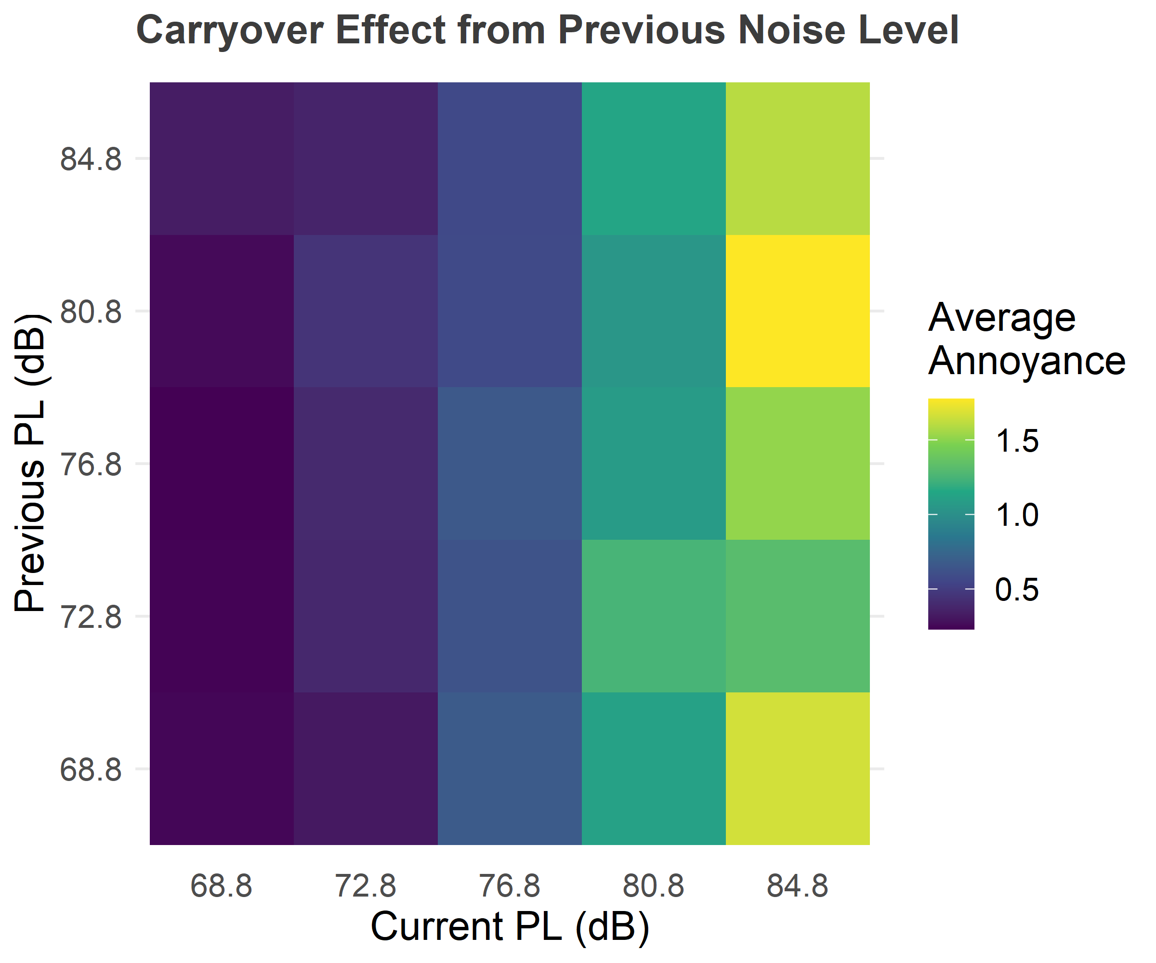
Graphical Analysis Results – Previous Dose
Annoyance increases as current dose increases (horizontal trend)
  Expected direct effect
Previous dose does not appear to affect the current annoyance (vertical trend)
  No carryover effect
Lab Data Results
85
Average
Current
Annoyance
81
77
73
69
69
73
77
81
85
Notes:
Average Current Annoyance: 0 – 1.75
Doses in PL (dB) noted by midpoint of the bin
No real discernable vertical pattern indicative of carryover effect
Horizontal is direct effect
Vertical is carryover effect

Slide 9
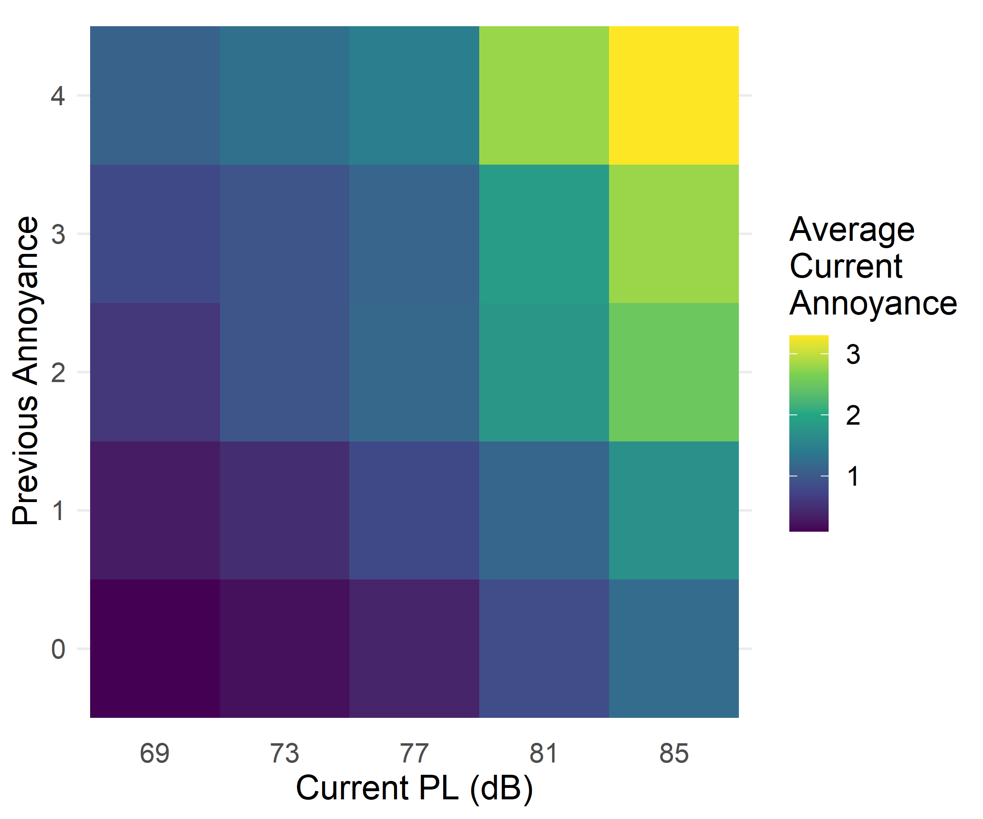
Graphical Analysis Results – Previous Annoyance
Similarly, previous annoyance ratings can be used in place of previous dose
Annoyance increases as current dose increases (horizontal trend)
  Expected direct effect
Previous annoyance does appear to affect the current annoyance (vertical trend)
  Decisional carryover
Lab Data Results
Notes:
Average Current Annoyance: 0 – 3.3?

Slide 10
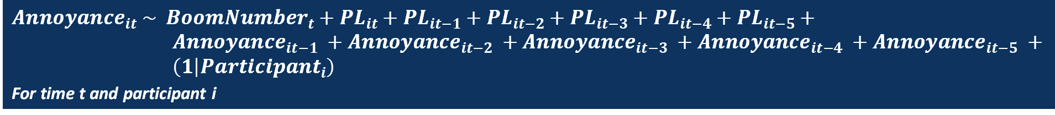
Regression Analysis Methodology
Look for carryover effects with regression modeling
  Model annoyance as a function of lagged noise exposure
    Can go beyond first order effects of PL and even include past responses
      Ward (1973) found that the response to auditory stimulus in a magnitude estimation situation assimilated to the values of the stimuli as far as five trials back
    Can include time in the model (boom number ranges 1-140) to look at habituation or contrast effect
  Use a mixed-effect model to account for person-to-person differences
  Use a generalized linear mixed model (GLMM)
    Gamma family used since annoyance is skewed towards 0
  Test significance of terms and remove until a suitable model is reached
$${Annoyance}_{it} \sim {{BoomNumber}_{t}+PL}_{it}+{PL}_{it−1}+{PL}_{it−2}+{PL}_{it−3}+{PL}_{it−4}+{PL}_{it−5}+$$
${Annoyance}_{it−1} +{Annoyance}_{it−2} +{Annoyance}_{it−3} +{Annoyance}_{it−4} +{Annoyance}_{it−5} +$
$\left(1 | {Participant}_{i}\right)$
For time t and participant i
Notes:
Look beyond first order effects, how far back do you go?
While this model produces trends for each individual, we will be looking at overall trends

Slide 11
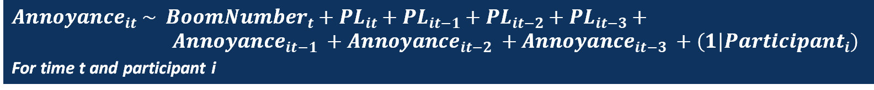
Regression Analysis Results
Final Gamma GLMM model fit contains these terms:
  Noise level of booms occurring 4 and 5 runs before the current one did not affect current annoyance
  Annoyance ratings for the 4th and 5th previous booms also did not affect current annoyance
$${Annoyance}_{it} \sim {{BoomNumber}_{t}+PL}_{it}+{PL}_{it−1}+{PL}_{it−2}+{PL}_{it−3}+$$
${Annoyance}_{it−1} +{Annoyance}_{it−2} +{Annoyance}_{it−3} +\left(1 | {Participant}_{i}\right)$
For time t and participant i

Slide 12
Regression Analysis Results
Final Gamma GLMM model effects
  Current PL value has large positive effect on current annoyance
  Up to 3 previous booms have a small negative effect on current annoyance
  Up to 3 previous responses have a large positive effect on current annoyance
  As the study progressed, there was a very small increase in annoyance
Fixed Effect | Estimate | Std. Error | P-value
PL_{t} | 1.18 | 1.003 | < 0.001
PL_{t-1} | 0.99 | 1.004 | 0.002
PL_{t-2} | 0.98 | 1.004 | < 0.001
PL_{t-3} | 0.99 | 1.004 | 0.001
Annoyance_{t-1} | 1.22 | 1.032 | < 0.001
Annoyance_{t-2} | 1.10 | 1.030 | 0.001
Annoyance_{t-3} | 1.07 | 1.030 | 0.015
Boom Number | 1.001 | 1.000 | < 0.001
Notes:
Estimated Coefficients: if all others held constant (which is not technically possible with each variable since they are lagged versions of each other), a one unit increase in X yields a percent increase/decrease in annoyance
PLt: Annoyance increases with louder booms – each increase in 1 PL leads to an 18% (comes from 1.18) increase in annoyance
PLt-1,2,3: increasing previous booms have a small shrinking effect on annoyance (decrease of 1-2 percent)
Annoyt-1,2,3: 7 to 22% increase in annoyance when previous annoyance rating increases
As the study went on, annoyance rose a tiny amount (<1%)
${PL}_{t}$ and Annoy t-1 have the largest effects
Lab data as a surrogate for field study
Statistically significant, but not sure of the practical or operational significance
PS – if it comes up, the standard errors are likewise percentages, so the standard error around PL_t is 0.3%, or around Annoy_t-1 its 3.2%

Slide 13
Conclusion
A series of longitudinal community noise surveys are being planned starting in 2024 using the X-59
Longitudinal data (multiple responses per person) can lead to bias due to carryover effects
Reanalyzed lab data shows some evidence of previous boom doses and previous annoyance responses affecting current annoyance responses
  How relevant or impactful are these results to X-59 tests?
Experimental design consideration for X-59 community tests:
  Noise doses should vary over time and capture many orders of doses so that direct effects can be differentiated from possible carryover effects (AABBA)
Notes:
How do these ‘continuous’ annoyance trends translate to a discrete scale?
Does a 20% change in your continuous annoyance rating up it to the next category on a discrete scale?
How does the time scale difference factor in. Participants in the lab study responded to booms 10-15 seconds apart, the shortest duration between booms for X-59 will be 15 minutes apart.

Slide 14
Questions?

Slide 15
References
Loubeau, A. (2015). Supporting the FAA and ICAO in Developing Proposed Sonic Boom Standards [Conference presentation]. Acoustics Technical Working Group Meeting, Cleveland, OH, United States.
Ward, L.M. (1973). Repeated magnitude estimations with a variable standard: Sequential effects and other properties. Perception & Psychophysics, 13, 193-200.
Wiener, M., Thompson, J., & Coslett, H. (2014). Continuous Carryover of Temporal Context Dissociates Response Bias from Perceptual Influence for Duration. PLoS ONE, 9.

Slide 16
Abstract
NASA is planning community noise surveys in the coming years to collect data that might enable the return of overland supersonic flight. Community noise surveys are typically cross-sectional, with only a single response per respondent. However, to determine community response to individual supersonic overflights, longitudinal surveys with repeated responses per respondent are more practical. The downside of repeated responses is the potential for response bias, such as a carryover effect in which previous test conditions affect current behavior. Subjective sonic boom listening test data collected at NASA Langley Research Center were reanalyzed to look for evidence of carryover effects. Initial results do not suggest strong carryover effects. This presentation will provide results and suggestions for experiment design of future community surveys.

