Slide 1
FMEA/CIL 201
RAMS Training Summit
Paul britton nasA
Gwyer Sinclair NASA
Ryan Deters Bastion Technologies

Slide 2
FMEA/CIL Skills
Who will be good at FMEA?
Analytical, Methodical, Skeptical, Imaginative
Notes:
Done forget the purpose of FMEA/CIL.

Slide 3
FMEA/CIL scope
FMEA/CIL is a powerful design-analysis tool (and communication tool)
What are the reliability and safety expectations?
Risk understanding and acceptance
Design influence
FMEA is bottoms-up. Where is the bottom? Where is the top?
What should be the boundaries of the analysis?
Initial Criticality Assessment
Are there down stream requirements that depend on FMEA/CIL results?
Notes:
How to scope to achieve objectives.
Communication tool: failure space analog to engineering drawings.
System boundaries vs Environment
Exceptions and ICA Triage (needs sound rationale)
Producing documentation is more than a paper weight.

Slide 4
Terminology
Integrated Vehicle Level
Next Higher Assembly Level
Item under Analysis
Immediate
Effect
Next
Effect
End
Effect
The FMEA intends to identify all failure modes at the bottom level and to categorize the worst-case severity of the end effect by determining the worst-case Criticality of each failure mode.
The bottom. Example 1: hardware level = individual components or circuit paths. Example 2: functional level = LRU or box level. The intent is to drive reliability and safety into the architecture, testing, operations and detailed design as earlier as possible.
Notes:
FMEA/CIL influence is limited by the bottom level of the analysis.
Worst-case vs likelihood vs probabilistically defined environments.

Slide 5
More Terminology
Failure Mode
(End) Effect
Cause
Failure Mode
Cause
(Next)
Effect
Failure Mode
Cause
(Immediate)
Effect
Next Higher Assembly Level
Integrated Vehicle Level
Item under Analysis
Item under Analysis
Item under Analysis
Notes:
Get on the same page with failure scenarios. Failure Modes identify a reference point within a chain of events.
Supplier perspective terminology.

Slide 6
Fmea/cil Use-Cases
Criticality can help inform risk-based decisions
Design influence
Test and Inspection influence
Support down-stream analysis and requirements
Notes:
Dispositioning waivers or NC.
Add redundancy or design controls.
Criticality as criteria.
FMEA/CIL approach -> use-cases -> objectives.

Slide 7
CIL Worksheet Fields
FMEA Worksheets
Prepared by Information
Hardware Information
Item Name, Part Number, Schematic ID, System Location, etc
Item Function Description
Failure Mode
Failure Causes
End Failure Effect by Phase or Operational Mode
Worst Case Criticality
Failure Detection
Failure Detection, Software Response, Corrective Action
Retention Rational
Design, Test, Inspection, Failure History
References
Operational Requirements, Hazard Reports, Supplier FMEA, Other related databases
CIL Worksheets
Notes:
Talk use cases here.

Slide 8
Questions

Slide 9
Criticality Definitions
Criticality
1
1S
1R
3
Definition
Failure that could result in loss of life or vehicle
Failure in safety or hazard monitoring system that could prevent system from detecting a hazardous condition or fail to operate during such condition
Redundant hardware that, if all failed, could cause loss of life or vehicle
Failure that could cause degradation to mission objectives

Slide 10
CiL Retention rationale
Retention rationale consists of controls to minimize the risk associated with the critical item
Design
Manufacturing controls, safety factors, unique physical characteristics
Tests
Identify specific tests performed that would detect presence of failure
Inspections
Identify specific Inspections performed that would detect presence of failure
Failure History
Summary of all previous occurrences and actions taken
Operational Use
Description of operations to mitigate or limit effect
Malfunction Procedures, Operating Constraints, Crew Training
Notes:
Talk relevant use cases here.

Slide 11
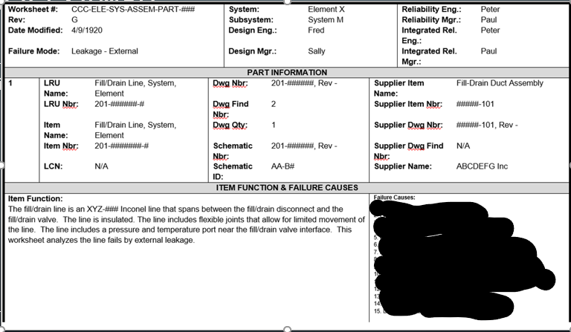
FMEA Example

