Slide 1

  Overview of Predictive Simulation Capability Development for Crater Evolution and Ejecta in Continuum/Rarefied Flows
  Andrew Weaver
  Geocent,
  Jacobs Space Exploration Group
  William Krolick
  CFD Research Corporation,
  Jacobs Space Exploration Group
  Peter Liever
  CFD Research Corporation,
  Jacobs Space Exploration Group
  Jeff West
  NASA MSFC
  Fluid Dynamics Branch (MSFC-ER42)
  2022 AIAA SciTech Forum, Jan. 3–7, 2022
  This material is a work of the U.S. Government and is not subject to copyright protection in the United States.

Slide 2
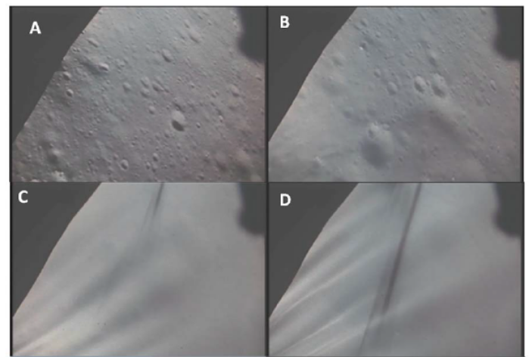
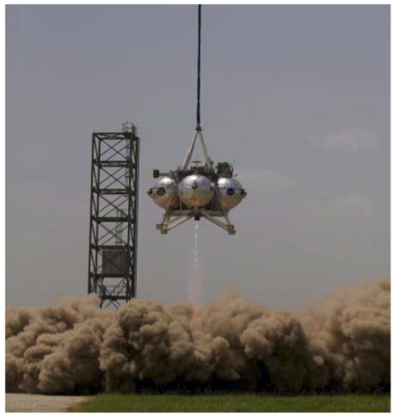
Introduction
Plume surface interaction (PSI) induced environments poses several risks to future Lunar and Martian landers:
  Forming a crater below the lander – potentially causing excessive tilting of the lander
  Obscuring view of surface below lander
  Eroding surface, potentially causing high-speed ejecta/debris impacts to the vehicle or nearby assets
Predictive Simulation Capability (PSC) being developed in 4 separate tasks to accurately and reliably predict PSI in Martian and Lunar environments:
PSC Tasks:
Plume flow in low pressure environment
Effect of continuum/rarefied flow on crater development and ejecta sheets
Regolith particle phase modeling
Gas/particle interaction modeling
Apollo 15 LEM camera views showing progression of plume-regolith interaction resulting in high speed particle sheets obscuration. (Immer et al., 2011¹)
Regolith dust cloud formation during Morpheus lander plume impinging on Mars simulant (Morpheus, 2013)
(The entire vehicle was obscured within ≈1 second)

Slide 3
Introduction: Crater and Ejecta Simulation Capability
Development of new predictive simulation capabilities involves:
  Implementation of needed capability into predictive simulation tool, Loci/GGFS
  Solution verification of newly implemented capabilities (axisymmetric, overset/moving mesh, multi-species)
  Predictive tool maturation through demonstrations on production-level simulations (3D Apollo LM)
  Validation of predictive tool against PSI data in relevant environments (Axisymmetric/3D Martian and Lunar)
Focus of this presentation

Slide 4
Predictive Simulation Capability Development

Slide 5
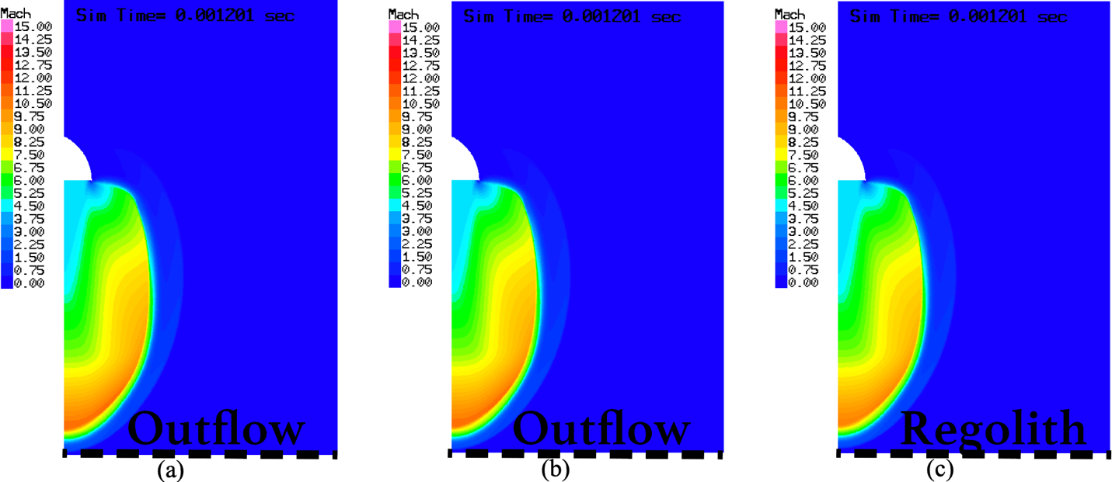
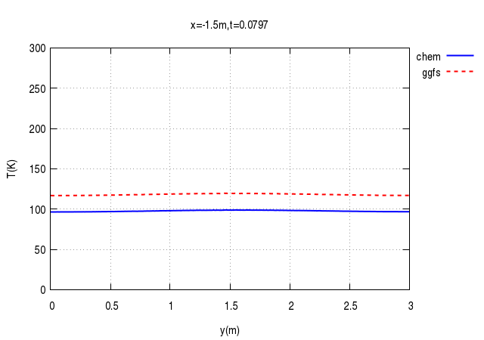
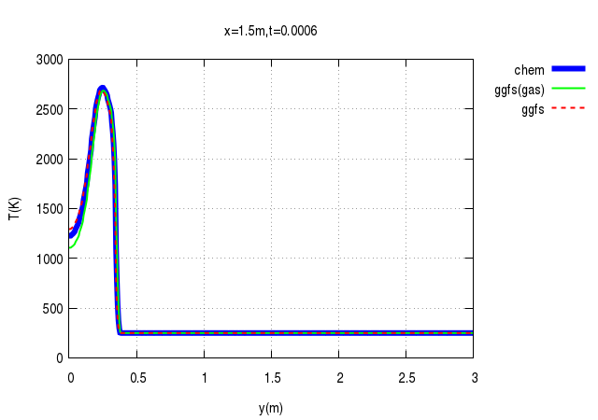
PSC Development: Axisymmetric Modeling
Axisymmetric model implementation useful for its computational efficiency
Good agreement overall between Loci/CHEM and Loci/GGFS, with and without regolith
Loci/GGFS predicting similar flow properties as Loci/CHEM, with max. differences of 10%-20% in temperature at:
  Upstream ambient region at late flow times
  Near symmetry axis at early times during initial transient
Loci/GGFS w/Regolith
Loci/GGFS
Loci/CHEM
Verified same flow properties overall with axisymmetric model
T (K)
T (K)

Slide 6
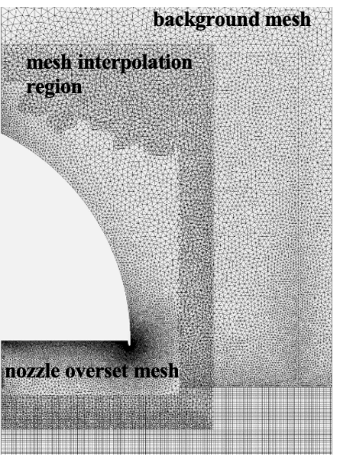
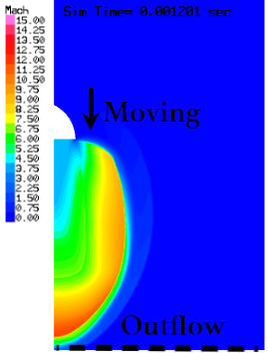
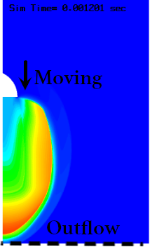
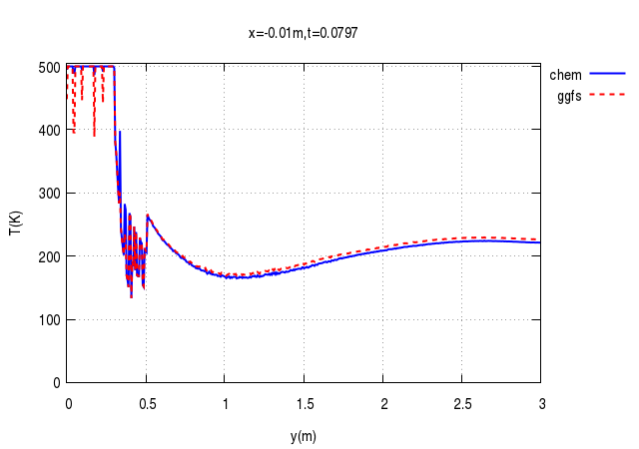
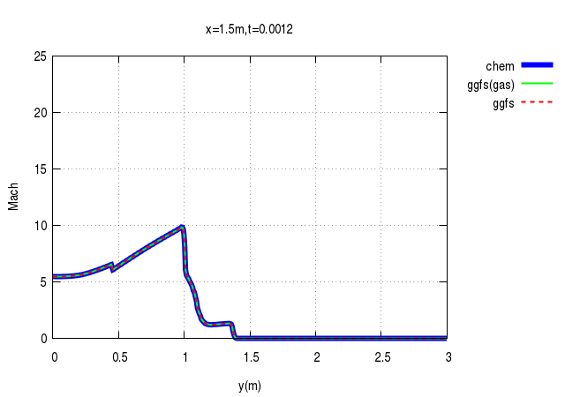
PSC Development: Overset Mesh/Moving Mesh
Overset moving mesh allows for simulation of landing vehicle during descent
Good agreement overall between Loci/CHEM and Loci/GGFS both with and without a descending nozzle
Mach number and temperature profiles compare well between Loci/GGFS and Loci/CHEM, verifying its implementation
Agreement is worse (~10%) in upstream ambient region and near nozzle exit – likely due to differences in interpolation
Loci/GGFS
Loci/CHEM
T (K)
Mach
Verified same flow properties overall with overset moving mesh

Slide 7
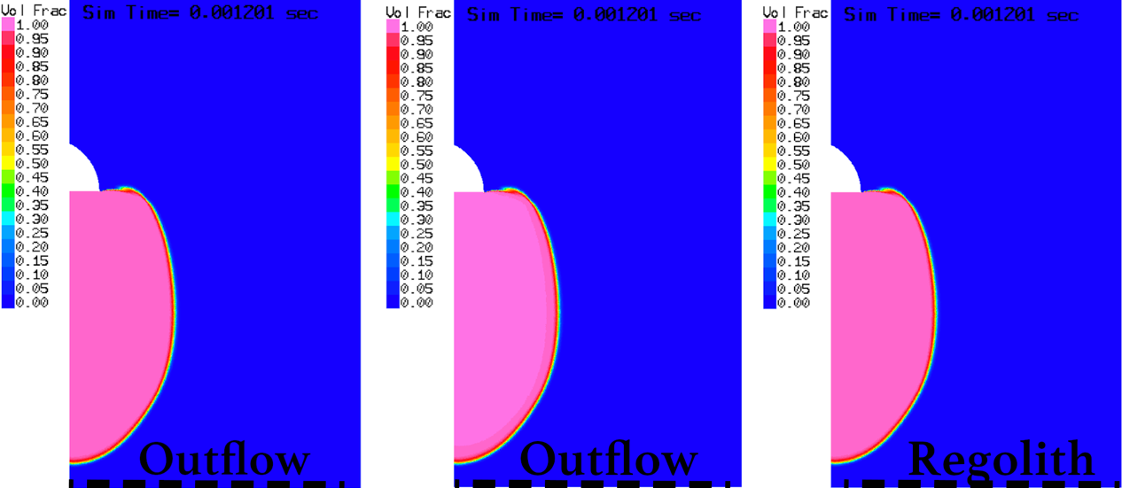
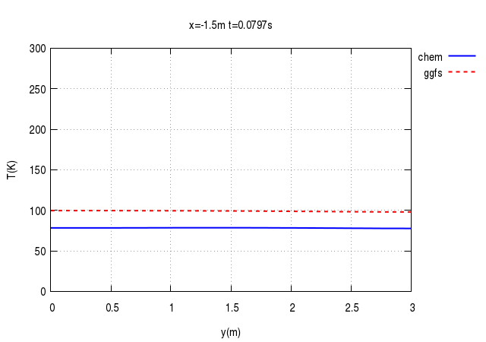
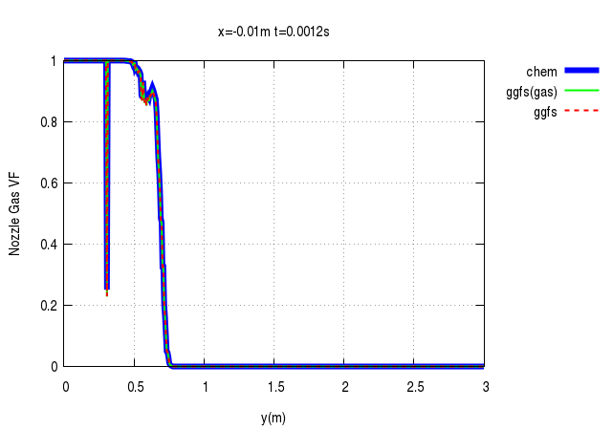
PSC Development: Multi-Species Mixture Modeling
Multi-species gas mixture modeling adds physics to simulate realistic gas mixtures and species transport
Good agreement overall between Loci/CHEM and Loci/GGFS both with/without regolith
Mach number and nozzle gas volume fraction profiles compare well, verifying its implementation
Similar trend as before, worst agreement in ambient region upstream of nozzle
Loci/GGFS w/Regolith
Loci/GGFS
Loci/CHEM
Verified same flow properties overall with multi-species mixture
T (K)
Nozzle Gas Vol. Fraction

Slide 8
Demonstration of Cratering Simulation Capability (Apollo LM)

Slide 9
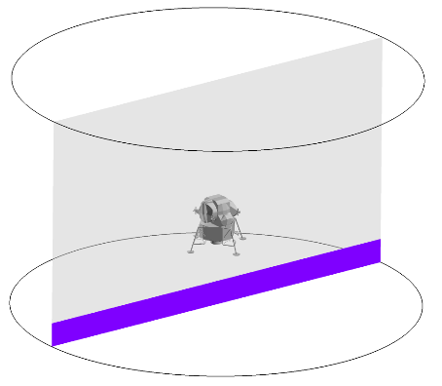
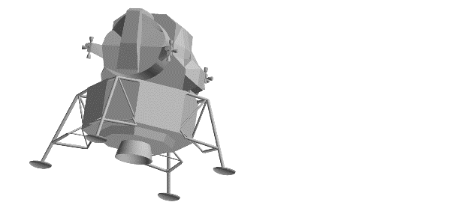
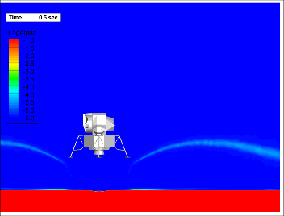
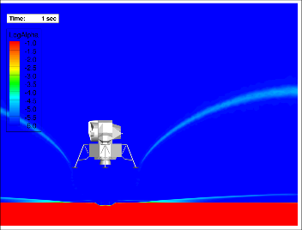
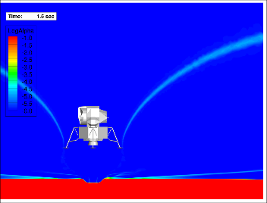
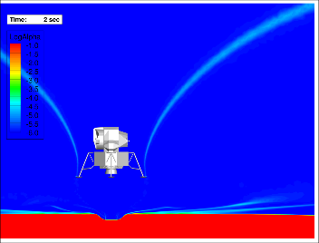
PSC Demonstration: Apollo LM
3D cratering simulation of Apollo LM at 5m altitude relative to nozzle exit plane
Low-angle (5-10 deg.) ejecta in streaking pattern like observed in actual landing footage
Simulation resulted in deeper than observed crater, but using monodisperse spheres instead of realistic, non-spherical, polydisperse particle mixtures
Apollo 15 LEM footage
(Immer et al., 2011¹)
Demonstrates capability to perform practical, full resolution, 3D, production level PSI simulations in Lunar environment
Low-Angle Streaks

Slide 10
Validation Analyses of Surface Cratering in Martian and Lunar-Like Environments

Slide 11
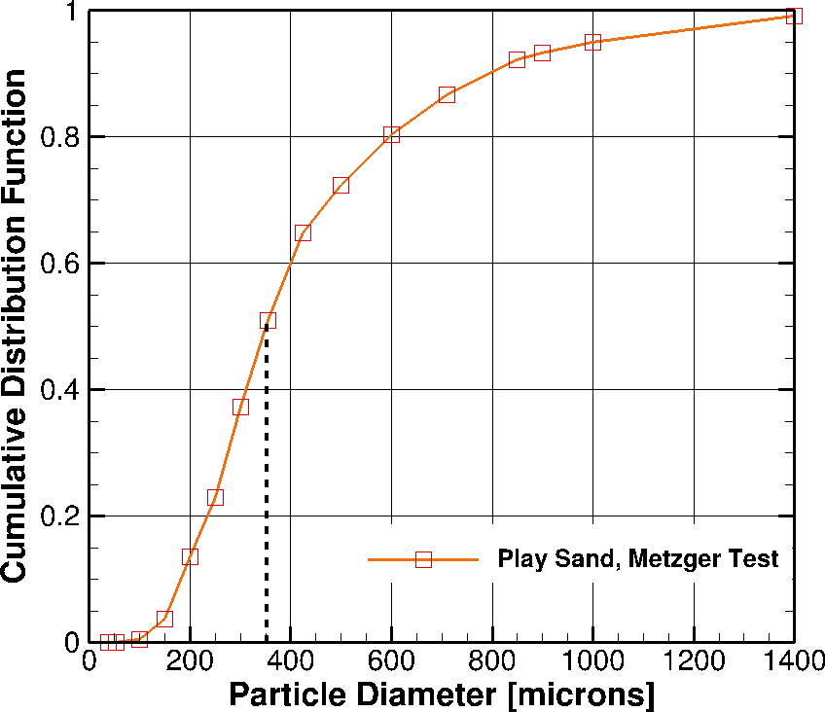
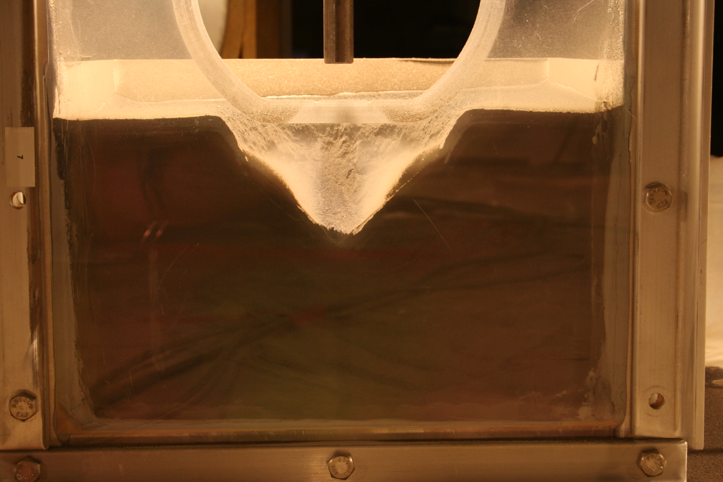
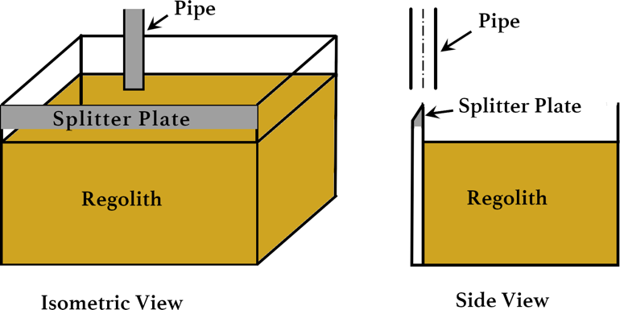
PSC Validation: Subsonic Pipe Flow (Martian)
Particle Size Distribution*
First test for validation is from Metzger’s² subsonic pipe flow in Martian-like environment:
  Velocity of 138 m/s
  Pipe height above undisturbed regolith is 1 in
  Mass flow rate of 8.82 g/min
  Vacuum chamber pressure of 9.8 Torr (1300 Pa)
  Jetty Park Beach Sand (distribution shown at right)
Modeling axisymmetric (no splitter plate) and with 353 micron monodisperse spheres
Mean Particle Diameter
2.54 cm
*Particle size distribution and cratering image from private communications with P. Metzger
Metzger 2016 Cratering Test*

Slide 12
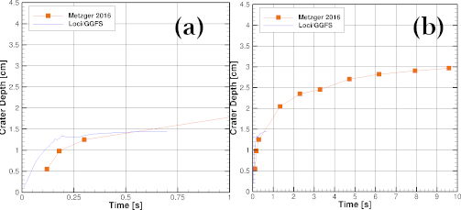
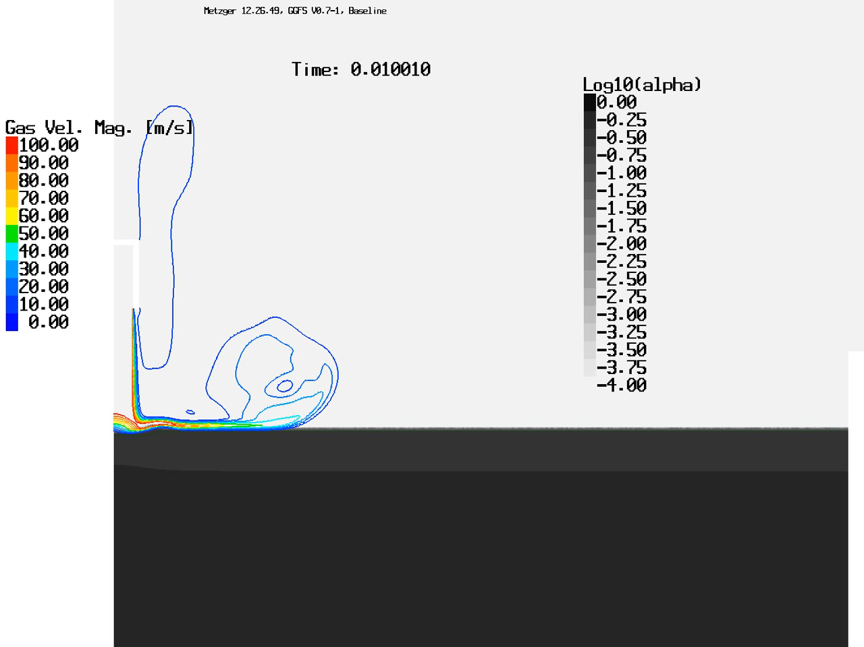
PSC Validation: Subsonic Pipe Flow (Martian)
Similar initial crater growth rates between Loci/GGFS simulations and data
At ~0.15 s, ejected soil recirculated back into crater and obstructs gas flow path
  Crater depth begins to oscillate over time and asymptote to ~1.5 cm
Preliminary assessment from 3D simulations (shown next) indicates splitter plate reduces/eliminates this recirculation feature
Similar Initial Rates
Current status assessed, continue to revisit as predictive tool develops and matures

Slide 13
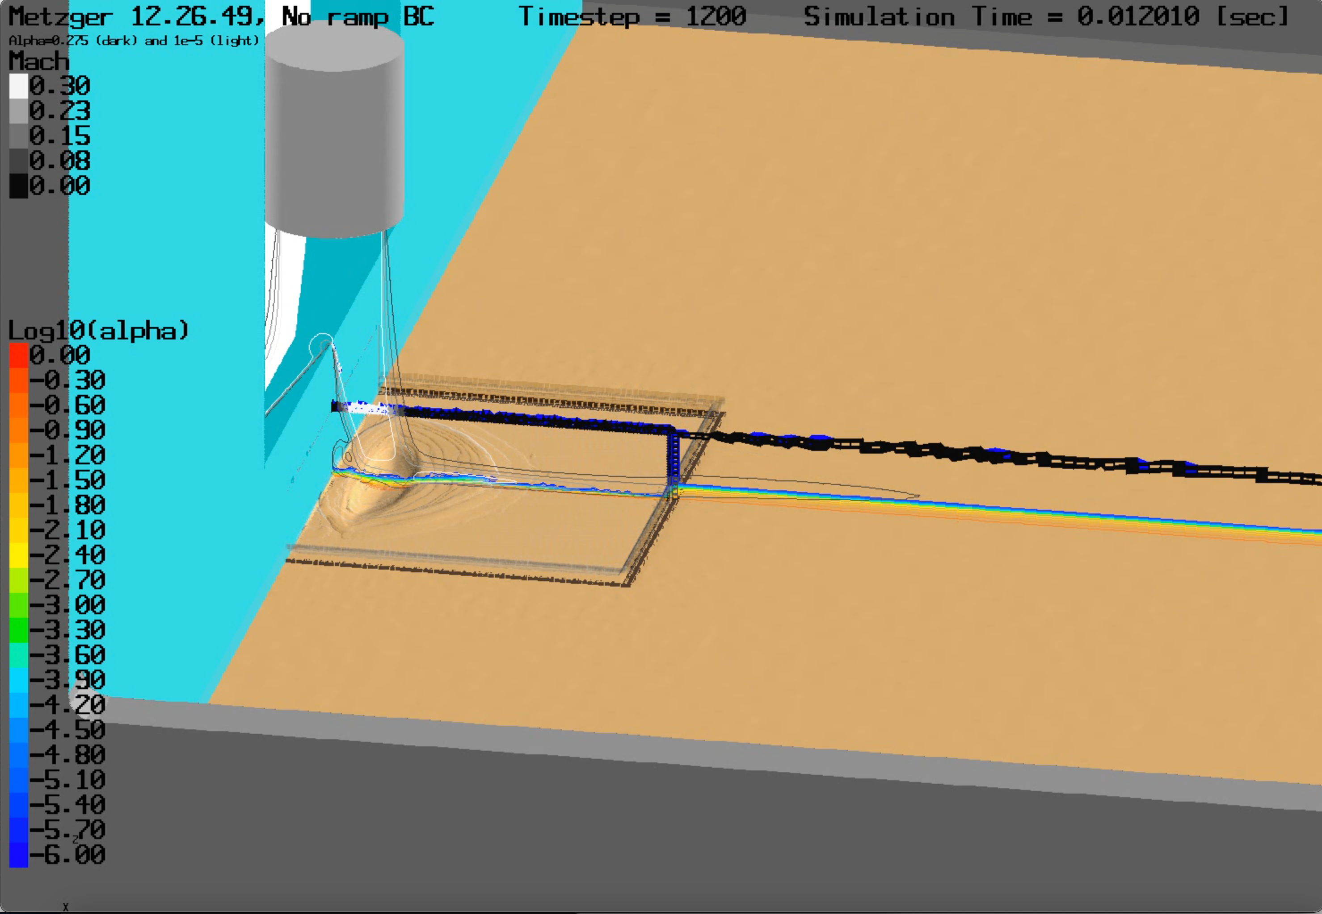
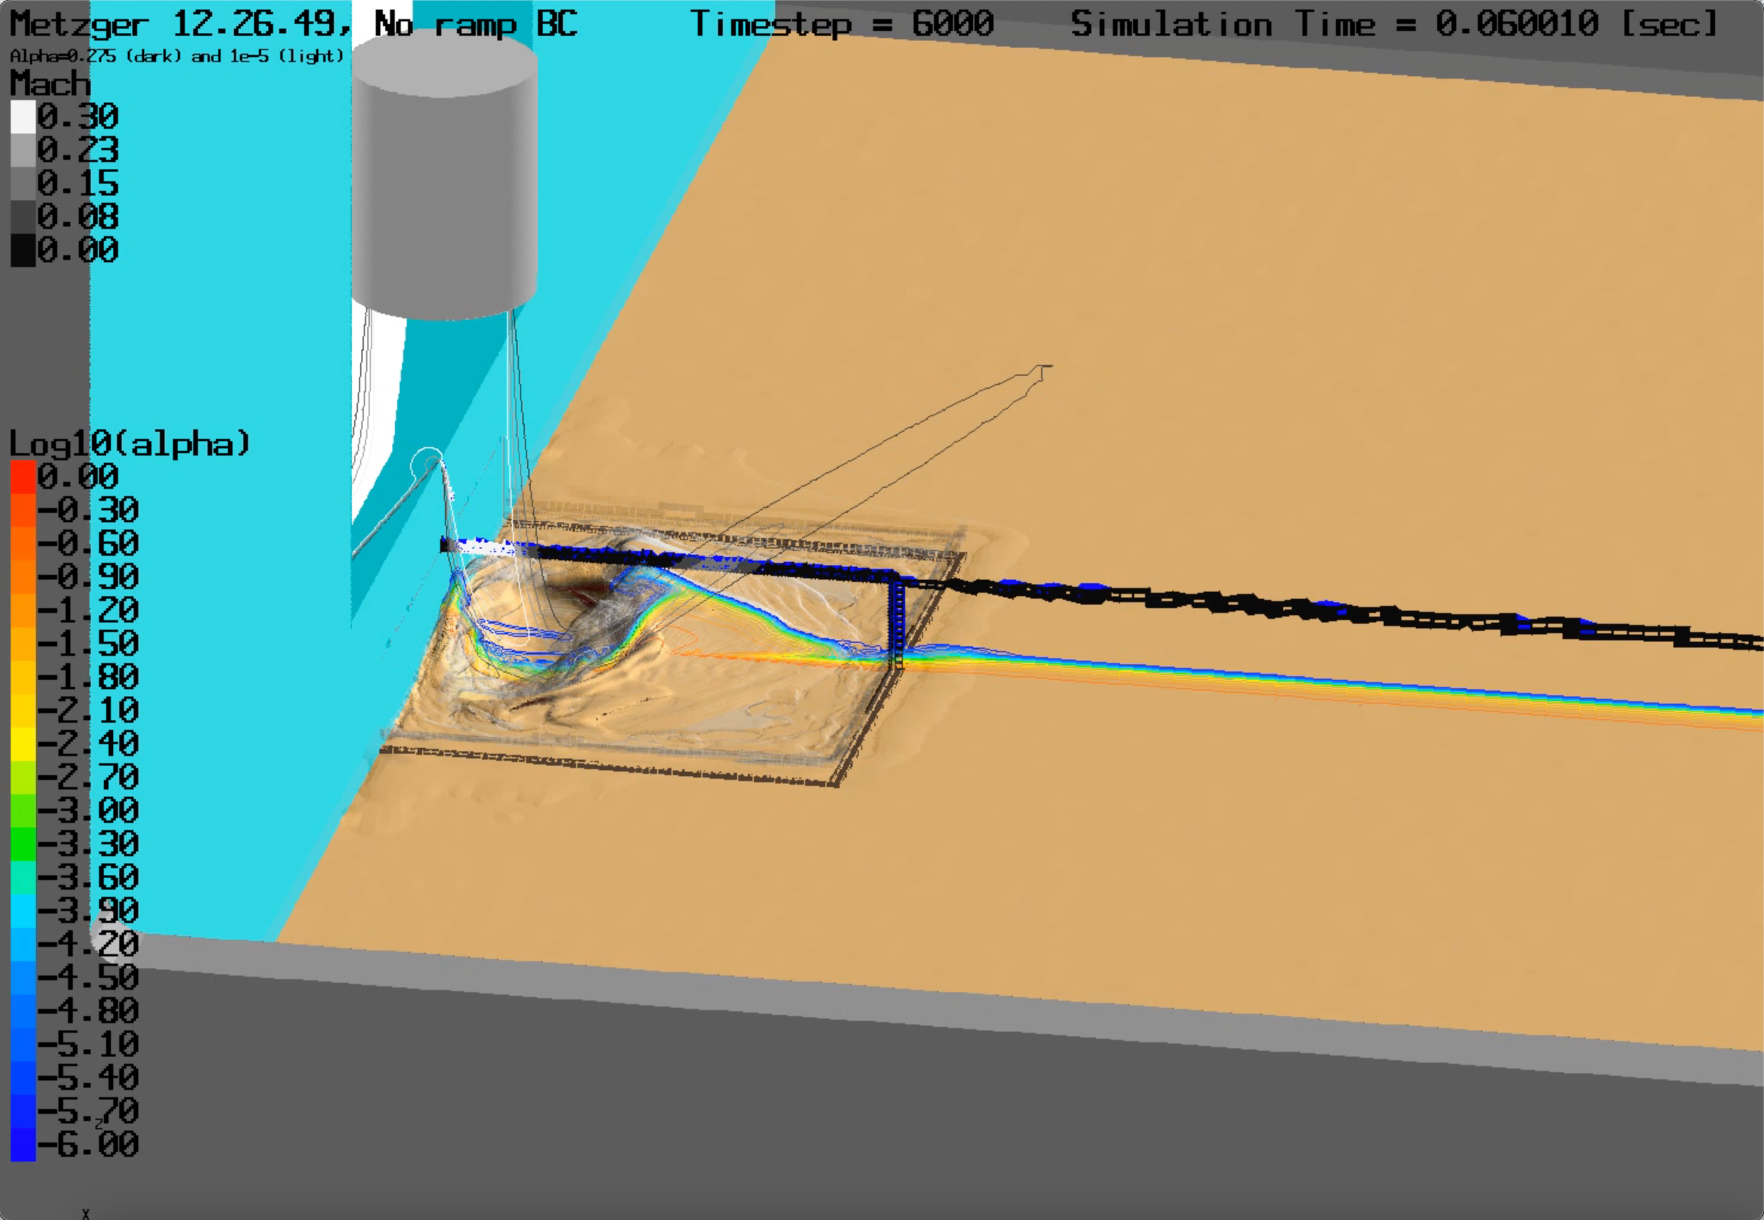
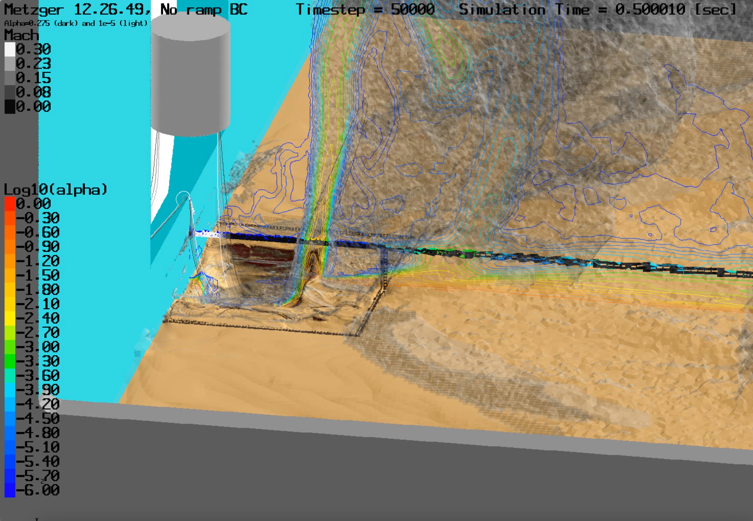
PSC Validation: 3D Subsonic Pipe Flow (Martian)
Full 3D simulation performed to demonstrate current capabilities with splitter plate geometry in Martian-like environment
Significant 3D effects not captured with axisymmetric simulation, e.g.:
  Observe elongated, noncircular crater shape with max depth away from splitter plate
  Piling of soil against splitter plate
  Nonuniform gas flow and ejecta pattern
Demonstrates need for the current 3D modeling capabilities with splitter plate geometry

Slide 14
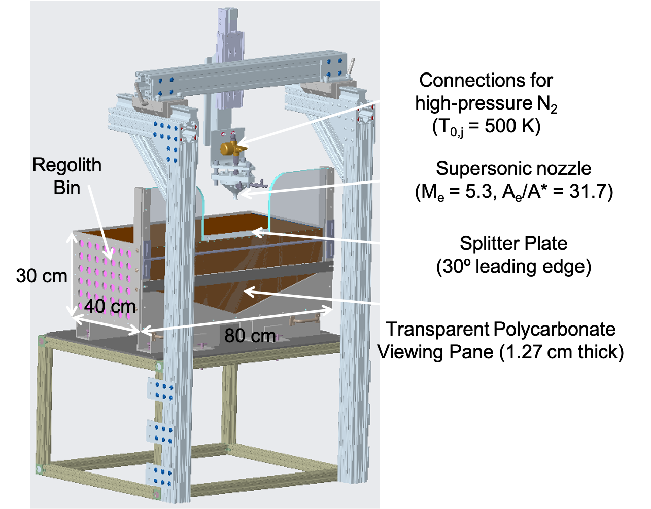
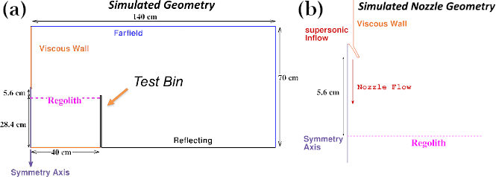
PSC Validation: PFGT1 Test Setup
PFGT1 uses same splitter plate concept from Metzger’s test²
PFGT1 pre-test simulation under Martian-like environment performed axisymmetric with:
  Mach 5.3 supersonic nozzle
  150 micron monodisperse sphere model
  Nozzle height of 5.6 cm above undisturbed regolith
  Vacuum chamber pressure of 267 Pa (Martian) and 10 Pa (Lunar)
  Transient nozzle mass flow rate up to 8.6 g/s (Martian) and 0.32 g/s (Lunar)

Slide 15
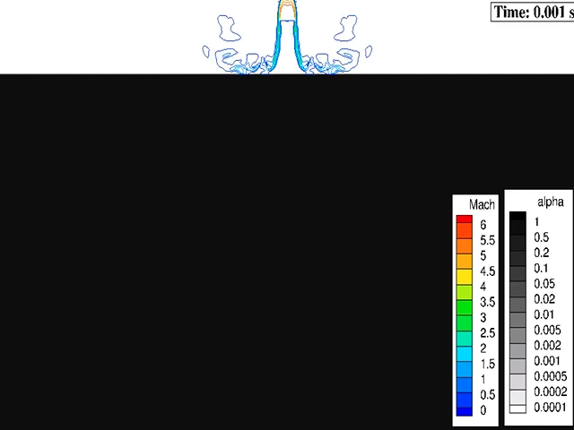
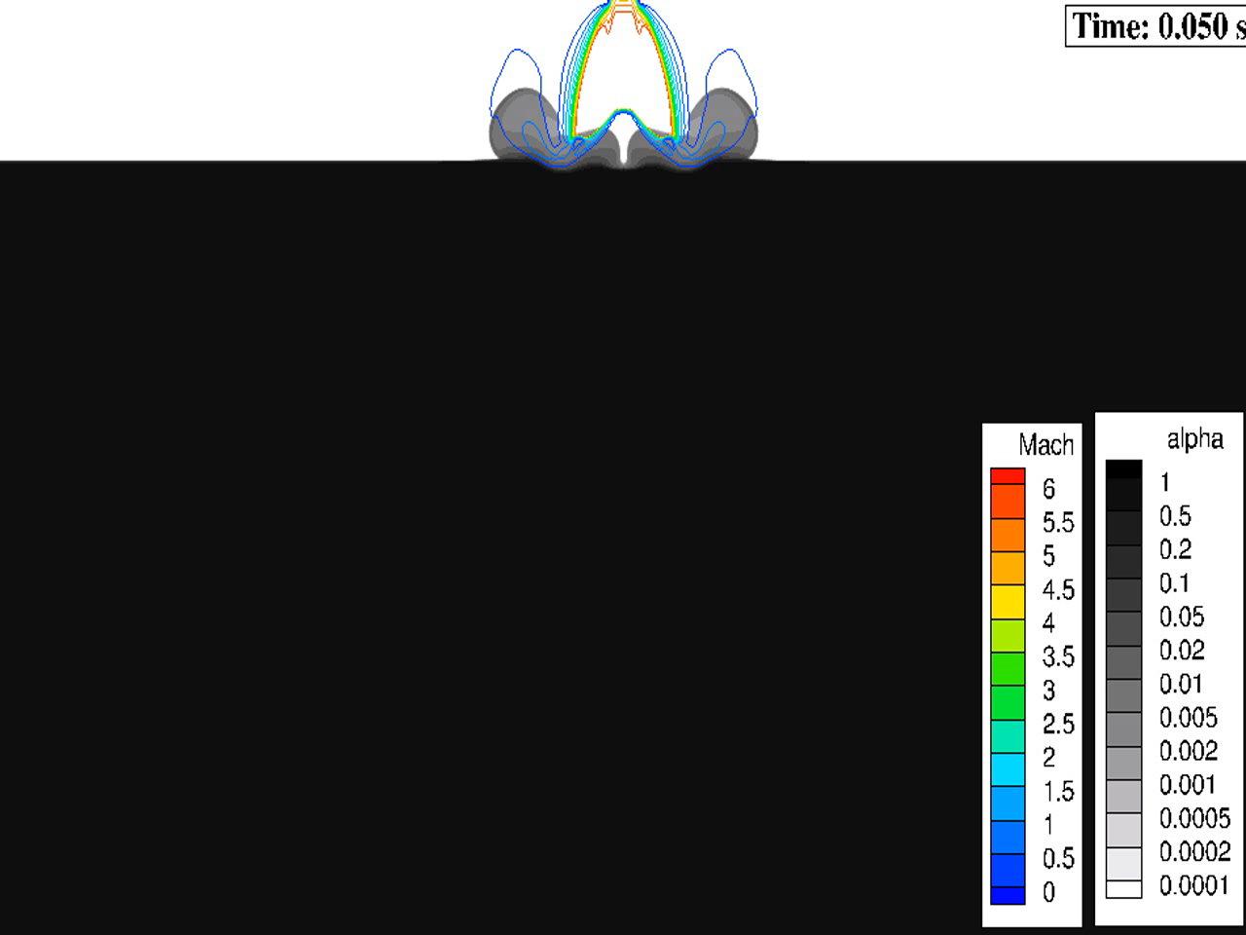
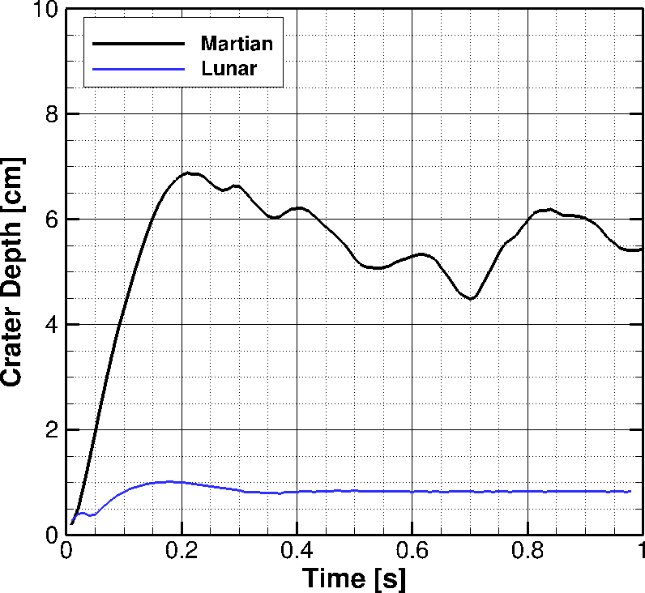
PSC Validation: PFGT1 Predictions for Martian and Lunar
Axisymmetric PFGT1 pre-test predictions in Martian-like and Lunar-like environments
Both have same plume expansion ratio – both predicting annular plume impingement
Martian case more violent cratering process with pulsing behavior starting ~0.2 s
Crater depth significantly greater for Martian with higher flow rate than for Lunar case
This is current status, but will need to revisit with 3D simulations (demonstrated next)
Martian
Lunar
Crater Depth Vs. Time

Slide 16
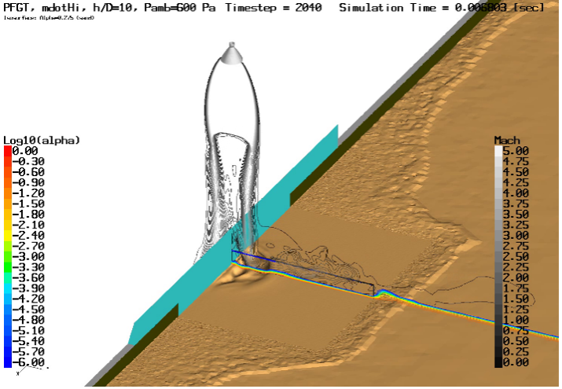
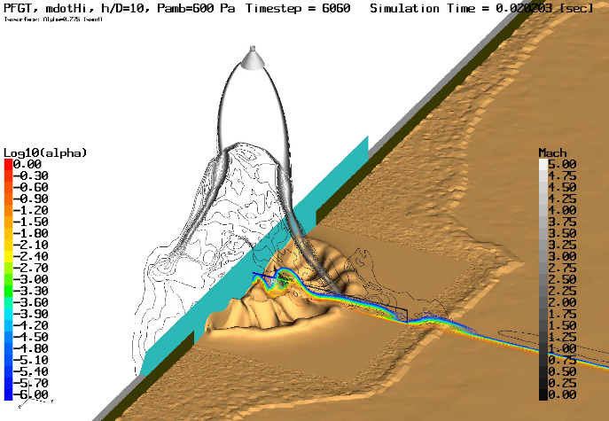
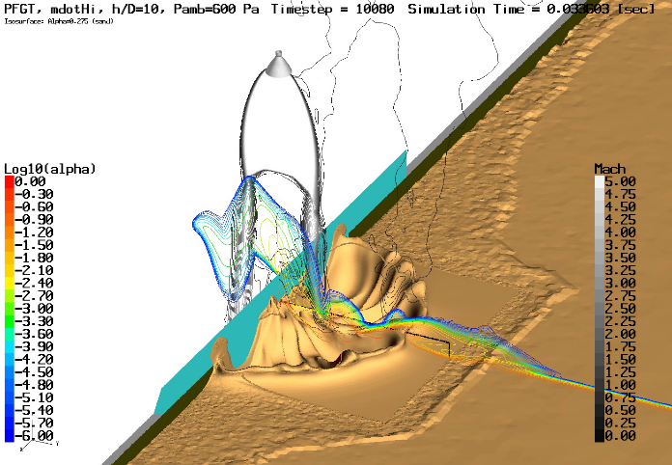
PSC Demonstration: 3D PFGT1 (Martian)
Full 3D simulation performed to demonstrate current capabilities with supersonic plume and splitter plate geometry in Martian-like environment
Predicting significant 3D PSI effects:
  Cellular structure along crater circumference
  Piling of soil against splitter plate
Demonstrates need for the current 3D modeling capabilities with splitter plate geometry

Slide 17
Summary
PSI induced environments is an important aspect to designing Entry Descent and Landing (EDL) systems
Predictive simulation capabilities developed through the GCD Program are the first of its kind to fulfill this need on upcoming NASA missions to the Moon and Mars
Statuses presented here provide scope and depth of analyses performed on one part of plan (cratering and ejecta in continuum/rarefied flows) to develop accurate and reliable prediction of PSI
  Solution verification of axisymmetric model, overset/moving mesh, and multi-species modeling implementation
  Demonstration of predictive tool capability (3D Apollo LM)
  Validation against relevant data in Martian and Lunar environments
Continuing to develop and mature tools to predict PSI, including coupling with a Boltzmann solver to capture rarefied flow effects and polydisperse, irregular particle models

Slide 18
References
Immer, C., Lane, J., Metzger, P., and Clements, S., “Apollo Video Photogrammetry Estimation of Plume Impingement Effects,” Icarus, Vol. 214, No. 1, 2011, pp. 46-52. doi: 10.1016/j.icarus.2011.04.018
Metzger, P. T., “Rocket Exhaust Blowing Soil in Near Vacuum Conditions Is Faster than Predicted by Continuum Scaling Laws,” Proceedings of Earth and Space 2016: Engineering, Science, Construction, and Operations in Challenging Environments, 2016, pp. 58–66. doi: 10.1061/9780784479971.007

