Slide 1


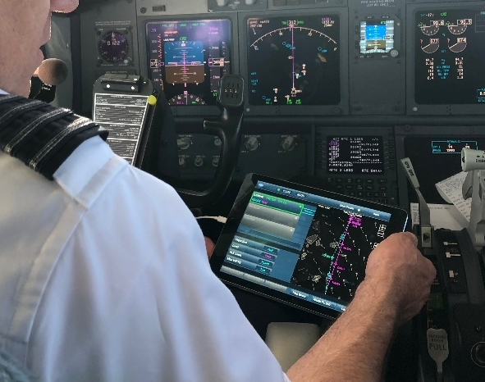
Traffic Aware Strategic Aircrew Requests
NASA Flight Deck Application for En Route Flight Optimization
TASAR Briefing
David Wing
TASAR Principal Investigator
NASA Langley Research Center
NASA / FAA Technical Interchange Meeting
November 30, 2021

Slide 2
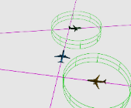
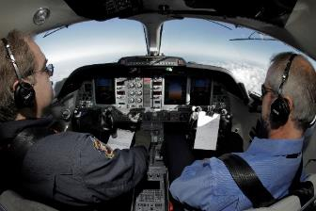
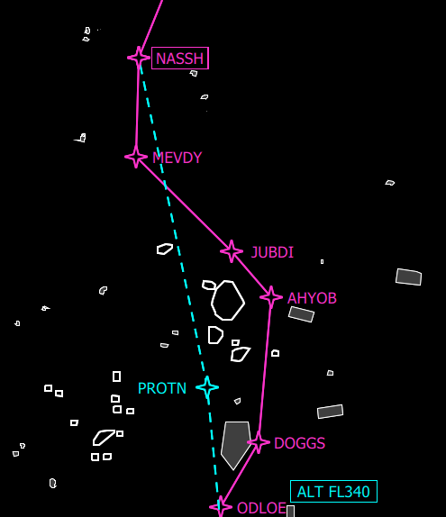
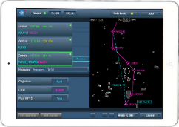
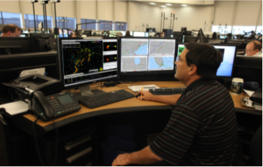
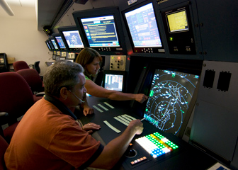
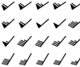
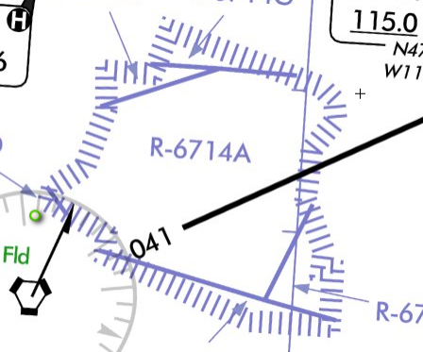
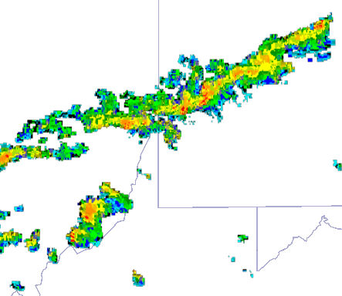
Traffic Aware Strategic Aircrew Requests (TASAR)
Enabling Strategic and Informed Route Optimization: Turning Data into Dollars
ADS-B Traffic
Better
Informed
TASAR provides
immediate benefits
while laying foundation for
Digital Flight
Connected
Air-to-Air
Opportunities
$$ Operational Savings $$
Onboard
Route
Optimizer
Connected
Internally
Better
Coordinated
Aircraft State
Original route
Current Route
Aircraft Sensors
Optimized
route
Electronic Flight Bag
More Likely
Approved
Winds
Airspace
Weather
Connected to
Ground Services
Flight Re-optimized Saving Time & Fuel
Notes:
“Strategic” meaning “well informed and purposeful”
Flow: data -> technology -> users -> benefits

Slide 3
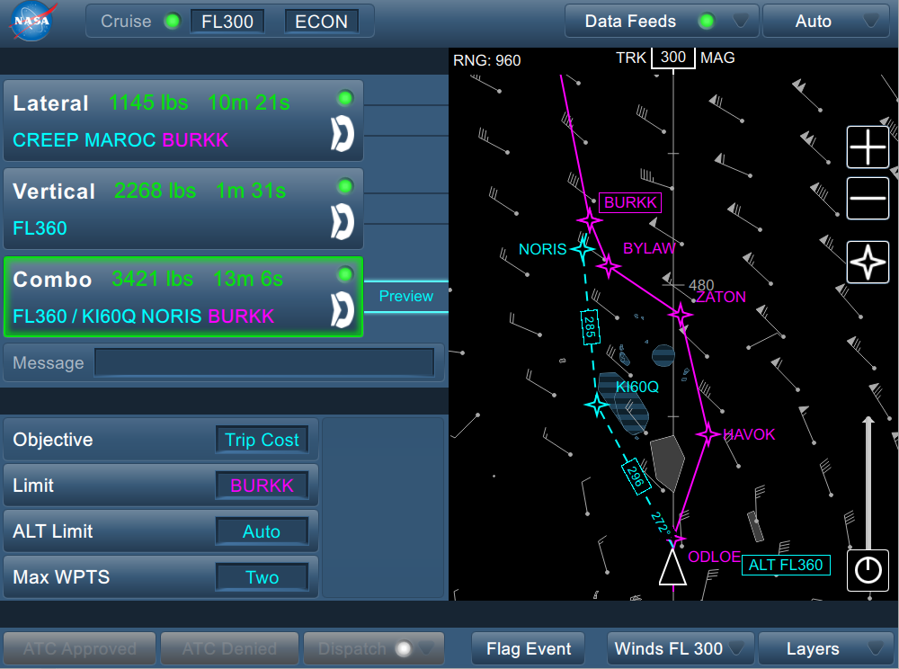
TASAR Technology: Traffic Aware Planner (TAP)
Interactive Route Optimization App for Pilots
Leverages connectivity for operational savings
Recognition of unique capabilities, near-term benefits, and long-term revolutionary impact:
Applies multiple degrees of freedom
U.S. Patent, 8,977,482
Method and apparatus for generating flight-optimizing trajectories
2015
Pilot-adjustable optimization objective
NASA
Software of the Year
2016
Powerful search algorithm finds
non-obvious reroutes
U.S. Patent, 10,102,756
TAP User Interface
2018
Incorporates complex dynamic constraints
R&D 100
Award Winner*
2019
Adaptable to different aircraft and hardware architectures
* Internationally selected as one the 100 most technologically significant new products of the year

Slide 4
NASA TASAR Project Accomplishments
2012
Developed route-optimization application for the Connected EFB
Estimated DOC savings (time, fuel) via modeling
Developed software prototype
Analyzed safety, human factors, FAA authorization, and market needs
Conducted simulations and flight trials
Integrated into commercial aircraft
Conducted airline operational evaluation
Validated DOC savings and operational utility
Transferred technology to industry via commercial licenses
Concluded project at TRL 7
CTD
Project
2015
2016
ATD-3
Project
2019
ATD Airspace Technology Demonstrations Project
CTD Concepts and Technology Development Project
DOC Direct Operating Cost
EFB Electronic Flight Bag
TRL Technology Readiness Level

Slide 5
TASAR’s Rapid Advancement
Timeline of Technology Maturity
Commercial
Evaluation
Multiple Evaluation Licenses Issued
Mult. Comm. License Appl.
Operational
Evaluation
Airline Partnership Development
Implementation
Installed Testing
Op. Evaluation
Flight Trials
FT 1
FT 2
FT 3
High Fidelity
Simulations
HITL 1
HITL 2
Software
Development
HITL 1
FT 1
HITL 2
FT 2
Partner Airline Adaptation Stage 1
Stage 2
Stage 3
Community
Engagements
Airlines
FAA
Industry
ATC
Industry Forums
FAA NextGen
Eurocontrol
Webinar
RTCA
Industry
Concept
Analyses
Benefits
Safety
FAA Approval Req’ts
Partner Benefits
S/W Certification
Enhancements
Concept
Development
Concept Published
TASAR Patent
User Interface Patent
2012
2013
2014
2015
2016
2017
2018
2019

Slide 6
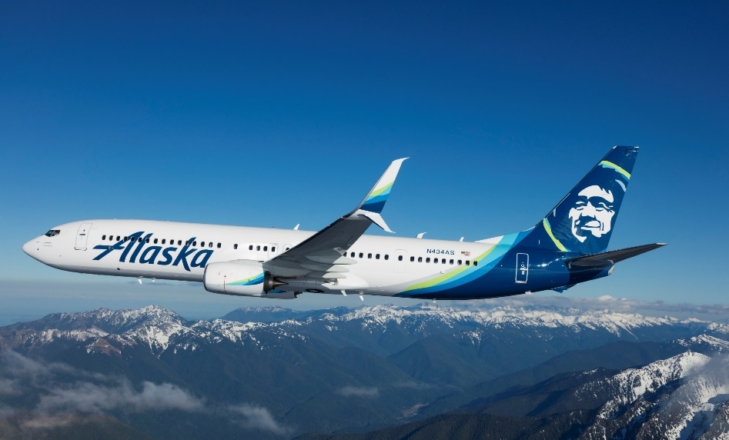



Operational Evaluation of TASAR
Conducted with Alaska Airlines
Partnered from 2015-2019
Collaborated with industry leaders
Equipped three aircraft for TASAR
Approved for revenue service operations
Conducted 90 valid flights for analysis
Validated cost savings and operational utility
Industry Collaborators
© Alaska Airlines. Used with permission.
The use of trademarks or names of manufacturers in this presentation is for accurate reporting and does not constitute an official endorsement, either expressed or implied, of such products or manufacturers by the National Aeronautics and Space Administration.

Slide 7
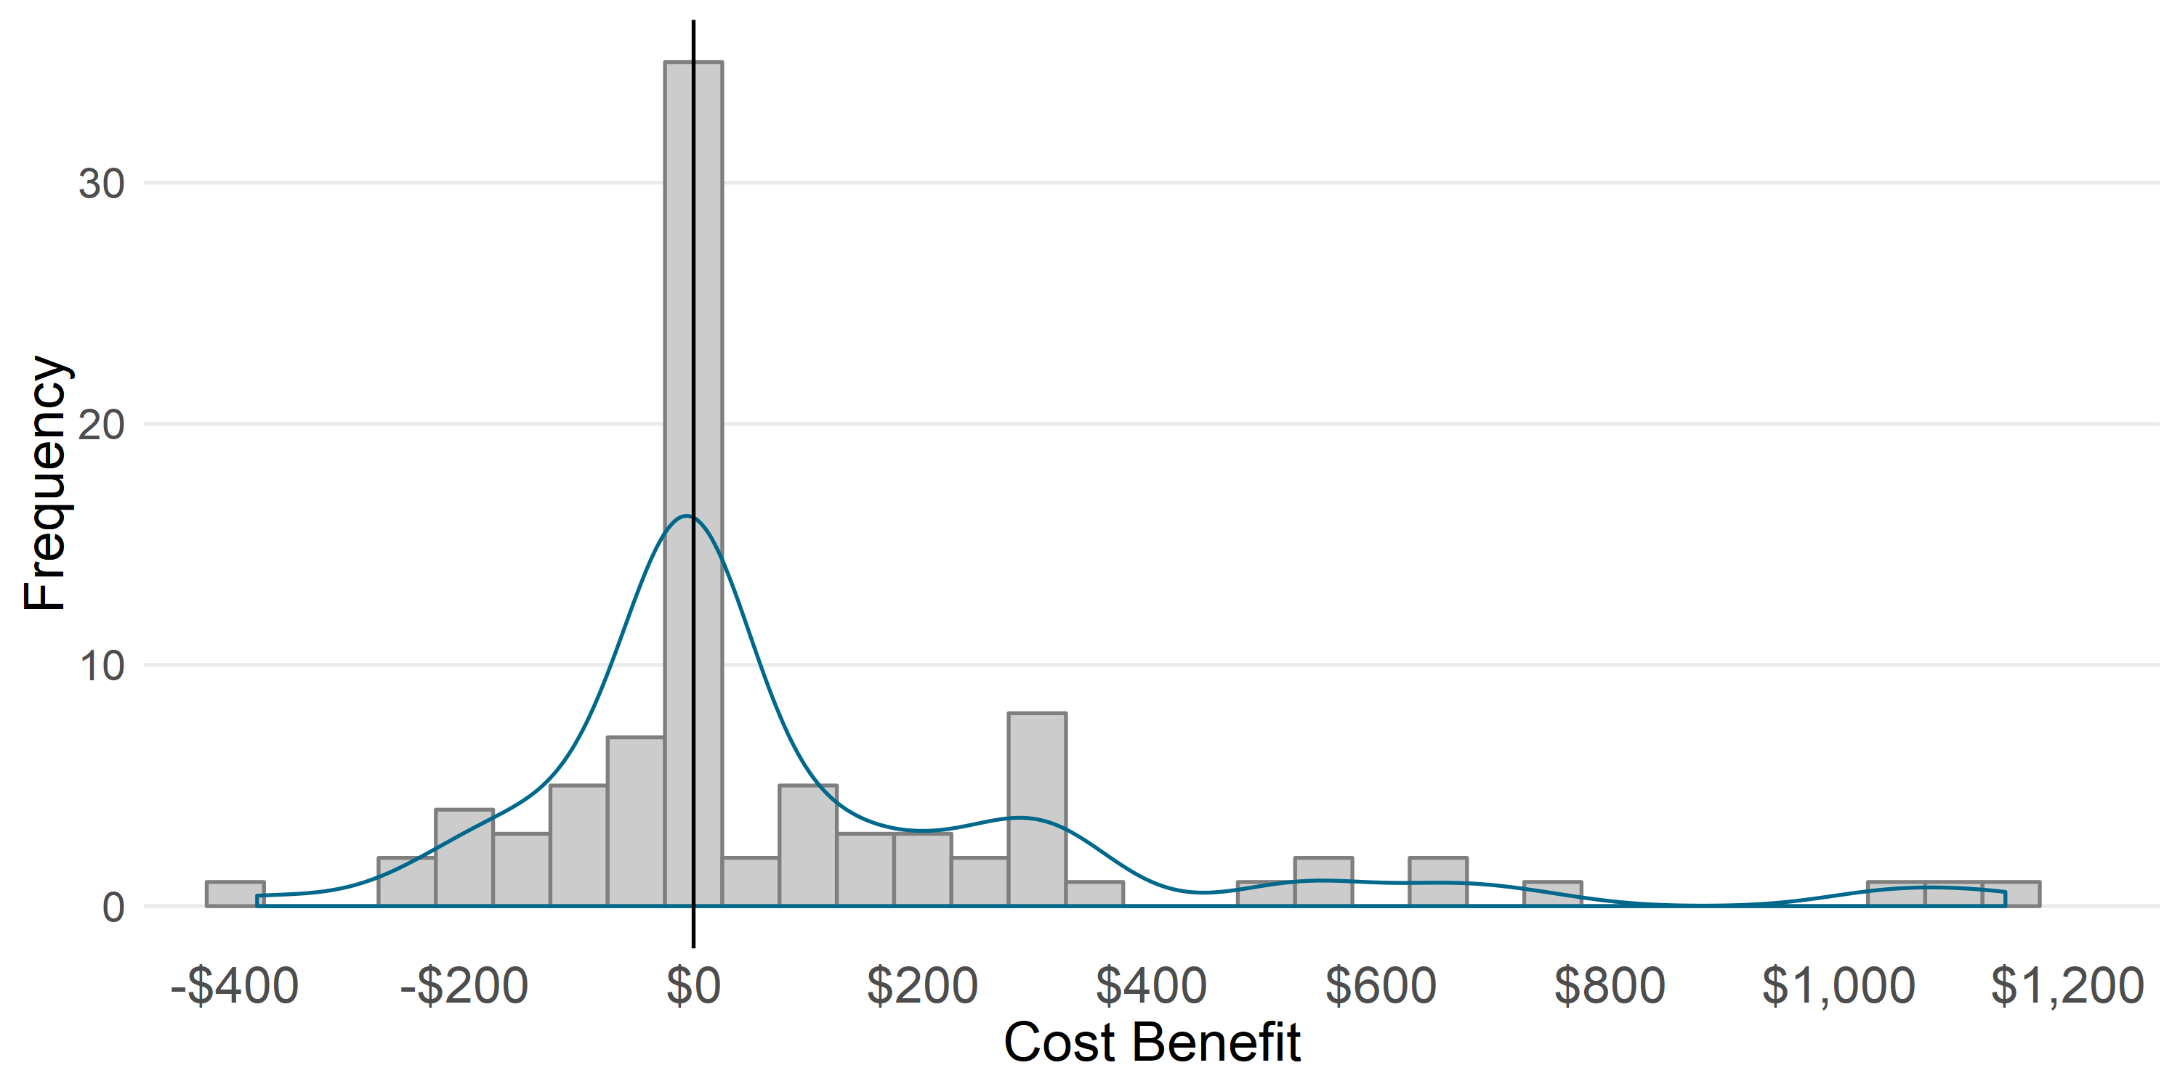
TASAR Cost Savings and Operational Utility
90 Evaluation Flights
July 2018 – April 2019
Cost Savings Estimated at $100-$200/flight
Mean Benefit
(All 90 Flights)
$97.00
Flight Duration | TAP Operator | Mean Benefit* | # Flights
All | Interns, NASA, Tech Pilots | $97 | 90
All | Tech Pilots | $204 | 22
Plan Validation
(But Counted as Zero)
*Mean benefit across all flights
Operational Utility Validated by Alaska Airlines
Unrelated route changes that offset TAP gains
Cumulative Small Gains
Home Runs

Slide 8
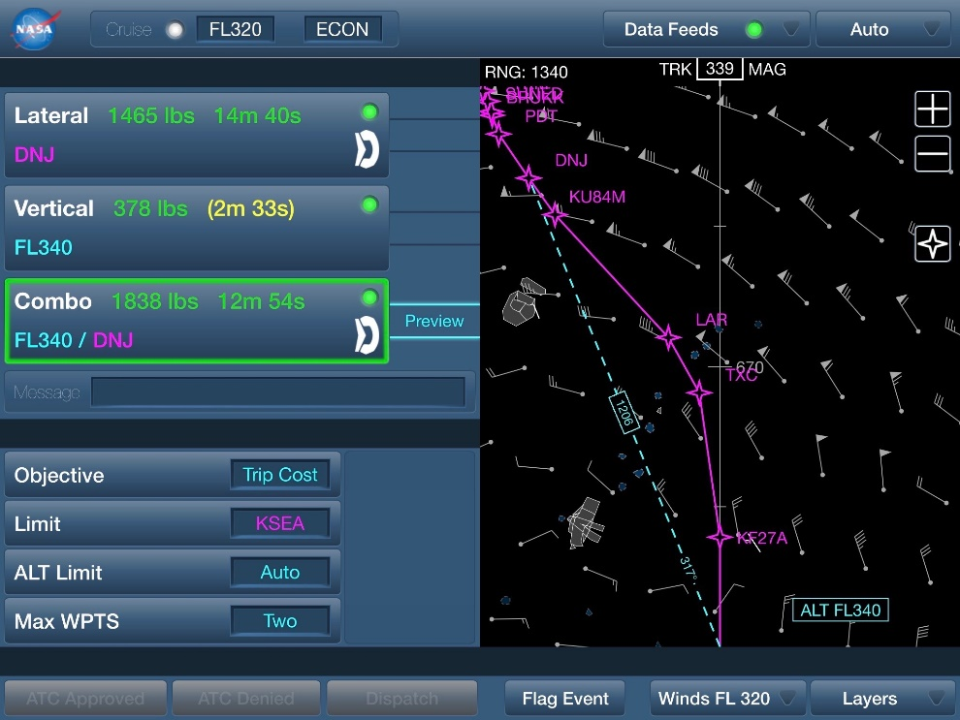
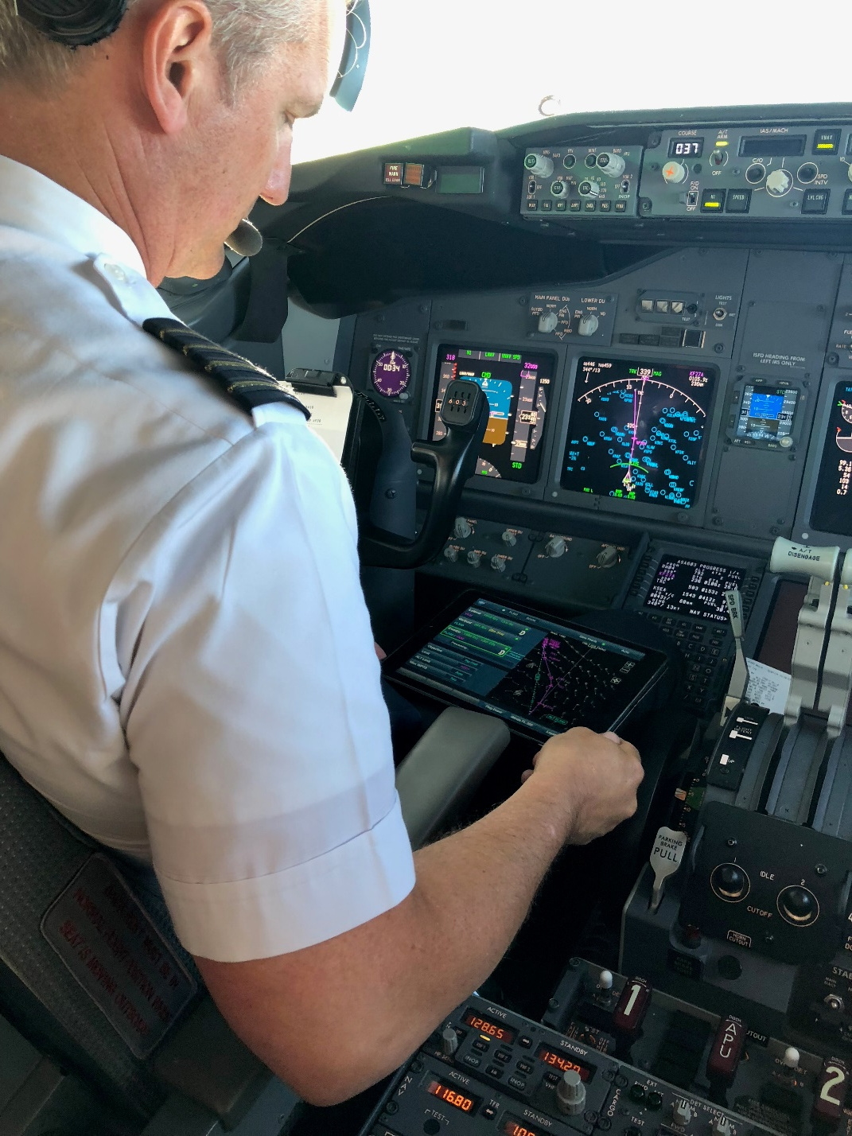
Home Runs
Yield Significant Benefits By Themselves

Slide 9
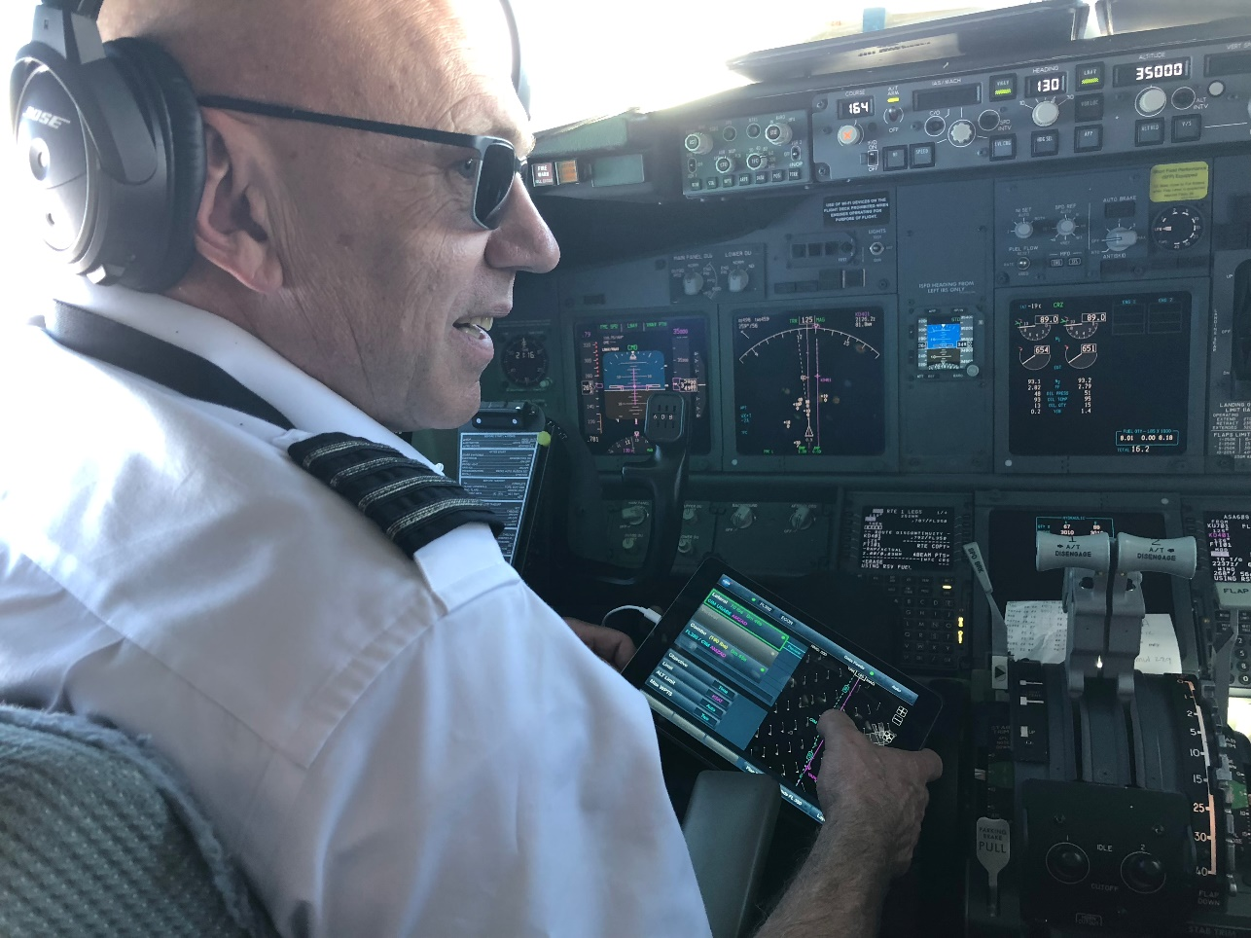
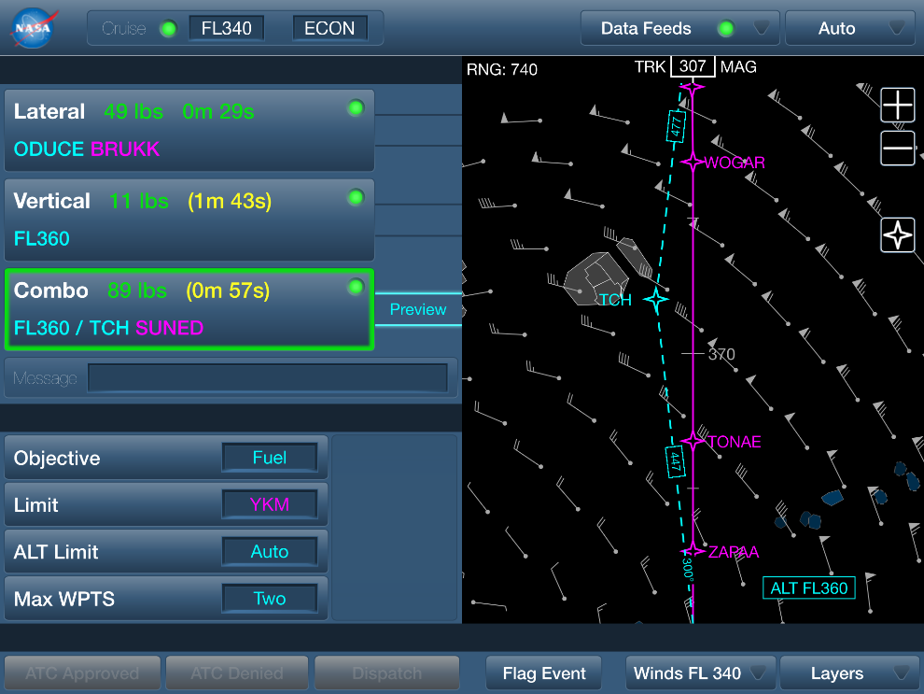
Cumulative Small Gains
Accrue Benefits Through Minor Improvements

Slide 10
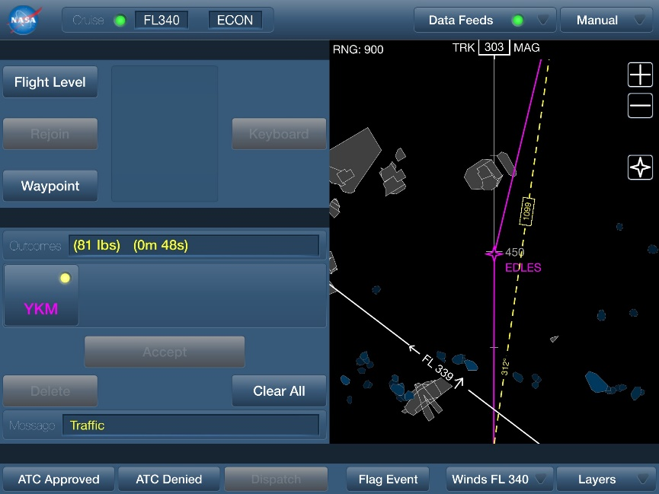
Plan Validation
Reduce Inefficient Deviations from Flight Plan

Slide 11
Projected Annual Benefits
Substantial savings are anticipated for U.S. airlines
Airline | Estimated Aircraft that are Candidates to be Equipped with TASAR | Estimated Annual Cost Savings due to TASAR | Estimated Annual Emission Reductions due to TASAR
Alaska | 180 | $14.97M/year | 101.6 million lb CO₂e
Allegiant Air | 37 | $1.41M/year | 10.51 million lb CO₂e
American | 831 | $52.29M/year | 348.29 million lb CO₂e
Delta | 466 | $23.61M/year | 166.11 million lb CO₂e
Frontier | 62 | $4.38M/year | 31.94 million lb CO₂e
JetBlue | 63 | $6.69M/year | 50.43 million lb CO₂e
Southwest | 754 | $36.47M/year | 280.04 million lb CO₂e
Spirit | 61 | $4.86M/year | 37.87 million lb CO₂e
Sun Country | 30 | $1.41M/year | 9.83 million lb CO₂e
United | 562 | $23.26M/year | 164.33 million lb CO₂e
Total | 3,000+ | ~$170M/year | 1200.41 million lb CO₂e
Pre-COVID-19 estimate
Applies Alaska’s achieved benefits (time and fuel savings by flight length)
Applies conservative benefits estimate ($97/flight)
Adjusts for fleet size, flight lengths, and direct operating costs (all public data)
Includes modern mainline jets; excludes regional and older jets
Includes domestic origin & destination only

Slide 12
TASAR Project Final Status
NASA role is complete at TRL 7
  “System prototype demonstration in an operational environment”
  TAP prototype developed, tested, and matured
  Implemented on 3 distinct aircraft types (turboprop, bizjet, transport)
  Evaluated in airline revenue service
    Validated DOC savings in operational flights
    Demonstrated diverse operational utility to airline operations
    Inspired new ideas for expanded functionality and connectivity
Industry role is underway
  Commercialization in progress
  Multiple US airlines are evaluating TASAR for their fleets

Slide 13
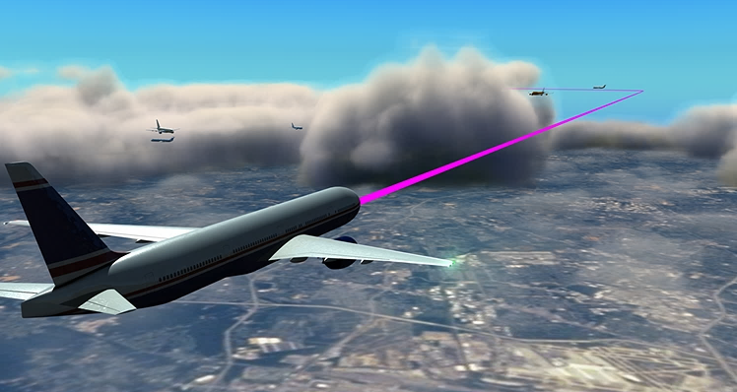
TASAR Growth Path
TASAR Evolution
Expanding Connectivity
Diversifying Input Data
Enhancing Functionality
Applying to Diverse Use Cases
Adapting to New Users
Flight Path Management (FPM) Automation Evolution
Advisory
Assistive
Responsible
Digital Flight
Notes:
Expanding Connectivity
FMS connectivity
Dispatch connectivity
ATC connectivity
Diversifying Input Data
4D winds
Onboard weather radar
Turbulence
Volcanic ash / icing
Ionizing radiation
FMS parameters
Traffic intent
Airspace structure
Political boundaries
Enhancing Functionality
Post-tactical optimization
Ride quality optimization
4D constraint adherence
4D solutions
New solution patterns
Handoff monitoring
Machine learning
Applying to Diverse Use Cases
Minimizing refueling stops (range limited flights)
Managing exposure to environment factors
Optimally meeting time objectives (ATC and operator)
Making complex requests via Data Comm
Achieving specialized mission objectives
Adapting to New Airspace Users
Airlines (mainline, regional, fractional)
Corporate, general aviation
Military, UAS, UAM

Slide 14
Traffic Aware Strategic Aircrew Requests
NASA Flight Deck Application for En Route Flight Optimization
Questions?

