Slide 1
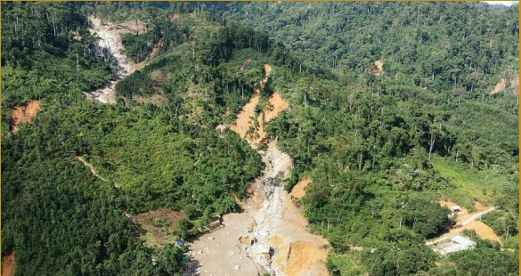
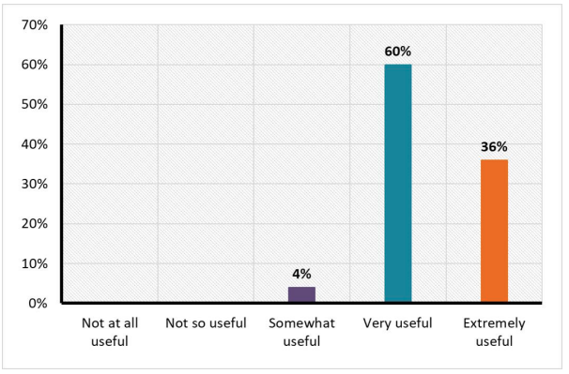
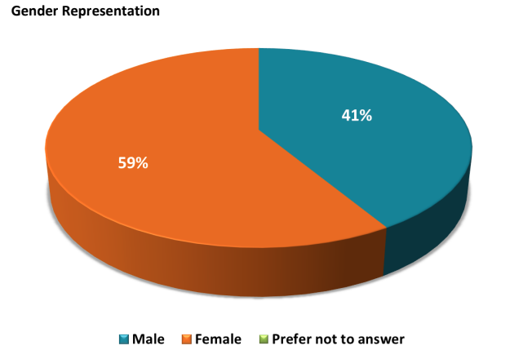
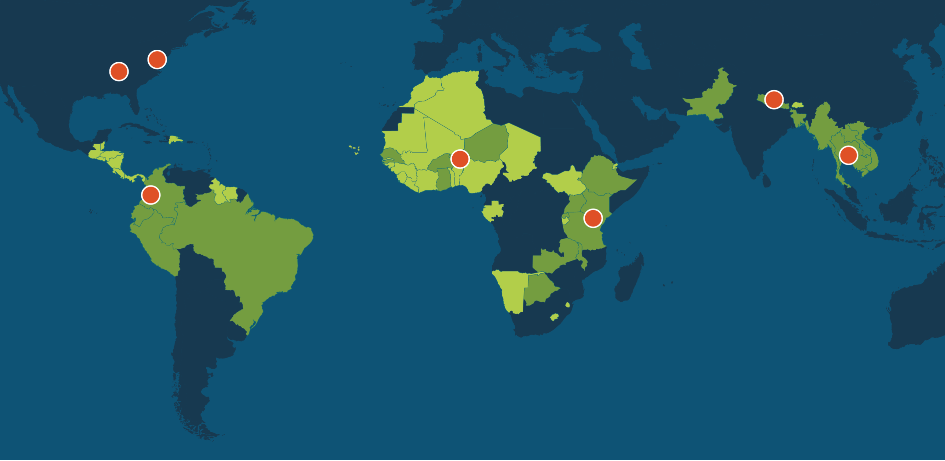
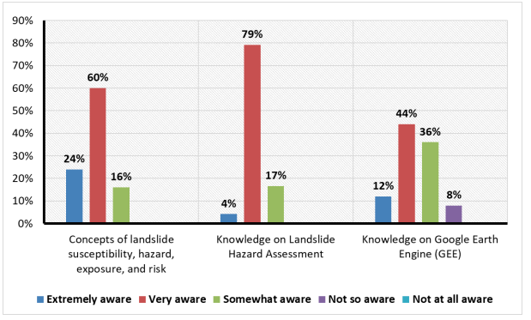
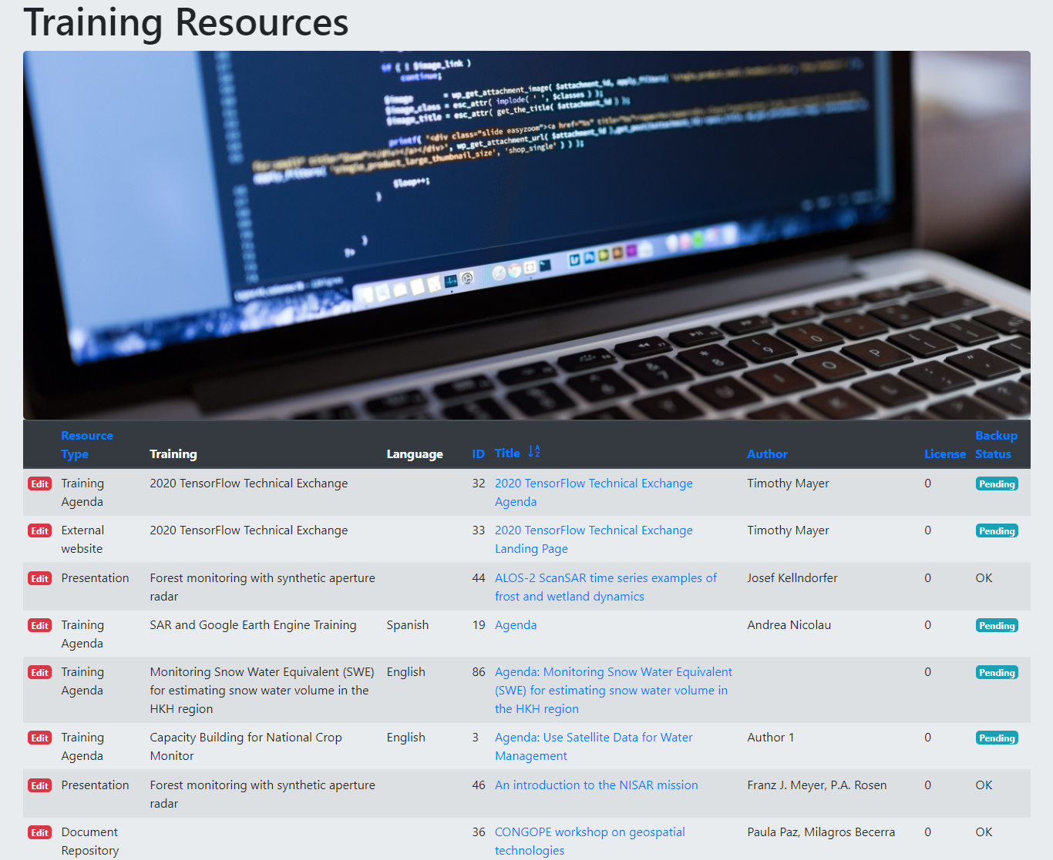
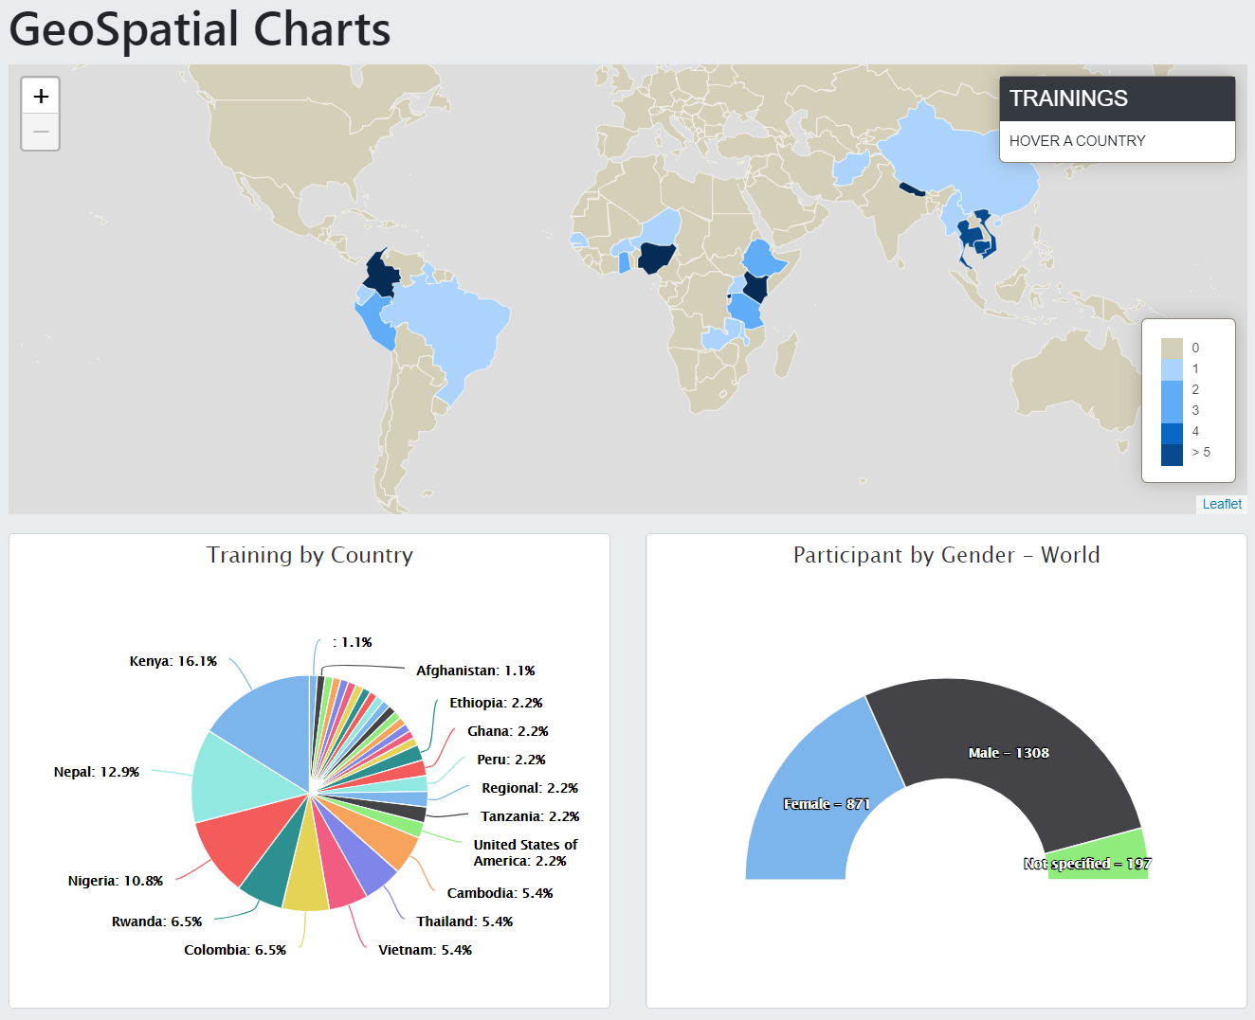
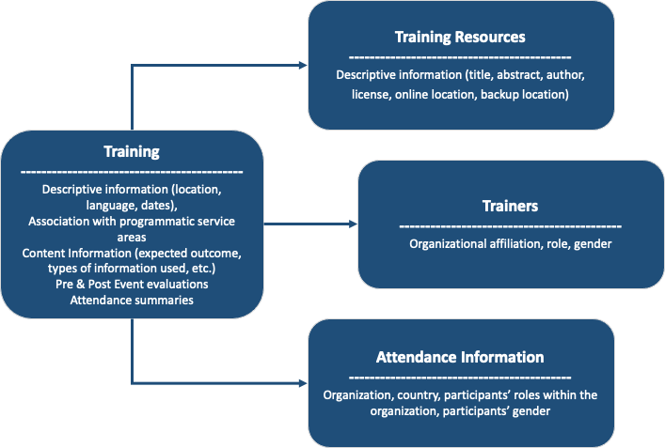









Lessons learned in the implementation of a Training Knowledge Management System for the SERVIR network
Betzy E. Hernández¹ , Francisco Jose Delgado², M. Kathleen Cutting³, Rebekke Muench¹, Rajesh Bahadur Thapa⁴, Rishiraj Dutta⁵, Jamilatou Chaibou Begou⁶, Lucy Chepkosgei Chepkochei⁷, Jason Tullis⁸, Simone Staiger-Rivas⁹, Katherine Casey¹⁰, Russell Raymond¹¹, (1) University of Alabama in Huntsville, Huntsville, AL, United States, (2) Universities Space Research Association Huntsville, Huntsville, AL, United States, (3) Jacobs Space Exploration Group, NASA SERVIR Science Coordination Office, Huntsville, AL, United States, (4) International Center for Integrated Mountain Development, Geospatial Solutions, Kathmandu, Nepal, (5) SERVIR-Mekong, Bangkok, Thailand, (6) AGRHYMET Regional Center, Niamey, Niger, (7) Regional Centre for Mapping of Resources for Development, Nairobi, Kenya, (8) University of Arkansas, Fayetteville, AR, United States, (9) International Center for Tropical Agriculture, Cali, Colombia (10) Chemonics International, Inc, Washington, United States, (11)Chemonics, Washington, DC, United States
I. Introduction
The SERVIR program is a unique partnership between NASA, the U.S. Agency for International Development (USAID), and leading regional organizations (‘hubs’) across the Americas, Africa, and Asia (Fig. 1). SERVIR has focused on building capacity to use Earth observations for addressing development challenges.
Since mid-2004, SERVIR has delivered 453 trainings to almost 10,000 professionals focused on capacity building in topics related to Earth observations, spatial analysis, and modeling.
Problem statement: The large number of training events delivered represents an opportunity and a challenge in terms of knowledge management. While the training materials developed can be reused in other parts of the SERVIR network, the lack of a central repository for those materials has prevented wider dissemination and use.
The recently developed Training Knowledge Management System (TKMS) is now becoming an integral part of the SERVIR Capacity Building Framework, supporting the exchange of resources and methods for conducting training activities across the network.
II. Methods/Objectives
The system, initiated in 2019, has undergone continuous evolution, based on the feedback generated by the Capacity Building Leads at the SERVIR regional hubs, who have identified ways to use the system more effectively to compile indicators useful to the Monitoring, Evaluation and Learning (MEL) aspects of the SERVIR Program, and to simplify the workflow to register information into the system and promote wider utilization within the entire SERVIR network. SERVIR’s TKMS is intended to serve three key capacity building needs:
To gain perspective of the trainings and events conducted by SERVIR, for identification of gaps and needs
To improve collaboration and awareness among members of the SERVIR network of these training activities, and
To provide access to non-curated training materials and information about training events to members of the SERVIR network.
Long term preservation of training resources offers a challenge, due to the huge array of platforms and formats that these resources are built upon, and the limited technical resources available for development and implementation of the system. However, the system is encouraging the discovery and adoption of best practices throughout the network.
III. Results and Discussion
At a high-level view, the central elements in the system are the training events. Around them the information collected is grouped into resources, trainers and attendance information. This information is collected in multiple relational tables which can be sliced and charted using third party tools such as Microsoft PowerBI or Tableau to obtain custom chart visualization and summaries in addition to the ones implemented already in the system.
Science Coordination Office
NASA / MSFC
USAID Washington
NASA Headquarters
SERVIR Himalaya
ICIMOD
SERVIR Amazonia
CIAT
SERVIR West Africa
CILSS / AGRHYMET
SERVIR Eastern &
Southern Africa
RCMRD
SERVIR Mekong
ADPC
FIGURE 4: Satellite Observations and Tools for Landslide Risk Management in the Lower Mekong Region -- Training Report results (SERVIR-Mekong/ADPC and NASA GSFC)
FOCUS COUNTRIES
ADDITIONAL REACH
Figure 4 shows post-training survey results and gender representation from a September 2021 training, illustrating key information on capacity building activities conducted across the SERVIR network that can be accessed within the TKMS.
IV. Conclusions
Need to conduct orientation workshops for data entry personnel, especially for data entry fields with non-standardized options. –Rajesh Bahadur Thapa
TKMS [provides] a standardized platform to capture, store and share knowledge across SERVIR networks and organizations. –Rishiraj Dutta
The platform provides a powerful search and report capability to allow users to quickly find useful and relevant information to subject matter experts. –Rishiraj Dutta
[The system should] keep it simple and short, people are happy to contribute but want it to be straightforward and quick . . . because this kind of information is also requested by others (partner institutions, donors, etc.) –Simone Staiger-Rivas
FIGURE 1: SERVIR focuses on countries in Asia, Africa, and the Americas.
The TKMS is driving adoption of best practices within the SERVIR network to compile and organize resources for discovery and re-use.
The lessons learned from previous events are readily available and will be used in the implementation of future events.
While the SERVIR TKM system is still in development, lessons learned to date include:
The system has been used to register 46 training events in 2021, 30 in 2020 and 16 in 2019, reaching over 100 organizations, with several training events still pending registration. In all these events a total of 96 training resources have been registered.
The training resources cataloged in the TKMS include exercise guides, tutorials, videos, scripts, datasets and complex collections such as code repositories (e.g., GitHub) or cloud-based file repositories (e.g., Google Drive) containing diverse elements in them.
FIGURE 2: Trainings carried out across the network in 2021.
FIGURE 3: Schematic diagram of the central elements of the SERVIR TKMS, and system screenshot.
ALLIANCE

