Slide 1
The effect of modeling dose uncertainty on low-boom community noise dose-response curves
Will Doebler, Aaron Vaughn,
Kathryn Ballard, and Jonathan Rathsam
NASA Langley Research Center
4aNSa3
181st Meeting of the Acoustical Society of America
December 2, 2021

Slide 2


Overview
Increasing dose uncertainty
Uncertainty in noise dose can cause attenuation (flattening) of dose-response curves (Horonjeff, 2021; Kirisits, 2018)
Previous NASA sonic boom community noise survey data has been modeled with Bayesian Multilevel Logistic Regression (BMLR)
assuming there is no dose uncertainty (Lee et al., 2020)
  However, estimates of uncertainty in dose in these sonic boom community tests were computed by Page et al. (2014; 2020)
We hypothesized that a term could be added to the BMLR model to correct the effect of dose uncertainty
The extra term can correct the attenuation due to dose uncertainty
  If the curve is sufficiently sampled
The extra term cannot correct the attenuation due to dose uncertainty
  If the curve is sparsely sampled
Model fit results for NASA’s previous sonic boom community noise survey data will be presented
  The model with the uncertainty term results in dose-response curves that are slightly steeper than those modeled without uncertainty
Response (% annoyed)
Dose
From Lee et al. in JASA, April 2020
Notes:
Say what sufficiently sampled means
Describe origin of dose uncertainty
State that we are doing this in prep for X-59 community test data

Slide 3
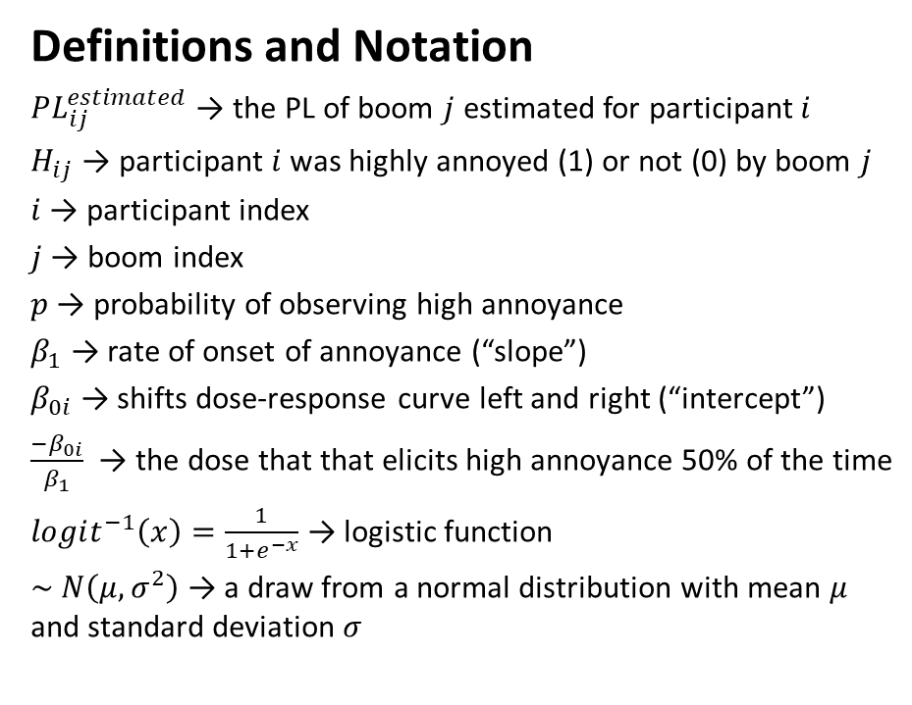
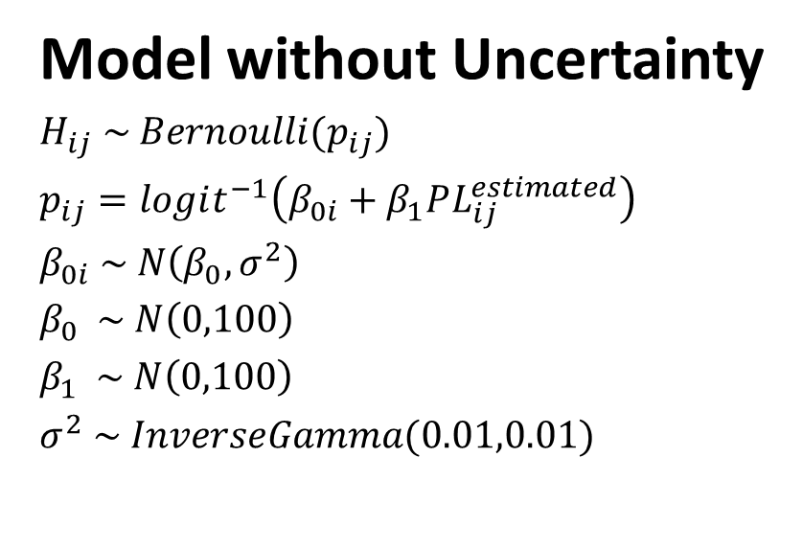
Bayesian Multilevel Logistic Regression (BMLR) Model
Model without Uncertainty
$H_{ij} \sim Bernoulli(p_{ij})$
$p_{ij}=logit^{−1}\left(β_{0i}+β_{1}PL_{ij}^{estimated}\right)$
$β_{0i} \sim N\left(β_{0},σ^{2}\right)$
$β_{0} \sim N\left(0,100\right)$
$β_{1} \sim N\left(0,100\right)$
$σ^{2} \sim InverseGamma(0.01,0.01)$
Definitions and Notation
$PL_{ij}^{estimated}$ → the PL of boom $j$ estimated for participant $i$
$H_{ij}$ → participant $i$ was highly annoyed (1) or not (0) by boom $j$
$i$ → participant index
$j$ → boom index
$p$ → probability of observing high annoyance
$β_{1}$ → rate of onset of annoyance (“slope”)
$β_{0i}$ → shifts dose-response curve left and right (“intercept”)
$\frac{−β_{0i}}{β_{1}}$ → the dose that that elicits high annoyance 50% of the time
$logit^{−1}\left(x\right)=\frac{1}{1+e^{−x}}$ → logistic function
$\sim N\left(μ,σ^{2}\right)$ → a draw from a normal distribution with mean $μ$ and standard deviation $σ$
Notes:
State that I’m describing the right panel while focusing on the left panel

Slide 4
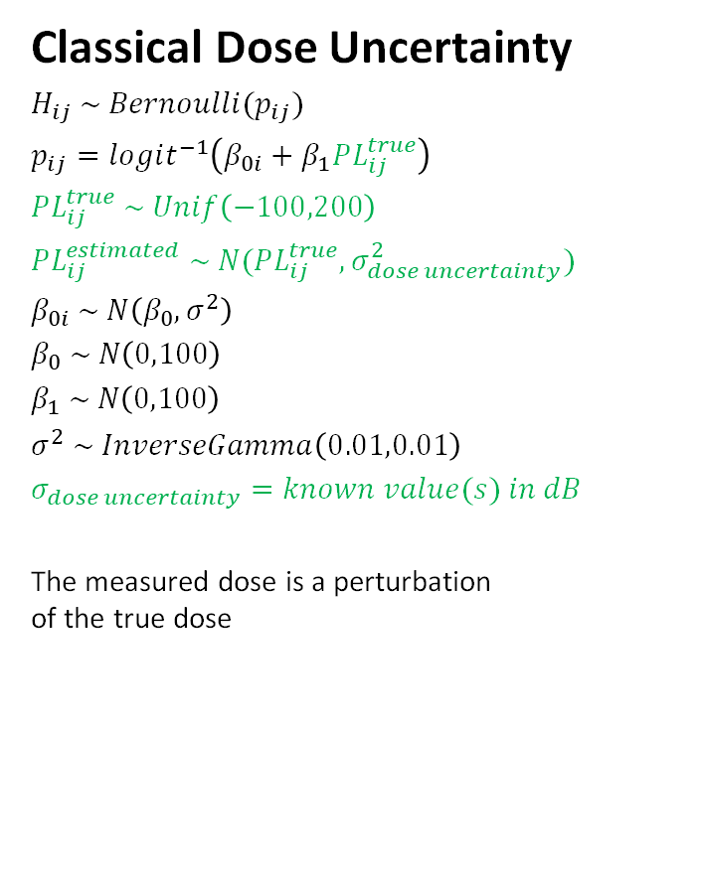
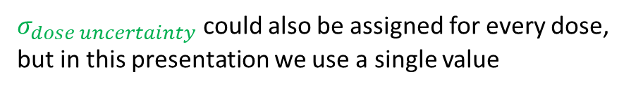
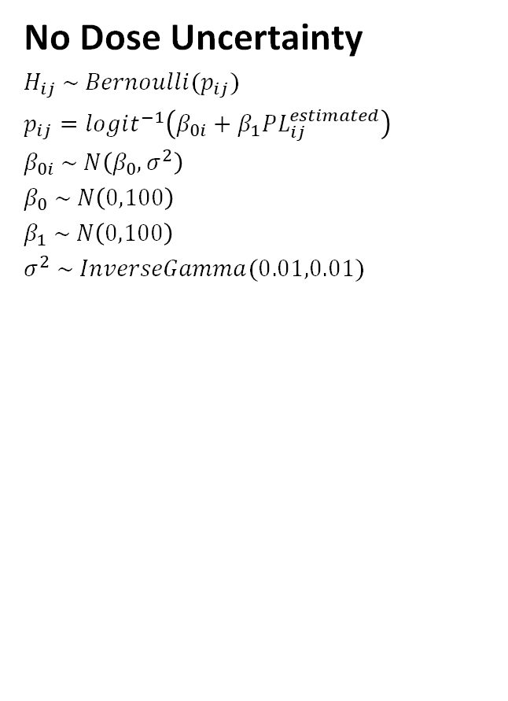
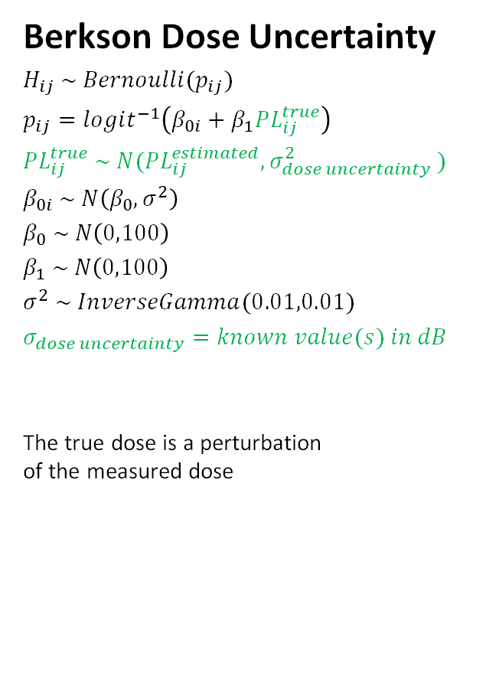
Inclusion of Dose Uncertainty in BMLR Model
No Dose Uncertainty
$H_{ij} \sim Bernoulli(p_{ij})$
$p_{ij}=logit^{−1}\left(β_{0i}+β_{1}PL_{ij}^{estimated}\right)$
$β_{0i} \sim N\left(β_{0},σ^{2}\right)$
$β_{0} \sim N\left(0,100\right)$
$β_{1} \sim N\left(0,100\right)$
$σ^{2} \sim InverseGamma(0.01,0.01)$
Classical Dose Uncertainty
$H_{ij} \sim Bernoulli(p_{ij})$
$p_{ij}=logit^{−1}\left(β_{0i}+β_{1}PL_{ij}^{true}\right)$
$PL_{ij}^{true} \sim Unif\left(−100,200\right)$
$PL_{ij}^{estimated} \sim N(PL_{ij}^{true},σ_{dose uncertainty}^{2})$
$β_{0i} \sim N\left(β_{0},σ^{2}\right)$
$β_{0} \sim N\left(0,100\right)$
$β_{1} \sim N\left(0,100\right)$
$σ^{2} \sim InverseGamma\left(0.01,0.01\right)$
$σ_{dose uncertainty}=known value(s) in dB$
The measured dose is a perturbation
of the true dose
Berkson Dose Uncertainty
$H_{ij} \sim Bernoulli(p_{ij})$
$p_{ij}=logit^{−1}\left(β_{0i}+β_{1}PL_{ij}^{true}\right)$
$PL_{ij}^{true} \sim N(PL_{ij}^{estimated}{,σ}_{dose uncertainty}^{2})$
$β_{0i} \sim N\left(β_{0},σ^{2}\right)$
$β_{0} \sim N\left(0,100\right)$
$β_{1} \sim N\left(0,100\right)$
$σ^{2} \sim InverseGamma(0.01,0.01)$
$σ_{dose uncertainty}=known value(s) in dB$
The true dose is a perturbation
of the measured dose
$σ_{dose uncertainty}$ could also be assigned for every dose, but in this presentation we use a single value
Notes:
“measured dose is perturbation of the true dose” -> measured dose is random, true dose fixed
“true dose is a perturbation of the measured dose” -> measured is fixed, true dose is random

Slide 5
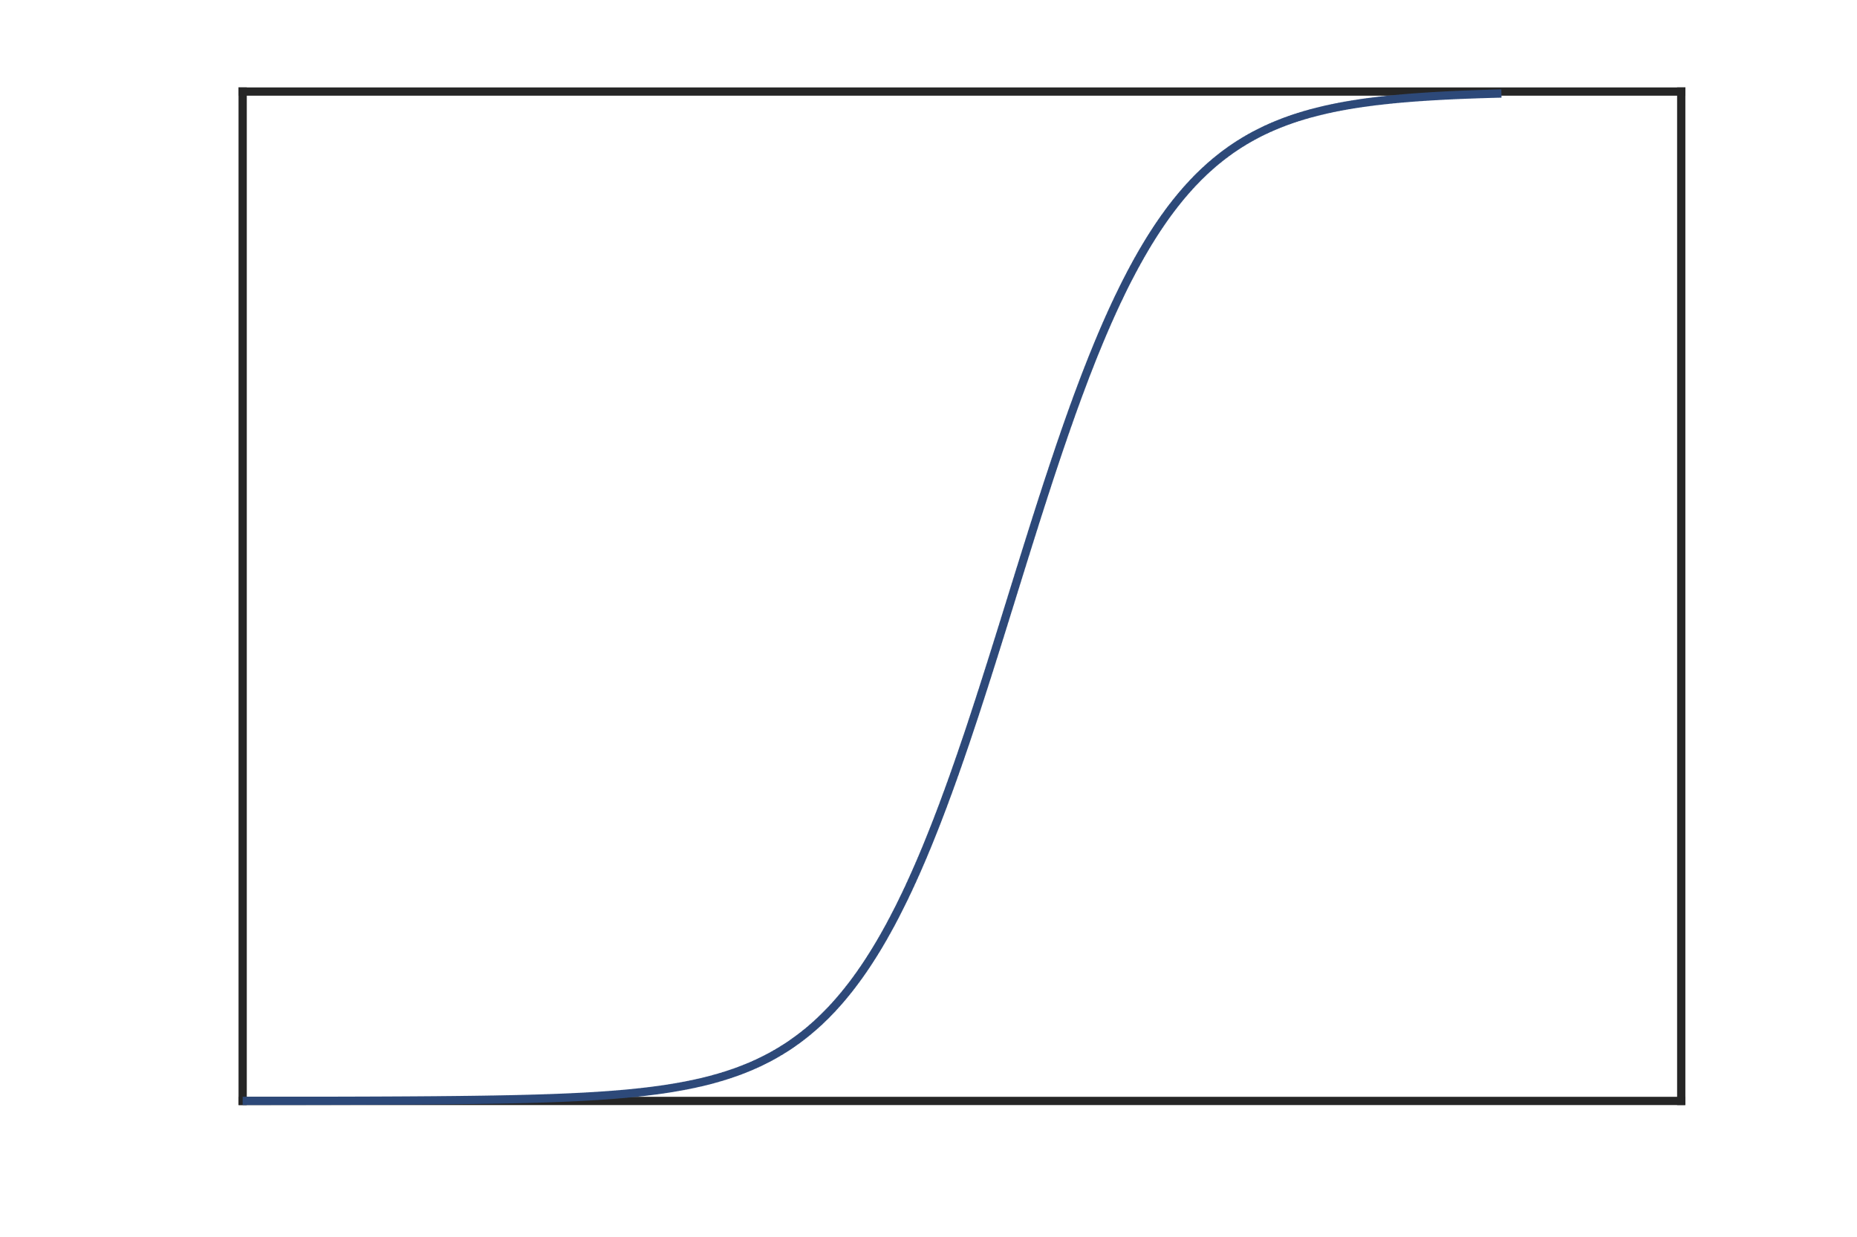

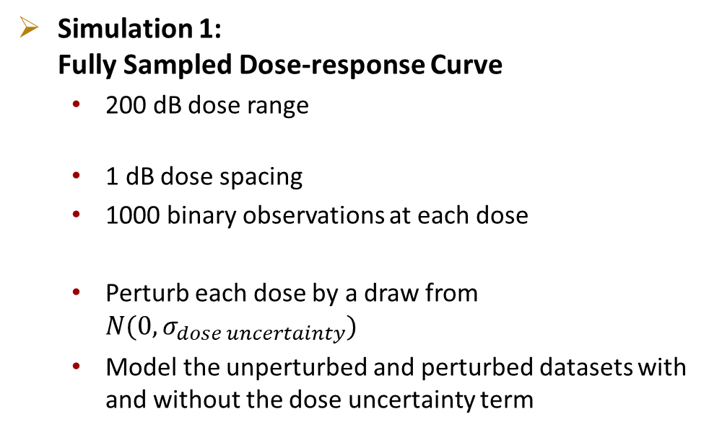
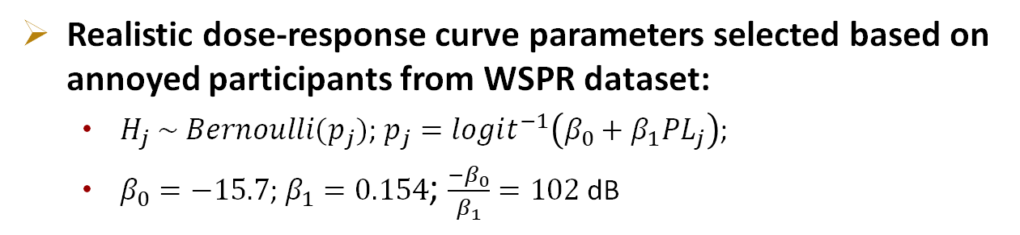
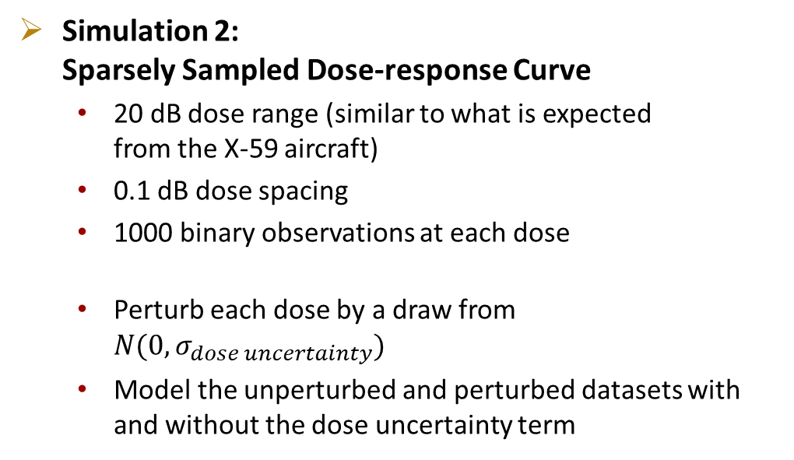
Single Participant Simulated Dataset Overview
100
Realistic dose-response curve parameters selected based on annoyed participants from WSPR dataset:
  $H_{j} \sim Bernoulli(p_{j})$; $p_{j}=logit^{−1}\left(β_{0}+β_{1}PL_{j}\right)$;
  $β_{0}=−15.7$; $β_{1}=0.154$; $\frac{{−β}_{0}}{β_{1}}=102$ dB
Response:
% Annoyed
$$\frac{{−β}_{0}}{β_{1}}$$
0
Dose: Boom Level (dB)
Simulation 1:
Fully Sampled Dose-response Curve
  200 dB dose range
  1 dB dose spacing
  1000 binary observations at each dose
  Perturb each dose by a draw from $N(0,σ_{dose uncertainty})$
  Model the unperturbed and perturbed datasets with and without the dose uncertainty term
Simulation 2:
Sparsely Sampled Dose-response Curve
  20 dB dose range (similar to what is expected
  from the X-59 aircraft)
  0.1 dB dose spacing
  1000 binary observations at each dose
  Perturb each dose by a draw from $N(0,σ_{dose uncertainty})$
  Model the unperturbed and perturbed datasets with and without the dose uncertainty term
Notes:
Say aloud what dose uncertainty SD was used (8 dB, to illustrate the flattening effect)

Slide 6
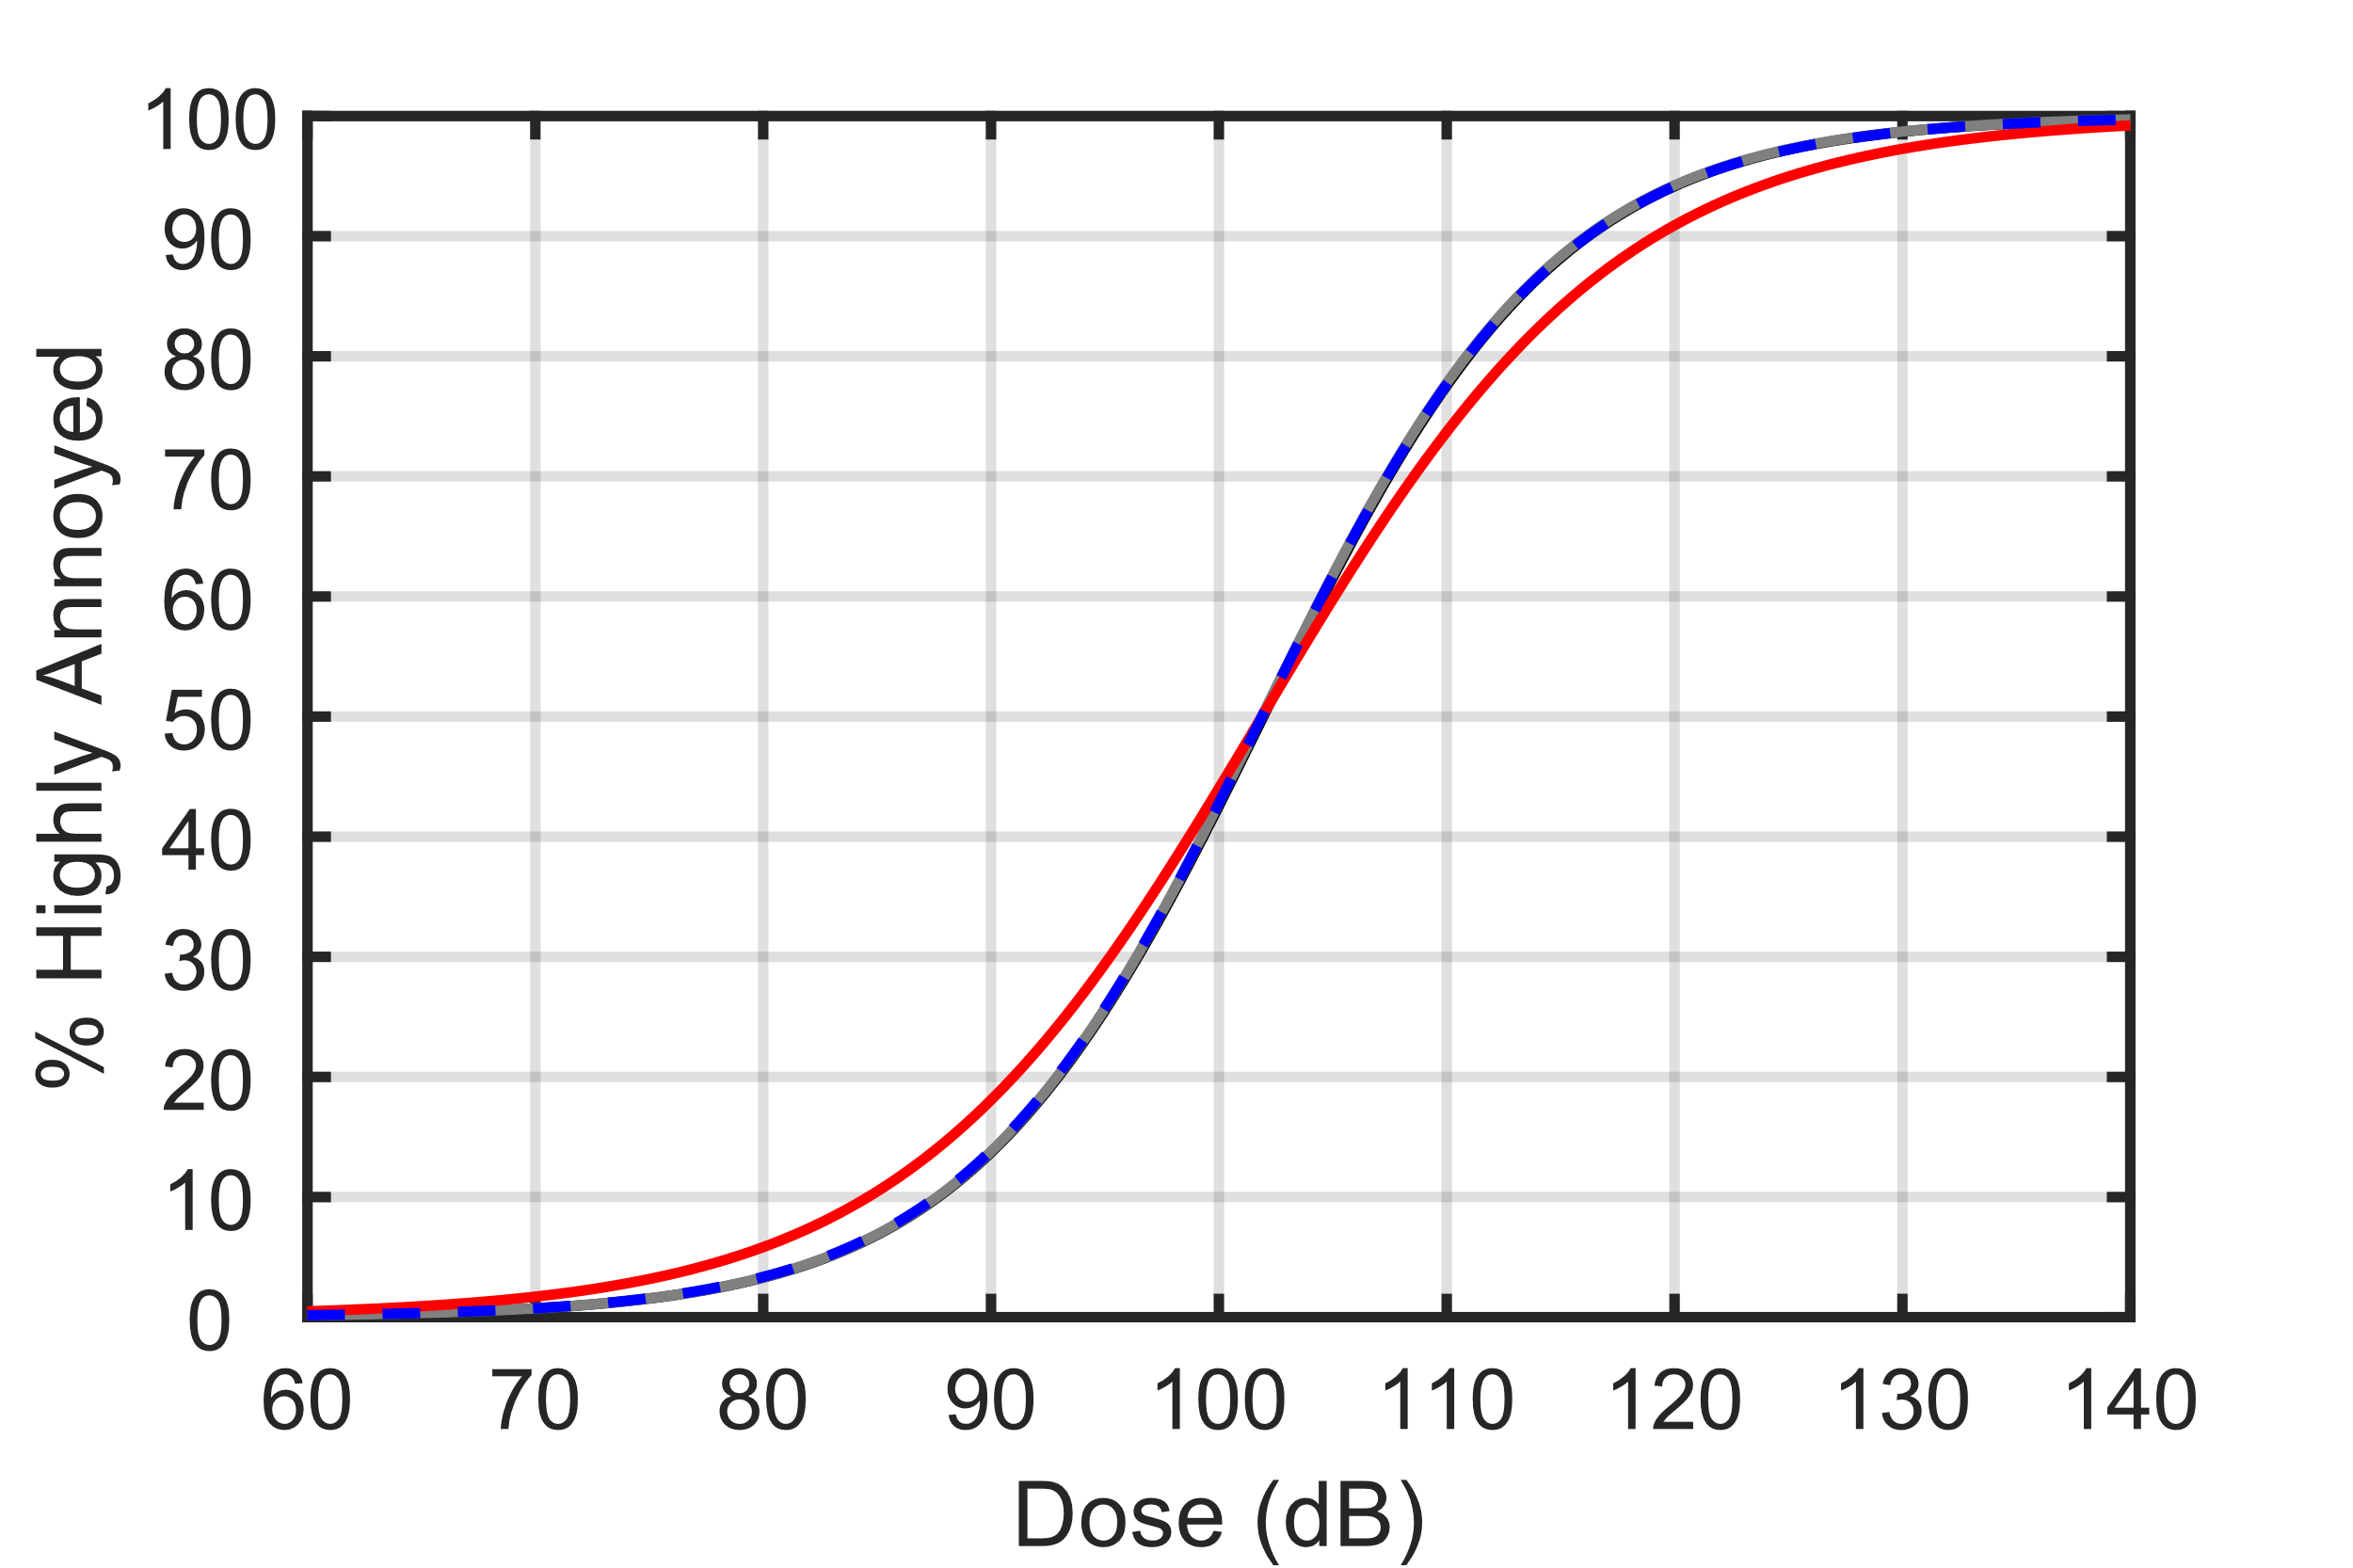
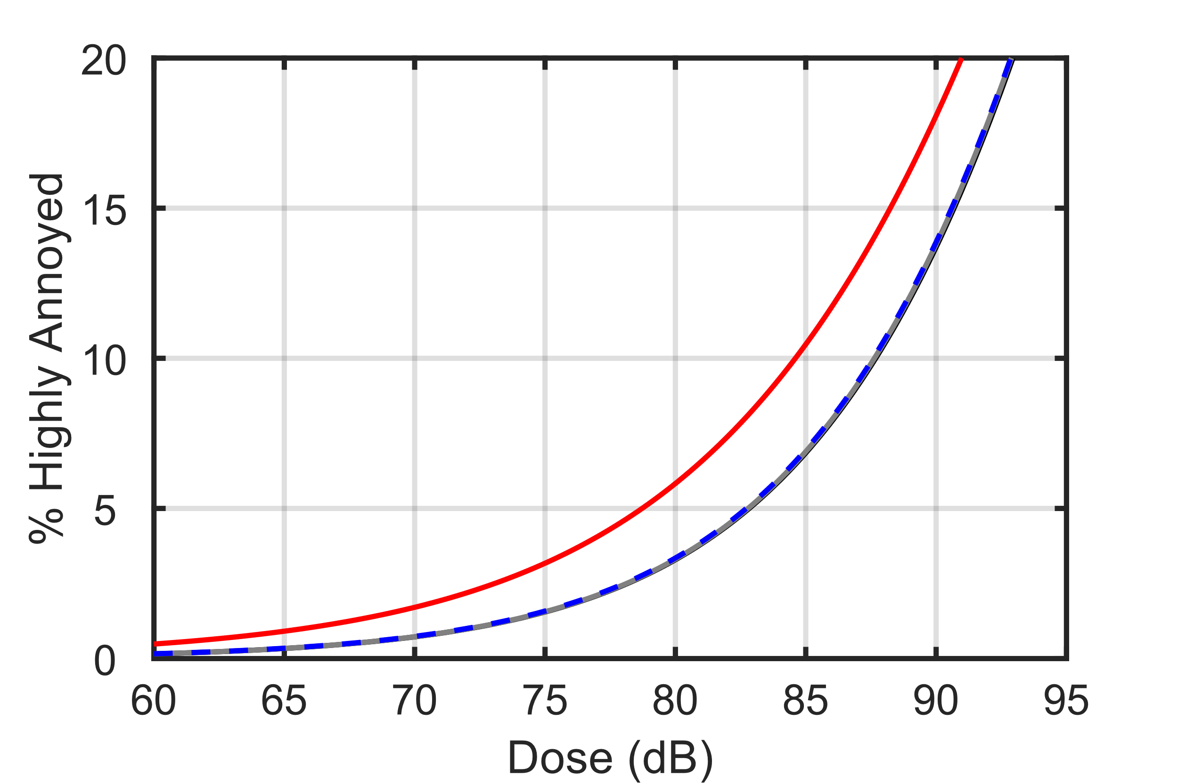
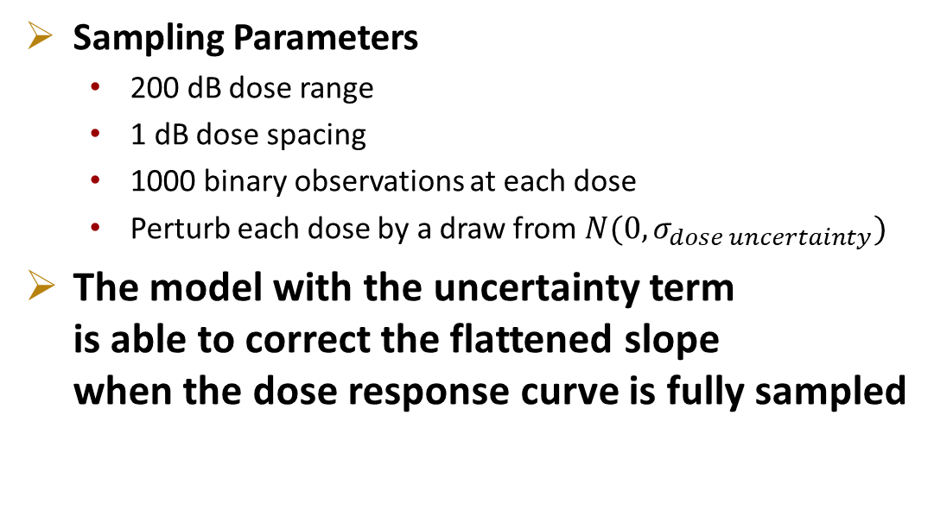
Simulation 1: Fully Sampled Dose-Response Curve
Underlying (Target) Dose-response Curve
Model w/o Uncertainty Term Fit to Unperturbed Dose Data
Model w/o Uncertainty Term Fit to Perturbed Dose Data
Model w Uncertainty Term Fit to Perturbed Dose Data
Observations across entire range
Sampling Parameters
  200 dB dose range
  1 dB dose spacing
  1000 binary observations at each dose
  Perturb each dose by a draw from $N(0,σ_{dose uncertainty})$
The model with the uncertainty term
is able to correct the flattened slope
when the dose response curve is fully sampled
Notes:
Clarify what is meant by unperturbed and perturbed

Slide 7
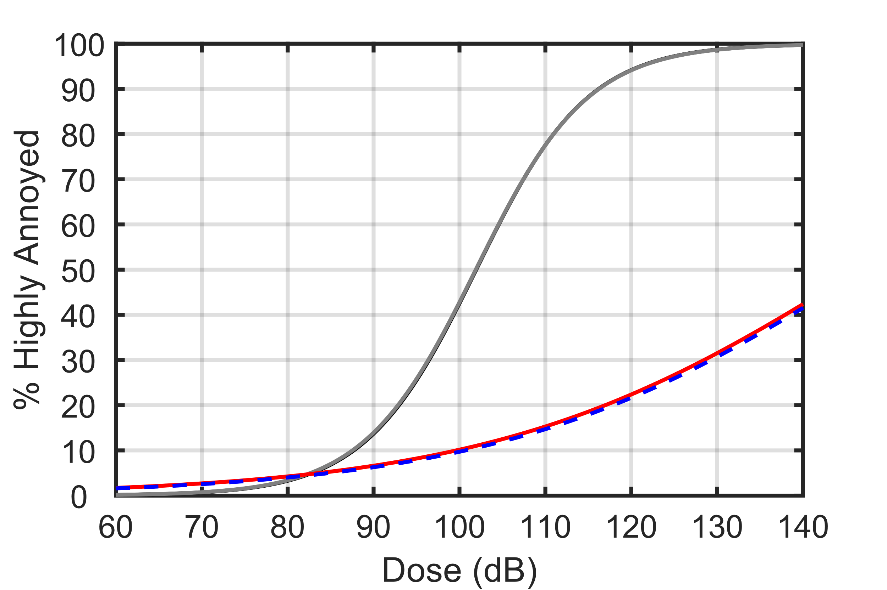
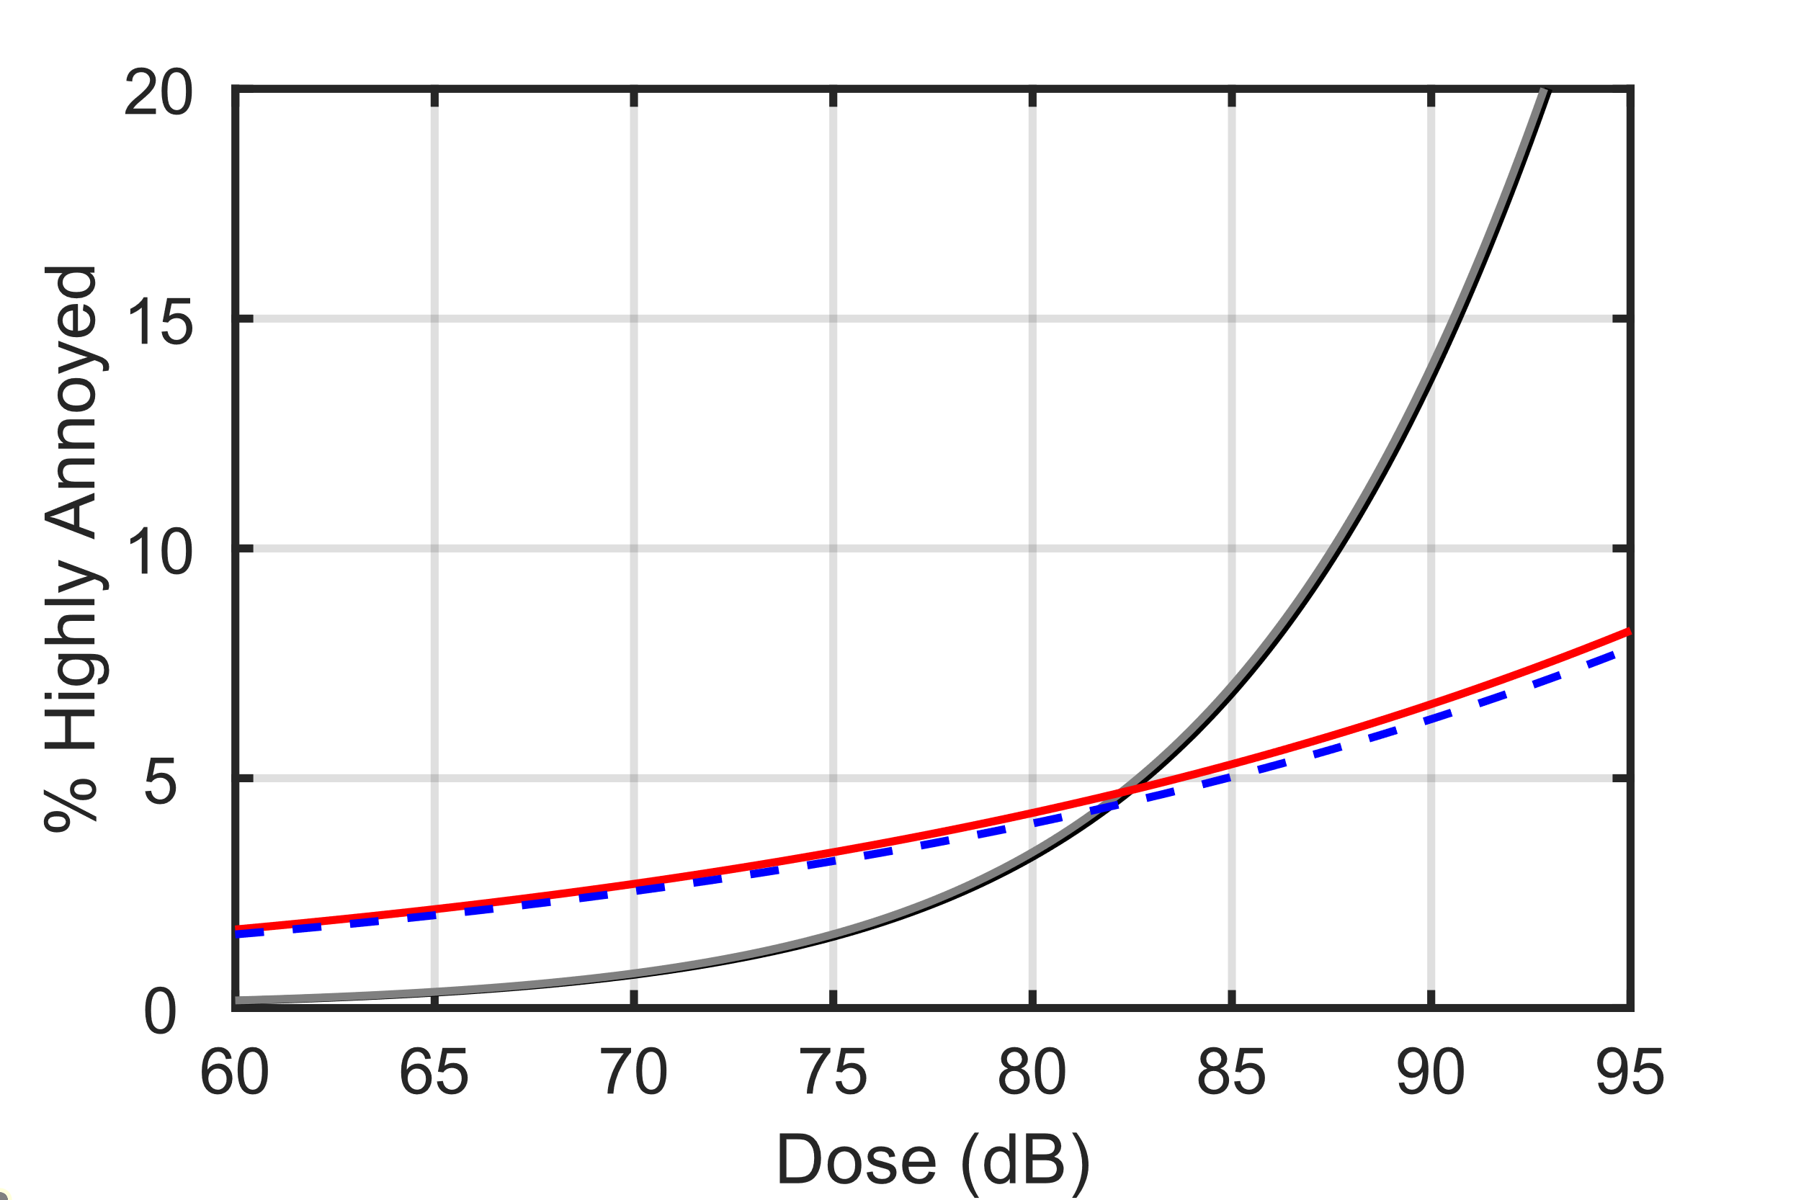
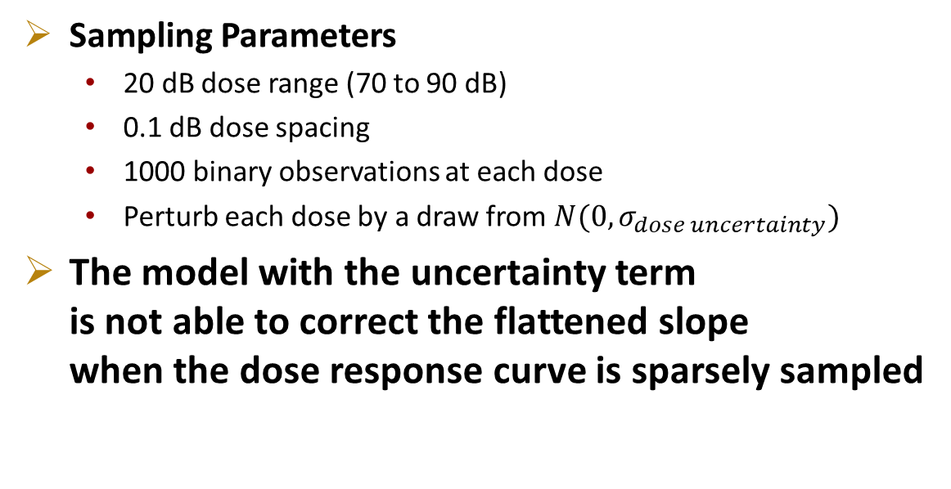
Simulation 2: Sparsely Sampled Dose-Response Curve
Underlying (Target) Dose-response Curve
Model w/o Uncertainty Term Fit to Unperturbed Dose Data
Model w/o Uncertainty Term Fit to Perturbed Dose Data
Model w Uncertainty Term Fit to Perturbed Dose Data
Observations across
limited range
Sampling Parameters
  20 dB dose range (70 to 90 dB)
  0.1 dB dose spacing
  1000 binary observations at each dose
  Perturb each dose by a draw from $N(0,σ_{dose uncertainty})$
The model with the uncertainty term
is not able to correct the flattened slope
when the dose response curve is sparsely sampled

Slide 8
Discussion of Simulation Results
Simulation 1 (Fully Sampled Annoyance) and Simulation 2 (Sparsely Sampled Annoyance) show the extremes in attenuation correction effectiveness
In longitudinal community noise surveys, both “Fully Sampled Annoyance” and “Sparsely Sampled Annoyance” participants may be present (and participants somewhere in between)
Including the dose uncertainty term in a multilevel model could correct “Fully Sampled Annoyance” participant slopes, leading to a steeper slope predicted by the model
The impact of including this uncertainty term in the NASA sonic boom community survey datasets will be presented next
  Page et al.’s WSPR and QSF18 estimates of noise dose uncertainty will be shown
  Dose-response model fits with and without the dose uncertainty term will be presented

Slide 9

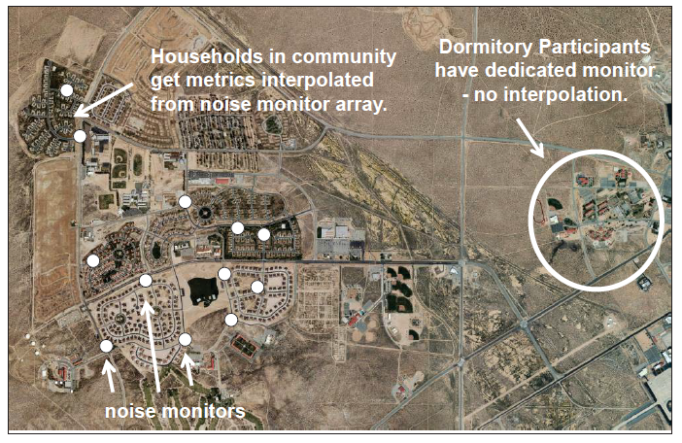
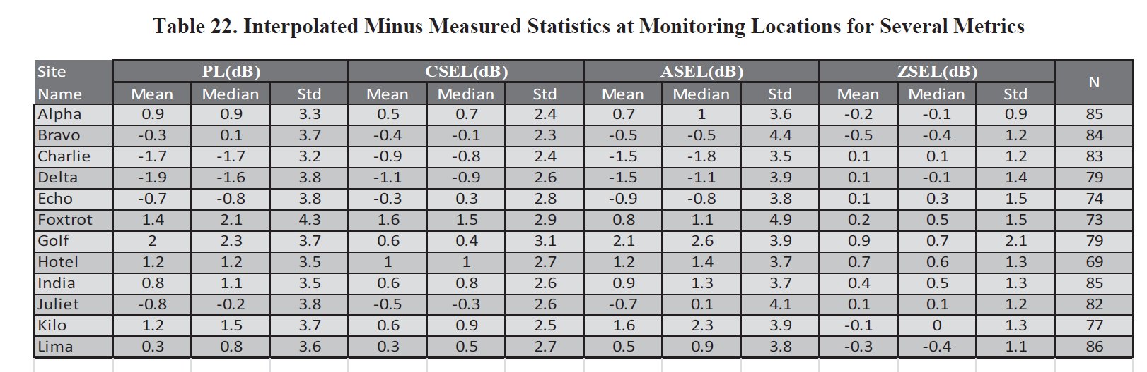
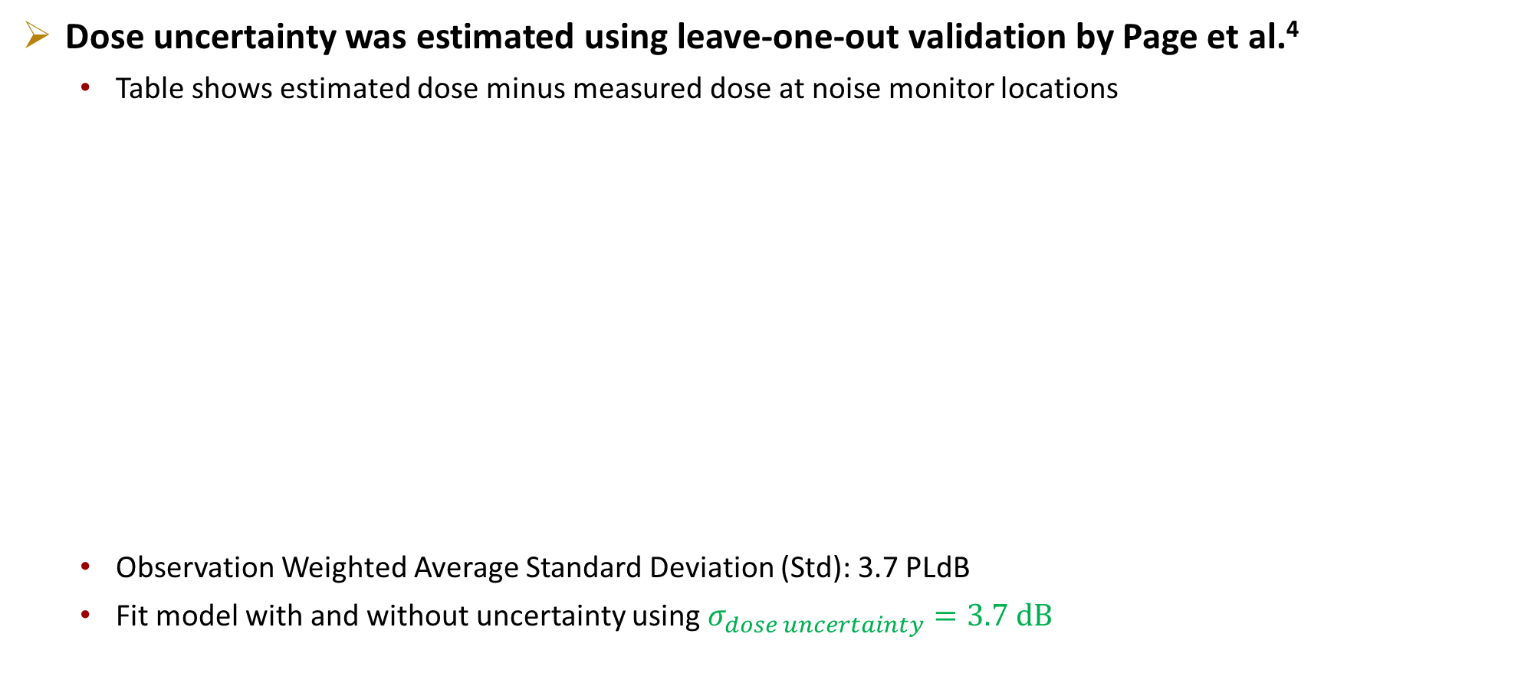
WSPR Dose Uncertainty
Dose uncertainty was estimated using leave-one-out validation by Page et al.⁴
  Table shows estimated dose minus measured dose at noise monitor locations
  Observation Weighted Average Standard Deviation (Std): 3.7 PLdB
  Fit model with and without uncertainty using $σ_{dose uncertainty}=3.7 dB$
Notes:
Add reference. Minimize time on this slide

Slide 10
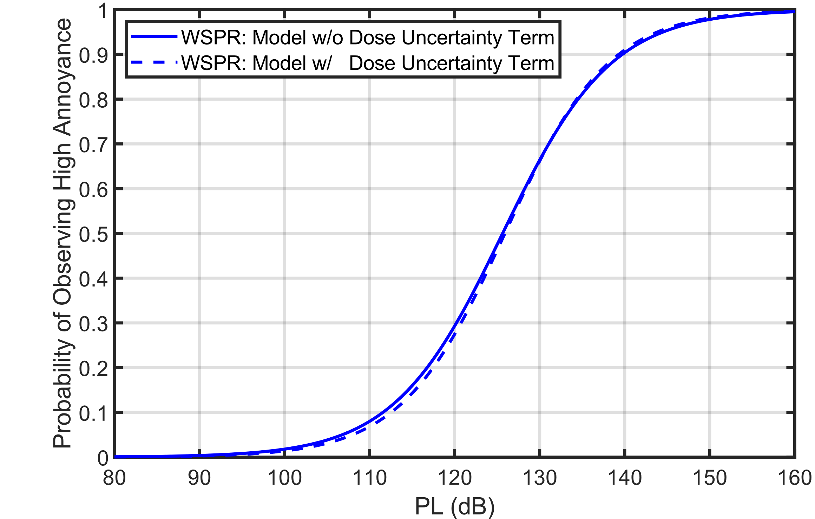
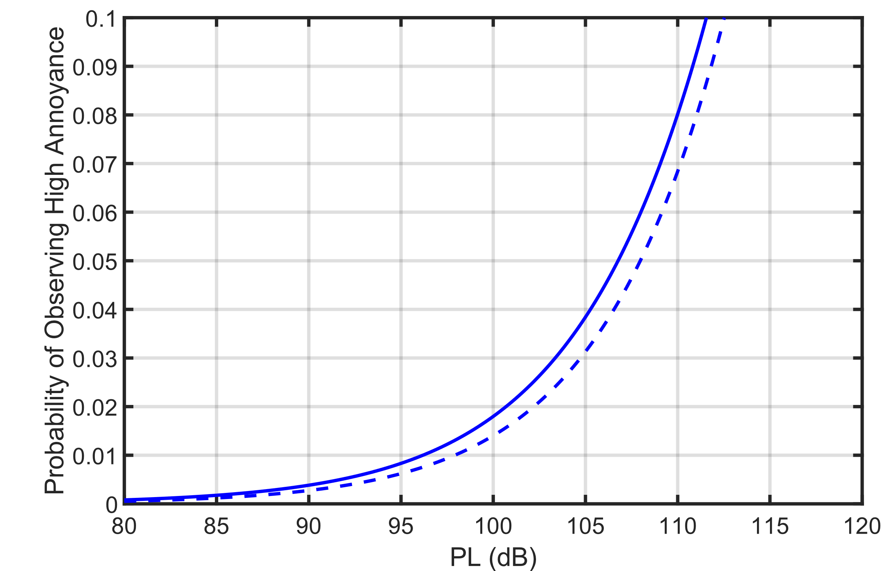
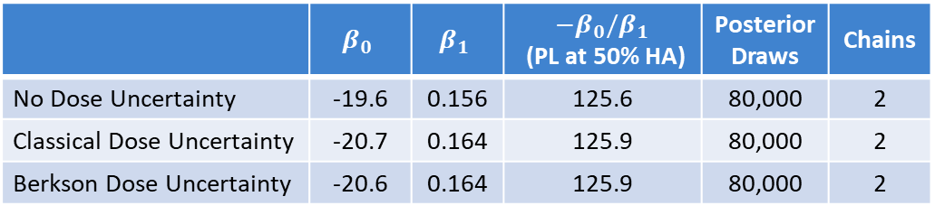
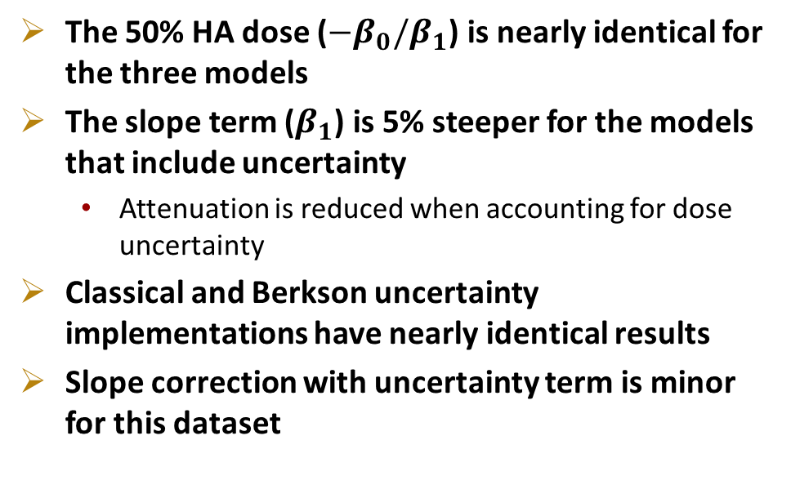
WSPR BMLR Comparison with and without Dose Uncertainty
 | $$β_{0}$$ | $$β_{1}$$ | $−β_{0}/β_{1}$ (PL at 50% HA) | Posterior Draws | Chains
No Dose Uncertainty | -19.6 | 0.156 | 125.6 | 80,000 | 2
Classical Dose Uncertainty | -20.7 | 0.164 | 125.9 | 80,000 | 2
Berkson Dose Uncertainty | -20.6 | 0.164 | 125.9 | 80,000 | 2
Probability of Observing
High Annoyance
The 50% HA dose ($−β_{0}/β_{1}$) is nearly identical for the three models
The slope term ($β_{1}$) is 5% steeper for the models that include uncertainty
  Attenuation is reduced when accounting for dose uncertainty
Classical and Berkson uncertainty implementations have nearly identical results
Slope correction with uncertainty term is minor
for this dataset
~1 PLdB difference
at 5% HA:
Probability of Observing
High Annoyance
Notes:
Be clear about subject specific and population average. Showing the average participant here

Slide 11

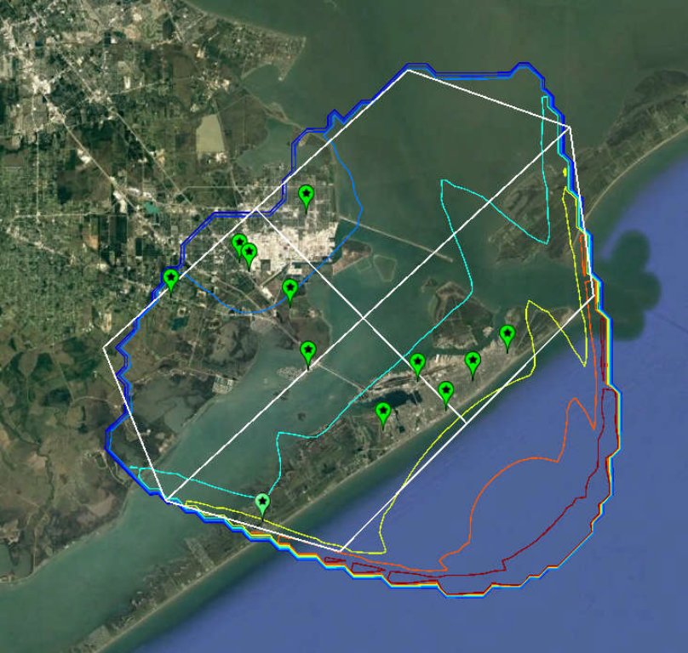
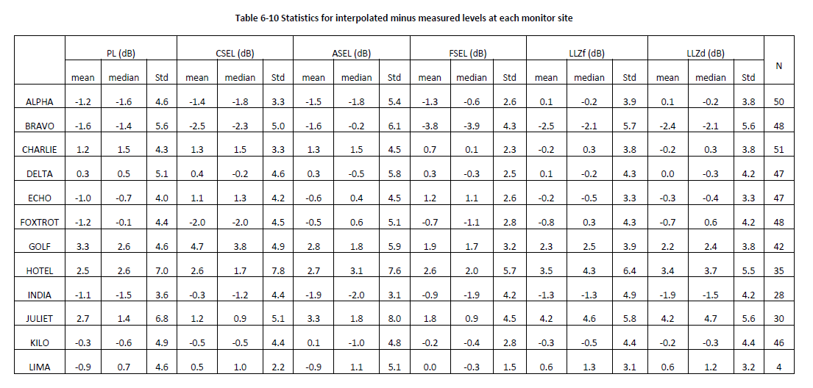
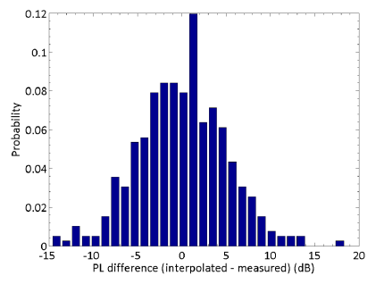
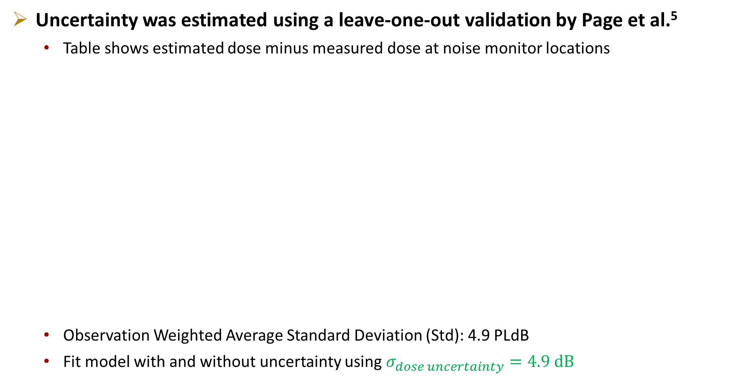
QSF18 Dose Uncertainty
Uncertainty was estimated using a leave-one-out validation by Page et al.⁵
  Table shows estimated dose minus measured dose at noise monitor locations
  Observation Weighted Average Standard Deviation (Std): 4.9 PLdB
  Fit model with and without uncertainty using $σ_{dose uncertainty}=4.9 dB$

Slide 12
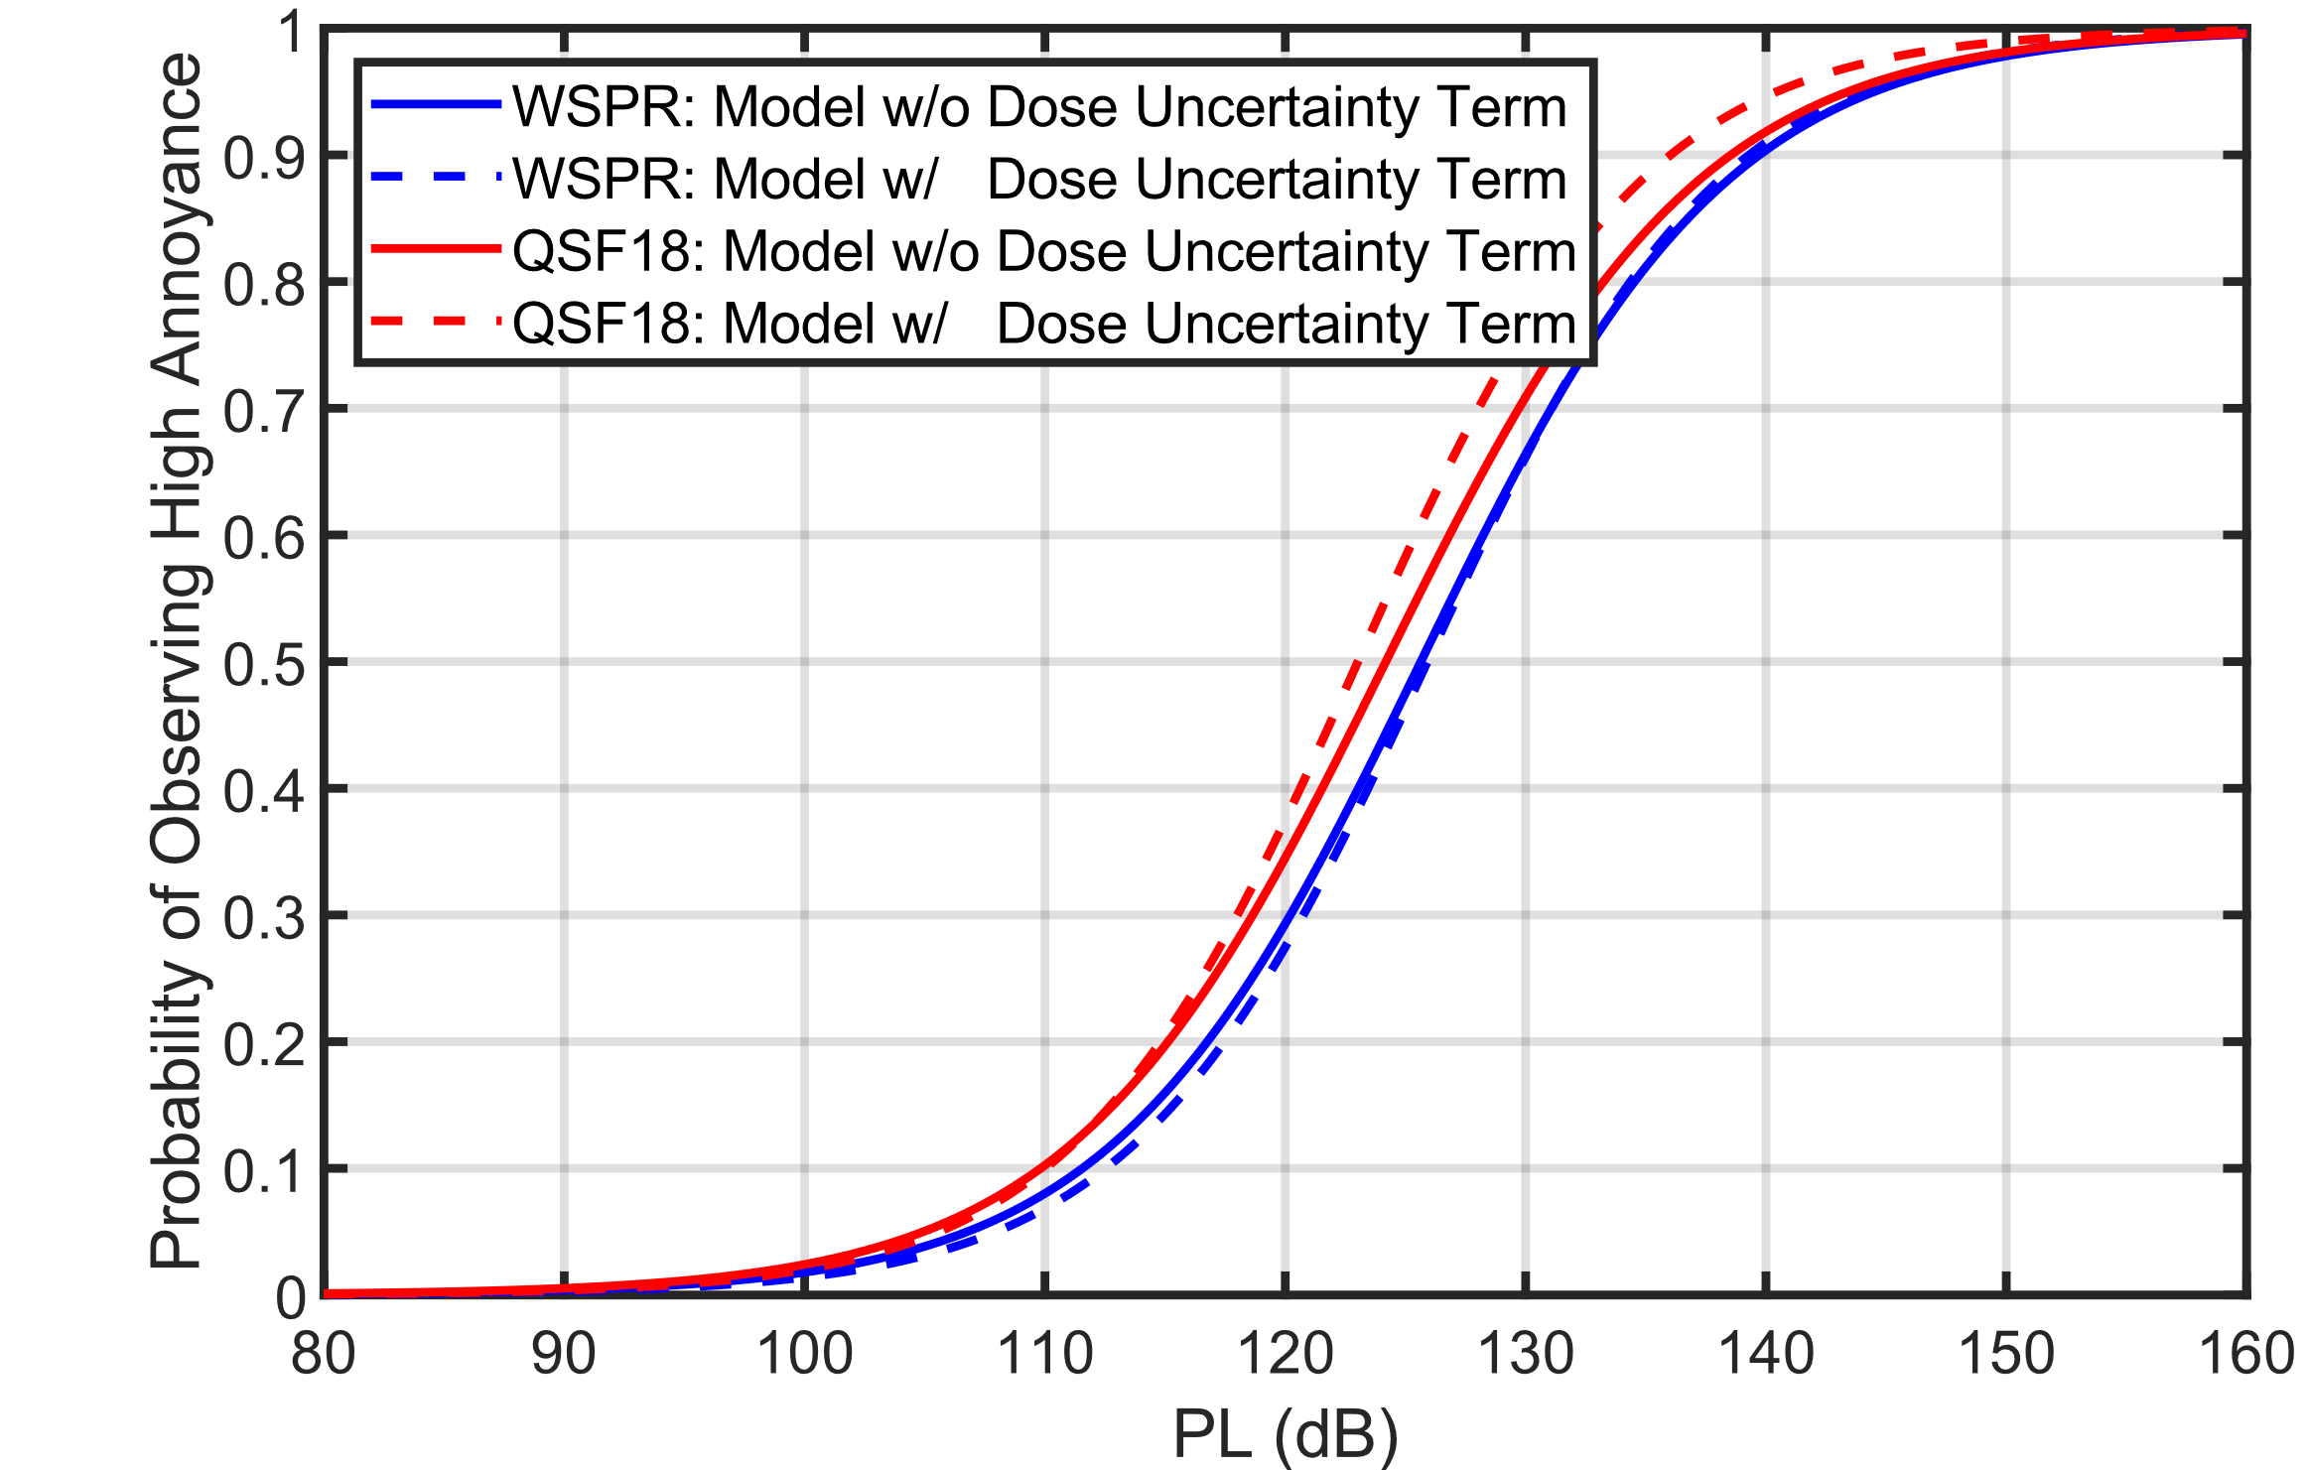
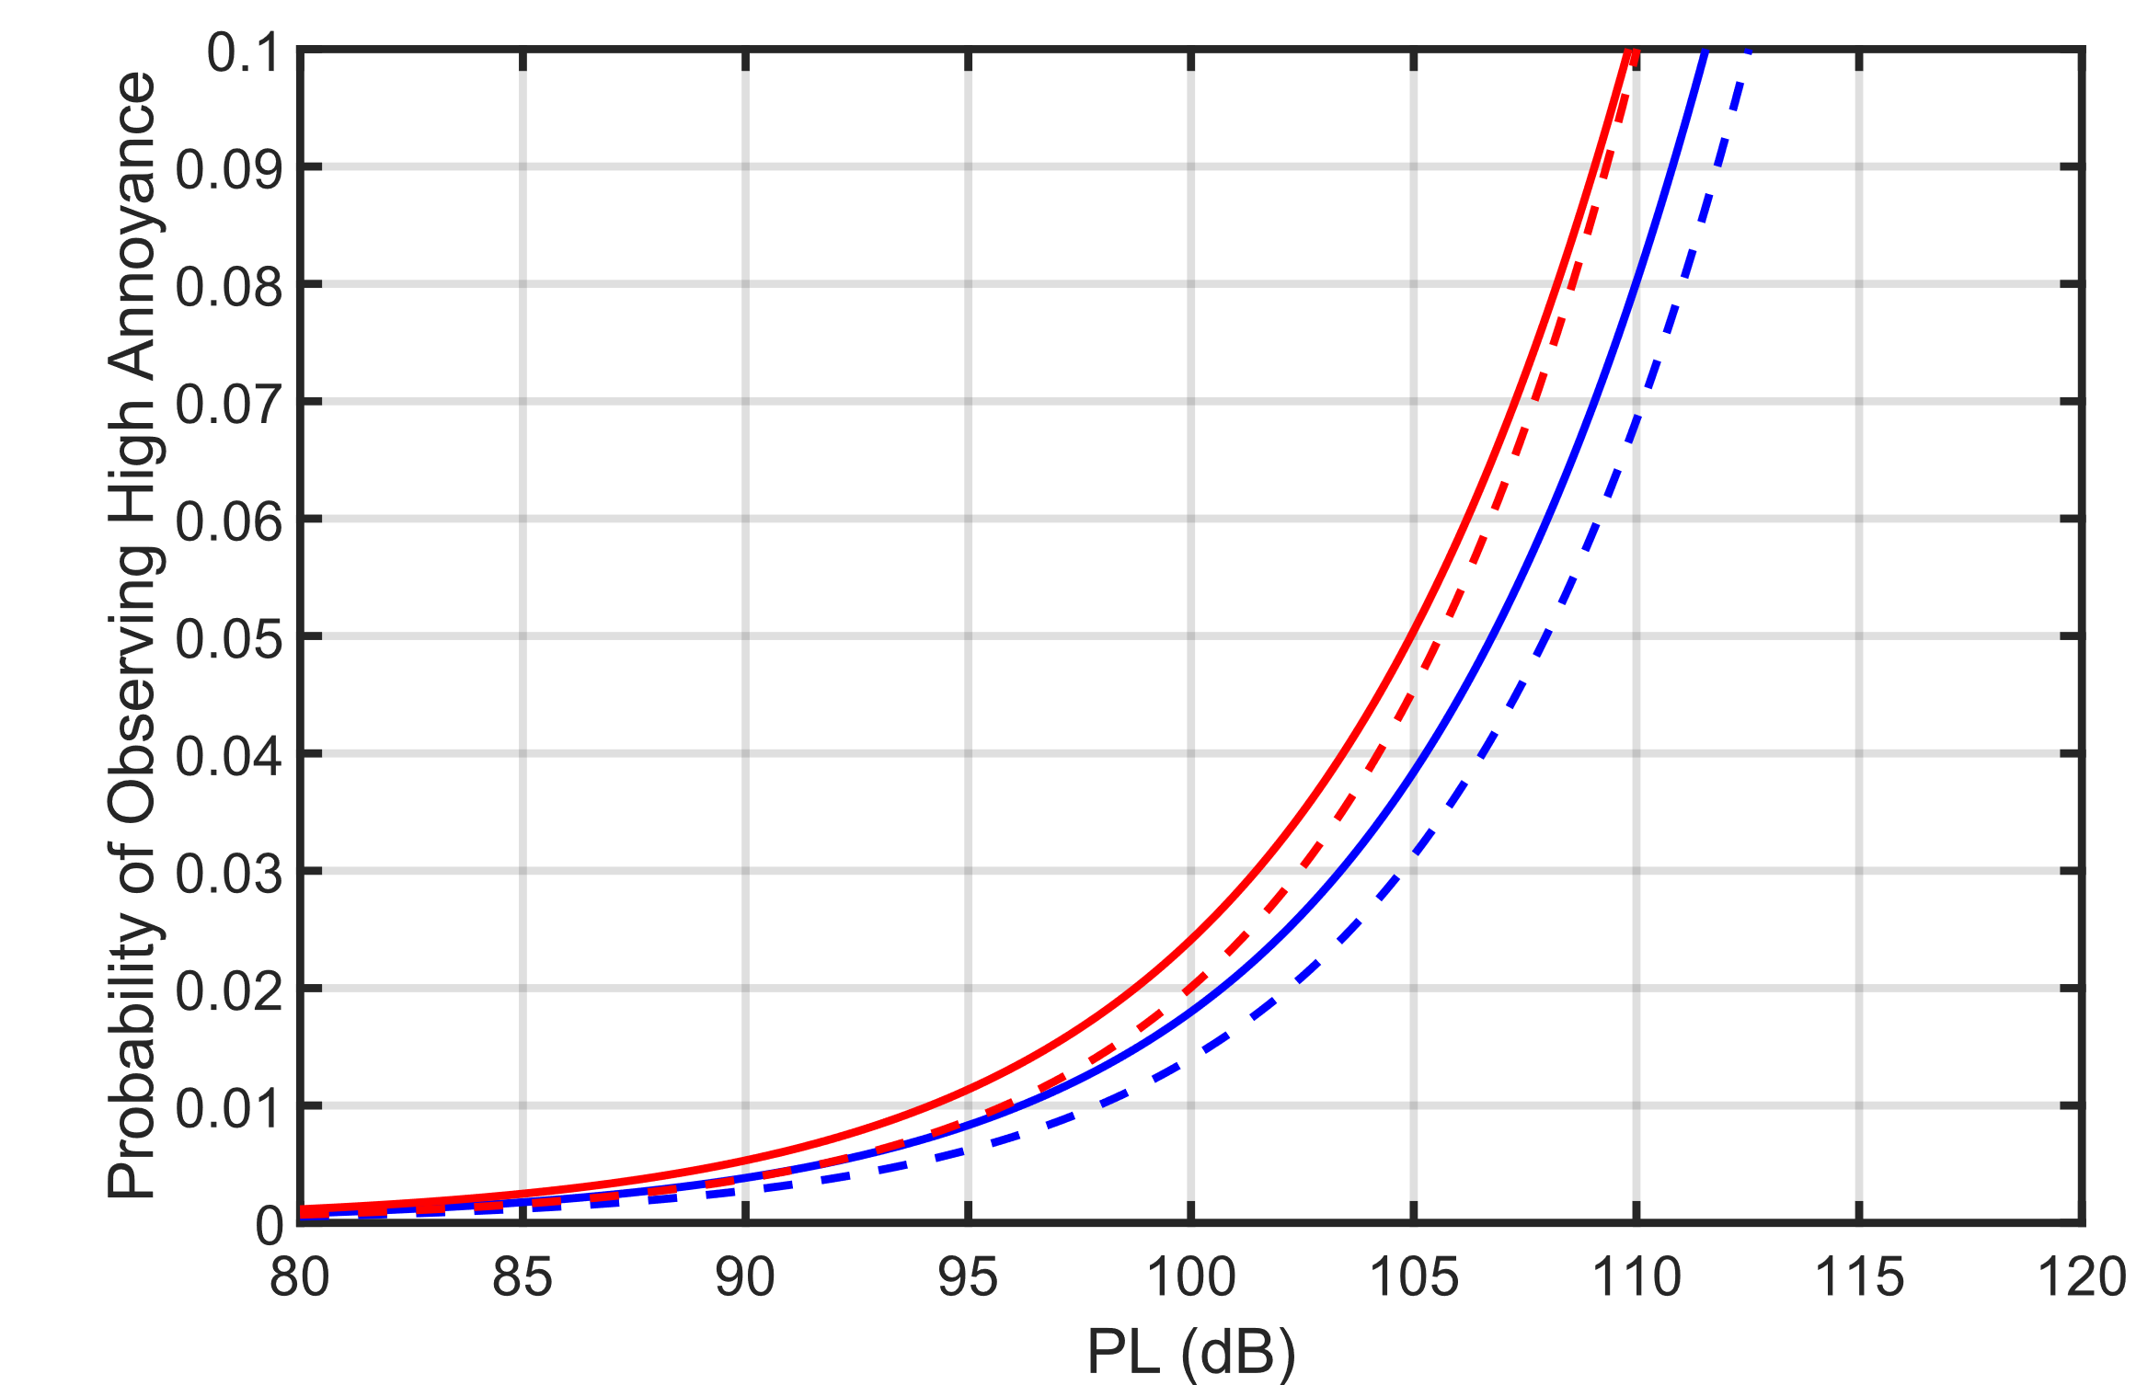
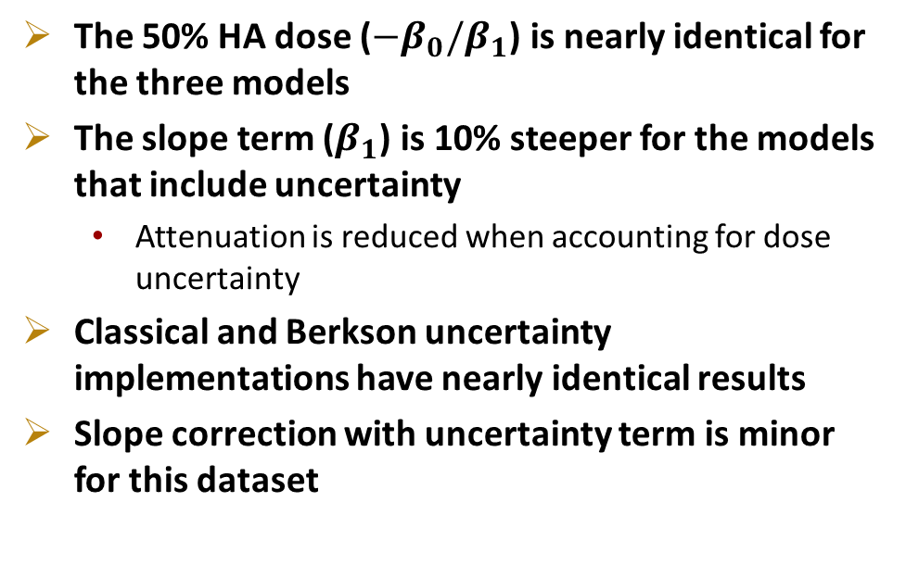
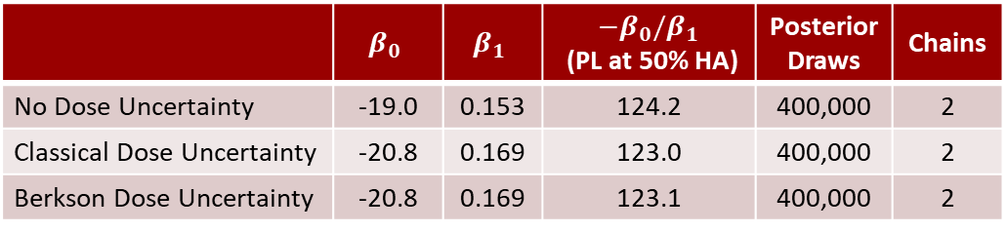
QSF18 BMLR Comparison with and without Dose Uncertainty
 | $$β_{0}$$ | $$β_{1}$$ | $−β_{0}/β_{1}$ (PL at 50% HA) | Posterior Draws | Chains
No Dose Uncertainty | -19.0 | 0.153 | 124.2 | 400,000 | 2
Classical Dose Uncertainty | -20.8 | 0.169 | 123.0 | 400,000 | 2
Berkson Dose Uncertainty | -20.8 | 0.169 | 123.1 | 400,000 | 2
Probability of Observing
High Annoyance
The 50% HA dose ($−β_{0}/β_{1}$) is nearly identical for the three models
The slope term ($β_{1}$) is 10% steeper for the models that include uncertainty
  Attenuation is reduced when accounting for dose uncertainty
Classical and Berkson uncertainty implementations have nearly identical results
Slope correction with uncertainty term is minor
for this dataset
~0.2 PLdB difference
at 5% HA:
Probability of Observing
High Annoyance
Notes:
Be clear about subject specific and population average. Showing the average participant here

Slide 13
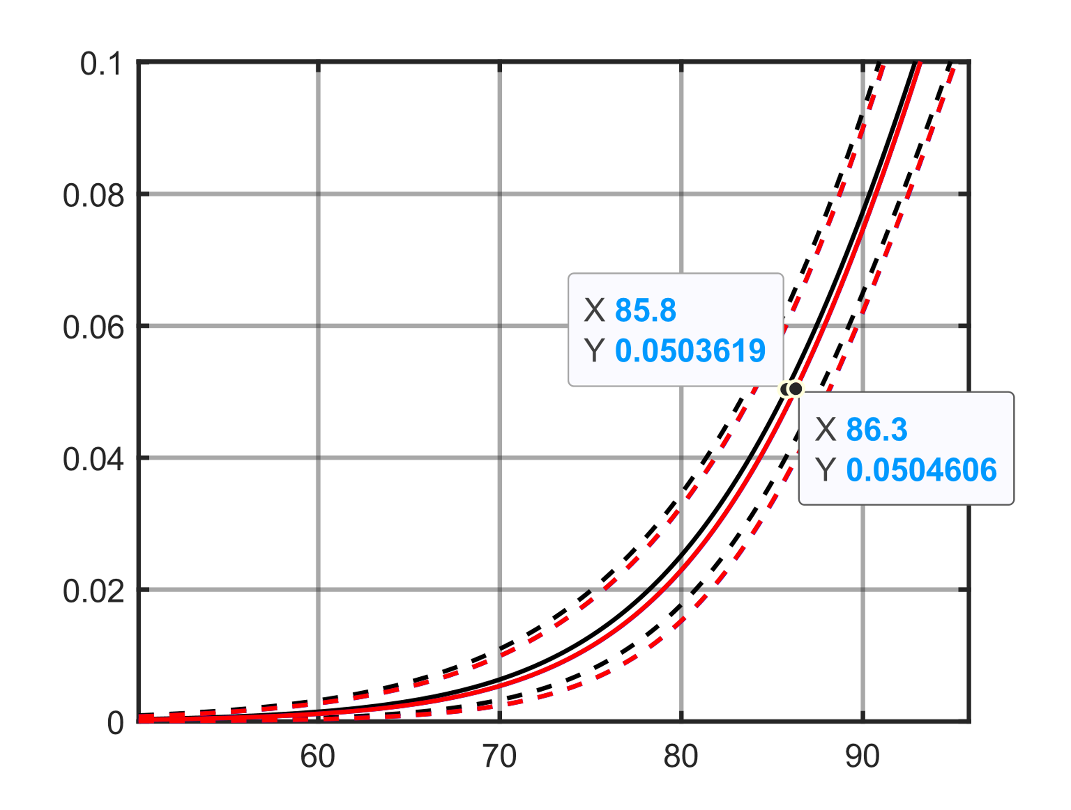
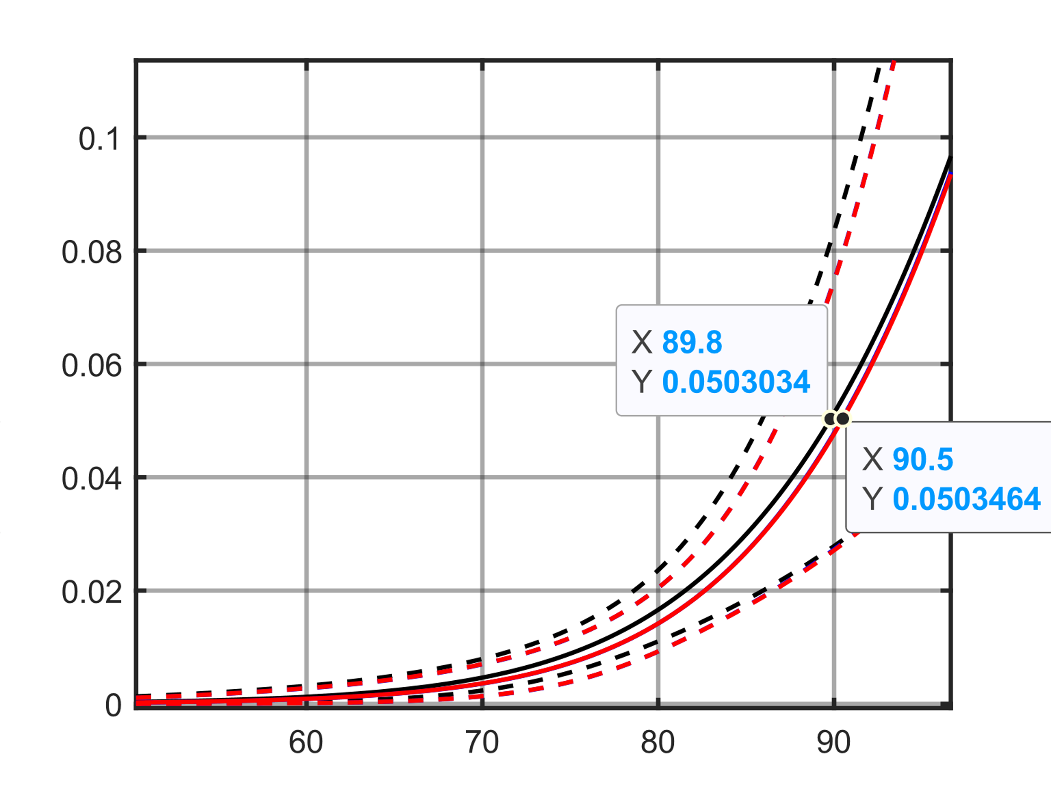
Population Summary Curves: Pointwise Average Results
Difference at 5% HA:
  WSPR: 0.5 PLdB
  QSF18: 0.7 PLdB
95% Credible Intervals overlap
No dose uncertainty term
Included dose uncertainty term
WSPR
QSF18
Fraction Highly Annoyed
Fraction Highly Annoyed
Dose (PLdB)
Dose (PLdB)
Notes:
Explain where the credible interval comes from. 95% CI overlap when curves are avg’d over all people

Slide 14
Summary
Previous Lee et al. Bayesian Multilevel Logistic Regression (BMLR) analyses of sonic boom community noise survey data did not include uncertainty in the noise dose
A term was added to the BMLR model to account for dose uncertainty
Two simulated datasets show when the uncertainty term can and cannot effectively correct the attenuated slope
  Future work: investigate what dose-response data is sufficient for this method to work effectively
The models with and without the uncertainty term were fit to WSPR and QSF18 datasets
  The dose uncertainty term results in 5-10% steeper subject-specific slopes
  The estimate of the dose that elicits 5% high annoyance differs by less than 1 PLdB

Slide 15
References
R. Horonjeff, “An examination of dose uncertainty and dose distribution effects on community noise attitudinal survey outcomes,” J. Acoust. Soc. Am. 150, (2021); doi: 10.1121/10.0005949
C. Kirisits, C. Lechner, and H. Kirisits, “Impact of Uncertainties Related to Noise Indicator Determination on Observed Exposure–Effect Relationship,” Noise Health, 20(96), (2018); doi: 10.4103/nah.NAH_57_17
J. Lee, A. Wilson, and J. Rathsam, “Bayesian statistical models for community annoyance survey data,” J. Acoust. Soc. Am. 147, (2020); doi: 10.1121/10.0001021
J. Page, et al., “Waveforms and Sonic Boom Perception and Response (WSPR): Low-Boom Community Response Program Pilot Test Design, Execution, and Analysis,” NASA/CR–2014-218180, (2014)
J. Page, et al., “Quiet Supersonic Flights 2018 (QSF18) Test: Galveston, Texas Risk Reduction for Future Community Testing with a Low-Boom Flight Demonstration Vehicle,” NASA/CR–2020-220589/Volume I, (2020)

Slide 16
Thank you!

Slide 17
Additional Material

Slide 18
NASA Sonic Boom Community Test Pilot Studies
WSPR2011
Noise source: N-wave sonic booms
  110 booms delivered
  PL Range: 63 to 106 dB
~1 square mile (2.6 km²) survey area
12 noise monitors
49 participants
1,981 survey responses
Dose estimated by 2D spatial interpolation of measurements to participant locations
QSF18
Noise source: N-wave sonic booms
  52 booms delivered
  PL Range: 56 to 90 dB
~60 square mile (155 km²) area
12 noise monitors
371 participants
4,998 survey responses
Dose estimated by combination of measurements and predictions at participant locations
Previous analyses of these pilot studies assumed the noise dose was known without uncertainty

Slide 19
Deviance Information Criterion (DIC) Results
Do the additional terms improve the model?
(Lower value is better)
The classical dose uncertainty DIC is much larger because it must estimate the true dose.
  Despite this, the resulting dose-response curve is nearly identical to the Berkson dose-response curve.
For WSPR, the dose uncertainty term does not reduce the DIC
For QSF18, the dose uncertainty term slightly reduces the DIC (about 1% lower)
DIC | WSPR | QSF18
No Dose Uncertainty (from Lee, et al., JASA) | 510.0 | 385.6
Classical Dose Uncertainty | 13275.0 | 35480.0
Berkson Dose Uncertainty | 510.0 | 381.7
Notes:
QSF18
No Uncertainty Term
Mean deviance: 312.6
penalty 73
Penalized deviance: 385.6
Berkson
Mean deviance: 287.3
penalty 94.4
Penalized deviance: 381.7
Classical
Mean deviance: 30408
penalty 5071
Penalized deviance: 35480
WSPR
No dose uncertainty
Mean deviance: 475.6
penalty 34.4
Penalized deviance: 510
Berkson
Mean deviance: 452.3
penalty 57.75
Penalized deviance: 510
Classical
Mean deviance: 11257
penalty 2018
Penalized deviance: 13275

Slide 20
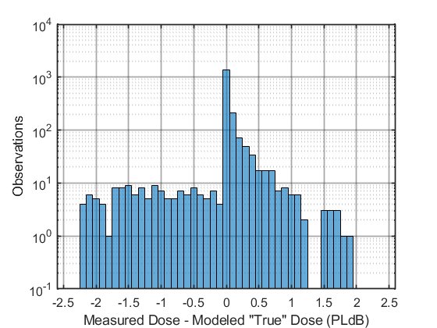

WSPR results: How are the doses shifted?
Classical
Histograms in 0.1 PLdB bins shows the number of observations of difference values
  Positive difference value indicates the measured dose was higher than the modeled dose
Mean difference:
  Classical: 0.00014 PLdB
  Berkson: 0.00021 PLdB
Median difference:
  Classical: 0.012 PLdB
  Berkson: 0.013 PLdB
Model used 80,000 samples and 2 chains
Future work: repeat this with QSF18 data
Berkson
Estimated true dose tended to be shifted higher for highly annoyed responses, and lower for not highly annoyed responses

Slide 21
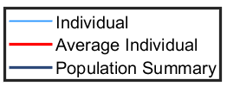
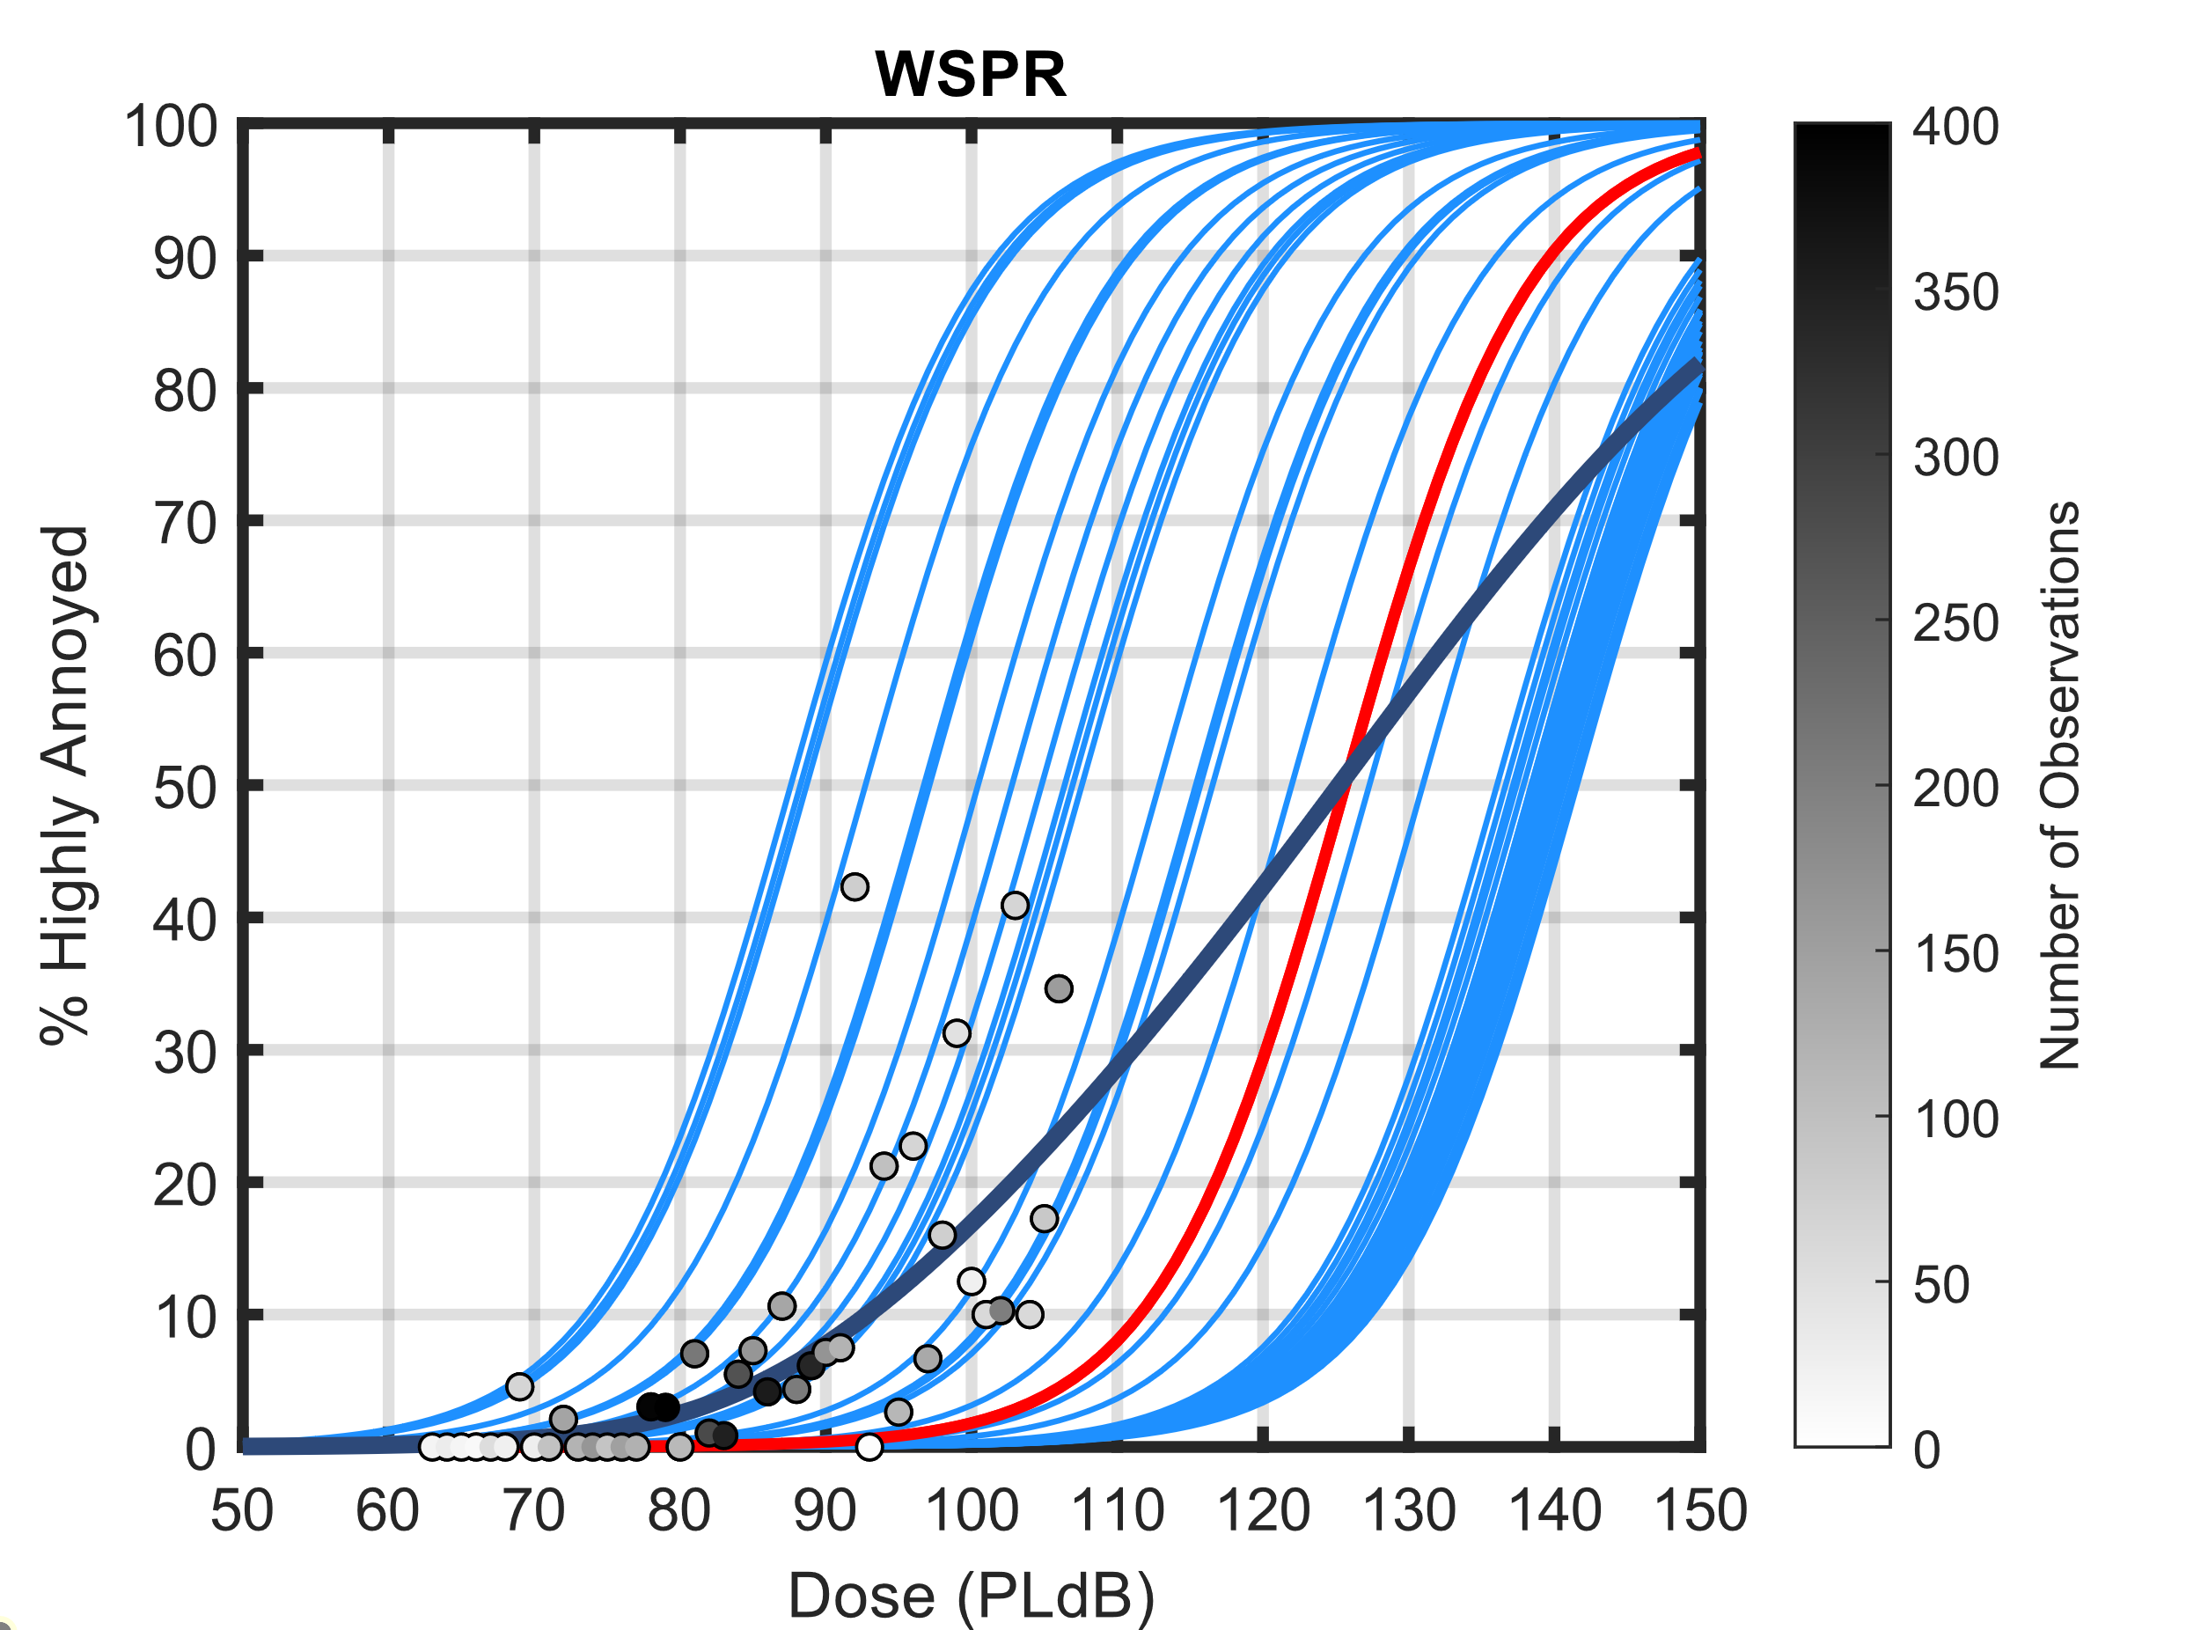
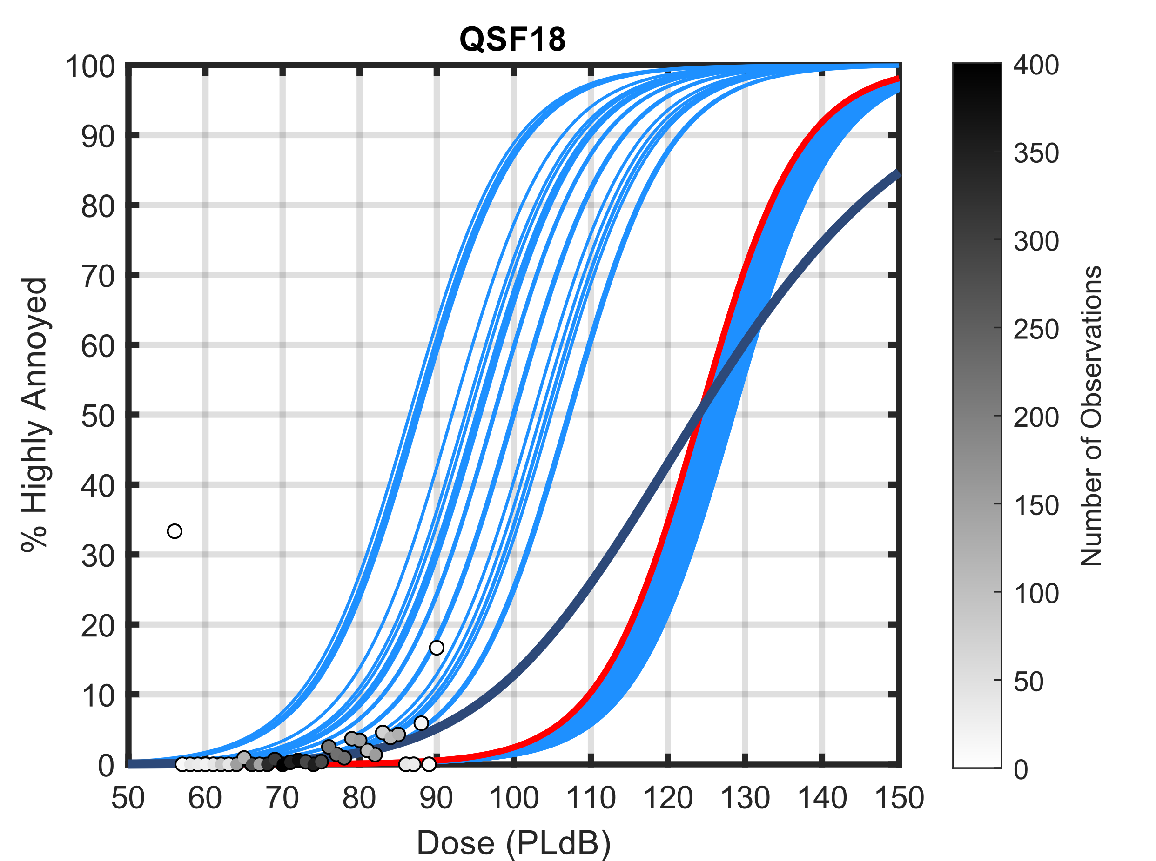
BMLR Results for WSPR and QSF18

