Slide 1

Biological and Physical Sciences
Expanding Science Beyond Low Earth Orbit
Kevin Sato, Ph.D.
Program Scientist for Space Exploration
NASA Biological and Physical Sciences Division
Science Mission Directorate
NASA Ames Research Center
IMSPG, December 2021
Notes:
STILL

Slide 2
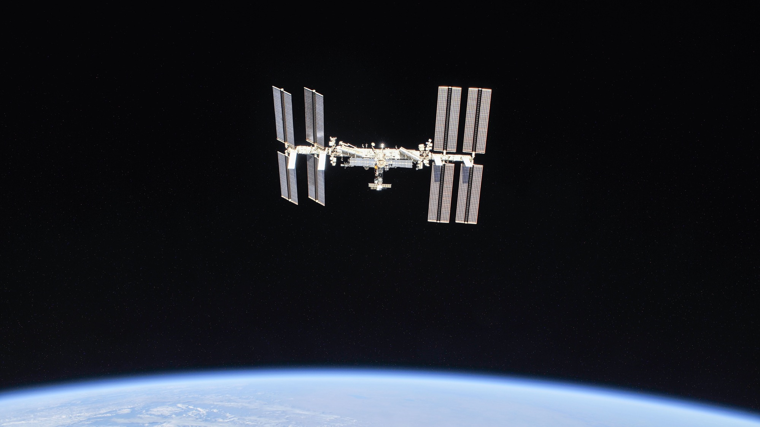

A convergence of science, technology and human innovation leading to research breakthroughs and demonstrates new capabilities
not possible on Earth.

Slide 3
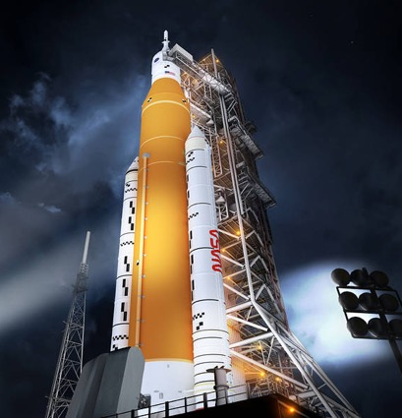
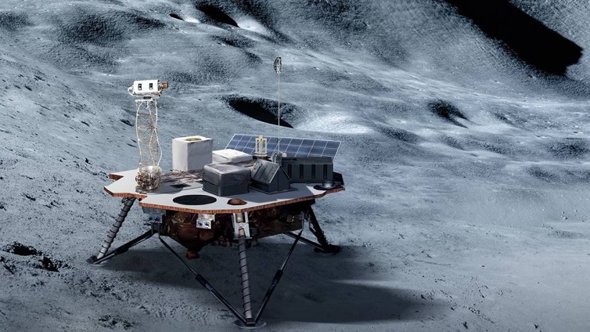
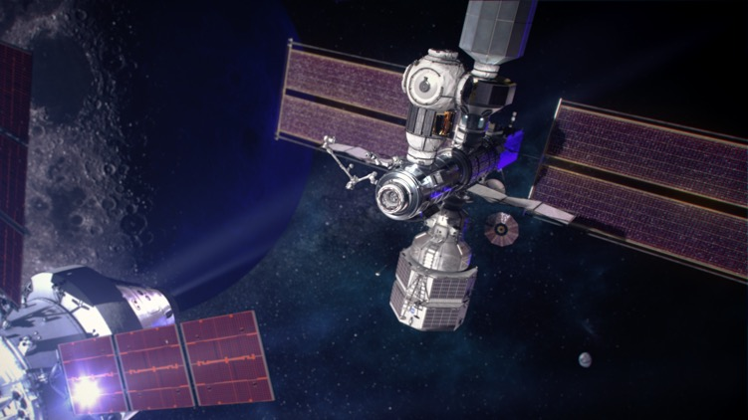
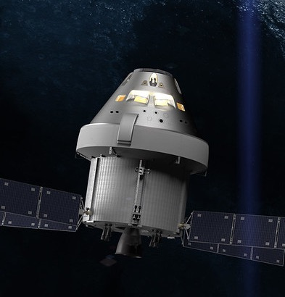
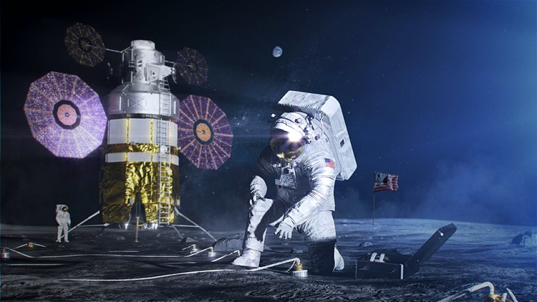
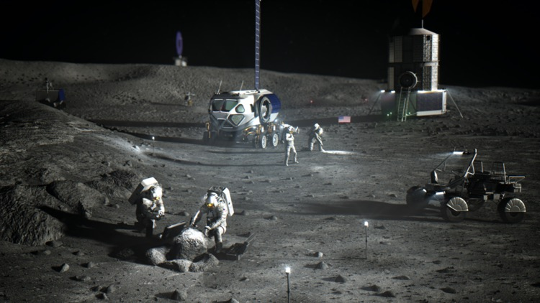
Artemis Snapshot
SLS
Commercial Lunar Payload Services
The Gateway in Lunar Orbit
First Woman and First
Person of Color to the Moon
Orion
Artemis Base Camp

Slide 4
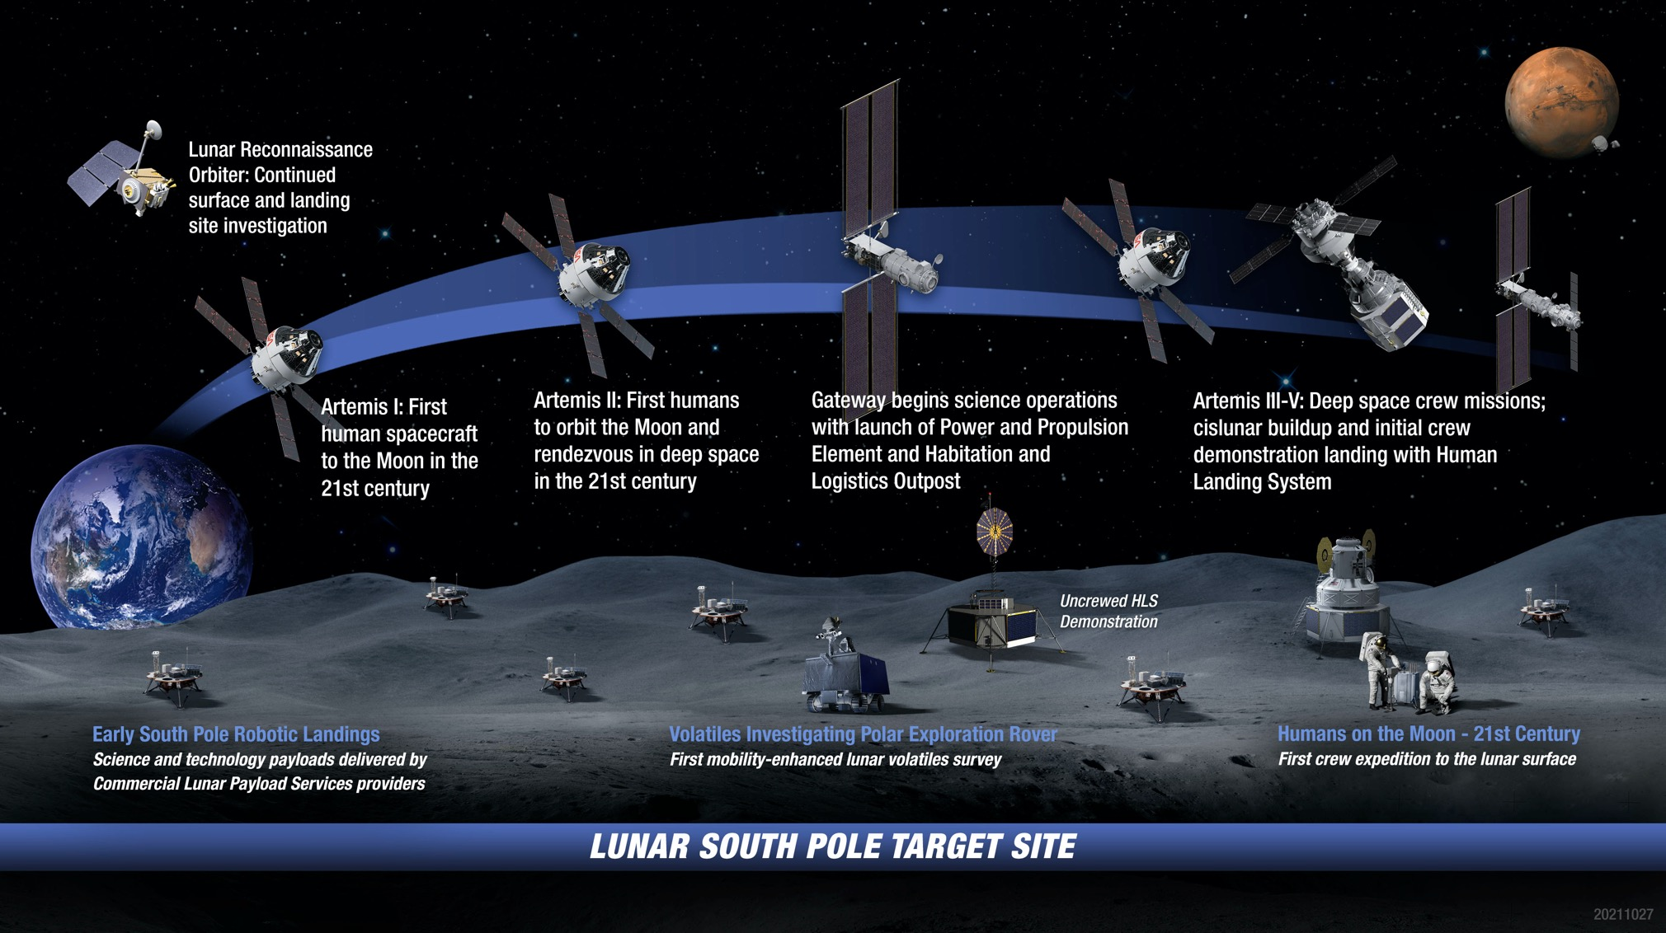
Artemis: Landing Humans On the Moon

Slide 5
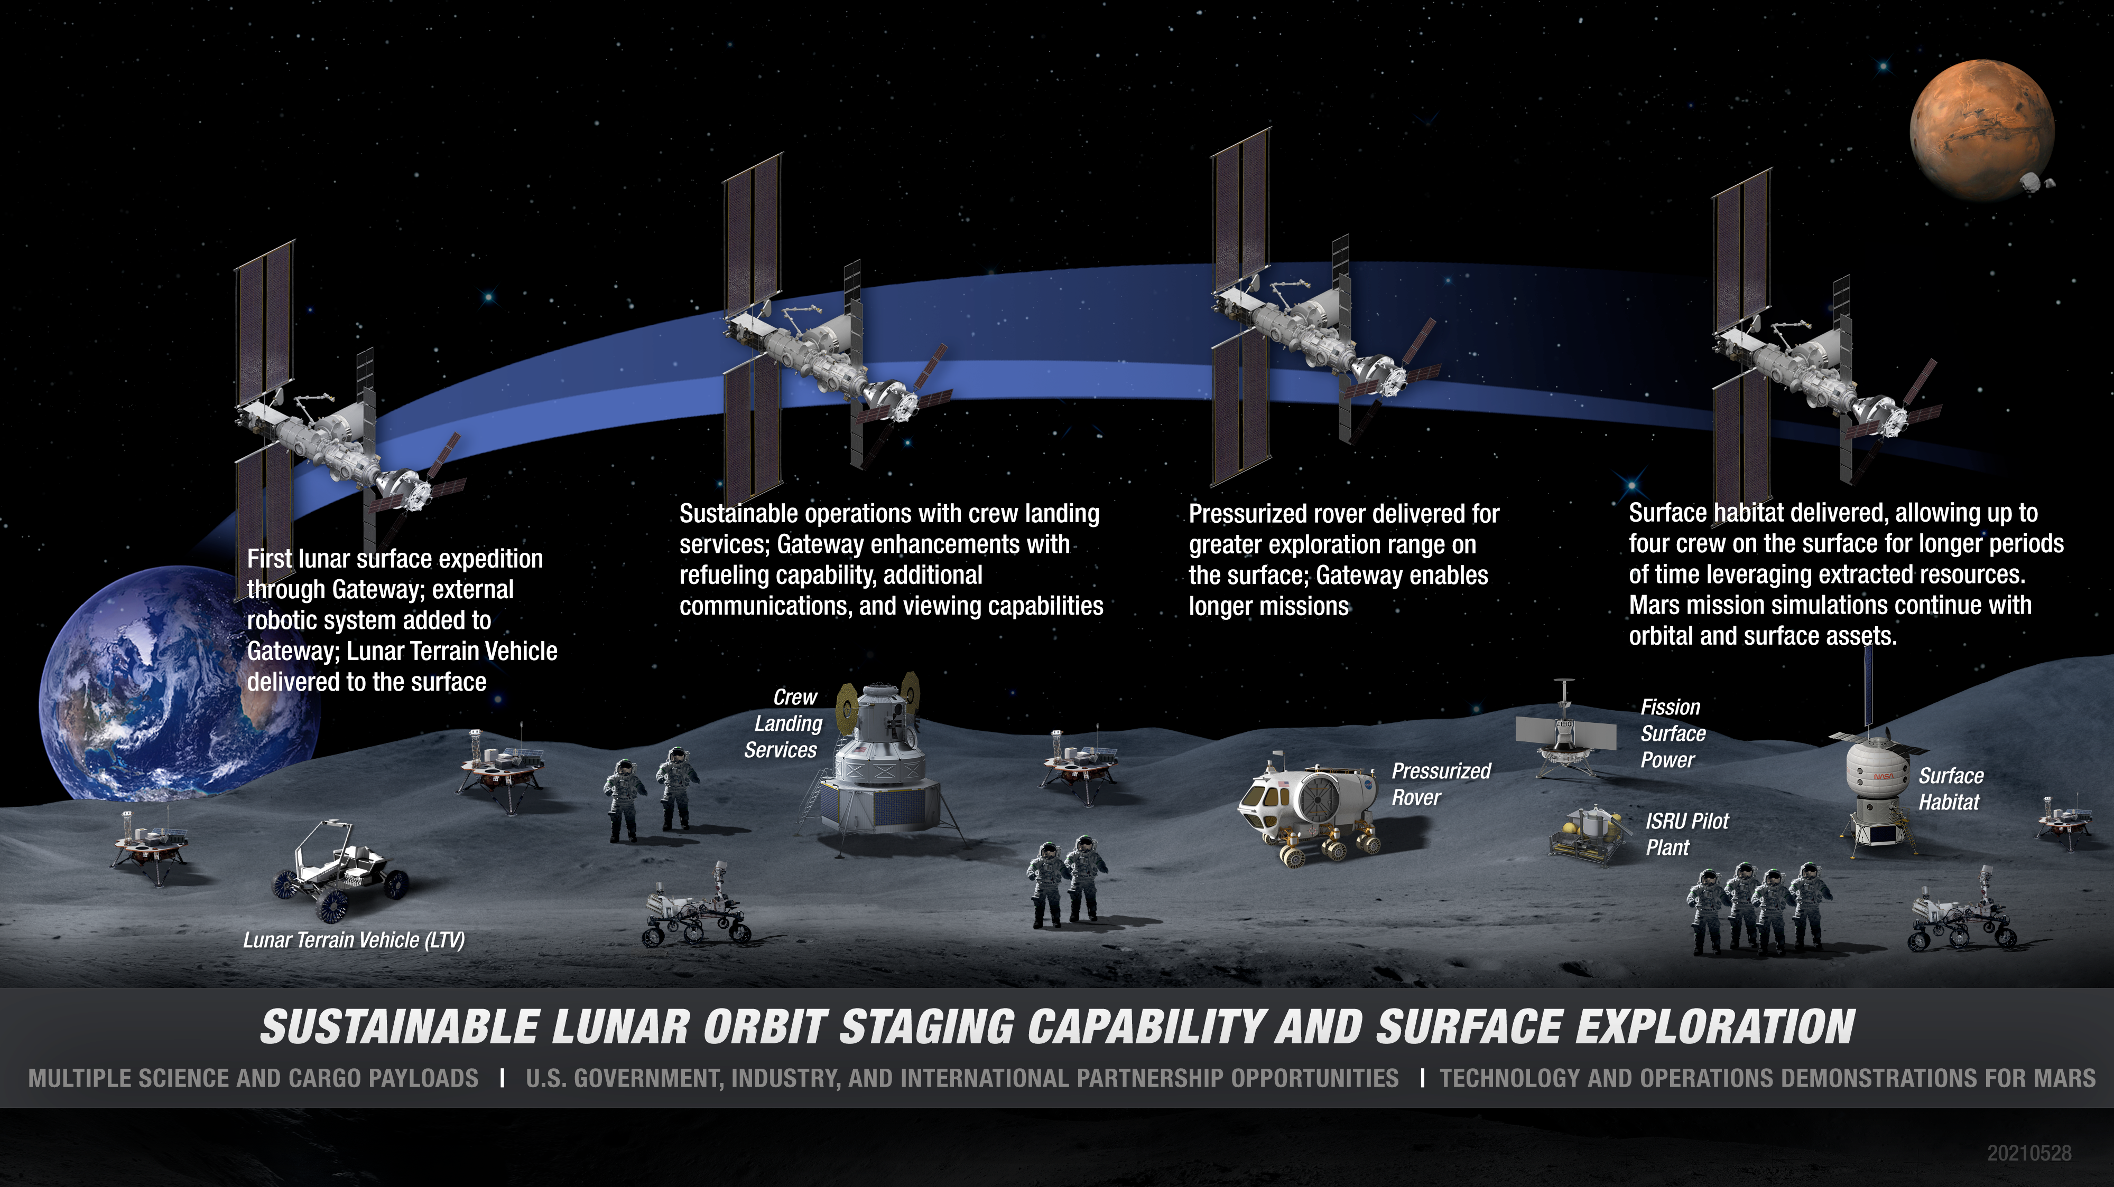
Artemis Base Camp Buildup

Slide 6
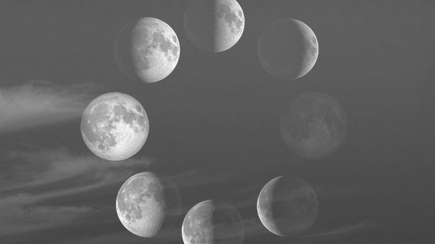
Artemis Update
Artemis mission planning is ongoing with updates to be publicly announced
Artemis III strategic research planning is now begun, with each Mission Directorate documenting its research goals, objectives, and requirements
Artemis I is schedule for launch in no earlier than February 2022
Artemis II is scheduled for no later than May 2024
Artemis III is targeted for no later than 2025
Activities are on going that will lead to later selection of the lunar landing sites and traverses
  Opportunities for community input
SpaceX awarded a contract for the first two missions – demo landing mission and Artemis III mission

Slide 7
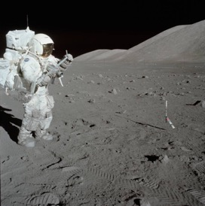
FUNDAMENTAL LUNAR SCIENCE
LIFE SCIENCES
Combined effects of fractional gravity & deep space radiation
PHYSICAL SCIENCES Combustion, fluid dynamics, dust, material sciences
FUNDAMENTAL PHYSICS
General relativity, gravitational physics, quantum information science
FOOD/DRUG DEGRADATION

Slide 8
Hazards of Human Spaceflight

Slide 9
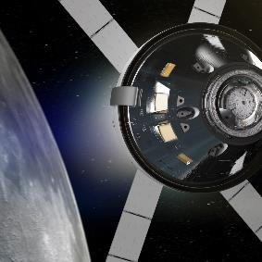
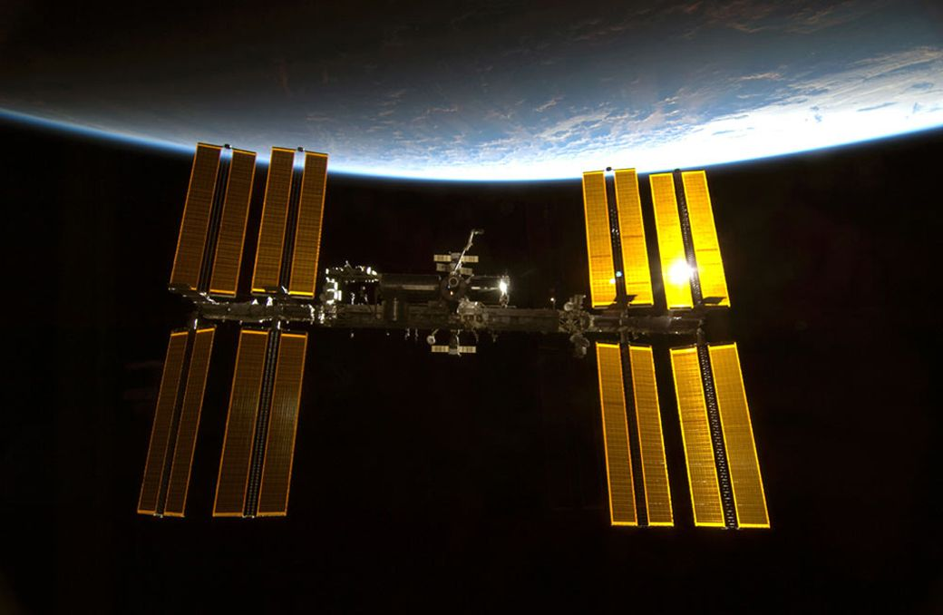
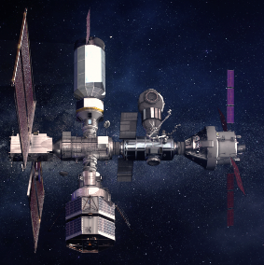
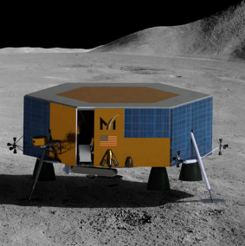
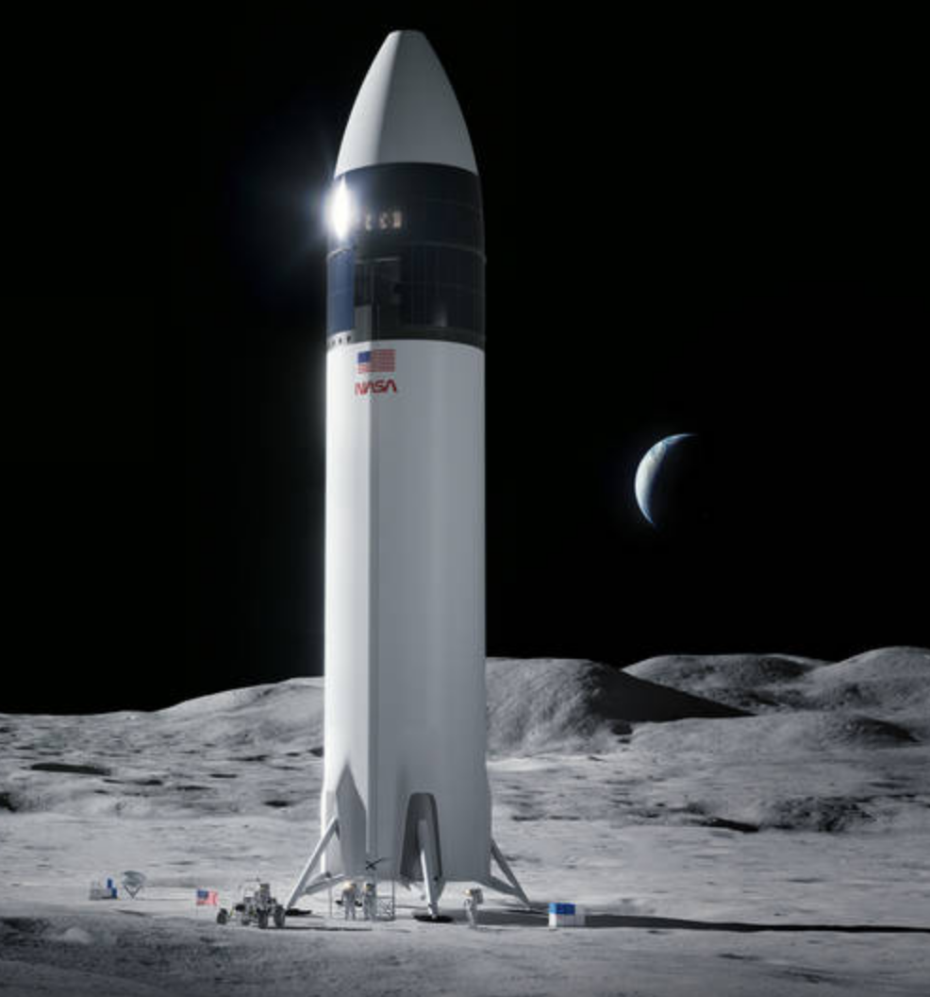

Lunar Exploration and NASA Biological and Physical Sciences Division
Orion Capsule
Gateway
• Multinational
science payloads
Data and specimen sharing
Low Earth Orbit Platforms
• ISS, Bion, Free-Flyers, etc
BPS
Human Landing
Systems
Commercial Lunar Payload Services Lander
Service-based delivery, deployment, and operations of payloads
Evolving capabilities: mobility service, on-orbit delivery, night survival
Ground-Based Research
Location-Specific and Continuum of Research Across All Platforms and Locations

Slide 10

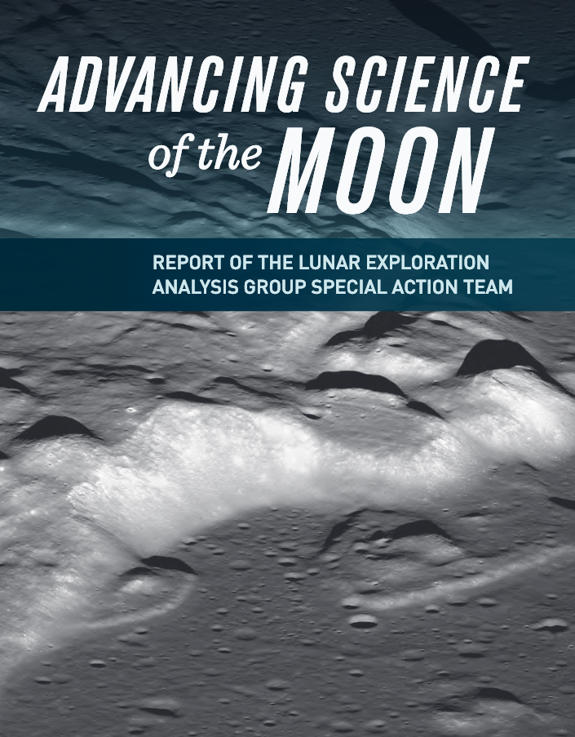
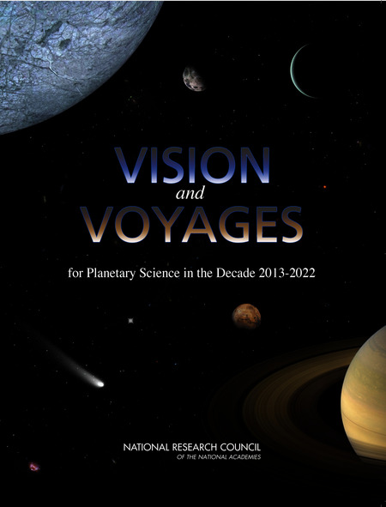
Guiding Community Documents - Artemis III Science
2016
2007
2018
2012
… as well as community-submitted white papers and draft report comments

Slide 11

Artemis III Science Definition Team Report
(available at www.nasa.gov/reports)
Table of Contents
Executive Summary
Introduction
Overview of Guiding Community Documents
Artemis Program and Architecture Summary
Artemis Science Objectives and Traceability to Science Priorities
  Objective 1: Understanding Planetary Processes
  Objective 2: Understanding the Character and Origin of Lunar Volatiles
  Objective 3: Interpreting the Impact History of the Earth-Moon system
  Objective 4: Revealing the Record of the Ancient Sun and Our Astronomical Environment
  Objective 5: Observing the Universe and the Local Space Environment from a Unique Location
  Objective 6: Conducting Experimental Science in the Lunar Environment
  Objective 7: Investigating and Mitigating Exploration Risks
Artemis III Candidate Science Program
Enabling Capabilities
Cartographic Recommendations
Considerations for Landing Site Selection
References
Appendix 1: Terms of Reference
Appendix 2: Summary of Community Involvement
Appendix 3: Biographies of Members
Appendix 4: List of White Papers Submitted to the Panel
https://www.nasa.gov/sites/default/files/atoms/files/artemis-iii-science-definition-report-12042020c.pdf
Notes:
… and our report was released on December 7th
It is available at nasa.gov/reports

Slide 12
Artemis Science Objectives and Traceability to Science Priorities
The objectives were traced to the 2011 Decadal Survey on Life and Physical Sciences
Objective 6: Conducting Experimental Science in the Lunar Environment
  Investigate and characterize the fundamental interactions of combustion and buoyant convection in lunar gravity
  Perform tests to understand and possibly discover new regimes of combustion
  Investigate interactions
  of multiphase combustion processes and convection in lunar gravity
  Use the unique environment of the lunar surface to perform experiments in the area of fundamental physics
  Obtain experimental data to anchor multiphase flow models in lunar gravity
  Study interfacial flow with and without temperature variation to anchor theoretical/ numerical models
  Study behavior of granular media in the lunar environment
  Investigate precipitation behavior in supercritical water in lunar gravity
  Investigate the production of oxygen from lunar regolith in lunar gravity
Notes:
The SDT prioritized investigations under the seven science objectives laid out in the Artemis Plan, focusing on the compelling nature of the science and whether Artemis III presents an enabling opportunity given the architectural constraints, including down-mass and up-mass capabilities of the Human Landing System (HLS), the duration of the surface mission, and the expected number of EVAs.

Slide 13
Objective 6: Conducting Experimental Science in the Lunar Environment (cont’d)
  Use the unique environment of the lunar surface to perform experiments in the area of fundamental physics
  Investigate the behavior of liquid-phase sintering in lunar gravity
  Study and assess effects on materials of long-duration exposure to the lunar environment
  Study the production of lunar concrete samples in the lunar environment
  Study material flammability in the lunar environment
  Study the conversion of water-ice to gaseous hydrogen and oxygen, and liquefaction of gasses for propellant storage
  Study the water management in lunar plant growth systems
  Study pool and flow boiling in the lunar environment
  Study two phase adiabatic flow in the lunar environment
  Perform tests of lunar resource recovery of O, Al, Fe or Mg using ionic liquids
  Perform tests of biofilms on various materials and the effect of biocide surface coatings on biofilm

Slide 14
Artemis Science Objectives and Traceability to Science Priorities
Cross Discipline Objectives that may be Applicable to Physical Sciences
Objective 2: Understanding the Character and Origin of Lunar and Polar Volatiles
  Learn how water vapor and other volatiles are released from the lunar surface and migrate to the poles where they are absorbed in polar cold trap
  Understand the impact of human exploration on the lunar volatile record across the surface
Objective 5: Observing the Universe and Local Space Environment from a Unique Location
  Objective 5a: Astrophysical and Basic Physics Investigations using the Moon
  Objective 5b: Heliophysical Investigations using the Moon
  Objective 5c: Use the Moon as a platform for Earth-Observing Studies

Slide 15
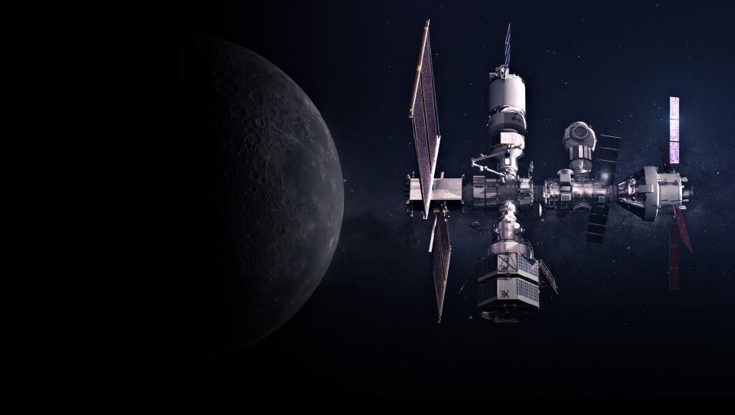







HUMANS IN LUNAR ORBIT
Gateway will be humanity’s first outpost in lunar orbit
EARLY SCIENCE PAYLOADS
ERSA: The European Space Agency’s radiation instrument package will help provide an understanding of how to keep astronauts safe by monitoring the radiation exposure in Gateway’s unique orbit.
HERMES: NASA’s space weather instrument suite will observe solar particles and solar wind created by the Sun.
ESA Internal Dosimeter Array, including instruments provided by the Japan Aerospace Exploration Agency.

Slide 16
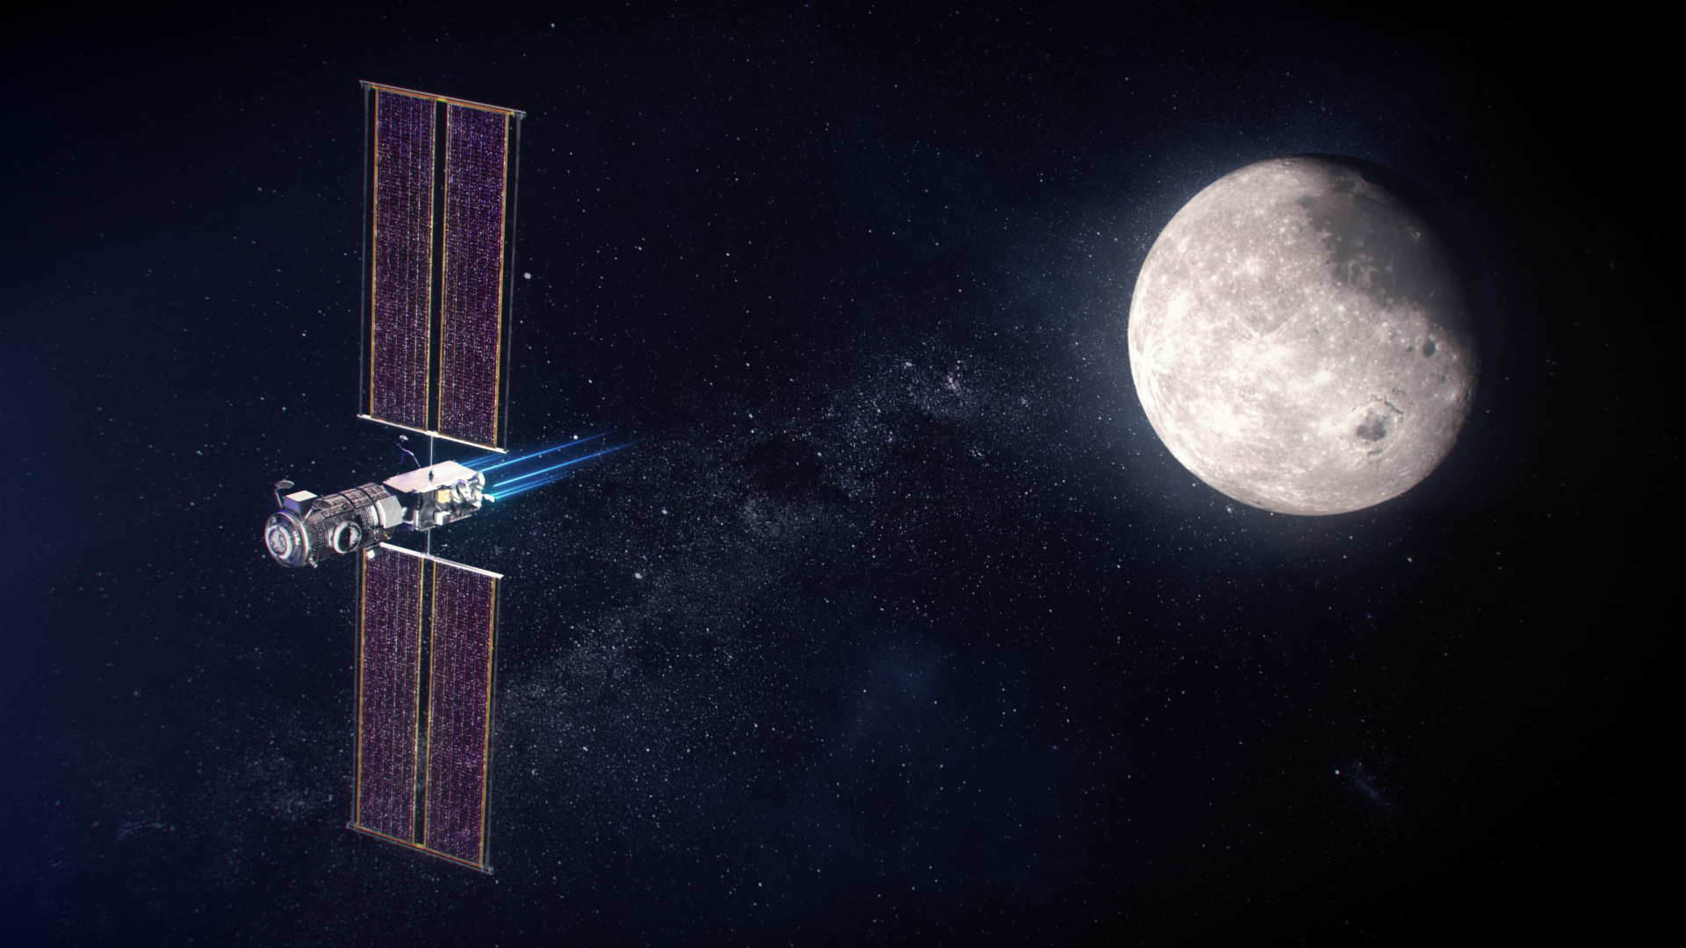
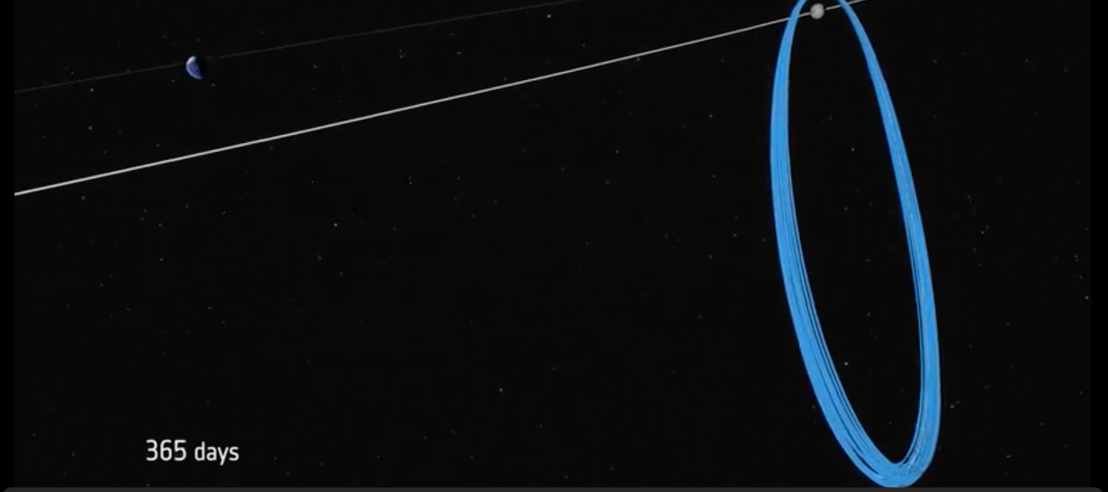

First Science Payloads:
HERMES¹ – NASA
ERSA² – ESA
IDA³ – ESA/JAXA
Particles and fields instrumentation for Radiation and Space Weather studies
Initial Gateway Modules
Power and Propulsion Element (PPE)
Moon
Habitation and Logistics Outpost (HALO)
Earth
Gateway Orbit
7 Day Period
3000 x 70000 km
(0.5 x 11 R_{E})
¹Heliophysics Environmental and Radiation Monitoring Experiment Suite
²ESA Radiation Sensor Array
³Internal Dosimeter Array
Perilune North
Apolune South

Slide 17
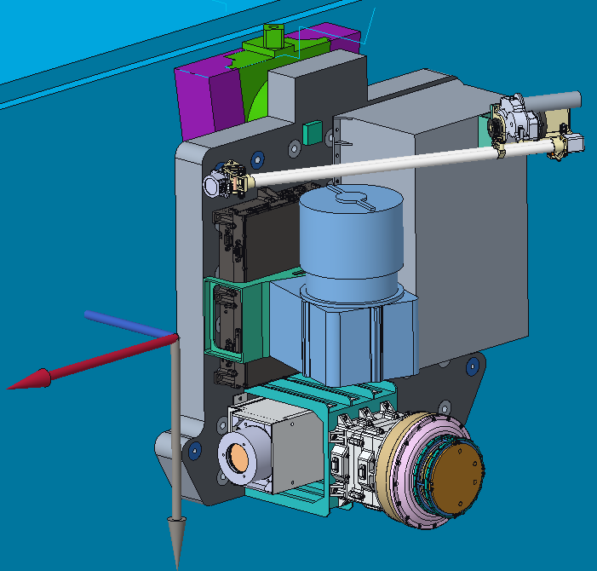
HERMES is composed of 3 particle instruments plus a set of magnetometers
Capabilities are typical of in-situ space weather instruments
MAG
SPAN-i
Instrument | Measurement | PI
EEA, Electron Spectrometer (electrons < 30 keV) | Electron Flux, Density, Speed, Temperature | D. Gershman, GSFC
SPAN-i, Ion Spectrometer (ions < 20 keV) | Ion Flux, Density, Speed, Temperature, M/Q Species | R. Livi, UC Berkeley
MERiT, Ion and Electron Telescope (energetic particles) | 0.3 – 9 MeV Electrons, 1 – 190 MeV Ions, Flux | S. Kanekal, GSFC
NEMISIS (MAG) (3 magnetometers) | Magnetic Field Vector | E. Zesta, GSFC M. Moldwin, U Mich
X
EEA
MERIT
Z
HERMES
MASS < 25 kg
(X,Y,Z) < 0.5 ✕ 0.5 ✕ 0.5 m (Boom Stowed)
Magnetometer Boom Extends ~ 1 m

Slide 18
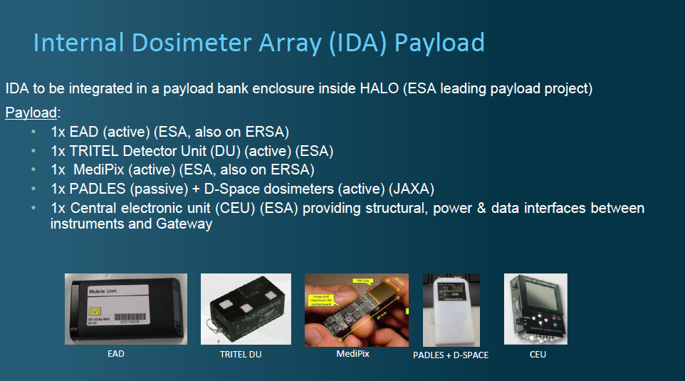

Slide 19
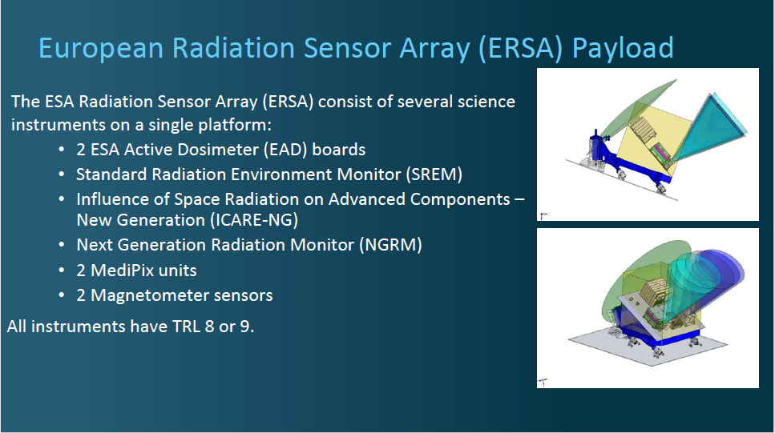

Slide 20
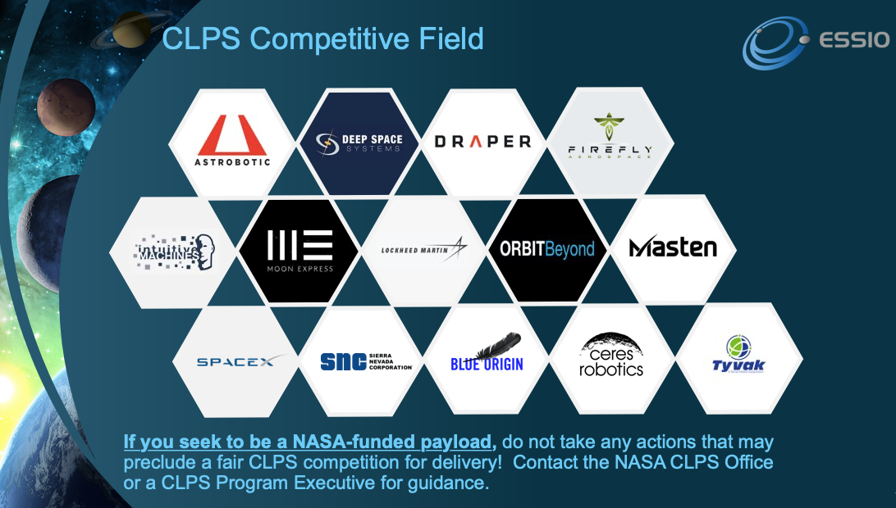

Slide 21
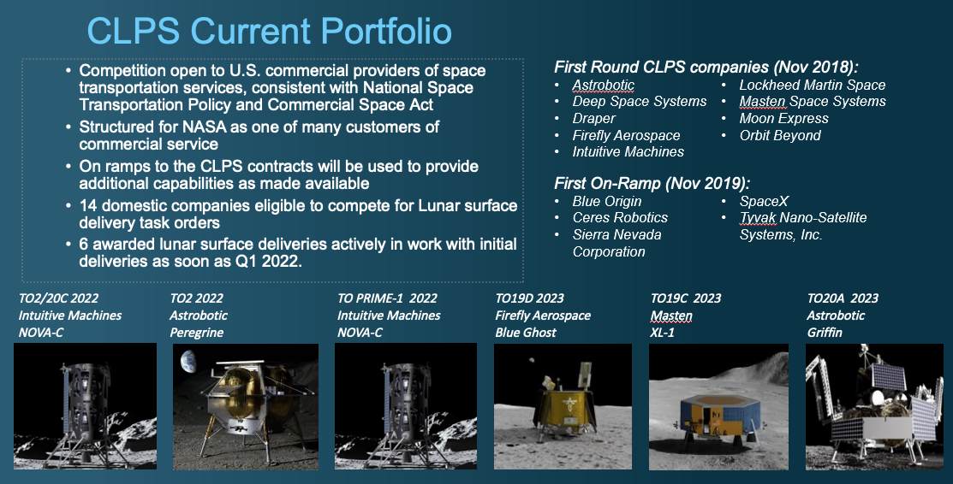
;CP-11 2024

Slide 22
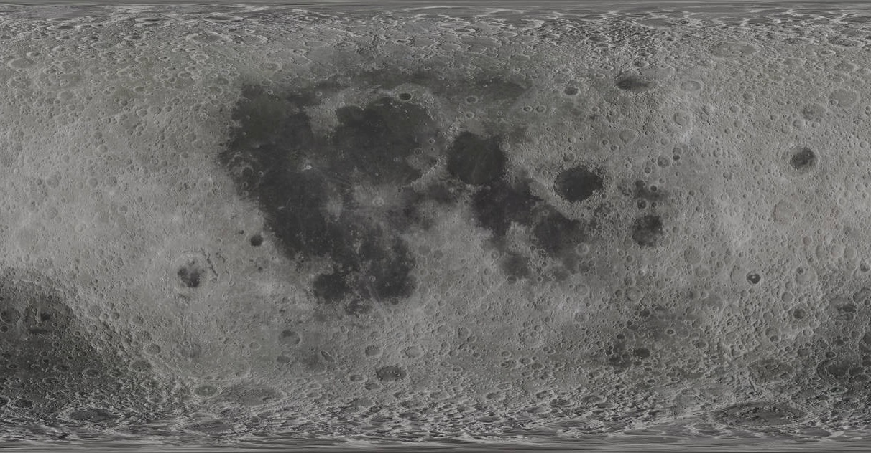
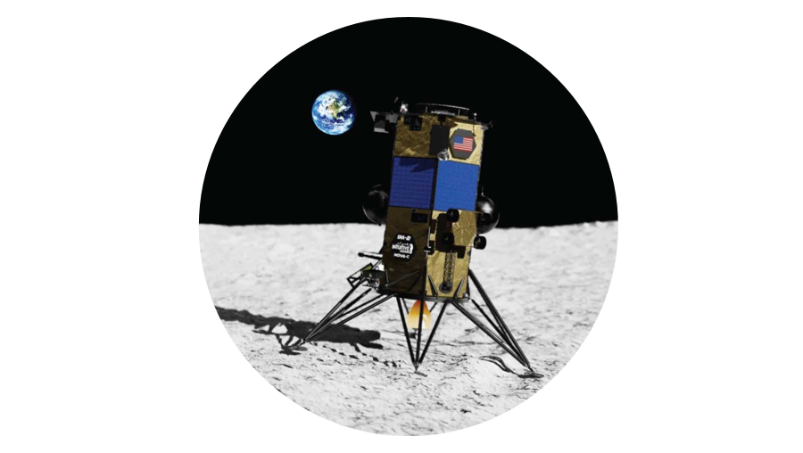
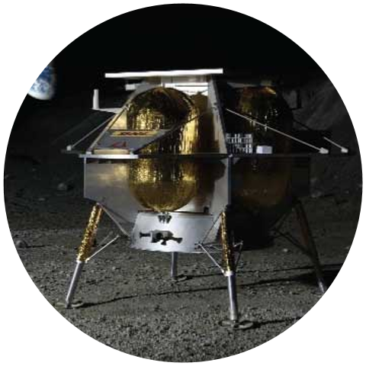
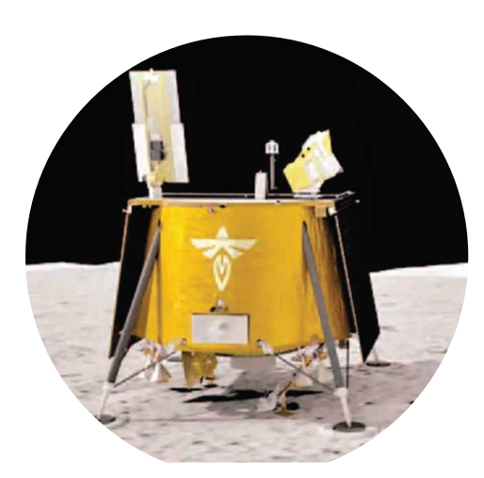
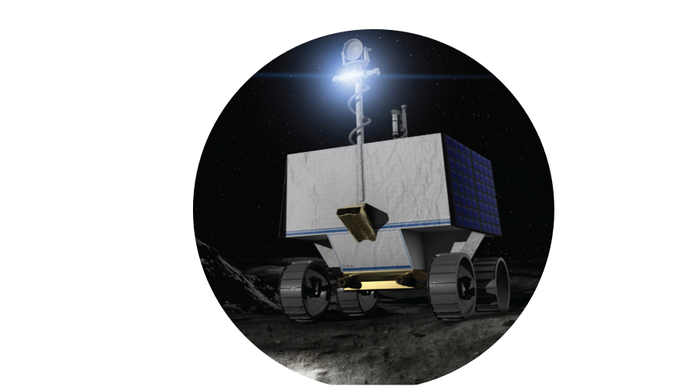
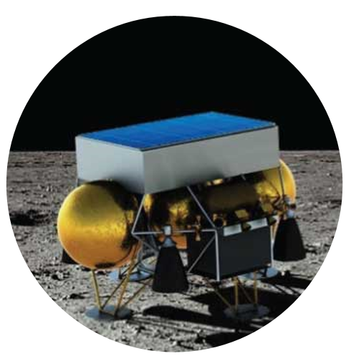
CLPS Deliveries
2022-2025
Delivery Site: Oceanus Procellarum
Provider: Intuitive Machines (IM)
Task Order (TO)2-IM │ Q1 2022
Delivery Site:
Lacus Mortis
Provider: Astrobotic
TO2-AB │ 2022
Delivery Site:
Gruithuisen Domes
Provider TBD
CP-21 │ 2025
Delivery Site:
Reiner Gamma
Provider: Intuitive Machines (IM)
CP-11 │ 2024
Delivery Site:
Mare Crisium
Provider: Firefly
TO19D │Q3 2023
Delivery Site:
Shackleton Connecting Ridge
Provider: IM
TO PRIME-1│Nov 2022
Delivery Site:
South Pole: Nobile Crater
Provider: Astrobotic
VIPER │Nov 2023
Delivery Site:
Schrödinger Basin
Provider TBD
CP-12 │ 2025
Delivery Site:
South Pole
Provider TBD
CP-22│ 2025
Delivery Site:
South Pole
Provider: Masten
TO-19C │Nov 2023
updated 11/6/21
Notes:
s

Slide 23
2023 CLPS Crisium Delivery Manifest
19D Firefly Aerospace
Lunar Environment [Heliospheric] X-Ray Imager
(LEXI)
Lunar Instrument for the Subsurface Thermal Exploration with Rapidity
(LISTER)
LEXI
PI: Brian Walsh
LISTER
PI: Seiichi Nagihara
LMS
PI: Robert Grimm
Lunar Magnetotelluric Sounder
(LMS)
Payloads largely selected from Lunar Surface
Instrument and Technology Payloads (LSITP)
Regolith Adherence Characterization (RAC)
RAC
PI: Johnnie Engelhardt
NGLR
PI: Douglas Currie
Next Generation Lunar Retroreflector
(NGLR)
Radiation Tolerant Computer System (RadPC)
RadPC
PI: Brock LaMeres
PlanetVac
PI: Kris Zacny
PlanetVac
Electrodynamic Dust Shield
(EDS)
Key
Stereo Cameras for Lunar Plume-Surface Studies (SCALPSS)
Lunar GNSS Receiver Experiment
(LuGRE)
Science
Technology
Exploration
STMD
HEOMD

Slide 24
2023 CLPS 19C Polar Delivery Manifest
Masten Space Systems
Sample Acquisition, Morphology Filtering & Probing of Regolith (SAMPLR)
Camera System for lunar science on commercial vehicles
(Heimdall)
SAMPLR
PI: Sean Dougherty
Heimdall
PI: Aileen Yingst
NIRVSS
PI: Tony Colaprete
Near-Infrared Volatile Spectrometer System (NIRVSS)
Payloads largely selected from Lunar Surface
Instrument and Technology Payloads (LSITP)
Linear Energy Transfer Spectrometer (LETS)
LETS
PI: Eddie Semones
L-CIRiS
PI: Paul Hayne
Lunar Compact Infrared Imaging System (L-CIRiS)
Moon Rover with Exploration Autonomy
(Moon Ranger)
Retroreflector
PI: Xiaoli Sun
Laser Retroreflector
Moon Ranger + NSS
PI: Andrew Horchler
Neutron Spectrometer System (NSS) – Deployed on Moon Ranger
MSolo
PI: Jackie Quinn
Mass Spectrometer Observing Lunar Operations (MSolo)
Key
Science
Technology
Exploration

Slide 25
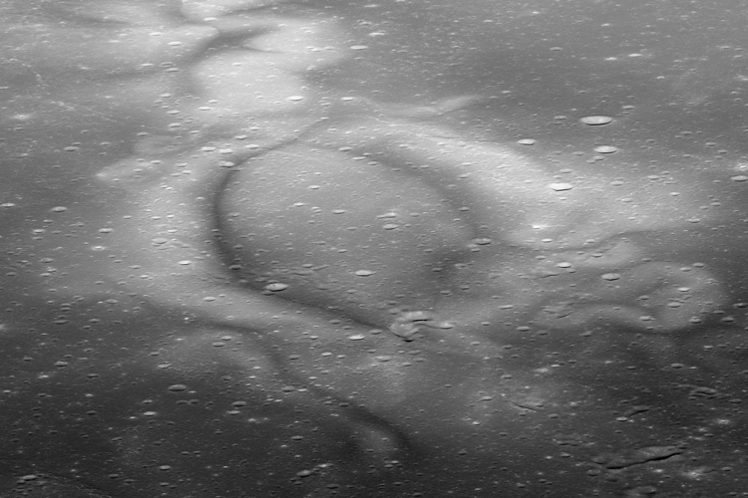
CP-11
Reiner Gamma
NASA Lunar Vertex
Joint lander and rover payload suite to measure local lunar magnetic field
(Dr. David Blewett, APL)
MoonLIGHT Retroreflector (ESA)
Lunar Space Environment Monitor (LUSEM; KASI)
Cooperative Autonomous Distributed Robotic Exploration (CADRE, NASA STMD/JPL)

Slide 26
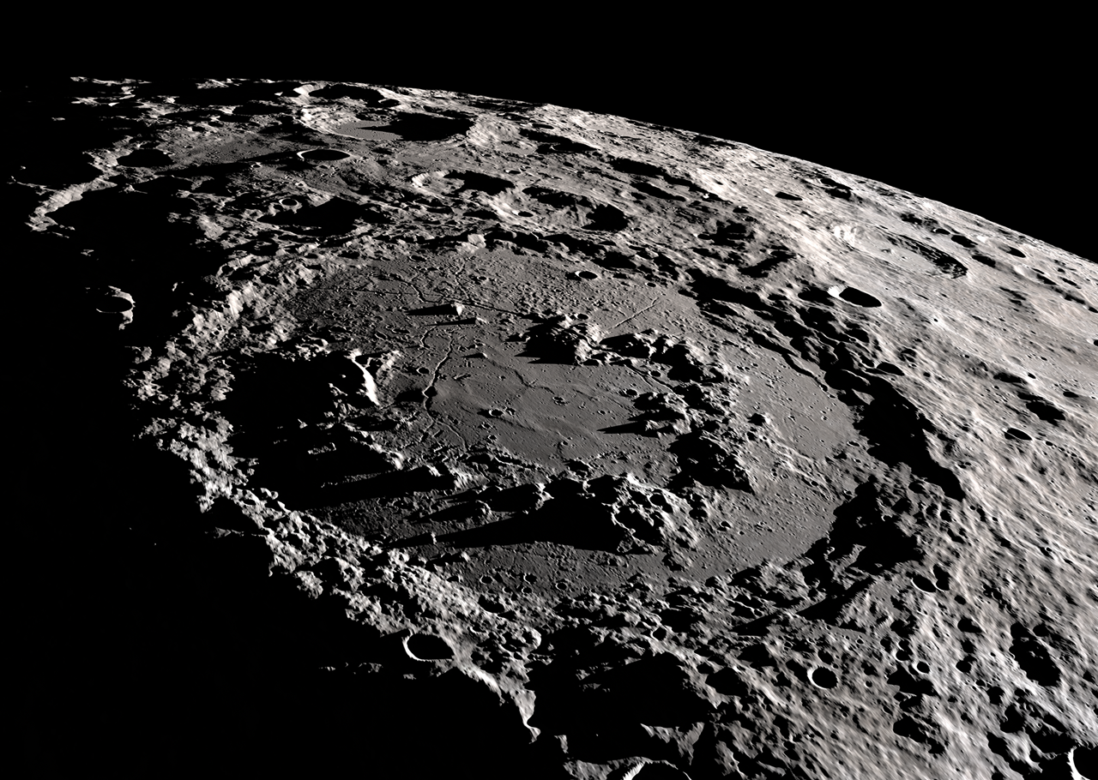
CP-12
Schrödinger Basin
Farside Seismic Suite
Dual seismometers to measure seismic activity on the lunar farside
(Dr. Mark Panning, JPL)
Lunar Interior Temperature and Materials Suite
Investigate heat flow and electrical conductivity of the lunar interior
(Dr. Robert Grimm, SWRI)

Slide 27
Payloads and Research Investigations on the Surface of the Moon (PRISM)
Overview
Early CLPS delivery manifests consist of a combination of
NPLP (NASA internal) and LSITP (external) calls
Now we are operating under a science-driven model:
  PRISM (Payloads and Research Investigations for the Surface of the Moon)
Early CLPS delivery manifests were focused on speed (NPLP and LISTP). CLPS is now operating under a science-driven model:
  PRISM (Payloads and Research Investigations for the Surface of the Moon)
PRISM calls occur at a regular cadence – Released and managed by the NASA Science Mission Directorate Exploration Science Strategy and Integration Office (ESSIO)
  1 solicitation per year, with two deliveries per solicitation.
  Selected PRISM instruments feed manifests for deliveries from late 2023 onwards.
  PRISM solicitations to date request science investigations utilizing multi-instrument suites to maximize the science for named locations.
Payloads from other mission directorates, directed payloads, and/or international payloads may be co-manifested with PRISM awards on CLPS deliveries.
  Standalone instruments, campaign science, and destination agnostic investigations may be solicited in future PRISM calls.
Landing sites are high science-value targets where significant progress can be made utilizing CLPS platforms; PRISM solicitations will state the location and timeline for each delivery, allowing PIs to propose science optimized for those locations.

Slide 28
Experiment Factors that are Drivers for Platform Capabilities, Logistics, and Operations Needs
Physical Sciences and Space Biology
Power duty cycles
Experiment duration
Nearly all of the science is obtained through video imagery and data recording
Quantitative analysis of test samples
In-situ analysis versus sample return
Observational and quantitative analyses
Physical Sciences
Data requirement through only video imagery and multiple sensors, which is investigation specific
Space Biology
Life span of a living specimen and its health
  Age of the specimen needed at time of experiment start
  Short life span versus long life span
  Changes in developmental biology and physiology of an organism over time (e.g. juvenile versus adult)
Specimens in stasis have limited viability duration
Life support systems (e.g. pressurized, temperature, air supply, etc)
Lunar sample regolith collection for specimen exposure studies

Slide 29
Enabling Lander Capabilities and Logistical and Operational Needs to Support Life and Physical Sciences Experiments
Power for Experiment Operation Some physical science experiments will have high spiked peak power during the duty cycle (e.g. combustion activation
  up to 1kW to 2.5kW, depending on the experiment
Power during Lunar Night (continuous, ”uninterruptable”)
Experiments that have long duration continuous runs to maintain temperature and environment controls around the specimen/sample
High data rate capability Physical science video imagery are very high resolution in order to obtain the required visual-based data from quantitative measurements
Sample Return
  For nearly all biological experiments, the observational recordings need deeper analyses for examining structures and systems biology, which will reveal genetic, gene expression, and metabolic impacts to explain the observations
  Material sciences will require return of coupon samples to analyze the weathering and degradation impacts
Data and Commanding
Pressurized compartment and environmental control, if the payload hardware cannot provide it

Slide 30
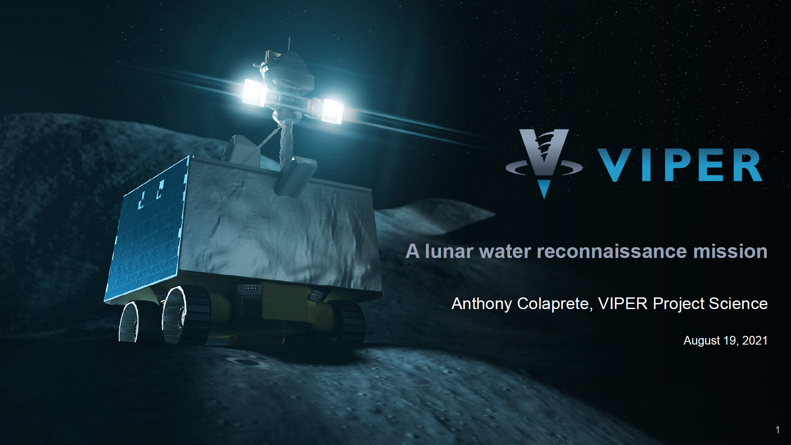

Slide 31
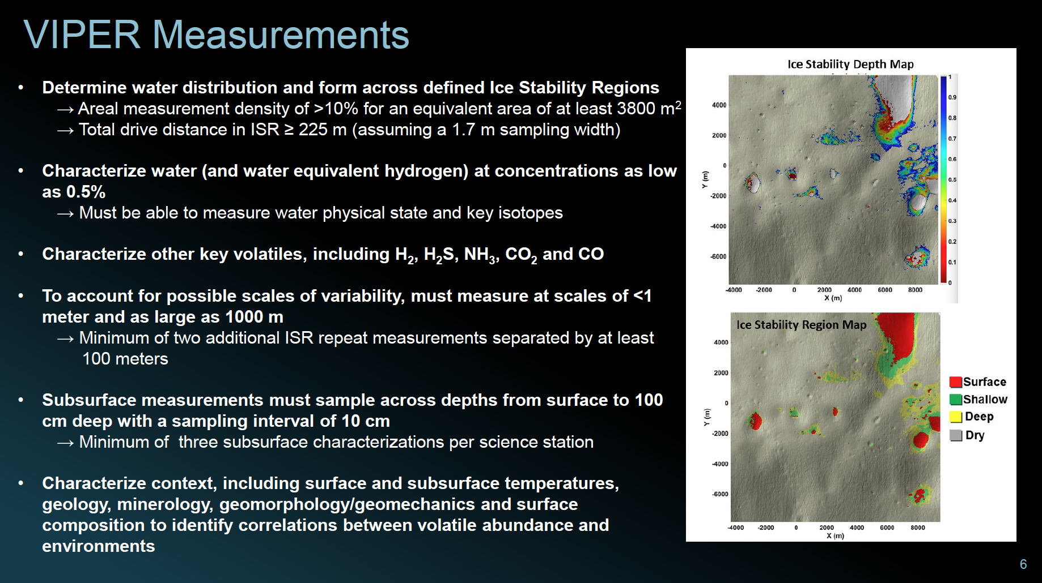

Slide 32
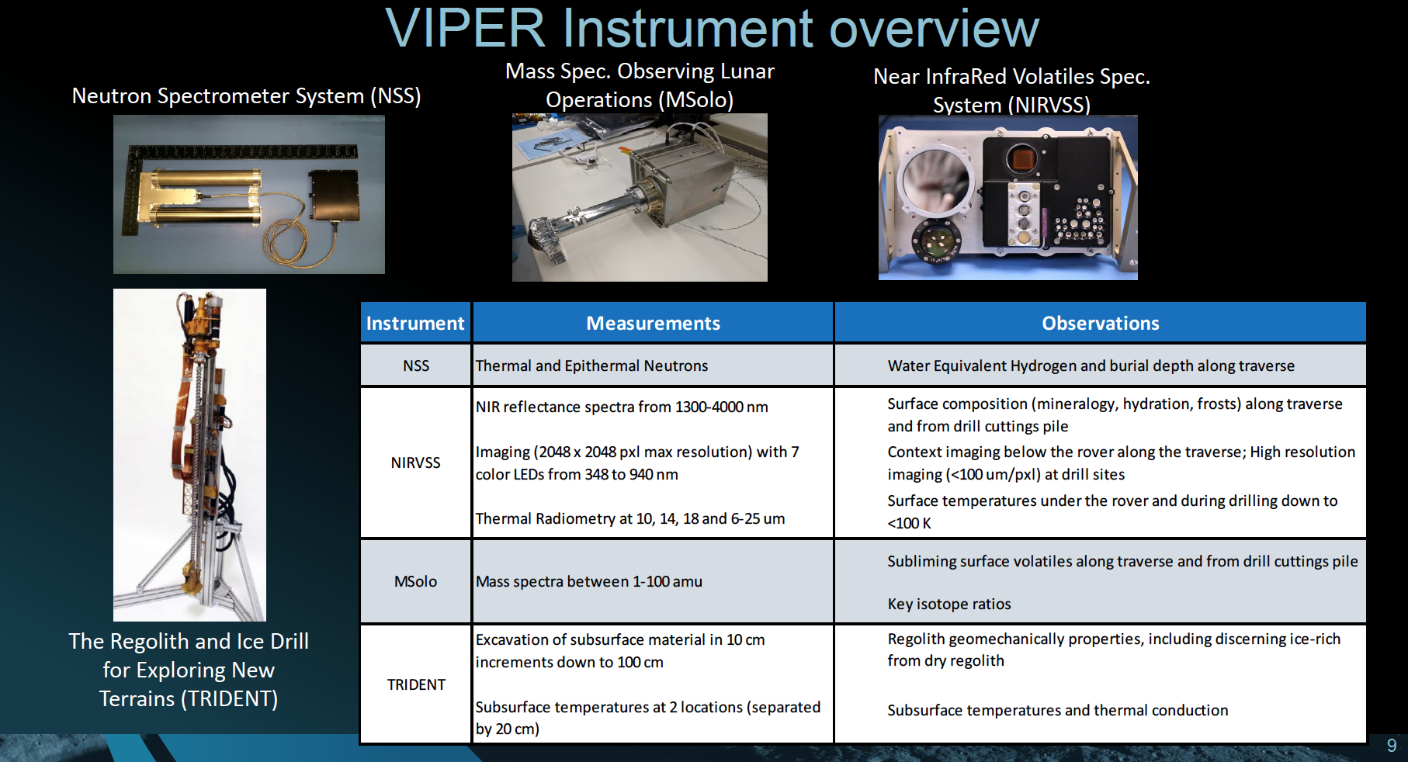

Slide 33
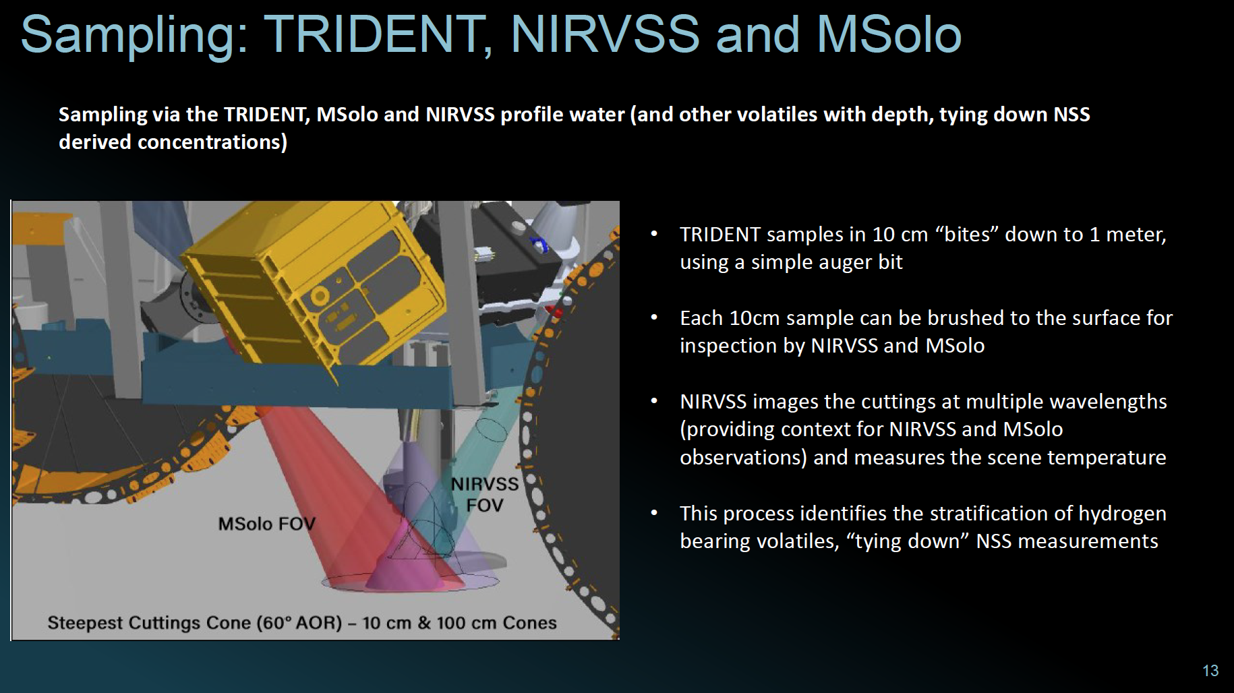

Slide 34

























SSERVI
RESOURCE
(Slide Deck from J. Heldmann, NASA ARC)
Principal Investigator: Dr. Jennifer Heldmann, NASA Ames Research Center, Planetary Systems Branch
Deputy Principal Investigators: Dr. Matthew Deans, NASA Ames Research Center, Intelligent Systems Division
Dr. Alexander Sehlke, NASA Ames Research Center / BAER Institute

Slide 35

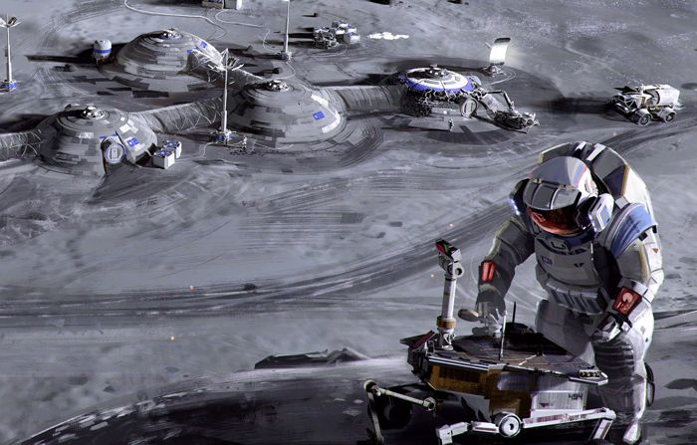
RESOURCE Premise
In Situ Resource Utilization (ISRU) near the sites of robotic and/or human missions may enable sustainable and affordable exploration of the SSERVI Target Bodies.
Key to using space resources is knowing their location, quantity, distribution, and extractability.
In addition, operations and hardware associated with each ISRU prospecting, excavation, transportation, and processing step must be examined, tested, and integrated to enable effective ISRU.

Slide 36
Task 1: Assess and Characterize Resource Inventories of SSERVI Target Bodies
Subtask 1.1 develops a semi-quantitative mineral potential model of resource assessment for water ice on the Moon utilizing state-of-the art knowledge regarding lunar resource inventories to identify prospective regions for the occurrence of ice.
We will also test and validate this approach in a terrestrial lunar analog environment.
Subtasks 1.2, 1.3, and 1.4 focus on scientific analysis of current datasets and numerical modeling to identify the form, character, and distribution of resources on the Moon, near Earth asteroids, and Phobos & Deimos, respectively.
Subtask 1.5 uses this analysis to develop predictive capabilities for resource identification where remote sensing data may be insufficient.
LEADS: Dana Hurley (JHU / APL) for Moon
Andy Rivkin (JHU / APL) for asteroids
Josh Coyan (USGS) for resource geostats, predictive capabilities
Photo credit Greg Schmidt / SSERVI.

Slide 37
Task 2: ISRU Technology Development and Testing
Task 2 will focus on technologies relevant to enabling lunar ISRU missions.
Under Subtask 2.1 we will focus on a lunar resource prospecting payload where advancements include borehole neutron and near-infrared spectrometers to advance the state of current rover-mounted systems.
Subtask 2.2 will demonstrate water extraction from ice cemented ground by using a lunar prototype drill as well as a drill corer.
Subtask 2.3 will analyze lunar mining and demonstrate technologies for the collection and processing of extracted water for future mining feasibility.
For completeness, Subtask 2.4 is a paper study focused on feasibility of a mineral-based ISRU system.
LEADS: Kris Zacny (Honeybee) for drills
Tony Colaprete, Rick Elphic (NASA Ames) for prospecting instruments
Aaron Paz (NASA JSC) for ISRU technologies
Photo credit Greg Schmidt / SSERVI.

Slide 38
Task 3: Assessing Concepts of Operations, Capabilities, and Related Human-Robotic Interactions in support of Lunar Robotic ISRU
Task 3 focuses on optimization of the robotic and human interactions for a mission to prospect for resources and conduct lunar ISRU.
Task 3.1 will assess the concept of operations and develop methodologies to optimize human-machine collaboration (HMC) and human factors engineering task allocation among humans and machines in the context of a lunar rover mission to characterize and process polar volatiles.
Task 3.2 will critically examine human-robotic interactions (HRI) and develop best practices and solutions for optimizing the mission architecture, including assessment of continuous science operations via autonomy and novel distributed robotic swarms and multifunctional robotic platforms for lunar polar ISRU.
Task 3.3 will design and test different components of mixed reality (including augmented reality (AR) and virtual reality (VR)) to enhance and optimize the productivity of a lunar polar rover mission.
LEAD: Dava Newman (MIT)
Photo credit Greg Schmidt / SSERVI.

Slide 39
Task 4: Future ISRU Robotic Mission Support Activities (lunar test case)
Subtask 4.1 will produce data products required for lunar polar rover mission traverse planning purposes.
Subtask 4.2 will develop advanced mission planning capabilities for a lunar polar rover prospecting mission and will integrate mission scheduling tools into the ground data system software suite.
Subtask 4.3 includes a field test of integrated systems (including prospecting payloads integrated into the lunar prototype drill and operated with relevant ground data systems). We will test the ISRU hardware, software, and operations where subsurface ground ice is overlain by several to a few 10s of cm of dry regolith, the same ice stratigraphy expected in the polar regions of the Moon, and specifically compare the rover mounted near-infrared and neutron spectrometer approach with the drill-integrated instrumentation suite (developed in Subtask 2.1).
Photo credit Greg Schmidt / SSERVI.

Slide 40
Physical Sciences Lunar Surface Science Workshop
Fundamental and Applied Lunar Surface Research in Physical Sciences
August 18-19, 2021
The NASA Biological and Physical Sciences Division hosted a workshop on fundamental and applied research on the Moon in physical sciences. This workshop brought together the scientific community, commercial companies, and NASA Divisions and Programs with the goals of discussing investigations on reduced gravity and lunar environmental effects in physical sciences research for sustained lunar human habitation and in preparation for human exploration to Mars and to inform and inspire the science community to contribute white papers for the Biological and Physical Sciences Decadal Survey.
The workshop umbrella topics:
  Lunar dust and its properties, behavior, and mitigation
  Life support and thermal management
  Materials flammability and habitat fire safety
  Extraction of water-ice from regolith research, including separation, purification, electrolysis, and liquefaction
  Lunar environment and its effects on materials
  Lunar research in extraction, processing, and handling
  Lunar research for advanced manufacturing
  Fundamental physics research on the lunar surface
FOR ACCESS TO THE RECORDINGS OF THE SESSION TALKS AND POSTERS:
https://lunarscience.arc.nasa.gov/lssw/falsrps

Slide 41
Points of Contact
Commercial Lunar Payload Services:
  PRISM Solicitations: Brad Bailey (Program Scientist, NASA ESSIO): brad.bailey@nasa.gov
            Ryan Watkins (Program Scientist, NASA ESSIO): ryan.n.watkins@nasa.gov
  All other questions: Angela Melito (Program Executive, NASA ESSIO): angela.m.melito@nasa.gov
Jay Jenkins (Program Executive, NASA ESSIO): jason.e.jenkins@nasa.gov
HERMES: Jim Spann (Space Weather Lead, NASA Heliophysics Division): jim.spann@nasa.gov
ERSA and IDA: Leonardo Surdo (ERSA/IDA Project Scientist, ESA): Leonardo.Surdo@esa.int

Slide 42
Thank You
NASA
  Brad Bailey
  Debra Needham
  Ryan Watkins
  Zachary Pirtle
  Jay Jenkins
  Julie Robinson
  Dina Contella
  Tim Horvath
  James Spann
  Sarah Noble
  Rene Weber
  Amanda Nahm
  Noah Petro
  John Gruener
  Sam Lawrence
  Cindy Evans
  Bette Siegel
Sabrina Savage
Jennifer Heldmann
Anthony Colaprete
Lisa Carnell
DeVon Griffin
Fran Chiaramonte
Brad Carpenter
Ulf Israelsson
Kristina Gibbs
Ricky Guest
SMD ESSIO (NASA HQ) and CLPS Office (NASA JSC)
ESDMD and AES Artemis and Gateway Teams
BPS Physical Sciences Program Team – NASA GRC and NASA MSFC
BPS Fundamental Physics Team – NASA JPL
Lunar and Planetary Institute, USRA
NASA Solar System Exploration Research Virtual Institute (NASA ARC)
NASA Lunar Surface Science Working Group
ESA
  Leonardo Surdo

Slide 43
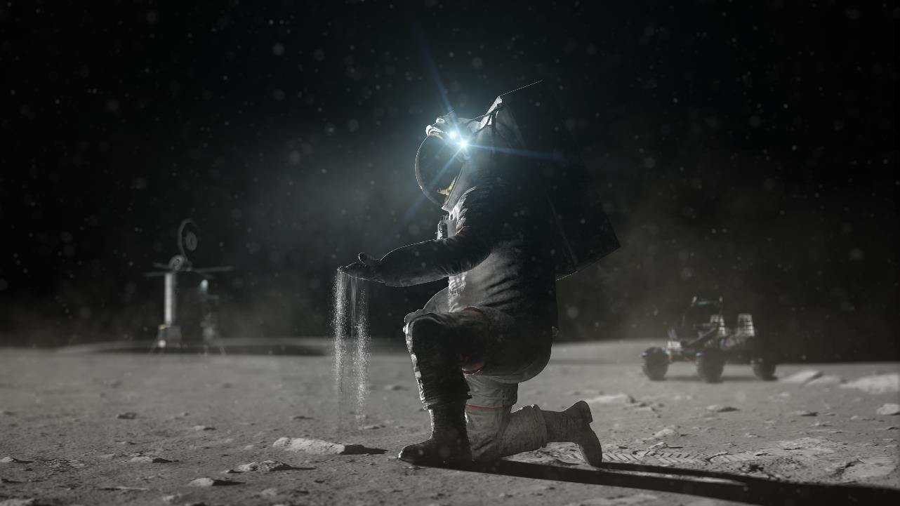

Thank you

Slide 44
Back-Up

Slide 45
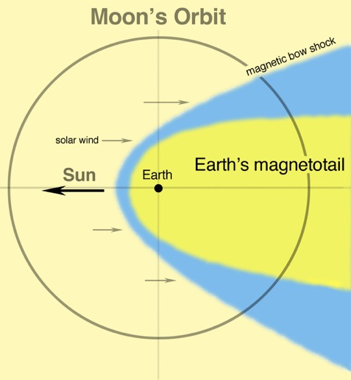
HERMES Goals
Goal A: Determine mechanisms of solar wind mass and energy transport
Goal B: Characterize energy, topology, and ion composition in the deep magnetotail
Goal C: Establish observational capabilities of an on-board pathfinder payload measuring local space weather to support deep-space and long-term human exploration
Goal A
Solar Wind
80% of Moon’s orbit
Goal B
Magnetotail
20% of Moon’s Orbit

Slide 46
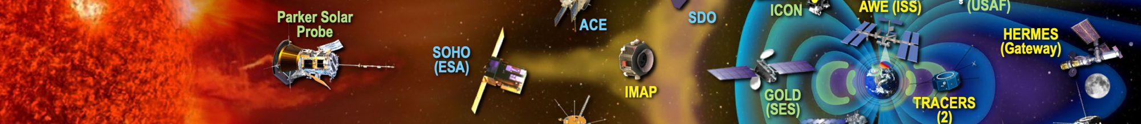
As an element to the Heliophysics System Observatory, HERMES offers several advantages for science
Forming a triad with the two THEMIS/ARTEMIS probes (in equatorial lunar orbit) HERMES will probe the smaller scale (5 – 10 R_{E}) structures (e.g. the magnetopause, solar wind flux tubes, coronal mass ejections, shocks, flux ropes)
Along with L1 monitors, HERMES will probe larger-scale features
Energetic Particle Telescope to detect Solar Particle Events at Earth/Moon
Ion Mass Spectrometer will map the loss of ionospheric ions through the magnetotail
0.5 by 11 R_{E} polar lunar orbit provides for studies of the vertical extent of the magnetotail

Slide 47
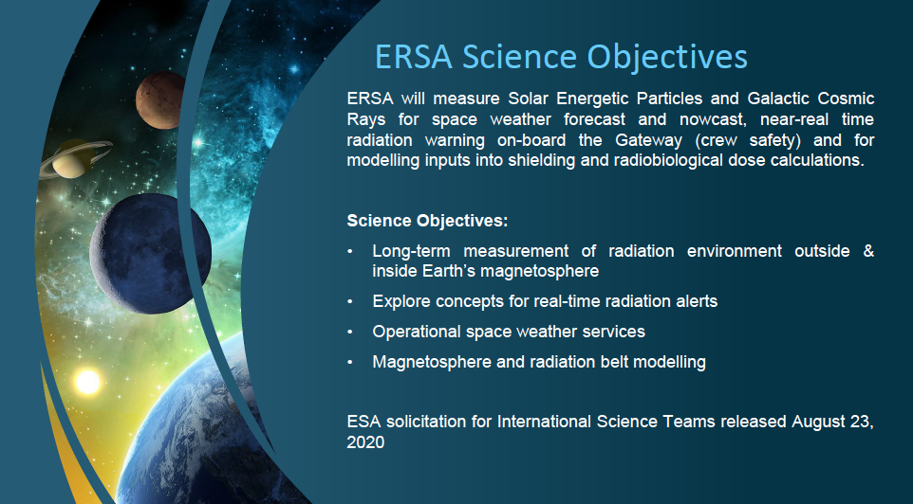

Slide 48
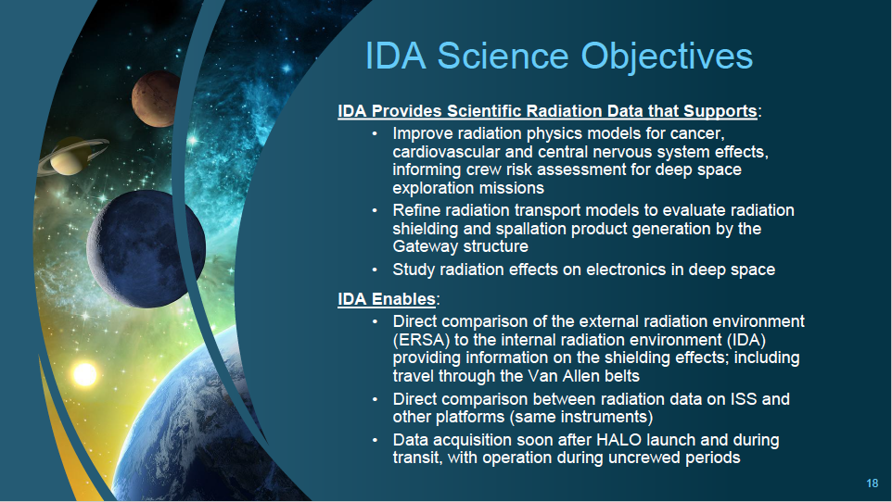

Slide 49
2022 CLPS TO2 Manifest
Astrobotic
Surface Exosphere Alterations by Landers (SEAL)
PROSPECT Ion-Trap Mass Spectrometer for Lunar Surface Volatiles (PITMS)
SEAL
PI Center: GSFC
Baseline Mass: 2.8 kg
PITMS
PI Center: GSFC
Baseline Mass: 1.5 kg
PILS
PI Center: GRC
Baseline Mass: 3.0 kg
Photovoltaic Investigation on Lunar Surface (PILS)
Linear Energy Transfer Spectrometer (LETS)
LETS
PI Center: JSC
Baseline Mass: 1.5 kg
Payloads largely selected from NASA Provided
Lunar Payloads (NPLP)
NIRVSS
PI Center: ARC
Baseline Mass: 5 kg
Near-Infrared Volatile Spectrometer System (NIRVSS)
Neutron Measurements at the Lunar Surface (NMLS)
NMLS
PI Center: MSFC
Baseline Mass: 2.0 kg
NSS
PI Center: ARC
Baseline Mass: 1.9 kg
Neutron Spectrometer System (NSS)
Fluxgate Magnetometer (MAG)
MAG
PI Center: GSFC
Baseline Mass: 1.6 kg
Key
Navigation Doppler Lidar for Precise Velocity and Range Sensing (NDL)
NDL
PI Center: LaRC
Baseline Mass: 14 kg
MSolo
PI Center: KSC
Baseline Mass: 7.5 kg
Mass Spectrometer Observing Lunar Operations (MSolo)
Science
Technology
Exploration
HEOMD/STMD

Slide 50
2022 CLPS TO2 IM Manifest
Intuitive Machines
LN-1
PI Center: MSFC
Baseline Mass: 1.8 kg
Lunar Node 1 Navigation Demonstrator (LN-1)
Stereo Cameras for Lunar Plume-Surface Studies (SCALPSS)
SCALPSS
PI Center: LaRC
Baseline Mass: 1.8 kg
Payloads largely selected from NASA Provided
Lunar Payloads (NPLP)
Low-frequency Radio Observations from the Near Side Lunar Surface (ROLSES)
ROLSES
PI Center: GSFC
Baseline Mass: 14.6 kg
Navigation Doppler Lidar for Precise Velocity and Range Sensing (NDL)
NDL
PI Center: LaRC
Baseline Mass: 14.0 kg
Key
Science
RFMG
PI Center: GRC
Baseline Mass: kg
Radio Frequency Mass Gauge (RFMG)
Technology
Exploration
HEOMD/STMD

