Slide 1


Benchmark Problem Development for Testing Maturity of Intelligent Contingency Management Tools
Jon Holbrook, Natasha A. Neogi, Michael J. Acheson, Irene M. Gregory
NASA Langley Research Center
AIAA SciTech Forum, 3-7 January 2022
Copyright © by the National Aeronautics & Space Administration
Published by the American Institute of Aeronautics and Astronautics, Inc., with permission.

Slide 2
Introduction
  Increasingly autonomous Advanced Air Mobility (AAM) vehicles will be required to handle diverse conditions with limited human intervention
  Intelligent contingency management (iCM) approaches are under development to address how automated agents can handle unforeseen, unplanned, and unanticipated events
  Benchmark scenario is needed to test the maturity of the developed iCM tools and techniques

Slide 3
Scenario Development Process
  Identify clear objectives
  Assess capabilities of the tools being evaluated
  Assess necessary levels of fidelity
  Develop process flow map with key decision points
  Identify metrics that map back to objectives

Slide 4
Identification of Objectives
  Specific
  Measurable
    What agents are involved?
    What are the desired outcomes?
    What are the success criteria?
    How is progress toward success measured?
  Attainable

Slide 5
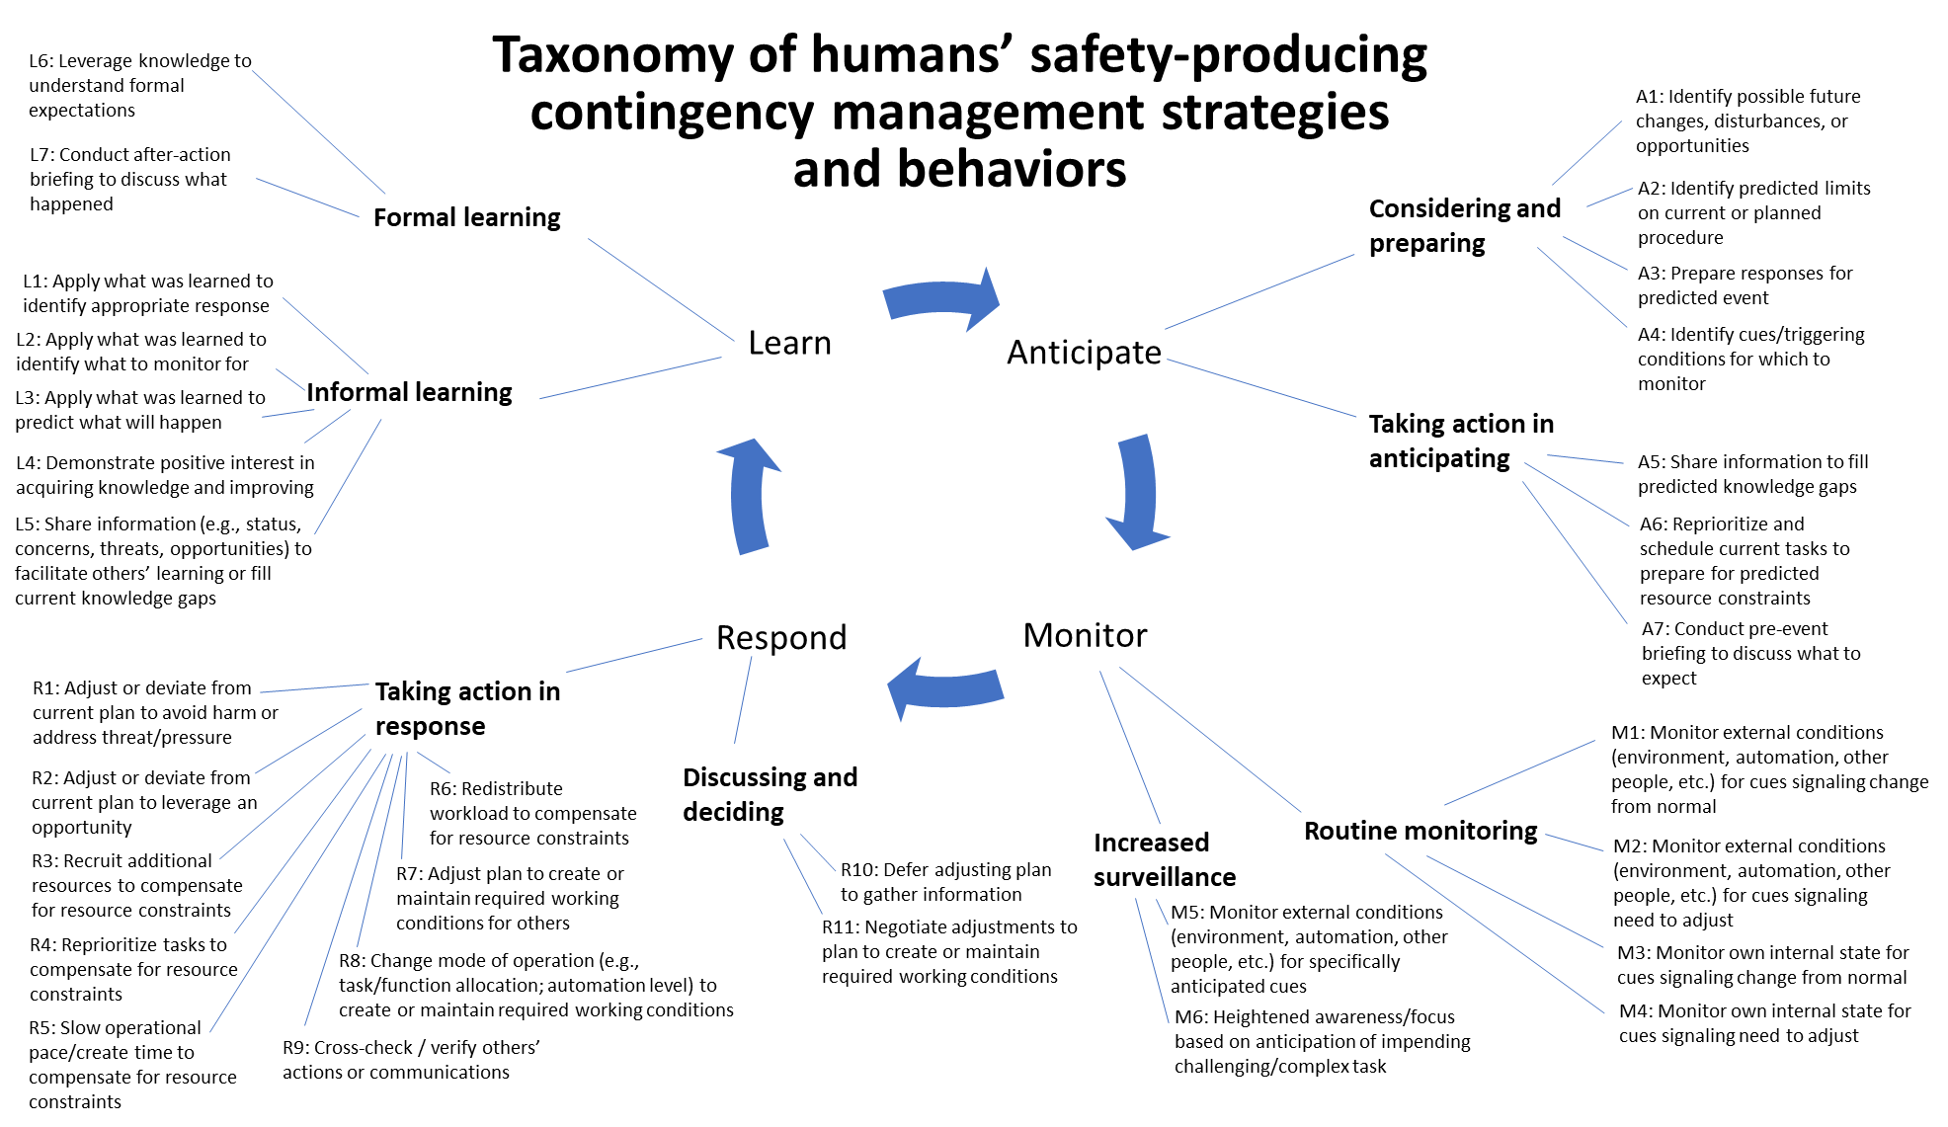
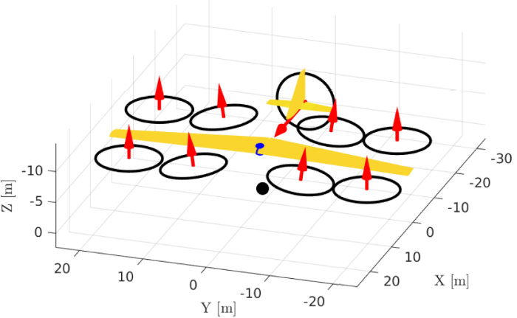
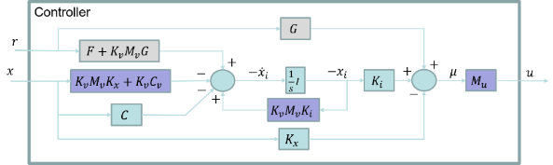
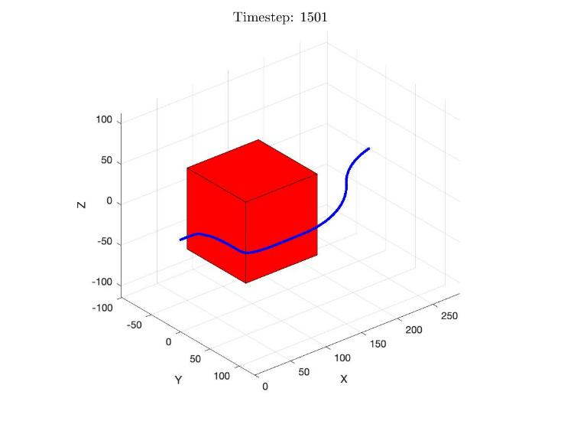
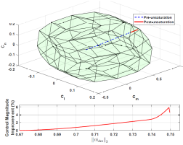
Capabilities Assessment: iCM tools
  What are current capabilities of the participating agent(s) to detect, decide, and act?
  How do these capabilities address the same objectives as those met by existing (human) agents?
?
Image credits: NASA

Slide 6
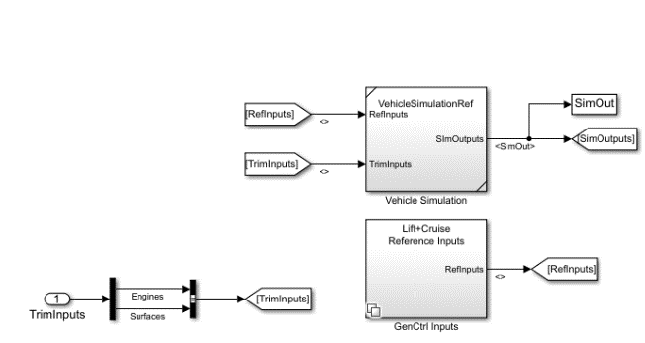

Capabilities Assessment: Simulation Environment
  Limited by knowledge and expertise of designers
    Not possible to test edge cases not contained in simulation requirements
    Full-fidelity real-world simulation environment is not attainable
    Computational complexity of environment trades against simulation speed
  Must clearly understand and document levels of fidelity
    Meaningful with respect to benchmark objectives
    Metrics must not convey more fidelity than is possible to assess
Image credits: NASA

Slide 7
Process Flow Development Considerations
  Scenario
  Setting
  Duration
  Operational realism
  Robustness
  Extensibility / Expandability
  Triggering Events
  Level of uncertainty / ambiguity
  Annunciated vs. Unannunciated events
  Onset
  Timing

Slide 8
Process Flow Development Considerations
  Agents
  Number
  Level of autonomy
  Capability to
    Detect
    Decide
    Act
  Knowledge state
  Interactions/Dependencies
  Possible outcomes
  Downstream consequences
  Behavior of “confederate” agents

Slide 9
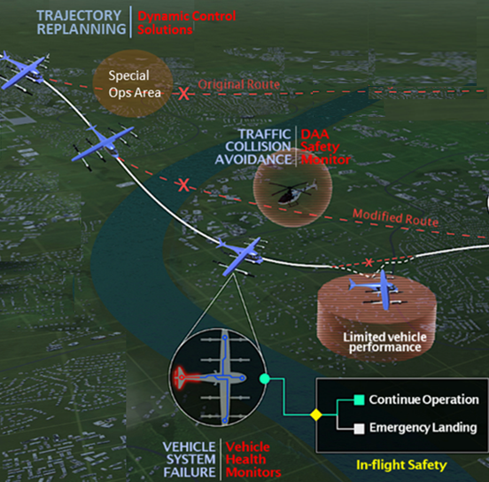
Process Flow Development
Examples of triggering events* that can precipitate contingency management
Vehicle mechanical (e.g., system fault; fuel issue; MEL-ed equipment; etc.)
Airport/vertiport/airspace (e.g., challenging design features; NOTAMS; special ops area; etc.)
Air traffic control/management (e.g., challenging procedure; complex clearance; ATC-applied time-pressure; additional restrictions applied; etc.)
Automation (e.g., undesired mode or mode change; flight track or speed deviation; etc.)
Cabin (e.g., passenger issues, etc.)
Dispatch/paperwork (e.g., release errors; takeoff performance; EFB issues; etc.)
Environment (e.g., conflicting traffic; terrain; birds; etc.)
Weather (e.g., tailwind; wind gusts; turbulence; ice/snow; convective weather; etc.)
Ground servicing (e.g., clear zone not clear; pushback error; gate restrictions; etc.)
Maintenance servicing (e.g., impacts on flight crew duties, logbook issues, etc.)
Operations pressure (e.g., gate/customer service; operational changes; late arrival; etc.)
Image credit: NASA
* List adapted from American Airlines Department of Flight Safety (2021)

Slide 10
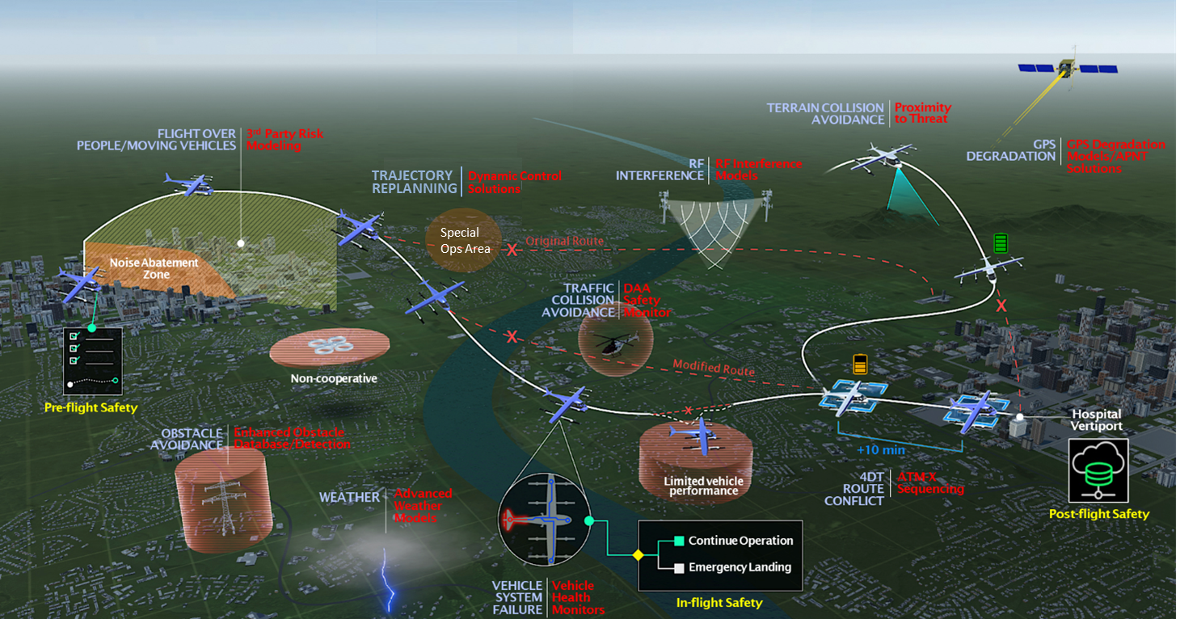
Example of Designing for Extensibility
Image credit: NASA

Slide 11
Measurement Opportunities
  Metrics must map back to objectives
  Metrics must be operationally plausible / realistic
  Identify basis for comparison
  Include both outcome metrics and process metrics
  Take care to avoid “gaming” in design, evaluation, and interpretation of metrics

Slide 12
Documenting Assumptions
  Important to document, monitor the validity of assumptions, and identify when they are violated
  Assumption is something that is accepted as being true, or as certain to happen, without proof
    Paradigmatic assumptions
    Prescriptive assumptions
    Causal assumptions
    Simplifying assumptions

Slide 13
Conclusion
  Scenario development helps to highlight the complexity of the problem and the challenges that need to be addressed
    Establish a baseline capability that is extensible to new operational challenges as tools mature
    Integration of disparate tools within a common infrastructure
  Usefulness of a benchmark scenario depends on considerations and assumptions made during implementation and evaluation process

