Slide 1
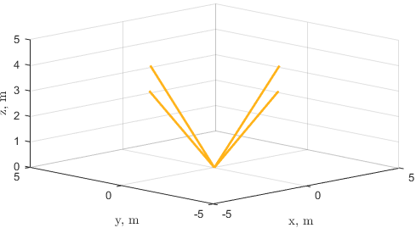
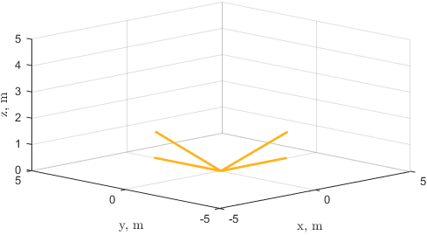
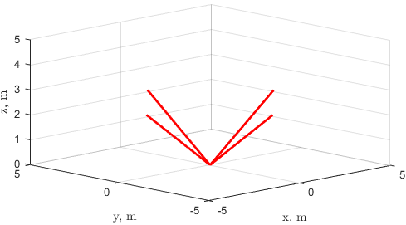
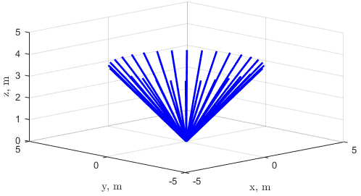
US side Magnetic nozzle computational modeling efforts update
11/19/2021
Nathan Schilling

Slide 2
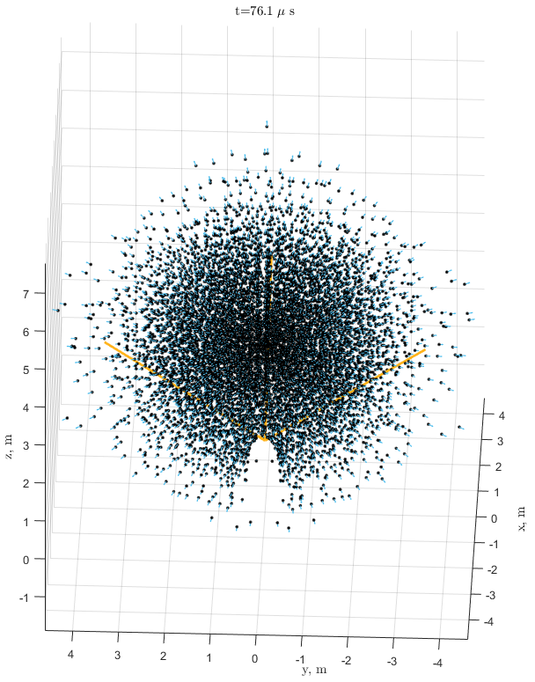
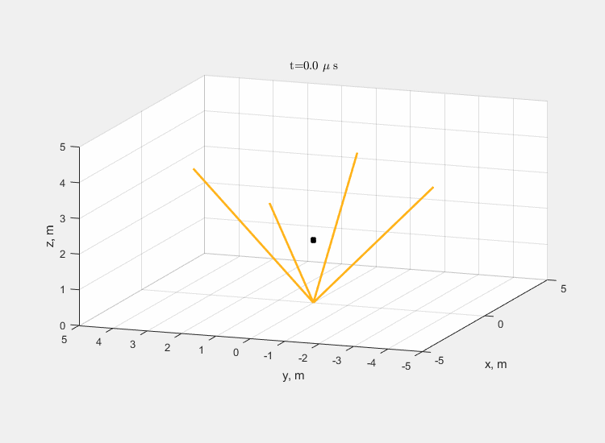
High level trends
Only texted axial nozzles so far
More leakage vs. more magnetic drag
  If magnetic field is too low, plasma will leak around the struts
  If magnetic field is too high, plasma will get turned around back into nozzle
More performance vs. higher heat loads
  More struts means less leakage and more performance (~1000 vs. ~2000 sec Isp)
  More struts means higher view factor and higher heat loads
Performance so far is lackluster
  2,000 sec Isp
  10kN Thrust (for ~100mT vehicle this is a T/W of 0.1)

Slide 3
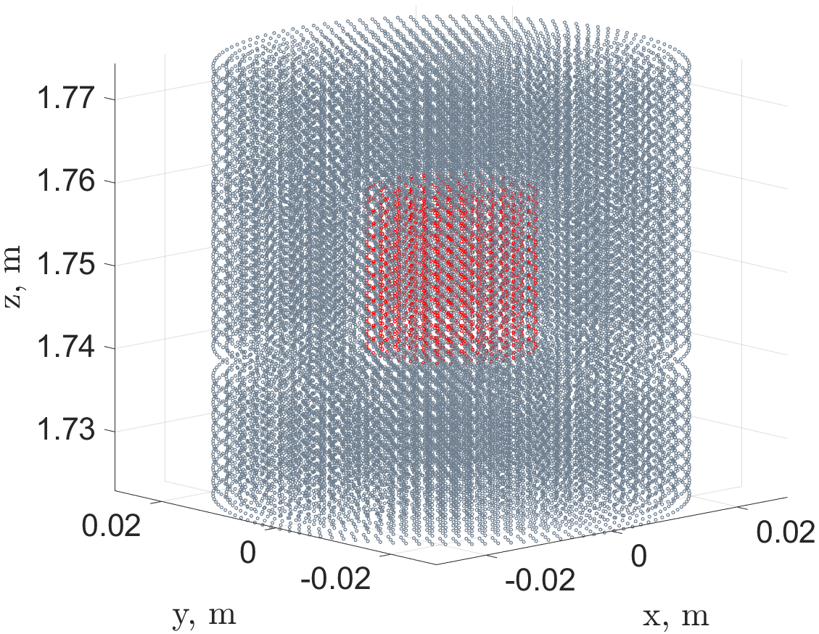
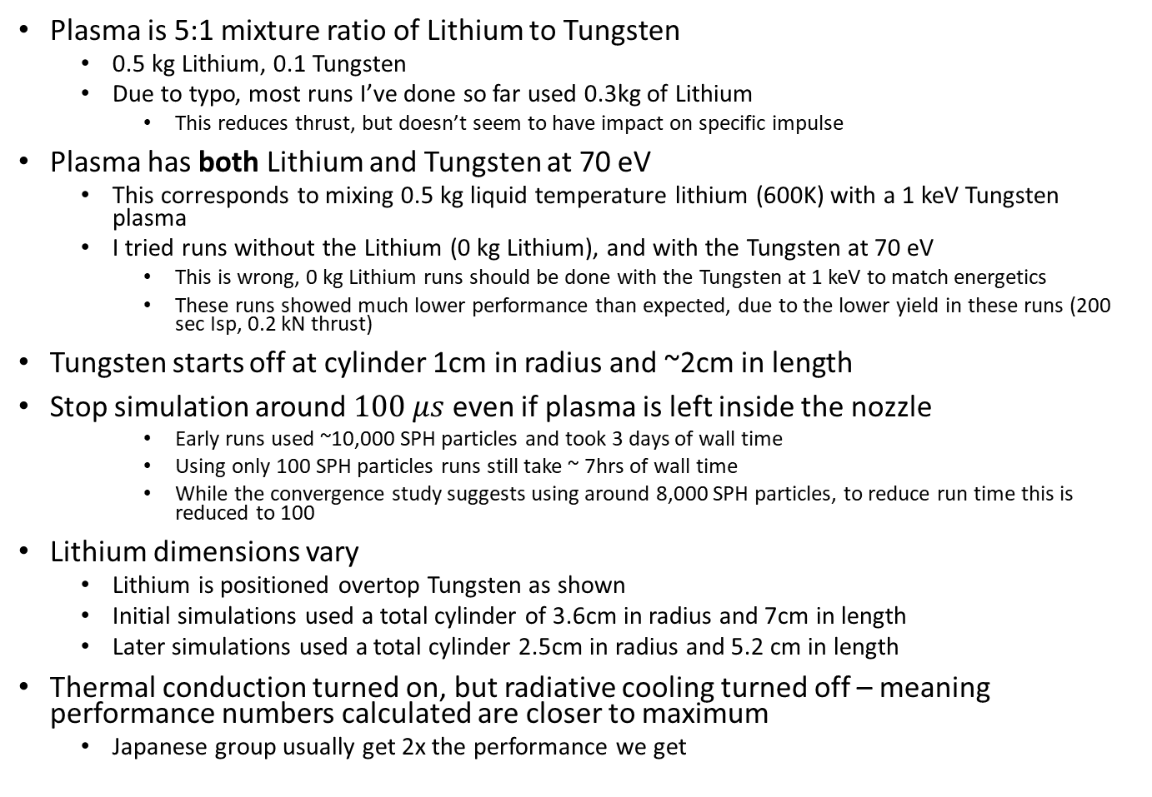
Input parameters
Plasma is 5:1 mixture ratio of Lithium to Tungsten
  0.5 kg Lithium, 0.1 Tungsten
  Due to typo, most runs I’ve done so far used 0.3kg of Lithium
    This reduces thrust, but doesn’t seem to have impact on specific impulse
Plasma has both Lithium and Tungsten at 70 eV
  This corresponds to mixing 0.5 kg liquid temperature lithium (600K) with a 1 keV Tungsten plasma
  I tried runs without the Lithium (0 kg Lithium), and with the Tungsten at 70 eV
    This is wrong, 0 kg Lithium runs should be done with the Tungsten at 1 keV to match energetics
    These runs showed much lower performance than expected, due to the lower yield in these runs (200 sec Isp, 0.2 kN thrust)
Tungsten starts off at cylinder 1cm in radius and ~2cm in length
Stop simulation around $100 μs$ even if plasma is left inside the nozzle
    Early runs used ~10,000 SPH particles and took 3 days of wall time
    Using only 100 SPH particles runs still take ~ 7hrs of wall time
    While the convergence study suggests using around 8,000 SPH particles, to reduce run time this is reduced to 100
Lithium dimensions vary
  Lithium is positioned overtop Tungsten as shown
  Initial simulations used a total cylinder of 3.6cm in radius and 7cm in length
  Later simulations used a total cylinder 2.5cm in radius and 5.2 cm in length
Thermal conduction turned on, but radiative cooling turned off – meaning performance numbers calculated are closer to maximum
  Japanese group usually get 2x the performance we get
Lithium
Tungsten

Slide 4
Nozzles tested
Configuration | Number of struts | Current (MA) | Initial distance from plasma center to nozzle exit (m) | Mixture ratio (kg Lithium:kg Tungsten)
Axial | 4 8 32 | 0.1 1 10 100 | 2 0 -1.75 -2 -2.75 | 5:1 0

Slide 5
Best nozzle so far - axNozz_32s_10MA__175cm_5
Aside about input file naming convention
axNozz_32s_10MA__175cm_5
Prefix specifies nozzle configuration
(“axNozz” for axial and
“solNozz” for solenoidal)
Mixture ratio
“5” indicates a mixture ratio of 5kg of lithium for 1kg of Tungsten
Number of struts/coils
“32s” means 32 struts.
Solenoidal nozzles use coils
Distance from the center of the plasma to the nozzle exit. A distance of 0 m indicates the center of the plasma is in the same place as the nozzle exit In this case, the underscore indicates a negative, so “_175cm” means the plasma is -175cm away from the nozzle exit, or 1.75 m inside the nozzle. For the 3.5 m long nozzle, this means the plasma is in the center of the nozzle
Strut/coil current
So this nozzle used
a current of 10 MA

Slide 6
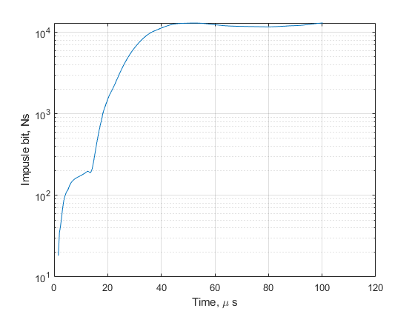
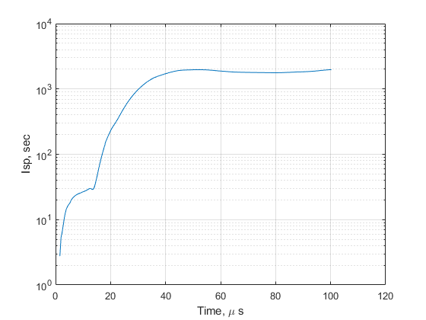
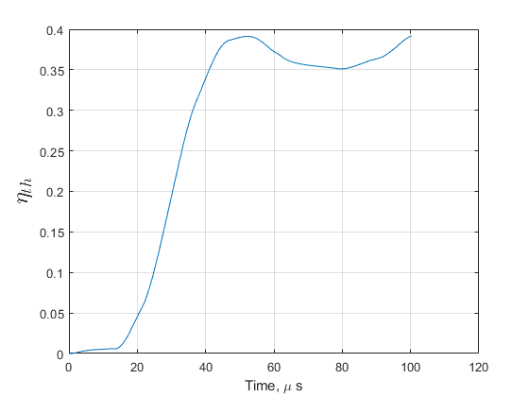
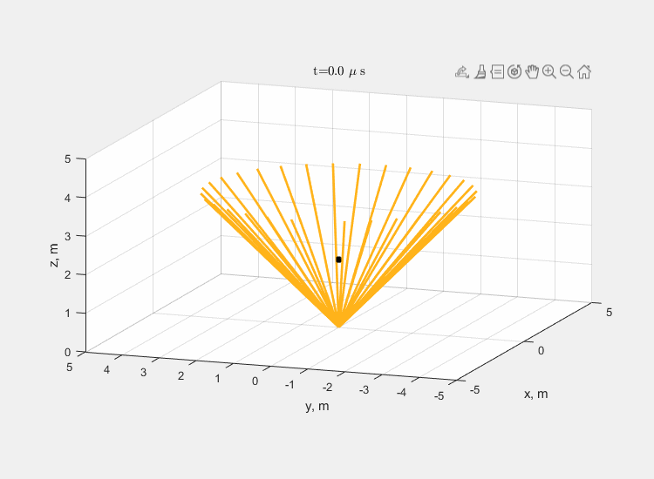
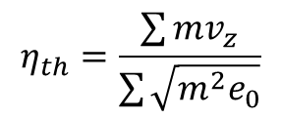
Best nozzle so far - axNozz_32s_10MA__175cm_5
$$η_{th}=\frac{\sum{mv_{z}}}{\sum{\sqrt{m^{2}e_{0}}}}$$
Notes:
e_0 is initial specific internal energy

Slide 7
Next Steps
Optimize design
  Maybe increase current to reduce leakage and hope it doesn’t also increase magnetic drag signifigantly?
  See if I can get away with fewer struts
  Maybe move the plasma closer/farther away from the nozzle exit and see what happens?
  Try to get the tungsten out of the nozzle
Try a solenoidal nozzle design and see what happens

