Slide 1
Seeding Method for Velocimetry and Visualization of Supersonic Retropropulsion Nozzle Plumes
Adit S. Acharya¹, K. Todd Lowe¹, Wing F. Ng¹, Paul M. Danehy², Karl T. Edquist²,
Ross A. Burns², Harry T. Pham²
¹Virginia Tech, ²NASA Langley Research Center
2022 AIAA SciTech Forum, January 3-7 2022
Copyright © 2021 by Virginia Polytechnic Institute and State University and the U.S.A, as represented by the Administrator of the National Aeronautics and Space and Administration. All rights reserved.
Published by the American Institute of Aeronautics and Astronautics, Inc., with permission.
Funding from: NASA Aerosciences Evaluation and Test Capabilities (AETC) Portfolio

Slide 2
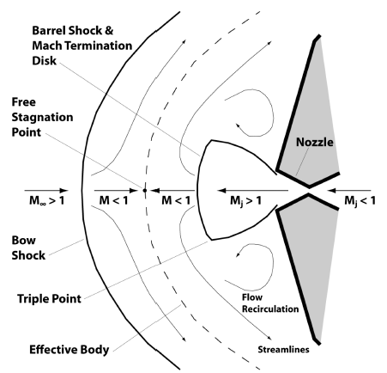
Motivation
Growing interest in supersonic retropropulsion (SRP) for Martian vehicle descent¹
Current EDL systems not suitable for massive payloads
SRP: propulsive deceleration while still in supersonic flight
Figure 1: SRP flow features, adapted from Berry et al.²

Slide 3
Motivation
SRP model wind tunnel studies are desirable
Laser diagnostics such as particle image velocimetry can provide off-body measurements³
(requires seeding of tracer particles into flow)
tracer particle density is diminished
POOR MEASUREMENT QUALITY
if SRP nozzle expels dry air
BUT
observed in similar studies of SRB booster separation models^{4,5}

Slide 4
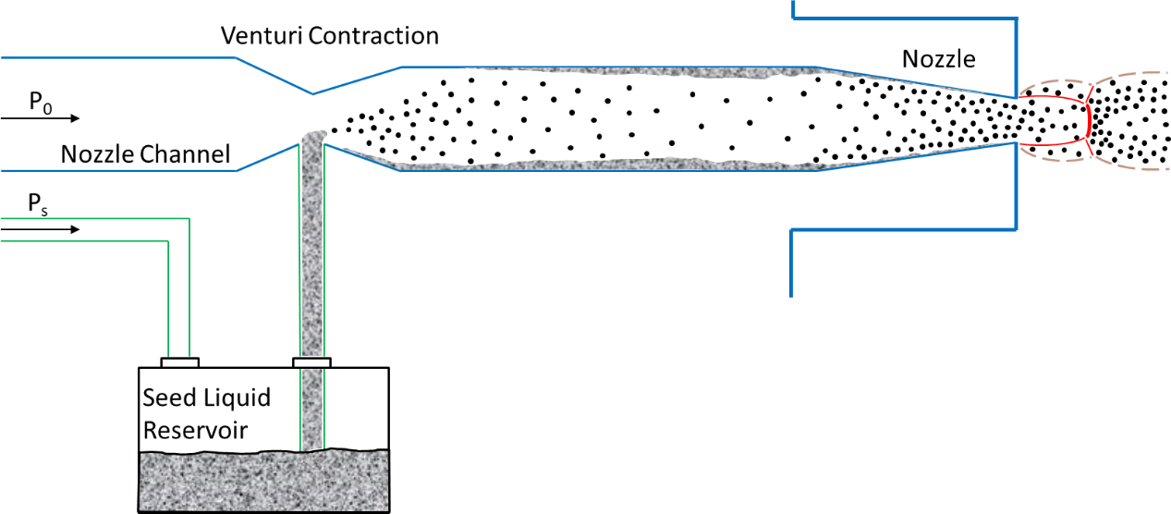
Concept
Goal: seed underexpanded nozzle flow with particles suitable for PIV
Solution: Venturi contraction to draw liquid into flow path; atomized by strong shear forces (presented at SciTech 2021⁶)
1. Supply P₀ and P_{S}
2. Pressure drop forms at Venturi contraction
3. Seed liquid drawn into flow path
4. Seed liquid atomized by shear forces in nozzle
5. Particles ejected in jet
Figure 2: Schematic of “Venturi seeder” with shock structure (red) and jet contact surfaces (brown)

Slide 5
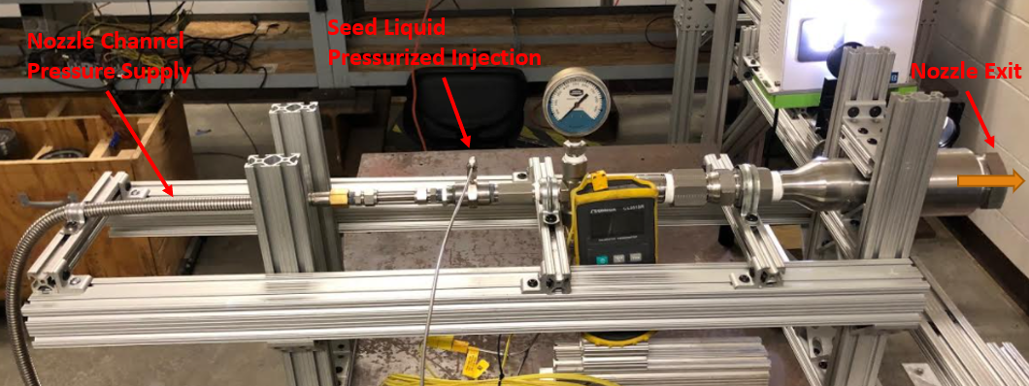
Experimental Methods
7.87 mm exit dia.
15°half angle
15.7 area ratio
Rig constructed with NPT + Swagelok fittings
Converging, sonic nozzle created by drilling into plug
Seed line connected to pressure pot filled with DEHS oil
Figure 3: Picture of SRP nozzle rig

Slide 6
Experimental Methods
≤ 1 μm dia. for suitable response times in typical gas flows⁷
Experiments aimed to ensure that:
Particles in spray acceptable size for PIV measurements
PIV results matched expectations for nozzle plume
Nozzle generated underexpanded jet
Measured with…
TSI™ 3321 Aerodynamic Particle Sizer (APS)
Shadowgraph imaging
2D PIV of axial and radial velocities

Slide 7
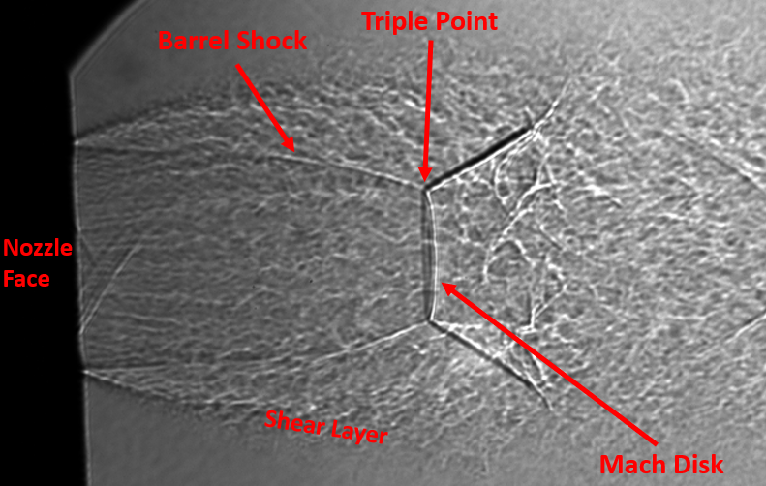
Results: Shadowgraph
Rig supplied with P₀ = 5.07 MPa
Seed line shut off
Significant losses, P₁ = 0.79 MPa downstream of Venturi
Underexpanded plume observed
Figure 4: Shadowgraph image of dry SRP nozzle plume

Slide 8
Results: Cases
Three cases of supply pressures used:
Table 1: Absolute pressure settings for the three test cases
Case | P₀ [MPa] | P₁ [MPa] | P_{s} [MPa]
A | 4.44 | 0.67 | 0.67
B | 4.93 | 0.76 | 0.60
C | 6.17 | 0.93 | 0.93
Used for TSI™ Particle Sizer and PIV experiments

Slide 9
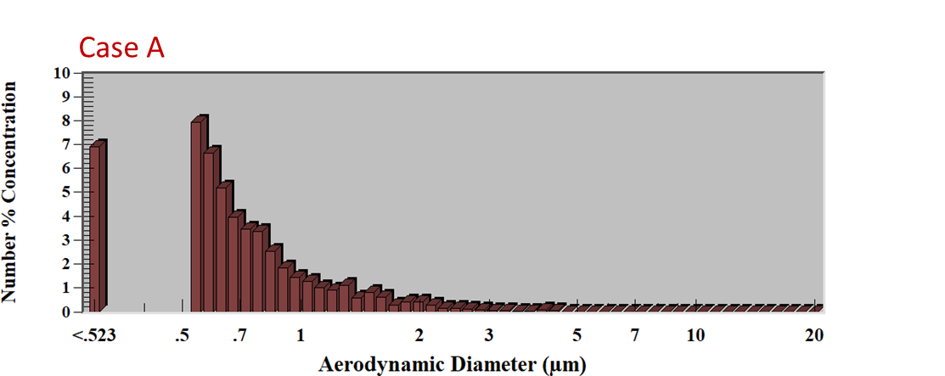
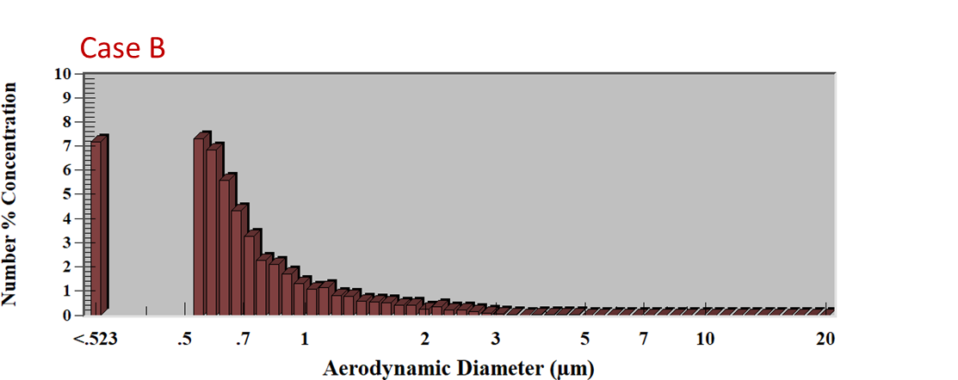
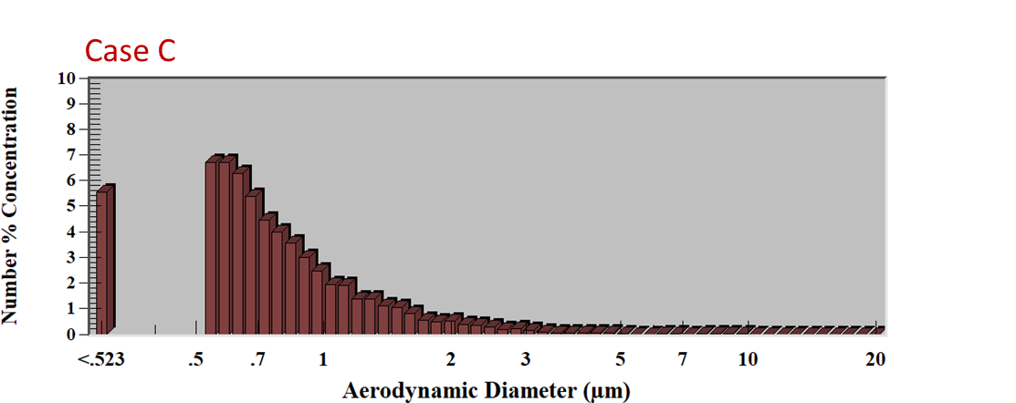
Results: Particle Sizer
Table 2: Statistical data for diameters of particles collected by TSI™ spectrometer
Case | Particles Collected | Particle Concentration [#/cm³] | Median Diameter [μm] | Mean Diameter [μm] | % Particles < 1 μm Diameter
A | 4912 | 252.2 | 0.68 | 0.83 | 93.2
B | 5116 | 288.5 | 0.67 | 0.82 | 93.3
C | 6636 | 476.0 | 0.73 | 0.90 | 88.8
Figure 5: Histograms of particle aerodynamic diameters

Slide 10
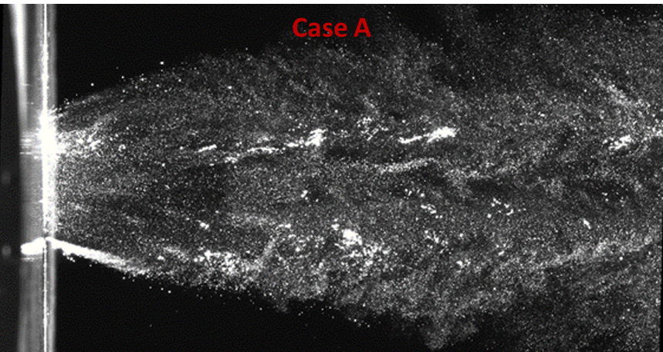
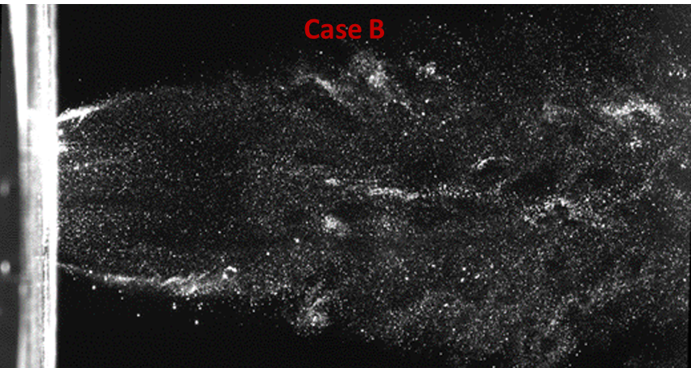
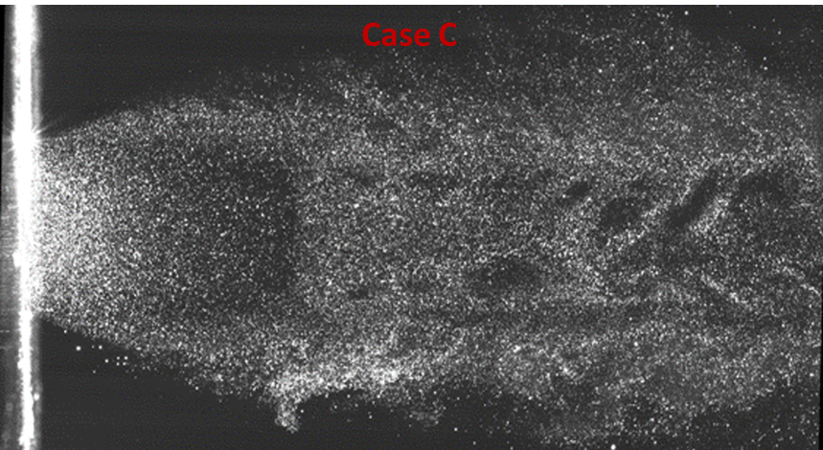
Results: PIV
Figure 6: Raw instantaneous PIV images of seeded plumes for each of the three cases
Visible particle density variation near nozzle and across shock!

Slide 11
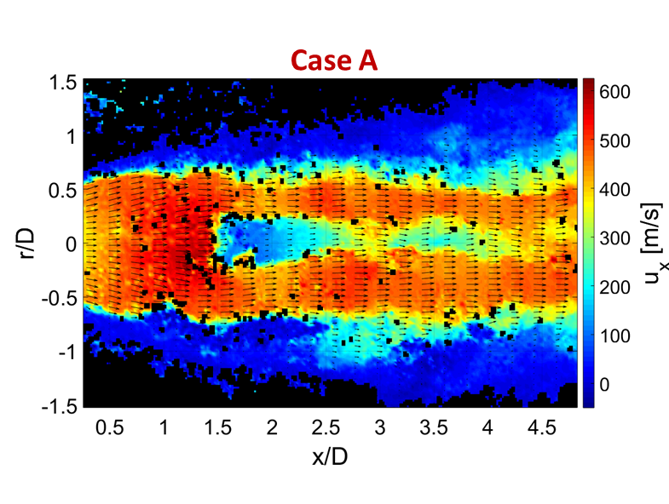
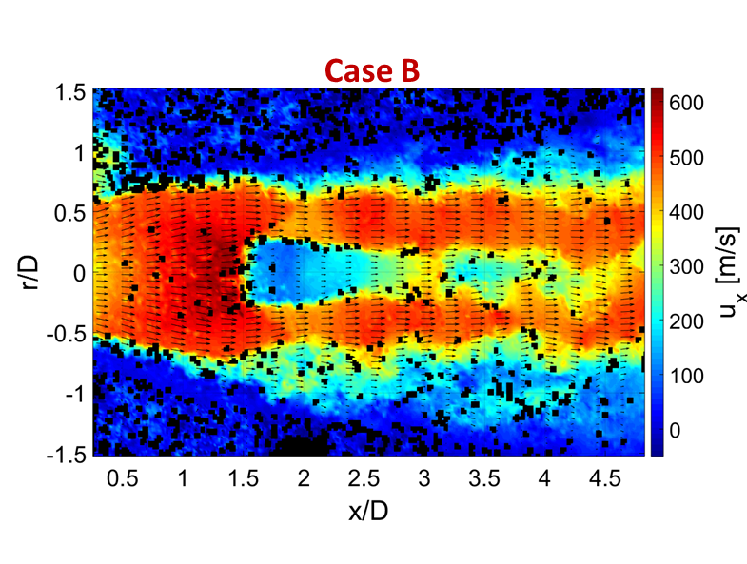
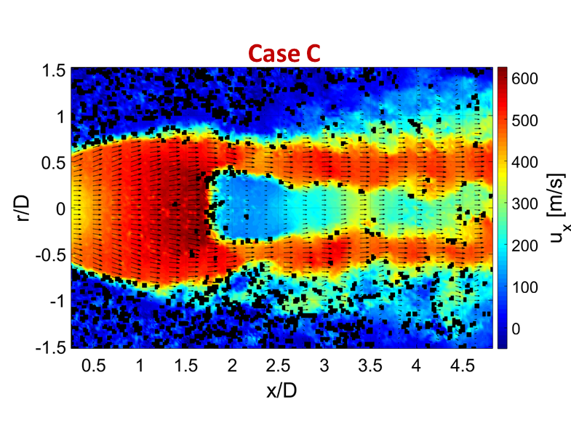
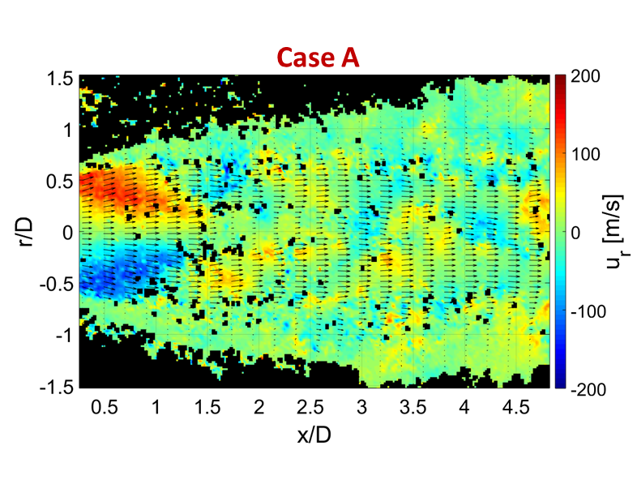
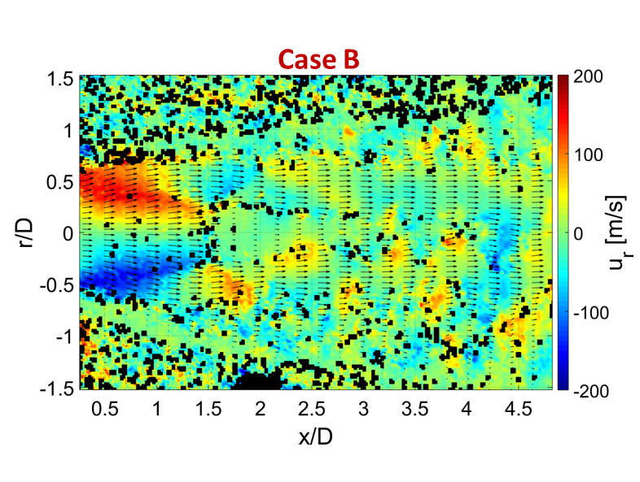
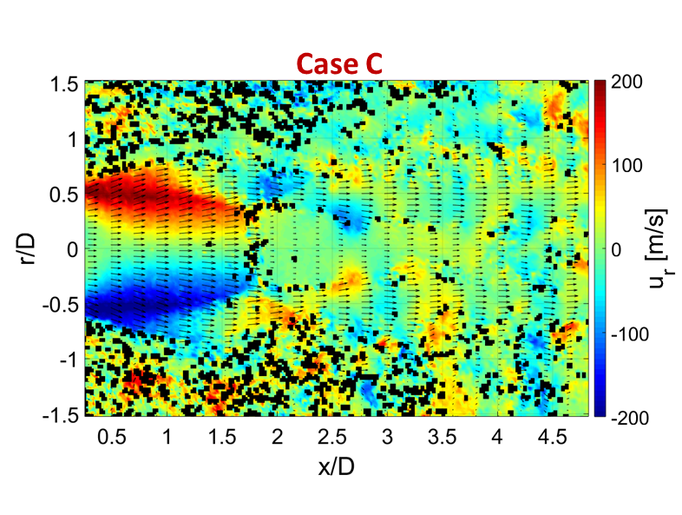
Results: PIV
Figure 7: Sample instantaneous axial (above) and transverse (below) velocity contours and vectors for each of the three cases

Slide 12
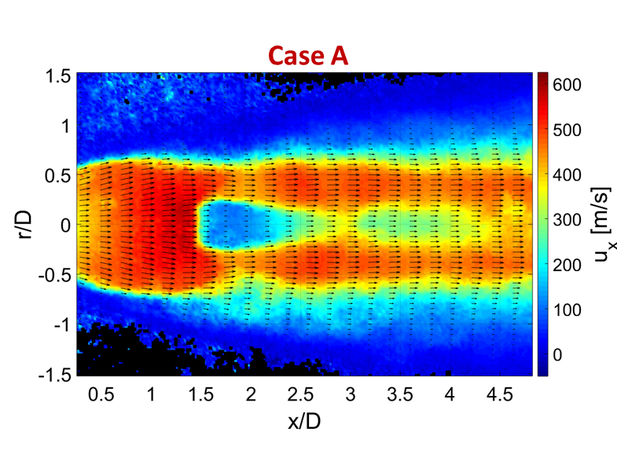
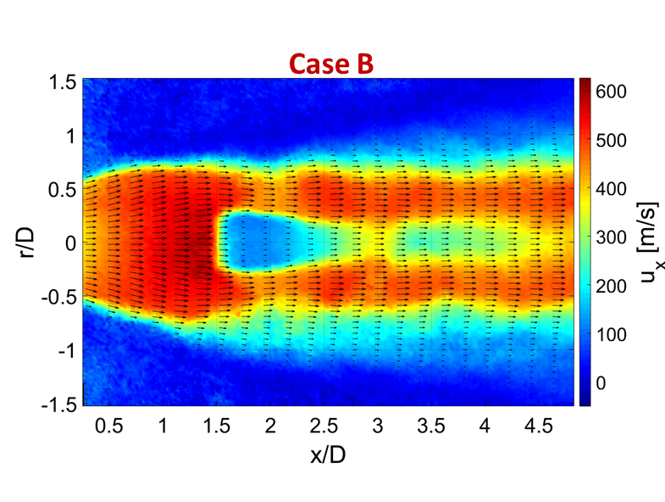
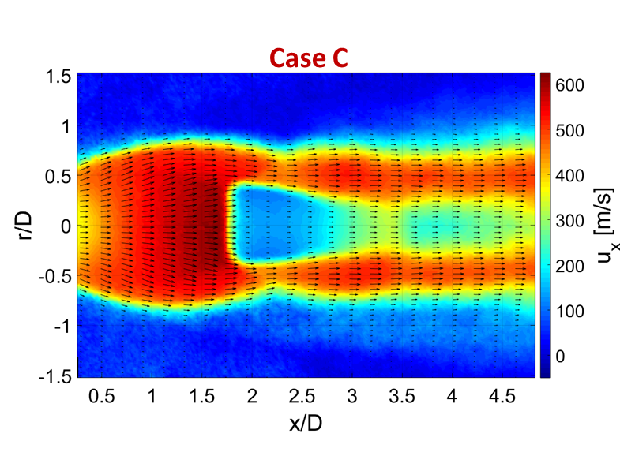
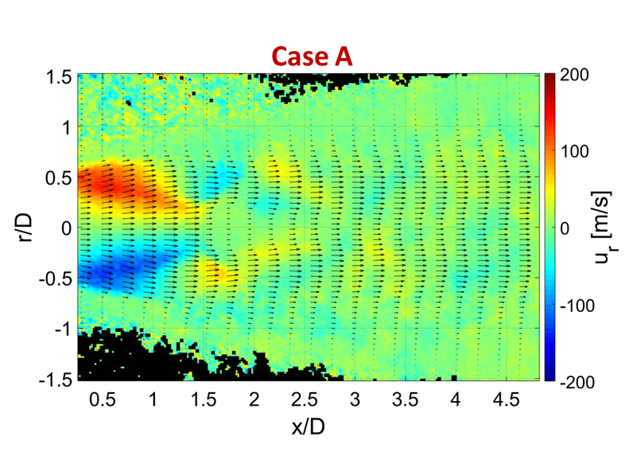
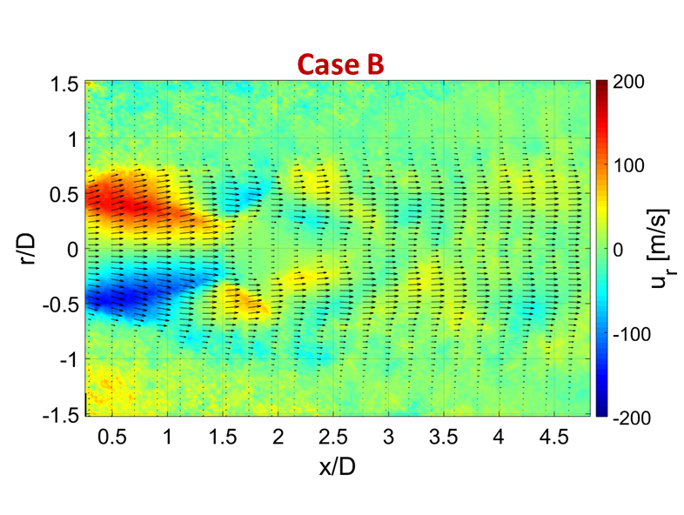
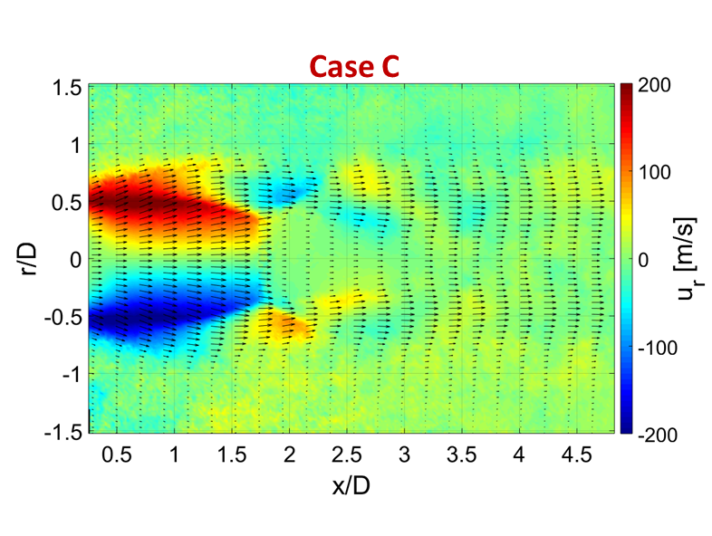
Results: PIV
Figure 8: Conditionally-averaged axial (above) and transverse (below) velocity contours and vectors for each of the three cases

Slide 13
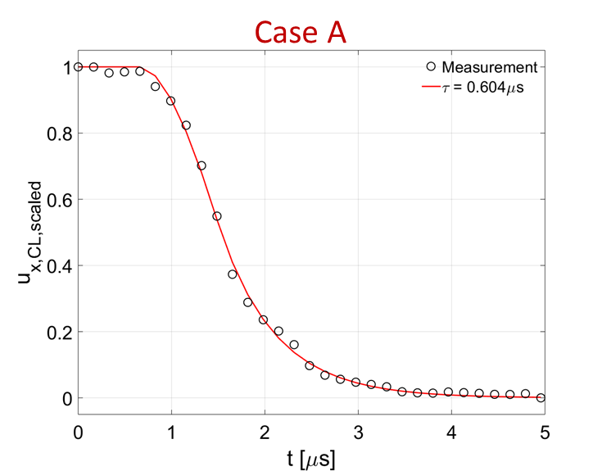
Results: Mach Disk Analysis
Aerodynamic response times of particles determined across normal shock
Space-time transform + exponential decay fitting
Mach disk location found from PIV; compared to relation from Crist⁸
Table 3: Mach disk standoff locations – observed (left) and computed (right) from Crist⁸
Case | x_{O} / D_{e} | x_{C} / D_{e}
A | 1.45 | 1.53
B | 1.49 | 1.64
C | 1.73 | 1.84
Figure 9: Measured velocity across Mach disk and exponential decay model for Case A

Slide 14
Results: PIV Particle Sizing
Aerodynamic response times converted to particle diameters using Stokes drag model⁷ and Melling rarefaction correction⁹
These methods can result in >2x underprediction of particle size in compressible flow¹⁰
Table 4: Particle response times and aerodynamic diameters using Stokes drag model (d_{p,S}) and Melling correction (d_{p,M})
Case | τ [μs] | d_{p,S} [μm] | d_{p,M} [μm]
A | 0.604 | 0.449 | 0.266
B | 0.634 | 0.460 | 0.329
C | 0.537 | 0.423 | 0.337
Figure 10: Particle sizes calculated from response times for eight PIV runs

Slide 15
Conclusions
“Venturi seeder” shown to be acceptable for PIV in multiple ways
TSI™ particle sizer reported at least 88.8% of particles ≤ 1 μm for three test cases
Instantaneous raw PIV images showed suitable tracer particle distributions and concentrations
Mean PIV velocity data revealed Mach disks, re-acceleration regions, etc. expected of underexpanded jet flow
Inexpensive, easy to implement in wind tunnels

Slide 16
References
¹Adler, M., Wright, M., Campbell, C., I., Engelund, W., Rivellini, T., “Entry, Descent, and Landing Roadmap: Technology Area 09”, National Aeronautics and Space Administration, 2012.
²Berry, S., Rhode, M., Edquist, K., Player, C., “Supersonic Retropropulsion Experimental Results from NASA Ames 9x7 Foot Supersonic Wind Tunnel”, Journal of Spacecraft and Rockets, Vol. 51, No. 3, 2014, pp. 724-734.
³Grant, I., “Particle Image Velocimetry: A Review”, Journal of Mechanical Engineering Science, Vol. 211, Part C, 1997.
⁴Lowe, K. T., Byun, G., Shea, S., Boyda, M., Winski, C., “Three-Velocity-Component Cross-Correlation Doppler Global Velocimetry for the Space Launch System Booster Separation Test in the NASA Langley Unitary Plan Wind Tunnel”, AIAA Aviation 2019 Forum, Dallas, Texas, 2019.
⁵Danehy, P., Wisser, B., Fahringer, T., Winski, C., Falman, B., Shea, S., Boyda, M., Lowe, K. T., “Laser Light Sheet Flow Visualization of the Space Launch System Booster Separation Test”, AIAA Aviation 2019 Forum, Dallas, Texas, 2019.
⁶Acharya, A. S., Lowe, K. T., Ng, W., Danehy, P., “Seeding Mechanism for High-Pressure Nozzles”, AIAA SciTech 2021 Forum, Virtual, 2021.
⁷Melling, A., “Tracer Particles and Seeding for Particle Image Velocimetry”, Measurement Science and Technology, Vol. 8, No. 12, 1997, pp. 1406-1416.
⁸Crist, S., Sherman, P., and Glass, D., “Study of Highly Underexpanded Sonic Jets”, AIAA Journal, Vol. 3, No. 6, 1965, pp. 68-71.
⁹Melling, A., “Seeding Gas Flows for Laser Anemometry”, AGARD Advanced Instrumentation for Aero Engine Components 1986.
¹⁰Williams, O., Nguyen, T., Schreyer, A.-M., Smits, A., “Particle response analysis for particle image velocimetry in supersonic flows”, Physics of Fluids, Vol. 27, No. 7, 2015.

