Slide 1
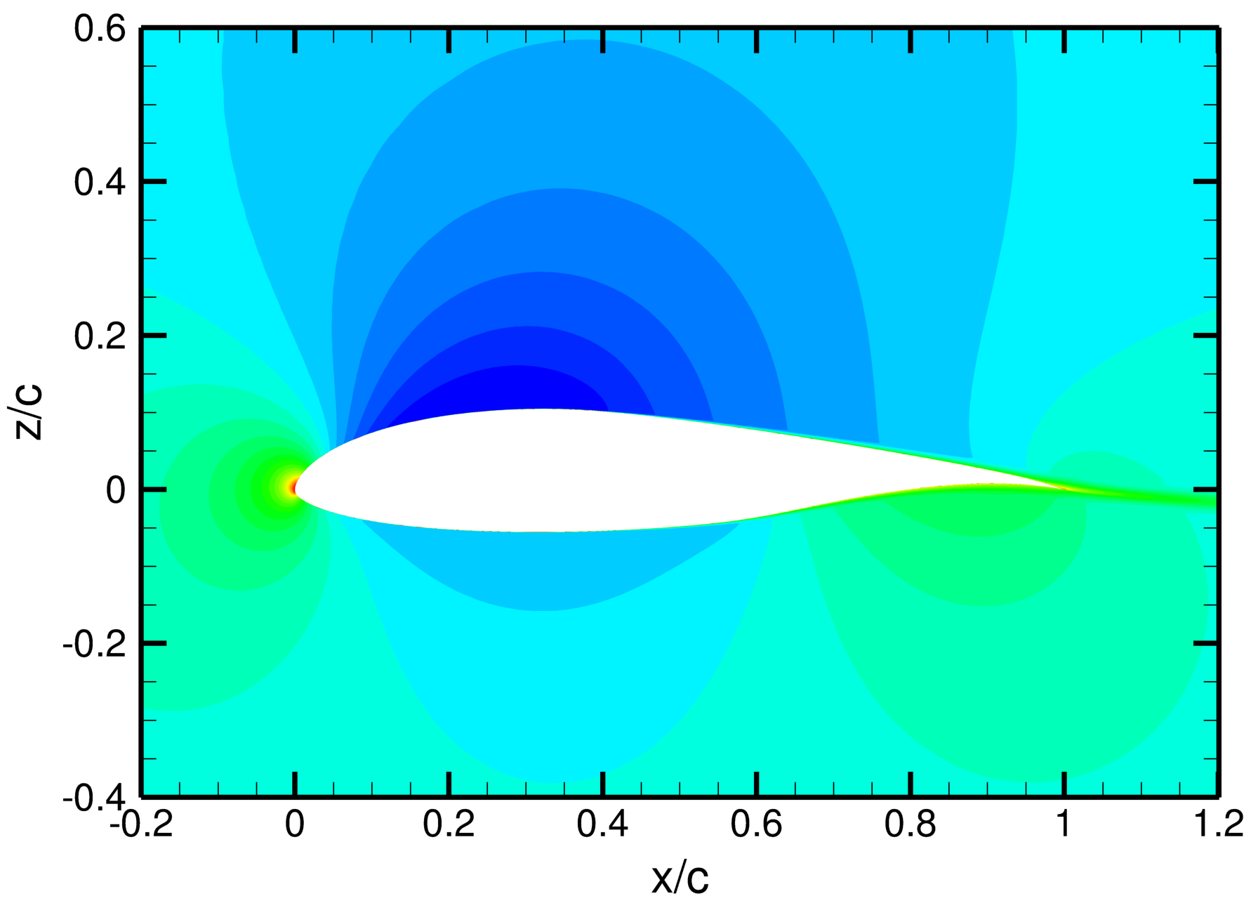
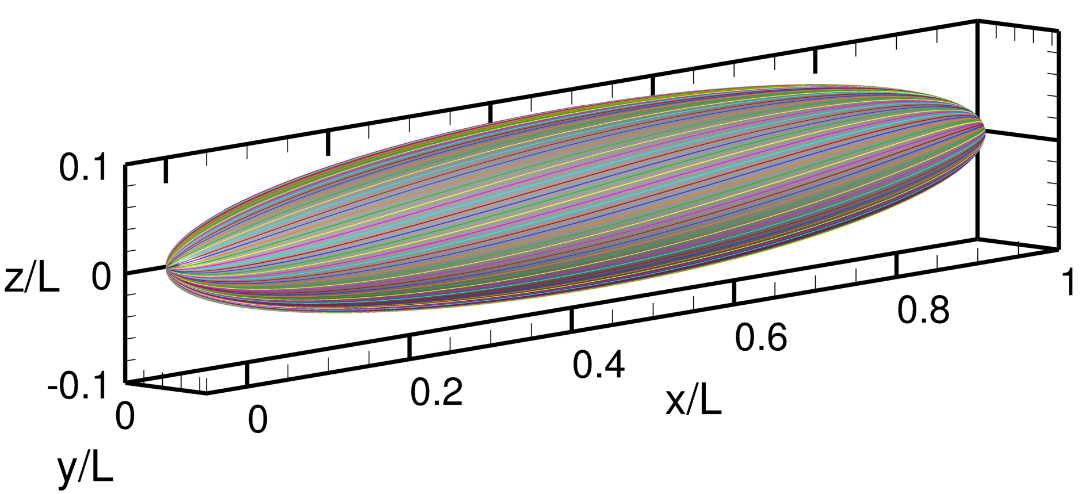




Coupling of the FUN3D Unstructured Flow Solver and the LASTRAC Stability Code to Model Transition
Nathaniel Hildebrand, Chau-Lyan Chang, Meelan M. Choudhari,
Fei Li, & Eric Nielsen
CASB, NASA Langley Research Center, VA
Balaji S. Venkatachari & Pedro Paredes
National Institute of Aerospace
Virtual Session
AIAA SciTech Forum
January 5, 2022
$$u/U_{∞}$$
$$Streamlines$$
Computational AeroSciences Branch

Slide 2
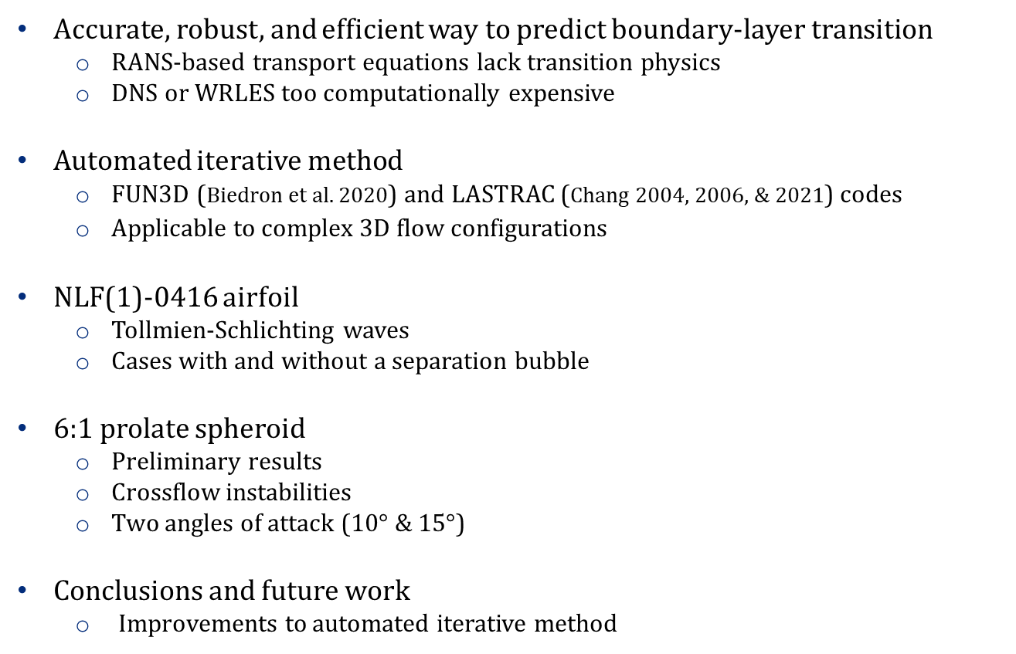
Outline
Accurate, robust, and efficient way to predict boundary-layer transition
  RANS-based transport equations lack transition physics
  DNS or WRLES too computationally expensive
Automated iterative method
  FUN3D (Biedron et al. 2020) and LASTRAC (Chang 2004, 2006, & 2021) codes
  Applicable to complex 3D flow configurations
NLF(1)-0416 airfoil
  Tollmien-Schlichting waves
  Cases with and without a separation bubble
6:1 prolate spheroid
  Preliminary results
  Crossflow instabilities
  Two angles of attack (10$°$ & 15$°$)
Conclusions and future work
  Improvements to automated iterative method
2/11

Slide 3
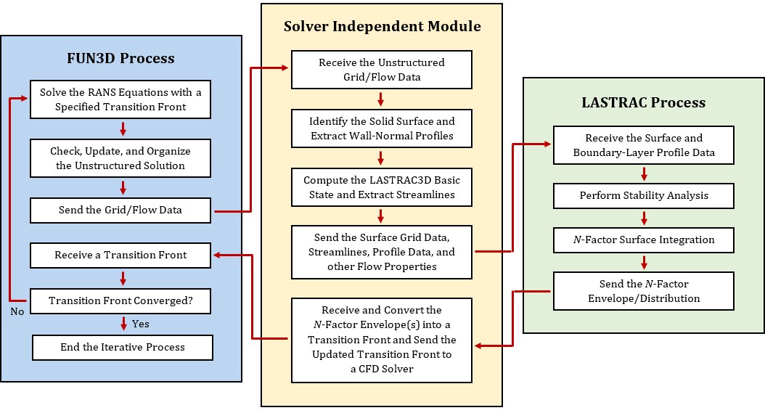
Automated Iterative Method
FUN3D unstructured RANS-based flow solver
  SA model (Spalart & Allmaras 1994) with imposed transition
LASTRAC stability solver
  Linear Stability Theory (LST) or Parabolized Stability Equations (PSE)
  Mode tracking approach
3/11

Slide 4
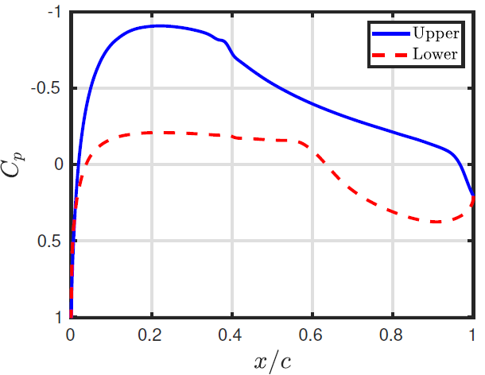
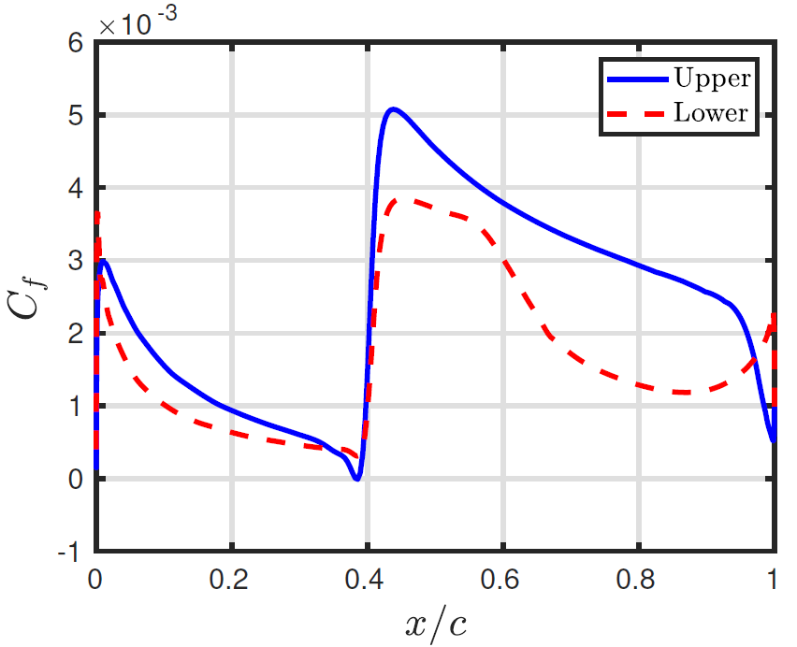
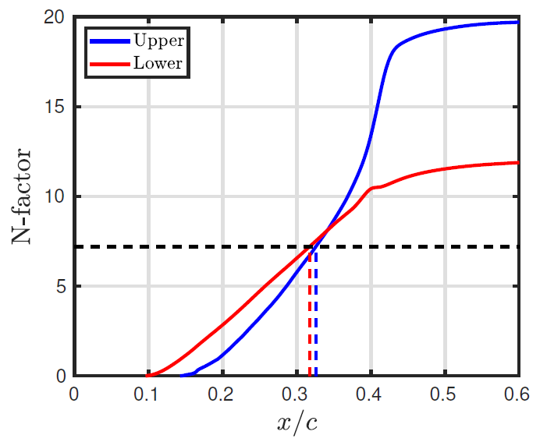
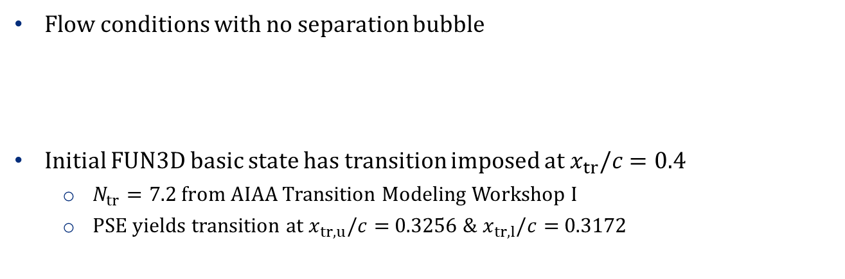
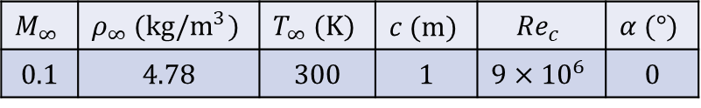
2D Basic State of NLF(1)-0416 Airfoil
Flow conditions with no separation bubble
Initial FUN3D basic state has transition imposed at$x_{tr}/c=0.4$
  $N_{tr}=7.2$ from AIAA Transition Modeling Workshop I
  PSE yields transition at $x_{tr,u}/c=$0.3256 & $x_{tr,l}/c=$0.3172
$$M_{∞}$$ | $$ρ_{∞} (kg/m^{3})$$ | $$T_{∞} (K)$$ | $$c (m)$$ | $${Re}_{c}$$ | $$α (°)$$
0.1 | 4.78 | 300 | 1 | $$9×{10}^{6}$$ | 0
4/11

Slide 5
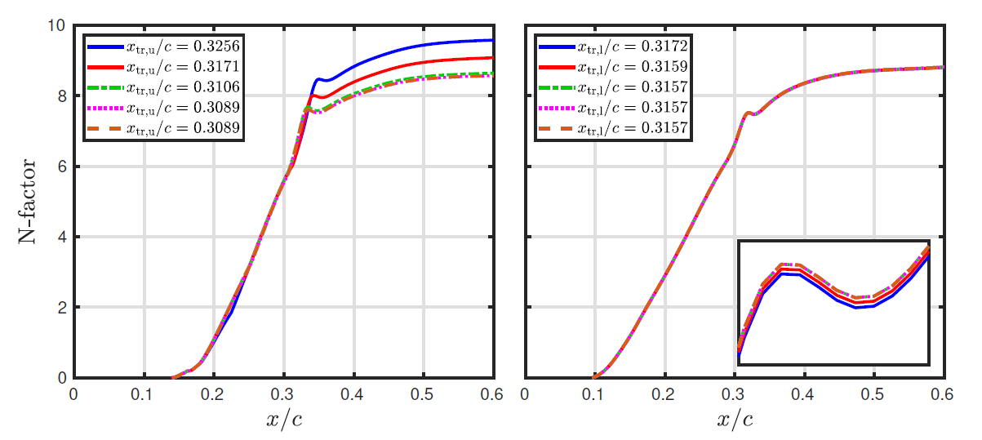
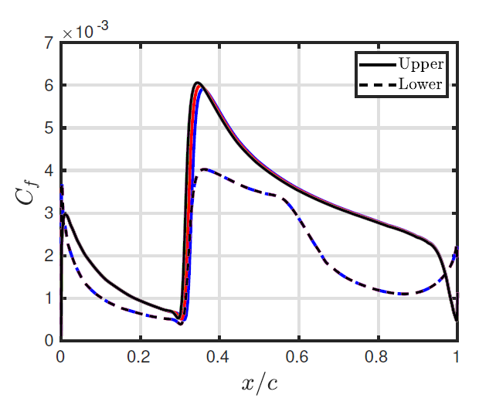
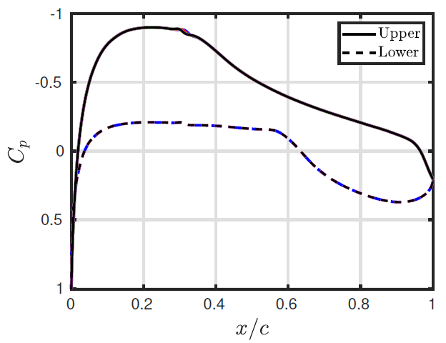
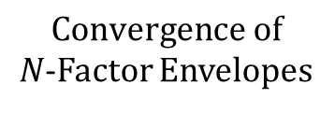
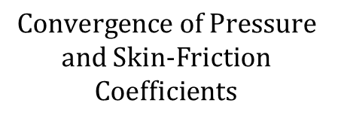
Subsequent Iterations for NLF(1)-0416 Airfoil
$$Convergence of$$
$N$-Factor Envelopes
4
$$Convergence of Pressure$$
and Skin-Friction
Coefficients
5/11

Slide 6
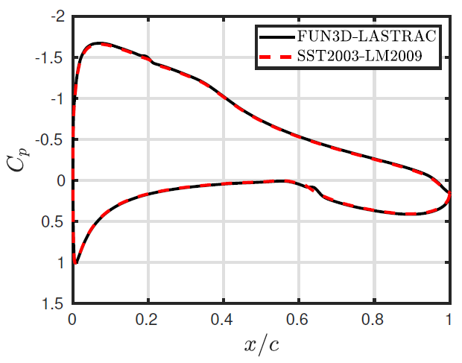
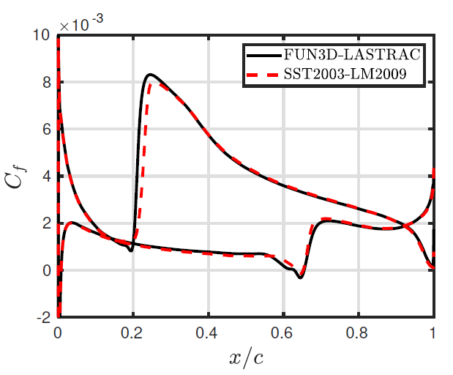
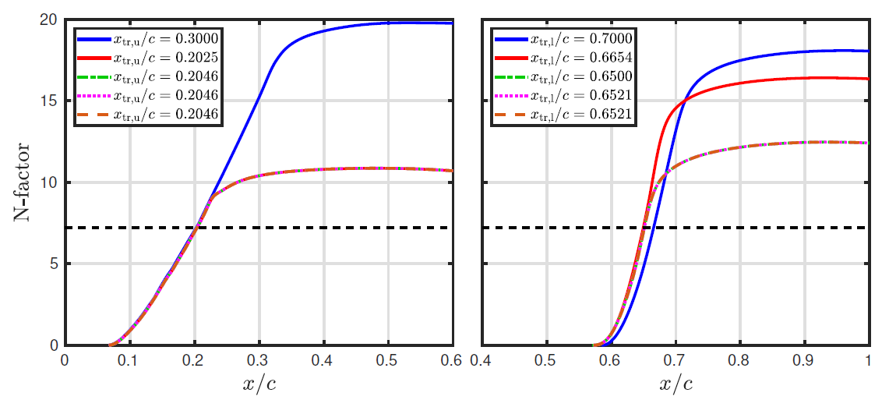
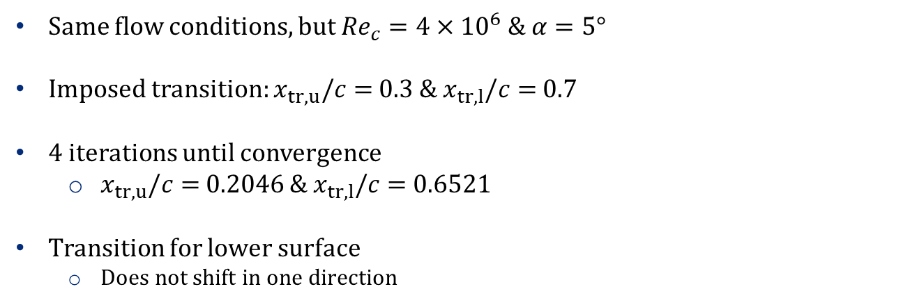
NLF(1)-0416 Airfoil with Separation Bubble
Same flow conditions, but ${Re}_{c}=4×{10}^{6} \& α=5°$
Imposed transition: $x_{tr,u}/c=$0.3 & $x_{tr,l}/c=$0.7
4 iterations until convergence
  $x_{tr,u}/c=$0.2046 & $x_{tr,l}/c=$0.6521
Transition for lower surface
  Does not shift in one direction
6/11

Slide 7
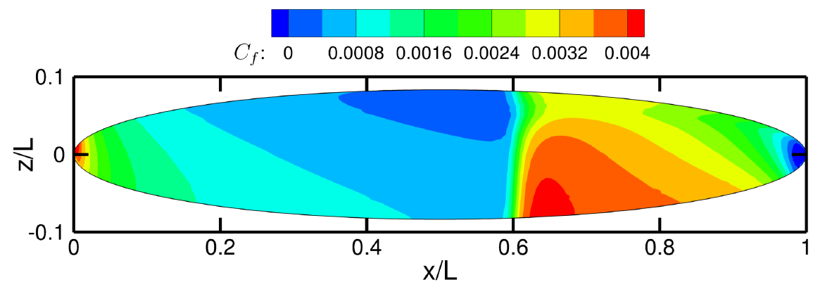
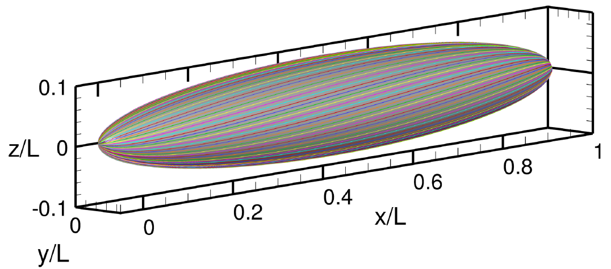

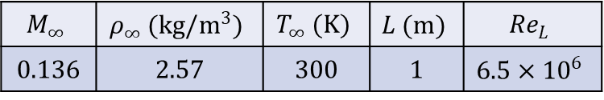
3D Basic State of 6:1 Prolate Spheroid
Flow conditions taken from AIAA Transition Modeling Workshop I
$$M_{∞}$$ | $$ρ_{∞} (kg/m^{3})$$ | $$T_{∞} (K)$$ | $$L (m)$$ | $${Re}_{L}$$
0.136 | 2.57 | 300 | 1 | $$6.5×{10}^{6}$$
$$x_{tr}/L=0.6$$
75 Streamlines are Computed
7/11

Slide 8
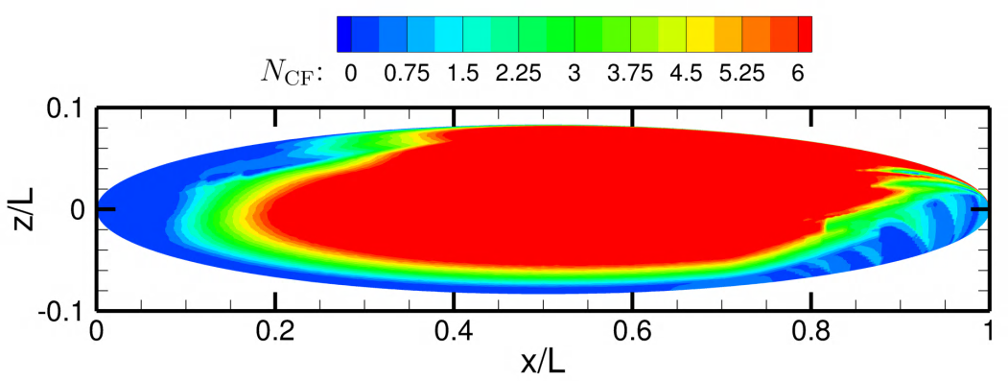
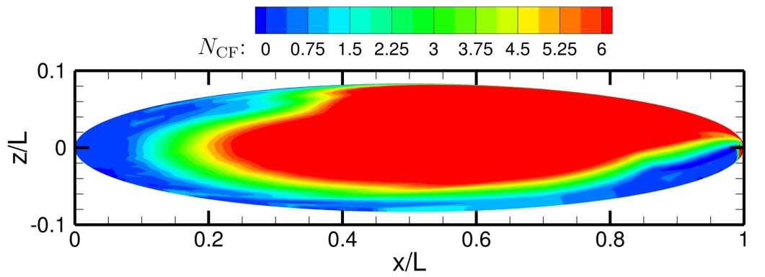
6:1 Prolate Spheroid with $α=10°$
Nonsingular computational grid
  Multiblock Structured Unstructured Format
  17,825,792 hexahedrals
N-factor distributions from LST and PSE computations with LASTRAC
  Only showing crossflow N-factors
LST
PSE
8/11

Slide 9
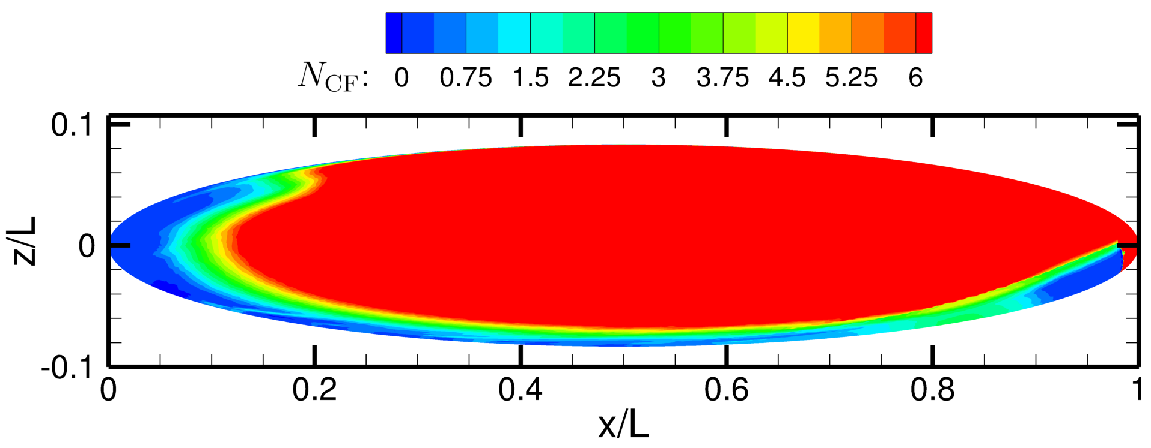
6:1 Prolate Spheroid with $α=15°$
Nonsingular computational grid
  Multiblock Structured Unstructured Format
  17,825,792 hexahedrals
N-factor distributions from PSE computations with LASTRAC
  Only showing crossflow N-factors
Dual N-factor criterion to compute 3D transition front
  Calibration transition N-factors
9/11

Slide 10
Conclusions and Future Work
Automated iterative method for predicting boundary-layer transition
  FUN3D (Biedron et al. 2020) and LASTRAC (Chang 2004, 2006, & 2021) codes
  Applicable to complex 3D flow configurations
NLF(1)-0416 airfoil
  Convergence with or without a separation bubble
  Good agreement with other transition prediction methods
6:1 prolate spheroid
  CF N-factors at two angles of attack
  Need to compute N-factors from Tollmien-Schlichting waves
  Need to compute 3D transition front with dual N-factor criterion
  Compare to experiments and previous computations
    Kreplin et al. (1985)
    Krimmelbein et al. (2018)
Improvements to automated iterative method
  Specification of initial transition location
  Automation for 3D cases
  Need to incorporate more variables/inputs
10/11

Slide 11
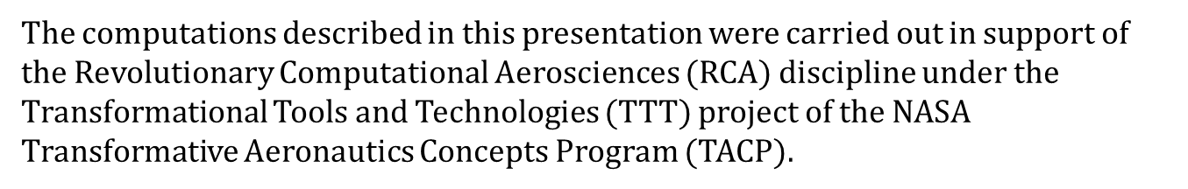
Acknowledgments
The computations described in this presentation were carried out in support of the Revolutionary Computational Aerosciences $($RCA$)$ discipline under the Transformational Tools and Technologies $($TTT$)$ project of the NASA Transformative Aeronautics Concepts Program $($TACP$)$.
11/11

