Slide 1
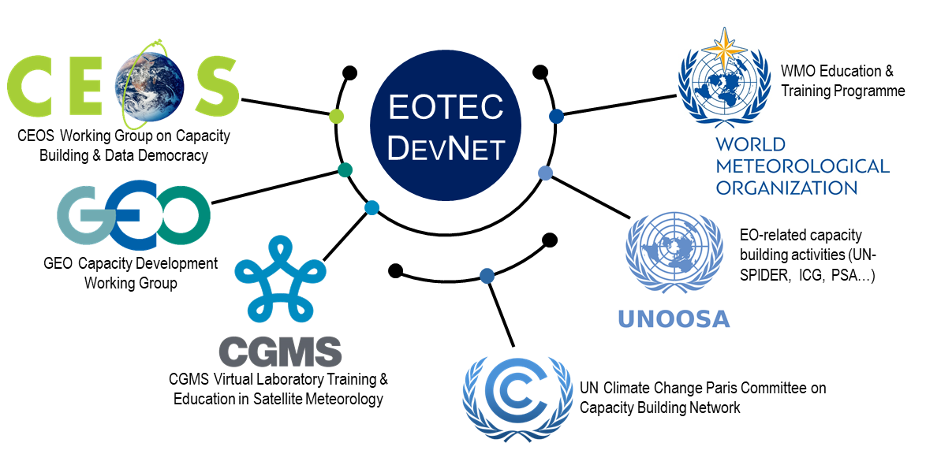
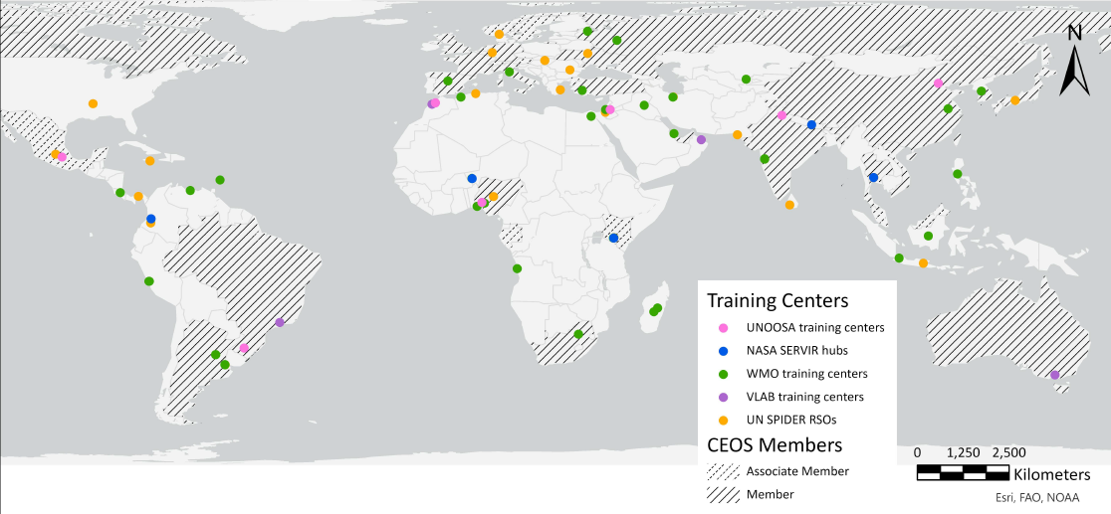

A Network-of-Networks Approach to Capacity Building
of EO for Disaster Risk Reduction
Yasha Moz, yakov.m.moz@nasa.gov, BAH
Erin Martin, eemartin08@gmail.com
Sydney Neugebauer, sydney.e.neugebauer@nasa.gov, SSAI/LaRC
Nancy D. Searby, PhD, nancy.d.searby@nasa.gov, NASA HQ
Many networks contribute to global Earth Observation capacity development by connecting data providers with educators and trainers, and eventually with users. Each of these organizations shares interests and maintains existing relationships that can be leveraged to bring the power of Earth Observations to more users. By connecting these networks, EOTEC DevNet seeks to streamline work and increase uptake of capacity development resources to empower users across the globe.
Network-of-Networks Approach
How We Work
Regional Communities
of Practice
+
Global Connections
Africa
Africa Regional Task Team
Network Leadership
Secretariat
The global landscape of EO training and education groups is not yet well-defined, and centers loosely around the operational needs of each network. EOTEC DevNet will undertake a multi-stakeholder network analysis to define this space and clarify gaps and overlaps between data providers, training networks, and academia.
Asia/Oceania
Floods
Organize meetings
Support regional communities
Provide infrastructure support
Theory of Change
Americas
Thematic Working Groups
Drought
Impact
Improved delivery of capacity development empowers national, regional, and local users to routinely integrate EO data in decision-making related to DRR, climate adaptation, and mitigation
Europe
Etc.
Intermediate
Results
Capacity building providers increase and improve outreach to users
Capacity building providers improve strategic and ad hoc coordination
Capacity building providers act to address needs/gaps
A Theory of Change outlines the process behind how a particular intervention will bring about the desired results. This framework describes the goal impact of the work, then outlines the intermediate steps will influence whether the outputs of an effort actually achieve the desired impact.
This Theory of Change was crafted with the global leadership team and network representatives through an iterative process. It was endorsed at CEOS plenary as part of pilot phase 1 summary.
Capacity building providers actively use the new resources in their outreach
Capacity building providers engage in the new collaboration practices and mechanisms
Capacity building providers employ new approaches and practices to assess needs
Outcomes
New or improved resources to engage and connect users with capacity building, training, and other tools
New or improved practices and mechanisms for fostering collaboration are created through the communities of practice and global structures
New or improved approaches or practices to assess, communicate, and act on needs/gaps
Outputs
Regional Training Centers in the Network
As EOTEC DevNet builds regional Communities of Practice across the globe, each network can access regional expertise through training centers and local partners, outlined in the map below. The geographic spread of centers underscores the crucial role of cross-network communication to synergize related work and fill gaps.
Get Involved!
Learn more about EOTEC DevNet and help us spread the word
Join your regional Community of Practice
Contribute to EOTEC DevNet projects, such as Flood Capacity Development Matrix
Visit our website at
ceos.org/eotec

