Slide 1
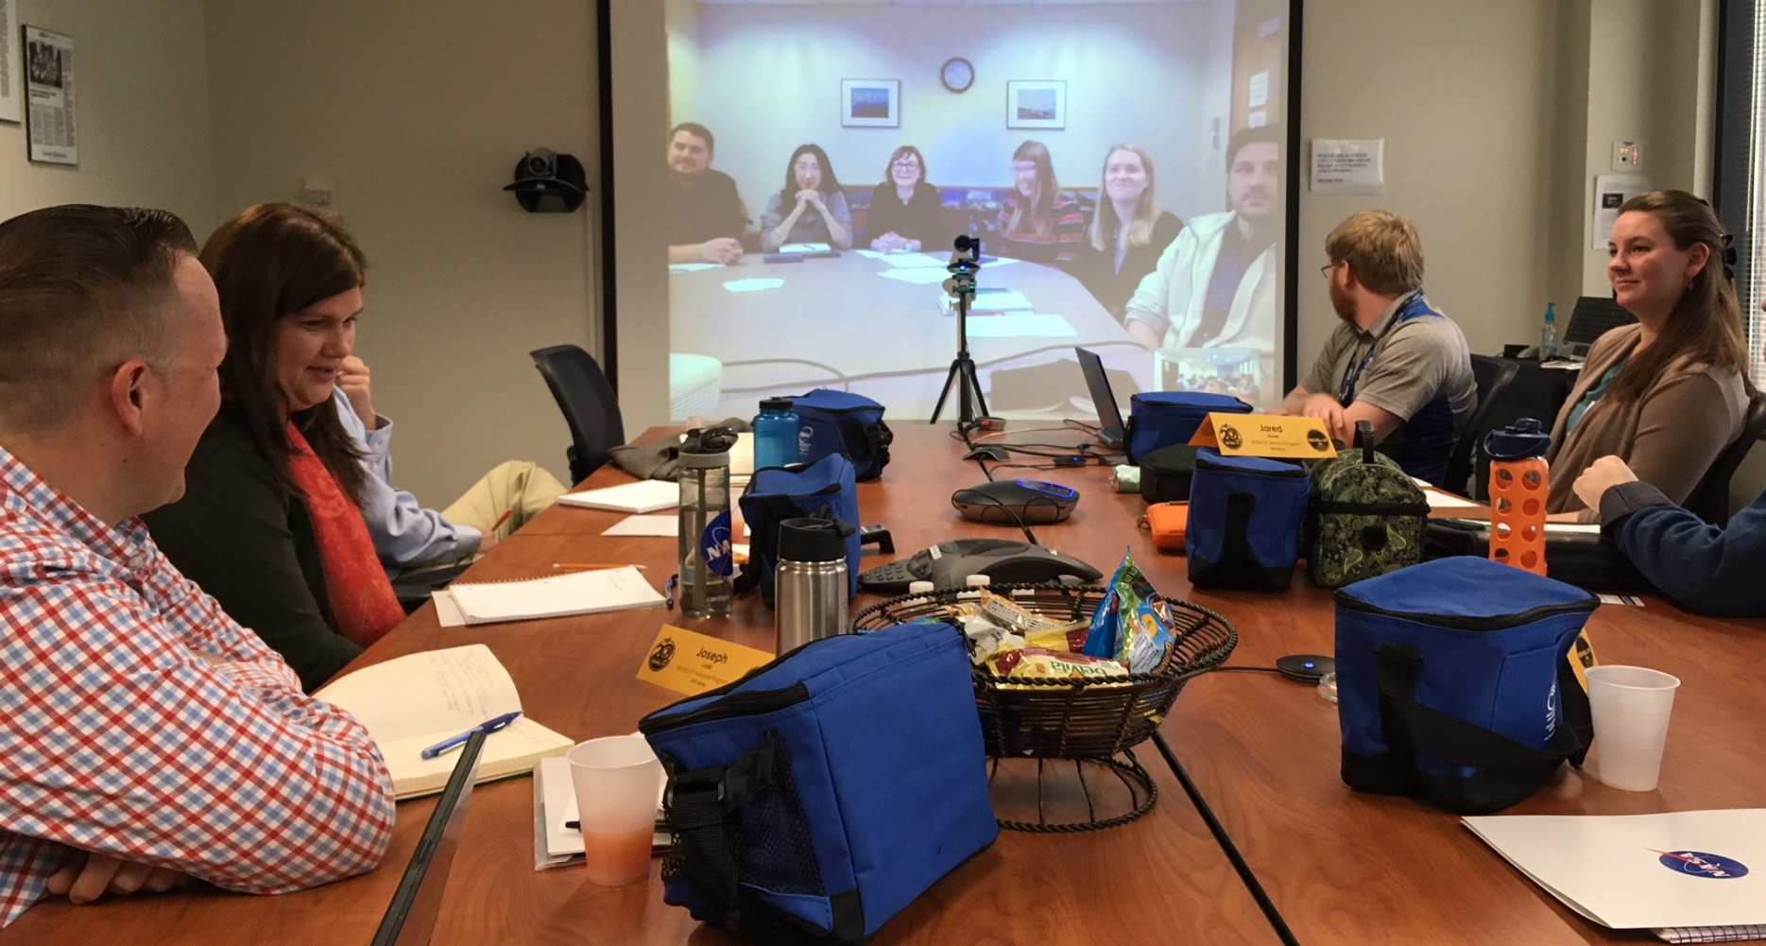
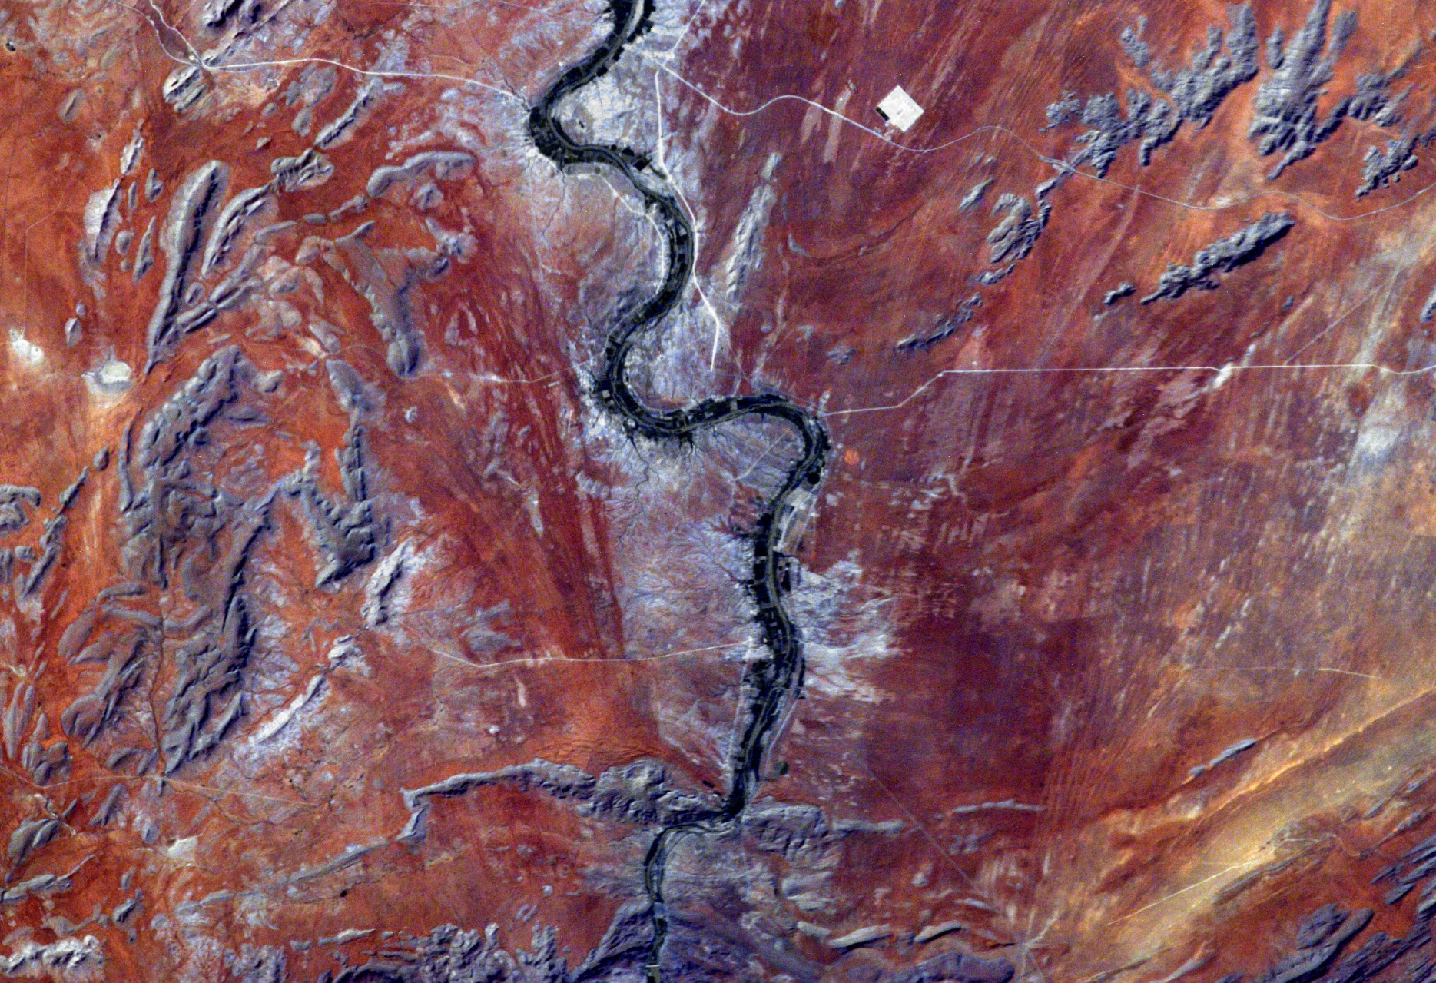
DEVELOP’s Approach to Experiential Learning
ED54A-04
Dr. Kenton Ross, NASA DEVELOP Chief Scientist

Slide 2
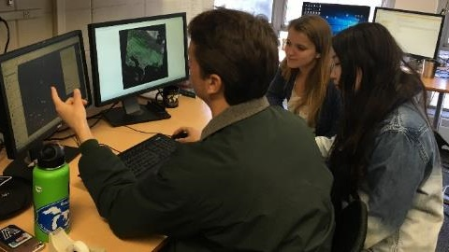
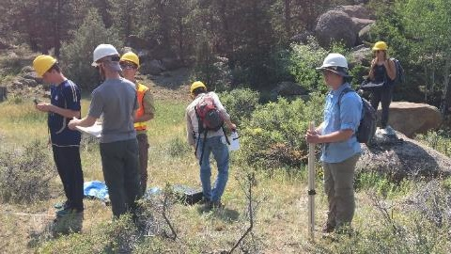
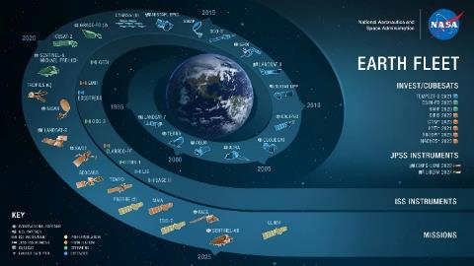
About DEVELOP
DEVELOP addresses environmental and public policy issues through interdisciplinary feasibility studies that apply the lens of NASA Earth observations to community concerns around the globe.
Hands-on exploration of how NASA EO can be applied and integrated into organizational decision making
Engage participants (i.e., students, recent graduates, early and transitioning professionals) in small teams
Enhance partner organizations (e.g., state, local and federal governments, NGOs) decision making processes
Rapid… projects are only 10 weeks!

Slide 3
DEVELOP’s Experiential Learning Model
Concrete Experience
Orientation & Project Work Plan
Explore Geospatial Assets & Project Methods
Conduct Analyses & Iterate w/Partners
Complete Project & Handoff to Partners
Finalize & Produce Deliverables
Active Experimentation
Reflective Observation
Abstract Conceptualization

Slide 4
Enhanced Leadership Opportunities
A pipeline of leadership positions enhances opportunities for individuals to get hands-on experience conducting data analyses, communicating their work, leading technical projects, building their knowledge bank of Earth-observing satellite capabilities, and building up soft skills.
Participant
Project Lead
Fellow
Senior Fellow
10 Week Term
Conduct Projects
Geospatial Analysis
Team Building
10 Week Term
Lead a Project
Science Communication
Geospatial Analysis
Team Building
1 Year Term (2 yr max)
Lead Participants
Manage Projects
Support Programmatic Priorities & Initiatives
1 Year Term (3 yr max)
Lead Fellows
Lead Programmatic Priorities & Initiatives

Slide 5
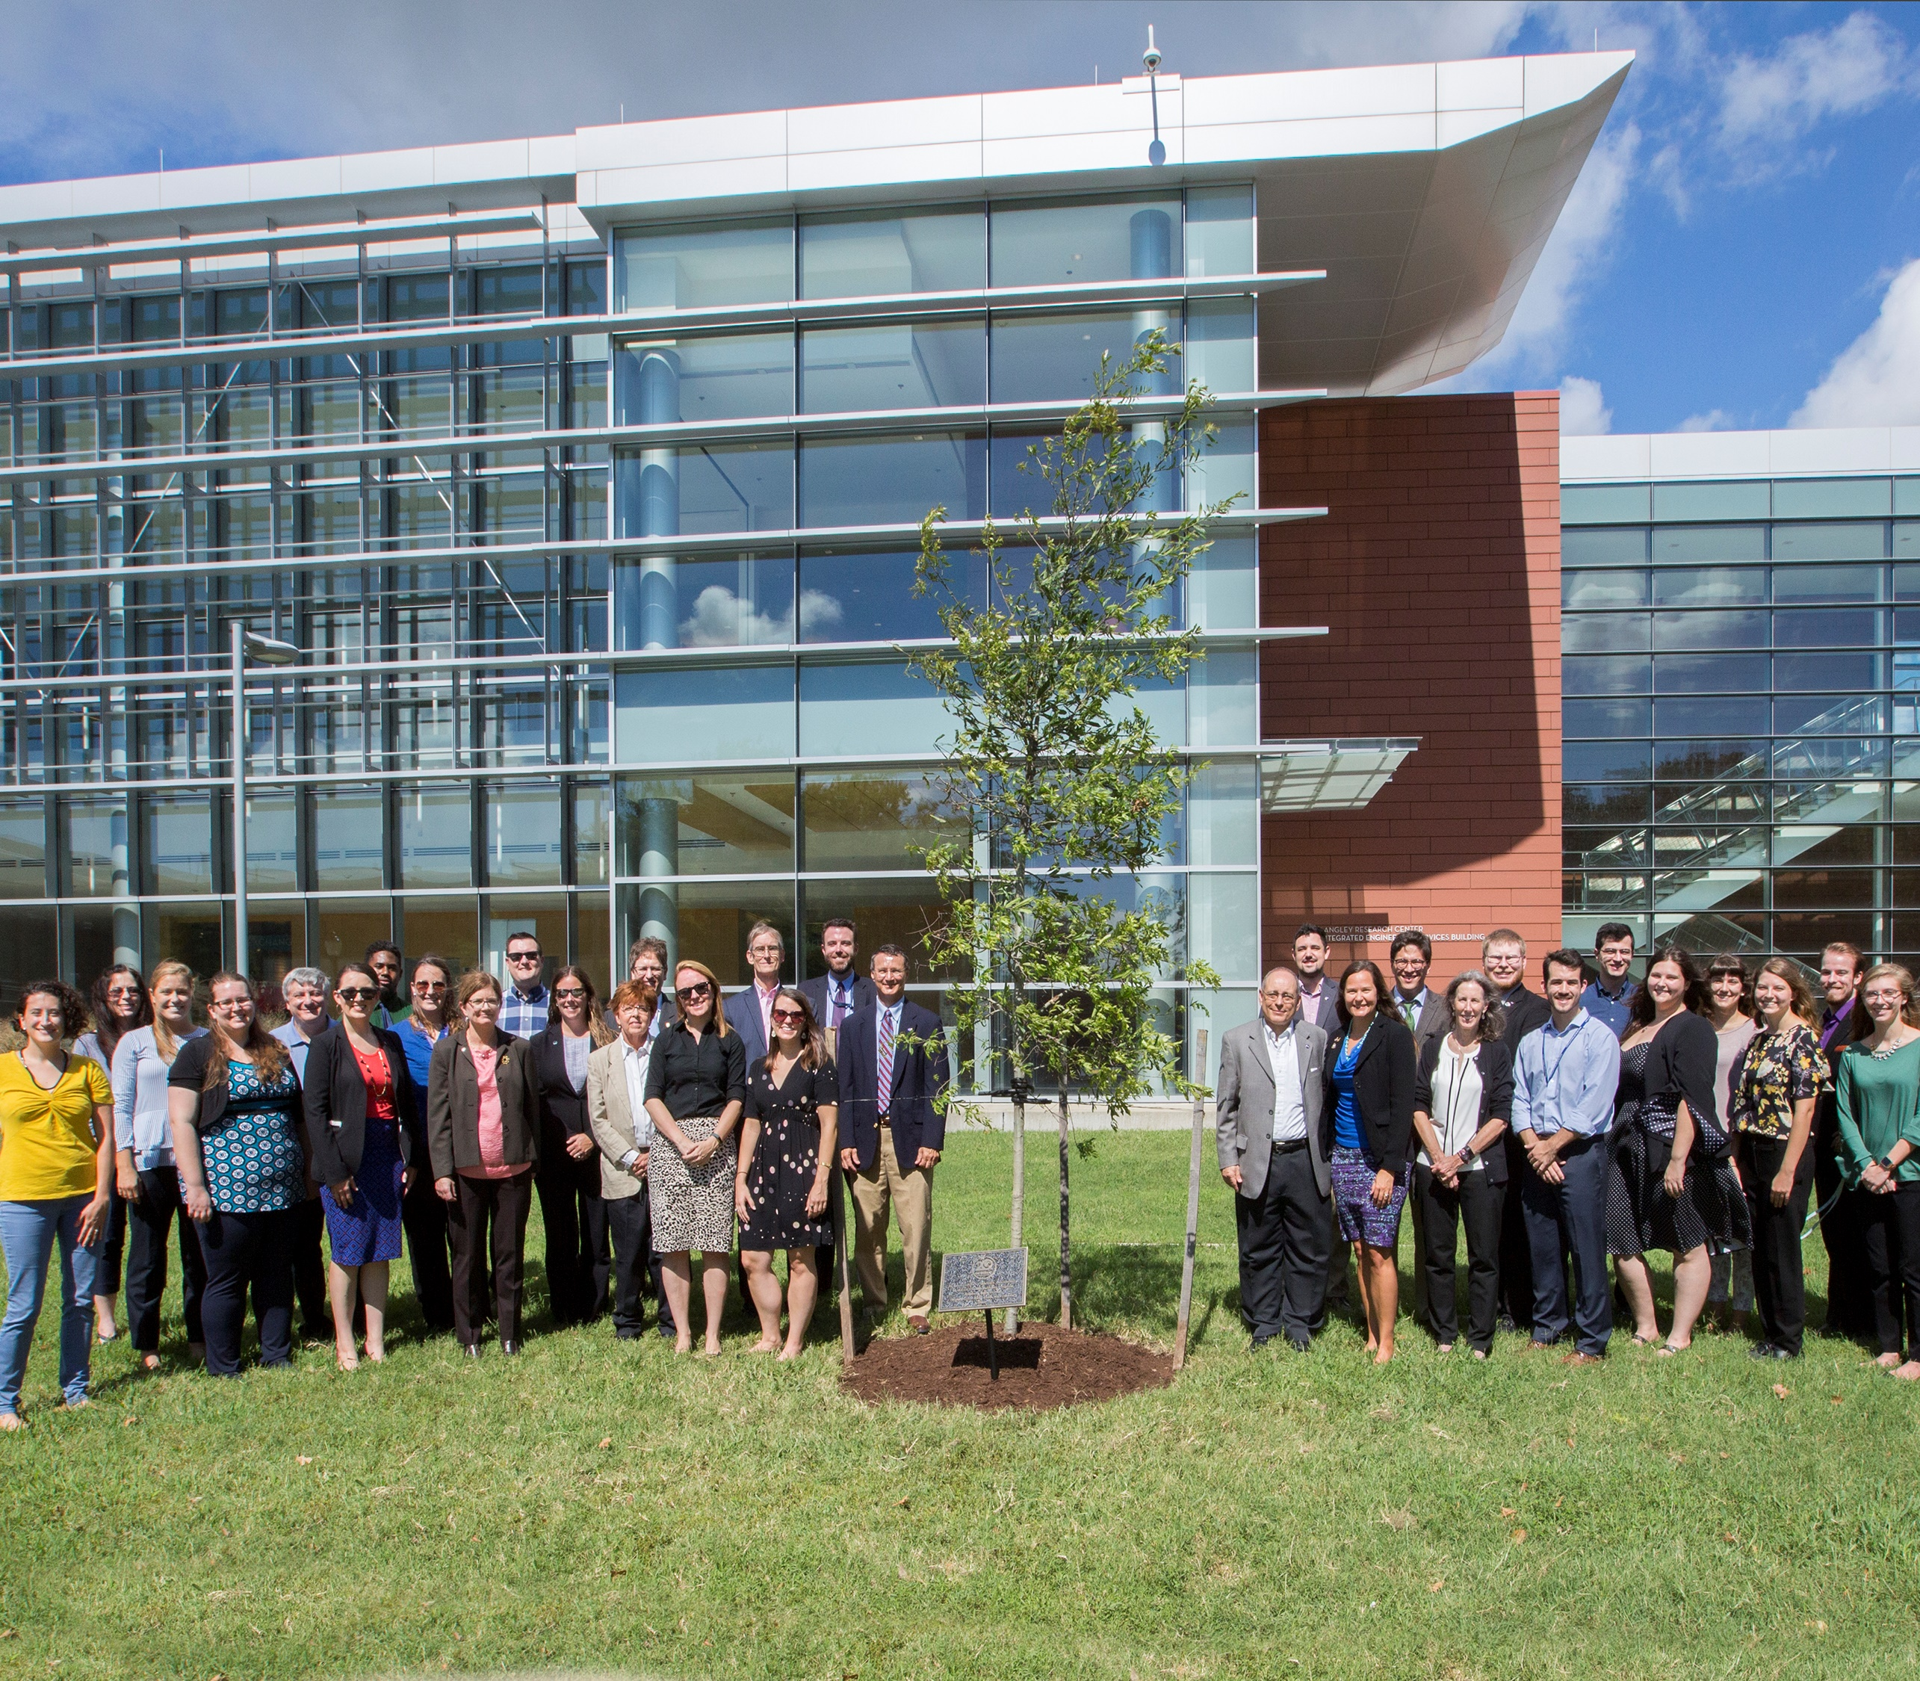
Thank you.
Kenton.W.Ross@nasa.gov
https://develop.larc.nasa.gov

