Slide 1
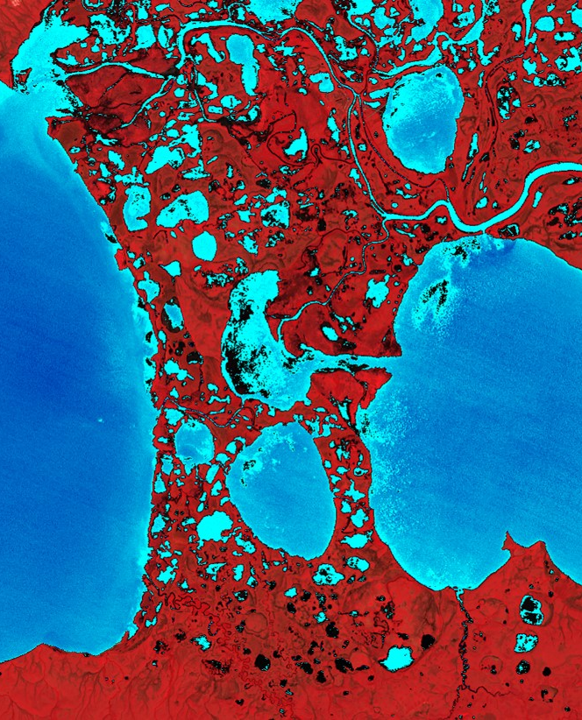
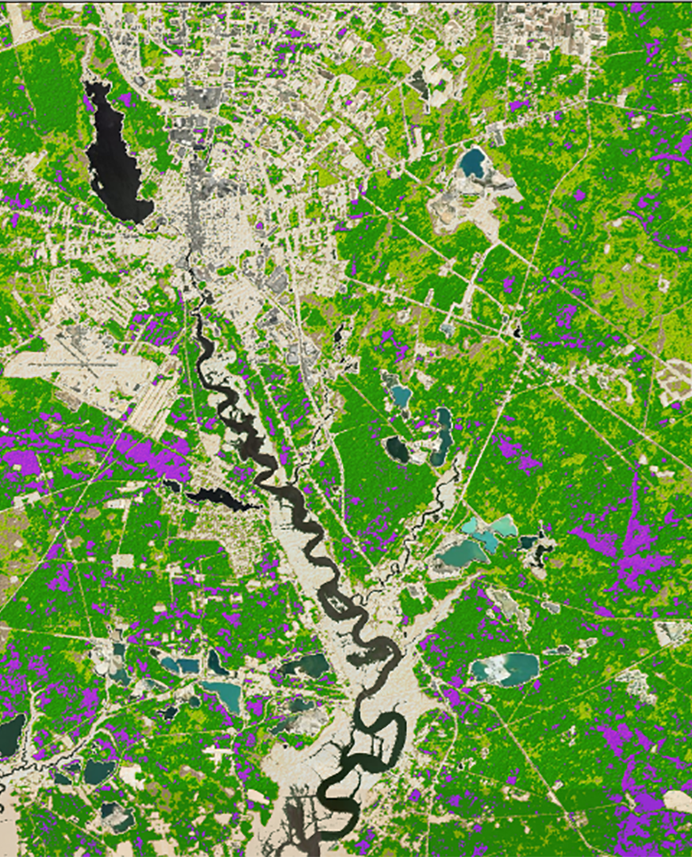
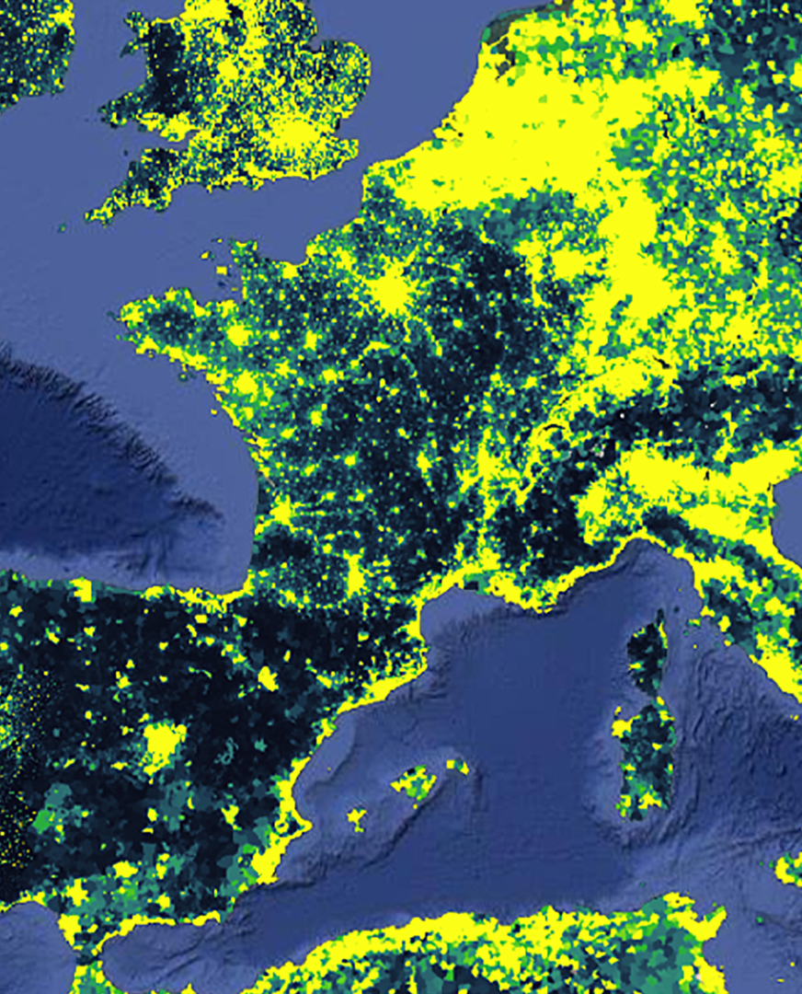
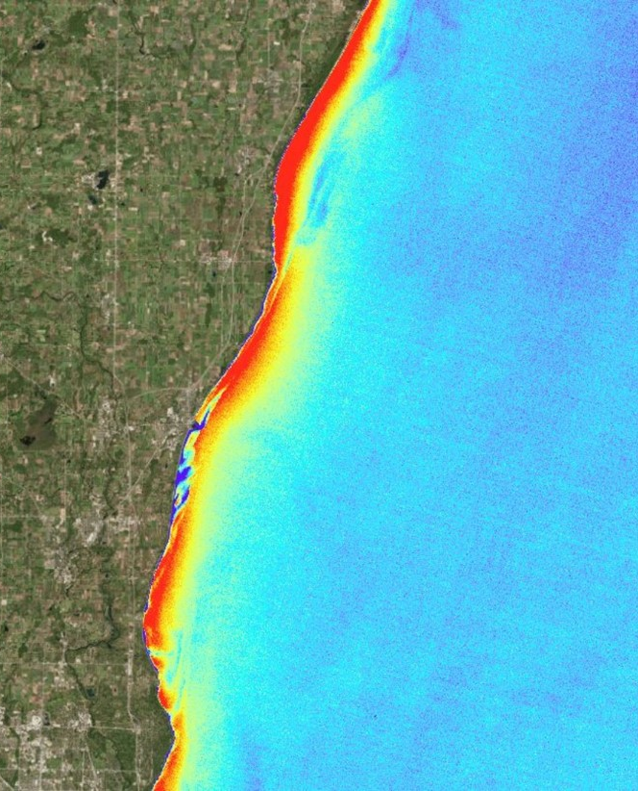
NASA DEVELOP’s Communication Strategy for Sharing Applied Science Outcomes
Celeste Gambino
Senior Communications Fellow | NASA DEVELOP

Slide 2

NASA’s Applied Sciences and Capacity Building Program (CBP)
Part of NASA’s Applied Sciences, the Capacity Building Program provides individuals and institutions with workforce development, training activities, and collaborative projects to strengthen understanding of Earth observations and expand their use around the world.
Through our ARSET, DEVELOP and SERVIR programs and our Indigenous Peoples Pilot project, we work with everyone at every level — from first-time users to long-time professional users of Earth observation data.
Image credits: NASA

Slide 3
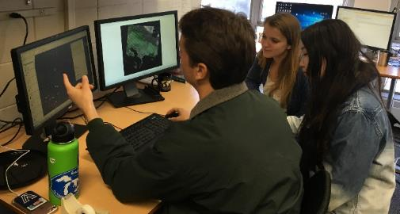
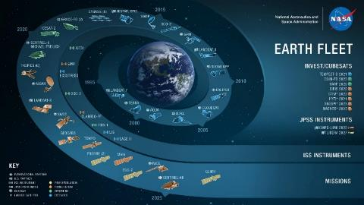
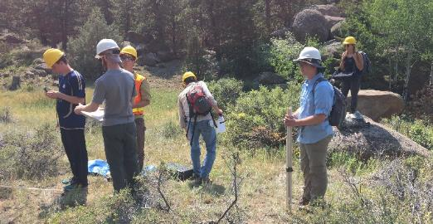
About DEVELOP
Empowered Participants + Earth Observations + Engaged Decision Makers
“Shaping the future by integrating Earth observations into global decision making”
DEVELOP bridges the gap between NASA Earth Science and society, building capacity in both its participants and end-user organizations to better prepare them to use remote sensing to address environmental challenges that face society.
Image credits: NASA

Slide 4








Project Characteristics
50+ projects take place each year – at their core they share these characteristics:
Highlight the applications and capabilities of NASA Earth observations
Address community concerns relating to decision-making for real-world environmental issues
Partner with organizations who can benefit from using NASA Earth observations to enhance decision making by providing decision support tools
Conducted in 10-week terms (spring, summer, and fall) by small teams with diverse backgrounds
Align with at least one of the eight NASA Applied Sciences Program’s National Application Areas
Create a consistent set of deliverables
Research is conducted under the guidance of Science Advisors and mentors from NASA and partner organizations

Slide 5
Project Participants
10-Week Participants = anyone 18+ (students, recent graduates, and early & transitioning career professionals), min 3.0 GPA at current/last school, US citizenship for federal locations
DEVELOP also offers enhanced opportunities for building capacity to use Earth observations and deeper professional development.
Senior Fellows
Fellows
Participants
10 Week Term
Conduct projects
1 Year Term (2 years max)
Lead participants
Manage projects
Support programmatic priorities & initiatives
1 Year Term (3 years max)
Lead Fellows
Lead programmatic priorities & initiatives

Slide 6
Project Partners
Any organization can partner with DEVELOP – state & local governments, federal agencies, tribal governments, non-profits, for-profits, international organizations, academia, etc.
Each project is tailored to a specific end user that is making an environmental decision.
LOCAL GOVERNMENT
STATE GOVERNMENT
FEDERAL GOVERNMENT
2021 Summer Term
Partner Sectors
NON-PROFIT
INSTITUTIONAL SECTOR
FOR-PROFIT
CONSORTIA
ACADEMIA
INTERNATIONAL

Slide 7



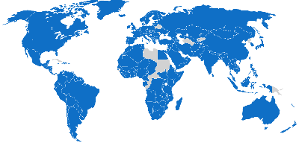





NASA CBP’s Audiences
DEVELOP works globally, across eight thematic areas, 11 user sectors, and all skill levels.
THEMES
GEOGRAPHIES
SECTORS
SKILL LEVEL
Eco Forecasting
153 Countries
50 US states
Academia
Federal/Central Govt.
Private Sector (For Profit)
Private Sector (Non-Profit)
State/Provincial Govt.
Local Govt.
Tribal Entity
Regional/Multi-State Agency
Research Institute
Intergovernmental
Consortium
Misc./Other
Beginner Advanced
Ag & Food Security
Disasters
Health & AQ
Energy
Transportation
Urban
Water Resources

Slide 8
Communication Initiatives
In DEVELOP we use multiple channels and means of telling our stories and connecting with users:
Social Media Posts & Campaigns
Peer-Reviewed Publications
GIFs
Interactive Mapper
Conference Presentations
Public End-of-Term Project Presentations
ArcGIS Online StoryMaps
Creative Videos on YouTube
Information Sessions
News Articles and Blog Series
Ambassador Corps
Print Materials
Newsletters and Brochures

Slide 9
Social Media
Twitter
Facebook
YouTube
Flickr
LinkedIn
Target Audience
General Public
Potential Applicants
Current DEVELOPers
Alumni
Project Partners
Local Communities
Previously Dabbled In:
Tumblr
Instagram
Google+

Slide 10
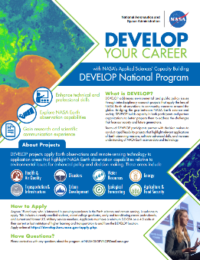
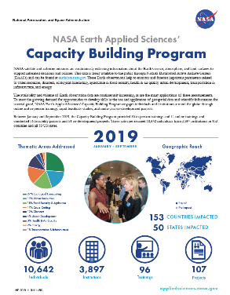
Print Materials
Flyers & Brochures
Infographics
Bookmarks
Project Booklets
Annual Reports
Posters
Target Audience
Potential Applicants
Potential Project Partners
Policy Makers
Veterans & Active Duty Military Personnel
General Public

Slide 11
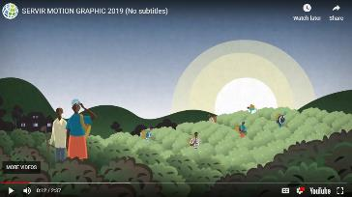
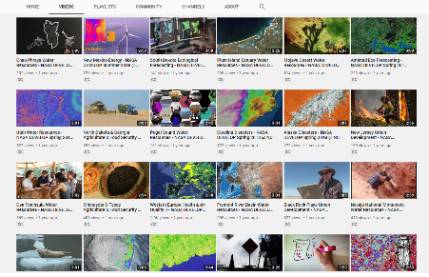
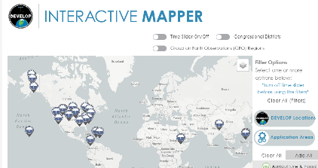
Videos & DEVELOP’s Website
Target Audience
Short Project Videos
GIFs
Interactive Mapper
Website Blog Series
General Public
Potential Applicants
Potential Partners
Policy Makers
Scientific Community
Alumni

Slide 12
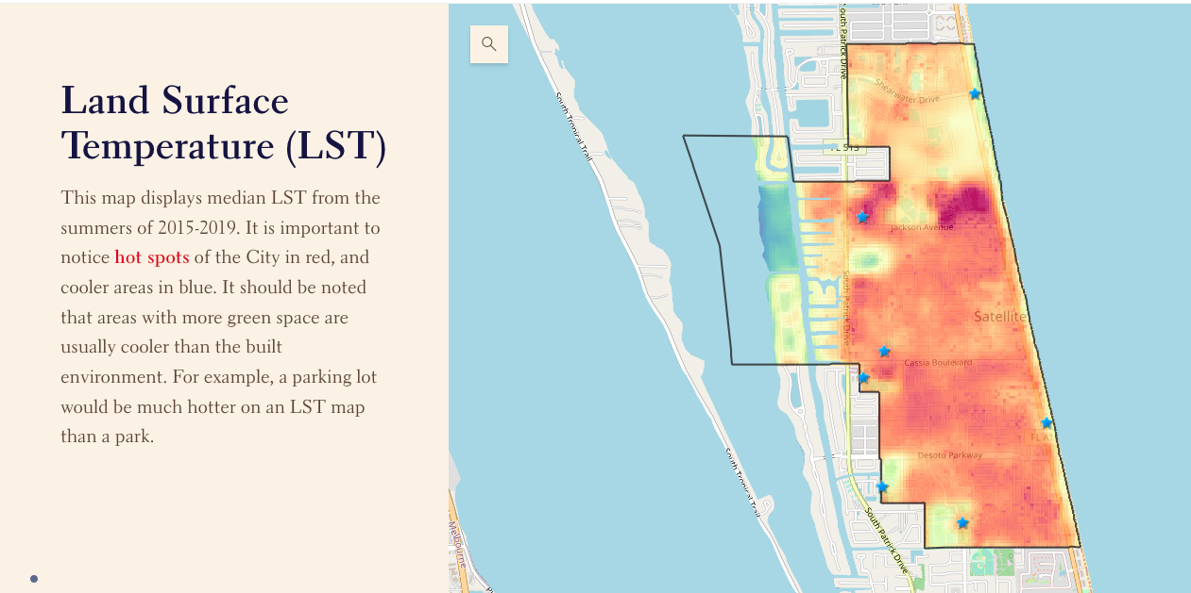
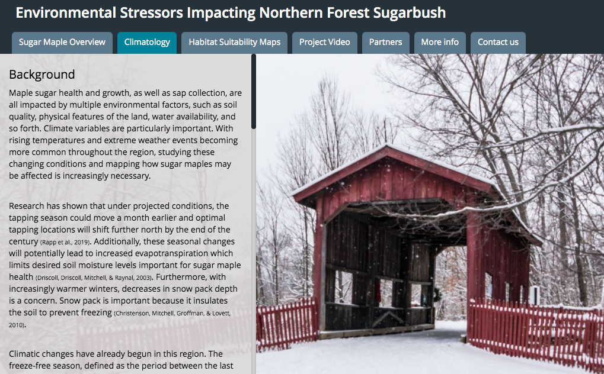
ArcGIS Online StoryMaps
Creative Project Highlights
Interactive Data
Tailored to Project Partners
Target Audience
Project Partners
Policy Makers
General Public
Local Communities

Slide 13
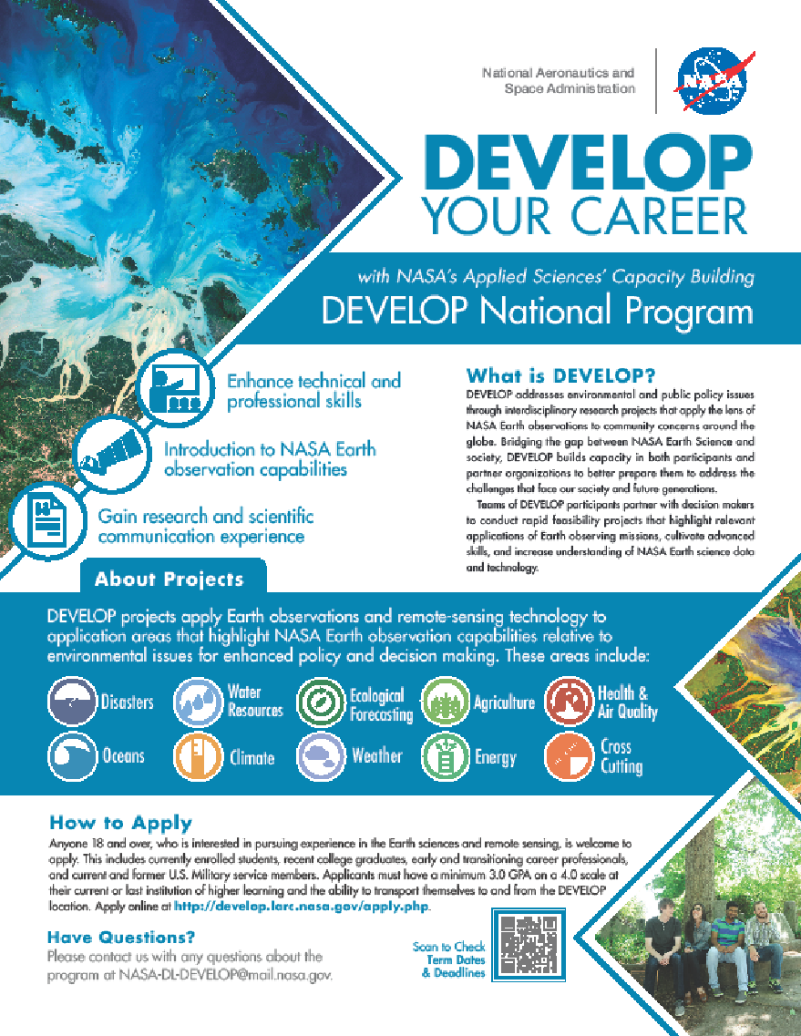
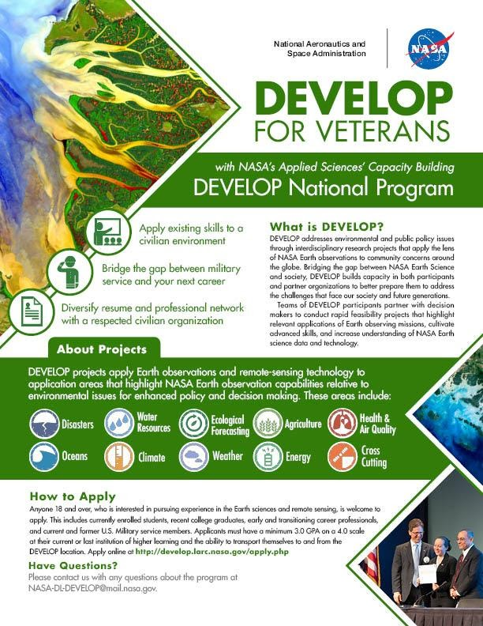
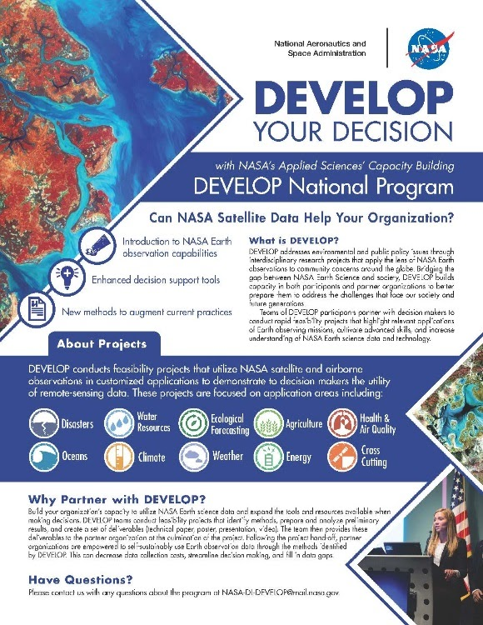

Volunteer Ambassador Program
Volunteer Alumni Program
Recruiting at University and Community Events
Currently 40 Ambassadors from 17 States
Target Audience
Potential Applicants
Academia
Veterans & Active Duty Military Personnel
Alumni

Slide 14
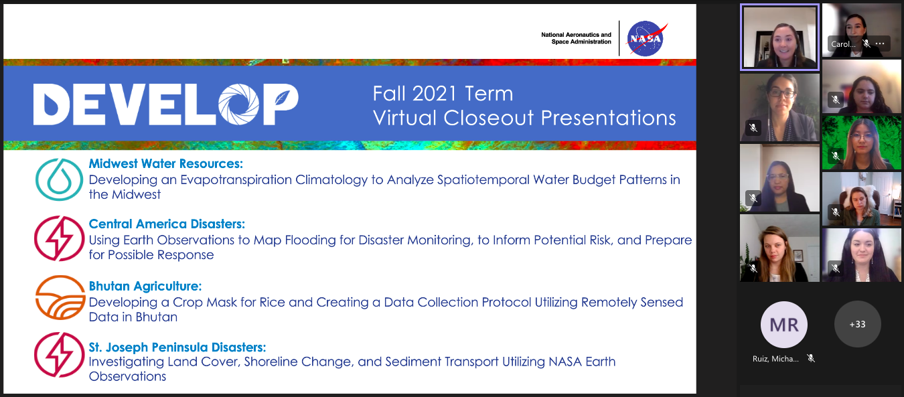
End of Term Presentations
Target Audience
Present both Privately to Partner Groups and Publicly to the General Public
Engage Local Communities, Alumni, and Project Partners
Opportunities for Participants to Gain Oral Communication Skills
Our Fall Presentations were Attended by over 350 People
General Public
Potential Applicants
Potential Partners
Policy Makers

Slide 15
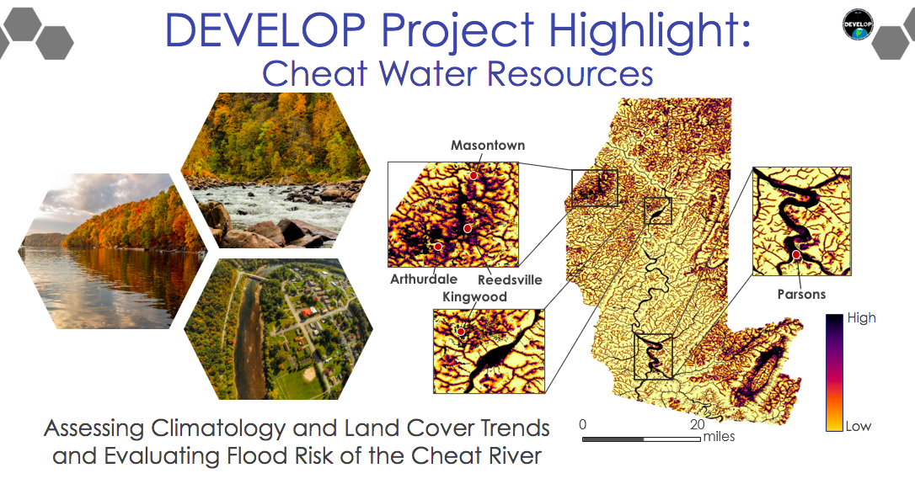
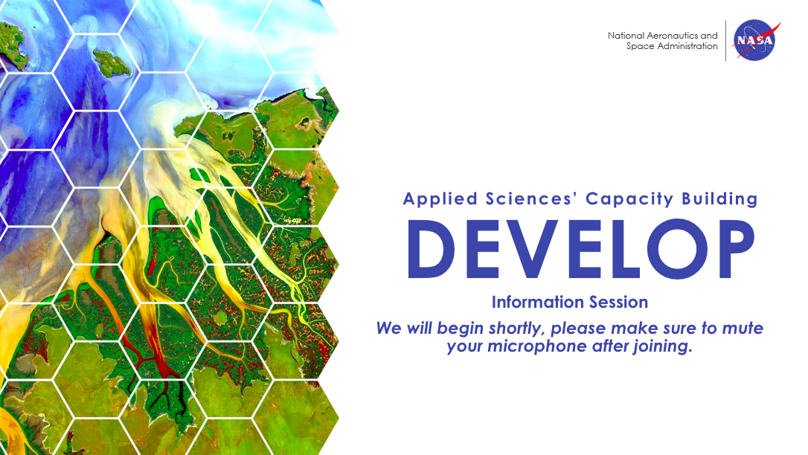
Information Sessions
Overview Presentations of the DEVELOP Program
Given During Every Application Cycle
MSI-Focused Information Sessions in 2022
Target Audience
Potential Applicants
Potential Partners
Policy Makers
General Public

Slide 16
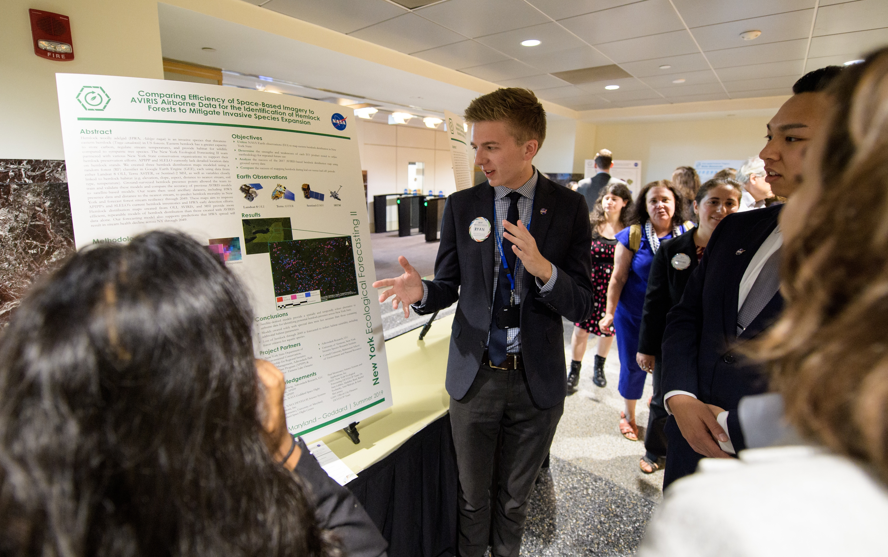
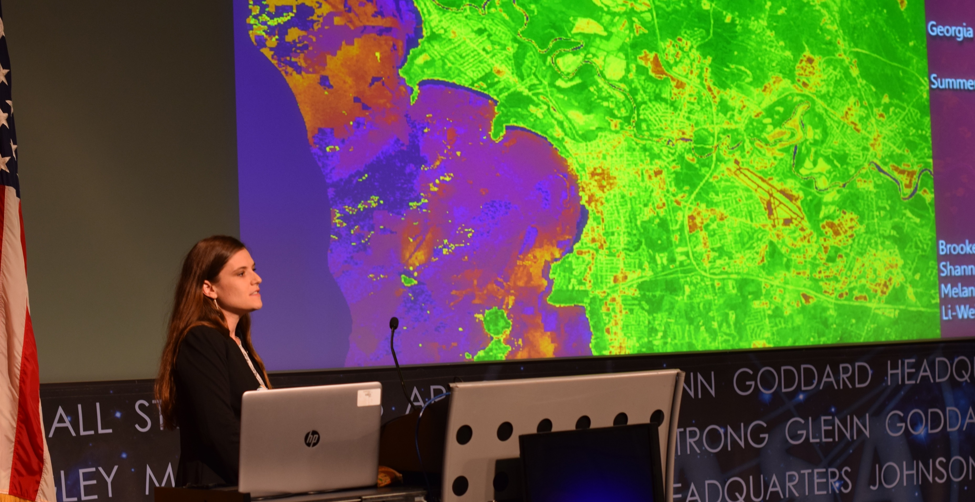
Conference Presentations
Target Audience
DEVELOPers Presented and Participated in 22 Conferences and Meetings this Year
Recruitment Opportunity for Future Participants, Partners Groups, and Science Advisors
Scientific Community
Policy Makers
Potential Project Partners
Potential Applicants
Image credits: NASA

Slide 17
Challenges & Lessons Learned
To reach a broad audience requires a multi-media / multi-channel approach – this helps connect relevant information to specific users
Majority of our team are scientists not trained in comms – lean heavily on a few comms people, others learning along the way, using some shared templates, and monthly calls
Keeping up with social media trends and trying out new platforms and channels is important for innovation and extending reach, but isn’t always sustainable
Collecting stories and comms materials is often a side or secondary effort – setting comms objectives at beginning and keeping comms people involved throughout can help

Slide 18

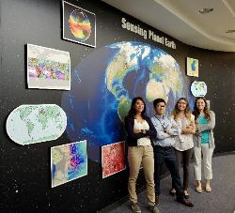
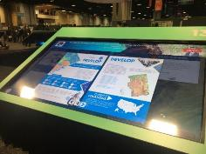
Looking Ahead to 2022
Newsletter
New NPS Communication Collaboration
New Blog Series
Space for U.S. Features
AGOL StoryMap Hub
Competitions
Image credits: NASA

Slide 19
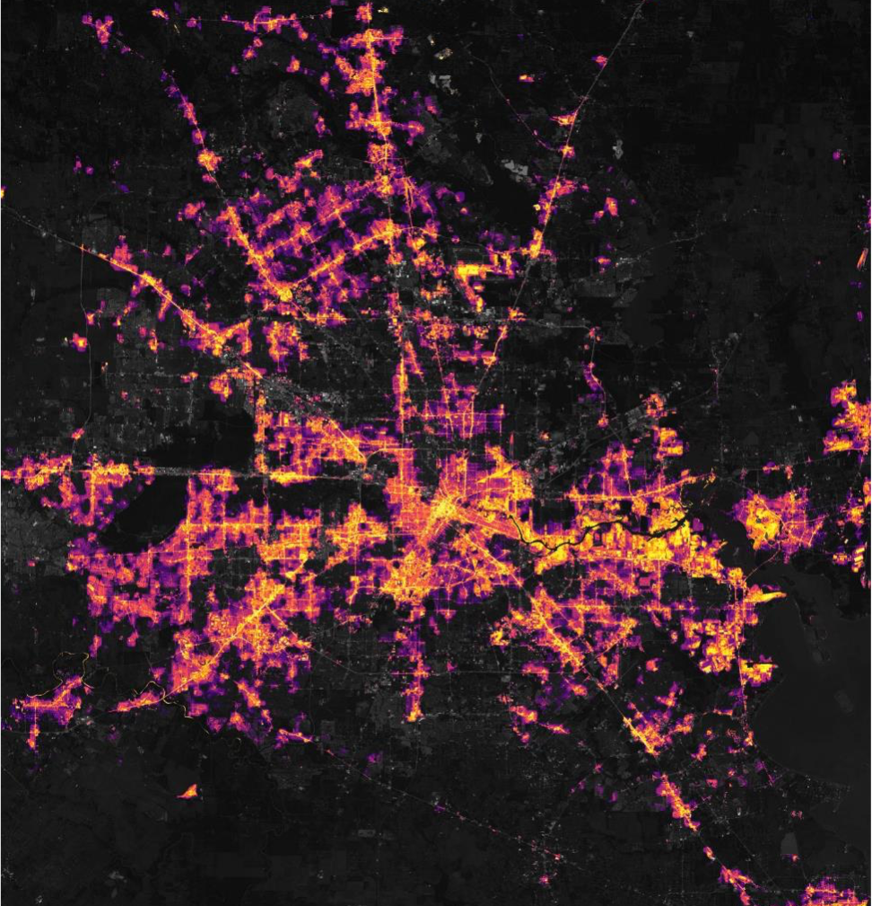
Thank you
Contact information:
celeste.gambino@nasa.gov
DEVELOP: develop.larc.nasa.gov/
Image credits: NASA

