Slide 1
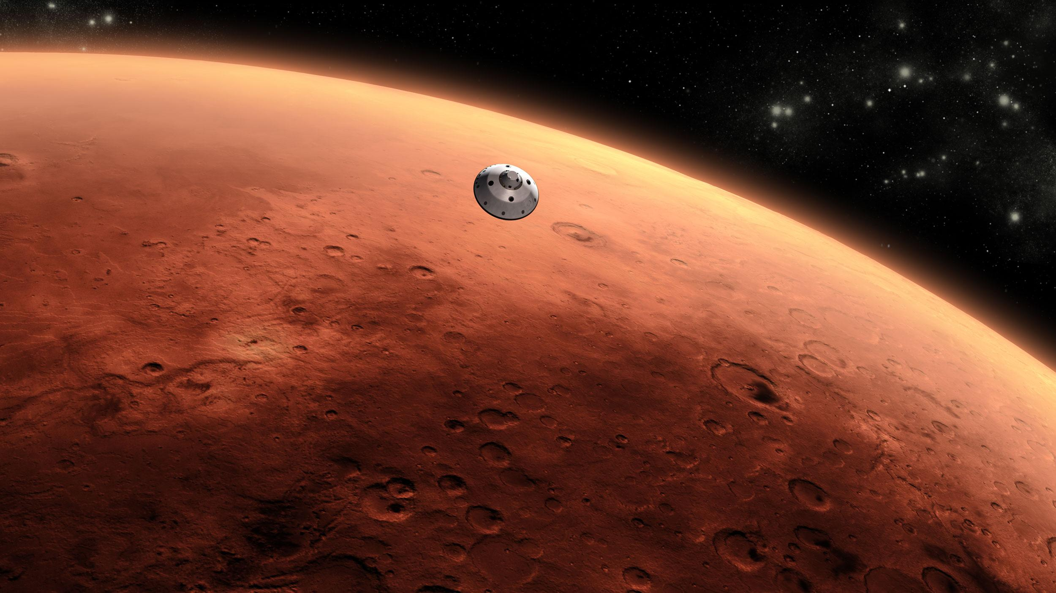
Performance of Flash Lidar with real-time image enhancement algorithm for Landing Hazard Avoidance
Farzin Amzajerdian, Alexander Bulyshev, Paul Brewster, Guoqing Shen,
Rafia Haq, and Byron Meadows
NASA Langley Research Center
Stefan Bieniawski, Brandon P. Smith, and Devin Kipp
Blue Origin
AIAA SciTech Forum 2022

Slide 2
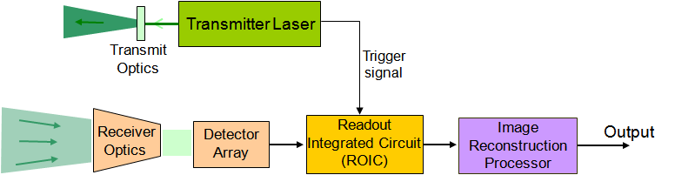
3-D Imaging Flash Lidar Sensor
A full 3-D image frame is generated by illuminating the scene with a single laser pulse
  High frame rate
  No blurring due to vehicle motion
Well-suited for detecting terrain hazards during descent from about 1 km altitude

Slide 3
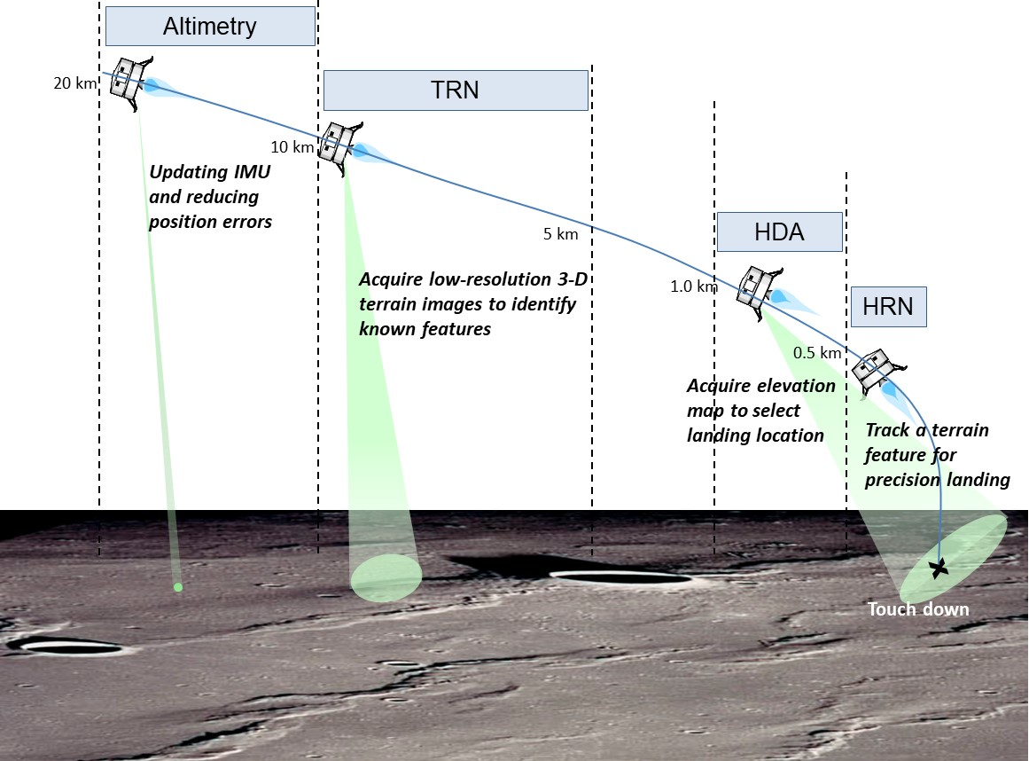
Flash Lidar Landing Operation Concept
Performs 4 critical landing functions:
Altimetry
Terrain Relative Navigation (TRN)
Hazard Detection and Avoidance (HDA)
Hazard Relative Navigation (HRN)

Slide 4
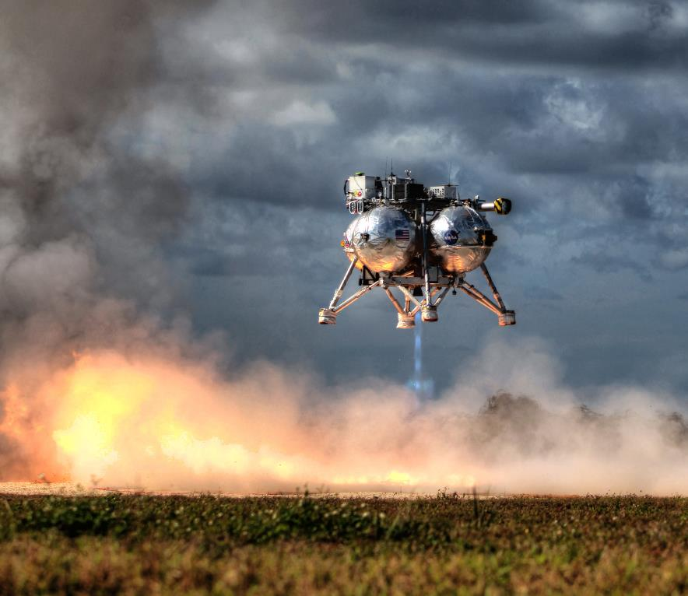
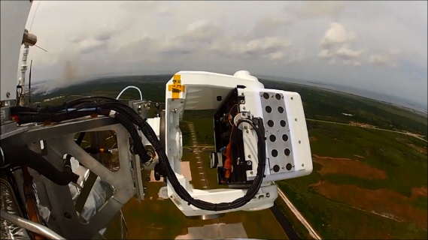
State of Technology
Capabilities of flash lidar was demonstrated under ALHAT project
  Series of helicopter and fixed-wing aircraft flight tests
  Closed-loop demonstration onboard rocket-powered Morpheus vehicle
Insufficient number of FPA pixels for mapping required area with desired resolution (70 mx70 m area, 10 cm resolution) with a single image frame
Used a mechanical gimbal to generate several 3-D image frames and stitch them together
Flash Lidar
Electronic Box
Flash Lidar
Sensor Head

Slide 5
Flash Lidar as a Landing Sensor
Commercial flash lidar camera has 128x128 = 16.4k pixels
Mapping 70 m x 70 m area with 10 cm Ground Sample Distance (GSD) requires 0.5 M pixels
  10 cm GSD is required to detect 30 cm diameter hazards
Developed a Super-Resolution algorithm to meet HDA requirements without a need for a mechanical gimbal

Slide 6
Flash Lidar Super-Resolution Algorithm
Super-Resolution (SR) technique uses a set of consecutive frames, from slightly different positions and angles (resulting from platform motion), to generate a high-resolution DEM
Performance of SR has been analyzed through simulations and by using data from past helicopter flight tests
Recently conducted a dynamic test of flash lidar integrated with real-time SR processor
Demonstrated >16X resolution enhancement using 20 frames ( > 0.26M pixels)
64X enhancement is feasible using current camera (1.0M pixels)

Slide 7
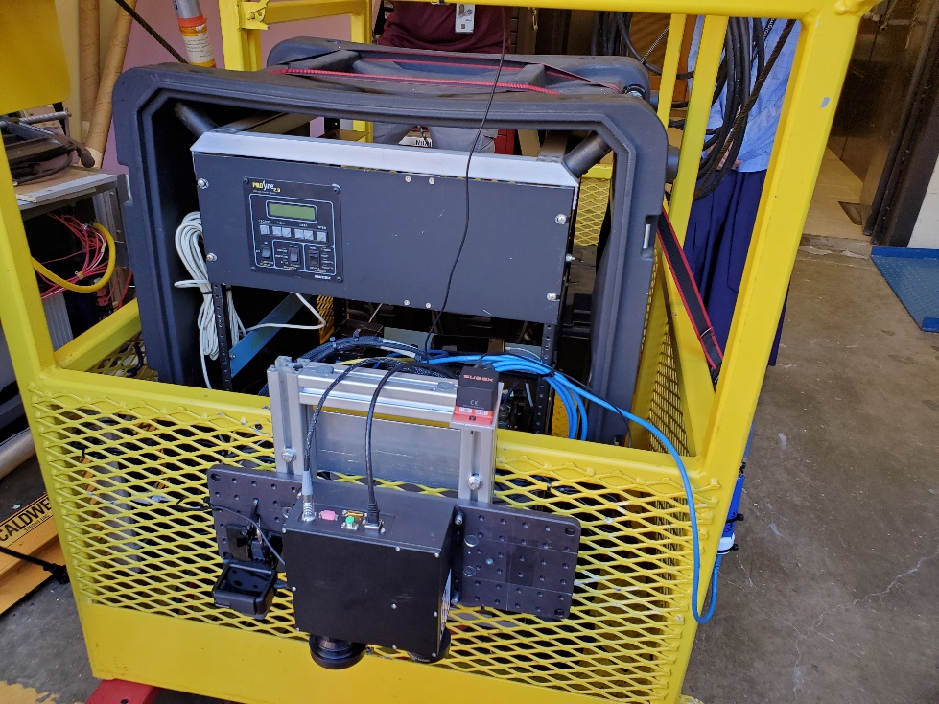
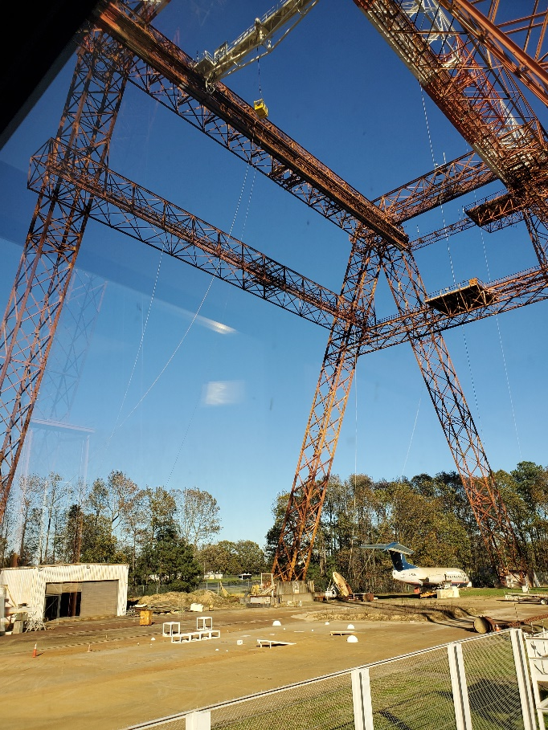
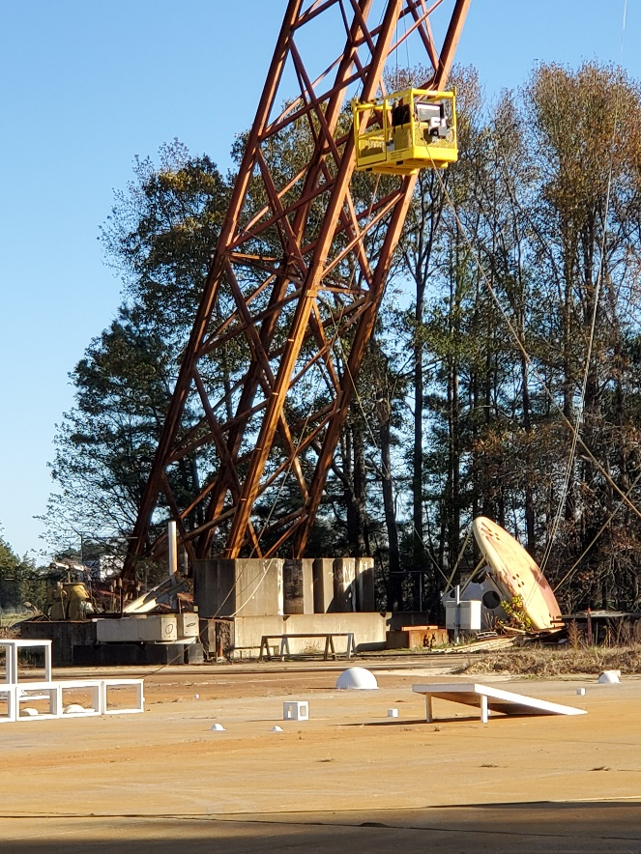
Flash Lidar Gantry Test
Basket
Hazard Field
Flash Lidar

Slide 8
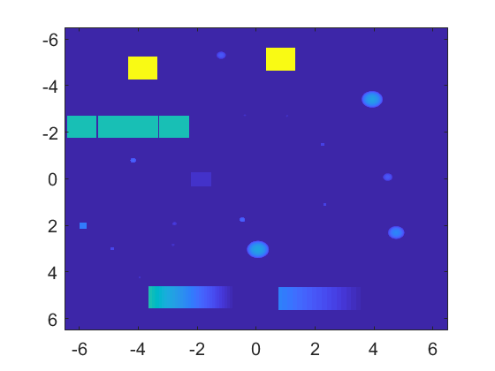
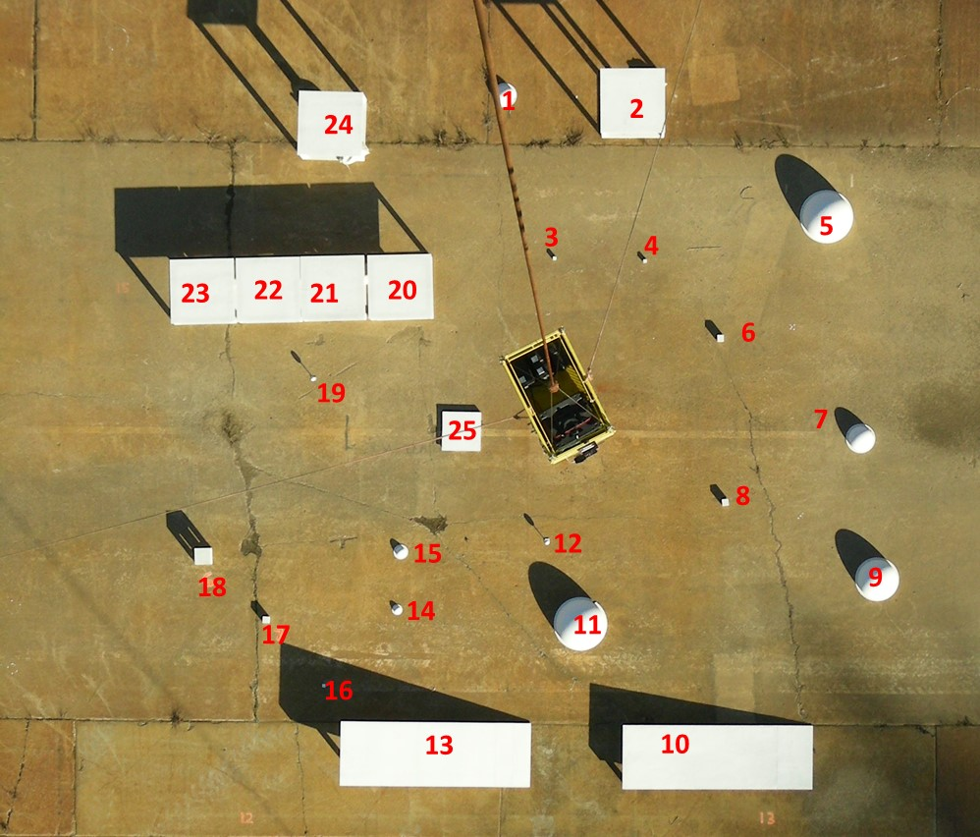
Hazard Field
Top View
Model, based on survey

Slide 9
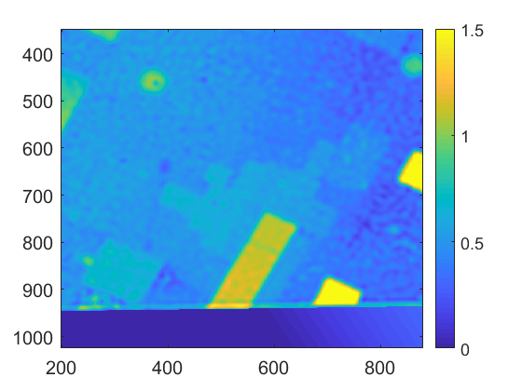
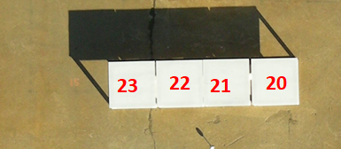
Resolution Enhancement by SR Algorithm
Resolved 3 cm and 5 cm gaps with 12 cm GSD
> 4X linear magnification (16X resolution enhancement)
5cm
1 cm
3cm
20
21
22
23

Slide 10
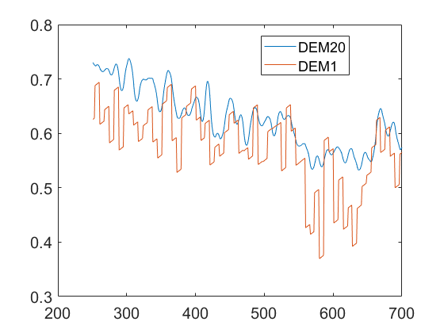
Noise Suppression by SR Algorithm
Reduced random range noise by > 2X ( from ~ 7 cm to ~ 3 cm)
Range profile along a line across an image frame
(m)
SR Pixel No.

Slide 11
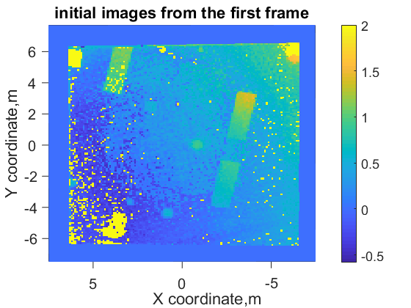
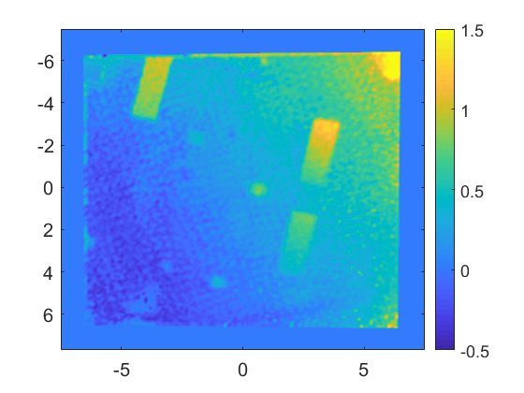
Recovering Bad or Dark Pixels by SR Algorithm
DEM, restored using 1 frame
DEM, restored 20 frames
Dark or bad pixels are shown as yellow dots

Slide 12
Concluding Remarks
Flash lidar utilizing SR algorithm is a viable option as a multi-functional landing sensor
Demonstrated performance of flash lidar with real-time SR algorithm
  Generated DEMs at 1 Hz rate
  Resolution enhancement by > 16X (0.26M pixels)
  Range resolution enhancement by 2X (4 cm)
  Range noise reduction by > 2X (3 cm)
  Effectively recovered dark pixels
Expect to achieve > 0.7M pixels by improving transmitted beam pattern
A drone test is planned by Blue Origin in early 2022
A compact prototype unit is under development

Slide 13
Backup

Slide 14
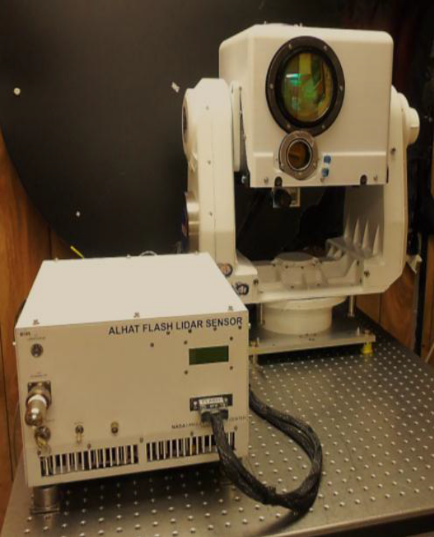
Flash Lidar built and demonstrated under Autonomous Landing and Hazard Avoidance (ALHAT) project
Sensor Head
Electronics Box
Parameter |  | Value
Max operational range |  | 1800 m
Array size |  | 16.4k
Range precision |  | 7 cm
Frame Rate |  | 20 Hz
Dimensions | Sensor Head | 28x34x33 cm
 | Electronics | 24x36x33 cm
Weight | Sensor Head | 16 kg
 | Electronics | 16 kg
Power (28 VDC) |  | 450 W
Much of SWaP was used for removing heat and controlling sensor engine and laser temperatures

Slide 15
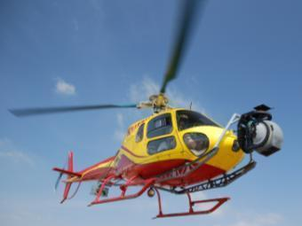

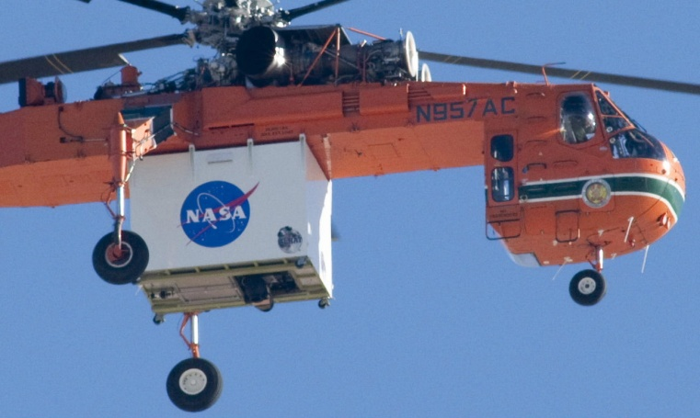
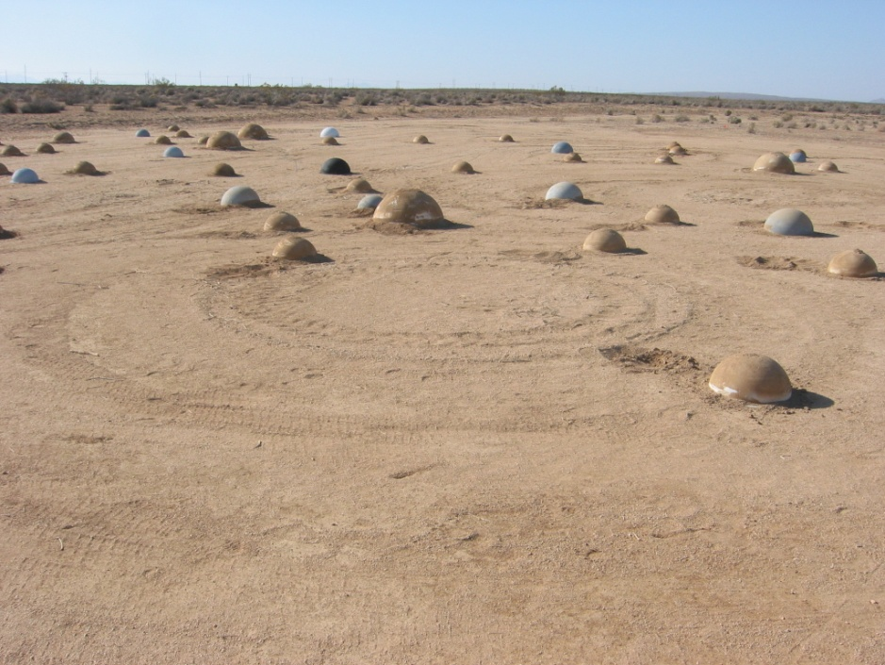
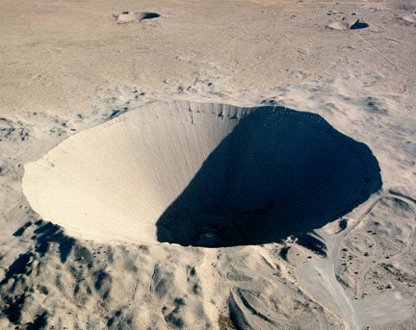
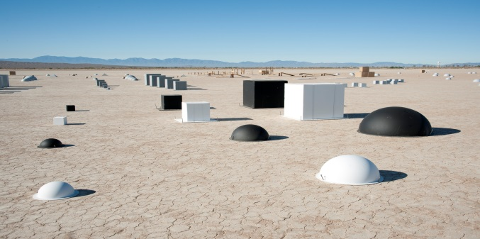
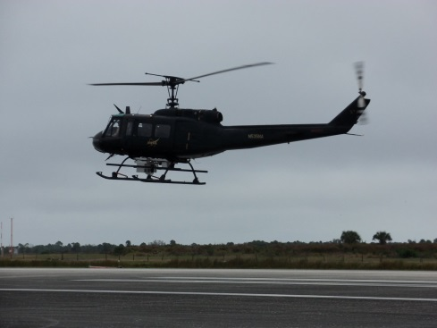
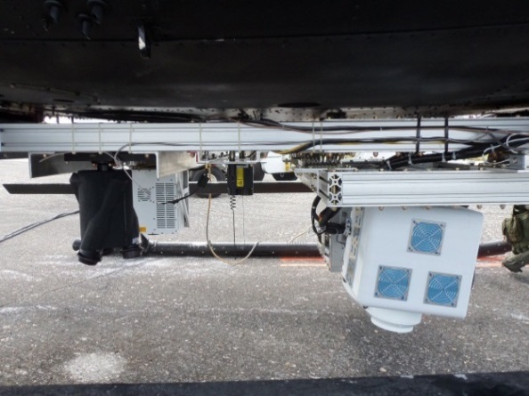
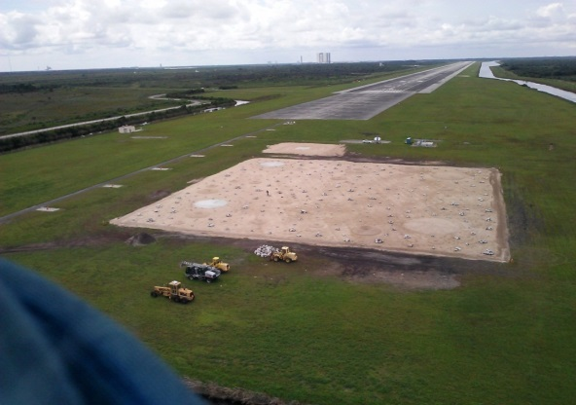
Field Tests:
Lidar development from breadboard to fully-autonomous prototype units
2008
2009
2010
2012

Slide 16
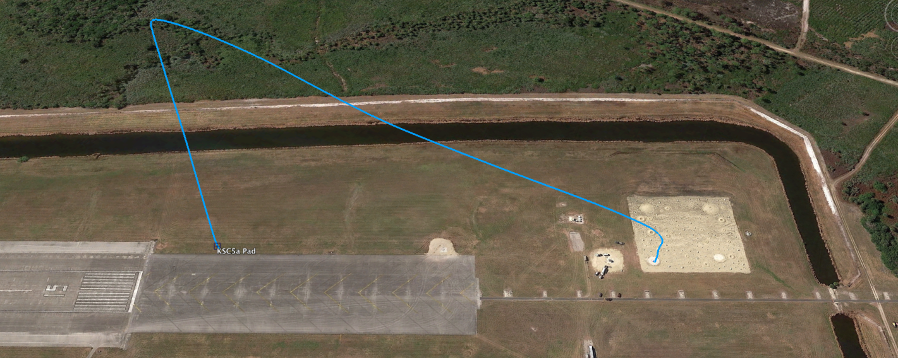

Morpheus Closed-Loop Demonstration
at NASA-KSC
3-D Flash Lidar mapped the terrain for real-time hazard detection and avoidance
NDL provided data for precision navigation and soft landing at the selected site
3 open loop flights (April 2014)
  3 closed loop flights (two in May 2014 and one in December 2014)
Approx. 450 m slant range
30 degree glideslope
250 m Altitude
100m x 100 m hazard field

Slide 17
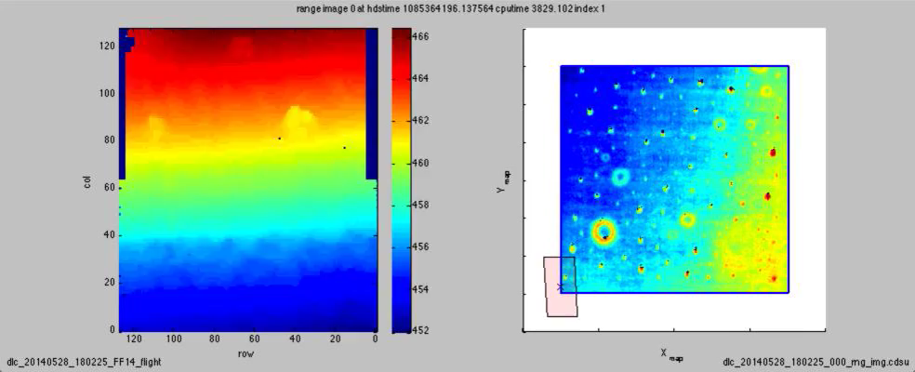
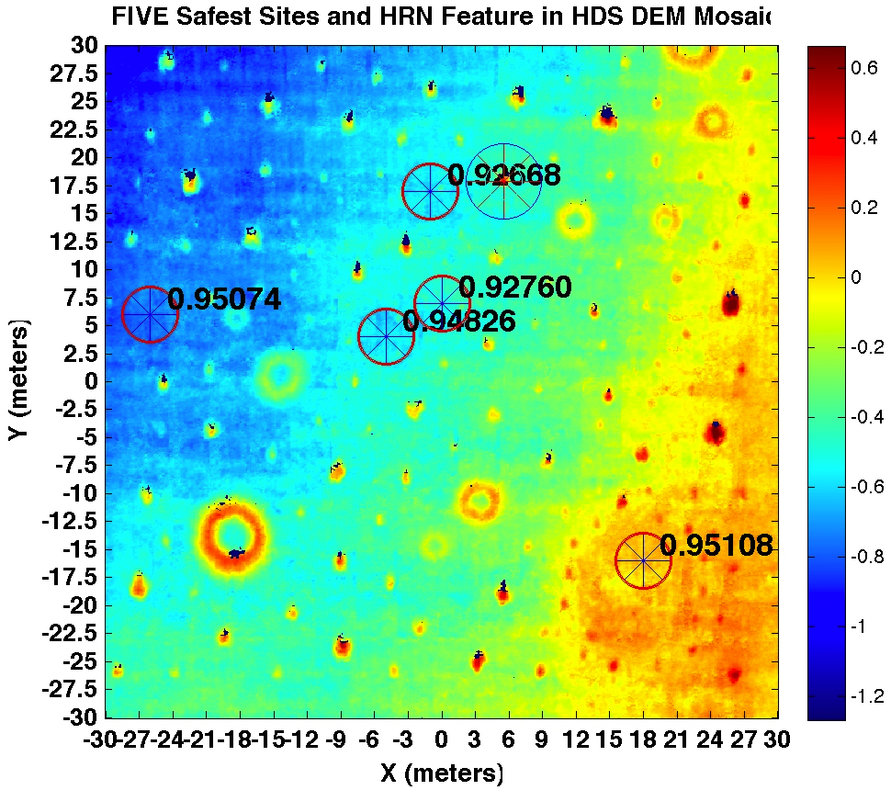
Morpheus Flight: Flash Lidar Data
Hazard Detection and Hazard Relative Navigation Operation

Slide 18
Flash Lidar Super-Resolution Algorithm
X-localization
Object
X-localization
Y
Object
Y
Y-localization
Y-localization
X
X
Cell, where object is registered
Cell, where object is registered
Using low resolution grid, it is possible to localize the object location only inside of the cell.
Using two shifted grids, it is possible to improve the object localization because it belongs to two cells at the same time.

