Slide 1
Analysis of Navigation Doppler Lidar Performance for Moon and Mars landing
Farzin Amzajerdian , Aram Gragossian , Glenn D. Hines , Bruce W. Barnes , Diego F. Pierrottet,
and Michael S. Cisewski
NASA Langley Research Center
AIAA SciTech Forum 2022
This material is a work of the U.S. Government and is not subject to copyright protection in the United States.

Slide 2
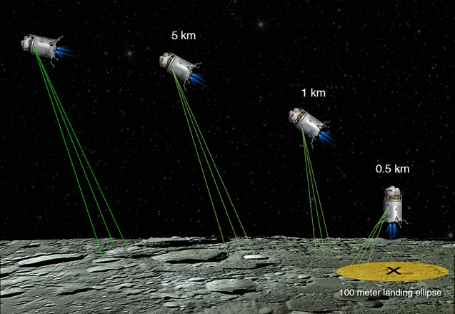
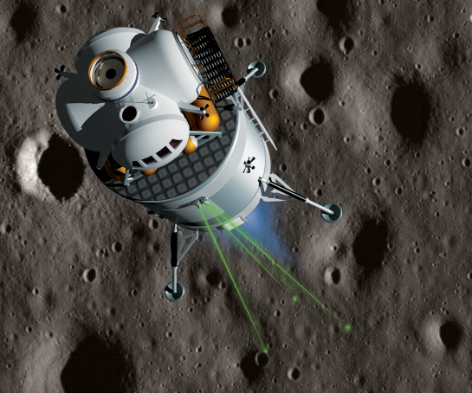
Navigation Doppler Lidar (NDL)
  NDL is a laser sensor capable of providing precision vector velocity and altitude data
  Viable replacement for radars with an order of magnitude higher precision and much better data quality
    Enables “precision navigation” to the designated landing location
    Enables “well-controlled” descent, landing, and ascent maneuvers to within a few cm/sec

Slide 3
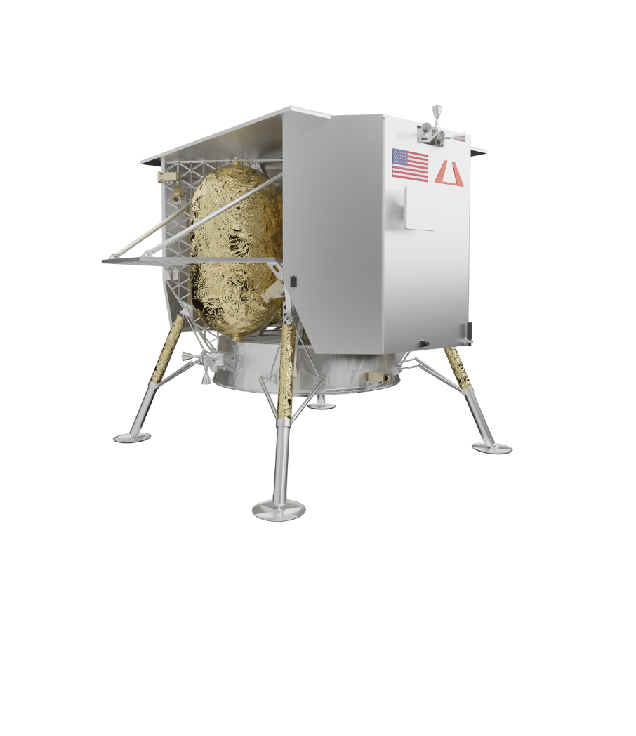
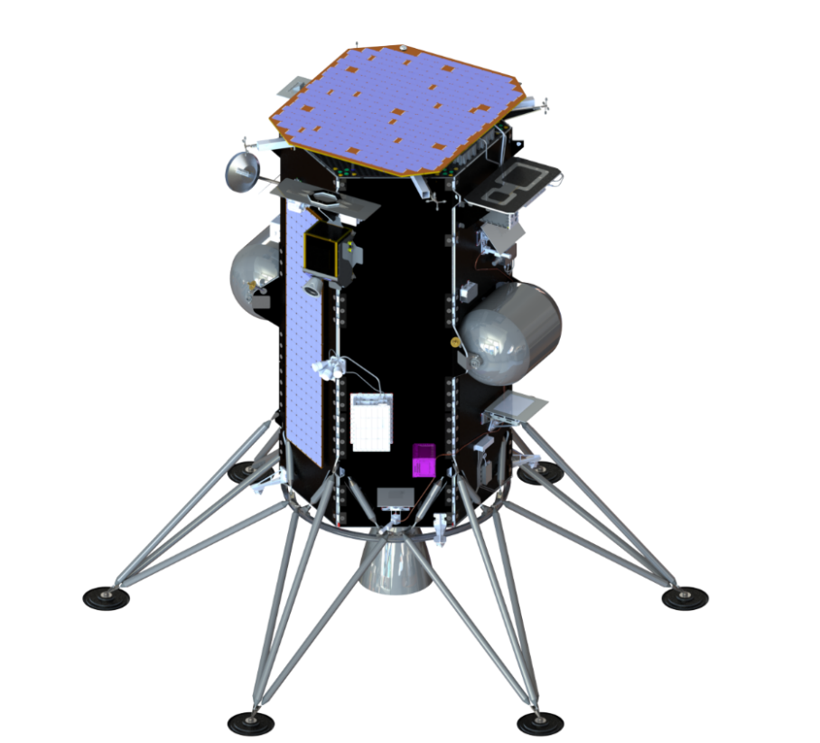
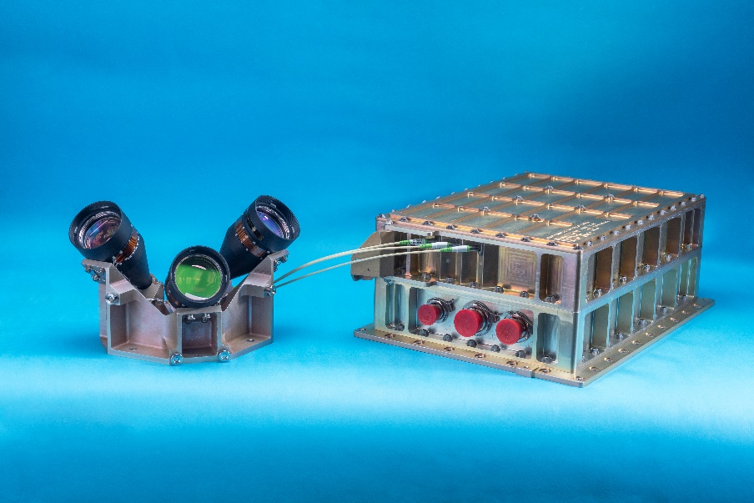
Spaceflight Engineering Test Units (ETUs)
  4 ETUs have been built and tested
  # 1 – Aircraft flight tests and integrated tests with other avionics
  # 2 – Suborbital flight test on Blue Origin New Shepard vehicle (2021)
  # 3 – Lunar Landing Demonstration onboard Intuitive Machines lander (2022)
  # 4 – Lunar Landing Demonstration onboard Astrobotic lander (2022)
Intuitive Machines
Nova-C Vehicle
Astrobotic
Peregrine Vehicle
Optical Head
Chassis
NDL

Slide 4
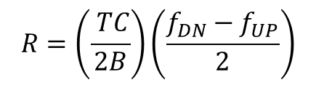
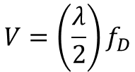
NDL Principal of Operation
NDL utilizes Frequency Modulated, Continuous Wave (FMCW) Technique
  3 segmented frequency waveform
Velocity and range are extracted from signal frequencies associated with each segment of the waveform
f_{D}
Transmit
Receive
Frequency
f_{UP}
f_{DN}
t_{d}
f_{UP}
f_{D}
f_{DN}
Time
$$V=\left(\frac{λ}{2}\right)f_{D}$$
$$R=\left(\frac{ TC}{2B}\right)\left(\frac{f_{DN}−f_{UP}}{2}\right)$$

Slide 5
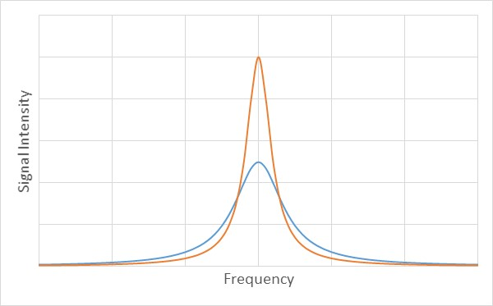
ETU performance is dominated by vehicle vibration
  Vibration broadens laser linewidth which in turn broadens the signal frequency spectra and lowers its peak intensity
    Reduces maximum operational range
    Increases measurement noise
  Signal frequency broadening is proportional to
    vibration load and increases with range
Signal spectra broadening with vibration
No vibe
With vibe

Slide 6
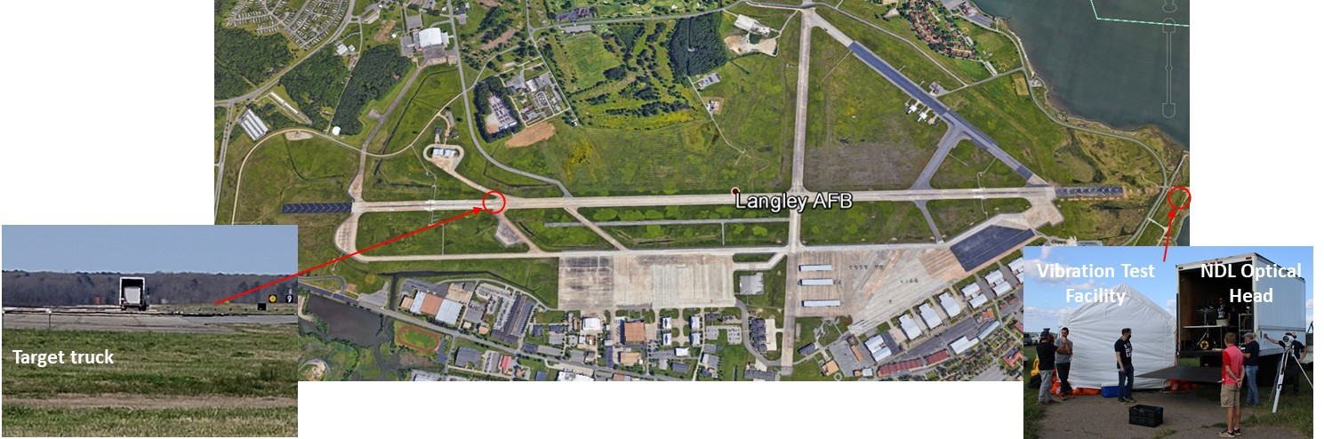
Comprehensive Functional Test
  Measured signal strength and spectral broadening at different vibration loads versus range
  Truck test at Joint Base Langley-Eustis

Slide 7
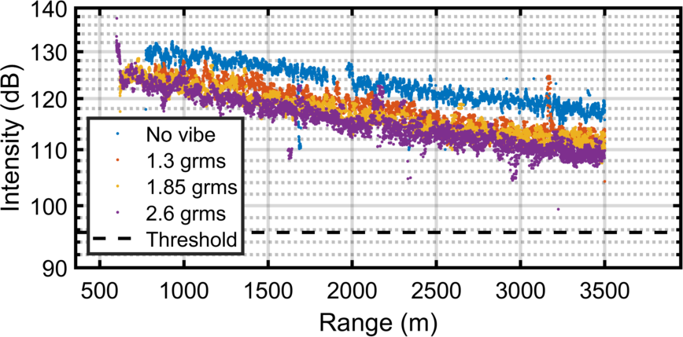
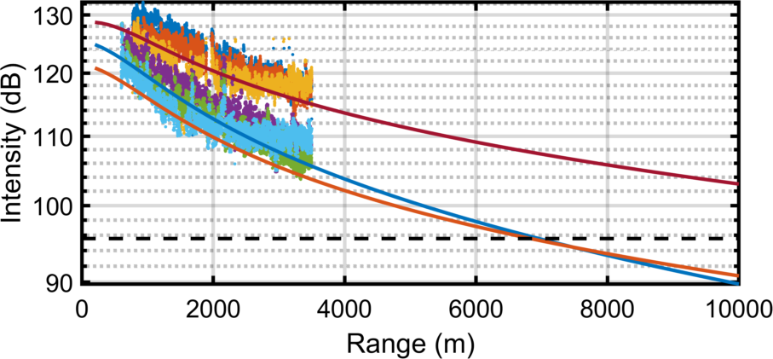

Maximum Operational Range
Maximum operational range in Moon environment is extrapolated from measured data
  Remove atmospheric effects
  Correct for lunar surface albedo
No vibration
Lidar Equation
Target reflectivity = 0.5
Visibility = 23 km
Turbulence $C_{n}^{2}$ = 5x10⁻¹⁵
2.6 grms vibration
Moon Performance Projection

Slide 8
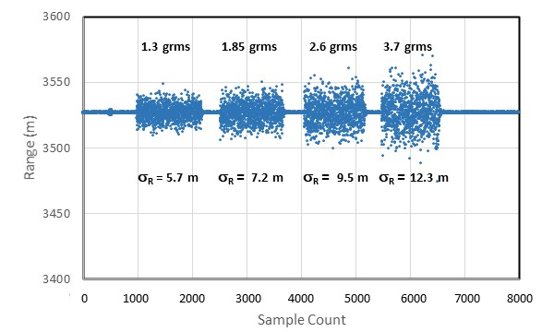


Measurements Precision
Estimated ETU range and velocity precision in 2.6 grms vibration environment:
$∂R=1.59+2.21×{10}^{−3}×R$ m
$∂v_{r}=1.62×{10}^{−2}+2.24$ $×{10}^{−5}×R$ m/s
LOS Range | Velocity Noise | Range Noise
1000 m | 3.86 cm/s | 3.80 m
5000 m | 12.82 cm/s | 12.64 m

Slide 9
Concluding Remarks
  NDL can provide critical vehicle velocity and altitude data for precision soft landing on the Moon, Mars, and other destinations
  Completed 4 ETUs of NDL for lunar landing demonstration and other tests
  Conducted a series of tests and analyses to estimate the NDL performance for Moon and Mars landing
  Performance of NDL ETU is dominated by the vehicle vibration
    Vehicle vibration impacts maximum operational range and measurements precision
    Velocity and range errors may increase from 2 mm/s and 13 cm by more than an order of magnitude

