Slide 1

b

Slide 2

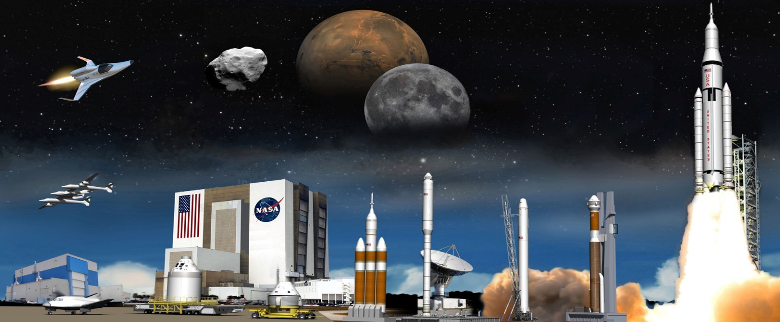
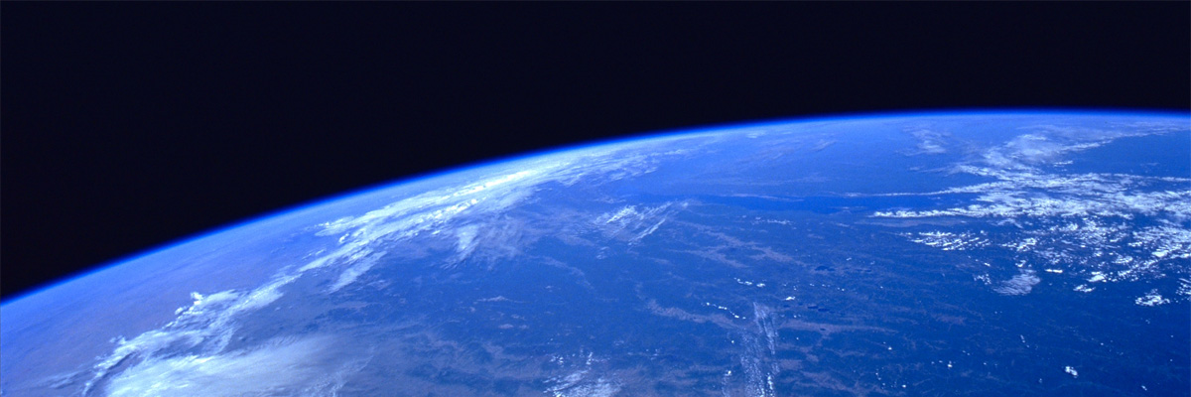
Exploration – Our Greatest Adventure
Curt Horanic

Slide 3
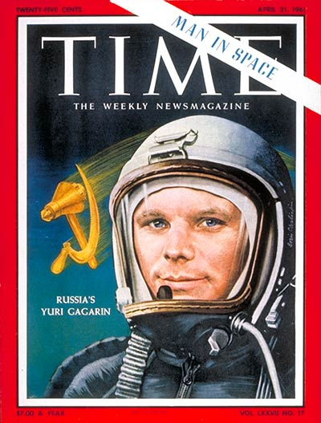
“I could have gone on flying through space forever.”
Yuri A. Gagarin
April 12, 1961

Slide 4
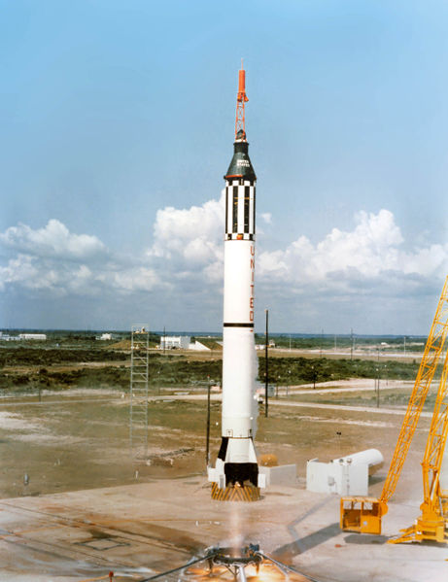

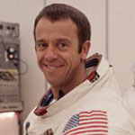
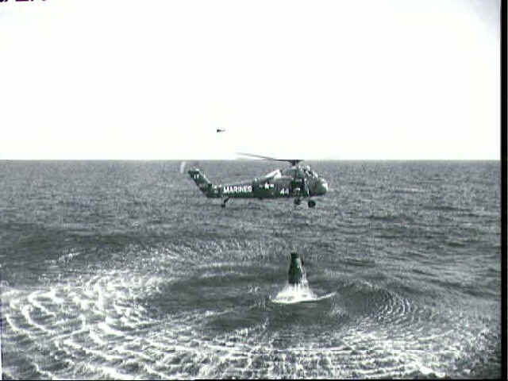
May 5, 1961 - First NASA Astronaut In Space
Alan Shepard
“Freedom-7”
  Altitude: 116.5 statute miles
  Orbits: 0
  Duration: 0 Days, 0 hours, 15 min, 28 secs
  Distance: 303 statute miles
  Velocity: 5,134 mph

Slide 5
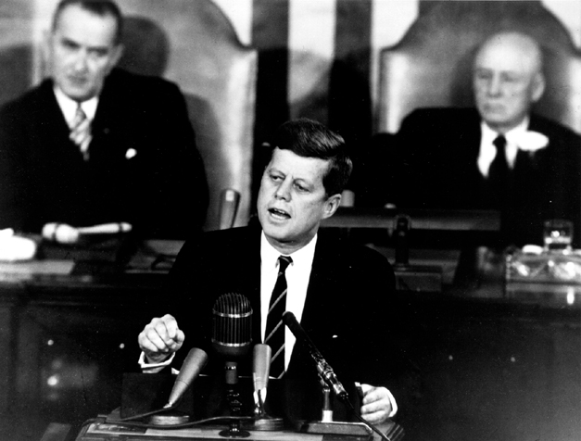
“I believe that this nation should commit itself to achieving the goal, before this decade is out, of landing a man on the moon and returning him safely to the earth “
President
John F. Kennedy
May 25, 1961
Notes:
During the early years of the Space Race, success was marked by headline-making "firsts": the first satellite, first robotic spacecraft to the Moon, first man in space, first woman in space, first spacewalk. To the dismay of the United States, each of these early feats was achieved by the Soviet Union. These events triggered a drive to catch up with--and surpass--the Soviets.

Slide 6
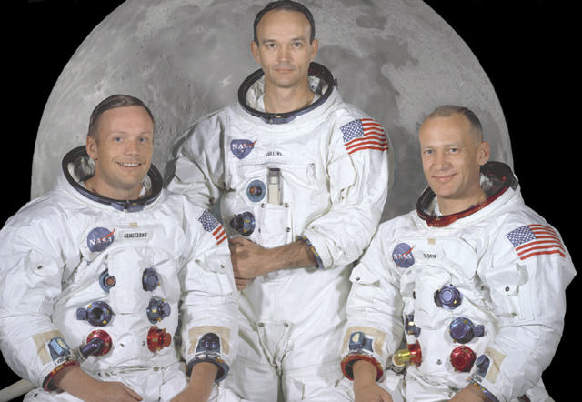
Mission Commander Command Module Lunar Module Pilot
Neil Armstrong, Pilot Michael Collins Edwin E. Aldrin Jr.
Notes:
Apollo XI - 'The Eagle has landed’
Crew
Neil Armstrong
Michael Collins
Edwin Aldrin, Jr.
Lift Off
Saturn V w/ Columbia (CM) & Eagle (LM)
July 16, 1969, 9:32 a.m. EDT
KSC, Florida, Complex 39-A
Lunar Landing
July 20, 1969, 4:18 p.m. EDT
Sea of Tranquility
Lunar Lift Off
July 21, 1969, 1:54 p.m. EDT
Splash-down
July 24, 1969, 12:50 p.m. EDT
Pacific Ocean
Duration
8 days, 3 hours, 18 minutes

Slide 7
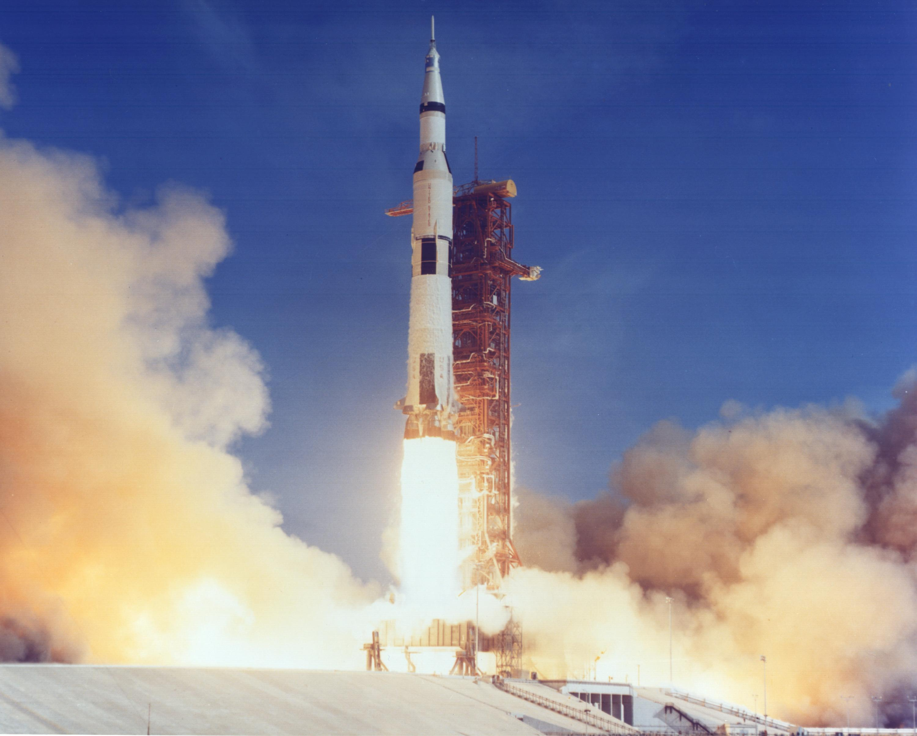
Apollo 11 Moon Launch
July 1969

Slide 8
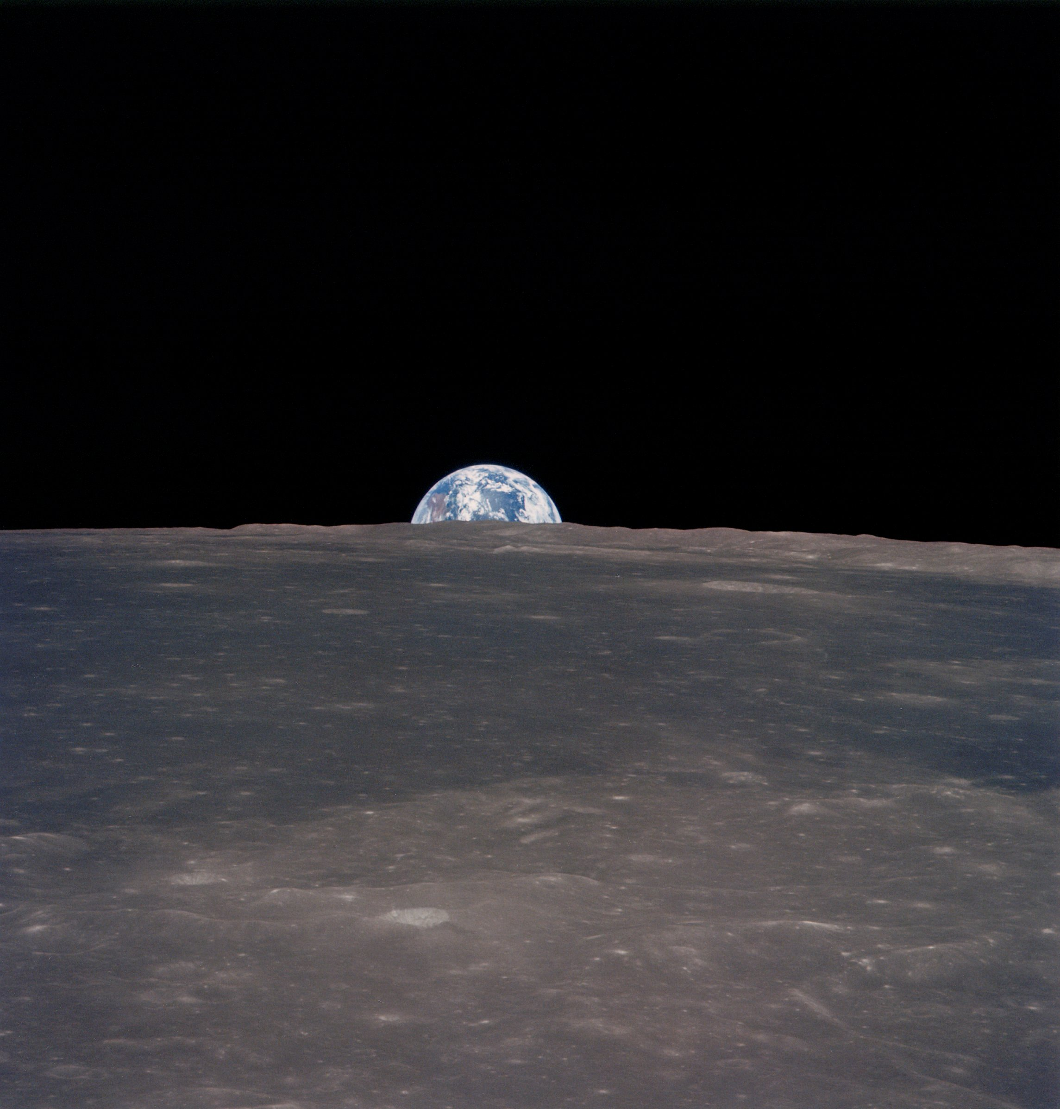
Notes:
The interaction of the Earth and the Moon slows the Earth's rotation by about 2 milliseconds per century. Current research indicates that about 900 million years ago there were 481 18-hour days in a year.

Slide 9
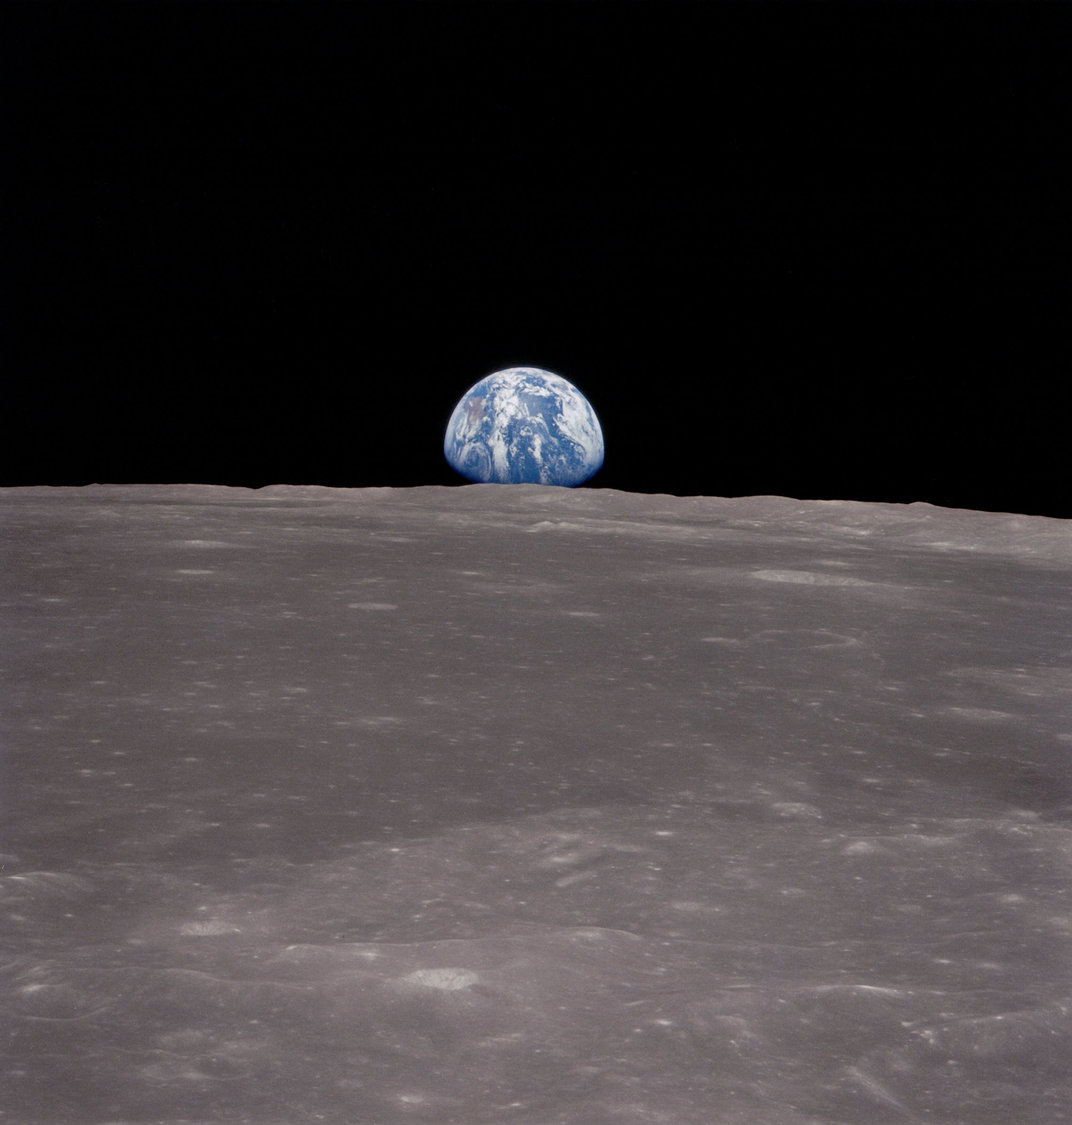
Notes:
The interaction of the Earth and the Moon slows the Earth's rotation by about 2 milliseconds per century. Current research indicates that about 900 million years ago there were 481 18-hour days in a year.

Slide 10
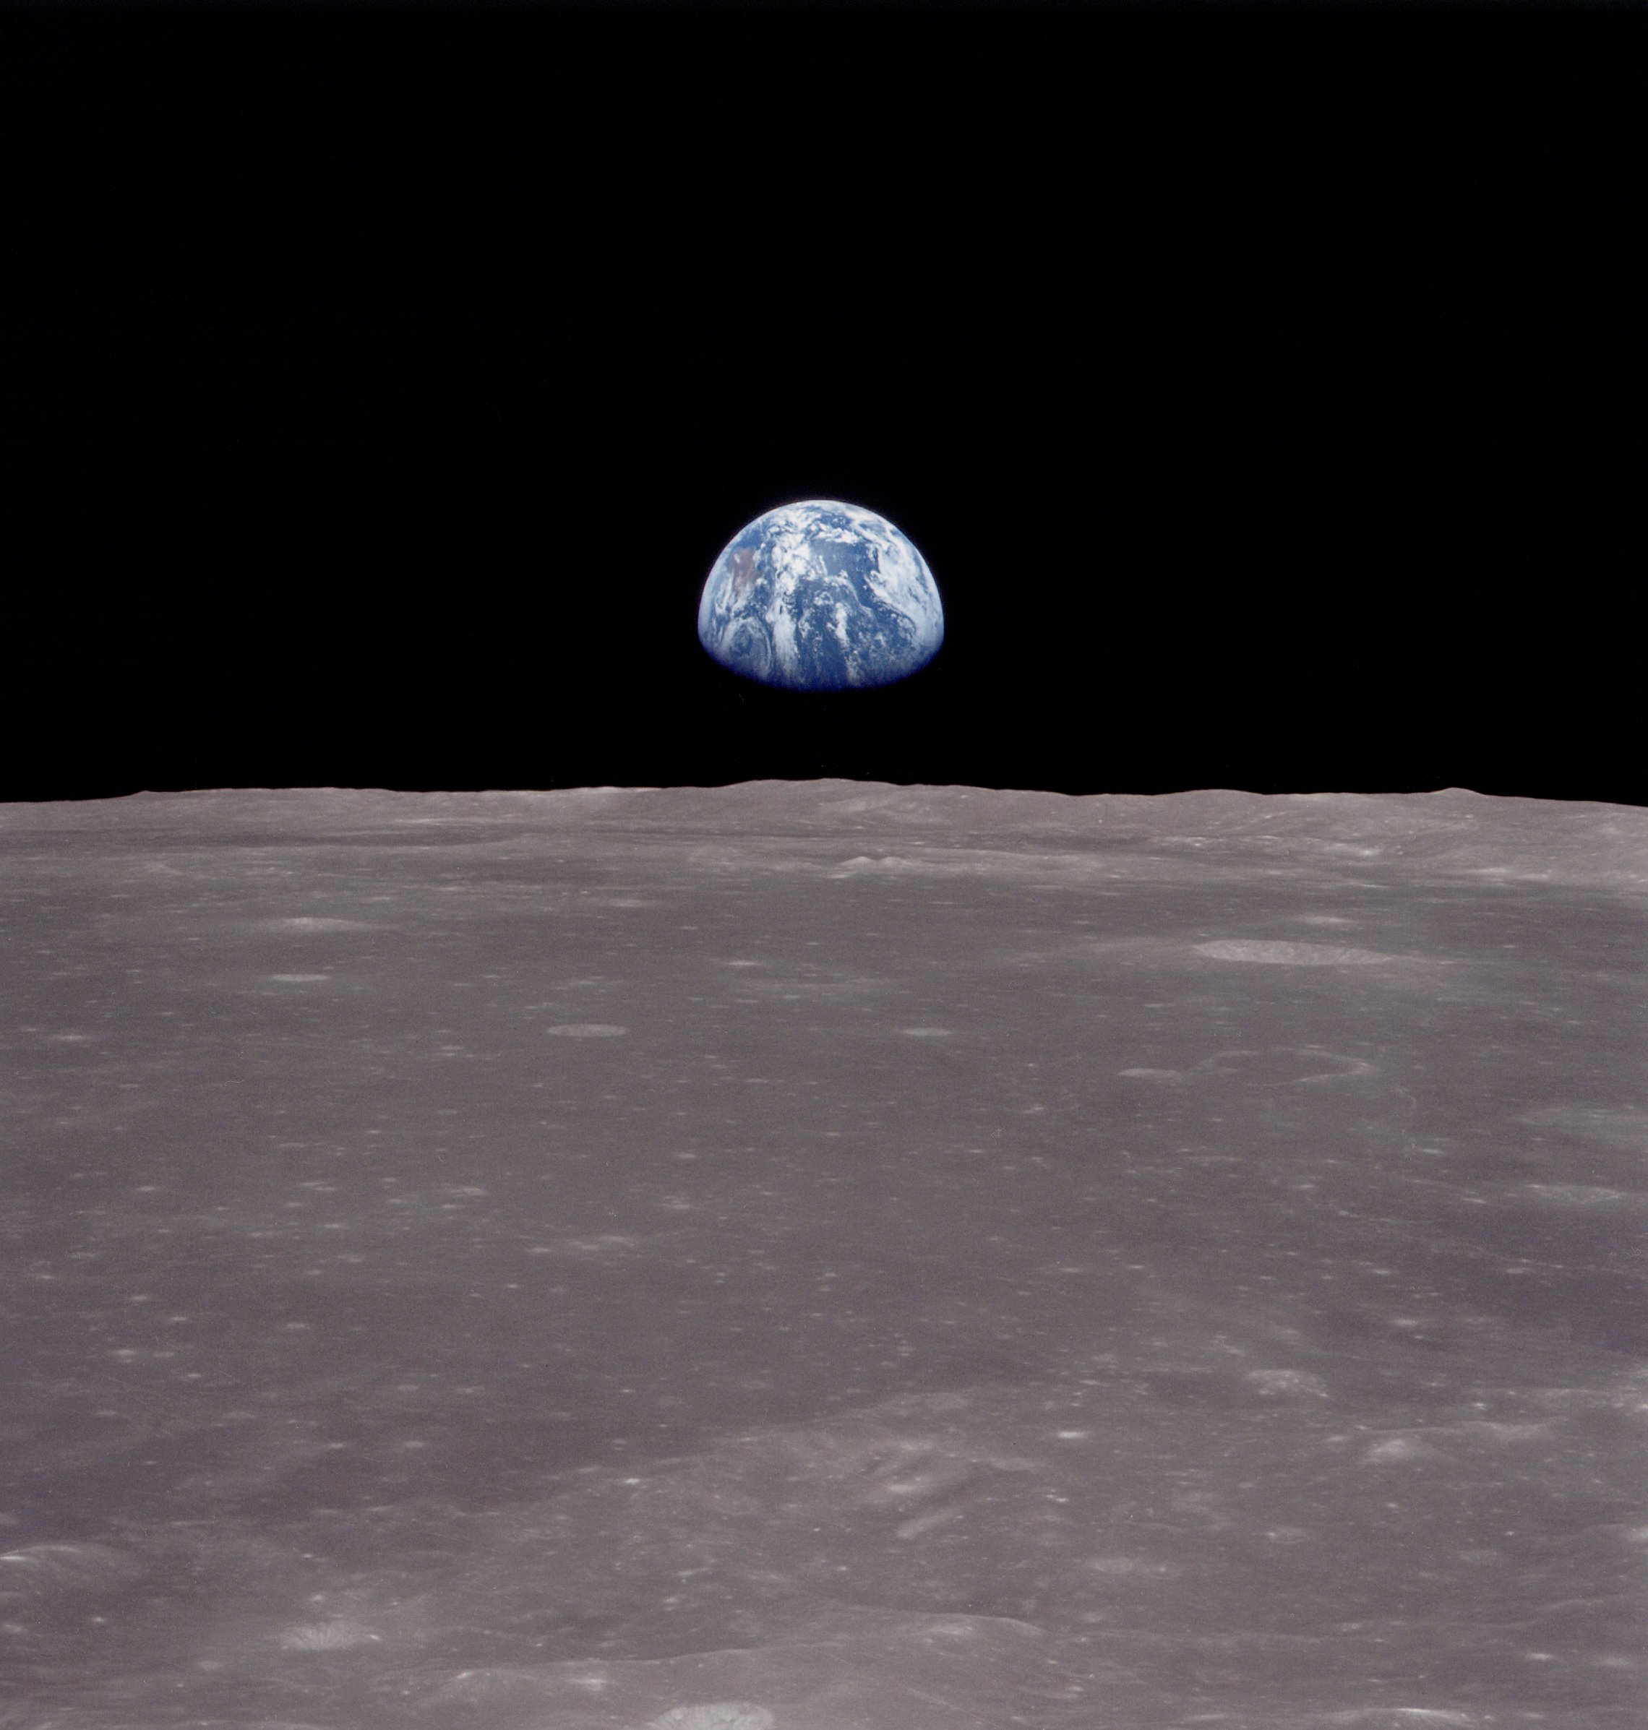
Notes:
The interaction of the Earth and the Moon slows the Earth's rotation by about 2 milliseconds per century. Current research indicates that about 900 million years ago there were 481 18-hour days in a year.

Slide 11
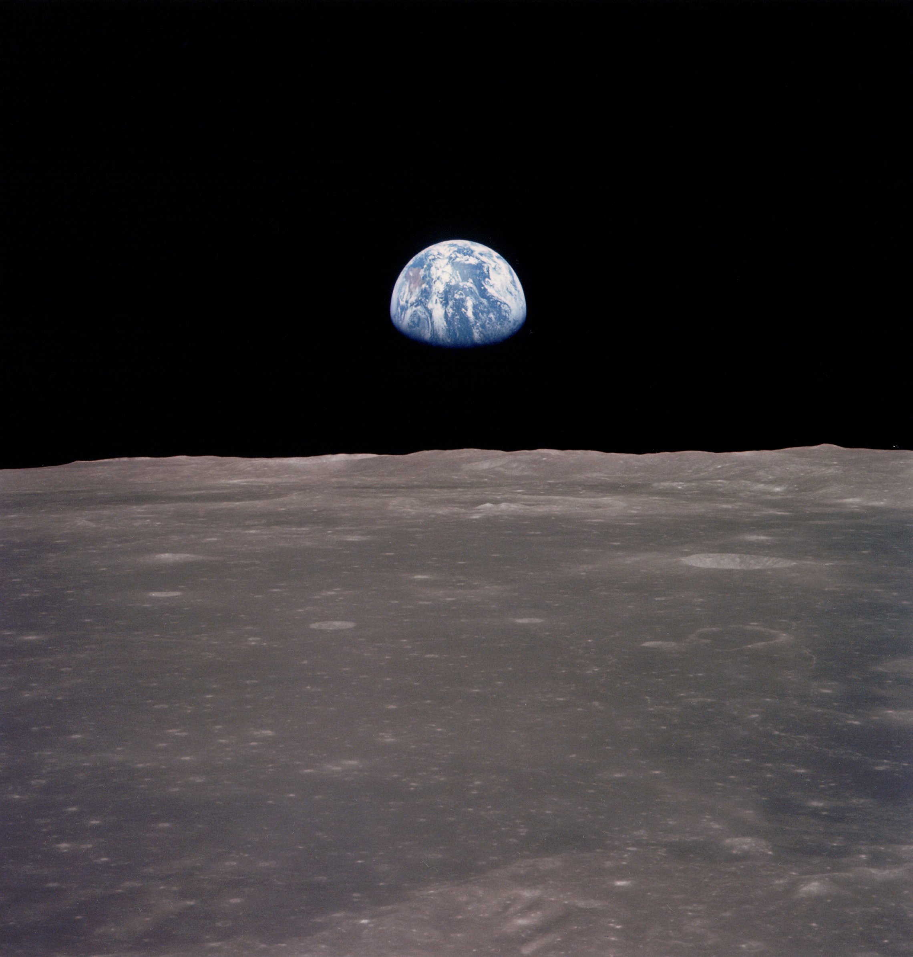
Notes:
The interaction of the Earth and the Moon slows the Earth's rotation by about 2 milliseconds per century. Current research indicates that about 900 million years ago there were 481 18-hour days in a year.

Slide 12
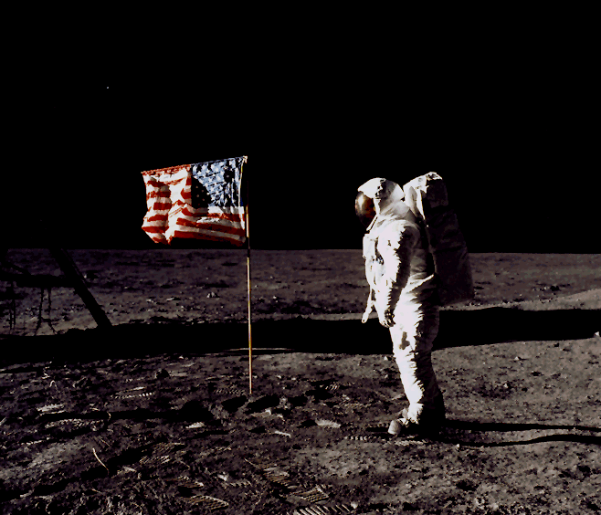
Notes:
This goal was first accomplished during the Apollo 11 mission on July 20, 1969 when astronauts Neil Armstrong and Buzz Aldrin landed, while Michael Collins remained in lunar orbit. Five subsequent Apollo missions also landed astronauts on the Moon, the last in December 1972. In these six Apollo spaceflights, 12 men walked on the Moon. These are the only times humans have landed on another celestial body.^{[3]}
The Apollo program ran from 1961 until 1975, and was America's third human spaceflight program (following Mercury and Gemini). It used Apollo spacecraft and Saturn launch vehicles, which were also used for the Skylab program in 1973–74, and a joint U.S.–Soviet mission in 1975. These subsequent programs are thus often considered part of the Apollo program.

Slide 13
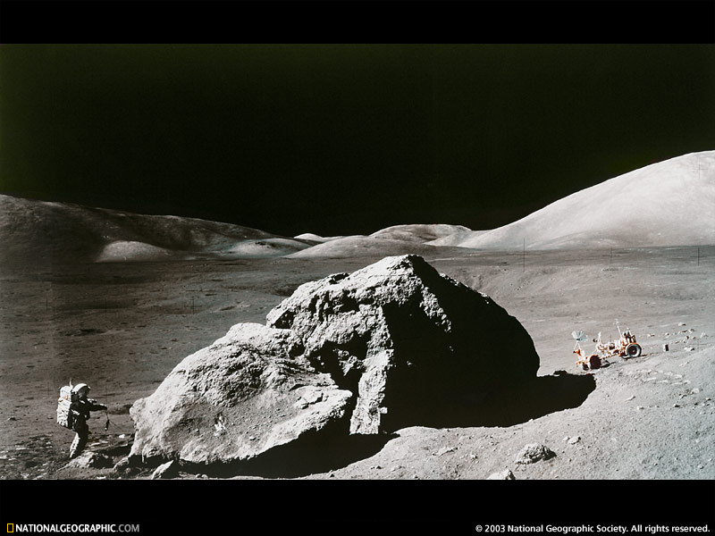

Slide 14
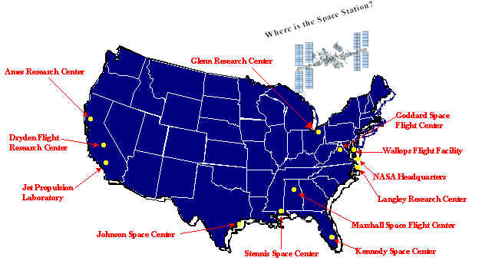
Where We Work
NASA Centers
Space Station
On Orbit
Glenn Research Center
Ames Research Center
Goddard Space
Flight Center
Dryden Flight Research Center
Wallops Flight Facility
NASA Headquarters
Jet Propulsion Laboratory
Langley Research Center
Marshall Space Flight Center
Johnson Space Center
Stennis Space Center
Kennedy Space Center
Notes:
Ames Research Center – Center of excellence for information technology which encompasses research in computer modeling and simulation, database and information management, high performance computing, networking and storage, software technology, smart sensor systems artificial intelligence and human factors. Also leads NASA in astrobiology.
Dryden Flight Research Center – Premier installation for atmospheric flight operations and flight research. Also Center of excellence for atmospheric flight operations. Charter is to research, develop, verify, and transfer advanced aeronautics, space and related technologies.
Glenn Research Center – Focus is on new aero propulsion, onboard propulsion, aerospace power, and communications technologies for applicati0ons to aeronautics and space and microgravity science. Also serves as NASA’s Center of excellence in turbomachinery.
Goddard Space Flight Center – Focus is on expanding knowledge of Earth and its environment, the solar system, and the universe through observations form space. Lead Center for the Earth Observing System. Devoted to research in Earth Science, space science, and space communications.
Headquarters – Responsible for leadership and management across NASA and development of the Agency strategy. Also provides Agency policy and procedures and functional leadership/
Johnson Space Center – Known for Mission Control and home of the astronauts. Focus is on expanding human presence in space through exploration and utilization. They are involved with the Space Shuttle, ISS, Space Operations Management, Biomedical Research & Countermeasures, and the Advanced Human Support Technology programs.
Kennedy Space Center – leads the world in preparing and launching missions into earth around Earth and beyond. Missions such as the Space Shuttle, Payloads, International Space Station, and Expendable Launch Vehicles. Center of excellence for launch and payload processing systems and also serves as NASA’s Lead Center for acquisition/manage-ment of Expendable Launch Vehicle services and payload carriers, payload processing, and support.
Langley Research Center – Focus is on Aeronautics, atmospheric sciences, and space technology. 70% of Langley’s efforts are in aeronautic research, aimed at improving today’s aircraft and developing concepts for future aircraft.
Marshall Space Flight Center – Focus is in on research, technology, design, development, and integration of space transporta-tion and propulsion systems. Lead center for microgravity research. World leader in space Optics manufacturing technology.
Stennis Space Center – Focus is on rocket propulsion testing and for commercial remote sensing within the Earth and Science enterprise. Manages the rocket propulsion test assets and assigns testing to other NASA Centers. Stennis tests all main engines that launch the space shuttle into orbit, and tests all new propulsion systems. Stennis also conducts remote sensing researching the environmental sciences. In addition, Stennis develops and validates advance technologies. ( i. e., high speed communications, intelligent data mining, data visualization).

Slide 15
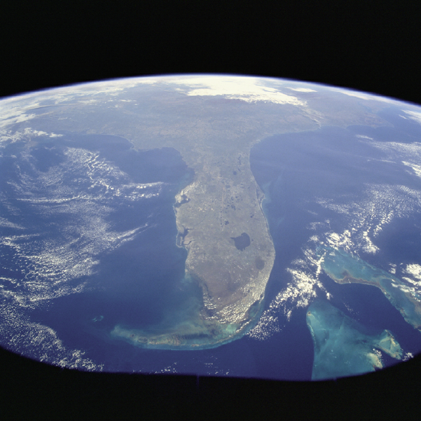
Notes:
The Gulf of Mexico and the Gulf Stream bracket the Florida Peninsula on the west and east. The lighter shade of blue in the Gulf of Mexico is due to the much shallower (continental shelf) water depths of less than 200 feet (60 meters), whereas the much darker blue of the Gulf Stream is due to water depths in excess of 2000 feet (610 meters). Tampa Bay and Charlotte Harbor are fairly large water embayment along the west coast, and Lake Okeechobee is the large body of water in the south-central part of the state. Numerous smaller lakes can also be seen generally extending north and south through the central part of the state. Practically all of the lakes in central Florida have been created by the interaction of water with the limestone rock that underlies most of the state.
To the west of this vibrant and ever-growing urban area is the vast, relatively uniform-looking swampland of the Everglades, which is virtually uninhabited by humans. In fact, most of the flat, saw grass landscape is occasionally interrupted by small stands of hardwood hammocks; this area is part of the Big Cypress National Preserve and the Everglades National Park. Most of the Florida Keys are visible as they form an archipelago that arcs to the southwest from the southern tip of Florida. Also visible are parallel lines of clouds that have been formed as a cool air mass from the northwest is pushed across the warmer water of the Gulf Stream. A very faint smoke plume that originates near the Georgia-South Carolina border provides a clue to the wind direction at the time this photograph was taken.
A Photo taken by a Crew member aboard Space Station while passing over Florida.

Slide 16
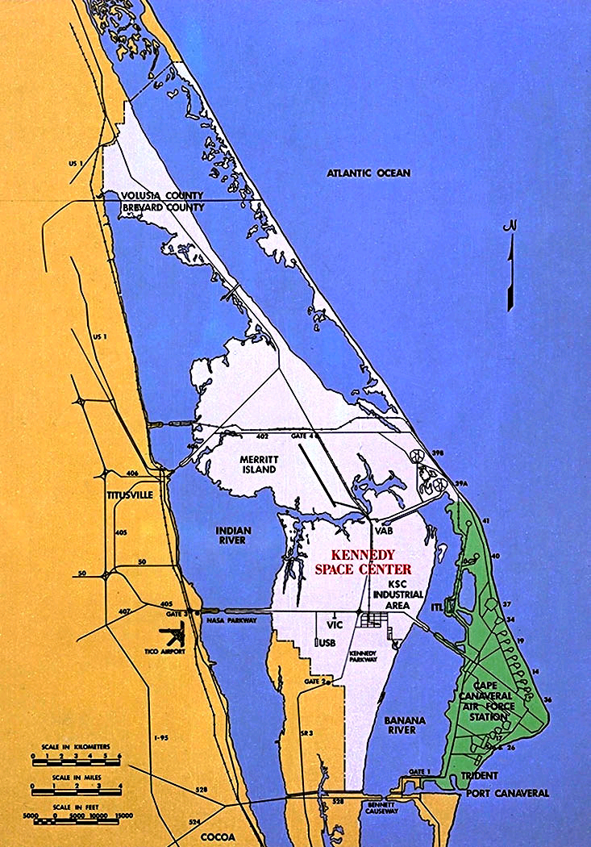
Notes:
The Cape was ideal for testing missiles. Virtually undeveloped, it enabled personnel to inspect, fuel and launch missiles without danger to nearby communities. The area's climate also permitted year-round operations, and rockets could be launched over water instead of populated areas. A chain of islands extending southeastward from Grand Bahama to Ascension provided sites for tracking stations to follow the progress of missiles in flight. Some years later, many of these same factors led to selection of the area adjacent to Cape Canaveral--Merritt Island--as the location of the Kennedy Space Center.
After the proving grounds were established, the Air Force took over the nearby Banana River Naval Air Station--renamed Patrick Air Force Base in honor of Maj. Gen. Mason Patrick, the first chief of the Army Air Corps--located 20 miles (32 kilometers) south of the Cape. Here, in 1951, the Air Force established headquarters for the Air Force Missile Test Center, which included a range. These facilities were redesignated in 1964 as the Air Force Eastern Test Range, which became Detachment 1, Space and Missile Test Center in 1977, and was redesignated the Eastern Space and Missile Center in 1979.

Slide 17
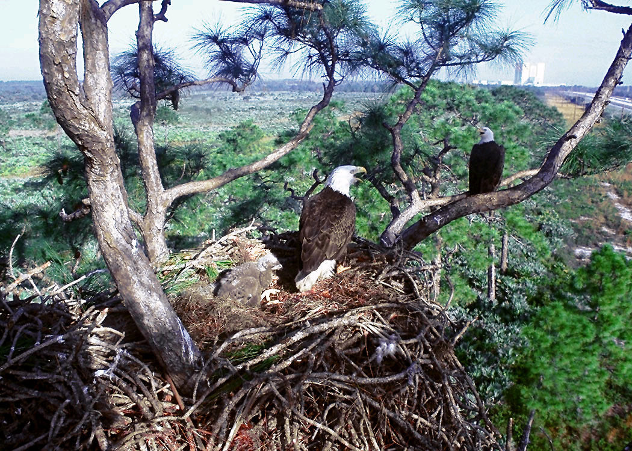
Notes:
There are more than 15 varieties of endangered wildlife at KSC. There are at least five active bald eagle nests around the Center. Nests can reach more than six feet in diameter and are usually inhabited from September through May. The eagles usually produce one or two chicks per year.

Slide 18
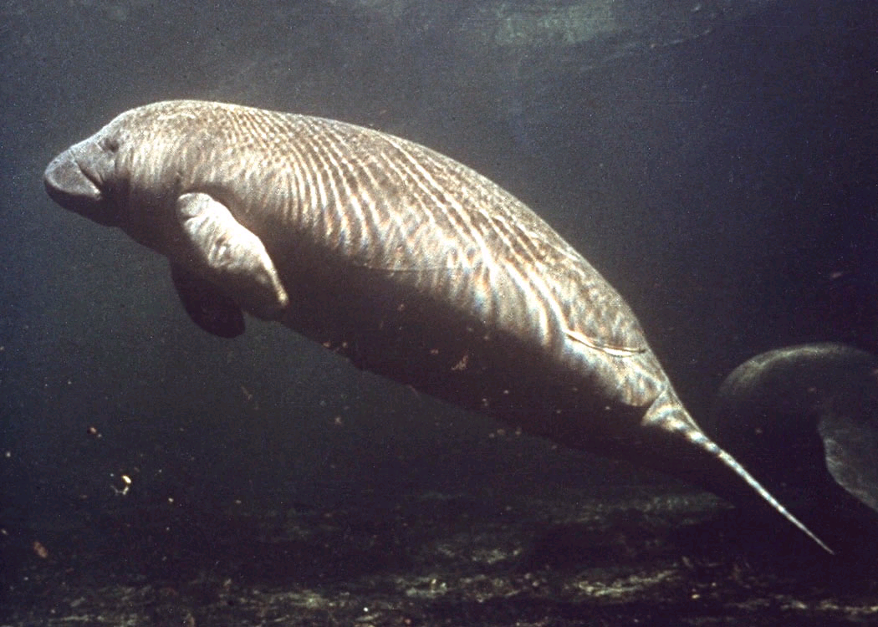
Notes:
Manatees are also abundant at the center with more than 300 of the lovable creatures accounted for, thus making up around 30 percent of Florida's total manatee population.

Slide 19
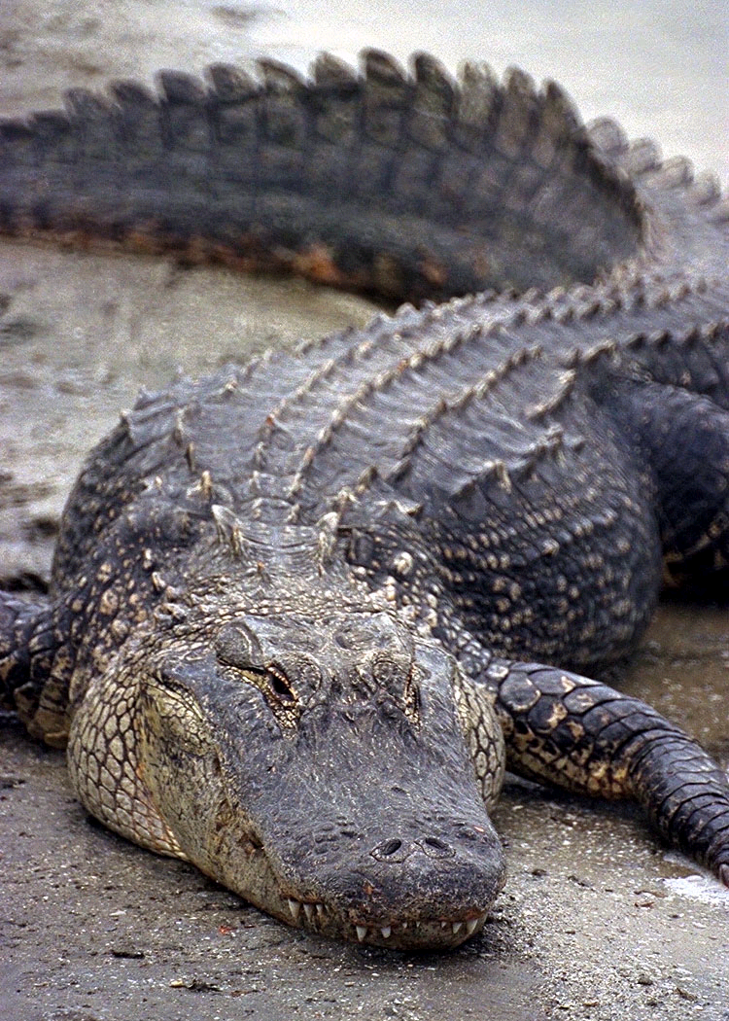
Notes:
No discussion of wildlife at KSC is complete without mentioning alligators! While the interactions between man and alligator are few, the biggest problem is during Shuttle landings. Prior to each KSC Shuttle landing, it is the task of a special crew to clear the runway of all debris, including any alligators that might be sunning themselves on the runway surface.

Slide 20
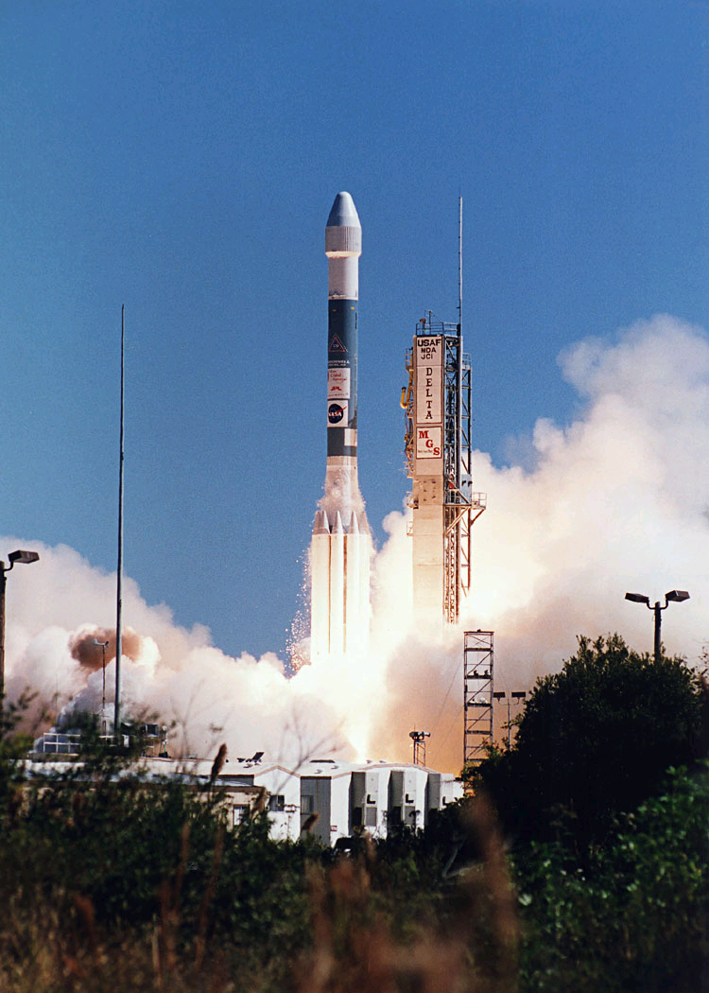
Notes:
The Delta rocket has been called the workhorse of the space program. Since 1960, NASA has been the responsible agency in the launch of more than 180 scientific, weather, and communications spacecraft, along with some military satellites. These spacecraft include the TIROS, Nimbus, ITOS, LANDSAT, and Westar series, and over 30 scientific Explorers.
The Delta II is the newest version of this rocket. The U.S. Air Force and McDonnell Douglas first launched this vehicle from Complex 17 at Cape Canaveral Air Force Station in February 1989, carrying the first of 21 upgraded Navstar Global Positioning Satellites into orbit. NASA relinquished control of this launch area to the Air Force in 1988. Delta commercial launches also take place here.
The Delta family of vehicles has been upgraded several times over the years. Currently, the most powerful version is the Delta II, which stands 128 feet (39 meters) tall. Nine Castor IV-A strap-on solid rocket boosters augment its first stage. Six of them ignite at liftoff. The remaining three Castors ignite after the first six burn out. All of them burn for approximately 1 minute.
The average first-stage thrust with the main engines and the six solid-propellant boosters is 873,400 pounds (3.9 million newtons). The Delta has liquid-fueled first and second stages and a solid-propellant third stage. For most launches today, the third stage has been replaced by a more powerful Payload Assist Module (PAM) solid-propellant stage attached to the spacecraft.
The newest version of the PAM upper stage, the PAM-DII, also has been used on Shuttle launches. It can boost spacecraft from the low Earth orbit achieved by the Shuttle orbiter into higher ones. Many spacecraft, especially communications satellites, operate in a geosynchronous orbit some 22,240 miles (35,792 kilometers) above the equator. The Delta II and the PAM-DII together can lift some 3,190 pounds (1,447 kilograms) into a highly elliptical orbit for eventual transfer into geosynchronous orbit by a motor built into the payload spacecraft. This is more than double the 1,500 pounds (680 kilograms) that a Delta built in 1980 could manage.

Slide 21
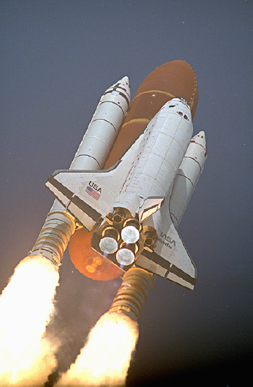
Atlantis
Discovery
Endeavour

Slide 22
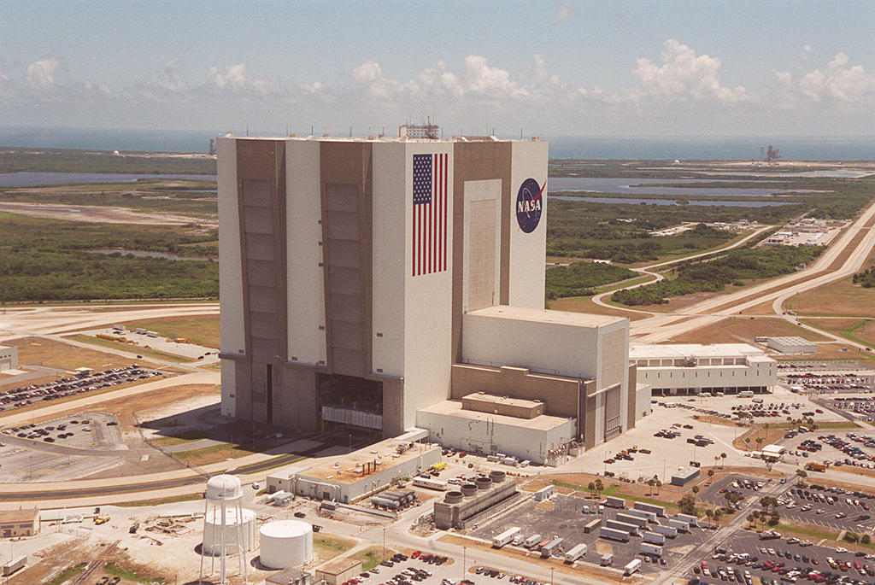
Vehicle Assembly Building
Kennedy Space Center Florida
525 Feet
48 Stories
Notes:
Built for the Apollo program, the Vehicle Assembly Building (VAB) was the hub of launch operations at the space center. Designed to house the assembly and final checkout of the 363-foot-tall Saturn V launch vehicle, the VAB enabled engineers to assemble the rocket in a protected, climate-controlled environment. At the time of its construction the VAB was the largest building in the world enclosing 128 million cubic feet of space, three times the volume of the Empire State Building.
Rising to a height of 525 feet above the surrounding wetlands, the VAB covers almost eight acres. The mammoth structure rests on 4,200 steel piles, each driven to bedrock 160 feet below the surface. One of the VABs most notable features is its 456-foot-high doors. Designed to accommodate a fully assembled Saturn V, the T-shaped doors are 152 feet wide at the base and taper to 76 feet wide at the top. Construction of the VAB, which began in 1962, was completed in 1966. It required 58,000 tons of steel and more than one million rivets. The building cost approximately $100 million to complete.
The south face of the VAB displays a gigantic American flag and the NASA logo commonly referred to as the NASA “meatball.” The American flag took 600 gallons of paint and nearly 4 months to complete.
Shown in the picture is the southwest corner of the building with launch pad A in the background. The Launch Control Center (LCC) juts out from the VAB to the right of the picture.

Slide 23
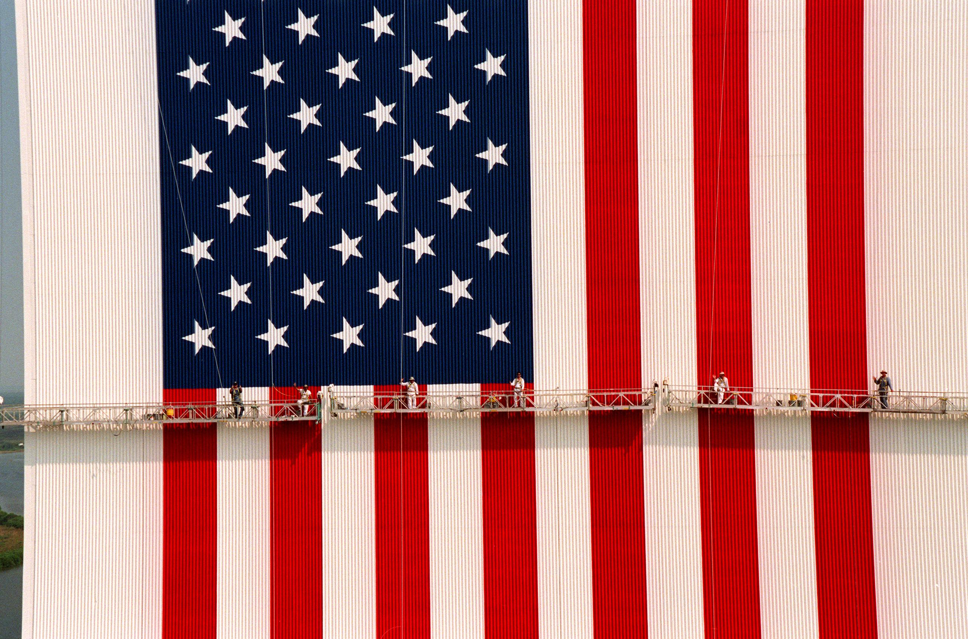
Vehicle Assembly Building
Kennedy Space Center Florida
Notes:
(08/31/1998) --- KENNEDY SPACE CENTER, FLA. -- This aerial view shows workers, suspended on platforms from the top of the 525-foot-high VAB, using rollers and brushes to repaint the flag on the Vehicle Assembly Building (VAB). The facelift honors NASA's 40th anniversary on Oct. 1 and is expected to be complete in mid-September. The flag spans an area 209 feet by 110 feet, or about 23,437 square feet. Each stripe is 9 feet wide and each star is 6 feet in diameter

Slide 24
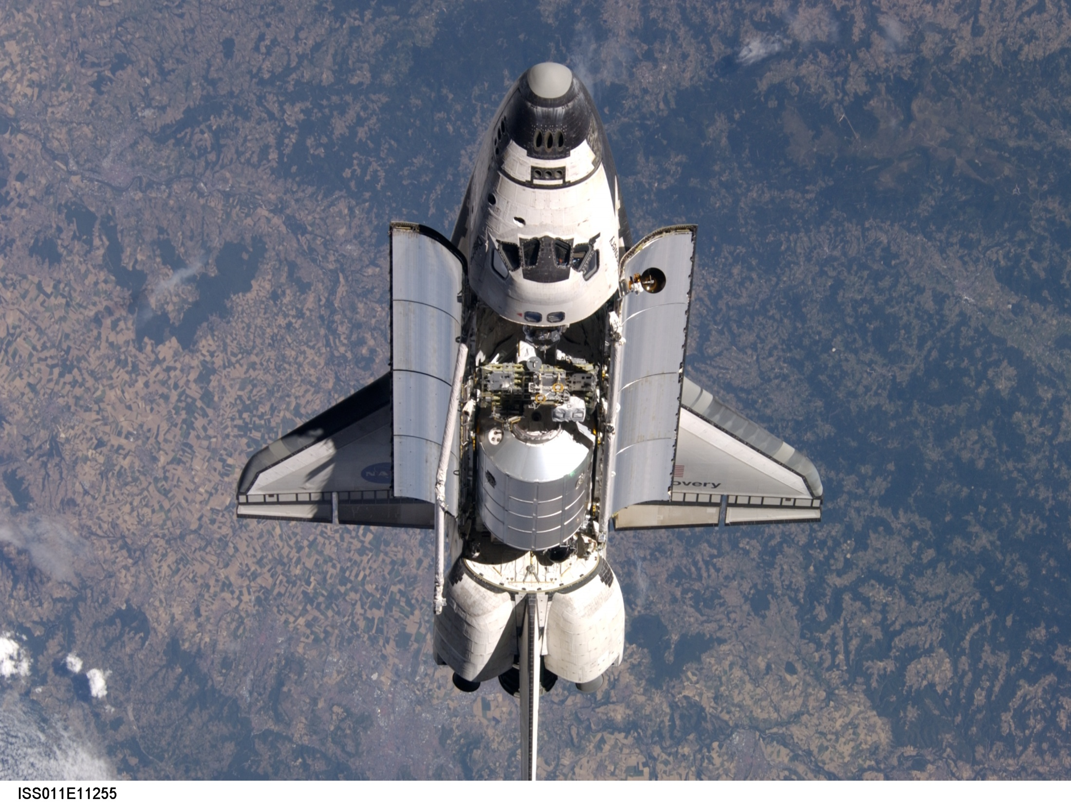

Slide 25
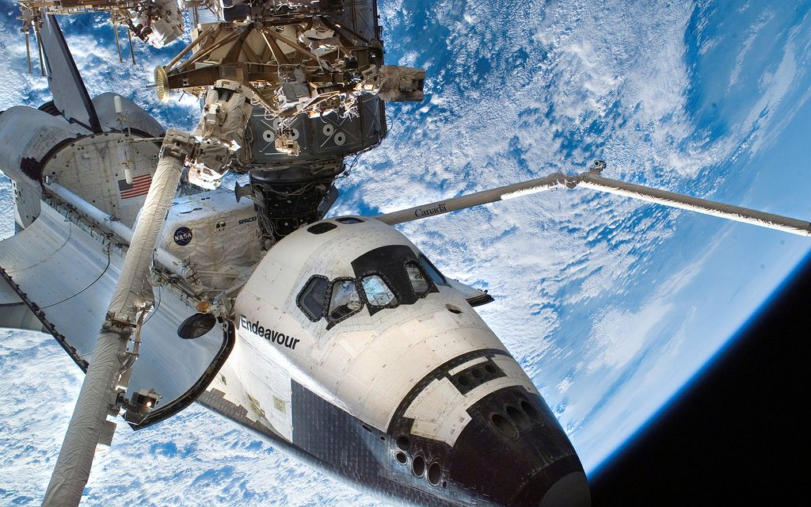
STS 116
Notes:
25
S116-E-05983 (12 Dec. 2006) --- Backdropped by New Zealand and Cook Strait in the Pacific Ocean, astronaut Robert L. Curbeam Jr. (left) and European Space Agency (ESA) astronaut Christer Fuglesang, both STS-116 mission specialists, participate in the mission's first of three planned sessions of extravehicular activity (EVA) as construction continues on the International Space Station. Cook Strait divides New Zealand's North and South Islands.

Slide 26
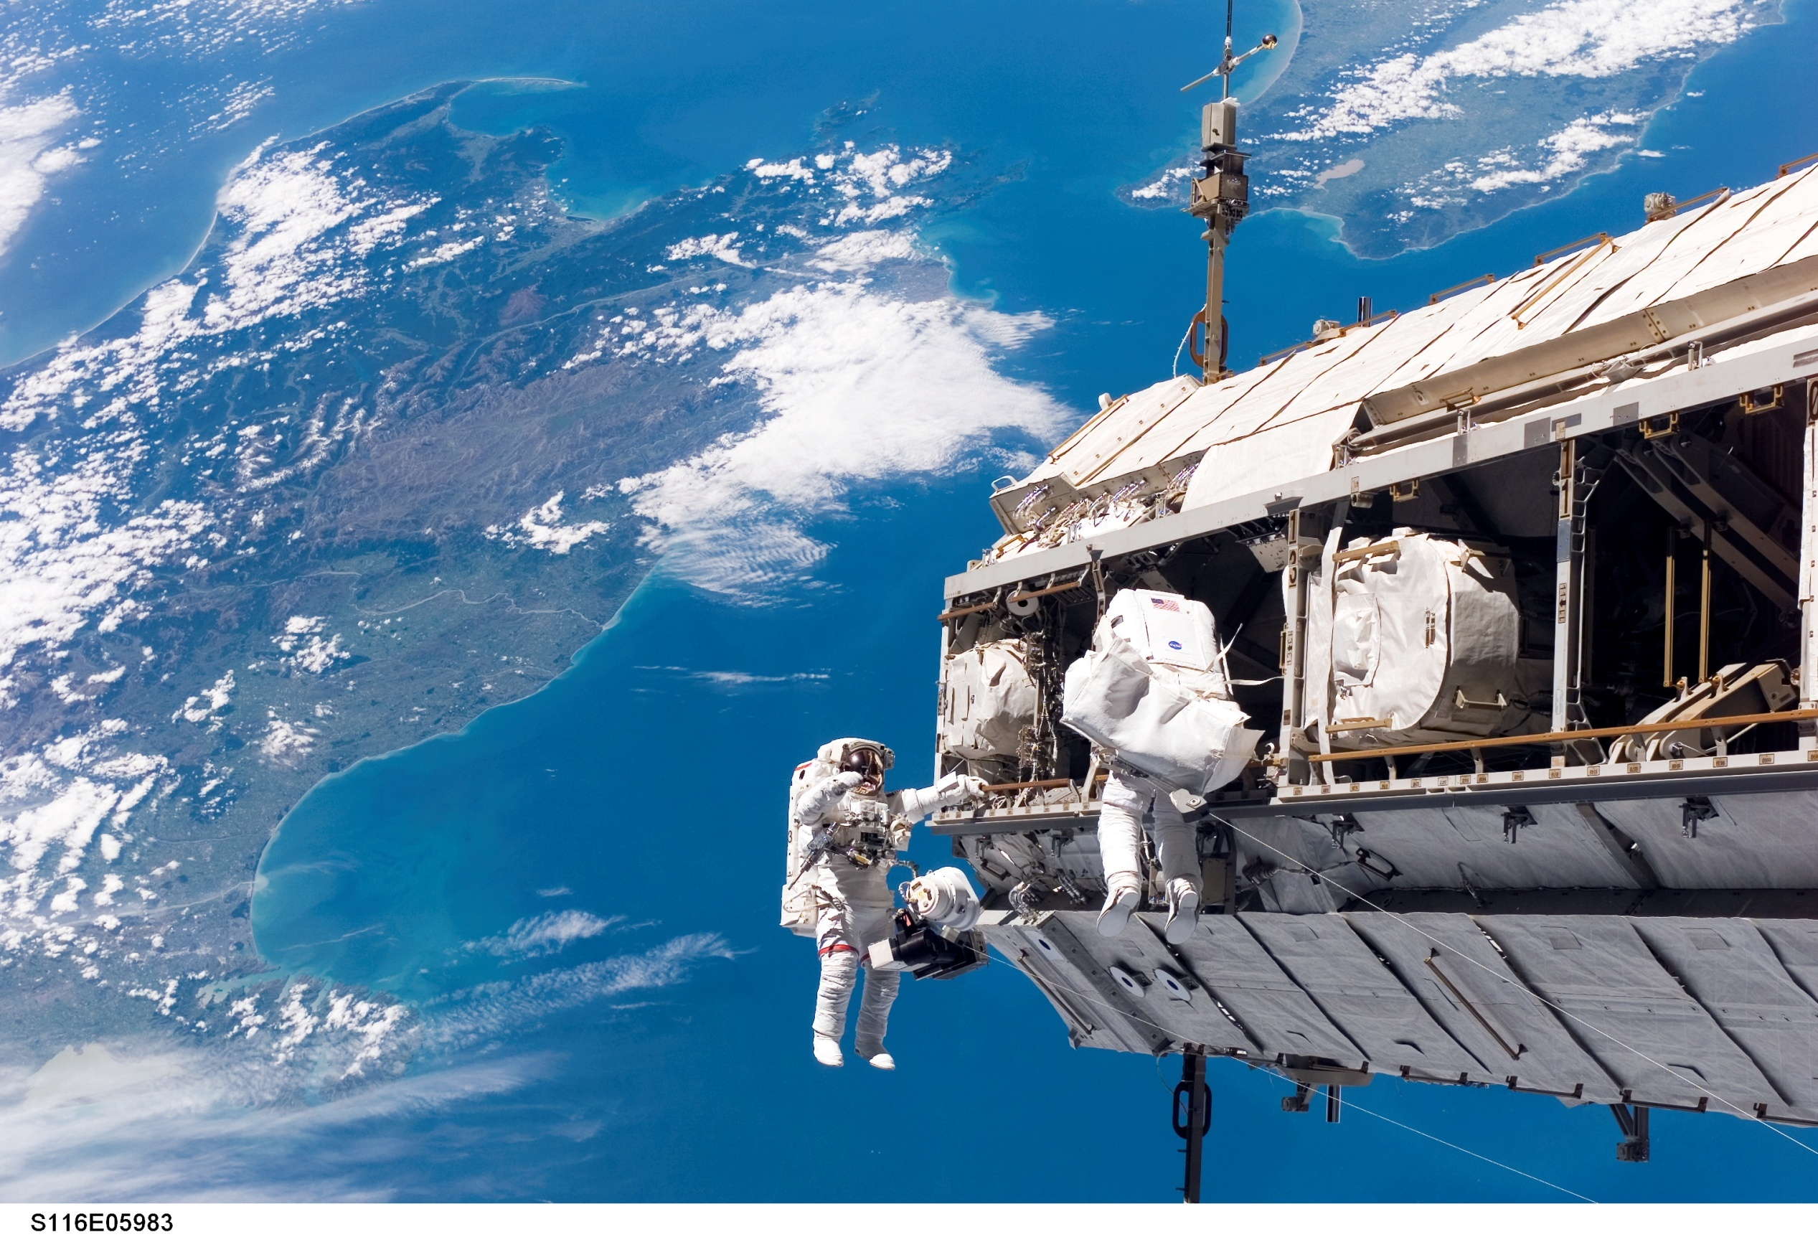
STS-116 Mission Dec 2006 - Port Truss
New Zealand and Cook Strait in the Pacific Ocean
Notes:
26
S116-E-05983 (12 Dec. 2006) --- Backdropped by New Zealand and Cook Strait in the Pacific Ocean, astronaut Robert L. Curbeam Jr. (left) and European Space Agency (ESA) astronaut Christer Fuglesang, both STS-116 mission specialists, participate in the mission's first of three planned sessions of extravehicular activity (EVA) as construction continues on the International Space Station. Cook Strait divides New Zealand's North and South Islands.

Slide 27
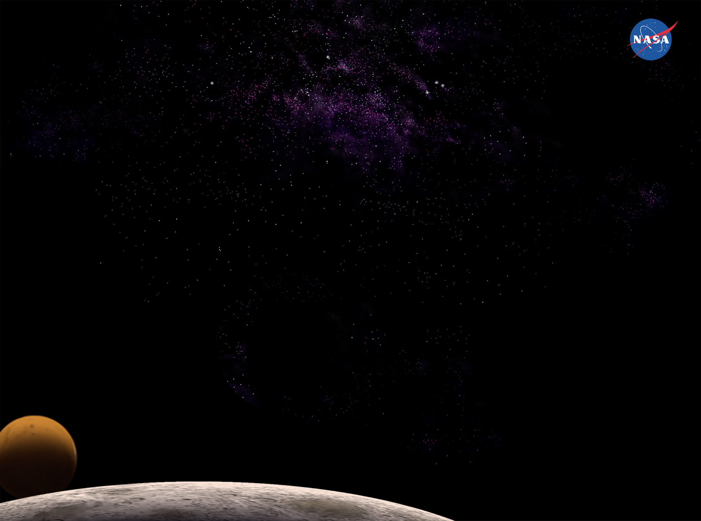
International Space Station

Slide 28
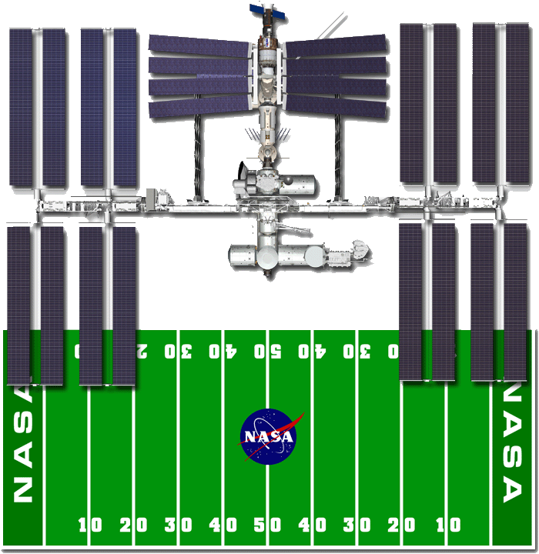
Overview & Capabilities
Wingspan End-to-End --
Operating Altitude --
Length --
Weight --
Inclination --
Volume --
Crew --
Atmosphere --
Speed --
361 feet
220 nautical mile average
199 feet
Approx. 750,000 pounds
51.6 degrees to the equator
Approx 25,000 cubic feet of
pressurized living
6 people on orbit today
14.7 pounds per square inch
(same as Earth)
17,500 mph orbiting the Earth 16
times a day
Notes:
Hauling the parts and pieces of the space station into orbit will require 45 space flights on three different types of launch vehicles over a five-year period. This unprecedented, complex orchestration of space flights will include the U.S. Space Shuttle and Russian Proton and Soyuz rockets.
The station will come with batteries included. It will have four U.S. photovoltaic modules, each with two arrays measuring 112 feet long by 39 feet wide. Each module generates about 23 kW. They rotate to face the sun, which provides maximum power to the station.
The solar array surface area is 27,000 square feet, or more than half an acre
The electric power system is connected with 42,000 feet, or about eight miles, of wire.
The batteries, lined up end-to-end, measure 2,900 feet, more than ½ mile long
Electrical and electronic parts include 1,900 different types of resistors, 500 types of capacitors and 150 types of transistors (note that this is not the part count; rather, it is a count of different types of hardware).
The station will have a Habitation Module for the crew as well as six scientific laboratories for research-a U.S. laboratory, the European Space Agency's Columbus Orbital Facility, a Japanese experiment module and three Russian research modules.
Fifty-two computers will control the systems on the International Space Station. There will be more than 400,000 lines of software for 16 of those computers which, in turn, talk to 2,000 sensors, effectors and embedded "smart" hardware controllers.
Two computers in the U.S. laboratory are dedicated to keeping the station in proper orientation (attitude) as it orbits the Earth once every 90 minutes.
The flight support software has 1.7 million lines of code
The 55-foot-long robot arm, built by the Canadian Space Agency, has a 125-ton payload capability and mobile transporter which can be positioned along the station's truss for robotic assembly and maintenance operations.

Slide 29







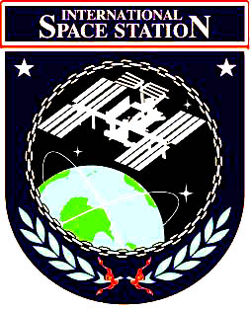











Belgium
Brazil
France
Spain
The Netherlands
Germany
Japan
Sweden
Denmark
Canada
Switzerland
Norway
Italy
Russia
United Kingdom
United States
Notes:
ISS is truly an International space collaboration effort, with the
participation of many countries:
United States - Science laboratory, Node1, Mating Adaptors
(PMA’s), All Truss Elements w/ Power Solar Panels & Thermal
Radiators, Airlock, Mobile Transport (MT)
Russia - Control & Service Modules, Docking Module, Research
Modules, Science Power Platform (SPP), Soyuz Spacecraft
Europe (ESA)
Node2 & Node3
Columbus (pressurized science module)
Cupola (observation window)
Italy (ASI)
Mini Pressurized Logistics Module’s (MPLM’s)
Japan (NASDA)
Pressurized Module (PM) & logistics carrier
Exposed Facility (EF) w/ robotics arm & logistics carrier
Centrifuge Element (CE)
Canada - ISS Robotics Arm and associated robotics systems
Brazil (status is currently TBD w/ details of participation)

Slide 30
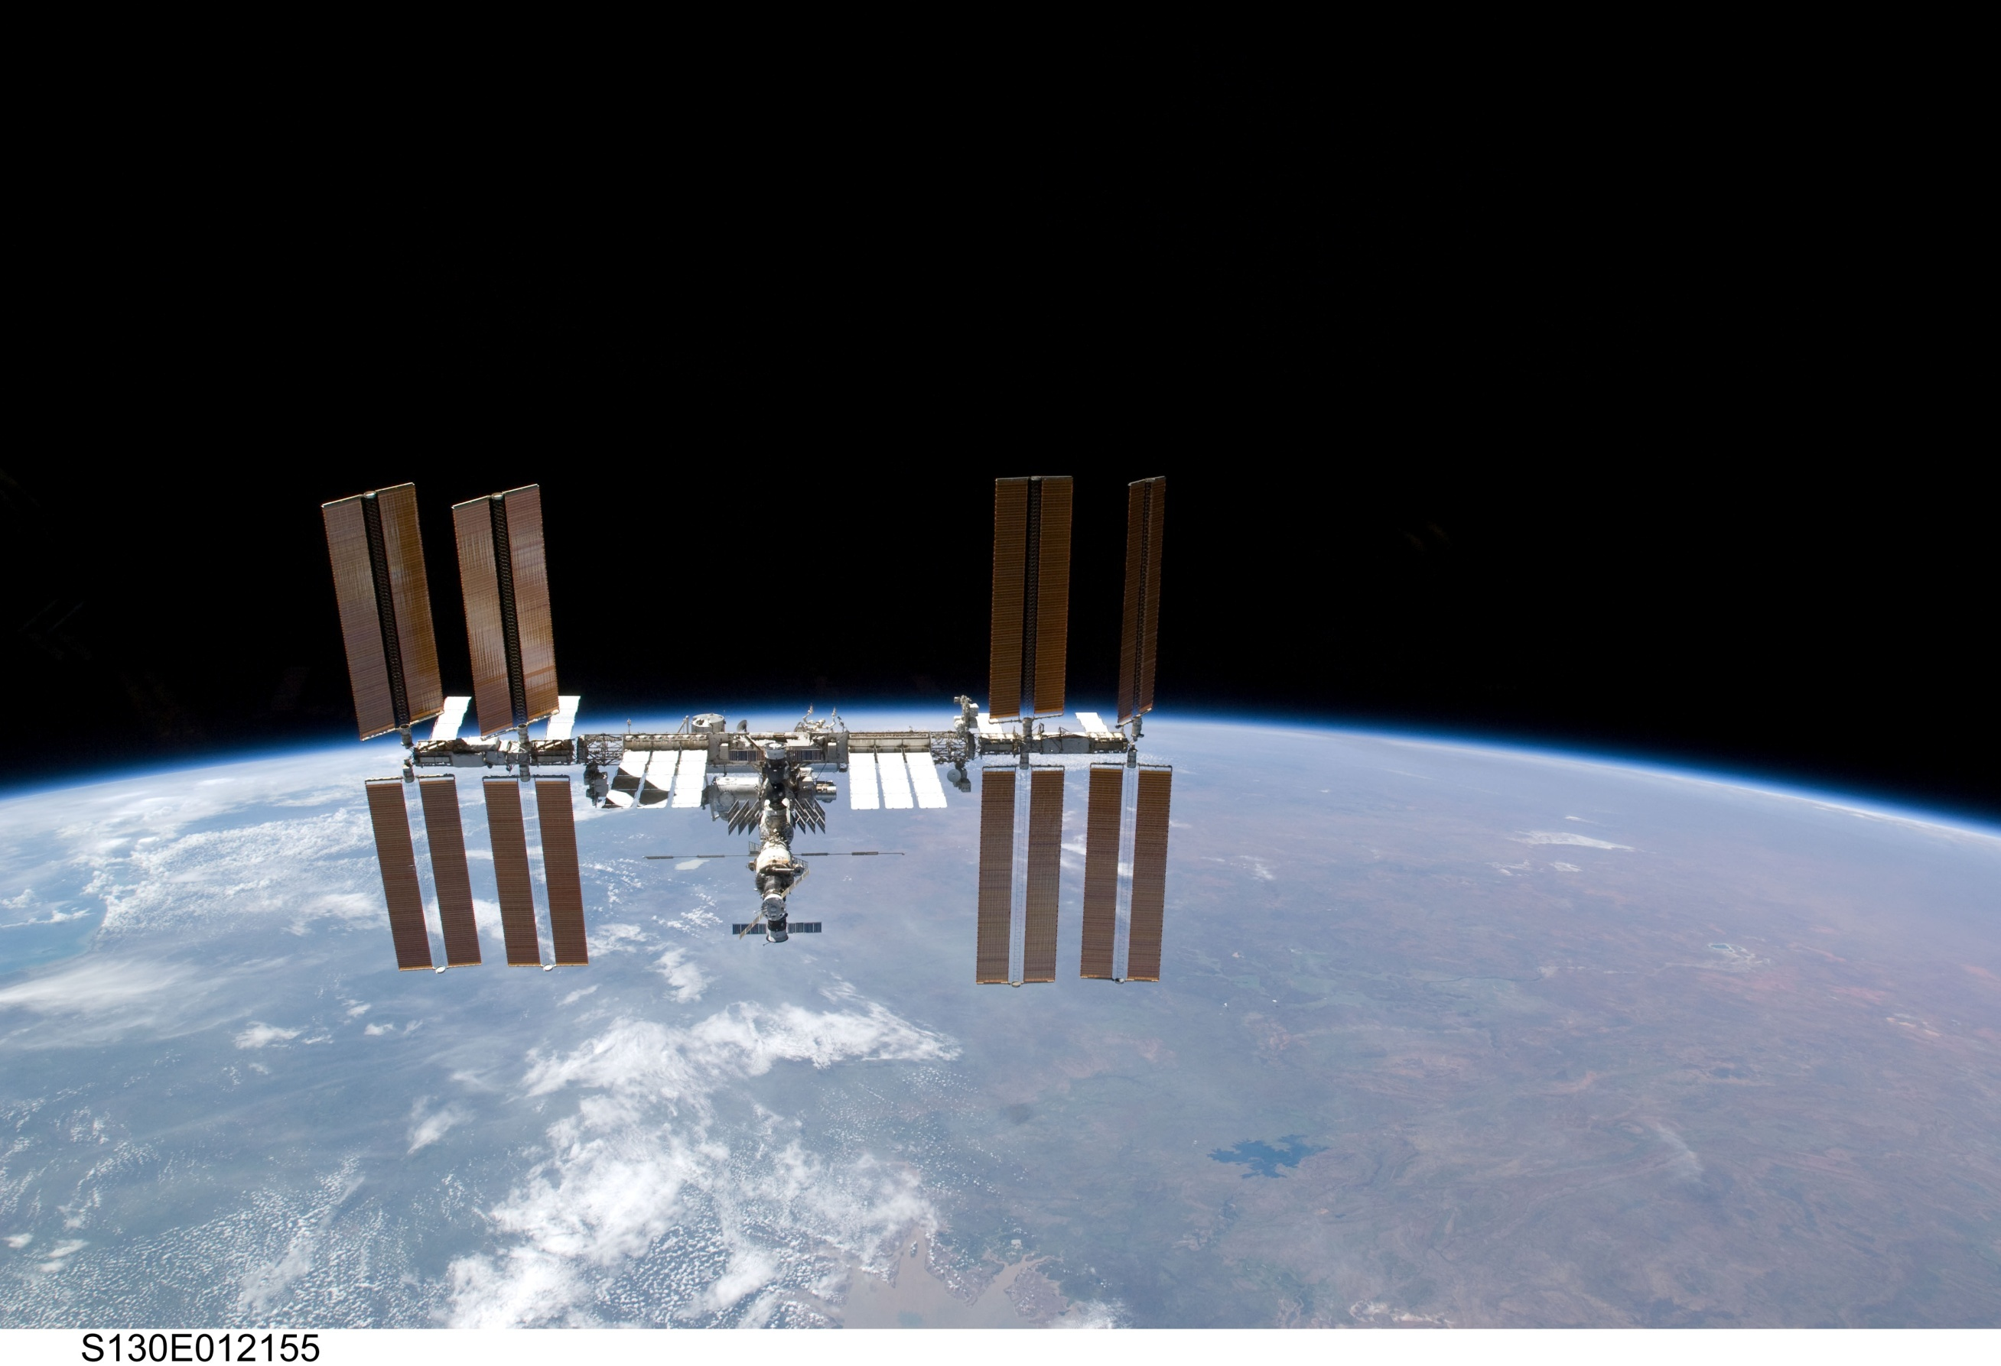
Notes:
30
Hauling the parts and pieces of the space station into orbit will require 45 space flights on three different types of launch vehicles over a five-year period. This unprecedented, complex orchestration of space flights will include the U.S. Space Shuttle and Russian Proton and Soyuz rockets.
The station will come with batteries included. It will have four U.S. photovoltaic modules, each with two arrays measuring 112 feet long by 39 feet wide. Each module generates about 23 kW. They rotate to face the sun, which provides maximum power to the station.
The solar array surface area is 27,000 square feet, or more than half an acre
The electric power system is connected with 42,000 feet, or about eight miles, of wire.
The batteries, lined up end-to-end, measure 2,900 feet, more than ½ mile long
Electrical and electronic parts include 1,900 different types of resistors, 500 types of capacitors and 150 types of transistors (note that this is not the part count; rather, it is a count of different types of hardware).
The station will have a Habitation Module for the crew as well as six scientific laboratories for research-a U.S. laboratory, the European Space Agency's Columbus Orbital Facility, a Japanese experiment module and three Russian research modules.
Fifty-two computers will control the systems on the International Space Station. There will be more than 400,000 lines of software for 16 of those computers which, in turn, talk to 2,000 sensors, effectors and embedded "smart" hardware controllers.
Two computers in the U.S. laboratory are dedicated to keeping the station in proper orientation (attitude) as it orbits the Earth once every 90 minutes.
The flight support software has 1.7 million lines of code
The 55-foot-long robot arm, built by the Canadian Space Agency, has a 125-ton payload capability and mobile transporter which can be positioned along the station's truss for robotic assembly and maintenance operations.

Slide 31
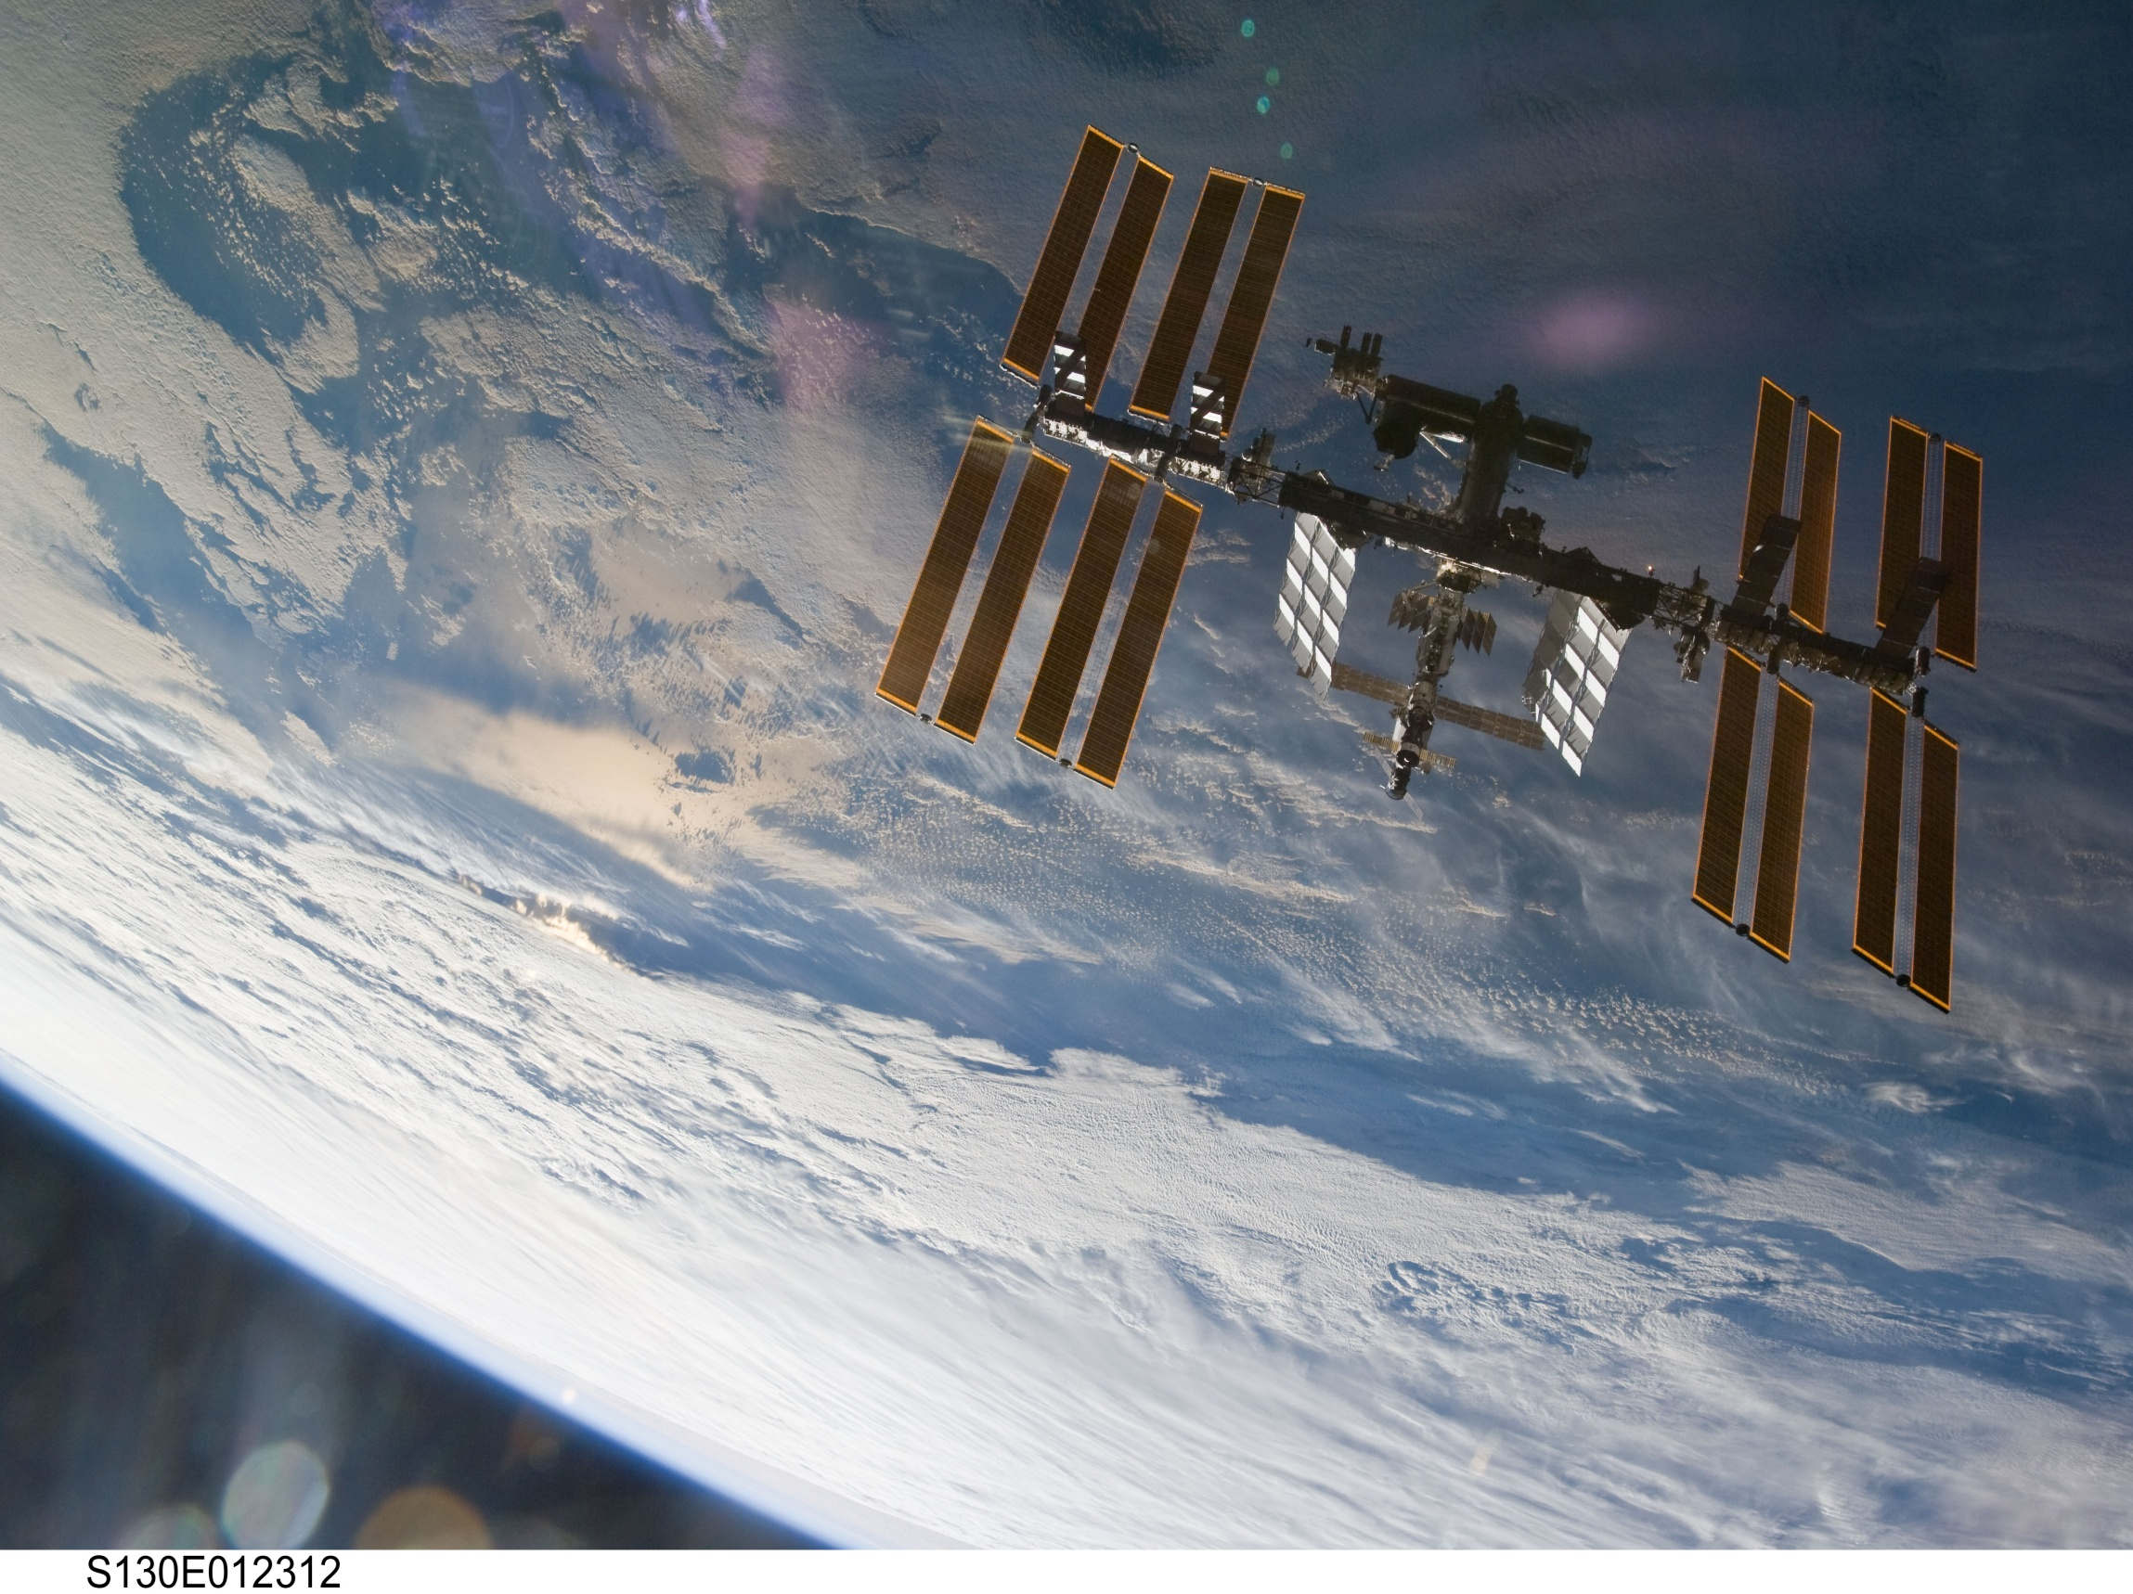
Notes:
31
Hauling the parts and pieces of the space station into orbit will require 45 space flights on three different types of launch vehicles over a five-year period. This unprecedented, complex orchestration of space flights will include the U.S. Space Shuttle and Russian Proton and Soyuz rockets.
The station will come with batteries included. It will have four U.S. photovoltaic modules, each with two arrays measuring 112 feet long by 39 feet wide. Each module generates about 23 kW. They rotate to face the sun, which provides maximum power to the station.
The solar array surface area is 27,000 square feet, or more than half an acre
The electric power system is connected with 42,000 feet, or about eight miles, of wire.
The batteries, lined up end-to-end, measure 2,900 feet, more than ½ mile long
Electrical and electronic parts include 1,900 different types of resistors, 500 types of capacitors and 150 types of transistors (note that this is not the part count; rather, it is a count of different types of hardware).
The station will have a Habitation Module for the crew as well as six scientific laboratories for research-a U.S. laboratory, the European Space Agency's Columbus Orbital Facility, a Japanese experiment module and three Russian research modules.
Fifty-two computers will control the systems on the International Space Station. There will be more than 400,000 lines of software for 16 of those computers which, in turn, talk to 2,000 sensors, effectors and embedded "smart" hardware controllers.
Two computers in the U.S. laboratory are dedicated to keeping the station in proper orientation (attitude) as it orbits the Earth once every 90 minutes.
The flight support software has 1.7 million lines of code
The 55-foot-long robot arm, built by the Canadian Space Agency, has a 125-ton payload capability and mobile transporter which can be positioned along the station's truss for robotic assembly and maintenance operations.

Slide 32
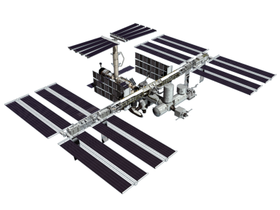





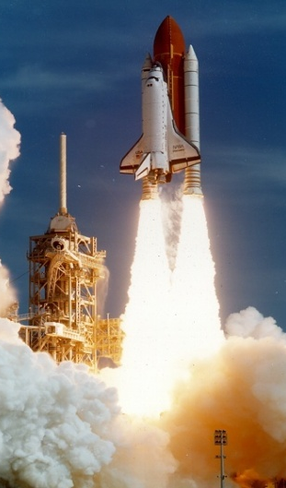
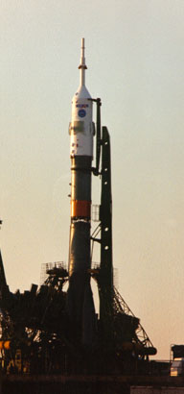
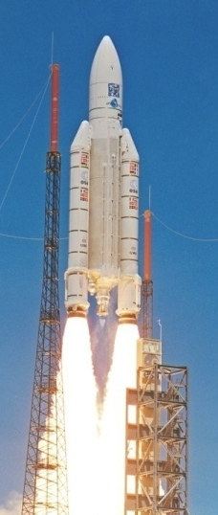
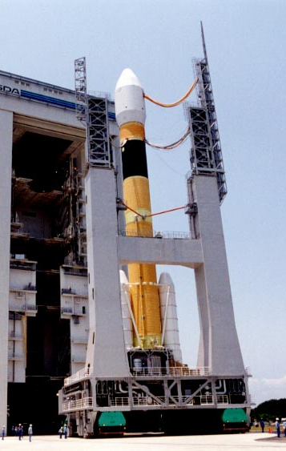
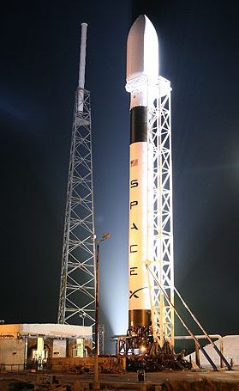

ISS Launch Vehicles
X
X
Shuttle
Soyuz
Ariane& ATV
HIIA & HTV
Falcon 9 & Dragon
Taurus II & Cygnus
12
8
Notes:
Overview and Capabilities: 90 Launches to Complete
In all, 90 space launches are needed to assembly the International Space
Station, through year 2010. Other major ISS elements will be launched
by the Russians using the Proton rocket (i.e. for their research modules),
and Europe and Japan plan to use the Ariane and HIIA rockets,
respectively, to bring their cargo vehicles to the station, in the future.

Slide 33
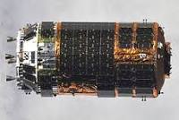
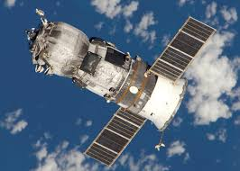
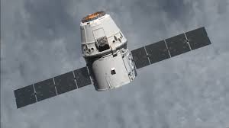
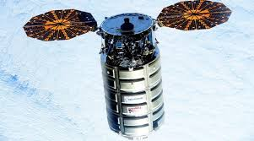
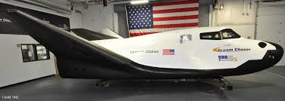
ISS Cargo Vehicles
JAXA HTV
Russian Progress
Cygnux
SpaceX Dragon
Orbital ATK Cygnus
Sierra Nevada Dream Chaser

Slide 34
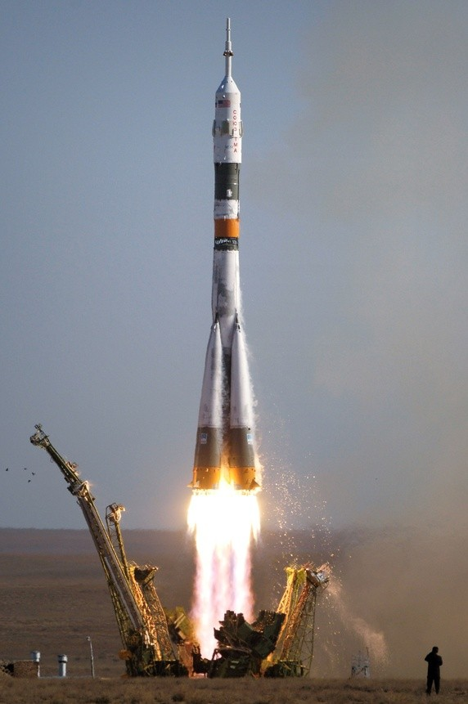
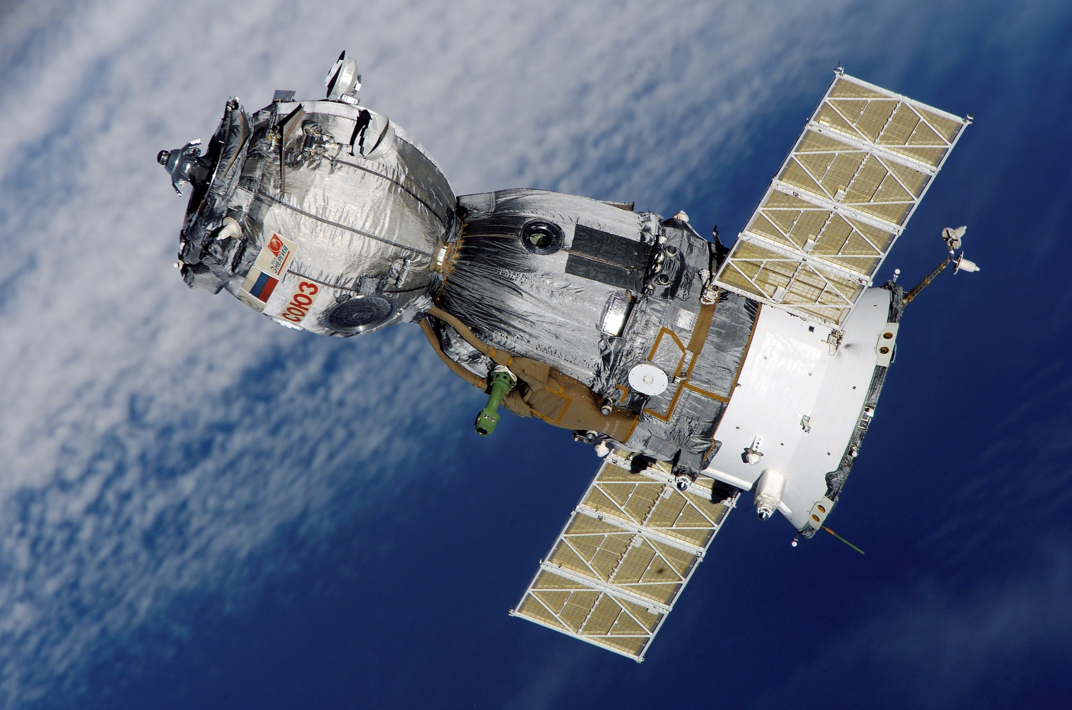
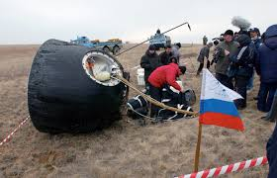
Crew To ISS Now
Currently all ISS crew travels to and from ISS aboard the Russian Soyuz vehicles
The Soyuz launches from Baikonur Cosmodrome in Kazakhstan and lands on land in Kazakhstan
The Soyuz carries three crew members to ISS

Slide 35
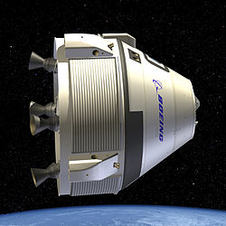
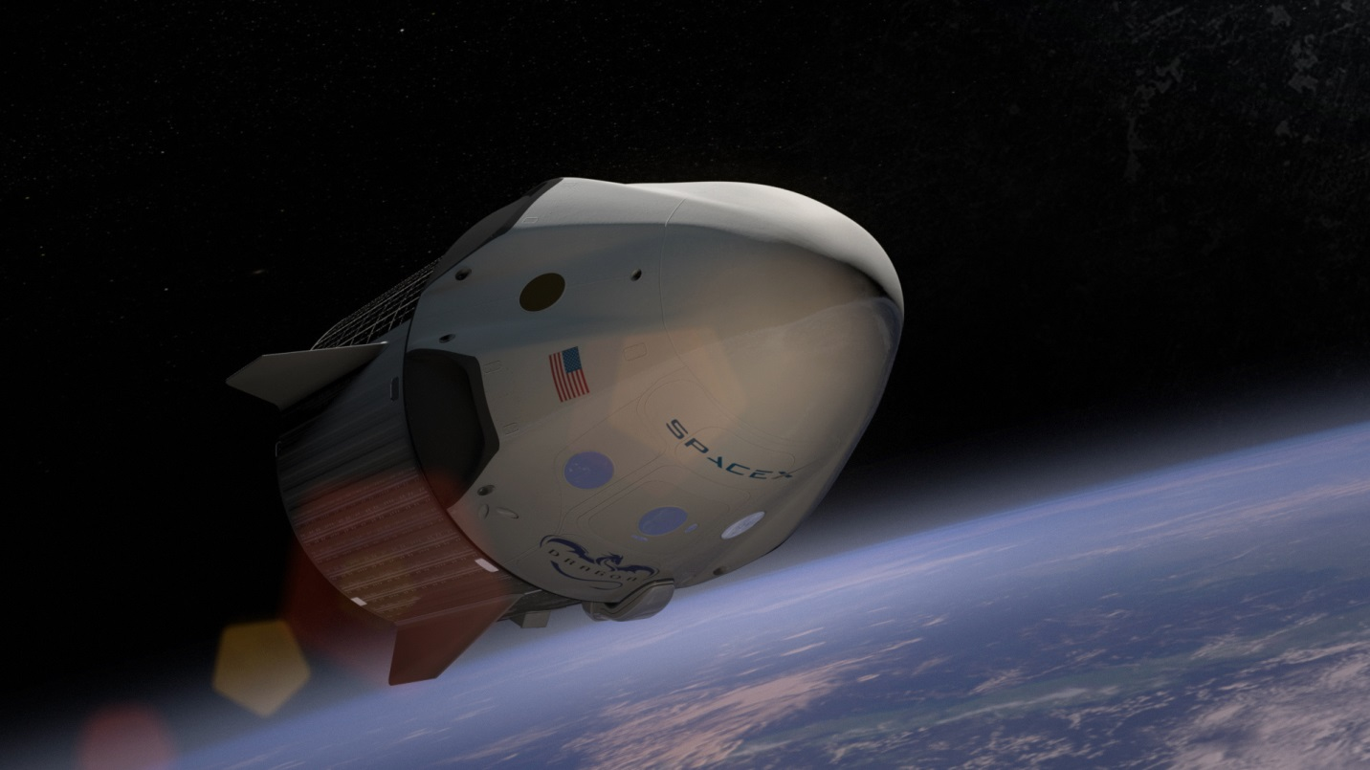
Crew to ISS Soon
UPDATE
Beginning in late 2017 along with the Soyuz launches we will begin sending crew to ISS from the US aboard two new commercial vehicles.
The Boeing CST-100 Starliner and SpaceX Dragon 2 will each launch from the Space Coast and will carry up to 4 crewmembers.
First flight for SpaceX to bring astronauts to the ISS was May 2020

Slide 36

Fires in the Everglades
Notes:
To Fly Free in Space
Credit: STS-41B, NASA
Explanation: At about 100 meters from the cargo bay of the space shuttle Challenger, Bruce McCandless II was further out than anyone had ever been before. Guided by a Manned Maneuvering Unit (MMU), astronaut McCandless, pictured above, was floating free in space. McCandless and fellow NASA astronaut Robert Stewart were the first to experience such an "untethered space walk" during Space Shuttle mission 41-B in 1984. The MMU works by shooting jets of nitrogen and has since been used to help deploy and retrieve satellites. With a mass over 140 kilograms, an MMU is heavy on Earth, but, like everything, is weightless when drifting in orbit. The MMU was replaced with the SAFER backpack propulsion unit.

Slide 37
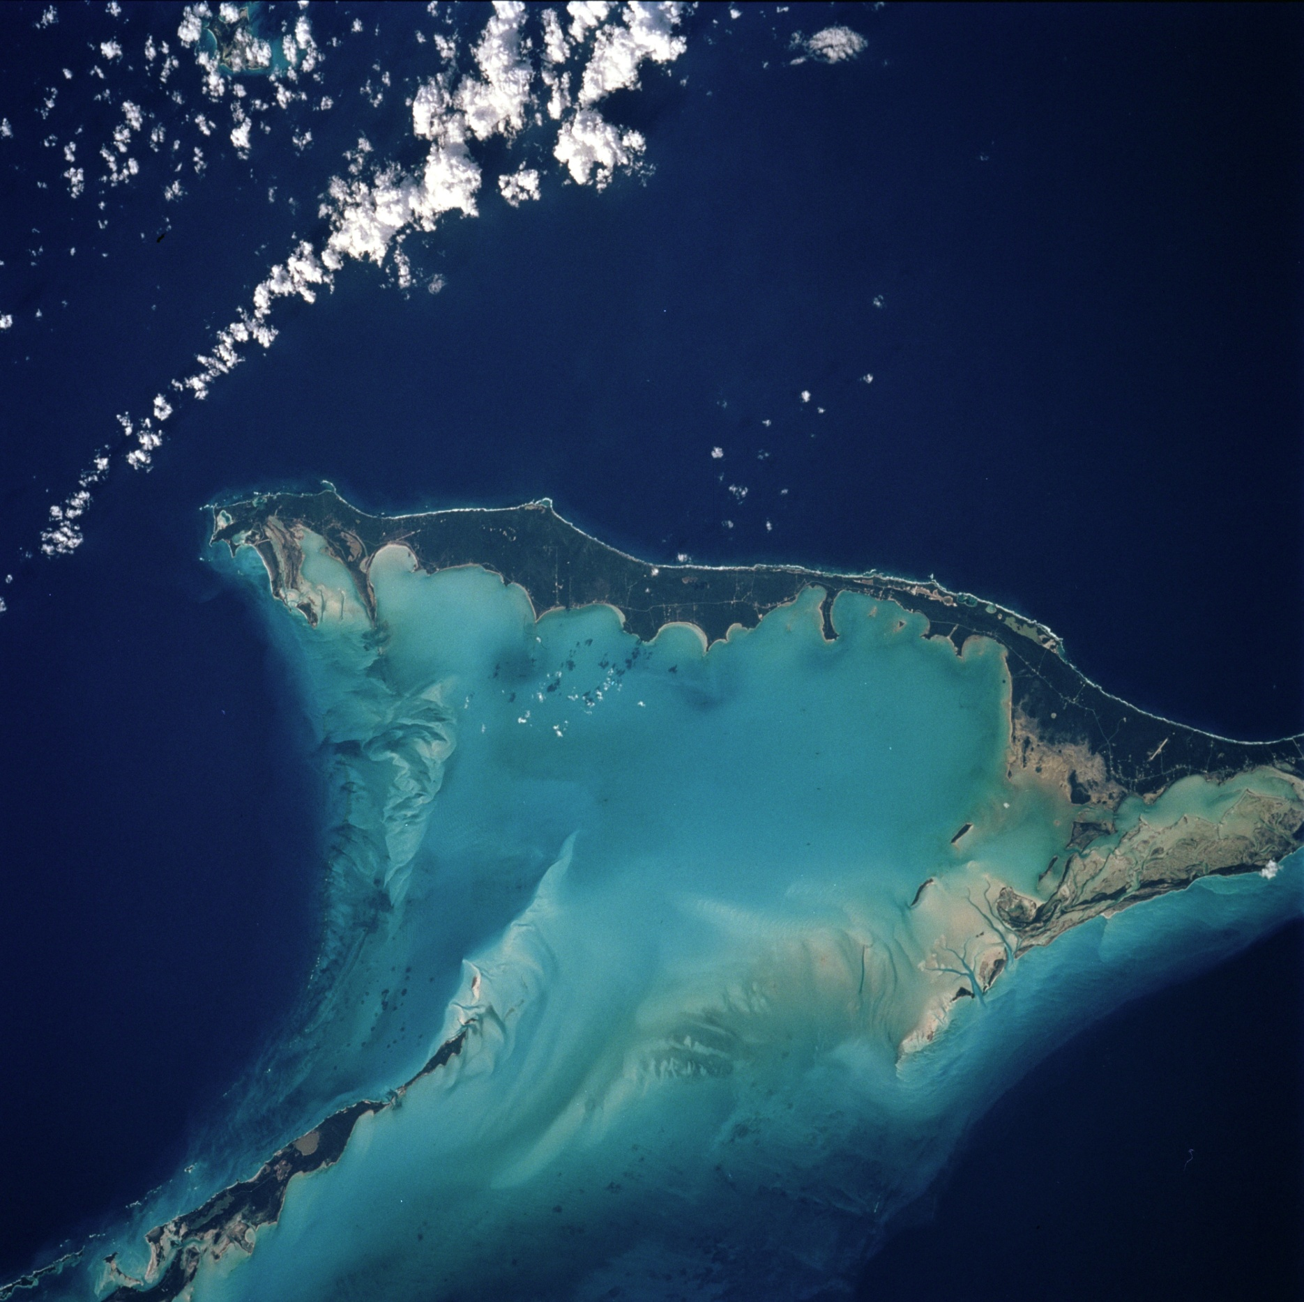
Northern half of Long Island, Bahamas
Notes:
37
STS083-712-063 (4-8 April 1997) --- Northern half of Long Island, Bahamas. The vivid blues of the Bahamas stand out from space. Long Island and Great Exuma Island, which extends from the west north west into the photo, is on the eastern side of the Great Bahama Bank and form the borders of Exuma Sound. This photograph provides a rare opportunity to observe a natural chemical laboratory at work. Limestone of quite a different sort from that forming the Great Barrier Reef is actually in the process of formation. Long Island itself is little more than a sandbar rising just a few meters (about 30 to 50 meters) above sea level but it separates the deep, dark blue waters of the Atlantic on the right from the 10-meter (33 feet) shallows of the Great Bahama Bank (left). Details of the topography of the bank are visible through the clear waters. The shallow waters are warm and become extremely salty. Crystals of aragonite, a calcium carbonate mineral, are precipitated and formed into spherical sand-sized oolites as the tidal currents swirl back and forth. Lithification of the carbonate sands produces an oolithic limestone. Although the water is warm and clear, corals do not live in the shallows, probably because of the elevated salt content. Although chemically similar, the oolithic limestone forming Long Island is very different from coral reef limestone. An airfield is visible at the northern and central (bottom of photo) part of the island.

Slide 38

Hurricane Frances
September 2004
Notes:
Quotes From Astronauts
For those who have seen the Earth from space, and for the hundreds and perhaps thousands more who will, the experience most certainly changes your perspective. The things that we share in our world are far more valuable than those which divide us.
- Donald Williams, USA My first view - a panorama of brilliant deep blue ocean, shot with shades of green and gray and white - was of atolls and clouds. Close to the window I could see that this Pacific scene in motion was rimmed by the great curved limb of the Earth. It had a thin halo of blue held close, and beyond, black space. I held my breath, but something was missing - I felt strangely unfulfilled. Here was a tremendous visual spectacle, but viewed in silence. There was no grand musical accompaniment; no triumphant, inspired sonata or symphony. Each one of us must write the music of this sphere for ourselves.
- Charles Walker, USA
Looking outward to the blackness of space, sprinkled with the glory of a universe of lights, I saw majesty - but no welcome. Below was a welcoming planet. There, contained in the thin, moving, incredibly fragile shell of the biosphere is everything that is dear to you, all the human drama and comedy. That's where life is; that's were all the good stuff is.
- Loren Acton, USA
The Earth was small, light blue, and so touchingly alone, our home that must be defended like a holy relic. The Earth was absolutely round. I believe I never knew what the word round meant until I saw Earth from space.
- Aleksei Leonov, USSR
The sun truly "comes up like thunder," and it sets just as fast. Each sunrise and sunset lasts only a few seconds. But in that time you see at least eight different bands of color come and go, from a brilliant red to the brightest and deepest blue. And you see sixteen sunrises and sixteen sunsets every day you're in space. No sunrise or sunset is ever the same.
- Joseph Allen, USA
The Earth reminded us of a Christmas tree ornament hanging in the blackness of space. As we got farther and farther away it diminished in size. Finally it shrank to the size of a marble, the most beautiful marble you can imagine. That beautiful, warm, living object looked so fragile, so delicate, that if you touched it with a finger it would crumble and fall apart. Seeing this has to change a man, has to make a man appreciate the creation of God and the love of God.
- James Irwin, USA
Suddenly, from behind the rim of the moon, in long, slow-motion moments of immense majesty, there emerges a sparkling blue and white jewel, a light, delicate sky-blue sphere laced with slowly swirling veils of white, rising gradually like a small pearl in a thick sea of black mystery. It takes more than a moment to fully realize this is Earth . . . home.
- Edgar Mitchell, USA
My view of our planet was a glimpse of divinity.
- Edgar Mitchell, USA
For the first time in my life I saw the horizon as a curved line. It was accentuated by a thin seam of dark blue light - our atmosphere. Obviously this was not the ocean of air I had been told it was so many times in my life. I was terrified by its fragile appearance.
- Ulf Merbold, Federal Republic of Germany
A Chinese tale tells of some men sent to harm a young girl who, upon seeing her beauty, become her protectors rather than her violators. That's how I felt seeing the Earth for the first time. "I could not help but love and cherish her.
- Taylor Wang, China/USA

Slide 39

Alaskan Volcano Erupts
Taken by ISS Expedition 13 Crew
May 25, 2006
Notes:
An Alaskan Volcano Erupts
Credit: J. N. Williams, International Space Station 13 Crew, NASA
Explanation: What is happening to that volcano? It's erupting! The first person to note that the Aleutian Cleveland Volcano was spewing ash was astronaut Jeffrey N. Williams aboard the International Space Station. Looking down on the Alaskan Aleutian Islands two weeks ago, Williams noted, photographed, and reported a spectacular ash plume emanating from the Cleveland Volcano. Starting just before this image was taken, the Cleveland Volcano underwent a short eruption lasting only about two hours. The Cleveland stratovolcano is one of the most active in the Aleutian Island chain. The volcano is fueled by magma displaced by the subduction of the northwest-moving tectonic Pacific Plate under the tectonic North America Plate.

Slide 40

Sunset on Orbit
Notes:
15 sun sets per day

Slide 41

Notes:
To Fly Free in Space
Credit: STS-41B, NASA
Explanation: At about 100 meters from the cargo bay of the space shuttle Challenger, Bruce McCandless II was further out than anyone had ever been before. Guided by a Manned Maneuvering Unit (MMU), astronaut McCandless, pictured above, was floating free in space. McCandless and fellow NASA astronaut Robert Stewart were the first to experience such an "untethered space walk" during Space Shuttle mission 41-B in 1984. The MMU works by shooting jets of nitrogen and has since been used to help deploy and retrieve satellites. With a mass over 140 kilograms, an MMU is heavy on Earth, but, like everything, is weightless when drifting in orbit. The MMU was replaced with the SAFER backpack propulsion unit.

Slide 42
WE ARE EXPLORERS!
Notes:
15 sun sets per day

Slide 43

MARS
Notes:
The largest canyon in the Solar System cuts a wide swath across the face of Mars. Named Valles Marineris, This "Grand Canyon" of Mars is about 2500 miles long and up to 4 miles deep. By comparison, the Earth's Grand Canyon is less than 500 miles long and 1 mile deep.

Slide 44


Mars Fact Sheet
Average Distance from Sun 142 million miles
Mass 0.107 Earth's mass
Diameter 4,222 miles (Earth =7,926 m)
Length of Day 24.6 Earth hours
Length of Year 687 Earth days
Surface Gravity 0.377 that of Earth (If you weigh 80 pounds, you would weigh about 30 pounds on Mars.)
Known Moons 2 Phobos & Deimos
Escape Velocity 11,229 mph (Earth is 25,022 mph)
Temperatures on Mars average about -67 degrees F. However, temperature's range from around -207 degrees F. in the wintertime at the poles, to +80 degrees F. over the lower latitudes in the summer. (Earth -129 to +136 F)

Slide 45



2003 Twin Mars Exploration Rovers
First microscopic view of Mars
Spirit Rover
Launch: May 30, 2003
Landing: January 4, 2004
Opportunity Rover
Launch: June 27, 2003
Landing: January 25, 2004
Notes:
Will learn about the climate on Mars and scout for regions where mineralogical evidence of water has been found.
The rover twins will determine the geologic record of the landing site, what the planet’s conditions were like when the Martian rocks and soils were formed, and help us learn about ancient water reservoirs.
The rover has a top speed on flat hard ground of 5 centimeters (2 inches) per second. However, in order to ensure a safe drive, the rover is equipped with hazard avoidance software that causes the rover to stop and reassess its location every few seconds. So, over time, the vehicle achieves an average speed of 1 centimeter per second. The rover is programmed to drive for roughly 10 seconds, then stop to observe and understand the terrain it has driven into for 20 seconds, before moving safely onward for another 10 seconds.
MER top speed traveling to Mars = 24,842 MPH !

Slide 46

Mars Exploration Rover at KSC
April 2003
Notes:
In the Payload Hazardous Servicing Facility, technicians reopen the lander petals of the Mars Exploration Rover 2 (MER-2) to allow access to one of the spacecraft's circuit boards. A concern arose during prelaunch testing regarding how the spacecraft interprets signals sent from its main computer to peripherals in the cruise stage, lander and small deep space transponder. The MER Mission consists of two identical rovers set to launch in June 2003. The problem will be fixed on both rovers.

Slide 47
Mars Exploration Rover Mission Profile Video
Notes:
Only three of humanity's nine landing attempts at the Red Planet have succeeded, said Ed Weiler, NASA's space science chief in Washington, D.C. prior to the Mars Rovers and Beagle failure
Mars Exploration Rovers (Spirit and Opportunity) only Opportunity is working. Mars Science Lab MSL named Curiosity
LAUNCH
Each Mars Exploration Rover will be launched on a Delta II launch vehicle from Cape Canaveral, Florida.
The Delta II stands about 100 feet tall and the rover is housed in a payload fairing that sits on top of the rocket. The first MER spacecraft launches in the daytime and the second one at night.
The Delta II engines produce more than 140,000 pounds of thrust to break the grip of Earth’s gravity.
Nine solid rocket boosters ring the Delta launch vehicle. Six are ignited at launch and then discarded after they use up their fuel. The remaining three boosters are ignited in mid-air.
After the first stage of the rocket stops firing, it is discarded. Then the second stage engine ignites.
The payload fairing separates and reveals the MER spacecraft.
Small rockets are fired to spin up the third stage. The spinning motion helps to stabilize the spacecraft, acting like a gyroscope.
A burn of the third stage pushes the spacecraft out of Earth orbit and on a trajectory to Mars
The spacecraft must be de-spun so that it can achieve its proper cruise orientation. A set of weights called “yo-yos” are released from the spinning vehicle on flexible lines. They slow the spin of the spacecraft in much the same way that an ice skater decreases the velocity of a spin by extending his or her arms
The MER spacecraft separates from the Delta's third stage and begins its seven-month journey to Mars.
ENTRY, DESCENT AND LANDING
The cruise stage carries the items necessary to support the vehicle on its long journey through space. As the spacecraft approaches Mars, this stage is no longer needed and separates from the spacecraft.
Each MER spacecraft will enter the Martian atmosphere in January of 2004. They will be protected by a heat shield as they plummet toward the planet's surface.
A supersonic parachute slows the spacecraft's descent.
The heat shield separates and the lander is lowered by a bridle.
During the descent, gas generators inflate a cluster of airbags around the lander in less than one second.
Rockets are fired to bring the lander to a near-stop above the Martian surface.
At less than 20 meters above the surface, the bridle is cut and the lander drops to the ground. The airbags cushion the impact.
After what could be many bounces, the lander will roll to a stop.
LANDED OPERATIONS
The airbags deflate and retract, the lander “petals” open, and the lander rights itself.
When the lander structure first opens, the rover is tightly folded.
A series of steps are involved in the deployment of the rover. They could take as many as several days to complete.
After deployment is complete, scientists and engineers can begin to command the rover
They use the Pancam camera to get a color panoramic view of the rover’s surroundings. An instrument called Mini-TES also uses the rover’s mast to view the Martian surface in the infrared. Both instruments help scientists decide which rocks should be studied more closely.
Once a rock target is selected, the rover is sent a command to travel to that target.
The rover is programmed to avoid hazards. It knows enough to go around any rock that is larger than the size of its wheels.
When the rover reaches a rock target, its arm is deployed. The arm of the rover has three science instruments and a Rock Abrasion Tool (RAT). In this simulation, the RAT grinds into a rock to reveal a fresh surface for study.
The Microscopic Imager offers a close-up view of the exposed rock.
Not shown in the video are two other science instruments on the arm of the rover. They are APXS or Alpha-Particle-X-ray Spectrometer, and the Mössbauer Spectrometer. The APXS reads the elemental make-up of rocks; the Mössbauer detects iron-bearing minerals.
Information gathered from all six instruments will be used to understand how Mars evolved geologically. Scientists will investigate the role water may have played in the planet’s past and try to determine how suitable the conditions would have been for life.
Because the Martian atmosphere is only about 1% as dense as that on Earth, the parachute assembly does not slow the craft down enough to permit a safe landing. For this reason, a technique known as Rocket Assisted Descent (RAD) is used.
The Rover is secured in the Lander with special bolts, which contain explosive charges to unshackle it from its storage position. The Rover will then roll down specially built ramps on the petals, which protect it from getting tangled up in the remains of the airbags, or falling and being damaged.
Data taken by Spirit during descent indicates that the rover bounced 28 times, and almost a half mile
The rovers were designed to last for 90 days on the Martian surface.
Toward the end of the surface phase for both missions, both power and telecom capabilities will be decreasing, as the Earth and the Sun become more distant from Mars, dust falls on the solar panels, the batteries lose capacity, and the Sun moves further North past the landing site latitude.
The rovers are about the size of a golf cart. Each vehicle has a mass of 170 kilograms. Each weighs 375 pounds on Earth. Since the gravity on Mars is weaker, each rover weighs just 140 pounds on Mars
The rovers aren't very fast. The rover has a top speed on flat hard ground of 5 centimeters (2 inches) per second. However, in order to ensure a safe drive, the rover is equipped with hazard avoidance software that causes the rover to stop and reassess its location every few seconds. So, over time, the vehicle achieves an average speed of 1 centimeter per second. The rover is programmed to drive for roughly 10 seconds, then stop to observe and understand the terrain it has driven into for 20 seconds, before moving safely onward for another 10 seconds.
3 years to design, build, and test
Arrival on Mars – from about 12,000 mph to 0 in about 6 minutes
Two spectacular landings on each side of the planet
Two rovers still going strong
Spirit navigation accuracy – after a flight of 303 million miles – landed about 6 miles from center of the target
Height of Spirit’s first bounce – 27.6 feet
Spirit has travel close to three miles since landing
Opportunity navigation accuracy – after a flight of 283 million miles – landed about 16 miles from center of the target
Number of hits to NASA Mars sites as of January 1 2004 – 9.1 Billion
Number of images returned over 32,000 from Spirit and about the same number from Opportunity (as of Dec 21 2004)
Days before sprit landed there was a global dust storm that hit mars
Worst solar flare event ever recorded in human history hit the vehicles
Spirit has been on Mars 680 Martian days – As of December 1, 2005
As of Sol 679 (November 30, 2005) Sprite has driven 5,463 meters (3.39 miles)
Opportunity has been on Mars 660 Martian days As of December 1, 2005
As of Sol 659 (November 30, 2005) Opportunity has driven 6,502 meters (4.04 miles)
Atmospheric friction in the next four minutes cut that speed by 90 percent, then a parachute fastened to the backshell portion of the aeroshell opened about two minutes before landing.
About 20 seconds later, the spacecraft jettisoned the heat shield. The lander descended on a bridle that unspooled from the backshell. A downward-pointing camera on the lander took three pictures during the final half-minute of the flight. An onboard computer instantly analyzed the pictures to estimate horizontal motion. In the final eight seconds before impact, gas generators inflated the lander’s airbags, retro rockets on the backshell fired to halt descent speed, and transverse rockets fired (on Spirit’s lander) to reduce horizontal speed. The bridle was cut to release the lander from the backshell and parachute. Then the airbagencased lander dropped in free fall.
It bounced about 8.4 meters (27.6 feet) high. After 27 more bounces and then rolling, it came to a stop about 250 to 300 meters (270 to 330 yards) from its first impact.
Opportunity landed on Jan. 25, Universal Time (at 9:05 p.m. Jan. 24, Pacific Standard Time). It traveled about 200 meters (220 yards) while bouncing 26 times and rolling after the impact, with a 90-degree turn northward during that period. It came to rest inside a small crater. One scientist called the landing an interplanetary hole in one.”
The names of the rovers, Spirit and Opportunity, were selected in a student essay contest that drew nearly 10,000 entries.
Cost: Approximately $820 million total, consisting approximately of $645 million spacecraft development and science instruments; $100 million launch; $75 million mission operations and science processing

Slide 48

Notes:
Top speed traveling to Mars approx 25,000 MPH.
Because the Martian atmosphere is only about 1% as dense as that on Earth, the parachute assembly does not slow the craft down enough to permit a safe landing. For this reason, a technique known as Rocket Assisted Descent (RAD) is used.
The Rover is secured in the Lander with special bolts, which contain explosive charges to unshackle it from its storage position. The Rover will then roll down specially built ramps on the petals, which protect it from getting tangled up in the remains of the airbags, or falling and being damaged.
Data taken by Spirit during descent indicates that the rover bounced 28 times, and almost a half mile
The rovers were designed to last for 90 days on the Martian surface.
Toward the end of the surface phase for both missions, both power and telecom capabilities will be decreasing, as the Earth and the Sun become more distant from Mars, dust falls on the solar panels, the batteries lose capacity, and the Sun moves further North past the landing site latitude.
The rovers are about the size of a golf cart. Each vehicle has a mass of 170 kilograms. Each weighs 375 pounds on Earth. Since the gravity on Mars is weaker, each rover weighs just 140 pounds on Mars
The rovers aren't very fast. The rover has a top speed on flat hard ground of 5 centimeters (2 inches) per second. However, in order to ensure a safe drive, the rover is equipped with hazard avoidance software that causes the rover to stop and reassess its location every few seconds. So, over time, the vehicle achieves an average speed of 1 centimeter per second. The rover is programmed to drive for roughly 10 seconds, then stop to observe and understand the terrain it has driven into for 20 seconds, before moving safely onward for another 10 seconds.
3 years to design, build, and test
Arrival on Mars – from about 12,000 mph to 0 in about 6 minutes
Two spectacular landings on each side of the planet
Two rovers still going strong
Spirit navigation accuracy – after a flight of 303 million miles – landed about 6 miles from center of the target
Height of Spirit’s first bounce – 27.6 feet
Spirit has travel close to three miles since landing
Opportunity navigation accuracy – after a flight of 283 million miles – landed about 16 miles from center of the target
Number of hits to NASA Mars sites as of January 1 2004 – 9.1 Billion
Number of images returned over 32,000 from Spirit and about the same number from Opportunity (as of Dec 21 2004)
Days before sprit landed there was a global dust storm that hit mars
Worst solar flare event ever recorded in human history hit the vehicles
Spirit has been on Mars 680 Martian days – As of December 1, 2005
As of Sol 679 (November 30, 2005) Sprite has driven 5,463 meters (3.39 miles)
Opportunity has been on Mars 660 Martian days As of December 1, 2005
As of Sol 659 (November 30, 2005) Opportunity has driven 6,502 meters (4.04 miles)
Atmospheric friction in the next four minutes cut that speed by 90 percent, then a parachute fastened to the backshell portion of the aeroshell opened about two minutes before landing.
About 20 seconds later, the spacecraft jettisoned the heat shield. The lander descended on a bridle that unspooled from the backshell. A downward-pointing camera on the lander took three pictures during the final half-minute of the flight. An onboard computer instantly analyzed the pictures to estimate horizontal motion. In the final eight seconds before impact, gas generators inflated the lander’s airbags, retro rockets on the backshell fired to halt descent speed, and transverse rockets fired (on Spirit’s lander) to reduce horizontal speed. The bridle was cut to release the lander from the backshell and parachute. Then the airbagencased lander dropped in free fall.
It bounced about 8.4 meters (27.6 feet) high. After 27 more bounces and then rolling, it came to a stop about 250 to 300 meters (270 to 330 yards) from its first impact.
Opportunity landed on Jan. 25, Universal Time (at 9:05 p.m. Jan. 24, Pacific Standard Time). It traveled about 200 meters (220 yards) while bouncing 26 times and rolling after the impact, with a 90-degree turn northward during that period. It came to rest inside a small crater. One scientist called the landing an interplanetary hole in one.”
The names of the rovers, Spirit and Opportunity, were selected in a student essay contest that drew nearly 10,000 entries.
Cost: Approximately $820 million total, consisting approximately of $645 million spacecraft development and science instruments; $100 million launch; $75 million mission operations and science processing
Video Narration:
LAUNCH
Each Mars Exploration Rover will be launched on a Delta II launch vehicle from Cape Canaveral, Florida.
The Delta II stands about 100 feet tall and the rover is housed in a payload fairing that sits on top of the rocket. The first MER spacecraft launches in the daytime and the second one at night.
The Delta II engines produce more than 140,000 pounds of thrust to break the grip of Earth’s gravity.
Nine solid rocket boosters ring the Delta launch vehicle. Six are ignited at launch and then discarded after they use up their fuel. The remaining three boosters are ignited in mid-air.
After the first stage of the rocket stops firing, it is discarded. Then the second stage engine ignites.
The payload fairing separates and reveals the MER spacecraft.
Small rockets are fired to spin up the third stage. The spinning motion helps to stabilize the spacecraft, acting like a gyroscope.
A burn of the third stage pushes the spacecraft out of Earth orbit and on a trajectory to Mars
The spacecraft must be de-spun so that it can achieve its proper cruise orientation. A set of weights called “yo-yos” are released from the spinning vehicle on flexible lines. They slow the spin of the spacecraft in much the same way that an ice skater decreases the velocity of a spin by extending his or her arms
The MER spacecraft separates from the Delta's third stage and begins its seven-month journey to Mars.
ENTRY, DESCENT AND LANDING
The cruise stage carries the items necessary to support the vehicle on its long journey through space. As the spacecraft approaches Mars, this stage is no longer needed and separates from the spacecraft.
Each MER spacecraft will enter the Martian atmosphere in January of 2004. They will be protected by a heat shield as they plummet toward the planet's surface.
A supersonic parachute slows the spacecraft's descent.
The heat shield separates and the lander is lowered by a bridle.
During the descent, gas generators inflate a cluster of airbags around the lander in less than one second.
Rockets are fired to bring the lander to a near-stop above the Martian surface.
At less than 20 meters above the surface, the bridle is cut and the lander drops to the ground. The airbags cushion the impact.
After what could be many bounces, the lander will roll to a stop.
LANDED OPERATIONS
The airbags deflate and retract, the lander “petals” open, and the lander rights itself.
When the lander structure first opens, the rover is tightly folded.
A series of steps are involved in the deployment of the rover. They could take as many as several days to complete.
After deployment is complete, scientists and engineers can begin to command the rover
They use the Pancam camera to get a color panoramic view of the rover’s surroundings. An instrument called Mini-TES also uses the rover’s mast to view the Martian surface in the infrared. Both instruments help scientists decide which rocks should be studied more closely.
Once a rock target is selected, the rover is sent a command to travel to that target.
The rover is programmed to avoid hazards. It knows enough to go around any rock that is larger than the size of its wheels.
When the rover reaches a rock target, its arm is deployed. The arm of the rover has three science instruments and a Rock Abrasion Tool (RAT). In this simulation, the RAT grinds into a rock to reveal a fresh surface for study.
The Microscopic Imager offers a close-up view of the exposed rock.
Not shown in the video are two other science instruments on the arm of the rover. They are APXS or Alpha-Particle-X-ray Spectrometer, and the Mössbauer Spectrometer. The APXS reads the elemental make-up of rocks; the Mössbauer detects iron-bearing minerals.
Information gathered from all six instruments will be used to understand how Mars evolved geologically. Scientists will investigate the role water may have played in the planet’s past and try to determine how suitable the conditions would have been for life.

Slide 49

Notes:
Top speed traveling to Mars approx 25,000 MPH.
Because the Martian atmosphere is only about 1% as dense as that on Earth, the parachute assembly does not slow the craft down enough to permit a safe landing. For this reason, a technique known as Rocket Assisted Descent (RAD) is used.
The Rover is secured in the Lander with special bolts, which contain explosive charges to unshackle it from its storage position. The Rover will then roll down specially built ramps on the petals, which protect it from getting tangled up in the remains of the airbags, or falling and being damaged.
Data taken by Spirit during descent indicates that the rover bounced 28 times, and almost a half mile
The rovers were designed to last for 90 days on the Martian surface.
Toward the end of the surface phase for both missions, both power and telecom capabilities will be decreasing, as the Earth and the Sun become more distant from Mars, dust falls on the solar panels, the batteries lose capacity, and the Sun moves further North past the landing site latitude.
The rovers are about the size of a golf cart. Each vehicle has a mass of 170 kilograms. Each weighs 375 pounds on Earth. Since the gravity on Mars is weaker, each rover weighs just 140 pounds on Mars
The rovers aren't very fast. The rover has a top speed on flat hard ground of 5 centimeters (2 inches) per second. However, in order to ensure a safe drive, the rover is equipped with hazard avoidance software that causes the rover to stop and reassess its location every few seconds. So, over time, the vehicle achieves an average speed of 1 centimeter per second. The rover is programmed to drive for roughly 10 seconds, then stop to observe and understand the terrain it has driven into for 20 seconds, before moving safely onward for another 10 seconds.
3 years to design, build, and test
Arrival on Mars – from about 12,000 mph to 0 in about 6 minutes
Two spectacular landings on each side of the planet
Two rovers still going strong
Spirit navigation accuracy – after a flight of 303 million miles – landed about 6 miles from center of the target
Height of Spirit’s first bounce – 27.6 feet
Spirit has travel close to three miles since landing
Opportunity navigation accuracy – after a flight of 283 million miles – landed about 16 miles from center of the target
Number of hits to NASA Mars sites as of January 1 2004 – 9.1 Billion
Number of images returned over 32,000 from Spirit and about the same number from Opportunity (as of Dec 21 2004)
Days before sprit landed there was a global dust storm that hit mars
Worst solar flare event ever recorded in human history hit the vehicles
Spirit has been on Mars 680 Martian days – As of December 1, 2005
As of Sol 679 (November 30, 2005) Sprite has driven 5,463 meters (3.39 miles)
Opportunity has been on Mars 660 Martian days As of December 1, 2005
As of Sol 659 (November 30, 2005) Opportunity has driven 6,502 meters (4.04 miles)
Atmospheric friction in the next four minutes cut that speed by 90 percent, then a parachute fastened to the backshell portion of the aeroshell opened about two minutes before landing.
About 20 seconds later, the spacecraft jettisoned the heat shield. The lander descended on a bridle that unspooled from the backshell. A downward-pointing camera on the lander took three pictures during the final half-minute of the flight. An onboard computer instantly analyzed the pictures to estimate horizontal motion. In the final eight seconds before impact, gas generators inflated the lander’s airbags, retro rockets on the backshell fired to halt descent speed, and transverse rockets fired (on Spirit’s lander) to reduce horizontal speed. The bridle was cut to release the lander from the backshell and parachute. Then the airbagencased lander dropped in free fall.
It bounced about 8.4 meters (27.6 feet) high. After 27 more bounces and then rolling, it came to a stop about 250 to 300 meters (270 to 330 yards) from its first impact.
Opportunity landed on Jan. 25, Universal Time (at 9:05 p.m. Jan. 24, Pacific Standard Time). It traveled about 200 meters (220 yards) while bouncing 26 times and rolling after the impact, with a 90-degree turn northward during that period. It came to rest inside a small crater. One scientist called the landing an interplanetary hole in one.”
The names of the rovers, Spirit and Opportunity, were selected in a student essay contest that drew nearly 10,000 entries.
Cost: Approximately $820 million total, consisting approximately of $645 million spacecraft development and science instruments; $100 million launch; $75 million mission operations and science processing
Video Narration:
LAUNCH
Each Mars Exploration Rover will be launched on a Delta II launch vehicle from Cape Canaveral, Florida.
The Delta II stands about 100 feet tall and the rover is housed in a payload fairing that sits on top of the rocket. The first MER spacecraft launches in the daytime and the second one at night.
The Delta II engines produce more than 140,000 pounds of thrust to break the grip of Earth’s gravity.
Nine solid rocket boosters ring the Delta launch vehicle. Six are ignited at launch and then discarded after they use up their fuel. The remaining three boosters are ignited in mid-air.
After the first stage of the rocket stops firing, it is discarded. Then the second stage engine ignites.
The payload fairing separates and reveals the MER spacecraft.
Small rockets are fired to spin up the third stage. The spinning motion helps to stabilize the spacecraft, acting like a gyroscope.
A burn of the third stage pushes the spacecraft out of Earth orbit and on a trajectory to Mars
The spacecraft must be de-spun so that it can achieve its proper cruise orientation. A set of weights called “yo-yos” are released from the spinning vehicle on flexible lines. They slow the spin of the spacecraft in much the same way that an ice skater decreases the velocity of a spin by extending his or her arms
The MER spacecraft separates from the Delta's third stage and begins its seven-month journey to Mars.
ENTRY, DESCENT AND LANDING
The cruise stage carries the items necessary to support the vehicle on its long journey through space. As the spacecraft approaches Mars, this stage is no longer needed and separates from the spacecraft.
Each MER spacecraft will enter the Martian atmosphere in January of 2004. They will be protected by a heat shield as they plummet toward the planet's surface.
A supersonic parachute slows the spacecraft's descent.
The heat shield separates and the lander is lowered by a bridle.
During the descent, gas generators inflate a cluster of airbags around the lander in less than one second.
Rockets are fired to bring the lander to a near-stop above the Martian surface.
At less than 20 meters above the surface, the bridle is cut and the lander drops to the ground. The airbags cushion the impact.
After what could be many bounces, the lander will roll to a stop.
LANDED OPERATIONS
The airbags deflate and retract, the lander “petals” open, and the lander rights itself.
When the lander structure first opens, the rover is tightly folded.
A series of steps are involved in the deployment of the rover. They could take as many as several days to complete.
After deployment is complete, scientists and engineers can begin to command the rover
They use the Pancam camera to get a color panoramic view of the rover’s surroundings. An instrument called Mini-TES also uses the rover’s mast to view the Martian surface in the infrared. Both instruments help scientists decide which rocks should be studied more closely.
Once a rock target is selected, the rover is sent a command to travel to that target.
The rover is programmed to avoid hazards. It knows enough to go around any rock that is larger than the size of its wheels.
When the rover reaches a rock target, its arm is deployed. The arm of the rover has three science instruments and a Rock Abrasion Tool (RAT). In this simulation, the RAT grinds into a rock to reveal a fresh surface for study.
The Microscopic Imager offers a close-up view of the exposed rock.
Not shown in the video are two other science instruments on the arm of the rover. They are APXS or Alpha-Particle-X-ray Spectrometer, and the Mössbauer Spectrometer. The APXS reads the elemental make-up of rocks; the Mössbauer detects iron-bearing minerals.
Information gathered from all six instruments will be used to understand how Mars evolved geologically. Scientists will investigate the role water may have played in the planet’s past and try to determine how suitable the conditions would have been for life.

Slide 50

Earth From Mars
This is the first image ever taken of Earth from the surface of a planet beyond the Moon. It was taken by the Mars Exploration Rover Spirit one hour before sunrise on the 63rd Martian day, or sol, of its mission.

Slide 51

Olympus Mons 15 miles high, 340 miles in diameter volcano.
By comparison the largest volcano on Earth is Mauna Loa which is 6 miles high 75 miles across.
Notes:
Olympus Mons is classified as a shield volcano. It is 24 kilometers (15 miles) high, 550 kilometers (340 miles) in diameter and is rimmed by a 6 kilometers (4 miles) high scarp. It is one of the largest volcanoes in the Solar System. By comparison the largest volcano on Earth is Mauna Loa which is 9 kilometers (6 miles) high and 120 kilometers (75 miles) across.

Slide 52

2003 Mars Exploration Rover
Spirit
Silica-rich deposit
McMurdo Panorama
Silica rich deposit. 900 days into a 90 day mission.
Ancient hot springs are only way to have created this
Notes:
Mineral deposits on the Martian surface can elucidate ancient environmental conditions on the planet. Opaline silica deposits (as much as 91 weight percent SiO₂) have been found in association with volcanic materials by the Mars rover Spirit. The deposits are present both as light-toned soils and as bedrock. We interpret these materials to have formed under hydrothermal conditions and therefore to be strong indicators of a former aqueous environment. This discovery is important for understanding the past habitability of Mars because hydrothermal environments on Earth support thriving microbial ecosystems.
NASA's Mars Exploration Rover Spirit has found a patch of bright-toned soil so rich in silica that scientists propose water must have been involved in concentrating it.
The silica-rich patch, informally named "Gertrude Weise" after a player in the All-American Girls Professional Baseball League, was exposed when Spirit drove over it during the 1,150th Martian day, or sol, of Spirit's Mars surface mission (March 29, 2007). One of Spirit's six wheels no longer rotates, so it leaves a deep track as it drags through soil. Most patches of disturbed, bright soil that Spirit had investigated previously are rich in sulfur, but this one has very little sulfur and is about 90 percent silica.
This image is a approximately true-color composite of three images taken through different filters by Spirit's panoramic camera on Sol 1,187 (May 6). The track of disturbed soil is roughly 20 centimeters (8 inches) wide.
Spirit's miniature thermal emission spectrometer, which can assess a target's mineral composition from a distance, examined the Gertrude Weise patch on Sol 1,172 (April 20). The indications it found for silica in the overturned soil prompted a decision to drive Spirit close enough to touch the soil with the alpha particle X-ray spectrometer, a chemical analyzer at the end of Spirit's robotic arm. The alpha particle X-ray spectrometer collected data about this target on sols 1,189 and 1,190 (May 8 and May 9) and produced the finding of approximately 90 percent silica.
Silica is silicon dioxide. On Earth, it commonly occurs as the crystalline mineral quartz and is the main ingredient in window glass. The Martian silica at Gertrude Weise is non-crystalline, with no detectable quartz.
In most cases, water is required to produce such a concentrated deposit of silica, according to members of the rover science team. One possible origin for the silica could have been interaction of soil with acidic steam produced by volcanic activity. Another could have been from water in a hot spring environment.

Slide 53

An image from NASA's Mars Reconnaissance Orbiter shows the Mars Exploration Rover Opportunity near the rim of "Victoria Crater."
October 6, 2006

Slide 54

High Resolution Imaging Science Experiment on NASA's Mars Reconnaissance Orbiter
October 6, 2006
Victoria crater," an impact crater at Meridiani Planum, near the equator of Mars ½ mile in diameter
Opportunity
Notes:
54

Slide 55

NASA’s Future Launch Vehicle

Slide 56

Orion System Elements
Orion consists of four
functional modules
  Launch Abort System --
  emergency escape during launch
  Crew Module –
  crew and cargo transport
  Service Module –
  propulsion, electrical power, fluids storage
  Spacecraft Adapter –
  structural transition to launch vehicle

Slide 57

In The Shadow of Saturn
Earth from 1 Billion
Miles Away (1.6 billion Km)
Cassini–Huygens studying the planet Saturn and its moons launched October 15, 1997 and entered into orbit around Saturn on July 1 , 2004
Notes:
57
With giant Saturn hanging in the blackness and sheltering Cassini from the Sun’s blinding glare, the spacecraft viewed the rings as never before, revealing previously unknown faint rings and even glimpsing its home world.
This marvelous panoramic view was created by combining a total of 165 images taken by the Cassini wide-angle camera over nearly three hours on Sept. 15, 2006. The full mosaic consists of three rows of nine wide-angle camera footprints; only a portion of the full mosaic is shown here. Color in the view was created by digitally compositing ultraviolet, infrared and clear filter images and was then adjusted to resemble natural color.
The mosaic images were acquired as the spacecraft drifted in the darkness of Saturn’s shadow for about 12 hours, allowing a multitude of unique observations of the microscopic particles that comprise Saturn’s faint rings.
Ring structures containing these tiny particles brighten substantially at high phase angles: i.e., viewing angles where the Sun is almost directly behind the objects being imaged.
During this period of observation Cassini detected two new faint rings: one coincident with the shared orbit of the moons Janus and Epimetheus and another coincident with Pallene’s orbit. (See PIA08322 and PIA08328 for more on the two new rings.)
The narrowly confined G ring is easily seen here, outside the bright main rings. Encircling the entire system is the much more extended E ring. The icy plumes of Enceladus, whose eruptions supply the E ring particles, betray the moon’s position in the E ring’s left side edge.
Interior to the G ring and above the brighter main rings is the pale dot of Earth. Cassini views its point of origin from over a billion kilometers (and close to a billion miles) away in the icy depths of the outer solar system. See PIA08324 for a similar view of Earth taken during this observation.
Small grains are pushed about by sunlight and electromagnetic forces. Hence their distribution tells much about the local space environment.
A second version of the mosaic view is presented here in which the color contrast is greatly exaggerated. In such views, imaging scientists have noticed color variations across the diffuse rings that imply active processes sort the particles in the ring according to their sizes.
Looking at the E ring in this color-exaggerated view, the distribution of color across and along the ring appears to be different between the right side and the left. Scientists are not sure yet how to explain these differences, though the difference in phase angle between right and left may be part of the explanation. The phase angle is about 179 degrees on Saturn.
The main rings are overexposed in a few places. Reddish lens flares are visible in both versions of the view. These radially extending artifacts result from light being scattered within the camera optics.
This view looks toward the unlit side of the rings from about 15 degrees above the ringplane.
Cassini was approximately 2.2 million kilometers (1.3 million miles) from Saturn when the images in this mosaic were taken. Image scale on Saturn is about 260 kilometers (162 miles) per pixel.
The Cassini-Huygens mission is a cooperative project of NASA, the European Space Agency and the Italian Space Agency. The Jet Propulsion Laboratory, a division of the California Institute of Technology in Pasadena, manages the Cassini-Huygens mission for NASA's Science Mission Directorate, Washington, D.C. The imaging team consists of scientists from the US, England, France, and Germany. The imaging operations center and team lead (Dr. C. Porco) are based at the Space Science Institute in Boulder, Colo.
For more information about the Cassini-Huygens mission, visit http://saturn.jpl.nasa.gov and the Cassini imaging team home page, http://ciclops.org.
Credit: NASA/JPL/Space Science Institute
Released: October 11, 2006
Image/Caption Information

Slide 58
How Big is the Universe?

Slide 59


Slide 60


Slide 61


Slide 62


Slide 63

Galaxy Collisions
Notes:
This picture of the galaxy UGC 10214 was taken by the Advanced Camera for Surveys (ACS), which was installed aboard NASA's Hubble Space Telescope in March during Servicing Mission 3B. Dubbed the "Tadpole," this spiral galaxy is unlike the textbook images of stately galaxies. Its distorted shape was caused by a small interloper, a very blue, compact galaxy visible in the upper left corner of the more massive Tadpole. The Tadpole resides about 420 million light-years away in the constellation Draco.
Seen shining through the Tadpole's disk, the tiny intruder is likely a hit-and-run galaxy that is now leaving the scene of the accident. Strong gravitational forces from the interaction created the long tail of debris, consisting of stars and gas that stretch out more than 280,000 light-years.
Numerous young blue stars and star clusters, spawned by the galaxy collision, are seen in the spiral arms, as well as in the long "tidal" tail of stars. Each of these clusters represents the formation of up to about a million stars. Their color is blue because they contain very massive stars, which are 10 times hotter and 1 million times brighter than our Sun. Once formed, the star clusters become redder with age as the most massive and bluest stars exhaust their fuel and burn out. These clusters will eventually become old globular clusters similar to those found in essentially all halos of galaxies, including our own Milky Way.
The ACS image is so sharp that astronomers can identify distant colliding galaxies, the "building blocks" of galaxies, an exquisite "Whitman's Sampler" of galaxies, and many extremely faraway galaxies.

Slide 64

Birthplaces of New Planetary Systems
Notes:
This majestic view taken by NASA's Spitzer Space Telescope tells an untold story of life and death in the Eagle nebula, an industrious star-making factory located 7,000 light-years away in the Serpens constellation. The image shows the region's entire network of turbulent clouds and newborn stars in infrared light.
The color green denotes cooler towers and fields of dust, including the three famous space pillars, dubbed the "Pillars of Creation," which were photographed by NASA's Hubble Space Telescope in 1995 (see inset). But it is the color red that speaks of the drama taking place in this region. Red represents hotter dust thought to have been warmed by the explosion of a massive star about 8,000 to 9,000 years ago. Since light from the Eagle nebula takes 7,000 years to reach us, this "supernova" explosion would have appeared as an oddly bright star in our skies about 1,000 to 2,000 years ago.
According to astronomers' estimations, the explosion's blast wave would have spread outward and toppled the three pillars about 6,000 years ago (which means we wouldn't witness the destruction for another 1,000 years or so). The blast wave would have crumbled the mighty towers, exposing newborn stars that were buried inside, and triggering the birth of new ones.
The pillars of the Eagle nebula were originally sculpted by radiation and wind from about 20 or so massive stars hidden from view in the upper left portion of the image. The radiation and wind blew dust away, carving out a hollow cavity (center) and leaving only the densest nuggets of dust and gas (tops of pillars) flanked by columns of lighter dust that lie in shadow (base of pillars). This sculpting process led to the creation of a second generation of stars inside the pillars.
If a star did blow up in this region, it is probably located among the other massive stars in the upper left portion of the image. Its blast wave might have already caused a third generation of stars to spring from the wreckage of the busted pillars.
This image is a composite of infrared light detected by Spitzer's infrared array camera and multiband imaging photometer. Blue is 4.5-micron light; green is 8-micron light; and red is 24-micron light.
Image credit: NASA/JPL-Caltech/ Institut d'Astrophysique Spatiale

Slide 66

“If We Can Land A Man On The Moon
Why Can’t We . . . . . . . . .”
Notes:
66
The Vision for Space Exploration
The President’s Vision for U.S. Space Exploration directive was issued in January 2004 and endorsed by Congress in the NASA Authorization Act of 2005. This directive committed the Nation to a journey of exploring the solar system, returning astronauts to the Moon in the next decade, then venturing to Mars and beyond. In response, NASA established six Strategic Goals and the architecture to achieve them.
Goal 1: Fly the Shuttle as safely as possible until its retirement, not later than 2010.
Goal 2: Complete the International Space Station in a manner consistent with NASA’s International partner commitments and the needs of human exploration.
Goal 3: Develop a balanced overall program of science, exploration, and aeronautics consistent with the redirection of the human spaceflight program to focus on exploration.
Goal 4: Bring a new Crew Exploration Vehicle into service as soon as possible after Shuttle retirement.
Goal 5: Encourage the pursuit of appropriate partnerships with the emerging commercial space sector.
Goal 6: Establish a lunar return program having the maximum possible utility for later missions to Mars and other destinations.

Slide 67


Slide 68


Slide 69


Slide 70


Slide 71


Slide 72


Slide 73


Slide 74


Slide 75


Slide 76


Slide 77


Slide 78


Slide 79

Questions

