Slide 1
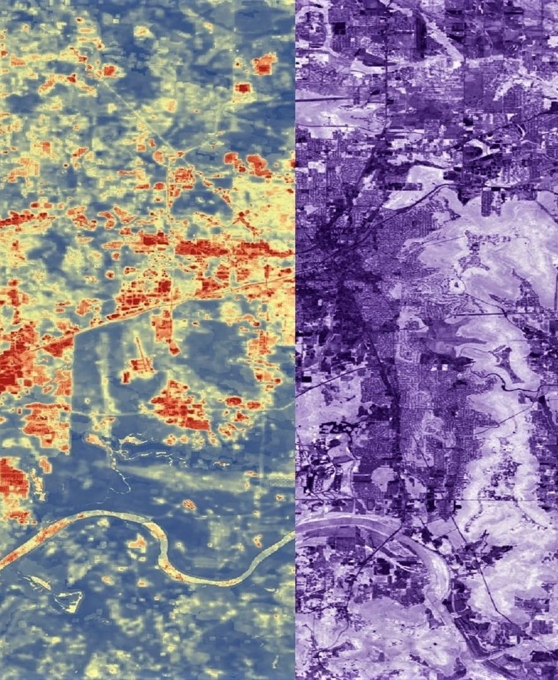
NASA DEVELOP’s Approach to Co-Production and Collaborative STEM Engagement
ED41B-02
Rochelle Williams, Lauren Childs-Gleason, Amanda Clayton, Kent Ross, Michael Ruiz, Karen Allsbrook, Stephanie Burke, R. Cecil Byles, Celeste Gambino, and Hayley Pippin
Image credit: NASA DEVELOP
Notes:
Hello everyone, My name is Rochelle Williams I am a Senior Fellow with the NASA DEVELOP National Program and today I will be talk about NASA DEVELOP’s Approach to Co-Production and Collaborative STEM Engagement

Slide 2

Making Earth Science Information Accessible to All
Part of NASA’s Earth Applied Sciences, the Capacity Building Program provides individuals and institutions with workforce development, training activities, and collaborative projects to strengthen understanding of Earth observations and expand their use around the world.
Through ARSET, DEVELOP, and SERVIR, we work with everyone at every level — from first-time users to long-time professional users of Earth observation data.
Image credit: NASA Applied Sciences

Slide 3
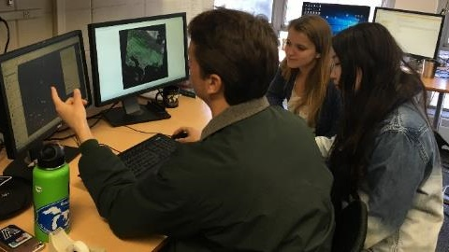
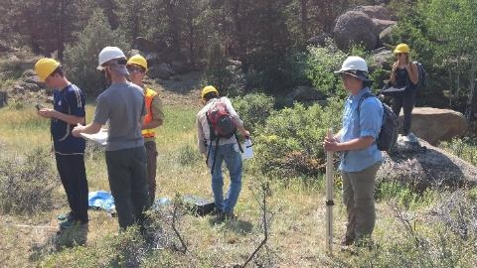
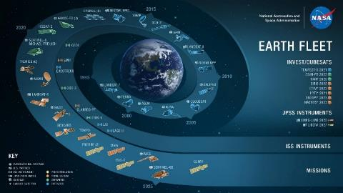
About DEVELOP
Addresses environmental and public policy issues through interdisciplinary feasibility studies that apply the lens of NASA Earth observations (EO) to community concerns around the globe
Hands-on exploration of how NASA EO can be applied and integrated into organizational decision making, with a focus on end-user decision making needs and processes
Engage participants (anyone over 18 – students, recent graduates, early and transitioning professionals) and partner organizations (e.g., state, local and federal governments, NGOs) in a co-production model
Rapid… projects are only 10 weeks!
Image credits: NASA DEVELOP

Slide 4
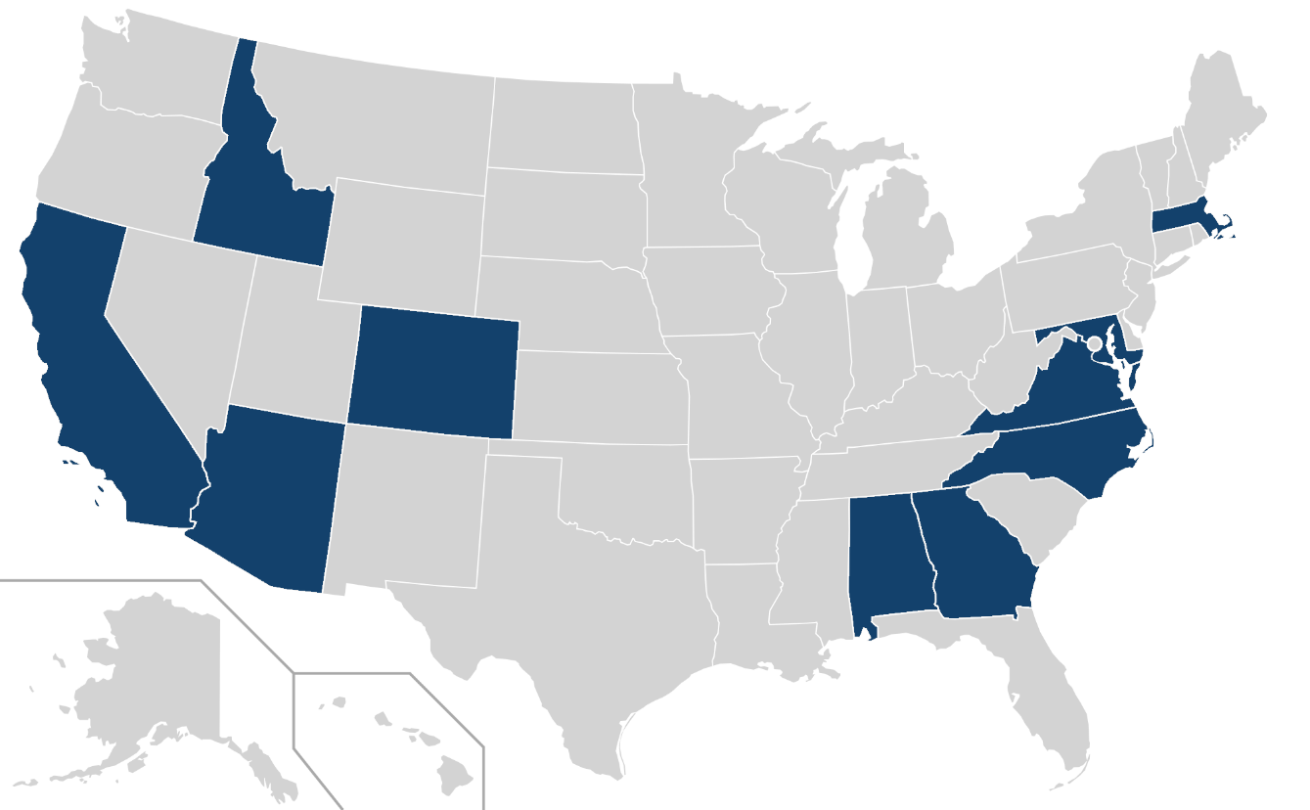
DEVELOP Office Locations* (AKA nodes)
*virtual since spring 2020
Alabama – Marshall
Arizona – Tempe
California – Ames
California – JPL
Colorado – Fort Collins
Georgia – Athens
Idaho – Pocatello
Maryland – Goddard
Massachusetts – Boston
North Carolina – NCEI
Virginia – Langley
9
7
3
5
8
11
4
10
2
1
6
Blue = NASA Nodes | Orange = Regional Nodes

Slide 5








Project Characteristics
50+ projects take place each year – at their core they share these characteristics:
Partner with organizations who can benefit from using NASA Earth observations to enhance decision making by providing decision support tools
Highlight the applications and capabilities of NASA Earth observations
Address community concerns relating to decision-making for real-world environmental issues
Conducted in 10-week terms (spring, summer, and fall) by small teams with diverse backgrounds
Align with at least one of the eight NASA Applied Sciences Program’s National Application Areas
Create a consistent set of deliverables
Research is conducted under the guidance of Science Advisors and mentors from NASA and partner organizations

Slide 6
Participants & Fellows
10-Week Participants = anyone 18+ (students, recent graduates, and early & transitioning career professionals)
DEVELOP also offers enhanced opportunities for building capacity to use Earth observations and deeper professional development. Fellow and Senior Fellow positions utilize skills built as participants and provide opportunities to strengthen both technical and leadership skills while contributing to the program.
Senior Fellows
Fellows
Participants
10 Week Term
Conduct projects
1 Year Term (2 yr max)
Lead participants
Manage projects
Support programmatic priorities
1 Year Term (3 yr max)
Lead Fellows
Lead programmatic priorities & initiatives

Slide 7
Project Partners
Any organization can partner with DEVELOP – state & local governments, federal agencies, tribal governments, non-profits, for-profits, international organizations, academia, etc.
Each project is tailored to a specific end user that is making an environmental decision.
LOCAL GOVERNMENT
STATE GOVERNMENT
FEDERAL GOVERNMENT
2021 Summer Term
Partner Sectors
NON-PROFIT
INSTITUTIONAL SECTOR
FOR-PROFIT
CONSORTIA
ACADEMIA
INTERNATIONAL

Slide 8
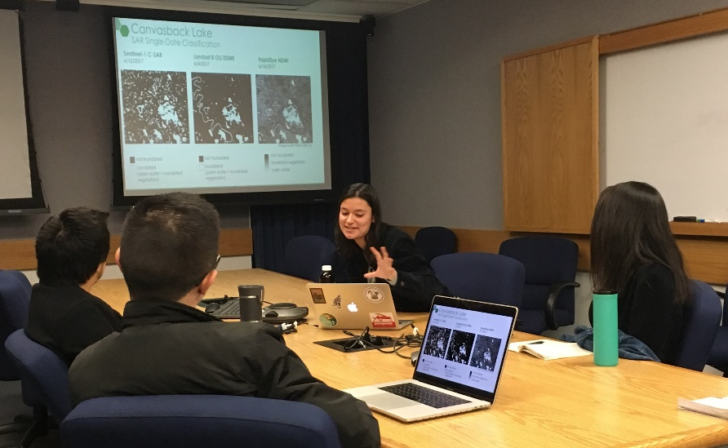
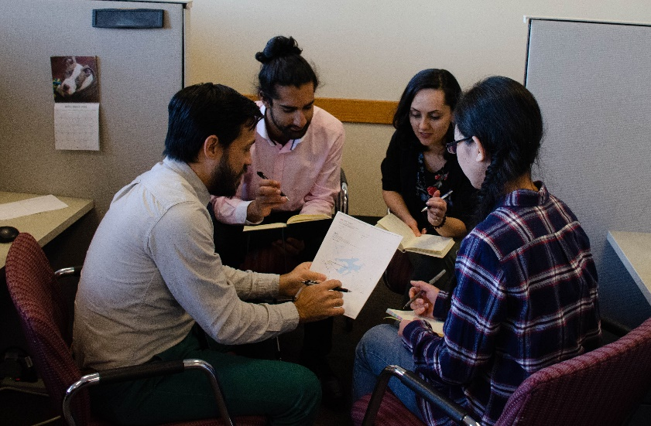
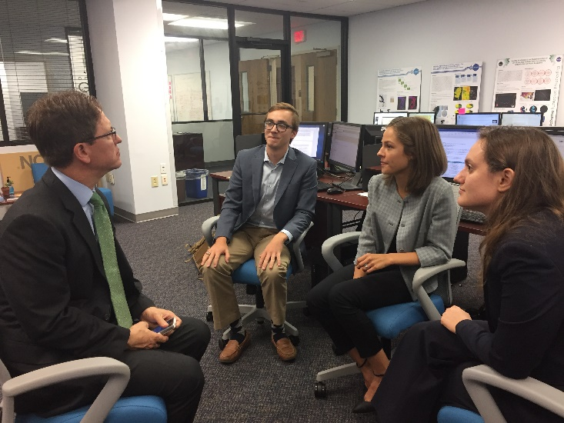
Collaboration w/Partners
All DEVELOP projects begin with a conversation. DEVELOP introduces how it works and listens to the potential partners priorities and needs, asks questions about their decision-making process, and begins to discuss the types of NASA Earth science information that are applicable to the issues at hand.
If interests and Earth observations align, then an iterative project development process begins, which leads to a 10-week engagement through the project.
Image credits: NASA DEVELOP

Slide 9
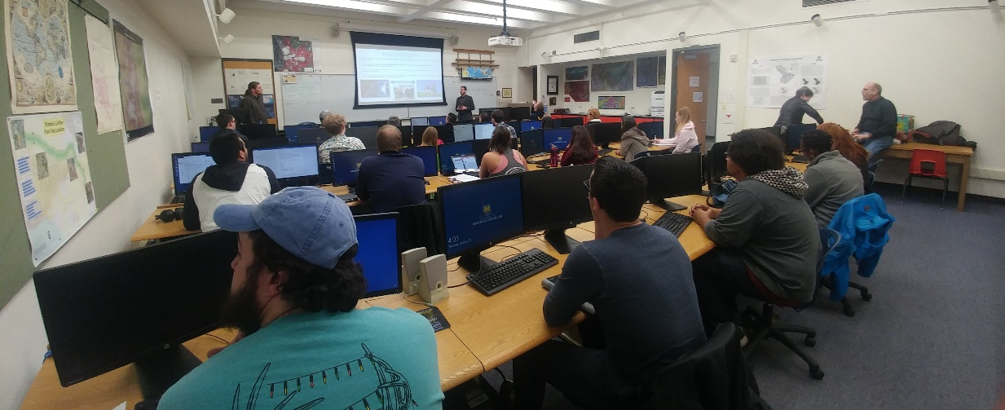

DEVELOP’s Approach to Teaming
The Program uses its model and a regimented approach to teaming that helps spark project teams to advance their projects from A to Z in just 10 weeks.
Personality Assessments: NASA 4D System, Myers-Briggs Type Indicators
Orientation Modules: cover all aspects of the 10 weeks (and beyond) – expectations & how things will work
Robust Schedules: map out the 10-week timeline w/milestones
Image credits: NASA DEVELOP

Slide 10
Project Development Process
Idea Generation & Partner Engagement
Proposal Writing & Approvals
Project Execution & More Iteration
Initial engagement w/potential partner – listen to their interests, priorities, needs, and understand their decision-making process.
Generate project idea – identify: study area, thematic focus area, actionable decision, potential end-products
Initial ideas reviewed by DEVELOP.
Fellows draft a proposal – including the partner in review and iteration.
Approved proposals are scheduled for a specific term and listed in the DEVELOP application.
Communication lines are reopened with partners following approvals.
Partners regularly meet with DEVELOP team during the term to discuss progress and results.
Project results and methods are handed off at the end of the term.

Slide 11
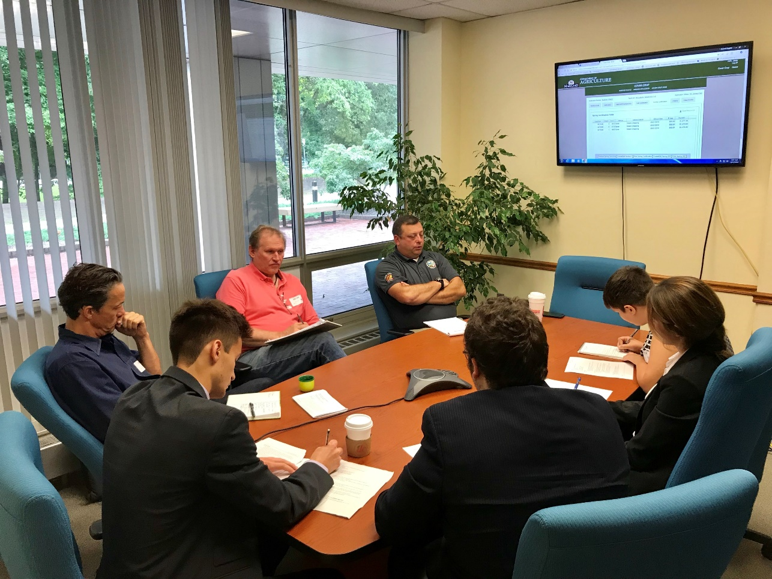
Monitoring, Evaluation & Learning
Project Partners complete:
Pre- and post-project forms that further clarify need (pre) and outcomes (post).
Participants complete:
Self-assessed Entrance & Exit Personal Growth Assessment (PGA), which identify skill levels in select areas.
Exit surveys that provide insights into programmatic structure and activities.
Project Feedback Forms that gather teams’ insights on datasets used and partner interactions.
Image credits: NASA DEVELOP

Slide 12
Lessons Learned
DEVELOP Node Partnering:
Successful partnerships with node hosts are driven by a champion with influence, vision, and a long-term position at the host location.
Site visits (pre-COVID) or virtual check-ins (during pandemic) are important early on in establishing the nodes and generally happen three times a year (if not more).
Initial conversations need to outline all the potential “deal-breakers” otherwise they can pop up as an issue after significant time (and even resource) investments.
DEVELOP Project Partnering:
The most successful partnerships occur when the partner organization clearly understands expectations, constraints, and timelines.
Don’t stray from the model – hold all projects to the same standard characteristic requirements and communicate those from the beginning.

Slide 13
Challenges & Looking Ahead
Challenges
Communication: w/participants and partners after projects can be limited.
In-person vs Virtual: The virtual environment allows for broader interaction but adds complexity to team interactions. Missing the “watercooler chat” and small personal interactions that build camaraderie. Can’t meet with local partners or give final presentations in-person, which can limit project handoff options.
Looking Ahead
Return to In-Person: phasing back a return to working in-person by the end of 2022.
Maintaining Some Virtual: DEVELOP has seen the benefits of virtual participation and will continue to offer some virtual opportunities for perpetuity.
New Project Types: exploring new project models – “listening projects” and “technology & innovation projects”, which have the same 10-week timeline but different workflows, deliverables, and milestone schedules.

Slide 14
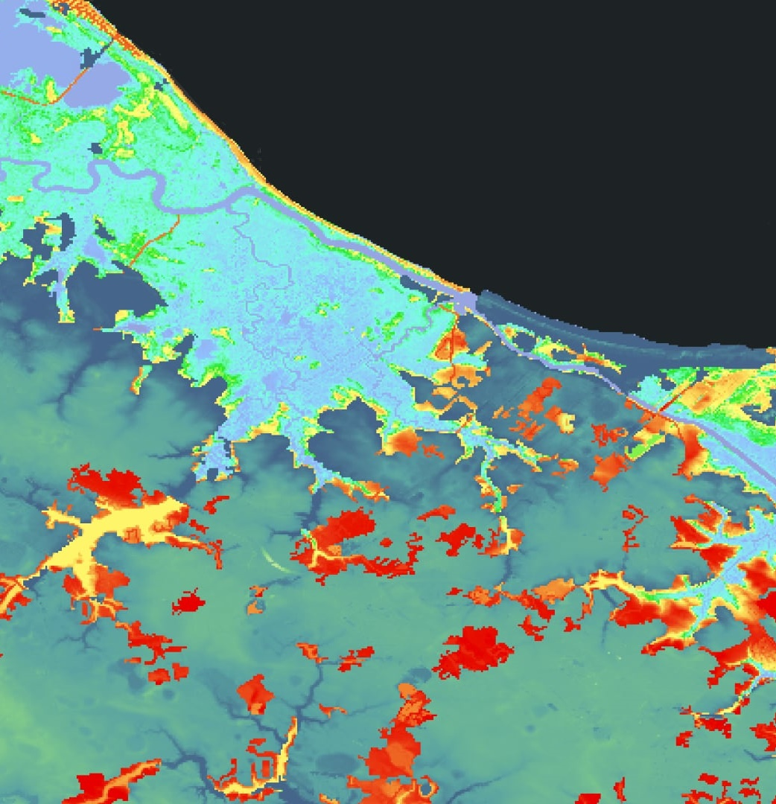
Thank you!
amber.r.williams@nasa.gov
Image credits: NASA DEVELOP
Notes:
Thank you all for your time.

