Slide 1



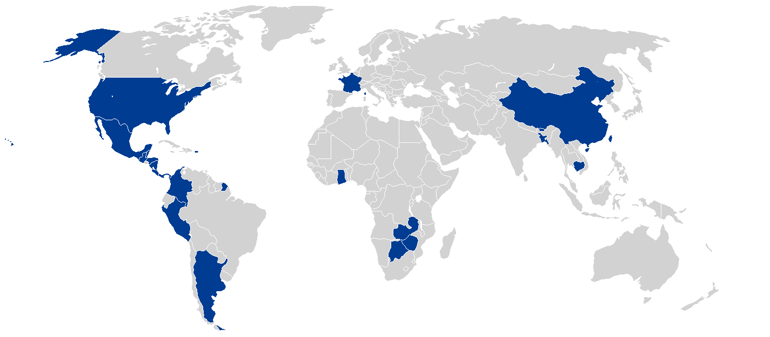

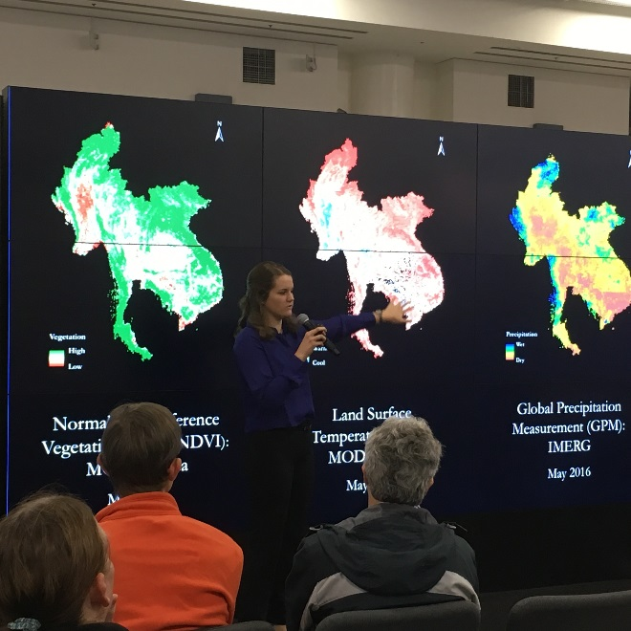
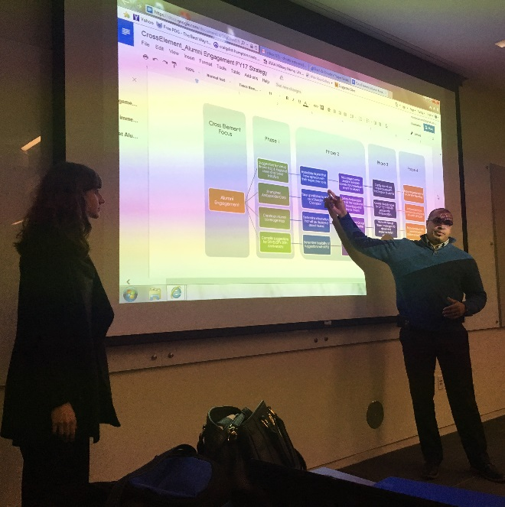
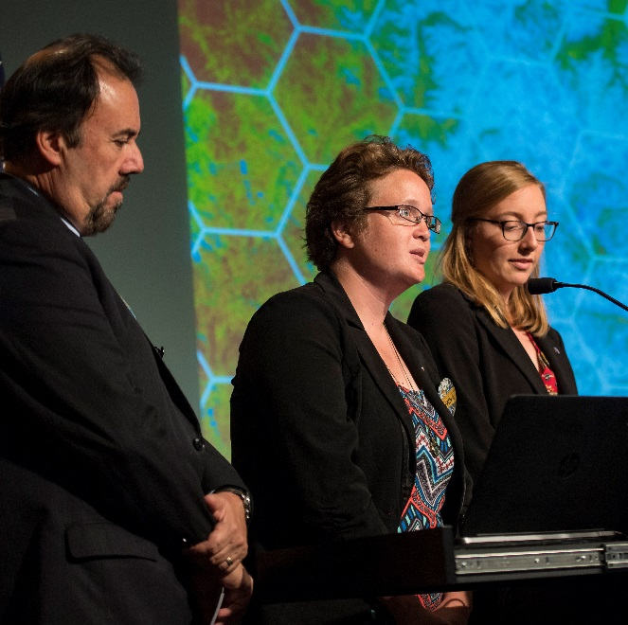
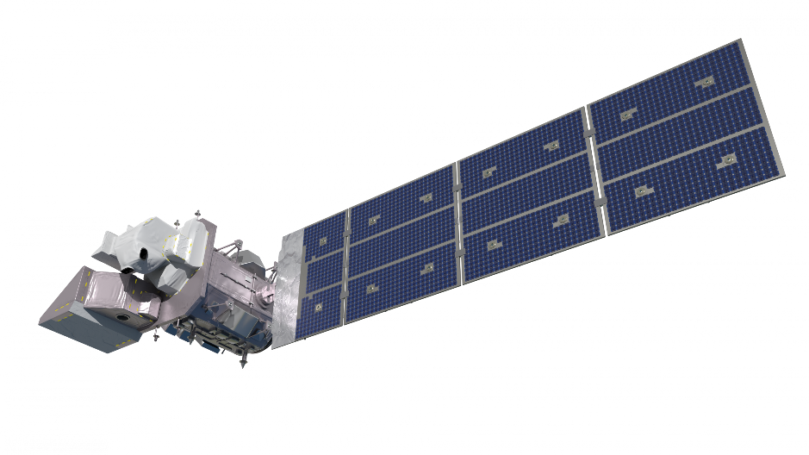
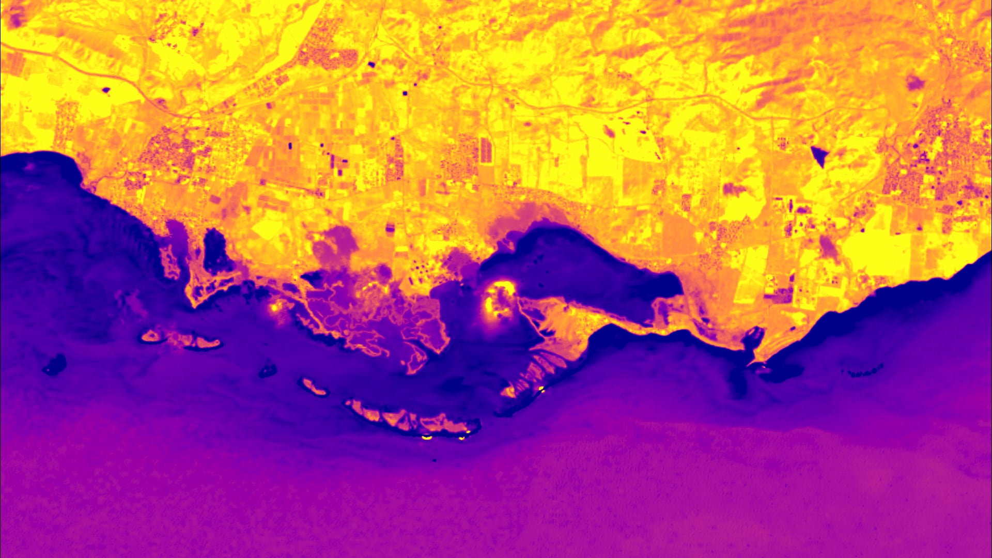
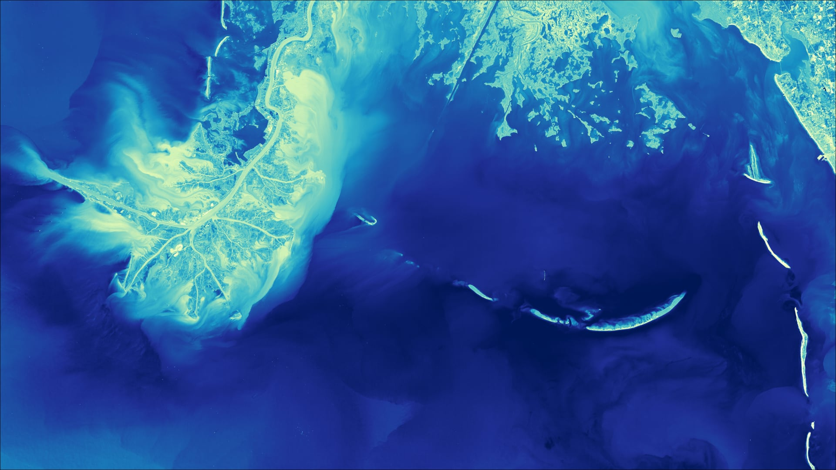
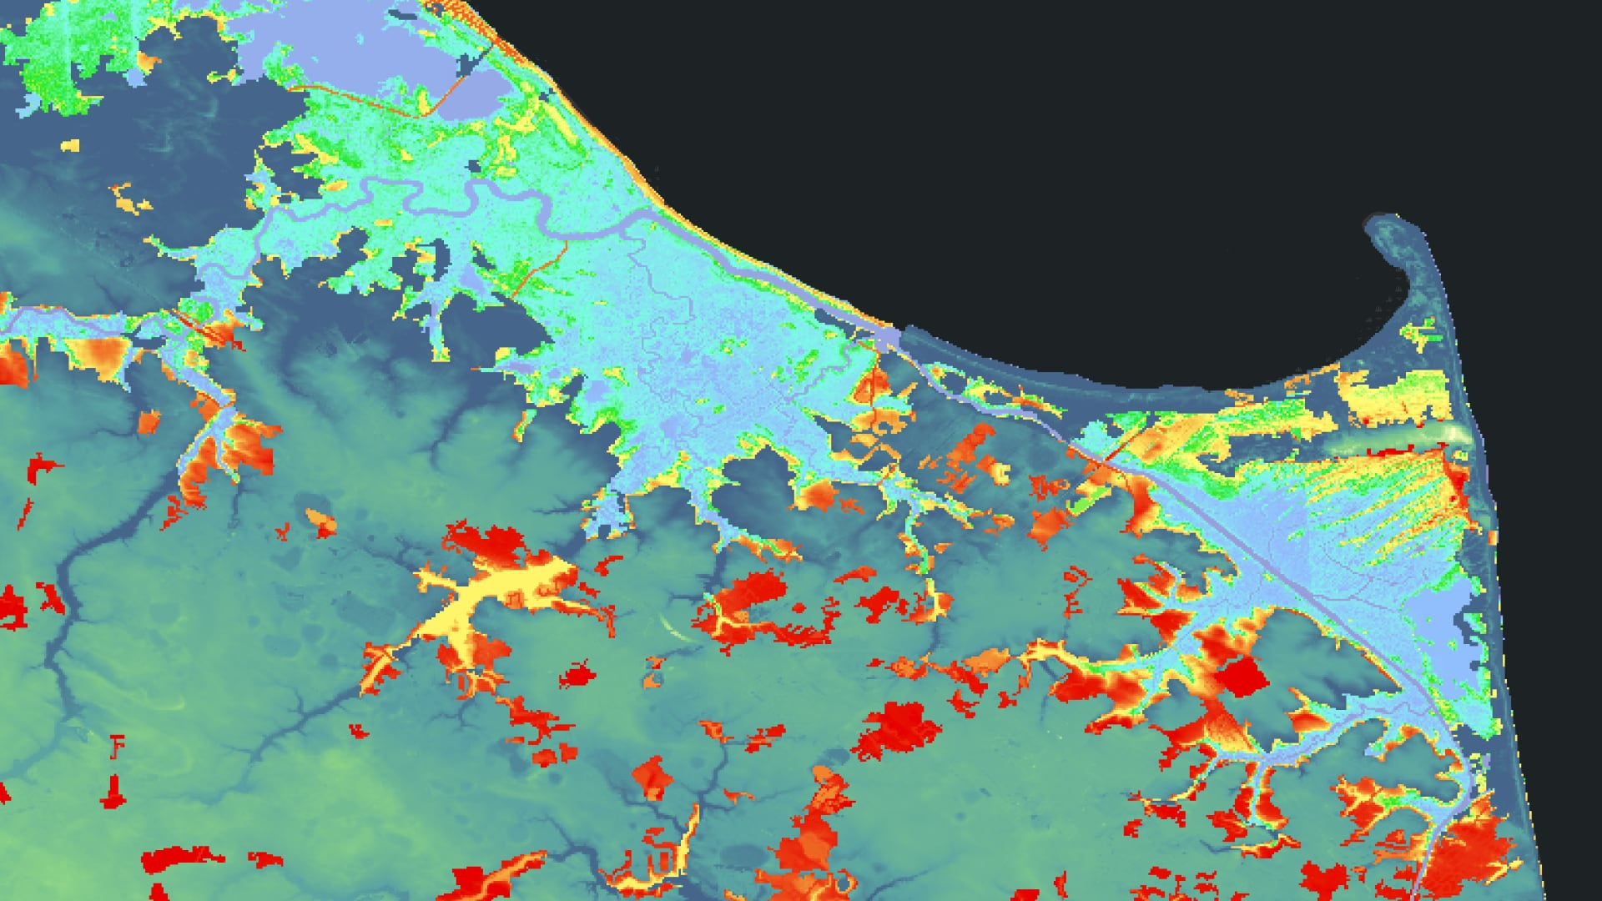
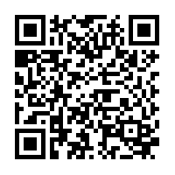
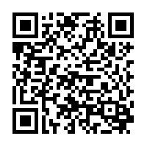
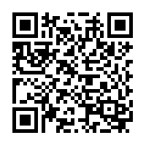
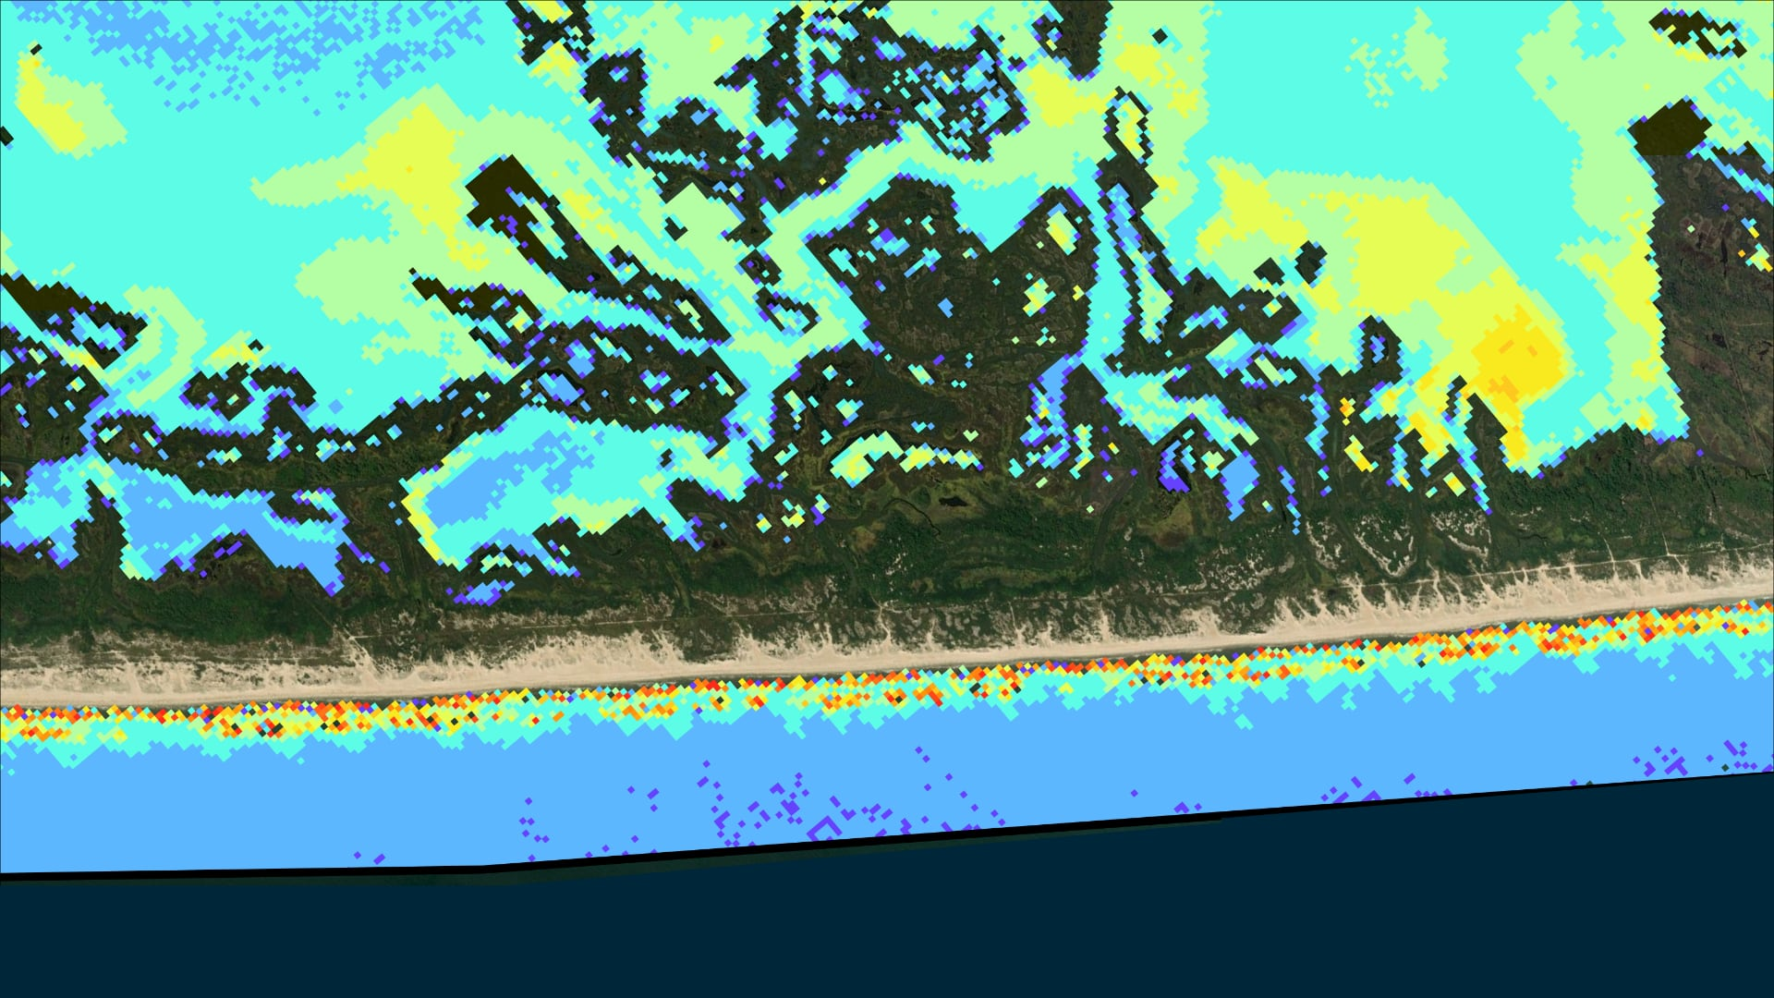
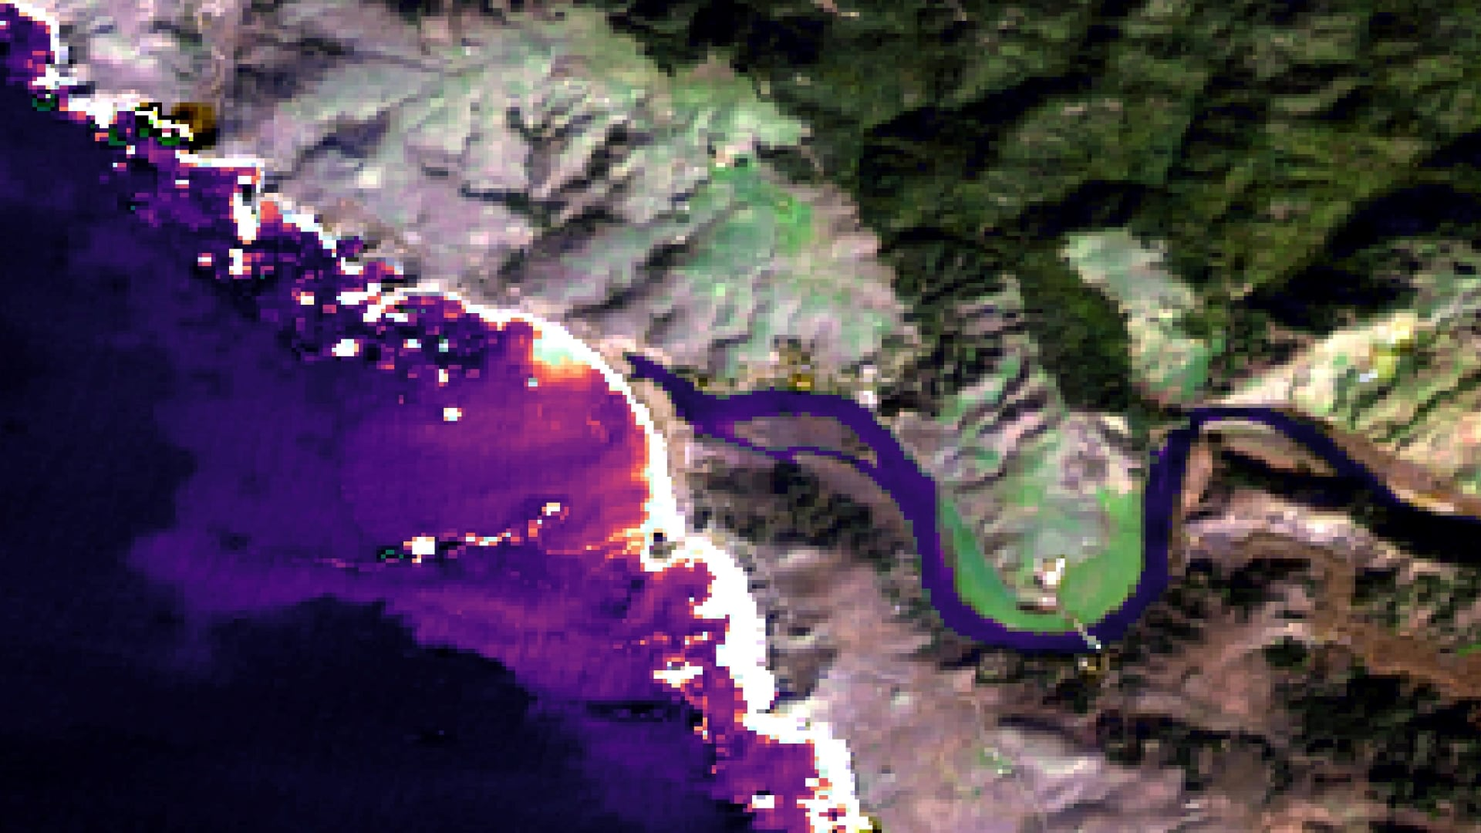
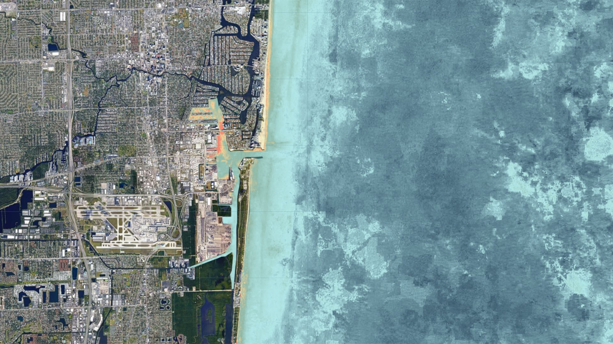
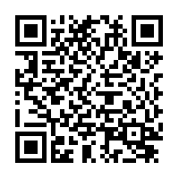
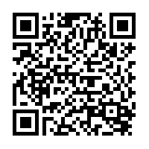
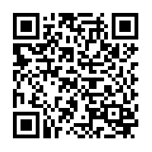
SY54C-0798
NASA DEVELOP’s Approach to Building Capacity to Apply Earth Observations for Coastal and Marine Decision Making
Hayley Pippin^{1,2} (hayley.a.pippin@nasa.gov), Kenton W. Ross^{1,3} (kenton.w.ross@nasa.gov), Amanda Clayton^{1,2} (amana.l.clayton@nasa.gov), Lauren M. Childs-Gleason^{1,3} (lauren.m.childs@nasa.gov), Michael L. Ruiz^{1,3} (michael.l.ruiz@nasa.gov), Karen N. Allsbrook^{1,3} (karen.n.allsbrook@nasa.gov), Stephanie L. Burke^{1,2} (stephanie.l.burke@nasa.gov), Celeste Gambino^{1,2} (celeste.gambino@ssaihq.com), Robert Cecil Byles^{1,2} (robert.c.byles@nasa.gov), Amber Rochelle Williams^{1,2} (amber.williams@ssaihq.com)
¹ NASA DEVELOP National Program, ² Science Systems and Applications, Inc., ³ NASA Langley Research Center
NASA DEVELOP Program
ABOUT DEVELOP
DEVELOP FEASIBILITY STUDIES
ABSTRACT
DEVELOP addresses environmental and public policy issues through interdisciplinary feasibility studies that apply the lens of NASA Earth observations to community concerns around the globe. Bridging the gap between NASA Earth Science and society, DEVELOP projects build capacity in both participants and partner organizations to better prepare them to address the challenges that face our society and future generations.
2021 By The Numbers
DEVELOP’s 10-week feasibility studies utilize NASA Earth observations in innovative and fresh applications that demonstrate to state and local governments how Earth observations can be utilized in their decision-making processes to save resources such as money and time.
Project Characteristics:
Highlight the applications and capabilities of NASA Earth observations
Address real-world environmental issues
Partner with decision-making organizations
Create a comprehensive set of deliverables: Technical Report, Poster, Presentation, and creative communications materials like videos, StoryMaps, and posters
Interdisciplinary teams conduct the study under the scientific guidance of DEVELOP Science Advisors
Part of NASA’s Applied Sciences, the DEVELOP Program builds capacity through 10-week interdisciplinary feasibility studies that identify how NASA Earth observations can be integrated into decision making processes. The program is a dual capacity building effort that fosters programmatic participants (early and transitioning career professionals, students, and recent graduates) to apply Earth observations to partner organizations’ decision making needs. The program conducts 50-60 projects annually, with about 10-15% of those focused on coastal and marine community concerns. These projects explore the use of satellite data and model outputs for measuring and mapping shoreline delineation, barrier island transgression, mangrove health and extent, sedimentation and water quality, and tropical cyclone impacts to coastal regions. This presentation will introduce DEVELOP and a series of project case studies, an overview of the organizations engaged and Earth observations utilized, and lessons learned.
272
58
173
Participants
Feasibility Studies
Partner Organizations
47
THE DEVELOP DUAL CAPACITY BUILDING MODEL
U.S. States
&
DEVELOP builds capacity to use Earth observations in both participants (students, recent graduates, early career professionals, and transitioning career professionals) and project end-users (organizations making environmental decisions) through co-developed 10-week feasibility studies.
21
Countries Reached
No Impact
Countries
Identify Partners
Needs Assessment
Earth Observations
Lessons Learned
Communication
2021 Coastal Partners
Community Concerns
EO Resources Utilized
Challenges & Lessons Learned
Partner Communications
State Government: Delaware Dept of Natural Resources & Environmental Control; Louisiana Dept of Natural Resources, Office of Coastal Management; Louisiana Coastal Protection and Restoration Authority
Federal Agencies: U.S. Army Corps of Engineers; NOAA Marine Fisheries Service; Jobos Bay National Estuarine Research Reserves; National Park Service
NGOs: Ocean Protection Council; So. California Coastal Water Research Project; Moss Landing Marine Labs
Academia: UC Los Angeles; UC Davis
DEVELOP’s coastal projects respond to partner needs by support decisions related to both land to water and water to land. The program explores monitoring topics such as:
Landsat 5 TM
Landsat 7 ETM+
Landsat 8 OLI
Sentinel-2 MSI
Aqua MODIS
Terra MODIS
Sentinel-1 C-SAR
GPM IMERG
PlanetScope & RapidEye Imagery
More in situ data is needed to validate the water quality parameter algorithms used in coastal projects.
Earth observations with moderate to coarse spatial resolution fail to capture smaller water bodies and coastal variability, particularly in complex ecosystems.
More rigorous cloud filtration methods would improve the accuracy of results in cloudy coastal areas.
In-depth historical analyses and examination of extreme weather events would help track and forecast shoreline change over time.
Each project team conducts a “handoff” of project results and methodologies to their partner organization at the end of each project term.
DEVELOP teams use a wide variety of methods for communicating project results: technical reports, presentations, tutorials, videos, StoryMaps, and posters.
The program actively looks for new partner organizations to collaborate with at science and policy conferences, meetings, workshops, through the DEVELOP website, and word of mouth.
Mangroves
Wetlands
Tidal Marshes
Sediment & Turbidity
Stormwater Discharge
Seagrass / Submerged Aquatic Vegetation
Salinity
Shoreline Change
Sea Level Rise
2021 COASTAL PROJECTS
SHORELINE CHANGE & SEA LEVEL RISE
SEAGRASS MEADOWS
TIDAL MARSH MIGRATION
Using Earth Observations to Analyze Shoreline Changes and Understand the Effects of Sea Level Rise in Southern Puerto Rico
Using NASA Earth Observations to Monitor Historical Changes in the Extension of Seagrass Meadows in the Breton National Wildlife Refuge in Louisiana
Assessing Land Cover and Soil to Identify Suitable Sites for Tidal Marsh Migration in Delaware
This project evaluated coastal shoreline change due to sea level rise in Jobos Bay, Puerto Rico. Using Landsat- and Sentinel-2-derived Earth observations, the team analyzed land use land cover change (LULC), mangrove forest extent, and water quality in the study area. Specifically, utilized Google Earth Engine to create historical LULC maps from 1997 and examine long term trends in turbidity, chlorophyll-a, sea surface temperature, and colored dissolved organic matter concentrations. This study, the first
Seagrass beds protect the barrier islands in Louisiana’s Breton National Wildlife Refuge from erosion, serving as vitally important pieces of the ecosystem in the area. This project examined how the surrounding land area and seagrass beds have responded to destructive weather events from 1984 to 2021. The team created the Tool for Coastal Remote Ecological Observations in Louisiana in Google Earth Engine, which accesses Landsat and MODIS Earth observations to generate maps and time
In response to the nearly 5,000 acres of wetlands the state of Delaware has lost over the past 30 years, this project aimed to develop a methodology for monitoring recent changes in wetland cover and forecast landward marsh migration due to sea-level rise, changes to climate, and human development. It utilized Landsat, MODIS, and GPM IMERG data to conduct a trend analysis of current and past climate conditions in precipitation and temperature and visualize landcover shifts over the last 20 years.
For more information:
For more information:
For more information:
comprehensive study to be done in the estuary in nearly a decade, serves as a baseline for future conservation efforts and research in the estuary.
series charts that illustrate the change in land area and seagrass extent over time. This project highlights how NASA Earth observations can be used to provide an up-to-date monitoring system that can assist in restoration and revegetation efforts in coastal areas.
Additionally, the team identified locations where marsh migration could potentially occur in the future. NASA Earth observations were used to give real-time insight into wetland health as well as inform decision-making to preserve ecosystem functions in the future.
SUSPENDED SEDIMENT
ESTUARINE BREACH EVENTS
WATER QUALITY & CORAL REEFS
Characterizing Nearshore Suspended Sediments and Land Cover Change Relative to Sediment Bypassing and Catastrophic Events
Utilizing NASA Earth Observations to Detect and Assess the Impacts of Estuarine Breach Events for Improved Coastal Wetland Monitoring and Management
Monitoring Water Quality Along Southern Florida Seaports to Assess Impact on Coral Reef Tracts from Harbor Deepening Projects
The United States Army Corps of Engineers initiated semiannual sediment bypassing operations in 2004 to reinforce the natural sediment transport processes of Assateague Island. This project used Landsat and Sentinel Earth observations to evaluate whether or not the operations were providing their intended benefits. Time series analyses conducted from 2004 to 2020 and a landcover change analysis from 2006 to 2018 indicated that suspended sediment levels are seasonally dependent. The team also predicted
Aiming to alleviate the time- and resource-intensive process of in situ data collection in California’s estuarine ecosystems, this project used remote sensing to gather data that examined the health and dynamics of California EMPAs in order to supplement ground-based field measurements. The team used Google Earth Engine to create the California Estuary Assessment (CEA) tool, which analyzes Landsat 8 OLI / TIRS, Sentinel-2 MSI, and Sentinel-1 C-SAR observations to analyze estuary mouth state, inundation, and
This project aimed to get a better understanding about the potential impacts from a harbor deepening project in Port Everglades on the nearby Florida reef tract. The team created an interactive Google Earth Engine tool to help establish a historical baseline of water quality parameters and assist monitoring these parameters more frequently than traditional sampling. By combining Landsat, Sentinel-2, and MODIS Earth observations, the tool allows users to view true color images and calculate water quality
For more information:
For more information:
For more information:
the most drastic land cover changes in the southern portion and the least on the eastern foreshore of the island. These results indicate that NASA Earth observations can successfully be used to understand the impact of sediment bypassing operations and inform island management decisions.
water quality. CEA allows partners to easily access NASA Earth observations to better understand estuary dynamics and more effectively conduct in situ estuary monitoring.
parameters, like turbidity and chlorophyll-a, for any given study area and time period from 1984 onward. The team established a historical baseline turbidity level from 2000 – 2020, which can assist in future decision-making for determining thresholds for turbidity in the area.

