Slide 1

Optimum Strategies for Selecting Descent Flight-Path Angles Overview
NASA Ames Patented Aerospace Technologies Webinar
Gilbert Wu
Optimum Strategies for Selecting Descent Flight-Path Angles
NASA Ames Research Center
12/8/21

Slide 2

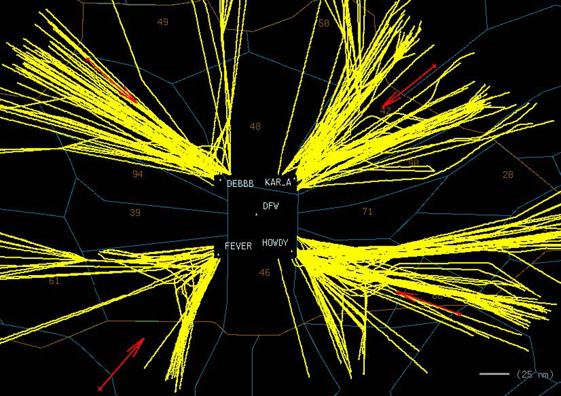
Motivation
Efficient and safe arrival operations under challenging traffic conditions is a key objective for air transportation modernization efforts
Trajectory predictability issues often prevent Air Traffic Control (ATC) from allowing continuous descent approach in congested airspaces.
An arrival procedure with a fixed-flight-path angle provides high trajectory predictability for air traffic management and can potentially increase throughput of the arrival operations.
Such a procedure is already supported by current avionics in almost all “small” (regional, business, and light) jets and a fraction of large jets such as Boeing and Airbus types.
Small jet arrival tracks into
Dallas Fort Worth, Texas

Slide 3
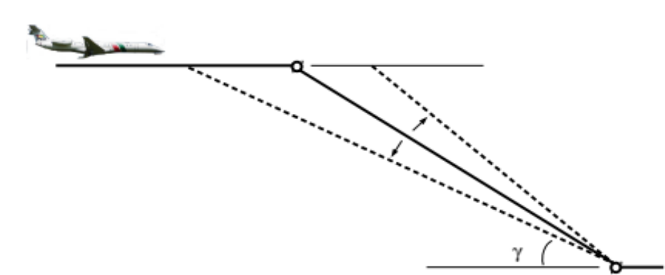

Technology
Selection of a descent profile (by an algorithm)
  with a fixed flight-path angle or a fixed descent rate
  for one or a group of arrival flights
Three selection strategies
  Minimum fuel: achieves most fuel benefit but requires communication of the profile in real time
  Descent-speed-based profile
  Universal profile
  Note: 2 and 3 can be customized by route and period of time
Key Input data
  airlines' preferred speeds
  aircraft performance data
  predicted prevailing wind
  arrival direction/route

Slide 4
Application and Benefits
Application
Airline operations
Air traffic management (by the Federal Aviation Administration)
Benefits
For airlines
  Reduction of operational costs with improved arrival trajectory efficiencies
For air traffic management
  Better efficiency with improved trajectory predictability
  Better accommodation of small jets’ avionics limitation

