Slide 1






Examination of the information in the spectral curvature of in situ aerosol hyperspectral (300-700 nm) optical properties measured from wildfire aerosols from a ground-based mobile lab during FIREX-AQ
AGU A53D-04 17 Dec. 2021
Carolyn E. Jordan^{1,2}, Bruce E. Anderson², John D. Barrick^{2,3}, Dani Blum⁴, Kathleen Brunke⁵, Jiajue Chai⁴, Gao Chen², Ewan C. Crosbie^{2,3}, Jack E. Dibb⁶, Ann M. Dillner⁷, Emily Gargulinski^{1,2}, Charles H. Hudgins^{2,3}, Emily Joyce⁴, Jackson Kaspari⁶, Robert F. Martin², Richard H. Moore², Rachel O’Brien⁸, Claire E. Robinson^{2,3,8}, Gregory L. Schuster², Taylor J. Shingler², Michael A. Shook², Amber J. Soja^{1,2}, Kenneth L. Thornhill^{2,3}, Andrew T. Weakley⁷, Elizabeth B. Wiggins², Edward L. Winstead^{2,3}, and Luke D. Ziemba²
¹National Institute of Aerospace, Hampton, VA, ²NASA Langley Research Center, Hampton, VA, ³Science Systems and Applications Inc., Hampton, VA, ⁴Brown University, Providence, RI, ⁵Christopher Newport University, Hampton, VA, ⁶University of New Hampshire, Durham, NH, ⁷University of California – Davis, CA, ⁸William & Mary, Williamsburg, VA

Slide 2
Overview
1) Brief description of FIREX-AQ, MACH-2, and 5 fires sampled
2) Overview of the 4 measured spectra sets, plus calculated SSA
3) Characterizing spectral variability via spectral fitting:
  -linear (Ångström Exponents) and 2nd order polynomial fits
4) Brief Discussion of Drivers of Spectral Variability: MeOH Absorption Example
5) Conclusions
Notes:
Bruce’s photo #289 from 204Cow fire, OR

Slide 3
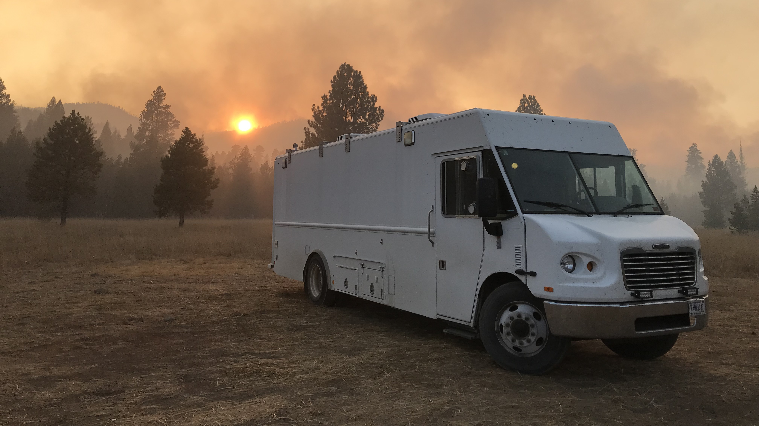
FIREX-AQ & MACH-2
•Fire Influence on Regional to Global Environments Experiment – Air Quality (FIREX-AQ)
-2 part fire study involving multiple ground, airborne, and space-based platforms
-Western U.S. wildfires (~22 July – 16 August 2019)
-Southeastern U.S. agricultural fires (~19 August – 5 September 2019)
•NASA Langley Research Center’s (LaRC) Mobile Aerosol Characterization (MACH-2) laboratory deployed for western portion of FIREX-AQ
-Sampled 8 fires in 6 states
-Vader, Shady, & Nethker in central ID
-Black Diamond, Lincoln, MT
-Williams Flats, Fort Spokane, WA
-Little Bear, Bryce Canyon, UT
-Castle, Jacobs Lake, AZ
-204 Cow, Prairie City, OR
-Measurements focused on aerosol optics, microphysics, mass, and composition,
along with CO, CO₂, H₂O, O₃, NO₂, HONO, and HNO₃
-for details see the FIREX-AQ MACH-2 data archive at https://www-air.larc.nasa.gov/cgi-bin/ArcView/firexaq?MOBILE=1
-Here, in situ aerosol hyperspectral (300-700 nm) extinction and absorption spectra from 5 fires will be discussed
Photo of MACH-2 at the 204Cow fire, B. E. Anderson
Notes:
Bruce’s photo #289 from 204Cow fire, OR

Slide 4
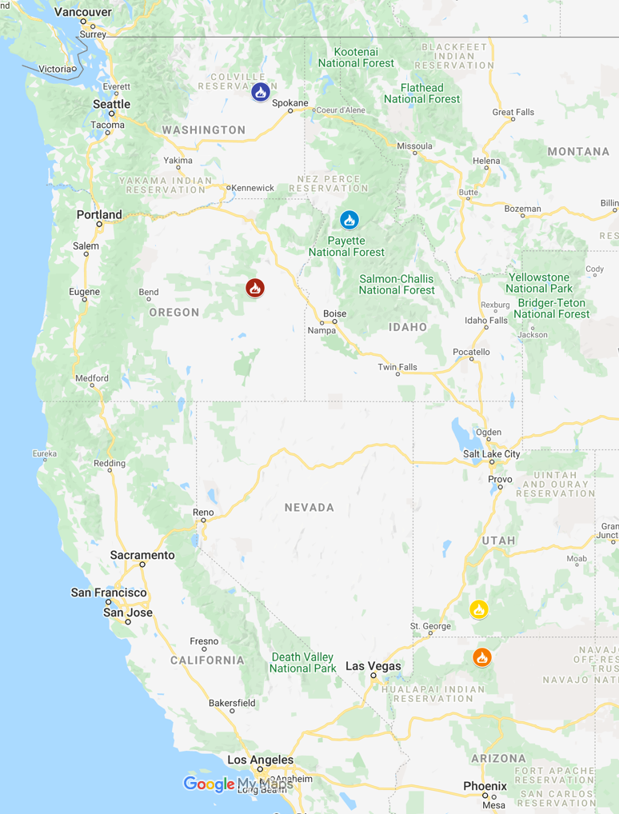
Fire Locations, Fuel Descriptions, & Characteristics
•Williams Flats (3-7 Aug. 2019)
1) Douglas fir, Pacific ponderosa pine, oceanspray forest; &
Idaho fescue-bluebunch wheatgrass grassland*
2) Total Daily GOES FRP: 381,693 - 2,366,411 MW
3) MACH-2 ~9-27 km downwind of fire front
•Nethker (9-16 Aug. 2019)
1) Douglas fir, Pacific ponderosa pine, oceanspray forest; &
Subalpine fir-lodgepole pine-whitebark pine-Engelmann spruce forest*
2) Total Daily GOES FRP: 32,829 MW GOES FRP
(only available 8/9/19, no other detections)
3) MACH-2 ~1.75-2.5 km downwind of fire front
•Little Bear (20-21 Aug. 2019)
1) White fir-gambel oak forest; Ponderosa pine savanna; &
Engelmann spruce-Douglas-fir-white fir-ponderosa pine forest*
2) Total Daily GOES FRP: 3,246 – 45,934 MW
3) MACH-2 ~3.5 km downwind of fire front
•Castle (22-23 Aug. 2019)
1) Ponderosa pine-two-needle pinyon-Utah juniper forest;
Madrean pine-oak forest; & Ponderosa pine-white fir/quaking aspen forest*
2) Total Daily GOES FRP: 1,135-1,827 MW
3) MACH-2 ~10-11 km downwind of fire front
•204 Cow (26-27 Aug. 2019)
1) Douglas fir, Pacific ponderosa pine, oceanspray forest; &
Grand fir-Douglas-fir forest*
2) Total Daily GOES FRP: 11,266 – 38,838 MW
3) MACH-2 ~3.5-7 km downwind of fire front
*FCCS 2014 30m fuels database
Williams Flats
Nethker
204 Cow
Little Bear
Castle

Slide 5
Fire Locations, Fuel Descriptions, & Characteristics
•Williams Flats (3-7 Aug. 2019)
1) Douglas fir, Pacific ponderosa pine, oceanspray forest; &
Idaho fescue-bluebunch wheatgrass grassland*
2) Total Daily GOES FRP: 381,693 - 2,366,411 MW
3) MACH-2 ~9-27 km downwind of fire front
•Nethker (9-16 Aug. 2019)
1) Douglas fir, Pacific ponderosa pine, oceanspray forest; &
Subalpine fir-lodgepole pine-whitebark pine-Engelmann spruce forest*
2) Total Daily GOES FRP: 32,829 MW GOES FRP
(only available 8/9/19, no other detections)
3) MACH-2 ~1.75-2.5 km downwind of fire front
•Little Bear (20-21 Aug. 2019)
1) White fir-gambel oak forest; Ponderosa pine savanna; &
Engelmann spruce-Douglas-fir-white fir-ponderosa pine forest*
2) Total Daily GOES FRP: 3,246 – 45,934 MW
3) MACH-2 ~3.5 km downwind of fire front
•Castle (22-23 Aug. 2019)
1) Ponderosa pine-two-needle pinyon-Utah juniper forest;
Madrean pine-oak forest; & Ponderosa pine-white fir/quaking aspen forest*
2) Total Daily GOES FRP: 1,135-1,827 MW
3) MACH-2 ~10-11 km downwind of fire front
•204 Cow (26-27 Aug. 2019)
1) Douglas fir, Pacific ponderosa pine, oceanspray forest; &
Grand fir-Douglas-fir forest*
2) Total Daily GOES FRP: 11,266 – 38,838 MW
3) MACH-2 ~3.5-7 km downwind of fire front
*FCCS 2014 30m fuels database
Williams Flats
Nethker
204 Cow
Little Bear
Castle

Slide 6
Fire Locations, Fuel Descriptions, & Characteristics
•Williams Flats (3-7 Aug. 2019)
1) Douglas fir, Pacific ponderosa pine, oceanspray forest; &
Idaho fescue-bluebunch wheatgrass grassland*
2) Total Daily GOES FRP: 381,693 - 2,366,411 MW
3) MACH-2 ~9-27 km downwind of fire front
•Nethker (9-16 Aug. 2019)
1) Douglas fir, Pacific ponderosa pine, oceanspray forest; &
Subalpine fir-lodgepole pine-whitebark pine-Engelmann spruce forest*
2) Total Daily GOES FRP: 32,829 MW GOES FRP
(only available 8/9/19, no other detections)
3) MACH-2 ~1.75-2.5 km downwind of fire front
•Little Bear (20-21 Aug. 2019)
1) White fir-gambel oak forest; Ponderosa pine savanna; &
Engelmann spruce-Douglas-fir-white fir-ponderosa pine forest*
2) Total Daily GOES FRP: 3,246 – 45,934 MW
3) MACH-2 ~3.5 km downwind of fire front
•Castle (22-23 Aug. 2019)
1) Ponderosa pine-two-needle pinyon-Utah juniper forest;
Madrean pine-oak forest; & Ponderosa pine-white fir/quaking aspen forest*
2) Total Daily GOES FRP: 1,135-1,827 MW
3) MACH-2 ~10-11 km downwind of fire front
•204 Cow (26-27 Aug. 2019)
1) Douglas fir, Pacific ponderosa pine, oceanspray forest; &
Grand fir-Douglas-fir forest*
2) Total Daily GOES FRP: 11,266 – 38,838 MW
3) MACH-2 ~3.5-7 km downwind of fire front
*FCCS 2014 30m fuels database
Williams Flats
Nethker
204 Cow
Little Bear
Castle

Slide 7
Fire Locations, Fuel Descriptions, & Characteristics
•Williams Flats (3-7 Aug. 2019)
1) Douglas fir, Pacific ponderosa pine, oceanspray forest; &
Idaho fescue-bluebunch wheatgrass grassland*
2) Total Daily GOES FRP: 381,693 - 2,366,411 MW
3) MACH-2 ~9-27 km downwind of fire front
•Nethker (9-16 Aug. 2019)
1) Douglas fir, Pacific ponderosa pine, oceanspray forest; &
Subalpine fir-lodgepole pine-whitebark pine-Engelmann spruce forest*
2) Total Daily GOES FRP: 32,829 MW GOES FRP
(only available 8/9/19, no other detections)
3) MACH-2 ~1.75-2.5 km downwind of fire front
•Little Bear (20-21 Aug. 2019)
1) White fir-gambel oak forest; Ponderosa pine savanna; &
Engelmann spruce-Douglas-fir-white fir-ponderosa pine forest*
2) Total Daily GOES FRP: 3,246 – 45,934 MW
3) MACH-2 ~3.5 km downwind of fire front
•Castle (22-23 Aug. 2019)
1) Ponderosa pine-two-needle pinyon-Utah juniper forest;
Madrean pine-oak forest; & Ponderosa pine-white fir/quaking aspen forest*
2) Total Daily GOES FRP: 1,135-1,827 MW
3) MACH-2 ~10-11 km downwind of fire front
•204 Cow (26-27 Aug. 2019)
1) Douglas fir, Pacific ponderosa pine, oceanspray forest; &
Grand fir-Douglas-fir forest*
2) Total Daily GOES FRP: 11,266 – 38,838 MW
3) MACH-2 ~3.5-7 km downwind of fire front
*FCCS 2014 30m fuels database
Williams Flats
Nethker
204 Cow
Little Bear
Castle

Slide 8
Spectra Data Set: 300-700 nm wavelengths*
•Extinction (red curves)
-custom in situ Spectral Aerosol Extinction (SpEx) instrument
(Cerex Monitoring Solutions, LLC, Atlanta, GA)
-4 min resolution
•Total Absorption* (black curves)
-quartz filters
-custom filter holder with optical path coupled to
SpEx light source (150W Xenon lamp) & 16-bit spectrometer
(QE65Pro, Ocean Optics, Inc., Dunedin, FL)
-wavelength range limited to 350-700 nm*
-normalized to Tricolor Absorption Photometer
(Brechtel, Hayward, CA)
•Methanol (MeOH) &
Water (DI)-soluble Absorption
(purple & blue curves, respectively)
-Teflon filters, cut in half
-half extracted in DI, half in MeOH
-extracts measured in a liquid waveguide capillary cell
-World Precision LWCC-3250, 250 cm optical pathlength
•Filter samples collected behind PM_{2.5} cyclone
-collection times ranged from ~ 1 – 6 h

Slide 9
Single Scattering Albedo Calculated from Measured Spectra
•SSA (350 - 700 nm) calculated via
SSA(λ) = (Ext(λ) – Total Abs(λ)) / Ext(λ)
•In general, across 350-700 nm range
-lowest values observed at Williams Flats
-highest values observed at Nethker
•The lowest SSA values observed at 350 nm
at Little Bear & Castle
•All of the spectra sets vary between fires &
from sample to sample
•Curve fitting is used to characterize spectral
shape and variability

Slide 10
All Measured Spectra Better Fit by 2nd order Polynomial
Example (Little Bear filter #25) Linear (top row) & 2nd order Polynomial (2nd row) Fits to Spectra
Extinction Fits
Total Absorption Fits*
MeOH Absorption Fits
DI Absorption Fits

Slide 11
All Measured Spectra Better Fit by 2nd order Polynomial
Example (Little Bear filter #25) Linear (top row) & 2nd order Polynomial (2nd row) Fits to Spectra
Extinction Fits
Total Absorption Fits*
MeOH Absorption Fits
DI Absorption Fits

Slide 12
All Measured Spectra Better Fit by 2nd order Polynomial
Example (Little Bear filter #25) Linear (top row) & 2nd order Polynomial (2nd row) Fits to Spectra
Extinction Fits
Total Absorption Fits*
MeOH Absorption Fits
DI Absorption Fits
(µm):
(0.3)
(0.37)
(0.45)
(0.55)
(0.67)
Fit Residuals from All Spectra

Slide 13
All Measured Spectra Better Fit by 2nd order Polynomial
Example (Little Bear filter #25) Linear (top row) & 2nd order Polynomial (2nd row) Fits to Spectra
Extinction Fits
Total Absorption Fits*
MeOH Absorption Fits
DI Absorption Fits
(µm):
(0.3)
(0.37)
(0.45)
(0.55)
(0.67)
•Note, the soluble absorption spectral feature evident ~0.450 µm
(LN(0.45 µm) ~ -0.8)) does not appear in total absorption spectrum
•Lin et al. [2017] attributed this phenomenon to a difference in pH
-lower in aerosol, higher in DI solution
-leading to a red-shift in the DI absorption spectrum; hence, underestimating UV and
overestimating visible absorption
•Illustrating the need for measuring total absorption spectra

Slide 14
Characterizing Spectral Shapes
• Characterize spectral behavior of aerosol optical properties using derivative of logarithmic transformation of measured spectrum, i.e., d ln p(λ) / d ln λ (1)
where, p(λ) refers to extinction, scattering, or absorption
•Assuming power law behavior, i.e., p(λ) = βλ^{-α} (2)
derivative is a constant (= -α); Ångström exponent = α where, β is p at 1 µm, [e.g. Ångström , 1989; Eck et al., 1999; Moosmüller, & Chakrabarty, 2011]
  •α describes wavelength-independent line in log space:
  α = - d ln p(λ) / d ln λ (3)
•However, spectral curvature in log space often observed, represented by a 2nd order polynomial:
ln p(λ) = a₀ + a₁ ln λ + a₂ (ln λ)² (4)
[e.g., Eck et al., 1999 and 2001; Schuster et al., 2006]
•Derivative of Eq. 4 is equal to Eq. 3; a₁, and a₂ related to α by
d ln p(λ) / d ln λ = (a₁ + 2 a₂ (ln λ_{ch})) = - α (5)
where, λ_{ch} = characteristic wavelength of the measurement
i.e., for any given spectrum there is one wavelength for which α and (a₁,a₂) are equivalent
[Jordan et al., 2021]
increasing degree of curvature (a₂)
axis of symmetry (= -a₁/2a₂) shifts to longer wavelengths

Slide 15
2nd order Polynomial Coefficient (a₁, a₂) Maps for 0.35-0.7 µm Fits
Extinction
Total Absorption
MeOH Absorption Fits
DI Absorption Fits
Pairs of panels (a₁,a₂) colored by:
Fire (left) and Ångström Exponents (right)
Fire number color code:
Williams Flats ( fire #3) dark blue
Nethker (fire #4) light blue
Little Bear (fire #5) yellow
Castle (fire #6) orange
204 Cow (fire #7) red
Key Observations:
•For each spectra set, (a₁,a₂) values cluster by fire
•For any given Ångström Exponent, there is separation in (a₁,a₂) space
Implications:
•(a₁,a₂) may offer more information about aerosol size distribution and composition than provided by Ångström Exponents

Slide 16
Drivers of Variability in (a₁,a₂): e.g., MeOH Absorption
2nd order polynomials are more sensitive to the spectral shape
Found MeOH-soluble absorption above detection from 300 to 700 nm
  Typically, an order of magnitude above the LLOD at 700 nm
  Consistent with findings of photoacoustic studies indicating presence of soluble chromophores at 660 nm [Murphy et al., 2020; Wagner et al., 2020]
  Suggests the spectral shape depends on chromophores contributing across the full range: UV, mid-visible, & throughout red wavelengths
Challenges to relating spectral characteristics to chromophores include
  Identifying MeOH-soluble chromophores that absorb from 600-700 nm
  Understanding contributions to absorption across full spectral range from small molecular weight chromophores (≤400 amu; [e.g., Fleming et al., 2020]), charge transfer complexes ([Phillips and Smith, 2014]), large molecular weight chromophores (>1000 amu; [Di Lorenzo and Young, 2016; Wong et al., 2017])
  Important chromophores may not comprise a significant fraction of aerosol mass ([e.g., Bones et al., 2010; Palm et al., 2020])
  Wide variety and state of biofuels (wet/dry, living/dead/decayed) may foster extensive variability in trace aerosol chromophores
  Fire state (e.g. smoldering/flaming, ground/crown fire) likely influences production of specific aerosol chromophores
  Atmospheric processing expected to alter emitted chromophores

Slide 17
Conclusions
Measured 4 sets of hyperspectral optical properties from in situ biomass burning aerosols sampled from the MACH-2 platform during FIREX-AQ
Calculated hyperspectral SSA from extinction and total absorption spectra
All measured logarithmically transformed spectra were better fit by 2nd order polynomials than traditional Ångström Exponents
Maps of 2nd order polynomial coefficients (a₁,a₂) showed aerosol spectra obtained from each fire tended to cluster together
  Suggesting aerosols emitted from a given fire are similar
Ongoing work to understand drivers of spectral variability in (a₁,a₂)
  i.e., sample-to-sample variability, as well as fire-to-fire variability
Future field measurements of ambient in situ aerosol hyperspectral optical properties needed to better understand drivers of spectral curvature arising from chromophores (absorption) and microphysical properties (extinction)

Slide 18
Acknowledgments & References
The authors gratefully acknowledge the support of the FIREX-AQ science teams and financial support from the NASA/NIA cooperative agreement NNL09AA00A
Ångström, A., SPIE Milestone Series, vol. 11, edited by: Bohren, C., SPIE, 156–166, 1989.
Bones, D. L., et al., J. Geophys. Res., 115, D05203, 2010.
Di Lorenzo, R. A., and Young, C. J., Geophys. Res. Lett., 43(1), 458-465, 2016.
Eck, T. F., et al.,Geophys. Res., 104(D24), 31333–31349, 1999.
Eck, T. F., et al., J. Geophys. Res., 106(D4), 3425–3448, 2001.
Fleming, L. T., et al., Atmos. Chem. Phys., 20, 1105–1129, 2020.
Jordan, C. E., et al., Atmos. Meas. Tech., 14, 695–713, 2021.
Lin, P., et al., Environ. Sci. Technol., 51, 11561–11570, 2017.
Moosmüller, H., & Chakrabarty, R. K., Atmos. Chem. Phys., 11, 10677-10680, doi:10.5194/ acp-11-10677-2011, 2011.
Murphy, S., et al., AGU 2020 presentation A232-07, 2020.
Palm, B. B., et al., Proceedings of the National Academy of Sciences, 117(47), 29469-29477, 2020.
Phillips, S. M., and Smith, G. D., Environ. Sci. Technol. Lett., 1(10), 382-386, 2014.
Schuster, G. L., et al., J. Geophys. Res., 111, D07207, doi:10.1029/2005JD006328, 2006.
Wagner, N., et al., AGU 2020 presentation A243-03, 2020.
Wong, J. P. S., et al., Environ. Sci. Technol., 51, 8414-8421, 2017.

